Slide 1
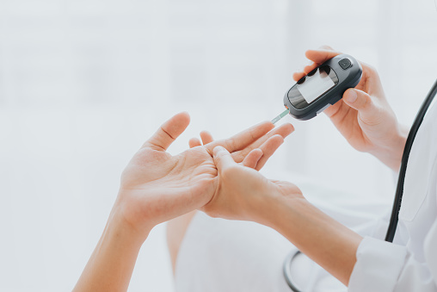
Controlling diabetes
WELCOME!
Notes:
Welcome! We are very pleased that you decided to participate in this program. This is a program that will last six months. Each month we will send you a video similar to this one to help you to prevent or to control diabetes. We hope that, over the next six months, you will watch these videos and apply some of the advice, and also answer the calls from your Community Health Workers weekly. Thank you, and we hope these videos and CHW calls will be beneficial to prevent or to control diabetes if you already have that condition.

Slide 2
Diabetes or at risk
But what is diabetes?
Notes:
To begin with, it is important to understand what diabetes is and what it means to be at risk to develop this condition. When your doctor told you for the first time about this condition, it may have been very worrisome for you. The easiest way to get relief from this worry is to educate yourself and understand the steps to take to prevent further complications. Therefore, we will look at what is happening when there is excess sugar, or glucose, in the blood.

Slide 3
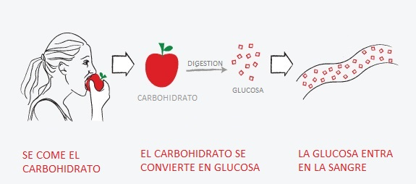
Glucose
Carbohydrate
Eats the carbohydrate
Carbohydrate is converted into glucose
Glucose enters the blood
Notes:
It is important to understand that EVERY, EVERY food we eat turns into SUGAR once eaten. This sugar is called glucose. By eating a fruit, a vegetable, or any other food, the process of digestion begins, and this process turns what you eat into glucose. Glucose itself is not bad! In reality glucose is NECESSARY for our bodies to work correctly. So a few minutes after eating some food, this transformation happens and glucose enters the bloodstream. Remember that this is the same for everybody and is a necessary process.

Slide 4
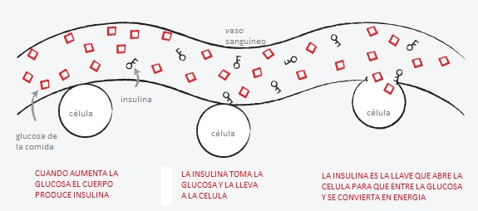
Blood vessel
Cell
Insulin
Cell
Glucose from food
Cell
Insulin is the key that opens the cell so that glucose enters and becomes energy
How much glucose increases the body produces insulin
Insulin takes glucose and carries it to the cell
Notes:
Once glucose enters the bloodstream your body starts to produce insulin. In this illustration the insulin is the little keys that you can see among the glucose. The work of the insulin that your body produces is to act like a key to open the cell and allow glucose to enter your cells. Once cells get glucose, they convert it into energy. I remind you, this process is very necessary for your body since the process enables your cells to produce the energy that we need to function effectively - to breath, walk, work, and do everything you need to do during the day. Your heart, your eyes, and every organ of your body depend on that energy.

Slide 5
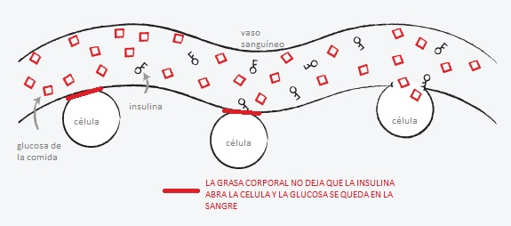
Blood vessel
Cell
Insulin
Cell
Glucose from food
Cell
Body fat doesn't let insulin open the cell and glucose stays in the blood
Notes:
Now that we understand this process, we’re going to try to understand the following question: Why does glucose remain in the blood and not enter the cells? There are a number or reasons, but we’re going to explain two of them.
1. We consume more glucose than our body needs.
2. Body fat does not allow the insulin to open the cell for glucose to enter and use it for energy. What happens then is that the extra glucose does not enter the cells and remains in the blood. That’s what we call excess sugar, or glucose, in the blood. If these cells cannot be opened using the little insulin key, then diabetes symptoms occur . . .

Slide 6
AND IT IS FOR THAT REASON THAT.......
TIREDNESS
IRRITABILITY
DRY MOUTH
CONSTANT THIRST
URINATING FREQUENTLY
Because no energy is coming to the cells
Lack of energy makes everything seem more difficult and tedious
The body is draining all the energy and drying your mouth
That lack of energy is demonstrated with a lot of thirst to replenish energy.
By satisfying its thirst, the body needs to get rid of the excess of water
Notes:
That lack of energy we feel despite having eaten is the reason why . . .
. . . we suffer from tiredness, because the energy is not getting to the cells.
. . . we also suffer from irritability. We get angry! Lack of energy makes us see everything as difficult and tedious.
. . . we also suffer from dry mouth, because our body is using up all the energy and making our mouths dry.
That dryness produces a constant thirst since the body is using everything to replenish the energy lost.
Once our thirst is satisfied, our body tells us to get rid of that water. Then the urge to urinate frequently develops.

Slide 7
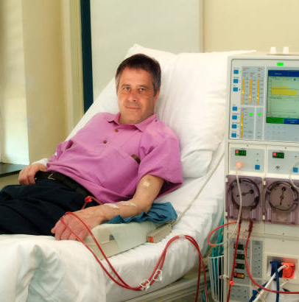
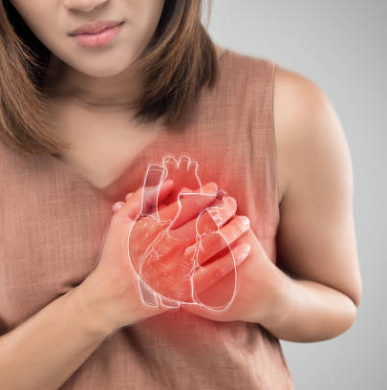
AND WHAT HAPPENS IF YOU DON'T TAKE CARE OF YOURSELF...
DIALYSIS
HEART ATTACK
LOSS OF VISION
Notes:
What happens if we don’t control the excess glucose in the blood? If our body is in a continuous imbalance of energy our vital organs start to suffer. They do not stop working immediately, but they start to deteriorate slowly. For example, kidneys begin to suffer to the point that their function is not ideal. Then they stop working and dialysis is needed in order to help the kidneys. Or also in the case of the heart, it ceases to function ideally and it weakens until it can no longer function. Also in other organs like your eyes, which stop working correctly until, little by little, vision is lost completely. This information is not intended to frighten you. We are sharing this with you because these complications cause many people to suffer greatly on a daily basis. And it is not just you. Your family suffers along with you. So what can we do? Our goal is to help you so that these complications will not occur.

Slide 8
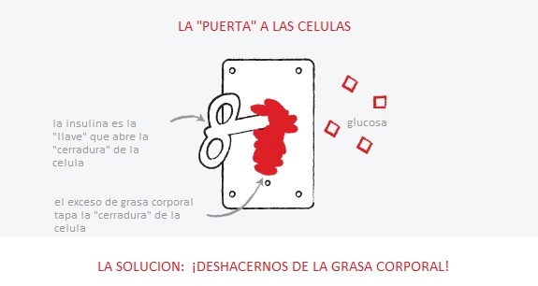
The "Door" To The Cells
insulin is the "key" that opens the "lock" of the cell
Glucose
excess body fat plugs the cell "lock”
The Solution: Get Rid of Body Fat!
Notes:
So how do we prevent or control diabetes? Reducing our body fat! Do you remember that insulin is the key that opens the cell to let the glucose in? That excess body fat keeps that key from functioning and opening that cell. Do you remember what happens when the insulin can’t open the cell? Glucose builds up in the blood. To prevent or to control our diabetes we MUST get rid of that body fat in order to help our body to work as it should. But this is a vicious circle; we don’t have energy because that cell is not receiving glucose to turn into energy. But that glucose cannot change it into energy until body fat is reduced. So we need to make an effort to move, walk, or do any other kind of physical activity. But it is also equally important to reduce our consumption of food that is not nutritious.

Slide 9
Who is at risk of developing type 2 diabetes?
Overweight
Are 45 years of age or older
Parents/Siblings
Physical Activity
Race and Ethnicity
Your body fat hinders the entry of glucose from food into the cell
As the years go by, the chances increase
If a parent or one of your brothers or sisters has type 2 diabetes
If you are physically active less than 3 times a week
Whether you are African-American, Hispanic or Latino, Native American or Alaska Native
Notes:
Who develops type 2 diabetes or is at risk to develop type 2 diabetes?
According to the reasons that we have been discussing, the most important factor is body fat. This is because your body fat keeps glucose from entering the cell.
People over 45 years old are also at risk to develop diabetes.
Another reason is our genes. If one of your parents or brothers or sisters have developed type 2 diabetes, there is a high probability that you will develop it too.
Another reason is lack of physical activity (exercise). People who are inactive and do not constantly engage in physical activity are at risk. This means five times a week for at least 30 minutes of physical activity during which your heart beats more rapidly. Generally speaking, if you walk and carry on a conversation, you are not making enough effort and the pace must be stepped up.
The last of these risk factors is the fact that we are Hispanics. The Centers for Disease Control and Prevention states that those of us who are Latino and over 45 years old have a 50% chance of developing diabetes.

Slide 10
But I feel good !
Notes:
Some diabetic patients tell us: “But I feel just fine!” Maybe this is true, but allow me to share this with you: Often the deterioration of our body and our health happens VERY slowly! That is to say that we get worse and worn down little by little, and in that process of getting worn down, we don’t feel the difference. Since this deterioration is so slow we get used to the way we feel and we think that we are fine. However the deterioration continues and the consequences occur.

Slide 11
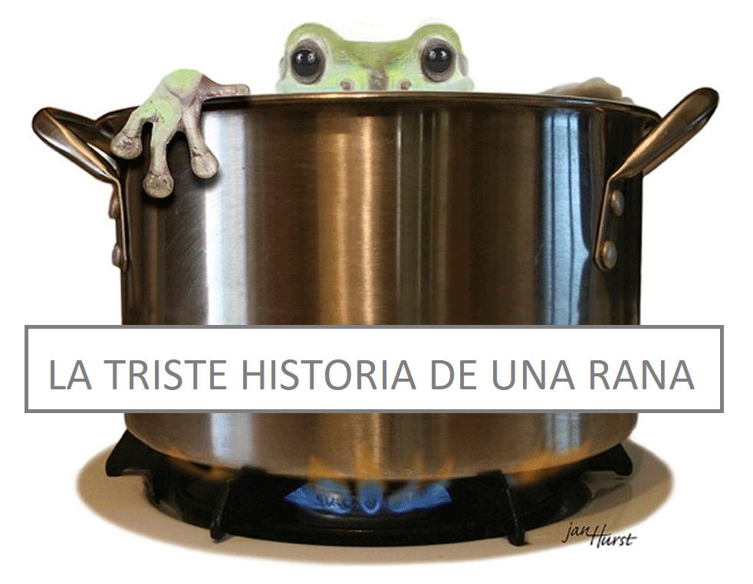
THE SAD STORY OF A FROG
Notes:
To illustrate that slow but lethal deterioration, let me share this story about a frog.
Do you know what’s going to happen if you put a frog into a pot of boiling water?

Slide 12
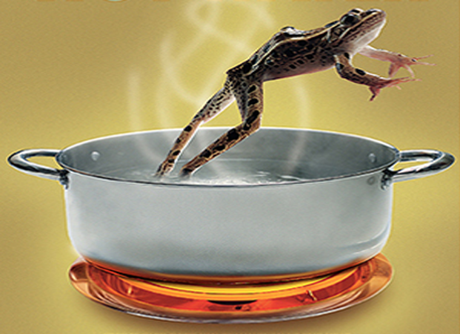
Notes:
As soon as the frog hits the hot water it will instantly leap out! The frog feels the sudden change in temperature and jumps out to save its life. But do you know what happens if you put it in water at room temperature? If you put the same frog in cool water and light the stove and little by little heat that water . . .

Slide 13
Notes:
. . . the frog will remain in the water. The frog will enjoy the warm water. However the heat will make the water boil! But since the water temperature will change little by little, the frog will not notice the difference. The frog does not have the ability to notice it. In a few minutes you will see that the water is boiling, but the frog will not jump out because it cannot feel the difference. The frog ends up cooking little by little, and will die, because it did not notice the difference even though its body suffered the consequences of the boiling water.
It could happen to us. We do not feel the excess glucose in the bloodstream. We get used to the risk levels rising slowly and we don’t notice it. However the vital organs continue to become damaged and we don’t feel it until we lose our sight or we suffer a heart attack, and then it is too late.

Slide 14
HOW DO I KNOW IF I HAVE DIABETES OR HOW CLOSE AM I TO DEVELOPING DIABETES?
Notes:
So, how do we know that we are developing diabetes if we can’t feel it? If we are relatively healthy and responsible people, we must have a medical check-up every year. There doctors perform several tests to detect if there is an illness that is starting to develop. One of those tests is the A1C. Perhaps you never hear of it, or maybe your doctor has already spoken to you about it. But the importance of this test is to understand what our A1C number is and what it means.
The A1C is an average of blood glucose. This average shows our glucose level over the last three months. It does not have to be done on an empty stomach because it is just an average and is not affected by what we ate for breakfast the day of the exam. What matters is what we ate for breakfast over the last three months. If our number shows 5.7 or above it means we are at risk to develop diabetes. We have the opportunity to make PERMANENT life changes, in what we eat and how physically active we will be, in order to avoid developing that condition. But if we reach 6.5 or more, then we are diagnosed with diabetes.

Slide 15
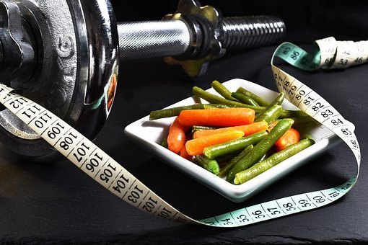
WHAT IS THE GOAL OF CONTROL IF I ALREADY HAVE DIABETES
UNDER 65 YEARS OLD
7.0
65 YEARS OR OLDER
7.5
Notes:
That does not mean we have to give up. We should still make PERMANET changes, in what we eat and how physically active we’ll be, to be able to control that condition. But in the case of people with a level of 6.5 or more, there are usually medications included to help lower the glucose level while the patient starts making those changes.
When a person has been diagnosed as diabetic, has medications, and makes permanent changes in their habits, it is easier to get to a controlled diabetes status. That number is 7.0 or less for people younger than 65 years old and 7.5 for those older than 65. Staying below 7.0 is crucial to protect our vital organs and our quality of life. It is also VERY IMPORTANT to reduce the risks that we discussed before, such as dialysis, heart attack, and vision loss, among many others that may develop.

Slide 16
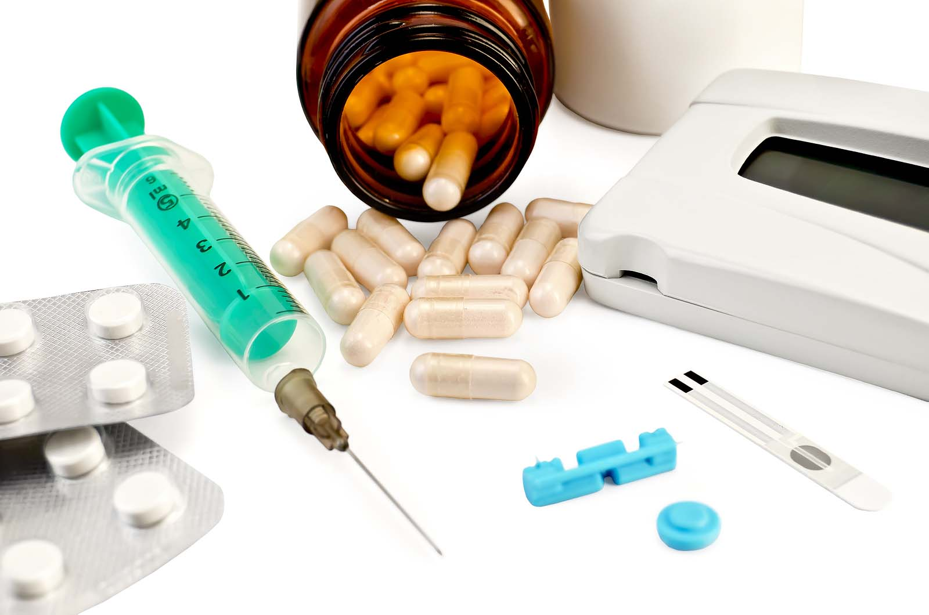
Medicine
they are VERY important!
Notes:
If it is the case that we already have diabetes, our medications become VITAL and very important. These will help us to lower our A1C number and they will protect us. But it is important not to forget that they only help to lower that number and do not actually fix the condition. WE MUST change our habits if we want to avoid tragic consequences. If you have difficulty understanding your dosage, getting your medications, or have any questions, you can talk to your Community Health Worker. We will be happy to help you with these habits of taking your medications regularly.

Slide 17
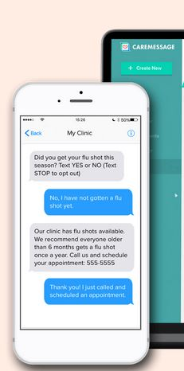
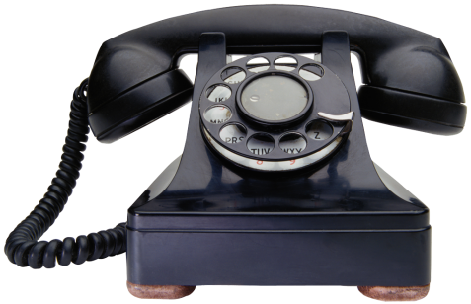
We are here to help you
We will be calling you weekly
Notes:
Speaking of your Community Health Worker!! By this time your Community Health Worker has contacted you and has begun to help you with any questions you may have. Each of us has been certified by the state of Texas to help take care of your health. We are not doctors nor are we legally authorized to give medical advice, but we have been trained in various topics including diabetes. We also communicate weekly with the doctors of the clinic and our supervising doctor to communicate everything you ask and to give us instructions on how to support and advise you. Having a Commumity Health Worker connects you directly so your doctor has the most up-to-date information and can help you more effectively prevent or manage diabetes. During more than 5 years of helping patients in this type of project, we have shown that a diabetic patient who is in communication with a Community Health Worker improves their health in most cases.

Slide 18
It's a long race
You will need support
Notes:
The prevention and control of diabetes does not occur overnight. It cannot be fixed with just a pill or an injection. It is a process of changing our habits, our routines, or even our likes, in order to have a better quality of life. Our life is a Long Race. The journey is always easier when we have a good support team on our side to cheer us on and to encourage us to continue trying.

Slide 19
Medical help
Notes:
We are here to get the answers you may need whether dealing with medical questions . . .

Slide 20
Social Assistance/Practice
Notes:
. . . or questions about how to defeat obstacles that keep us from implementing the necessary habits of nutrition and physical activity, as well as further questions . . .

Slide 21
Moral/Spiritual Help
Notes:
. . . that have more to do with our spiritual lives, that create obstacles that keep us from advancing. We are here to support you in your plan to prevent or to control your diabetes, and also to listen to you and support you in prayer.

Slide 22
CONFIDENTIALITY
Respecting the trust they give us
Notes:
And we want you to rest assured that we will always respect the trust that you give us. Our goal is to help you to reach YOUR goals.

Slide 23
Thank you for participating
Notes:
We thank you for your involvement in this program and we are happy knowing that we are here to help you. Do not forget that help is just a call away. If you have not been in touch with your Community Health Worker yet, please don’t hesitate to send a text using the same CareMessage message by which you received this video, so that you can get in touch with your Community Health Worker. Until next time, and may God bless you richly.

Slide 24
References
- American Diabetes Association (2022). Standards of Medical Care in Diabetes. Vol 45 (Supplement 1). Last accessed Sept 15, 2022. https://diabetesjournals.org/care/issue/45/Supplement_1
- Banday, M. Z., Sameer, A. S., & Nissar, S. (2020). Pathophysiology of diabetes: An overview. Avicenna journal of medicine, 10(4), 174–188.
- Hispanic/Latino Americans and type 2 diabetes. (2022, April 4). Centers for Disease Control and Prevention. Last accessed September 15, 2022. https://www.cdc.gov/diabetes/library/features/hispanic-diabetes.html
- Ismail, L., Materwala, H., & Al Kaabi, J. (2021). Association of risk factors with type 2 diabetes: A systematic review. Computational and structural biotechnology journal, 19, 1759–1785.
- Marín-Peñalver, J. J., Martín-Timón, I., Sevillano-Collantes, C., & Del Cañizo-Gómez, F. J. (2016). Update on the treatment of type 2 diabetes mellitus. World journal of diabetes, 7(17), 354–395.

