Slide 1
WELCOME
Controlling Diabetes with Medication
Second Month
Notes:
Welcome to our second session of diabetes prevention and management! This is the second class we'll be having and this month we'll be talking about how to control diabetes using the medications your doctor has prescribed.

Slide 2
Making Changes
Notes:
We hope the information from last month has helped you! We hope that you have been able to analyze your personal situations and have been able to identify some changes that you can begin to make in your lives. We have spoken to many of you and are glad that you are beginning to make changes to bad habits by setting achievable and measurable goals. If you don't already have a specific, measurable goal, talk to your Community Health Worker and they'll help you set up a goal that's achievable for you and will help you improve your physical activity and nutrition habits. One of the things we'll be encouraging you to change is the way you check your glucose. If you have already been diagnosed with diabetes, one of the things we have provided for free is a glucometer and the necessary strips to check your blood glucose. If you do not have it yet and YOU ARE DIABETIC, please contact your Community Health Worker so that we can give you one as soon as possible. If you already have it, USE IT! Your Community Health Worker will be explaining to you that one of the things you need to do is check your glucose at different times. Keep notes of those numbers and what time the test was done. These numbers help your doctor know if there are changes that need to be made to your medications. Remember that we are here to help you, just call us and we will gladly assist you.

Slide 3
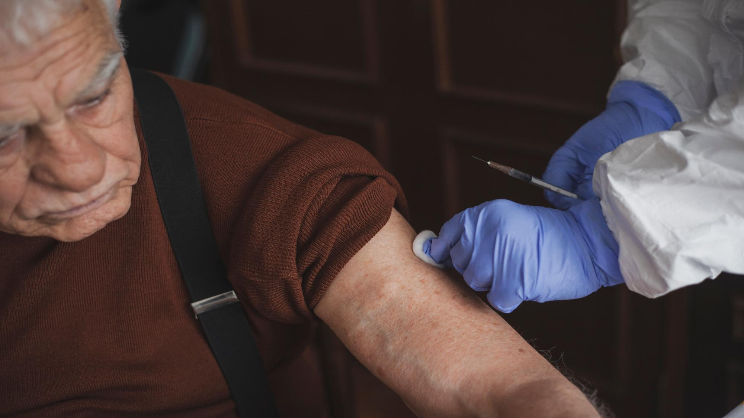
Blood and Urine Tests
Anemia
B12
Cholesterol
Thyroid
Liver
Kidneys
Notes:
This month you will receive a call for medical tests that are necessary to make sure all of your organs are working properly. Some of you have already done so and others will be contacted soon. These tests help us know if you suffer from any deficiency common to diabetics. People with diabetes are at risk of complications such as ANEMIA, low vitamin B12, HIGH CHOLESTEROL, THYROID PROBLEMS, LIVER OR KIDNEY PROBLEMS. If these tests find anything out of the ordinary, your doctor will let you know, and with that information we can help you take steps toward new good habits so your body can function more normally.

Slide 4
Diabetes
Managing diabetes is not easy
Notes:
These tests are necessary because, as we have already explained, controlling diabetes is not easy. It is NOT controlled overnight, it is achieved little by little, making small changes…. but permanently. Whenever we talk about changes, we need to understand that it is not enough for our goal to be something general like: “eat better”. Why do you think this goal is not very good? Because even though it is a phrase that sums up what we want to do, we must understand that most of us do not have a correct idea of ​​what eating better is. In our Society and in the countries where we come from, we were not taught how we should eat to be healthy. In fact, we grew up with very bad habits such as "finishing everything on our plate", or with the idea that eating well means eating a lot. But these are ideas that lead us to overweight or unbalanced eating. Eating with the right attitude and healthy ideas can change your life. Setting concrete and specific goals is what helps us move in the direction toward better habits.

Slide 5
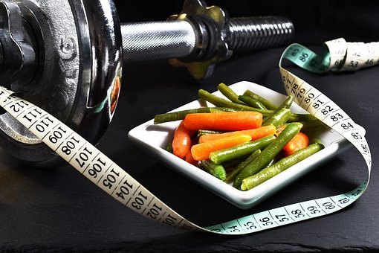
WHAT IS THE GOAL?
UNDER 65 YEARS OLD
7.0
65 YEARS OLD OR OVER
7.5
Notes:
Remember that:
If you are overweight, or have an a1c above 5.7, you are at risk of developing diabetes. If you have ever had an a1c of 6.5 or higher in your life – you have already been diagnosed with diabetes
A diabetic person with an a1c below 7.0 (or below 7.5 if older than 65) is considered controlled diabetic. But if you have your a1c over 7.0 (or over 7.5 if you're over 65), you have uncontrolled diabetes. How can we know if we are getting better or worse? Doing glucose tests at home frequently. These numbers give you and your doctor a very good idea of ​​whether you are getting better or worse BEFORE you go back for an A1C test (which is regularly every 3 months).

Slide 6
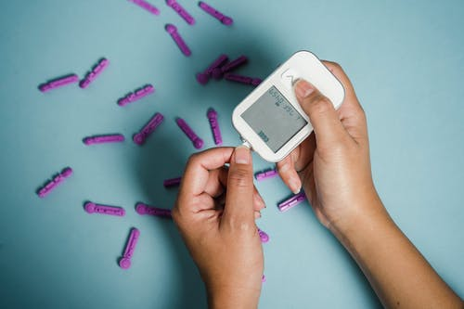
FASTING:
80-100
AFTERNOON OR EVENING BEFORE EATING:
80-150
TWO HOURS AFTER EATING:
80-200
Notes:
Also remember that there are 3 ideal times to check your glucose and that all 3 times are necessary to determine if your diabetes is being adequately controlled. 1) The first is on an empty stomach (this is the one most commonly thought of when we are told about checking our blood glucose at home). These numbers are normal if they are between 80-100. Above 100 is high. 2) The second is in the afternoon or evening before lunch or dinner. If these numbers are between 80 and 150, they are normal. If they go over 150, they're high. 3) The third is two hours after any meal (breakfast, lunch or dinner). If these numbers are between 80 and 200, they are normal. If they go over 200, they're high. Remember to do these tests at different times – not always fasting, not always before meals, and not always 2 hours after eating. Having this varied data will help your doctor detect medication needs only in the morning or only at night, or what is best suited to your body and needs. Not all of our bodies react in the same way.

Slide 7
LET'S TAKE CARE OF WHAT WE EAT!
IT IS IMPORTANT!
Notes:
It is VERY important to start being mindful of eating things that don't harm us. Some ways we can do this is by switching to nutritious food choices and eating things with LESS sugar, LESS grease, LESS processed, and cleaner foods. But above all, it is important to eat LESS overall. We need to learn how much we should eat. We will be sharing more information on that topic next month, but meanwhile let's start eating more vegetables, and less of everything that is unhealthy. This will lead to easier weight control.

Slide 8
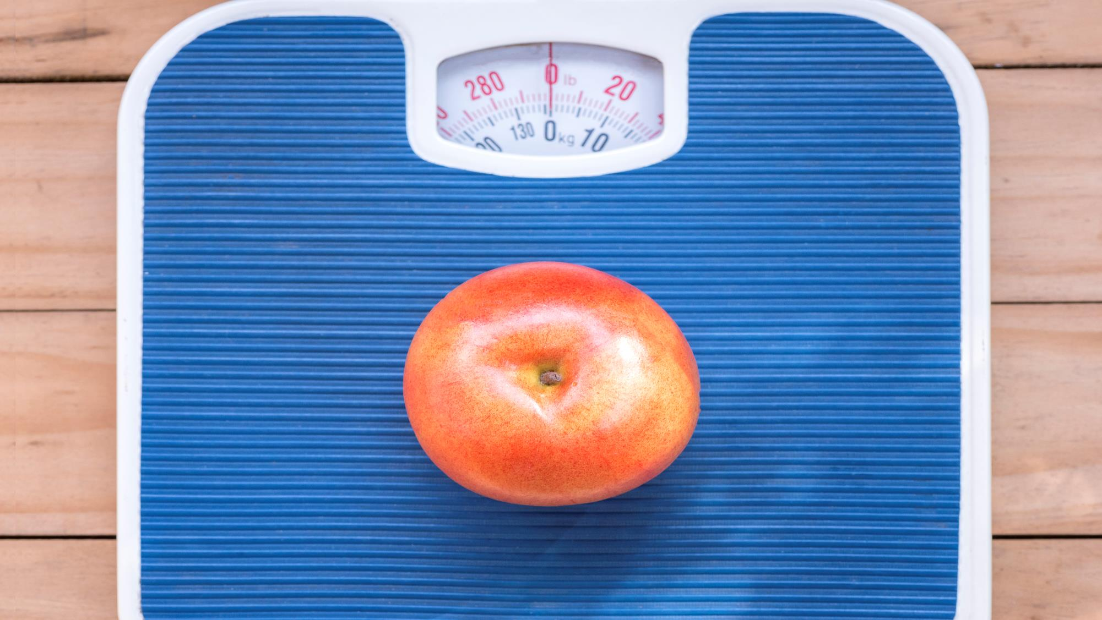
Managing your weight
is important
Notes:
The goal for most of us is to lose weight – because this loss of body fat is what helps insulin do its job of opening up the cell so that sugar can get in. This prevents sugar from staying in the blood. If you don't understand this concept, feel free to go back to the PowerPoint/video from the first month – it's always good to go over this so that we can understand it better with repetition.
So controlling and losing weight is the first step. This helps in the prevention of developing diabetes if you are at risk. If you have already developed diabetes – it helps you to gradually become less dependent on medication and to improve your body’s organ functions. Sometimes we say: “but I can't lose weight – it's too hard for me”… the worst thing we can do is give up – we have to make the effort. Weight loss is affected by many things, including how long you've had diabetes, what weight you are at, your age, and even whether you're a man or a woman. Cheer up! Learn to eat healthy, you will see that new habits do not have to be drastic, but they must be permanent.

Slide 9
Taking your medicine is important
Notes:
Taking your medications is important. Whether those medications are for diabetes or cholesterol or high blood pressure or any other condition, those medications have been prescribed by your doctor after performing important medical blood tests and after evaluating how best to protect your body. Your doctor has carefully studied these medical conditions and has experience that it works for a person suffering from these conditions and many others. You've taken the time to talk with your doctor and explain all of your health concerns, and by reviewing all of this information, your doctor has come up with a plan to help your body function at its best. However, sometimes we come home confused because we don't understand everything our doctor recommended. Being with the doctor and saying that if we understood everything, he told us is very common and many of us do, and then we don't know who to ask. That's what your Community Health Workers are for. We are not doctors or medical experts, but we do have training to help you understand what your medications are for and to answer all those questions you don't think about until your home. We have to understand that each body reacts differently to medications, so it is necessary to evaluate how each medication affects us and share that information with your doctor. If you have questions, never hesitate to write them down and bring that list to your next appointment or call your Community Health Worker and ask for more information about your medications. In this video we will focus on diabetes medications, but much of the information will apply to ANY medication you have been prescribed. So, with this we are going to learn about 5 reasons why we do not take medications:

Slide 10
But I feel good!
Notes:
Reason #1: I don't feel bad! Even if I don't take the medicine, I feel very good!!

Slide 11
THE SAD STORY OF A FROG!
Notes:
But don't forget the little frog that felt great until it slowly cooked because she never felt the danger. The damage is gradual and we don't feel it until it's too late.

Slide 12
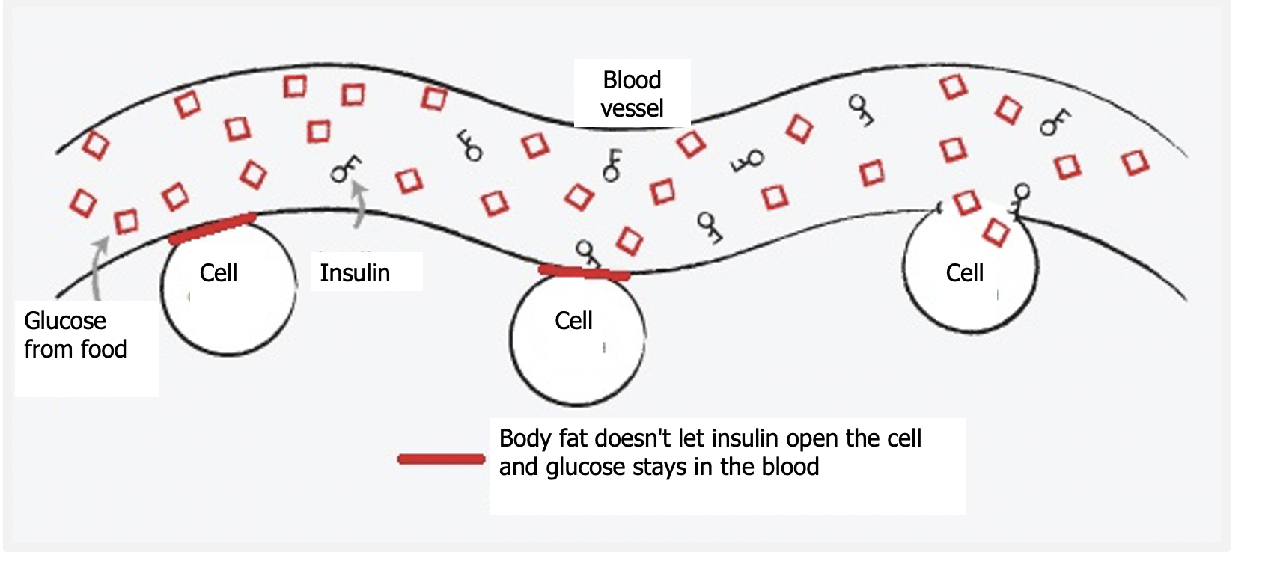
Notes:
Remember that each time your sugar gets too high, it damages your arteries, and the higher and longer that sugar is elevated, the more severe the damage. That extra sugar has nowhere to go and stays in your blood. That damages your vital organs. So even if you don't make a perfect change, slowly starting to make permanent changes will help with your blood sugar levels. Let's take action to prevent that damage!

Slide 13
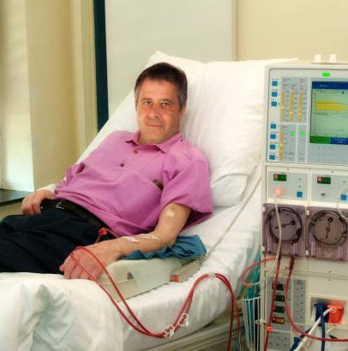
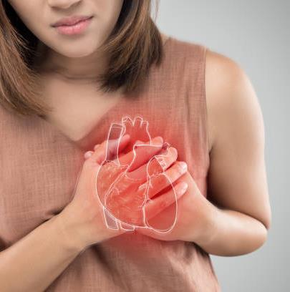
AND WHAT HAPPENS IF YOU DON'T TAKE CARE OF YOURSELF...
DIALYSIS
HEART ATTACK
LOSS OF SIGHT
Notes:
Remember that these damages are often irreversible, and the consequences come when we least expect it….Don't wait until you reach this point. Preventing and controlling diabetes is something we must take seriously.

Slide 14
Notes:
Our goal is to have a longer life, but with good quality. We can't go back and change our past, but WE CAN make our future something healthier so we can enjoy and care for our families.

Slide 15
BUT THE SIDE EFFECTS?
Notes:
Reason #2….Taking medication scares me! Side effects scare me! It is important to know about the side effects of each of your medications, ignoring them can cause serious problems! The side effects of each drug are real, but we must understand that these side effects can be controlled and in some cases eliminated with adjustments. When your doctor prescribed these medications, he performed medical tests that helped determine that you NEED these medications – the risk of these side effects is not very common……and if you compare them with the risks of continuing to live with uncontrolled diseases, the risk of damage to your vital organs is minor.

Slide 16
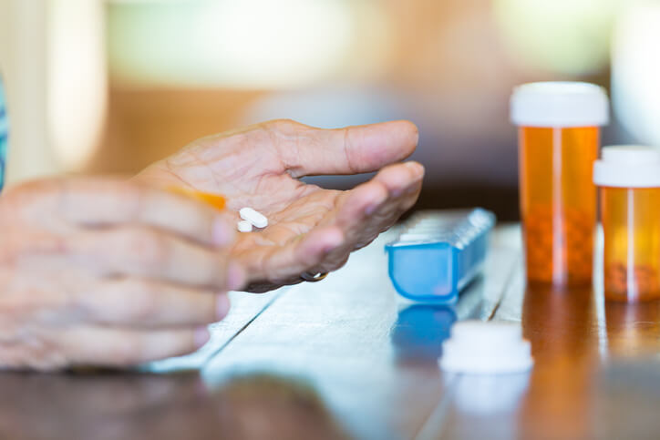
Metformin
“G’s”
Glyburide, Glimipiride
Insulin
Notes:
Know your medications – know the side effects, tell your doctor right away if you experience anything unusual, and take control of your health. The three most common medications are Metformin; the medications we will call “G” such as glyburide, glimipiride, glipizice; and insulin. Your doctor knows about the side effects of these medications and your Community Health Worker has been informed of them in order to help you determine ways to avoid these side effects, but also to inform the doctor in case any of these effects require an adjustment of medicine. Call us, we are ready to help you.

Slide 17
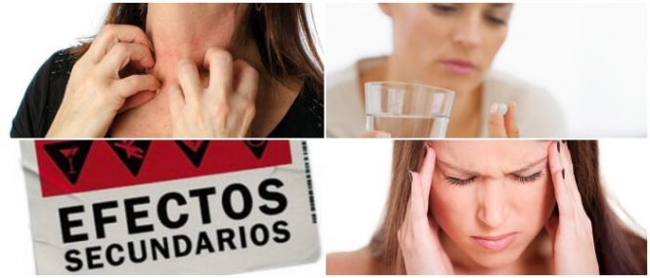
Balance
Notes:
As for the side effects… two things have to be balanced: my health or my fears. Sometimes we risk our health by not taking medication, because of the possibility of an effect that may not even happen. However, knowing the side effect of your medications helps us to detect this effect and inform the doctor, so that he can change your medication. The chance of these effects is 2 to 3 people out of 100 – but the benefits that these medications will provide are of MUCH value to your quality of life.

Slide 18
I forget!
Notes:
Reason #3: I forget to take them!! We all find it difficult to start a new habit. And getting used to taking your medications is a habit that requires planning and discipline. If we forget to take our medications, let's change where we put them – think of things you do every day without fail – wash your face, brush your teeth, pack your breakfast, charge your cell phone! Maybe it's good to move the drugs to these areas where we do something every day. Try different ways – until you find what works best for you. Put alarms on your cell phone, put a note on the mirror or refrigerator, until it becomes a habit to take your medications.

Slide 19
Social / Practical Help
Notes:
If you need more ideas or have specific situations, talk to your Community Health Worker. Together we can find the solution to your situation. Community Health Worker are here to help you break down those barriers that do not allow you to control your health.

Slide 20
I feel worse!
Notes:
Reason #4: When I take the medicine I feel worse! Have you ever carried such weights \that are tied to the feet? You walk around with that weight for a long time and then you take that weight off…..remember what happens when you take that weight off? It feels weird walking!! You will feel that each step is lighter, but it still feels very strange. Sometimes the same thing happens to us with our health. We are SO used to having certain discomforts in our body, that they have already become normal to us and when we feel a change – or an improvement – ​​we may feel that something is strange. Give your body time to get used to the changes. When your body has always had sugar in the 200s, it will feel "weird" to be normal. But trust us, your body and vital organs will thank you.

Slide 21
Tell us!
Notes:
However, tell your doctor about these changes you are experiencing. Your doctor will never know what you are feeling unless you tell them. With your help, your doctor will be able to determine if changes need to be made. And if you experience any change or don't feel good. Call your Community Health Worker and we will let you know from your doctor.

Slide 22
I don’t need the medicine anymore!
Notes:
Reason #5: I'm exercising and eating better and I don't need the medicine anymore! Many times we want to make changes and start to lose weight and decide that the medication is no longer needed. But be very careful! Stopping medications without consulting your doctor can worsen your health.

Slide 23
CONGRATULATIONS!……BUT…
Notes:
We encourage you to exercise, lose weight, and eat better – but remember that it's those changes AND the medicine together that are helping you feel better. If you make enough changes, your doctor will start to adjust your medication, but that's an assessment for your doctor alone. Don't interrupt your improvement: keep taking your medication – and if you see your blood sugar getting too low, talk to your Community Health Worker. We will report it to your doctor and the necessary changes will be made in the correct way.

Slide 24
So….let’s take action
Don’t let
your body
Deteriorate
further!
Notes:
So – take action – take your medications even if: 1) You feel you don't need them because you feel good 2) Balance the benefits and side effects 3) Develop a routine so you don't forget your medications 4) And if you feel bad, tell us to talk to your doctor 5) And keep making changes and reporting your glucose numbers so your doctor will determine when you can reduce your medications.

Slide 25
Ask if you have any doubts!
Notes:
If you are unsure which medications to take and if your doses are correct, please notify your Community Health Worker or call your doctor. To request that your medication be refilled, call your pharmacy. If you are no longer able to get the medication, leave a message with your doctor with the name of the medication you need. If you do not receive a call within 2 days, notify your Community Health Worker to assist you. It is very important that you take your medications and have a clear idea of how to take them.

Slide 26
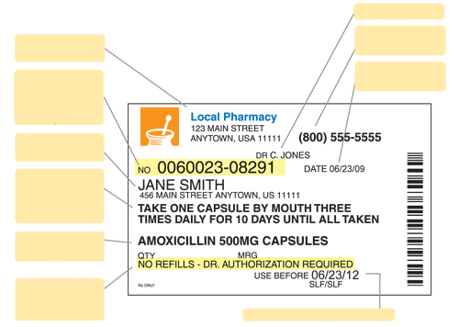
Name of Doctor
Nombre de Doctor
Pharmacy phone
Address of your pharmacy
Teléfono de la farmacia
Dirección de su farmacia
Day I filled the medicine
Prescription-pharmacy number uses this number to identify your medication
Dia que surtió el medicamento
Numero de receta – farmacia usa este numero para identificar su medicamento
Owner of this medicine
Dueño de este medicamento
Instructions on how much medication and how many times a day to take it
Instrucciones de cuanto medicamento y cuantas veces al día tomarlo
Name and strength of the drug
Nombre y potencia del medicamento
Number of times you can refill this medicine
Numero de veces que puede volver a surtir este medicamento
Fecha de caducidad del medicamento
Expiry date of the medicinal product
Notes:
This is a drug label with all the facts explained. Learn what each piece of data means. On your label you will see: Your doctor's name, The address of your pharmacy, The phone number of your pharmacy, The prescription number – with which you can refill your medication, The date you filled your medicine, Your name so you can identify your medication from others in your household, Instructions on how much medicine and how many times a day to take this medicine, The strength of your medication, The number of times you have left to refill this medicine, And the expiration date of this medicine. A couple of things worth mentioning: #1 Always keep an eye out for your medication running out – call for refills ahead of time – that way, if there are problems, they can be fixed before the one you have at home runs out. #2 Make sure you understand how much medicine and how often to take it – if you have any questions, call your Community Health Worker.

Slide 27
Pills: $4 per month or $10 per 3 months
Walmart
CVS
Kroger
GOODRX.com
Notes:
If you have trouble paying for your medicine, we remind you that most of the diabetes medicines that are prescribed, fall within the $4-per-month plans at these pharmacies. For those other drugs that don't fall into these financial plans, use GoodRX – if you don't know about this drug coupon program – tell us so we can help you
Some of you also get high-cost drugs for free through drug assistance programs. Be on the lookout to renew these programs on time so you don't run out of your medication. Talk to your doctor ahead of time about refills – as it sometimes takes a few weeks to refill these medications.

Slide 28
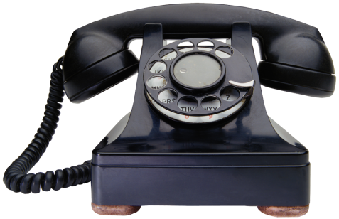
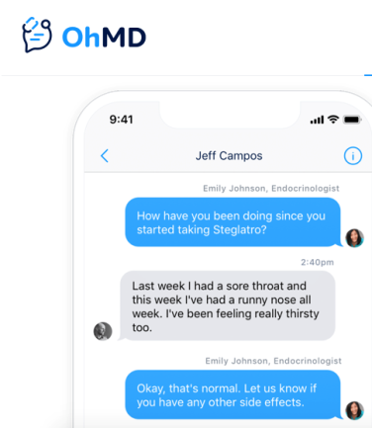
We are here to help you
Notes:
And as always – remember that we are YOUR health team...... You have our direct phone numbers and we want to help you

Slide 29
Thank You!
Don’t miss the next class!
Notes:
Thank you for your participation in this diabetes prevention and control program. Next month we will be talking about nutrition. We look forward to counting on you.

Slide 30
References
- Banday, M. Z., Sameer, A. S., & Nissar, S. (2020). Pathophysiology of diabetes: An overview. Avicenna journal of medicine, 10(4), 174–188.
- Medication & treatments | ADA. (n.d.). American Diabetes Association | Research, Education, Advocacy. Last accessed September 15, 2022. https://diabetes.org/healthy-living/medication-treatments
- Marín-Peñalver, J. J., Martín-Timón, I., Sevillano-Collantes, C., & Del Cañizo-Gómez, F. J. (2016). Update on the treatment of type 2 diabetes mellitus. World journal of diabetes, 7(17), 354–395.
- American Diabetes Association (2014). Diagnosis and classification of diabetes mellitus. Diabetes care, 37 Suppl 1, S81–S90.
- Type 2 diabetes. (2022, March 2). Centers for Disease Control and Prevention. Last accessed
September 15, 2022. https://www.cdc.gov/diabetes/basics/type2.html

