Slide 1
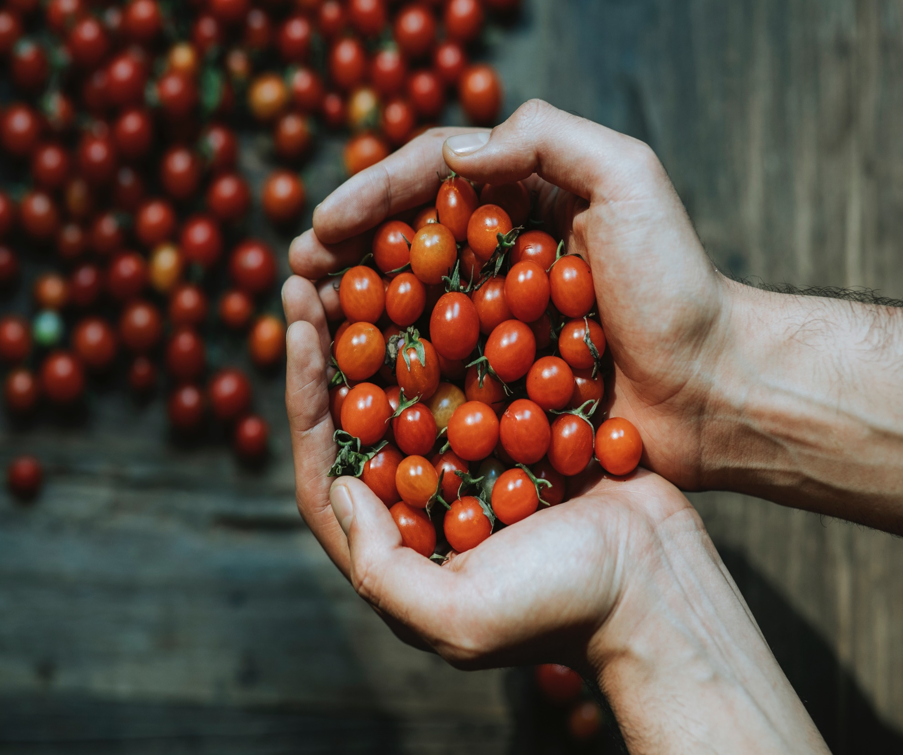
WELCOME! NUTRITION CLASS
Month 3
Notes:
Welcome! We are very happy that you are with us again in this third month of education in your Preventing and Controlling Diabetes program! If you haven't seen the first two videos yet, we invite you to let your Community Health Worker know so they can send you the links to those videos. If you've already seen them, we hope you've been able to start making changes to prevent or control diabetes. In this third month, we will be sharing with you some of the very extensive information on nutrition. Your Community Health Worker will be available to answer questions specific to your nutrition and although we are not experts, we are surrounded by information that is very relevant and can help you.

Slide 2
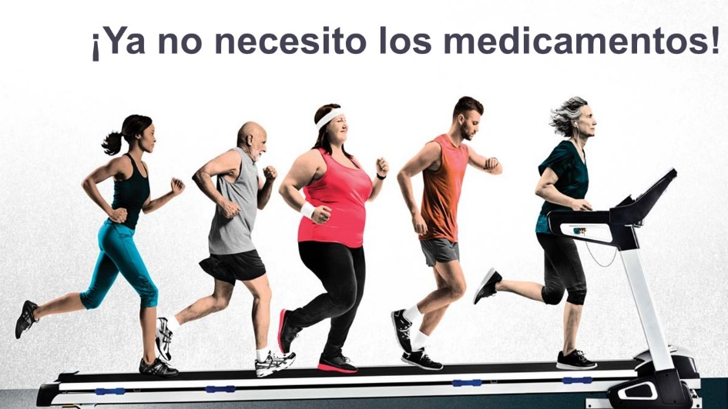
Review……
Notes:
To start off, let's quickly review some of the things we've learned in the last two months…..such as the importance of taking your medications – ones that you take to prevent or control your diabetes, as well as others that help you prevent and control other medical conditions. ALL your medications are important in your health!! Remember what we learned last month…there are 5 common reasons why we don't take our medications. The first is because we think that feeling good is a strong enough reason not to take them – when we do this, we do not recognize that there are symptoms that we cannot feel and that although for some time we “feel good”, our body and vital organs deteriorate with time. The second is that we fear side effects – remember… the best way to combat this obstacle is to inform us! The risk of a side effect is much smaller than the benefits that the medicine will give us! Remember, the key is to learn about side effects and how to prevent them! Talk to your promoter if you are experiencing any unusual effects and your promoter will help you. The third reason we don't take our medications is because we forget! - remember that in these times of smartphones, you can set alarms and reminders to help you. Talk to your Community Health Worker about the reasons why you forget to take your medications! Through our training and experience we have learned how to help you remember. The fourth reason is that when you take your medications you feel worse! When we are used to a way of feeling, we think that feeling different is worse. Remember, your body is used to a level of stress created by your medical and physical conditions. The change is going to feel different because we are not used to what we should feel under normal conditions! However, if you actually feel WORSE, talk to your Community Health Worker, and we'll let your doctor know if changes need to be made. The fifth reason for not taking your medications is that you feel like you don't need them anymore! If you make changes and your condition begins to improve to the point where you no longer need medication, medical tests will reflect the need to reduce medication, and then your doctor will make changes. DO NOT make these changes yourself without your doctor's recommendation! Stopping your medications can seriously make your situation worse.

Slide 3
Notes:
Remember, you have direct access to your Community Health Worker and we are here to help you have a better relationship and communication with your doctor. Doubts should always be clarified and we are available with a call or text message. We want to help you understand how to take better care of yourself. Our purpose will never be to scold you…..we are always a phone call away to answer your questions to prevent or manage your diabetes.

Slide 4
Notes:
So…..Have you been making changes? What has been improved? What is it that you are still struggling to change? Remember the importance of setting goals that you can measure. It is much more likely that by making goals you can achieve them. If we set ourselves the goal of exercising, it is something that is difficult to measure. But if we set a goal to go out three times this week to walk briskly for 15 minutes, we can clearly measure whether we are achieving this goal or not. Make a note of your goal and ask your advocate to help you make it measurable and achievable so that we can stay focused, but also so that we can start making changes and encourage ourselves to make these changes your new lifestyle.

Slide 5
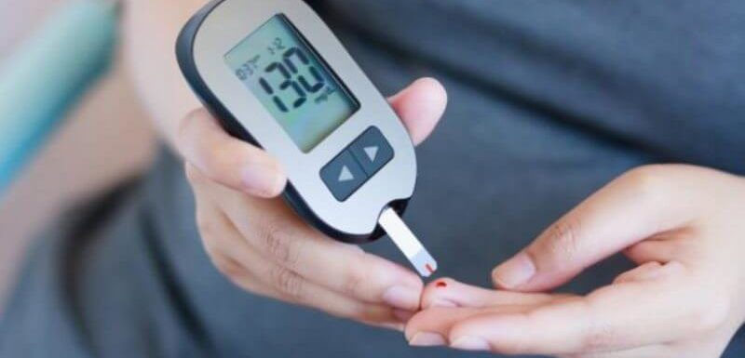
FASTING:
80-100
AFTERNOON OR EVENING BEFORE EATING:
80-150
TWO HOURS AFTER EATING:
80-200
Notes:
If you have already developed diabetes, remember that it is important to have these goals at hand. Write them down in a visible place so you can memorize them – so when you do your home glucose test, you'll know if your level is correct. Remember that fasting – must be between a minimum of 80 and a maximum of 100 before eating in the afternoon or evening – it should be at a minimum of 80 and a maximum of 150. And two hours after eating – the minimum is 80 and the maximum is 200. Learn to know your body! If your glucose is too low, you're going to feel weird - but it will also feel weird if your glucose is too high. If your blood glucose is less than 70 at any time of the day – you have low blood sugar – the recommendation in these cases is to drink a quarter cup of orange juice (no soft drinks, no sweets, no bread!). After 15 minutes you should check your glucose again and if it's still low, go back to another quarter cup of orange juice. Don't over do it! Just a quarter cup of orange juice can regulate your sugar in a healthy and safe way. If you experience low blood sugar a lot, talk to your Community Health Worker so they can alert your doctor. If your glucose is high on a daily basis, you really need to make changes. Do not have dinner so late at night, do not eat fatty or fried things, eat vegetables with your meals. If you do this, you may start to notice your glucose numbers go down.

Slide 6
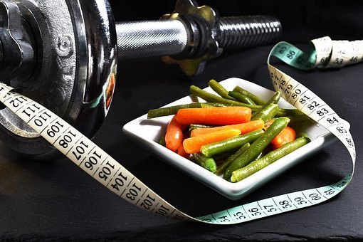
WHAT IS THE GOAL?
UNDER 65 YEARS OLD
7.0
65 YEARS OLD OR OVER
7.5
Notes:
Remember that in the long term the goal is to control – not to make changes for a few weeks and return to bad habits. Our goal is that if you are under 65, you can get your a1c down to a normal level. A person has diabetes when their a1c has been 6.5 or higher at some point in their life. From then on, the goal should be to stay in control. However, going down to a normal level of less than 5.7 is IDEAL. The American Diabetes Association recommends an a1c of less than 5.7. After exceeding 5.7, a person is considered at risk of diabetes. After exceeding 6.5, a person is considered diabetic. When your a1c is above 7.0 or 7.5 (if you are over 65) it is considered uncontrolled diabetes and it affects your body and vital organs in many ways that we have reviewed in other months – this causes many problems that you could prevent if you make the decision to do PERMANENT changes! Don't wait to get diabetes or consider yourself uncontrolled diabetic – take CONTROL today! Remember that if you don't control your diabetes, your diabetes will eventually control you.

Slide 7
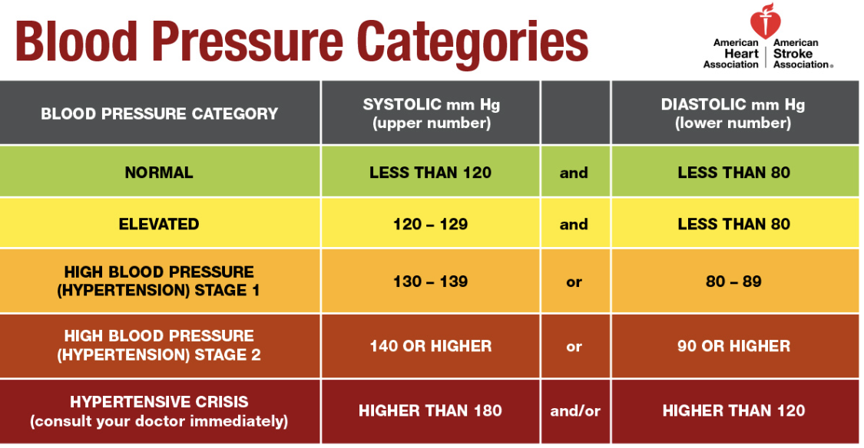
Notes:
We have also talked about blood pressure! These are the ideal levels recommended by the American Heart Association. Normal blood pressure is less than 120 over less than 80. Elevated blood pressure is between 120 to 129 over less than 80. Once it goes above 129 over 80, it is considered high blood pressure and is divided into three levels of hypertension. In this diabetes prevention and control program, our goal is for you to keep your blood pressure below 140 over 90. Achieving this goal would prevent health complications and lead a healthier life. What's important to understand is that by better managing your eating and exercise decisions, you'll be able to help lower your glucose level, and at the same time, these same changes will help control your blood pressure.

Slide 8
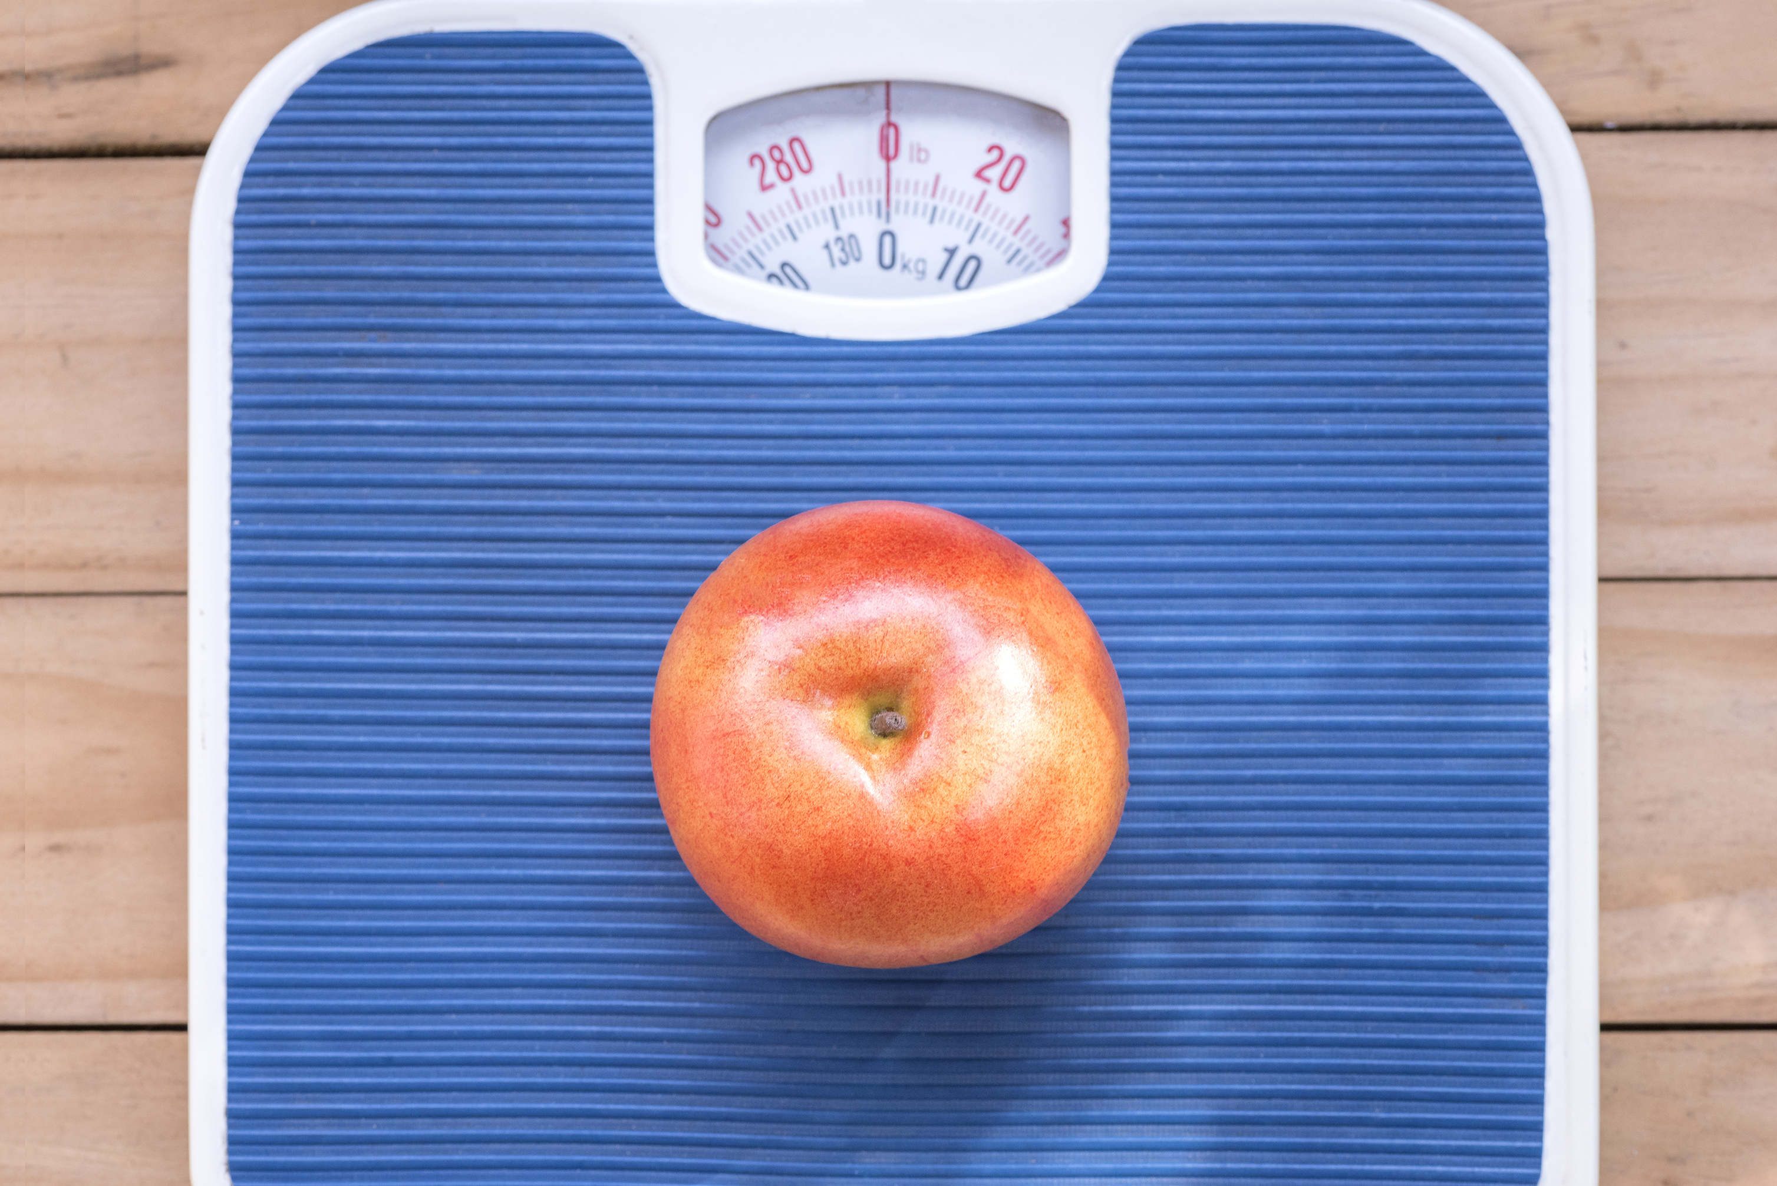
Managing your weight is important
Notes:
Controlling your weight is important! As we have talked in recent months, weight control is essential to your well-being! Our health depends on many factors, but being overweight is something that puts a lot of stress on your vital organs. This overwork by your vital organs contributes to wear and tear that leads to health complications. By reducing your weight (no matter how small) you can help your organs work more effectively and without much wear and tear.

Slide 9
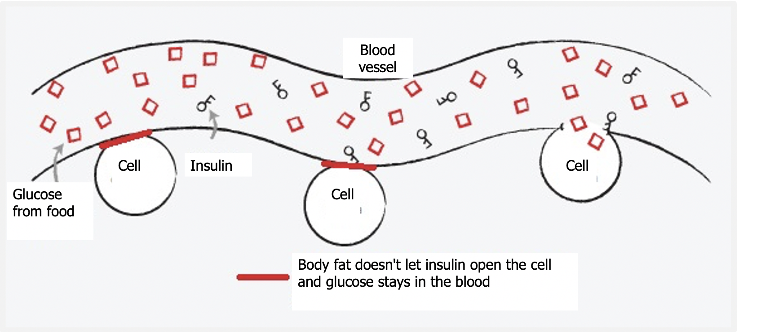
Notes:
Remember! Everything you eat turns into sugar…..EVERYTHING! That sugar is necessary for the body to produce energy. If the body can't use it - then that sugar stays in the blood. Being overweight or excess body fat is what prevents your cells from using that sugar to convert it into energy! The insulin is trying to get that sugar into your cells, but if it stays in your blood, it damages your arteries, and the bad arteries end up damaging your eyes, heart, etc. So the key to controlling your blood sugar: eat less food so your body can get rid of that fat and turn your sugar into energy – that way that sugar no longer has to stay in your blood.

Slide 10
Notes:
That body fat is not going to allow us to improve our health no matter how hard we try unless we get rid of it. Even 5 to 10 pounds less will make a difference. The goal is to improve little by little – but never return to any bad habit that we have managed to overcome. So….it is important that we set goals. As we said last month…not just the goal of eating healthy…but specifically WHAT to stop eating and for how long. Remember, the goal must be measurable and achievable.

Slide 11
Formula
Body mass index
FORMULA
WEIGHT (pounds) X 703
[HEIGHT (inches)]²
BMI BMI BMI BMI BMI BMI BMI
Notes:
Those goals like the ones we made for food, now we can do them with weight as well. But in order to make a goal about our weight, it is important to know what the ideal weight for our health is. Remember, this program is trying to help you improve your health…our weight is a big part of our health and quality of life. Our intention is not to scold you, but to help you achieve healthy goals. So, let's see the formula to know our BMI or Body Mass Index. This formula means that you are going to calculate your weight in kilos and write it down on a piece of paper. Then multiply your height by your height in meters. It sounds complicated, but here is the explanation: A person weighs 80 kilos and measures 1.50 meters. So we start by multiplying the height first: 1.50 X 1.50. That gives us 2.25. Now we know that we must divide 80 (that is, the weight) by that number that gave us the multiplication of the height, that is, 2.25. That gives us 35.6. That is the BMI of this person of 80 kilos and 1.50 meters tall….35.6. If we look at the graph, we can see that a BMI of 35 to 39.9 is classified as obesity level 2. Can you identify what the goal is? The goal is to reach a BMI between 18.5 to 24.9 Of course it is VERY difficult to reach that goal in a few months!!! But remember what we said about goals? They must be measurable and ACHIEVABLE. Perhaps our long-term goal can be to be at the normal level. But for this program, our goal is to lower your BMI. You can decide how many points to drop, but decide what your goal weight is…..5 pounds can be a starting goal (think about how long you need to achieve this goal). Write down your goal and do your best to make changes that will help you reach this goal. When you meet it… set another goal, write it down and define how long you need to achieve it. Make more changes….this is the key.

Slide 12
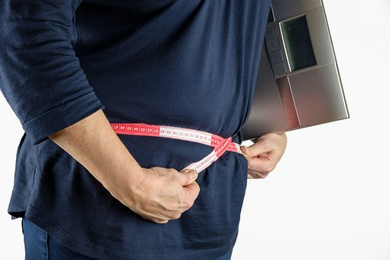
We know it’s frustrating!
(but don’t get discouraged)
Notes:
It is very important that you do not get discouraged! Your BMI changes according to your habits. So – to change your habits……Get a couple of people around you who are positive people who encourage and support you. Share your goals with those people and ask them to help you stick with your changes. Report your achievements AND your FAILURES to your Community Health Worker! Why do we report this? Because your Community Health Worker can encourage you, but they can also give you advice on how not to repeat mistakes! As we have repeated several times…..we are here to help you. That's why we call and text and ask you questions all the time…because we can get to know you and from those conversations we can come up with ideas that can help you. We are a team with you…we are on your side.

Slide 13
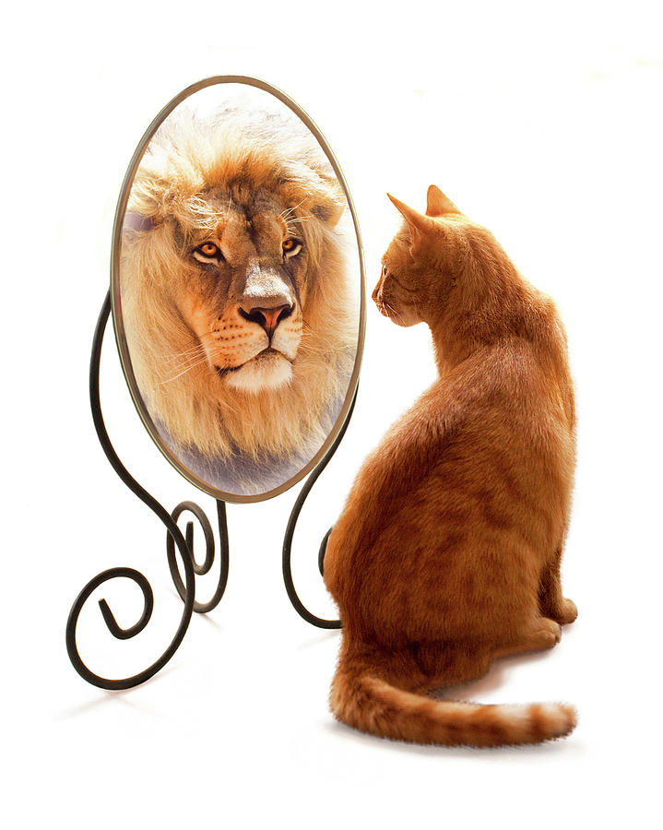
We must be realistic when
evaluating what we eat
Notes:
Why do you think it is so difficult to lose weight? Sometimes we do not evaluate what we eat in a correct way. We believe that we eat well and that despite eating well we CANNOT lose weight. But the truth is that what we think is not necessarily what reality is. What can we do to fix this incorrect perception of our habits? Learn to feed ourselves. Accept that what we are doing so far has not worked and that we need help. Being honest with ourselves about what our weaknesses are and recognizing: what we have been eating and in what quantities, what we have been eating outside of meal times, the snacks that we have been making part of our diet, and even the drinks we drink – because many times we do not know that these can also harm us. We also have to evaluate other habits, such as our sleeping habits, exercise habits, etc. To assess this correctly and find our weak points we will need help. Talk to your Community Health Worker. We can help you with that too.

Slide 14
Healthy
PLATE
Notes:
Many patients ask us for a "diet" to follow, but: remember that we want to change your lifestyle permanently, not do a "diet".

Slide 15
LET’S START WITH....
VITAMINS!
Notes:
One of the most common questions we get is about vitamins AND supplements. It is important to understand that unless your doctor has given you other instructions, the only thing necessary to supplement your diet is a multivitamin. These are sold in an option for women or men. REMEMBER….That is all that is needed UNLESS your doctor makes other recommendations. For example, there are some of you to whom your doctor will give you instructions to consume vitamins such as B12. This is because people with diabetes often tend to have a B12 deficiency. But, this is not necessary unless your doctor tells you to and this decision is made after doing blood tests that show that deficiency. Why do we emphasize this point? Because many times we think that vitamins are harmless because we think they are natural….. BUT in high doses or in the WRONG dose they can be very harmful. If you are taking vitamins other than a multivitamin, bring them to your next appointment so your doctor can take note of what you are taking. Also inform him about teas, and liquefied or liquid supplements. Not because it is "natural", it is healthy, and not because it is qualified as healthy, it is necessary in high quantities.

Slide 16
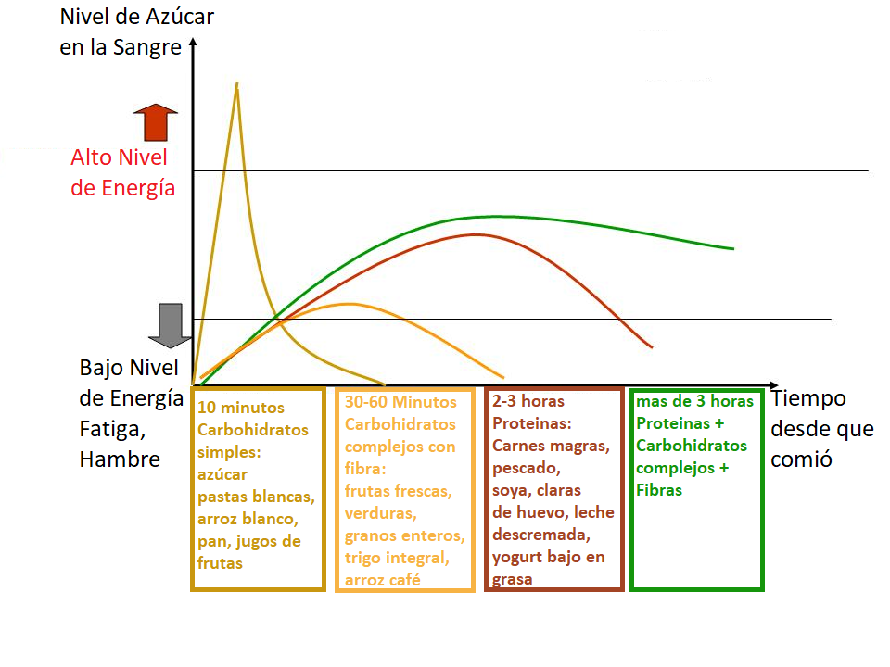
Blood sugar level
High level of energy
Low Energy Level Fatigue, Hunger
10 minutes Simple carbohydrates: sugar white pasta, white rice, bread, fruit juices
30-60 Minutes Complex carbohydrates with fiber: fresh fruits, vegetables, whole grains, whole wheat, coffee rice
2-3 hours Protein: Lean meats, fish, soy, egg whites, skim milk, low-fat yogurt
More than 3 hours Proteins Complex carbohydrates Fibers
Time since I ate
Notes:
Now…let's talk about diet and what these foods do to your body. This graph is one of the most important things we can learn…..why??? Because in this explanation you will be able to understand why when you eat certain things you feel without energy or hungry again even if only a few minutes have passed. To begin with we have to learn that the reason why we are recommended to eat a BALANCED meal is because we need all these nutrients... BUT we need them in each of the meals because each of these foods gives us a different energy level, it starts to work in your body after a certain time and lasts in our body for a certain time. In this graph we can see some lines that go up and down and the definition of each of these lines. For example….the first line that you see go up almost immediately tells us about what simple carbohydrates do in your body. Simple carbohydrates are things like sugar, candy, white pasta, white rice, bread, and fruit juices. These are the foods that should be eaten in VERY small amounts. This is because these foods, once they enter your body, are immediately activated and give energy, but this energy is used up quickly! In just 10 minutes, this energy has been activated and reaches its maximum, but as soon as it is activated, it begins to run out quickly. Do you know what happens when that energy runs out??? Your body asks you for more energy in the form of feeling hungry! So, if I'm hungry in the morning when I get up, and I eat a piece of bread with coffee, do you know how many minutes later I'll be hungry again??? In half an hour! If I eat another simple carbohydrate (for example, some cereals with sugar)….I will feel hungry again in 30 minutes!!! If I keep this up and eat more simple carbs for a snack (like some crackers with juice), I'll feel hungry again in 30 minutes! You know what this will do to weight??? It's going to make it go up... I'm going to be constantly hungry and I'll keep eating all the time without getting enough. My blood sugar level will rise out of control.
This quick spike in energy and sugar from simple carbohydrates is why some patients with low blood sugar are advised to drink ½ cup of orange juice. And it is for this very reason that we ask you to recheck your glucose 15 minutes later. So what can we do? Can you see the second line a little more clearly???? That is the complex carbohydrates. Complex carbohydrates are carbohydrates with fiber such as fresh fruits (especially those in which you eat the skin - not in syrup or processed, also in this category are vegetables, whole grains, whole wheat, brown rice, etc. These carbohydrates complexes start to give you the maximum of your energy in about 30 minutes and last giving energy in your body for about an hour. This is the reason why if you eat a bowl of oatmeal, you will feel fuller for longer – not just for 15 minutes! But let's not stop there! You can see the next line – it's a reddish one….this line shows us how proteins work. Proteins are foods like lean meats, fish, soy, egg whites, skim milk, and low-fat yogurt. Can you see that these protein foods provide you with energy for more hours? Up to 2 and 3 hours! That's why when you eat protein, you don't feel hungry for a longer period of time. Because your body feels energetic and has the ability to function without weakness.
In the last line – a green one, we can see that when you combine protein, plus complex carbohydrates, plus fiber – they combine to make sure your body is running with enough energy for more than 3 hours. That's why EVERY meal needs to be balanced – so that this set of foods can sustain your body and start giving you energy within a few minutes and continue to give you energy for over 3 hours! By making combinations that have a healthy serving of EACH of these food groups, you can begin to master your foods better.

Slide 17
MY HEALTHY PLATE!
Notes:
So let's start by defining your plate. Your plate should be made up of these food groups: protein, grains, fruits, vegetables, and dairy. EVERY GROUP is needed! ALL are beneficial if eaten in the RIGHT PORTIONS! One of the first comments we hear VERY frequently is: but if I'm diabetic I can't eat fruit because it contains A LOT OF SUGAR!! First of all, we NEED to get rid of myths – YES it is true that fruits have more sugar content (fructose) than other foods, BUT…..don't you think that it is better to eat a fruit than a hamburger!?!?!? So please remember that something natural will ALWAYS be better than something processed – plus we are DEFINITELY not talking about drinking orange juice!! Do you know that a cup of orange juice is usually made from about 5 to 6 oranges??? AND SOMETIMES EVEN MORE THAN THAT! In an orange juice you are consuming the sugars of 5 to 6 oranges! Do you think that if you were given 5 to 6 oranges in pieces to eat, you could finish them??? OF COURSE NOT!! None of us would do that! But how is it that if we think that it is bad to eat an orange and not so bad to drink a cup of orange juice! We must understand what we eat.
So, avoid fruits high in sugar, but if you have the choice between an apple and some cookies…..believe me, an apple will be better for your health! Now, if you look at the plate that's on the screen, can you see how much of that plate is made up of protein?? It's just under ¼ of the plate! That is equivalent to the fact that if you put a piece of chicken in the protein area, this piece of chicken would be the size of the palm of your hand! Just the palm of your hand – not your entire hand! That's all the protein you need for your healthy diet. Another thing we would like you to notice is that half of the plate is made up of fruits and vegetables. This area is the most important of your plate. This area is the one that will help you feel full and take advantage of that combination of protein, fiber and complex carbohydrates (like the area on the top right that indicates grains). It is in this area that you can combine your protein with grains. One important note – please remember to drink WATER! It's important and necessary – and it helps to avoid overeating and consuming liquids like smoothies. DON'T DRINK SMOOTHIES – these have the same explanation as juices – I don't think you could stand to eat yogurt, bananas, oranges and apples all at the same time unless you combine them in a smoothie. Smoothies are a tool we use so that people who are underweight can gain weight. Unless your doctor tells you to go on a liquid diet…….EAT (do not drink) your food and drink water. OH!! And before you forget it! DO YOU KNOW WHAT SIZE your plate should be??? 9 inches in diameter - please measure your plate! It is important that we have a good idea of ​​the amounts we are eating. Starting by eating on a medium plate no larger than 9 inches in diameter will help a lot! At myplate.org you can find more information and you can also find tools that help you make more varied combinations in your diet. If you have doubts about which foods are part of each group, talk to your Community Health Worker! Because although it sounds very repetitive… WE ARE HERE TO HELP YOU!

Slide 18
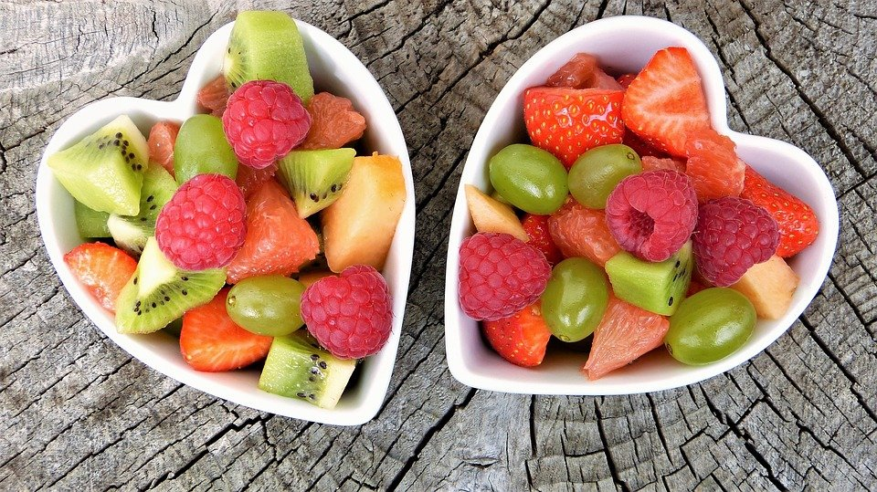
Colors matter a lot!
Notes:
Some extra tips……when you put your food on the plate see if there are colors! Colors are important, as every vegetable or fruit contains different nutrients, and variety is the secret to eating properly and not getting bored with the same dish. So remember, the more color, the more nutritious your meals are.

Slide 19
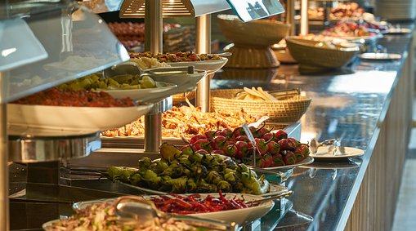
Avoid temptations!
Notes:
AVOID TEMPTATIONS!! Keep in mind that this smoothie or juice that you drink contains the sugar of 3 apples, or 4 oranges, or a couple of bananas and also milk and yogurt! It is very possible that you could never eat them on their own, but they are easy to blend and consume. They have a huge amount of calories!! Most people who consume these types of shakes gain weight. EAT your food and drink water! Avoid those buffets where you can eat an unlimited amount of food…it's hard to control ourselves in these places of excess food, better to avoid them.

Slide 20
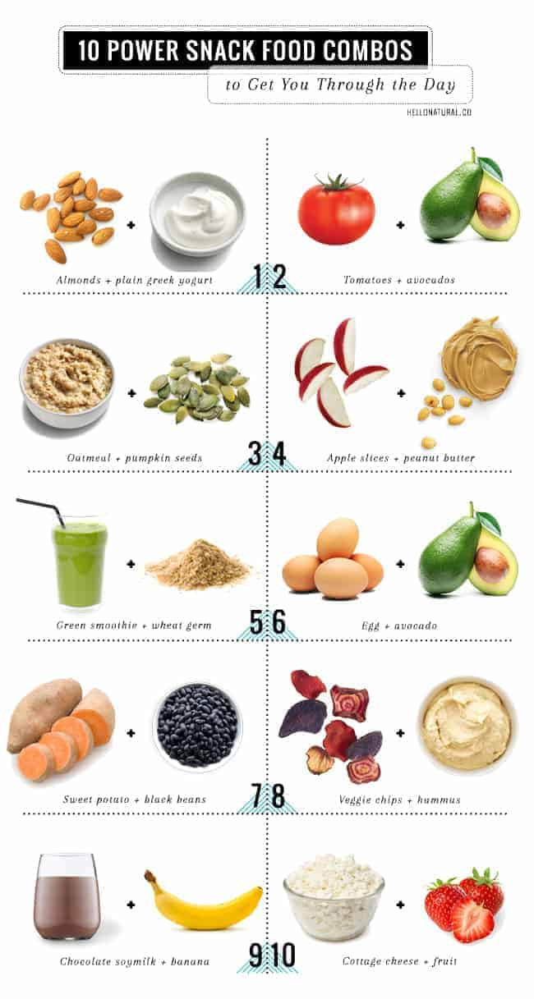
Simplify your snacks
Notes:
Another way to be successful in eating is by simplifying your snacks. These are healthy options to eat between meals in correct portions. If you have doubts about what is a correct portion, let us know, we can give you ideas on how to measure your food. If you're going to eat something light between long periods when you don't eat…make sure it's a fruit, vegetable, or protein. An example would be a small apple with a bit of cheese. Another example would be a few baby carrots with hummus.
Other important data:
Try to always eat at the same times. Don't forget to eat breakfast – it's important to eat a balanced meal at a balanced time. Don't overdo it – if you do, your blood sugar can drop too low and it can be dangerous. In addition, when we overdo it – we tend to overeat at the next meal because we're SO hungry. Eat natural things, not processed things – in the supermarket natural things are going to be found on the perimeter of the store…. These are the areas for vegetables, dairy, meats…and processed foods are going to be on the shelves in the center of the store (such as cookies, pasta, canned goods, boxes and jars). It will ALWAYS be healthier to stay away from the center shelves of a supermarket – limit how much you can eat from those shelves. Try to eat dinner as early as possible and not so heavy. If you have dinner tonight, try to walk after dinner and not lie down for at least a couple of hours.
If you have doubts or questions let us know! If we don't know the answer, we'll help you find it.

Slide 21
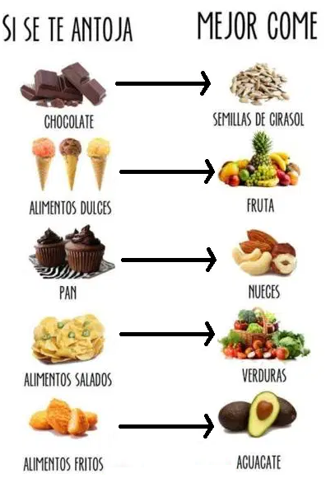
We struggle because we eat the wrong food
Notes:
So what have we learned???? That we struggle, because we eat the WRONG food!!! Note that in none of the food groups do we see:
Fried things or high-fat meals
Cakes or sweets
Sugary drinks such as juices or alcohol
Breads and tortillas
When we consume these types of foods, we are creating an endless cycle of eating, in which we feel BAD – without energy or strength, and in which we continue to consume things that continue to harm us. In this photo you can see some of the healthier alternatives – BUT REMEMBER….the portions you eat are also VERY important. NOT BECAUSE IT'S HEALTHY, I can eat it in large portions. The portions are VERY IMPORTANT!!! Talk to your Community Health Worker for alternatives to unhealthy foods. AND LET'S START to not only vary our meals, but to measure the portions.

Slide 22
Beware of emotional weight
Notes:
Since we share with you all this talk about food and weight, we want to ask you …… not to neglect your Spirit!! We are beings composed of spirit, soul and body! This is how God created us! But many times we focus on the physical weight and neglect the emotional weight. This is VERY important too! This carelessness can even make us physically sick! There are many things that affect this emotional weight – not forgiving…..living with hate….holding grudges. These consume the soul and mind and make us sick. Even this type of weight can cause lack of sleep, poor diet, lack of desire to TAKE CARE of our health. Physical weight is MANY times VERY related to emotional weight. If you are suffering from your emotional weight, we invite you to share your frustrations with us, we would love to pray with you…carrying this burden with someone else is much less burdensome. We are praying for you, for your physical health but emotional health as well. Sharing this weight with us is confidential and could help you take the first step of losing this weight too. We will be talking more about this in the coming months, but if you are going through a confusing or difficult situation – we want to pray for you and with you.

Slide 23
Thank you for being with us!
Notes:
Thank you for continuing to participate with us in this diabetes prevention and control program. We are very happy to have 3 months of classes with you and invite you to continue watching our videos, answering our calls, and allowing us to help you. God bless you and see you next month! Thank you!

Slide 24
References
- Banday, M. Z., Sameer, A. S., & Nissar, S. (2020). Pathophysiology of diabetes: An overview. Avicenna journal of medicine, 10(4), 174–188.
- Ley, S. H., Hamdy, O., Mohan, V., & Hu, F. B. (2014). Prevention and management of type 2 diabetes: dietary components and nutritional strategies. Lancet (London, England), 383(9933), 1999–2007.
- Nuttall F. Q. (2015). Body Mass Index: Obesity, BMI, and Health: A Critical Review. Nutrition today, 50(3), 117–128.
- Sami, W., Ansari, T., Butt, N. S., & Hamid, M. (2017). Effect of diet on type 2 diabetes mellitus: A review. International journal of health sciences, 11(2), 65–71.
- Understanding blood pressure readings. (2018, May 21). www.heart.org. Last accessed September 15, 2022. https://www.heart.org/en/health-topics/high-blood-pressure/understanding-blood-pressure-readings

