Slide 1
Complications and Diabetes
Month 4
Notes:
Thank you for being with us again. We are very happy that you continue to faithfully advance your commitment to prevent or control your diabetes. We are working to give you ideas to reach your goals, avoid temptations and make better decisions that help you have better health. Our commitment is as always to help you, answer your questions and give you ideas that can help you overcome the obstacles you have in your health care. This month we will be talking about the possible complications that come from diabetes. The purpose is not to scare you, but rather to inform you about these complications so that you can detect and resolve them if they occur in your life. There are times that the complications do not seem to be related to diabetes, but learning about these complications can help us to fix these problems before they affect your life more profoundly.

Slide 2
How do you feel?
Notes:
So, we start as usual with trying to check on how you have been feeling? What changes have you managed to make and maintain? How has the advice you received so far helped you? Of course, if you answered us right now, we wouldn't be able to hear you, but call us or share your experiences with us the next time your Community Health Worker calls you. If you agree, you can even send us texts or contact us in the way that is most convenient for you. We want to know your needs and questions! And if another time of day works better with your schedule, let us know.

Slide 3
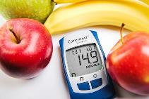
Keep checking your glucose levels!
80-100
80-150
80-200
On an empty stomach
In the afternoon/evening before eating
Two hours after eating
Notes:
In this effort that you are making for your health, one of the most important things to help you prevent and control diabetes is to understand what glucose numbers your body should have. Remember, everything we eat is converted to sugar or glucose in order to power your cells… this glucose is needed for energy and for your body to function properly, but keeping this glucose at a normal level is VERY important and it is the key in the prevention and control of diabetes. A very important reason to know your levels constantly is that UNDERSTANDING these levels helps us to form a relationship in our mind regarding which foods are the ones that raise our blood sugar level disproportionately and which foods help us maintain a normal level. A reminder… the normal fasting level is between 80 and 100. In the afternoon or evening BEFORE eating it is between 80 and 150. And after any meal (breakfast, lunch or dinner) the normal is between 80 and 200. The higher these levels are, the higher your 3-month average will be, which is called a1c.

Slide 4
UNDER 65
YEARS OLD
7.0
65 YEARS AND OVER
7.5
What is the goal?
Notes:
Do you remember what the goal of that 3-month average is? If you are diabetic and under the age of 65, that average must be below 7.0 to be considered a controlled diabetic. Or if you are over 65, that average must be below 7.5 to be considered a controlled diabetic. If you are NOT diabetic, the American Diabetes Association recommends that your a1c be no higher than 5.7. In a person NOT diabetic, an a1c above 5.7 is categorized as a person at RISK of developing diabetes.

Slide 5
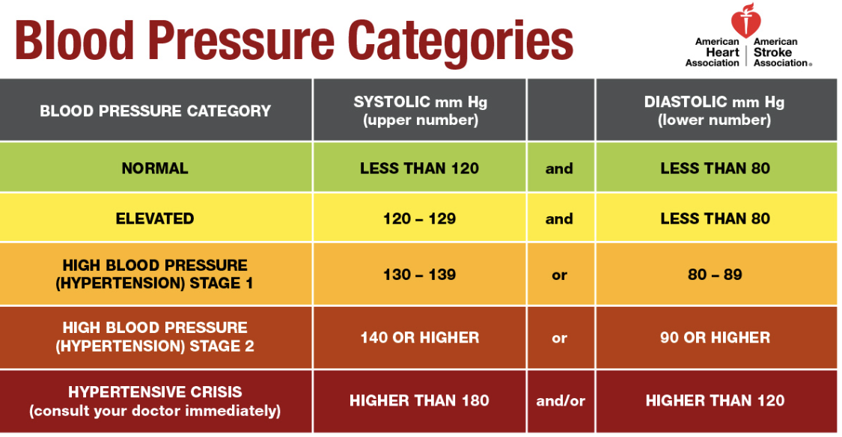
Notes:
According to the American Diabetes Association, people with diabetes are twice as likely to develop cardiovascular problems and strokes – so at the same time we must review the ideal numbers for your blood pressure. This chart shows the ideal levels recommended by the American Heart Association. Normal blood pressure is less than 120 over less than 80. Elevated blood pressure is between 120 to 129 over less than 80. Once it goes above 129 over 80, it is considered high blood pressure and is divided into three levels of hypertension. In this diabetes prevention and control program, our goal is for you to keep your blood pressure below 140 over 90. Achieving this goal would prevent health complications and lead a healthier life. What's important to understand is that by better managing your eating and exercise decisions, you'll be able to help lower your glucose level, and at the same time, these same changes will help control your blood pressure.

Slide 6
Formula
Body mass index
FORMULA
WEIGHT (pounds) X 703
[HEIGHT (inches)]²
BMI BMI BMI BMI BMI BMI BMI
Notes:
Remember we can make goals to improve our health and one of the keys has to do with weight. But in order to make a goal about our weight, it is important to know what the ideal weight for our health is. Remember, this program is trying to help you improve your health…our weight is a big part of our health and quality of life. Don't be discouraged if that number seems unattainable – the goal is to make small goals, but with determination. Let's focus on the first 5 to 10 pounds. Once this goal is achieved, we will make another goal…one goal at a time is more effective than making plans so big that they seem unattainable. Last month we explained how to calculate your Body Mass Index. If you need help doing this calculation and finding the ideal weight for your health, please call your Community Health Worker – we are ready to help you.

Slide 7
We are running a marathon – the road is long
Notes:
Remember that the prevention and control of diabetes, as well as improving our health in general, is a long race like a marathon in which it is more important to take a manageable pace that we can maintain for the rest of our lives and NOT a fast pace that wear us out and discourage us in a few weeks. We are not talking about going on a diet that will end when this diabetes prevention and control program is over…– we are talking about making lifestyle and nutritional changes that will last for the rest of your life.

Slide 8
A complicated subject
Notes:
In this long marathon of life – there may be some complications that are a bit difficult to talk about. In this program, for the first time we will be sharing this topic in a video format and not as an in-person talk. So it may be easier for you to talk about this more privately with your Community Health Worker. Let's start with a story...

Slide 9
DOCTOR, I HAVE A PROBLEM!
Notes:
A man diagnosed with diabetes comes to the clinic and, frustrated, finally shares with his doctor that he needs a prescription for Viagra. When the doctor asks more questions to try to understand what is driving this man to order this medication, his doctor discovers that this patient's diabetes has not been at controlled levels. In addition to this, other things like cholesterol level and blood pressure are in elevated numbers as well. After talking some more with the patient, the doctor also discovers that this patient has not been taking any of his medications. The patient tells the doctor that he is struggling to have relations with his wife, but nevertheless, he is very sorry to share his problem with her and says nothing…. Dealing with this problem for some time, the wife wants to separate…she suspects that he has another woman and wants to leave him….and so the patient asks for this medicine.

Slide 10
WHAT WAS THE REAL PROBLEM?
Notes:
But what do you think is the real problem? THE COMMUNICATION! He didn't talk to his wife, he didn't tell her anything about his problem – he just avoided having sex with her. She thought he was being unfaithful. No matter how much he tells her it's not like that, he can't convince her and now she wants the separation. He doesn't `t know what to do! What do you think is happening? What do you need to improve? Did you know that this is a common problem among people with diabetes?

Slide 11
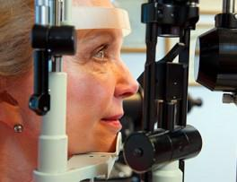
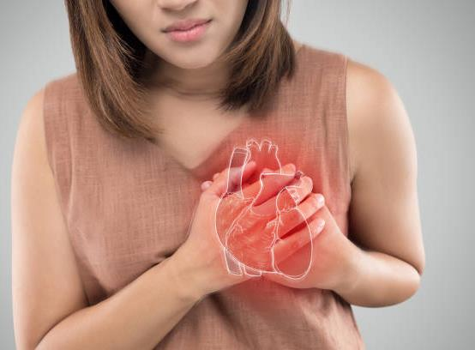
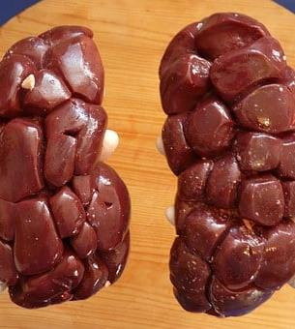
Prevention
Notes:
Next month we will be talking more about prevention and complications – for now we must understand that when you develop diabetes, your body begins to deteriorate. That excess of sugar in the blood (which remains uncontrolled and high for years), is damaging your veins and arteries. It desensitizes them. For this month, what we want to focus on is the problem that these veins and arteries produce in places that we cannot imagine.

Slide 12
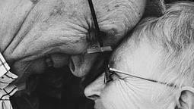
Everything is CONNECTED!
Notes:
Think about it: your body is ALL connected by these veins and arteries. These veins and arteries end in these extremities and are damaged by the uncontrolled excess of sugar. We commonly hear that they cause numbness in the extremities… in your feet and in your hands… but did you know that they also end up in your sexual organs?! These veins reach those organs and when damaged, the blood does not reach that point and loses sensitivity. That's why men who have this type of damage caused by years of deterioration from too much sugar in their blood have trouble getting an erection. When your blood sugar is high, your cholesterol is out of control and your blood pressure is elevated, these organs are affected as well… in both men and women! Women who have these uncontrolled sugar problems can also lose sensitivity and even not have enough sensitivity to enjoy sexual intercourse. The more of these medical conditions such as diabetes, high cholesterol, or high blood pressure you have, the higher your risk. We have to take care of ourselves now….because the more damage we cause to our body, the more easily it becomes irreversible damage. So, let's take care of our bodies, for our well-being and health... but also for the well-being of those around us... of those we love more.

Slide 13
Communication
Notes:
Just as taking care of our body, taking care of our marriage on the level of communication is very important. Especially when it comes to sex. Remember that patient who had problems with his wife? If he had maintained a good communication relationship with his wife and had communicated his physical problems to her – they could have avoided conflict and separation. Communication is important to both of you in a relationship.

Slide 14
Marriage – God’s Design
Notes:
It's something we rarely talk to someone about, either in the clinic or even in church! Sex and intimacy particularly in marriage were designed by God. And it is ironic that sex is embodied by all television commercials and our entire culture in an unhealthy way….to the point that we sometimes forget that it is a wonder and gift that God gave to the husband and wife when they get married.

Slide 15
Become friends again
Notes:
Talking with your husband or wife is important. Go back to being friends….remember those things that brought you together at the beginning. Reestablish the habit of going on “dates” – even if it's just for a walk in a park – it doesn't have to be anything fancy or expensive. The purpose is to reconnect and restore the communication that brought you together in the beginning. There may already be some damage that needs to be repaired, but communication will help you find and return to being the person you were at the beginning of your relationship – it's never too late to start over. These healthy relationships are part of your health as well. Many times we see among our patients that mental and emotional health are a HUGE part of our physical health. In many cases, mental and emotional health are also part of the complications of diabetes.

Slide 16
Depression
Notes:
In many cases of diabetic patients, depression and diabetes go hand in hand. Diabetes can be difficult on its own, but it is a big challenge when we add that one of the complications of diabetes is depression. Adding depression to what is already being problematic in your life can be devastating to many. You're not alone…depression is a common occurrence in people with diabetes, but it doesn't have to be hopeless. In order to begin to deal with and overcome depression we have to understand what depression is and what we can do about it.

Slide 17
What is depression
Notes:
To begin with, we have to understand what depression is: depression is a state of deep and prolonged sadness that lasts for more than a few weeks without an obvious or easily defined cause. To understand better, I give you a couple of examples: 1) If you lose your job today, it is very possible that you will feel very sad for a few weeks until your situation stabilizes and you find another job. In this case we CANNOT say that your situation of sadness is a depression because there is a very logical and normal reason for this sadness and it is due to a specific situation – job loss. Another example: 2) You lose a loved one and that leads to obvious deep sadness that paralyzes you for a few weeks – maybe even a month or two. You cry when you remember your loved one, but eventually over the weeks, you begin to return to your regular work and activities. You get sad every time you remember your loved one for a few months, but each time it is with a little more inner sanity and without this sadness preventing you from doing your job or living with people. This sadness is NORMAL, it is not depression because you can function in society and work in a normal way and you have a reason to feel this way. These two examples help us understand what depression IS NOT. Contrary to these two examples, a person in depression has no obvious reason for being sad and at many times this person cannot function normally in society or at work. You also cannot enjoy the things that normally make a person happy, such as funny movies, or birthdays, or gifts.

Slide 18
We don’t want to talk about it
Notes:
But usually, we don't want to talk about depression. THINK…if someone asks you: how are you? The response we consider appropriate in our society is: I'm FINE! To make matters worse…if we are Christians…this response MUST be positive – if not, we fear being branded as a bad Christian, or lacking in faith. Also, culturally as Hispanics, we tend not to react positively to what we don't understand. Depression is something that we often misunderstand and interpret as weakness…..weakness of character, weakness of strength, weakness of spirituality. But we MUST understand that there are MANY causes for depression. They are not a sign of weakness and should not be viewed in this way. God made us sensitive…..with feelings…..and many times we have not been able to understand that this only makes us NORMAL HUMANS! I want to inform you that as your Community Health Workers we understand very well that depression, besides being something that can happen to anyone, also has other roots that are much more common than we imagine. We also understand that for people with diabetes it is common to face complications such as depression.

Slide 19
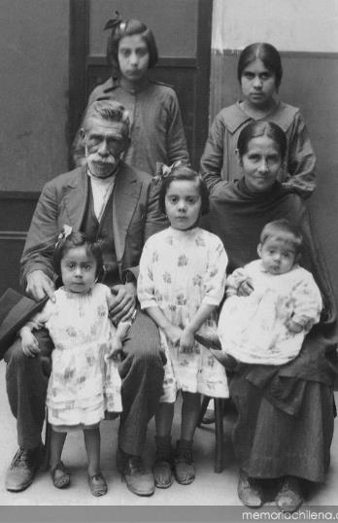
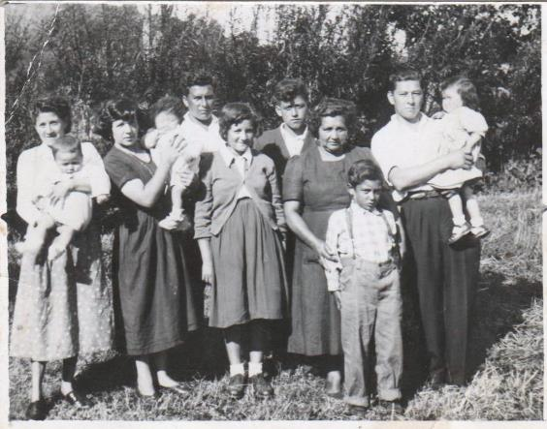
Our heritage…
Notes:
Why do some suffer from depression and others do not? Well….this is a bit complicated… To begin with, we have that… genetics or family history play an important part in being prone to depression. Some people are born with chemical imbalance problems that run in the family. Also….Life stressors are an important part of our mental health…for example the death of a spouse or children or the poor health of family members can cause depression that is difficult to cope with Other elements that contribute to depression are diseases such as diabetes!! People with diabetes are THREE times more likely to have depression!

Slide 20
Obvious solutions
Notes:
It is also important to emphasize that there are entirely physical conditions that cause depression. In other words, you may not have depression – there may be a medical problem! For example, if your vitamin B12 levels are low – your body may mimic depression. This deficiency is common in diabetes patients and this is why your doctor regularly checks your vitamin b12 levels. Make sure that if your doctor has recommended any supplements – you take them in the dosage that your doctor has recommended. MORE does not mean BETTER…you must follow your doctor's instructions. AND REMEMBER THAT IT IS IMPORTANT THAT as with any dietary supplement or vitamin – remember to tell your doctor what you are taking and in what amounts. Not just because you think it's “natural”…it's good for your health. Many of the natural things, if eaten in the wrong amounts, can be harmful. Whenever you go to the doctor, it is a good idea to bring the medications you take… but also the supplements or vitamins… It is worth having your doctor check them.

Slide 21
Our hope….
Notes:
However….whatever the reason you are experiencing any of these complications, know that you have hope that you have a team that is willing to help you whatever your situation. Most likely, as Community Health Workers, we have also gone through experiences similar to the ones you are facing. Call us, tell us your problem! We want to help you. Above all we want you to know one thing…apart from having us as your health team…you can have hope that God will provide you with the way to solve your situation…if it is health through the clinic, if it is advice – through assistance from the clinic or through your Community Health Worker. God made your body and knows your needs and ailments. Ask for help. If for any reason you need immediate help or think you may harm yourself or a loved one, call us….we are only a phone call away from being able to help you with practical help, but also with prayer.

Slide 22
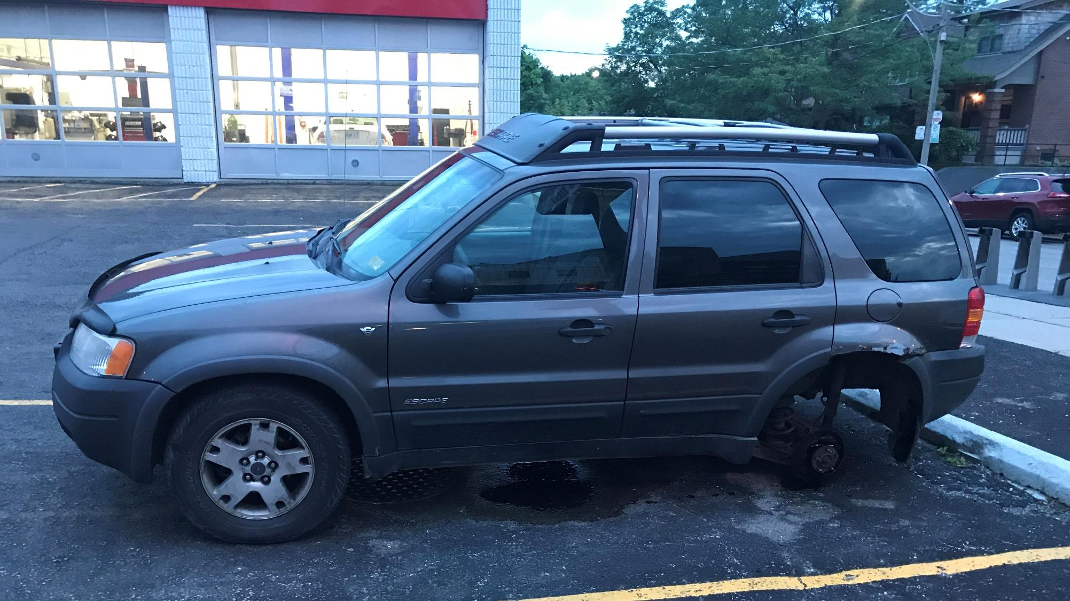
Everything is CONNECTED!
Notes:
Remember what we're talking about….Everything in your body is connected and treatment for depression or problems with sexual intimacy is like treatment for diabetes….It's one of the tires of a car….Each car moves with 4 tires and when you neglect one – the car will not move forward. Your treatment includes four wheels….. Don't neglect one

Slide 23
MEDICINE
Notes:
One of those wheels is medicine. Some people will need medicine and others won't – check with your doctor…..he will tell you when to start taking a medicine and when to stop taking it. He will give you advice according to what you particularly need and in the amounts that will help you. However, we clarify that the medication for depression only works in 60% of cases… many times you will have to adjust the dose and it can take up to 6 weeks to start feeling the effects. It is good that if your doctor recommends medications, you take them and report how you feel directly or through your Community Health Worker. But don't just rely on medication...

Slide 24
Eating well
Notes:
One of the wheels that are essential for your health car to work is your food! YES, YES….again food. Your diet is key to your success in your health. We cannot separate the mind from the body. In other words, if you have a poor diet and never exercise, you can't expect other areas like your strength, mood, and sex drive to be okay! Your body is connected!!! When you eat well and eat healthy, or exercise, your body activates chemicals that make you feel upbeat and happier. These chemicals are important to your intimate and sexual life. We will talk more about exercise in the next month.

Slide 25
Exercise
Notes:
Another one of the wheels that are essential for your health car to work is keeping your weight in check. This is important for both your sexual health and your depression. Taking care of yourself and being at a healthy weight raises those good chemicals in your blood…it's like natural medicine for depression and increases your sex drive and strength. Just going for a walk and getting some fresh air goes a LONG WAY….you don't have to run a marathon!

Slide 26
We are a team, and we are on your side
Notes:
The last of those wheels for your health car is the social support of family, friends and church. Having people who encourage you in your life is very important. Surround yourself with uplifting people….BE an uplifter – you will be able to see the change in the people around you when you become a positive uplifter yourself. Talk to someone if you feel that you are going through difficult times, go to your Community Health Worker, your pastor, your church or a place where you feel safe. Remember that if you have thoughts of harming yourself or others, talk to someone around you, your CHW or your doctor TODAY. We want to help you! You don't have to face this alone.

Slide 27
We want you to be healthy in all aspects of your life
Notes:
Diabetes and the complications that come with diabetes take a long time to improve….and there are several ways you can start to improve your health. We want you to have a long life, but we also want you to have a GOOD quality of life. Take your medicine, eat healthy, exercise, and find a community that supports and encourages you. Make goals, and share them with loved ones to help you stay focused. Having people around you to encourage you is critically important in order to MAINTAIN the discipline of those changes.

Slide 28
Thank You!
Notes:
Thank you for watching this video and don't forget we would like to talk more with you about these topics we share today. If you need more information, please contact your Community Health Worker. Until next time!

Slide 29
References
- Nuttall F. Q. (2015). Body Mass Index: Obesity, BMI, and Health: A Critical Review. Nutrition today, 50(3), 117–128.
- Chaturvedi N. (2007). The burden of diabetes and its complications: trends and implications for intervention. Diabetes research and clinical practice, 76 Suppl 1, S3–S12.
- Sartorius N. (2018). Depression and diabetes. Dialogues in clinical neuroscience, 20(1), 47–52.
- Bădescu, S. V., Tătaru, C., Kobylinska, L., Georgescu, E. L., Zahiu, D. M., Zăgrean, A. M., & Zăgrean, L. (2016). The association between Diabetes mellitus and Depression. Journal of medicine and life, 9(2), 120–125.
- Understanding blood pressure readings. (2018, May 21). www.heart.org. Last accessed September 15, 2022. https://www.heart.org/en/health-topics/high-blood-pressure/understanding-blood-pressure-readings

