Slide 1
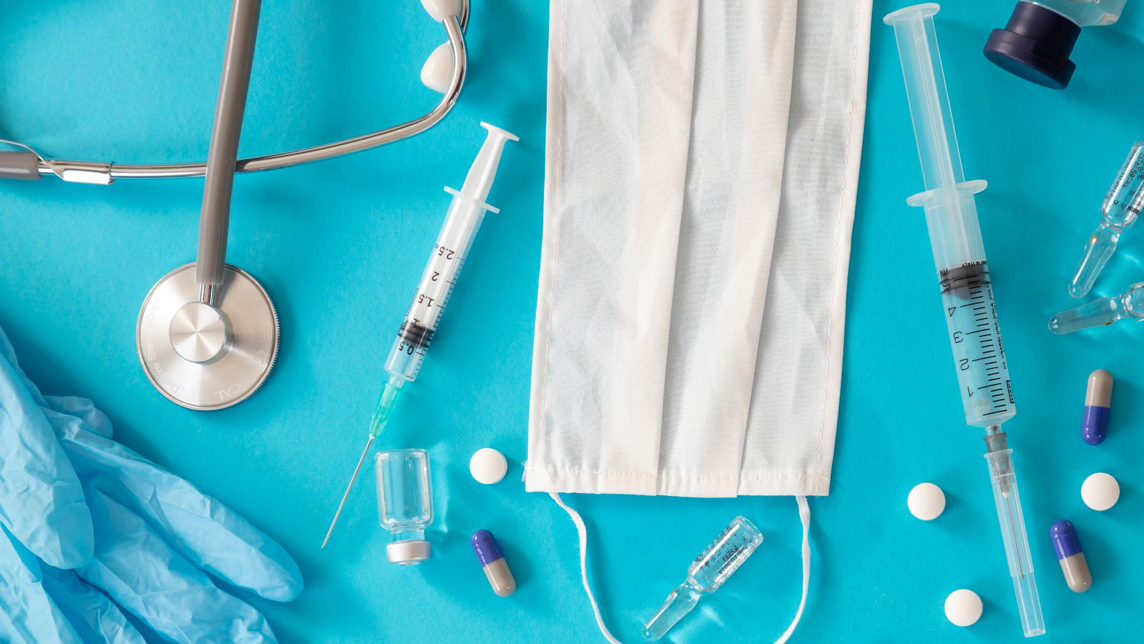
Prevention month 5
Notes:
Welcome and Thank you for once again joining our Diabetes Prevention and Control class! This class will have two parts so that we can explain in detail all the information we want to share with you.

Slide 2
Don’t get discouraged, continue your disciplines!
Stick with your medications
Stick with your good eating habits
Keep talking to your Community Health Workers
DON’T GIVE UP!
Notes:
Don't worry if you haven't managed to meet all of your goals. We want to encourage you to continue with the disciplines you've learned so far- we don't want you to get discouraged. The process of changing sometimes suffers from long moments of discipline, followed by discouragement. If you are going through a moment of discouragement, let us know, we want to help you get back to your goals. In the process of change, we really need to be able to talk with someone who has been through the same thing, through discouragement, to help us refocus. It is important that you continue with your medications, your good eating habits and that you continue to talk with your Community Health Worker. Don't give up – we all need to keep improving – there are always more ways to grow, change and improve. We need to make changes for life – not just for a season. Take back control of your health.

Slide 3
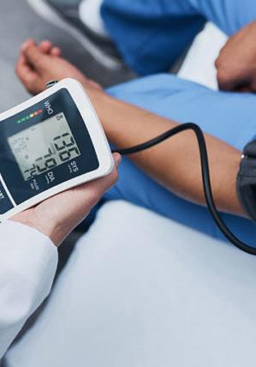
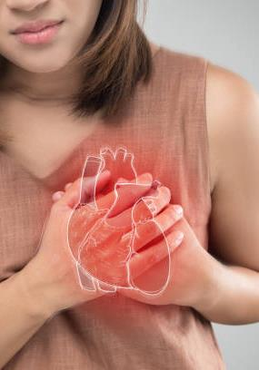
THE BEST OPTION IS PREVENTION
Notes:
Keep making changes- it is necessary because if you don't control your health, your complications end up controlling you. There are many habits that we can change to prevent illnesses – some of these habit changes even help to prevent more than one complication or illness. In that class we will teach you which diseases you could prevent by making the changes in habits that we have been teaching you in recent months. We will talk: Diabetes, High Blood Pressure, Cholesterol, Heart attack, Embolism, Kidney problems, Arterial or circulation problems, Vision problems, Loss of sensation in extremities and amputations, Respiratory complications – flu, pneumonia, and more recently the severe impact of COVID 19, depression and sexual dysfunction. These complications or illnesses are common in people who are at risk for diabetes or who are overweight. But we will be with each of these complications offering you the alternative of what we can do about it. Until now we have tried to help you prevent diabetes by teaching you: what are the sugar levels that are normal for you, what is the weight or Body Mass Index that is ideal for you, and what is the level of blood pressure in which your body functions healthiest. Why diabetes? Because we are in a diabetes prevention and control class…. But how do these diseases develop? And what are the ways to prevent them?

Slide 4
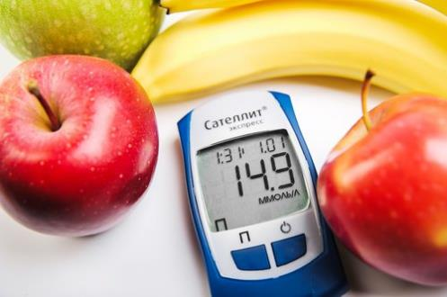
Diabetes
Notes:
Do you remember that in the first month we talked about what diabetes is??? Let's quickly review: Diabetes causes a build-up of sugar in the blood – to remind yourself how this disease works – you can watch the video from the first month titled Controlling Diabetes – if you no longer have that link, talk to your Community Health Workers and they will be happy to send it to you. So, because of that accumulation of sugar in the blood, the arteries become contaminated, they are at a disadvantage and there are more possibilities of complications. The solution to this disadvantage is to eat smaller portions, be at a more ideal weight, and take the medications that your doctor has prescribed, in order to reduce that excess sugar in your blood. The preventive test to keep this disease away or controlled is the a1c test that is done every 3 to 6 months in order to maintain an idea of ​​how our daily food is impacting our health. It is very important to check it regularly. We can prevent our body from being damaged, if we have this number monitored. In the past months we have talked about the level we should be at. Review these numbers with your Community Health Workers so you can take control of your a1c.

Slide 5
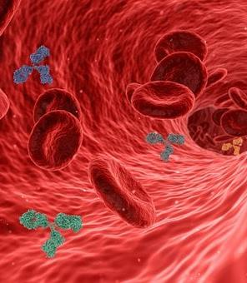
CHOLESTEROL and high blood pressure
Notes:
Another ‘contamination’ in the arteries is the accumulation of cholesterol. This is why your doctor monitors your cholesterol annually with blood tests. There are two types of cholesterol – it is very important to maintain a good balance of the two types of cholesterol. Cholesterol is a fatty substance that is deposited in the veins and arteries and this accumulation begins to prevent the passage of blood. These buildups have the same effect as when you use a garden hose. If you press or squeeze that hose, the water pressure is going to be higher…. Similarly, when it doesn't flow freely – the arteries start to get clogged and the pressure with which your blood flows increases. Prevention in these cases comes from eating less fatty foods, reducing your weight to an ideal weight, and also in the form of a low-strength aspirin pill – this aspirin (called baby aspirin) helps your blood flow more easily despite those cholesterol hurdles. That helps get your pressure to a normal level – if you like to remember normal blood pressure levels – you can find it in last month's video which talks about complications. Ask your Community Health Worker if you can't find the link to this video and they'll be happy to send you the link. Prevention of high cholesterol is directly connected to your diet. It is important to have this annual exam, but also to monitor your pressure to notice if there are any changes that have to be reported to the doctor.

Slide 6
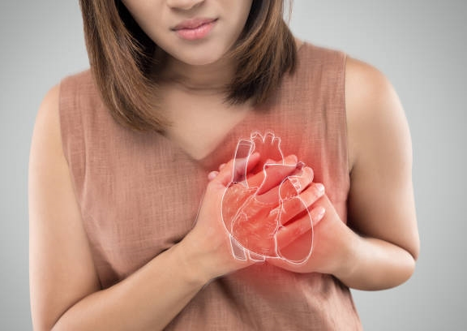
Heart attack
Notes:
Heart attacks
High blood pressure and high blood sugar over time damage your arteries. Since arteries run throughout your body, this damage can show up anywhere in your body. The American Heart Association warns us that in the case of heart attacks, these cholesterol and sugar contaminations produce a blockage or plaque in the arteries…. As all the blood travels to the heart and from the heart to all its vital organs, that plaque detaches and reaches the heart. It then produces an arrest in the heart because the heart cannot support that plaque. So the cholesterol and sugar plaque compound in a double risk for the heart to suffer. We can prevent these attacks or the percentage of risk that we have of suffering a heart attack, by controlling our nutrition and our exercise… so that this contamination of sugar, cholesterol, plaque and other contaminants (such as tobacco) do not increase our chances of suffering from heart attack.

Slide 7
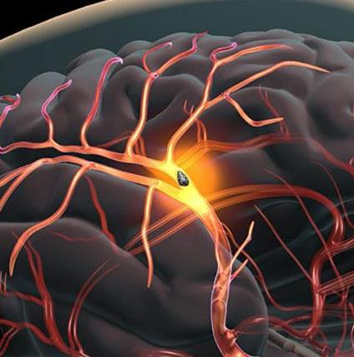
Embolism
Notes:
According to the American Heart Association, another one of the complications that we have when contaminating our blood is that of suffering a stroke or an embolism. The association explains that a stroke can be caused when a blood clot travels through the arteries to the brain and blocks the flow of blood in the arteries that nourish the brain or when the arteries rupture causing bleeding in the brain. Blood contaminated with sugar, cholesterol plaques, tobacco and the other contaminants increases the possibility of these clots.

Slide 8
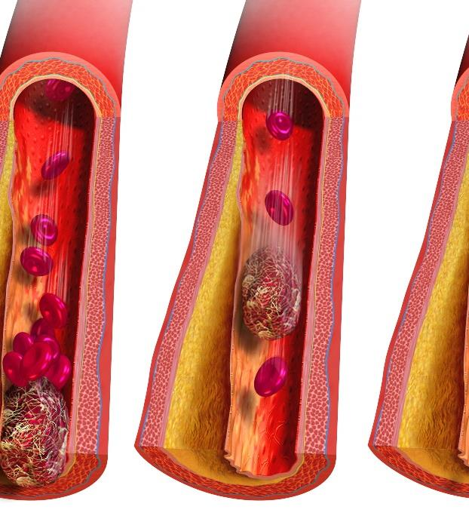
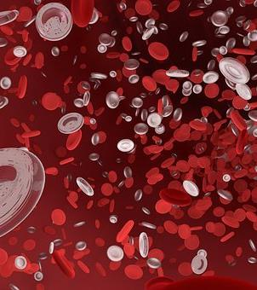
Blood clots
Notes:
These blood clots are formed by the contaminations that we cause in our blood – such as excess sugar, excess cholesterol plaque, or other contaminations such as tobacco contamination. How can we prevent these clots from forming and growing? I think you are noticing that prevention is almost the same for each of these complications, right? Nourishing ourselves more healthily and in better portions, maintaining a weight closer to the ideal weight, not contaminating our blood with excess fat, sugar and tobacco, and being more active!

Slide 9
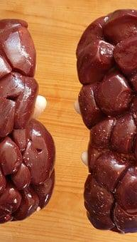
Protein in kidneys
Notes:
One of the preventive tests that your doctor also orders regularly is urine. Do you know why? Because our kidneys and the urine they expel can give us an excellent idea of ​​our health. It is through this test that your doctor can detect if your kidneys have protein. If you have protein in your kidneys it is because they are working much harder than they should. This is not good for you, because little by little your kidneys wear out and stop working. Then we have to start depending on machines that help us do the work of the kidneys.

Slide 10
Dialysis
Notes:
When your kidneys don't work, you can't urinate and get rid of chemicals that harm your body. A dialysis machine can help with this when your kidneys no longer can. This process is normally 3 hours, three times a week. It is very difficult to get to this point because many times there is no remedy or solution. But we must prevent reaching this point because there comes a time when even with the help of the machine, it is not enough. That's why your doctor tries to help you reach the health goals necessary to avoid this complication.

Slide 11
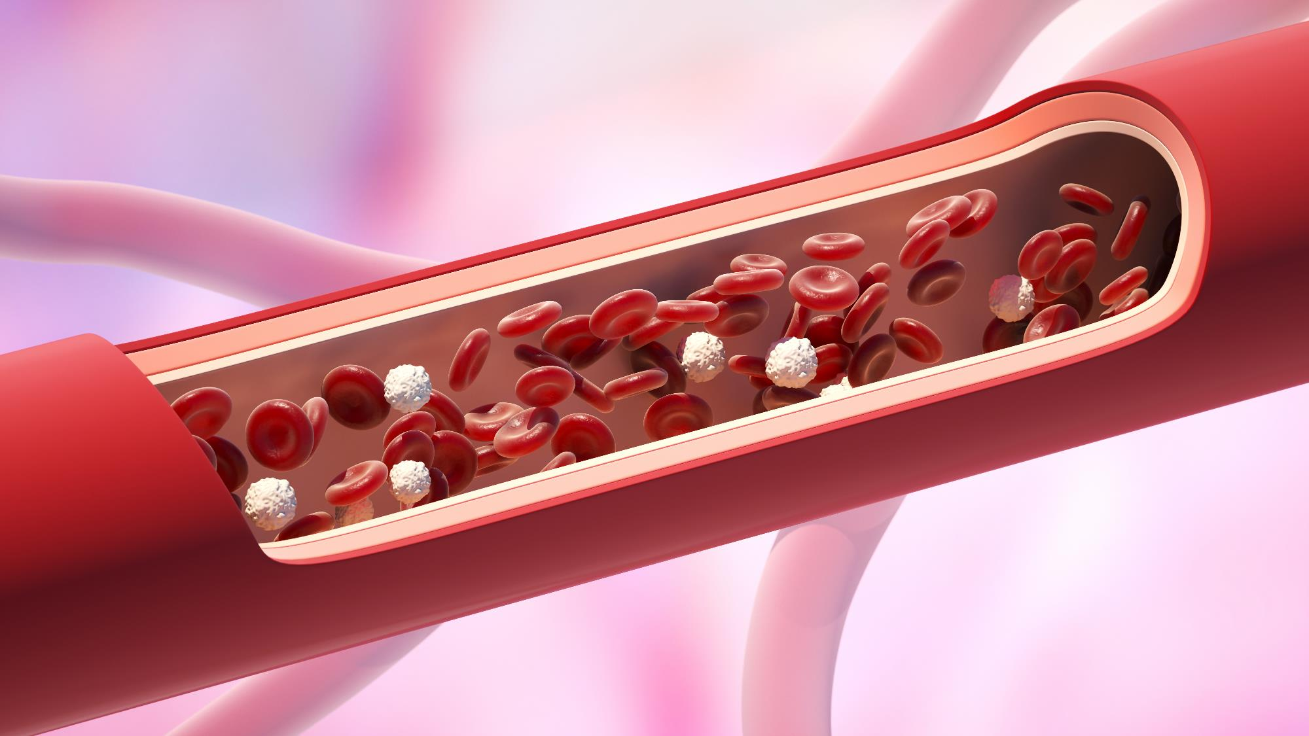
Arteries
Notes:
Our entire body is kept in good working order by our arteries. Our entire body has arteries – from our toes to our brains, from our sexual organs to our eyes – some arteries are larger and some are tiny. Everyone can cause damage to the arteries by having bad habits and everyone can stay healthy with good habits.

Slide 12
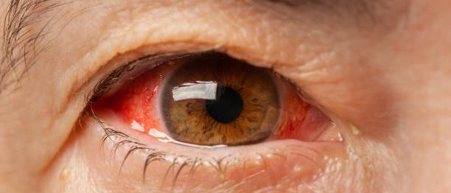
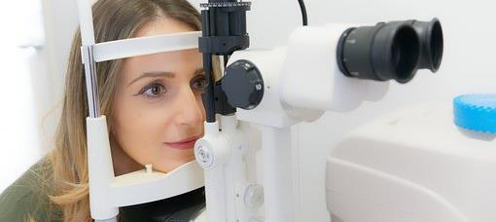
Arteries of the eyes
Notes:
Their eyes are one of the parts that have many very small arteries and by not taking care of preventing or controlling diseases like diabetes and high blood pressure, those arteries can cause problems and even cause blindness. Diabetes and high blood pressure are the most common causes of blindness.

Slide 13
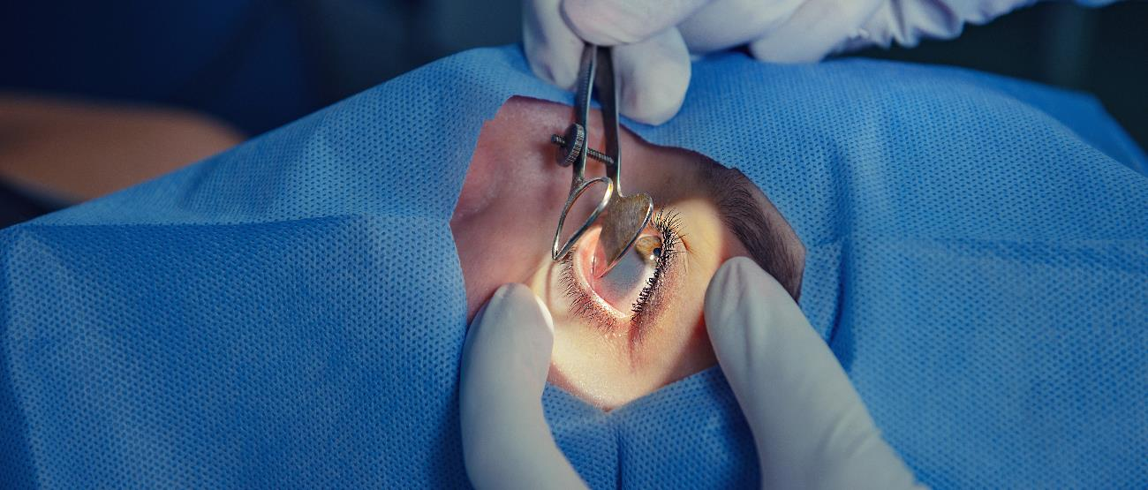
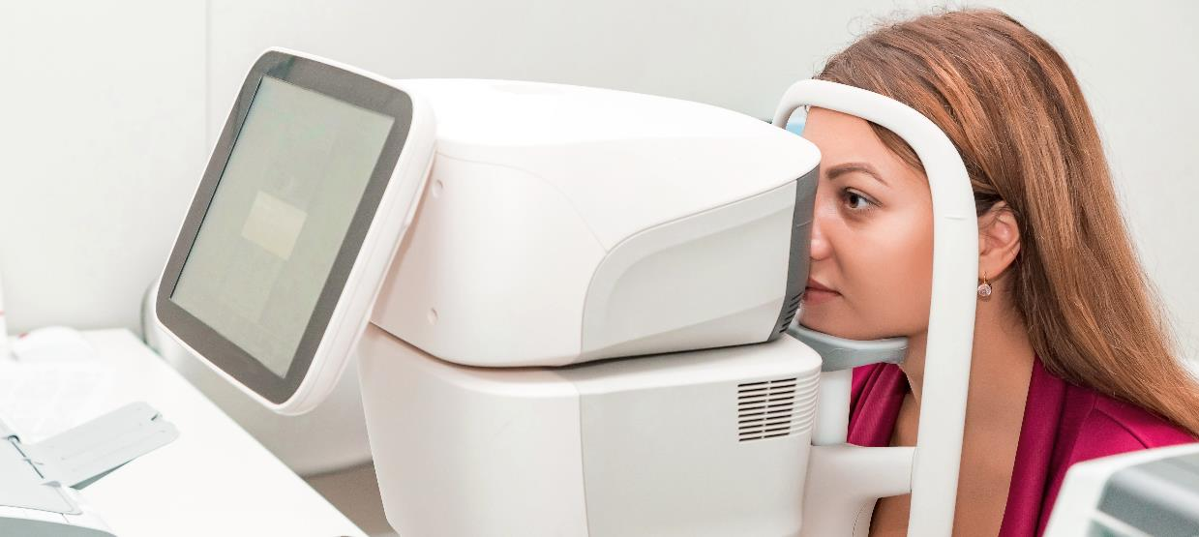
Limited vision or blindness
Notes:
You, whether you have diabetes or are at risk for diabetes, should see an eye doctor annually to check the health of your eyes. Your eye doctor will be able to detect if there are problems that need to be checked more carefully and will help you know if you are still able to drive a car, read, etc. The best form of prevention (aside from your diet and exercise) is to have this exam done annually. If your eyes have not been examined this year, please talk to your Community Health Worker to help you make an appointment with your eye doctor through the Clinic.

Slide 14
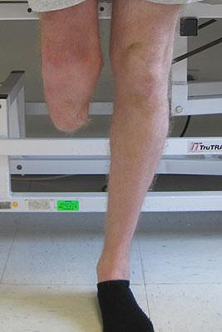
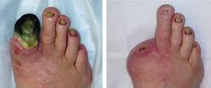
Amputations
Notes:
Another one of the common complications of uncontrolled diabetes is losing sensation in your extremities due to arteries that begin to damage! When blood no longer flows healthily to our extremities, we feel no sensation in places like our feet! This is why one of the simplest but most forgotten prevention tests – when you have already developed diabetes – is the foot check. If you can, do this test at home. Just check the bottoms of your feet, and between your toes…if you can't see them without help, ask someone who lives in your home to help you check. Another idea that we can suggest is to put a medium mirror on the floor to be able to see the soles of your feet. Any problems you see should be reported to your doctor as soon as possible. All infections, cuts or blisters in a person with diabetes heal very slowly or do not heal at all, for this reason, they must be treated as soon as possible to prevent these complications from progressing and becoming a bigger problem. Remember that this is easy to prevent.

Slide 15
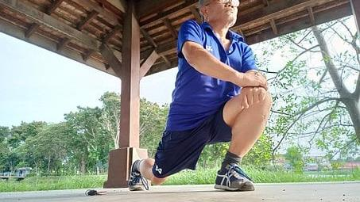
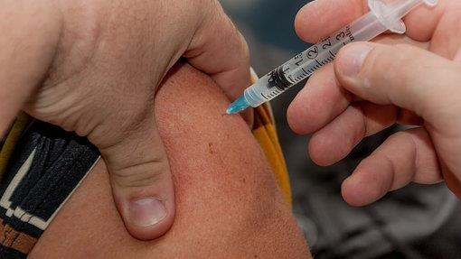
What can I do?
Notes:
How can we prevent these diseases and complications?

Slide 16
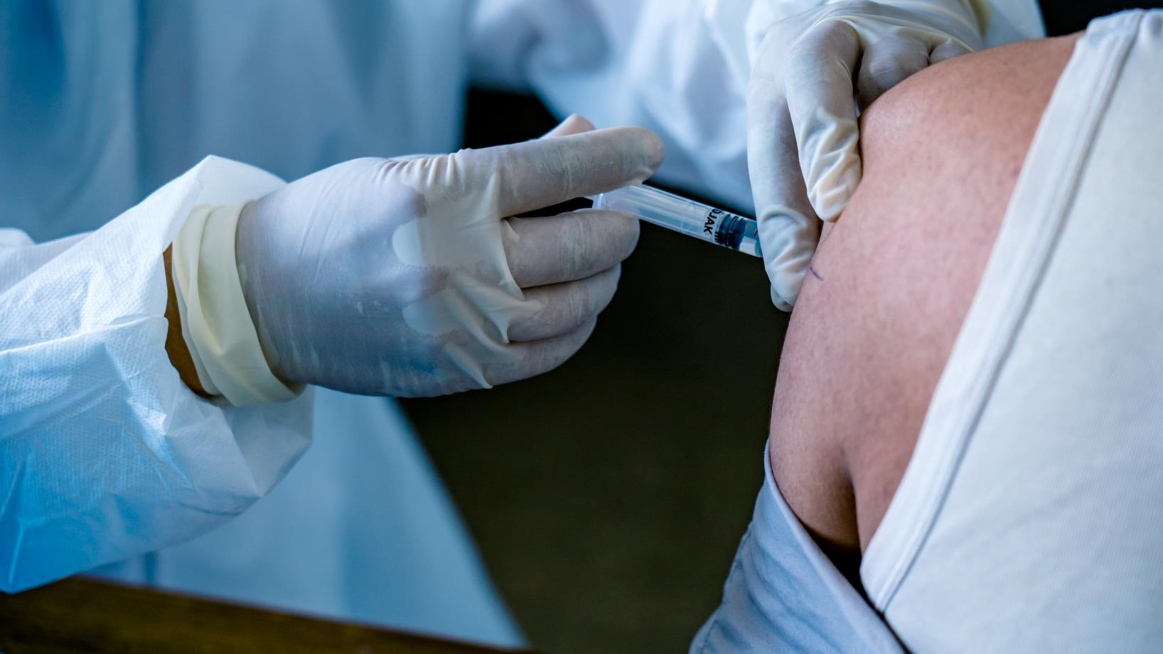
Vaccines
Notes:
One of the simple ways to prevent complications is vaccines. We know that there are many vaccines and that sometimes it can be confusing or sometimes it is difficult to understand how these vaccines work in your body. In our diabetes prevention and control we are concentrating on two in particular: Flu and pneumonia because these diseases are very common and can cause a lot of harm to a person who is at risk for diabetes or has uncontrolled diabetes.

Slide 17
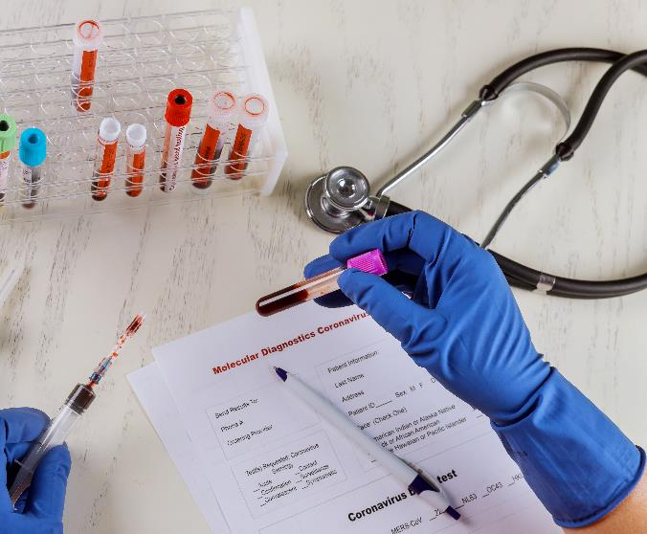
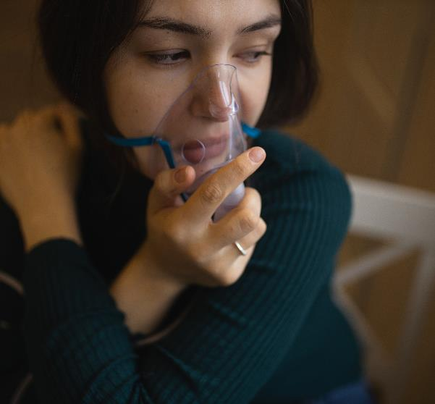
INFLUENZA, PNEUMONIA and COVID
Notes:
Many of us are already well informed about flu viruses that change annually and require vaccinations for prevention. The Good Samaritan Clinic is offering free flu shots – contact your Community Health Worker if you still need this shot. Another preventable disease is pneumonia which requires a vaccine that is sometimes a bit expensive – if you have the possibility to apply this vaccine for free – you should consider the opportunity to do so. It is important to do this to prevent complications. Now in these times of pandemic we also have a lot of information at our fingertips about the vaccine against the COVID virus and there are possibilities to get this vaccine for free. Just like the flu, if you have not had the opportunity to do so - contact your Community Health Worker and they can help you find a place to do it. There is SO MUCH information available to people about vaccines and how they work…..and we know that in recent times there has been more confusion regarding vaccines. The reality is that sometimes we tend to think that "it's not going to happen to me" and we leave something to chance when we can actually prevent it. If you have doubts about any of these vaccines, please consult valid and medically supported websites - or talk to your Community Health Worker - we would love to help you navigate your doubts and myths about vaccines.

Slide 18
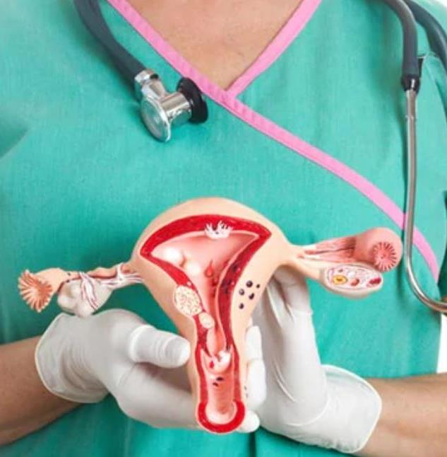
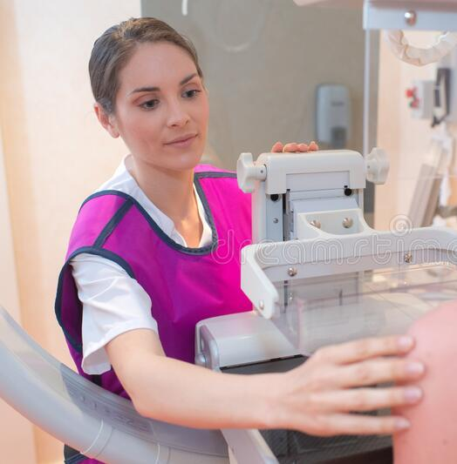
Other prevention exams
Colonoscopy
Mammogram
Pap-smear
Notes:
Other preventive tests that can make the difference between a short treatment or more advanced or more complicated diseases are:
1- Colonoscopy: The most current medical recommendations by the Center for Disease Control for colonoscopies are to have a screening beginning at age 45 and every 10 years thereafter. This test can help you find colorectal cancer and prevent it from progressing without being monitored and treated.
2- Mammography: The most current medical recommendations by the Center for Disease Control for mammograms are to have a screening beginning at age 50 and every two years thereafter. This exam can help detect breast cancer and prevent it from progressing without being monitored and treated.
3- Pap Smear: The most current medical recommendations by the Center for Disease Control for Pap smears are to have a Pap smear beginning at age 21 and every three years thereafter. This test can help detect cervical cancer and prevent it from progressing without being monitored and treated.
In any of the above-mentioned exams, it is always necessary that you follow your doctor's recommendations, since there may be other reasons or health conditions for which your doctor decides to do exams more frequently. These causes, such as susceptibility to these types of cancer in your family or other medical conditions, may change the recommendations for you in particular.

Slide 19
OTHER COMPLICATIONS
Notes:
As we discussed in one of the past lectures: the complications can be various and different in each patient. Remember that sometimes when we are at risk of diabetes or living with uncontrolled diabetes, we suffer without realizing that some complications are related to blood sugar.

Slide 20
Depression
How to fight depression?
Notes:
Like depression! In many cases of diabetic patients, depression and diabetes go hand in hand. Diabetes can be difficult on its own, but it is a big challenge when we add that one of the complications of diabetes is depression. Sometimes we ignore that depression is common in diabetics or people at risk of diabetes! But it's common….if you haven't seen the video where we talk about this topic yet – ask your Community Health Worker to send you this video so you can watch or review this information. The important thing about depression is recognizing what it is and what it is not.
WHAT IT IS: Depression is a state of deep and prolonged sadness that lasts for more than a few weeks without an obvious or easily defined cause.
WHAT IT IS NOT: It is not a sign of weakness and should not be viewed in this way.
Remember: God made us sensitive…..with feelings…..and many times we have failed to understand that this only makes us NORMAL HUMANS! Whatever the reason you are experiencing any of these complications, know that you have the hope of having a team that is willing to help you regardless of your situation. Most likely, as Community Health Workers, we have also gone through experiences similar to the ones you are facing….we are just one call away from being able to help you with practical help, but also with prayer.
How can we prevent depression? Controlling what we eat, going out to exercise and doing our routine medical check-ups…. In other words, you may not have depression – there may be a medical problem! For example, if your vitamin B12 levels are low – your body may mimic depression. This deficiency is common in diabetic patients and this is why your doctor regularly checks your vitamin b12 levels. Make sure that if your doctor has recommended any supplements – you take them in the same dosage that your doctor has recommended. MORE does not mean BETTER…you must follow your doctor's instructions. As for exercise – it is absolutely necessary for your health, but even more so if you suffer from depression – getting out, interacting with others while walking will help you feel better.

Slide 21
Sexual disfunction
Everything is connected
Notes:
Remember we talked about your body being ALL connected by these veins and arteries. These veins and arteries end in these extremities and are damaged by the uncontrolled excess of sugar. We commonly hear that they cause numbness in the extremities… in your feet and in your hands… but did you know that they also end up in your sexual organs?! These veins reach these organs. When damaged, the blood is not able to reach the organs and they lose sensitivity. That's why men who have this type of damage caused by years of deterioration from too much sugar in their blood have trouble getting an erection. When your blood sugar is high, your cholesterol is out of control and your blood pressure is elevated, these organs are affected as well… in both men and women! Women who have these uncontrolled sugar problems can also lose sensitivity and even not have enough sensitivity to enjoy sexual intercourse. The more of these medical conditions such as diabetes, high cholesterol, or high blood pressure you have, the higher your risk. We have to take care of ourselves now….because the more damage we cause to our body, the more easily it becomes irreversible damage. So, let's take care of our bodies, for our well-being and health... but also for the well-being of those around us... of those we love. Preventing all these complications is the same….

Slide 22
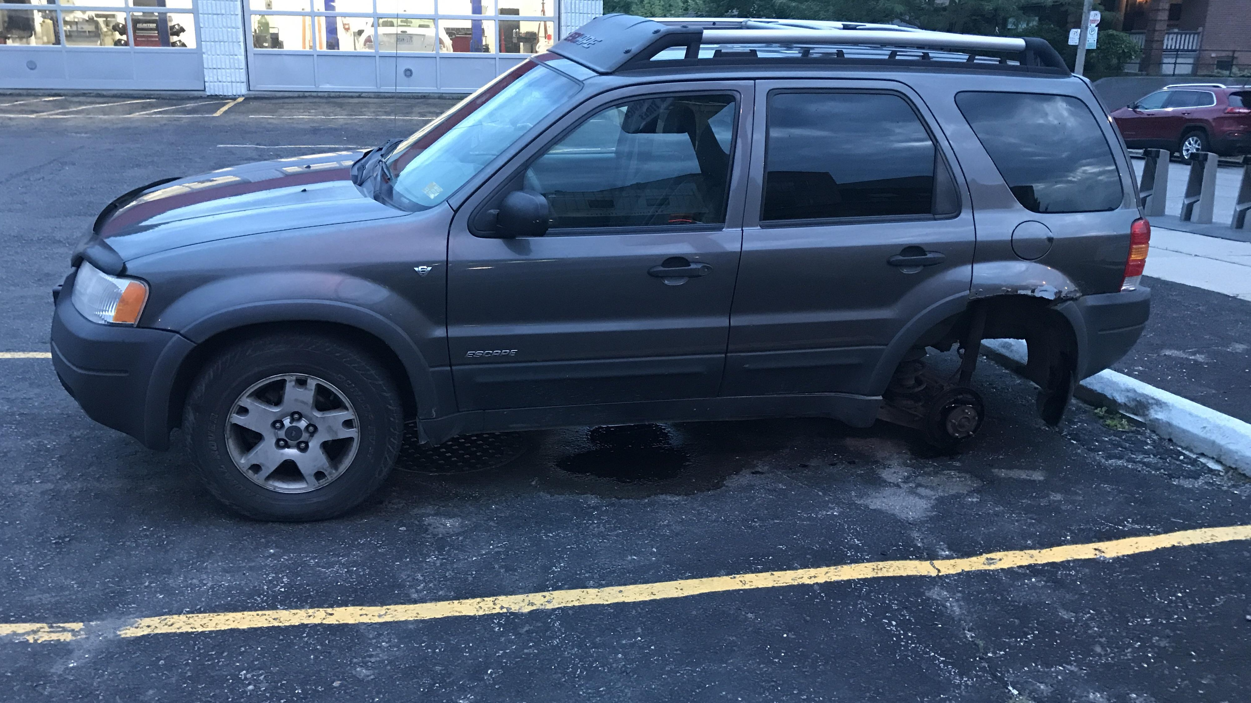
Everything Is Connected
Notes:
Remember what we talked about….EVERYTHING IN YOUR BODY IS CONNECTED AND PREVENTION IS Manifesting as a 4-wheeled cart…. each car moves with 4 tires and by neglecting one – the car will not advance. Your treatment includes four wheels….. Don't neglect any These four wheels are: MEDICATIONS, FOOD, EXERCISE, SOCIAL SUPPORT FROM FAMILY And FRIENDS

Slide 23
Medicine
Notes:
One of those 4 wheels is medicine. Some people will need medication and others won't – check with your doctor…..he will tell you when to start taking a medication and when to stop taking it. He will give you advice according to what you particularly need and in the amounts that will help you. However, sometimes your doctor will need to adjust the dose. It is good that if your doctor recommends medications, you take them and report how you feel directly or through your Community Health Worker. But don't just rely on medication...

Slide 24
Food
Notes:
The second wheel for that health car to work is your food! YES, YES….again with food. Your diet is key to your success in your health. We cannot separate the mind from the body. In other words, if you have a poor diet and never exercise, you can't expect other areas like your strength, mood, and sex drive to be okay! Your body is connected!!! When you eat well and healthy, your body responds positively and you begin to feel energized, encouraged and happier. This is important to prevent the complications we have discussed.

Slide 25
Exercise
Notes:
Another one of those wheels for a healthy car is keeping your weight in check. This is important both for your sexual health and for your depression and most of the complications we looked at today. Taking care of yourself and being at a healthy weight raises those good chemicals in your blood…it's like natural medicine for depression and increases your sex drive and strength. Just going for a walk and getting some fresh air goes a LONG WAY….you don't have to run a marathon! But if you have to be consistent.

Slide 26
WE ARE ON YOUR SIDE _______ WE ARE A TEAM
Notes:
The last of those wheels for your health is the social support of family, friends and church. Having people who encourage you in your life is very important. Surround yourself with uplifting people….BE an uplifter – you will be able to see the change in the people around you when you become a positive uplifter yourself. Remember that we want to be part of your team! The reason why your doctor and we, as your Community Health Workers, insist on controlling your blood sugar, blood pressure and weight numbers, is because every day we see the effects of living with uncontrolled diseases. We want you to be able to enjoy a better quality of life- because equal to or more important than how many years we live, is what quality of life we will have in those years. Everything we share with you today will help you live with better quality and prevent medical complications. We are on your side and we are here to help you.

Slide 27
Don't get discouraged, follow your disciplines
Stick with your medications
Stick with your good eating habits
Keep exercising Keep talking to your Community Health Worker
DON'T GIVE UP!
Notes:
Don't be discouraged if you haven't managed to meet all of your goals. We want to encourage you to continue with the disciplines you've learned so far, but we don't want you to get discouraged. The process of changing sometimes alternates between long moments of discipline, followed by discouragement. If you are going through a moment of discouragement, let us know, we want to help you get back to your goals. In the process of change, we really need to be able to talk with someone who has been through the same thing, through discouragement, to help us refocus. It is important that you continue with your medications, your good eating habits and that you continue to talk with your Community Health Workers. Don't give up – we all need to keep improving – there are always more ways to grow, change and improve. We need to make changes for life – not just for a season. Take back control of your health.

Slide 28
We are running a marathon – the road is long
Notes:
Remember, the goal is to run a marathon of best habits for your life – and not just making changes that last a few weeks. We hope you use this information and review it if you need to. Next month we will start talking to you every two weeks, but we hope you will call us if you need our help. Until next time!!

Slide 29
References
- American Diabetes Association (2010). Diagnosis and classification of diabetes mellitus. Diabetes care, 33 Suppl 1(Suppl 1), S62–S69.
- Chaturvedi N. (2007). The burden of diabetes and its complications: trends and implications for intervention. Diabetes research and clinical practice, 76 Suppl 1, S3–S12.
- Goeijenbier, M., van Sloten, T. T., Slobbe, L., Mathieu, C., van Genderen, P., Beyer, W., & Osterhaus, A. (2017). Benefits of flu vaccination for persons with diabetes mellitus: A review. Vaccine, 35(38), 5095–5101.
- Maiorino, M. I., Bellastella, G., & Esposito, K. (2014). Diabetes and sexual dysfunction: current perspectives. Diabetes, metabolic syndrome and obesity : targets and therapy, 7, 95–105.
- Zhang P. Y. (2014). Cardiovascular disease in diabetes. European review for medical and pharmacological sciences, 18(15), 2205–2214.

