Slide 1
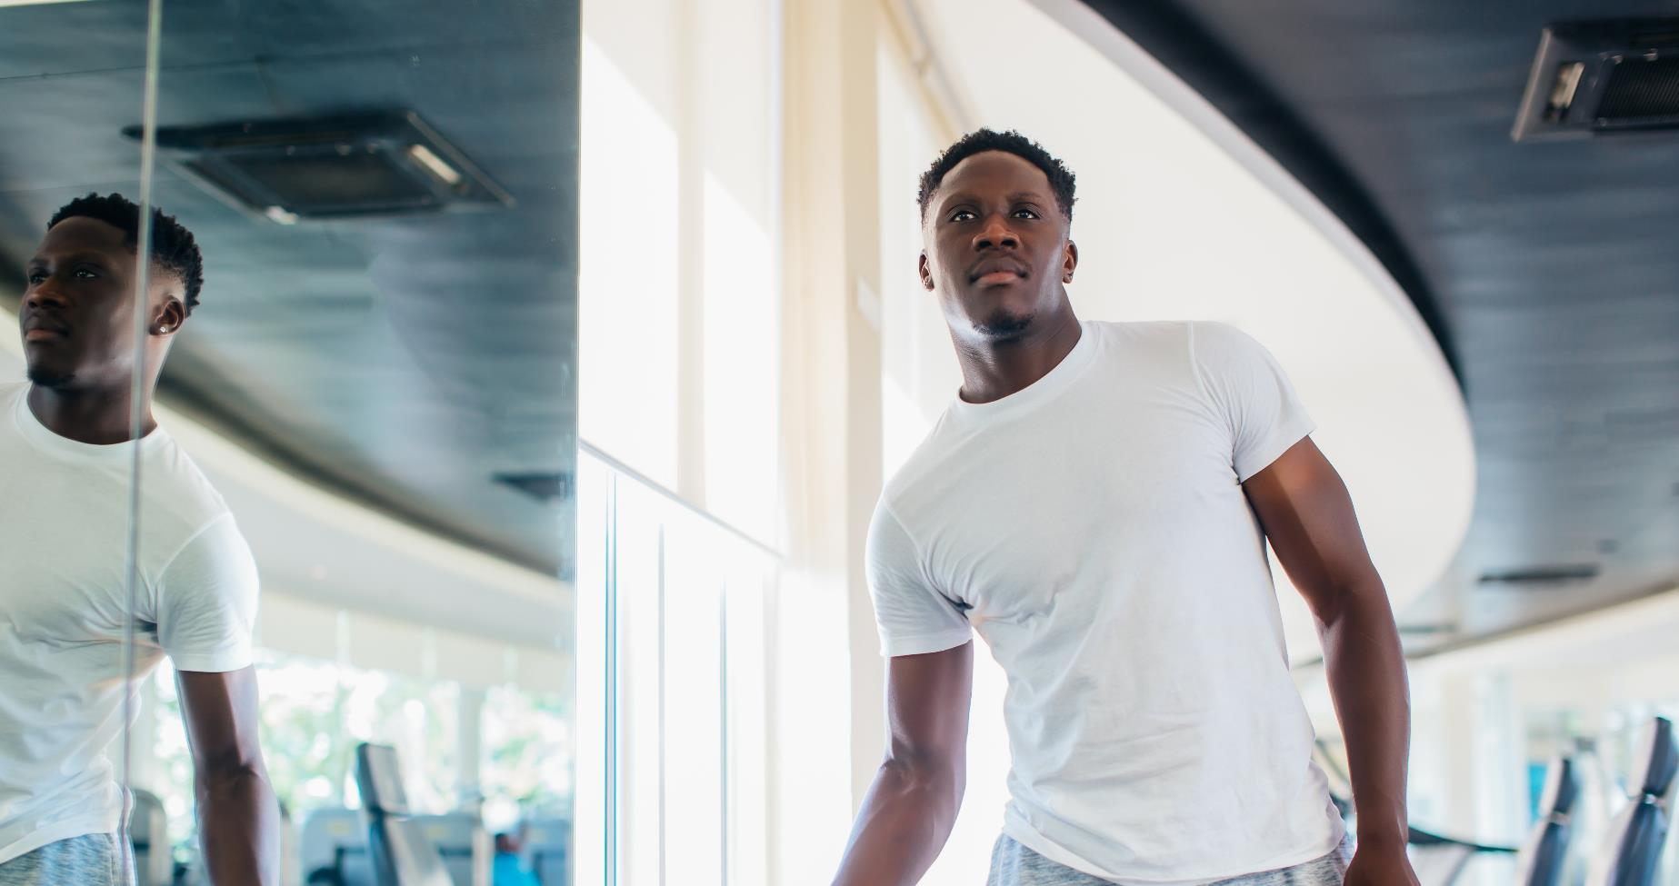
Exercise Month 6
Notes:
Welcome! We hope you are doing well and taking advantage of all the information we have been providing in these videos. Remember that if you have not been able to see any of the videos, you can ask your Community Health Worker to send you the links to the other videos so that you can take advantage of this program in a better way. If you have any questions, please call your Community Health Worker and we will be happy to help. This month we will be focusing on how we can prevent diabetes and indeed many other diseases and improve our quality of life through exercise.

Slide 2
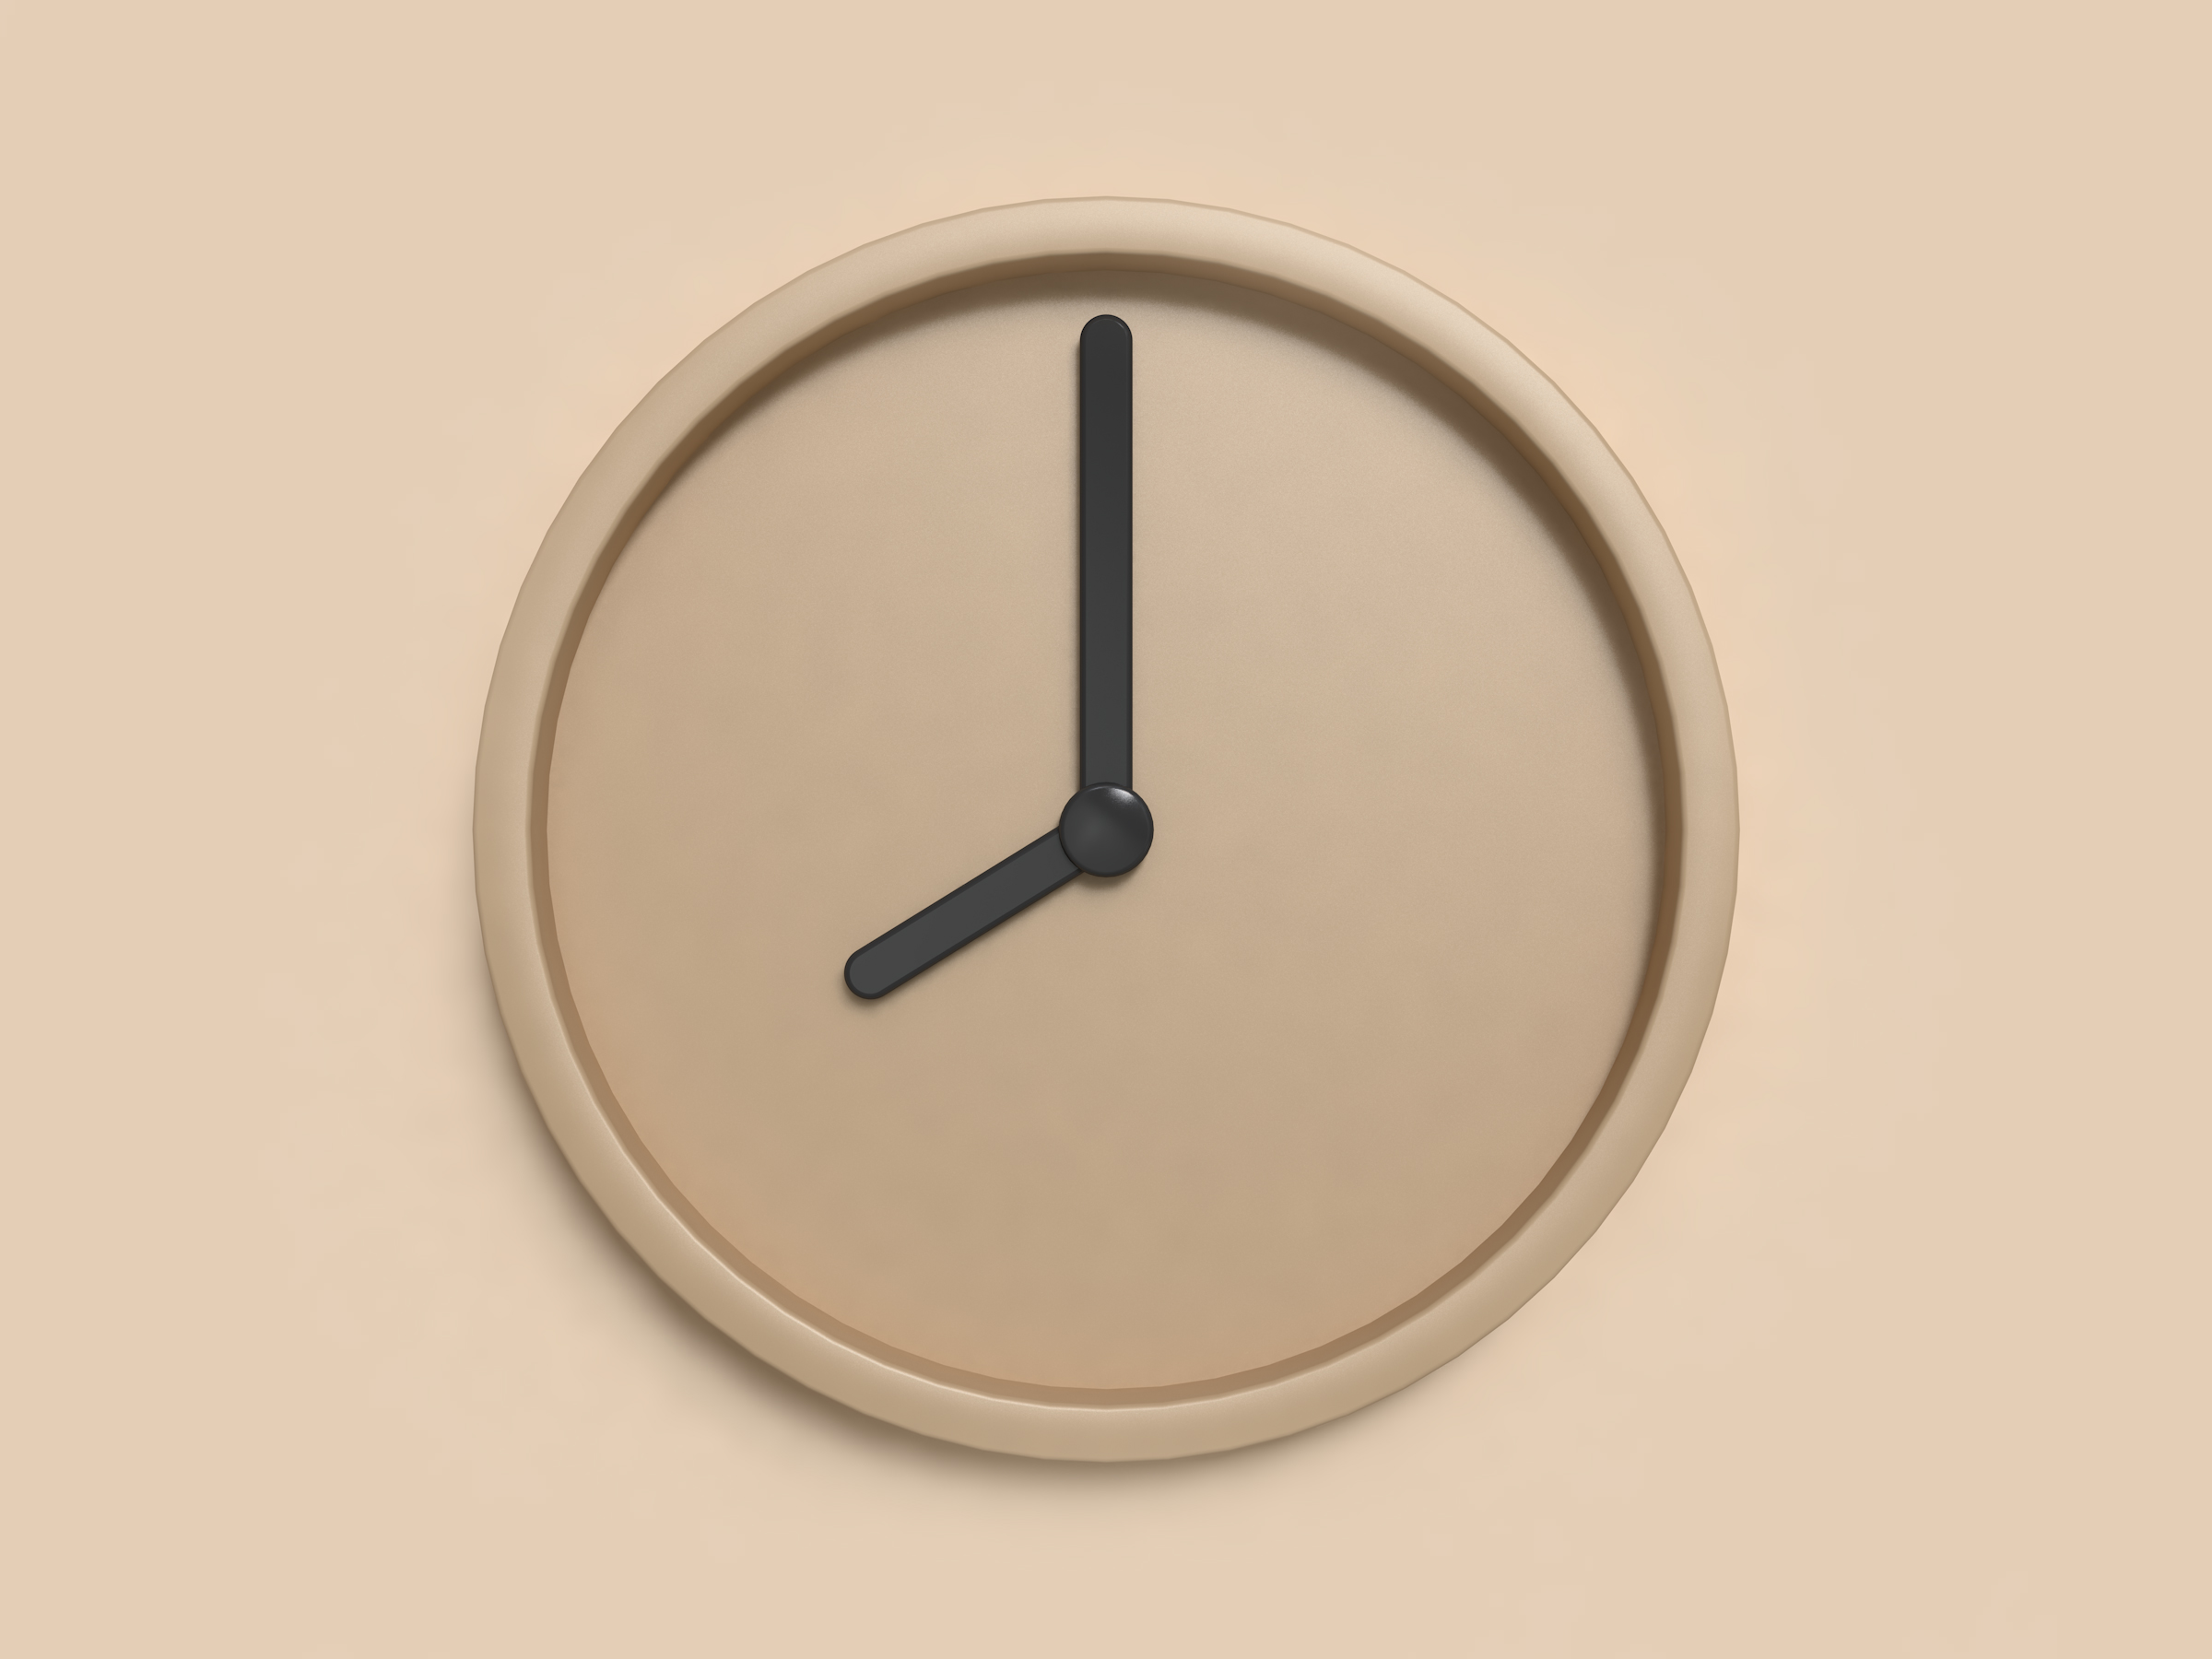
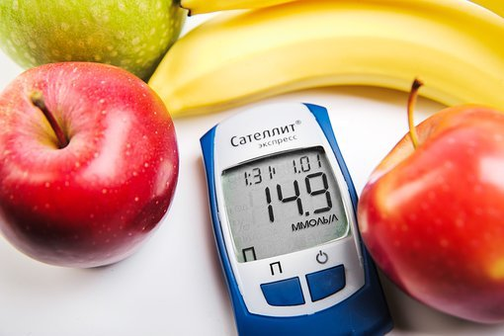
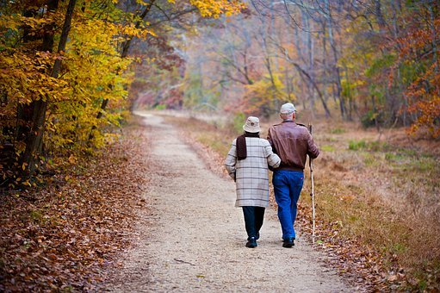
Keep checking your glucose levels!
80-100
80-150
80-200
On an empty stomach
In the afternoon/evening before eating
Two hours after eating
Notes:
We start by reminding you that you always need to keep checking your glucose levels! This helps us see how our new habits are affecting our glucose level. Remember that the goals to improve our health or prevent diabetes is to keep our glucose between 80 and 100 (fasting). Numbers above 100 start to cause our body to start functioning less than ideal. Also remember that it is good to check your glucose in the afternoon or evening before eating. We should also keep these levels between 80 and 150. And you can check your glucose two hours after any meal- it should be between 80 and 200. Remember that this it is true whether or not you have diabetes and that your body will function more ideally if these limits are maintained. Maintaining these levels will also help keep your three-month average at the ideal numbers…remember what this number is called?

Slide 3
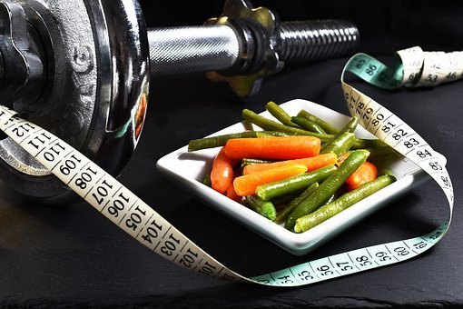
UNDER 65 YEARS OLD
7.0
65 YEARS OLD AND OVER
7.5
WHAT IS THE GOAL?
Notes:
It's called a1c. Do you remember what your A1c goal is? A person is considered diabetic when this number reaches 6.5. A1c can rise very high if not controlled. This causes the damage to your body that we have shared with you in previous lectures. So, ideally, we should keep it below 6.5, but even up to 7.0 a person is considered to have controlled diabetes (or for people over 65, 7.5). But the goal is to lower this number so your body can function better. If it's at the point of less than 7.0, Great! But if not, the most important thing is that you aim for that goal and DO NOT give up.

Slide 4
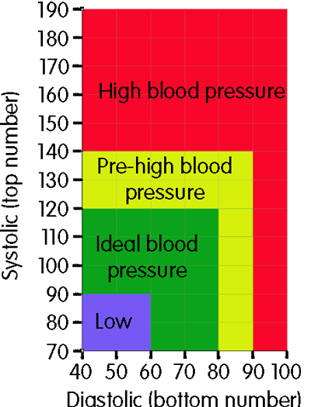
BLOOD PRESSURE
GOAL:
LESS THAN 140/90
Notes:
Same with your blood pressure. Remember what is the goal? The American Diabetes Association's recommendation is: less than 120/80…..For this program we recommend that you try to at least reach lower than 140/90. If you are not at that point, be sure to work toward your goal

Slide 5
Actividad Física
Notes:
And with these reminders we begin with our topic today...exercise. What do you think when someone mentions exercise???

Slide 6
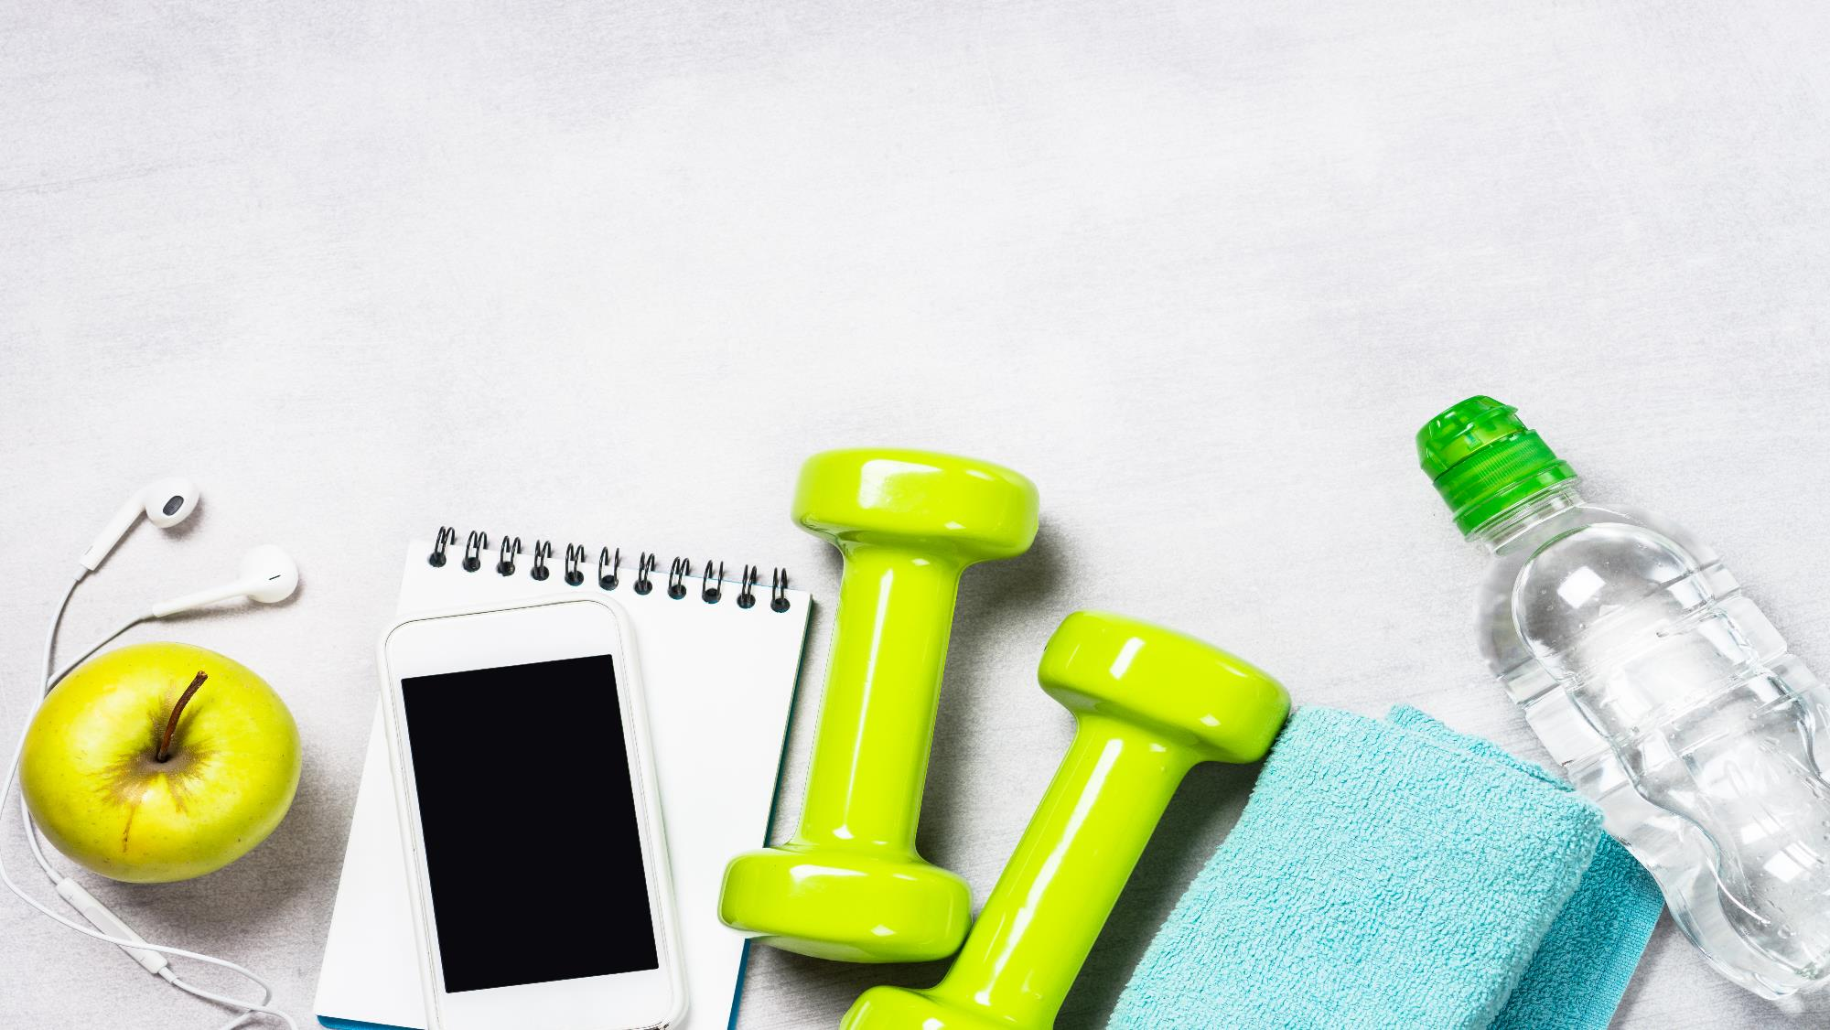
But there is no time!... It's very difficult!...
Notes:
The answers we have received before have been: it is very difficult to establish a routine, or I don't have time, or I don't have a place to exercise, I don't know how to start…. The truth is that they are all answers that we have evaluated and we will be giving you some ideas. But let's start with a definition….what is exercise? By definition, it is a “physical effort with the goal of maintaining or achieving health”. Exercise is often a topic we don't like to talk about. There are ideas that it is not fun, it is very exhausting, and that it takes a long time. So, many people make the excuse that they don't have time, they get enough exercise at work, it hurts too much, or they just don't want to.

Slide 7
Exercise can be fun...
Notes:
However, exercise CAN be fun…you don't have to feel like you're going to pass out or throw up afterwards because of how exhausting it is. And you probably don't need as much as you're thinking. You can exercise at home, in a park, in a gym, accompanied, with family or alone. Starting to exercise is a decision to start TODAY…just TODAY…and then make the same decision tomorrow, until it becomes a habit.

Slide 8
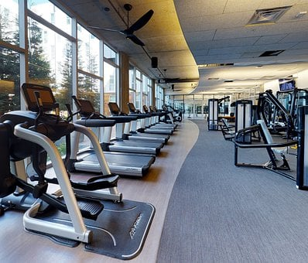
Complete Exercise
Stretching
Weight/Resistence
Aerobic
Notes:
Among other things, exercise is like a wheel that needs to be complete in order to turn. Think of a cart wheel….if you cut a piece off that wheel (let's say one third) you think the wheel might turn….? It's the same with exercise...
There are three different types of exercise: aerobic, weight lifting, and stretching… Each of these three types is just as important as the other. And like a wheel…if you take a piece off it, it won't turn…it won't work right. So let's start with aerobic exercise….

Slide 9
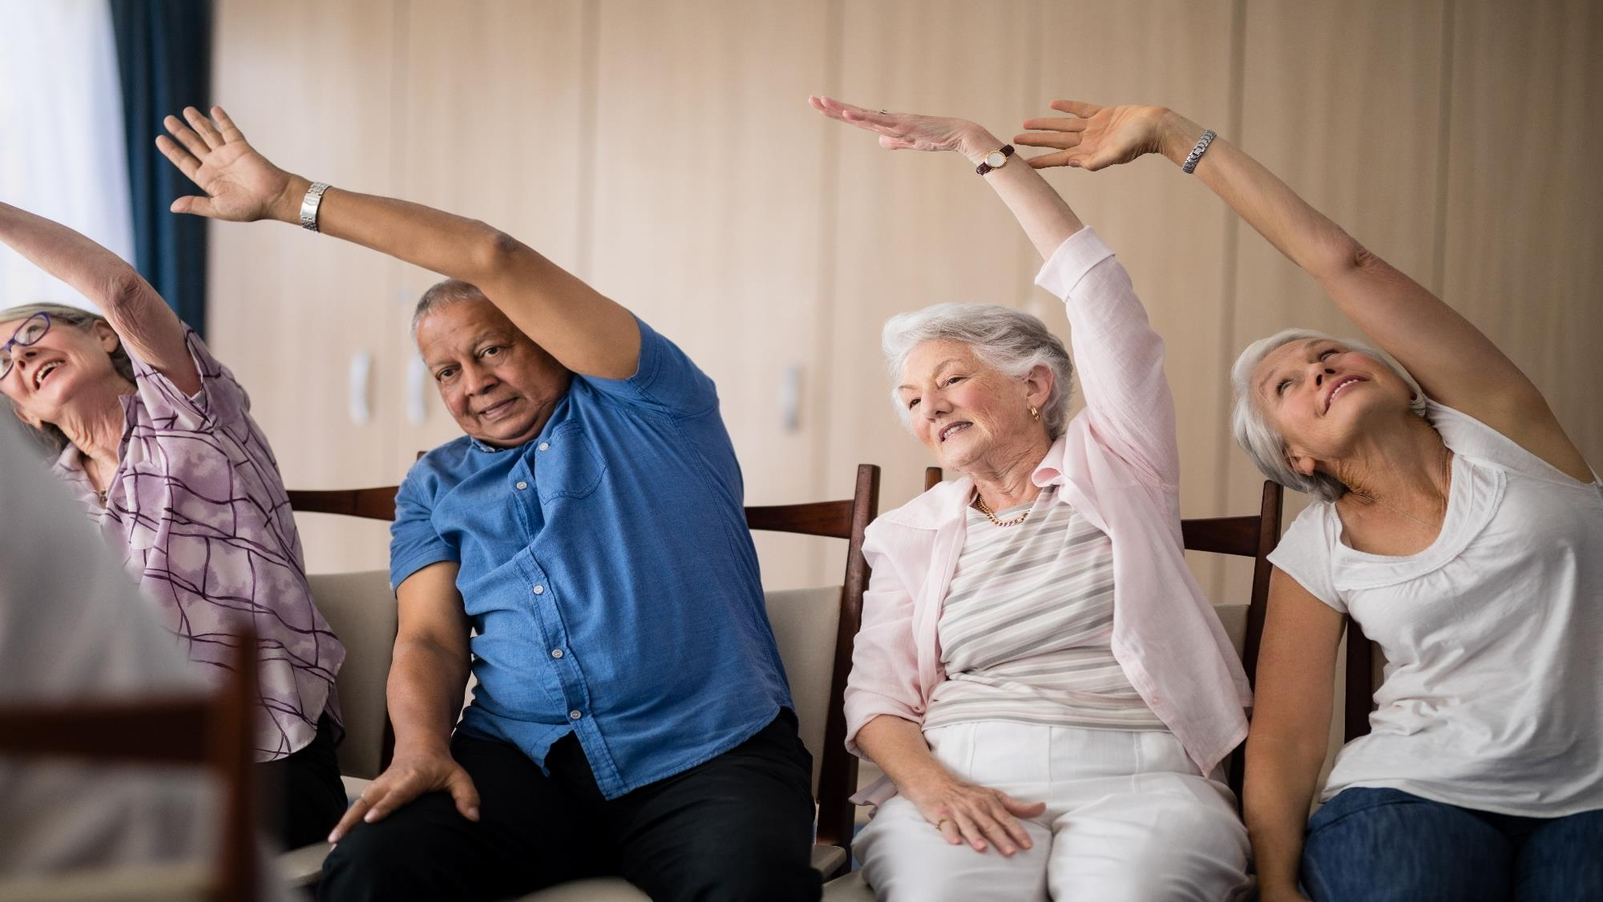
Warming up and Stretching
Notes:
You don't drive a car without warming it up… right?! You know that if you do, it damages the car. The same with the body… you have to slowly stretch those muscles that you will be using during your exercise. The first wheel on this cart is WARM UP and STRETCH. You don't have to be very flexible to stretch!! Stretching is important because it helps prevent injuries, helps increase blood circulation to your muscles, and eases pain. But how does stretching help us reduce pain?? The body is all connected….for example, some people who have knee pain…have healthy knees….the problem is actually in their hips!….Why?? Because when your hips are out of balance or not in ideal condition, the body goes out of balance and that is compensated for by the knees – because they are the ones that take the stress out of coping with the hip problem!

Slide 10
Heating and Stretching
Heating Exercise
To put to work
To muscles
Notes:
On youtube.com or any internet search on your phone, you can search for CHAIR WARMING EXERCISE If you've never exercised before, or if you're having problems with balance or mobility, it's best to start warming up in a chair. If you have balance and mobility, you can just look for WARM-UP EXERCISE

Slide 11
What for?
Muscle Stiffness
Pain
Stress and Tension
Helps relieve pain caused by muscle stiffness and helps relaxation
Prevents muscle pain after exercise
Relaxes your muscles, therefore helps you relax mentally as well
Notes:
So stretching -when we wake up…..before exercising….after exercising….and at other times of the day- helps our bodies to be ready to work and free of muscular stress. It helps us with muscle stiffness…because by stretching, we learn to relax our muscles. It helps us prevent pain, because our relaxed muscles were ready for exercise. And it helps us with stress and tension…because our neck and shoulders carry a lot of our stress and if we don't stretch, it will lead to more pain. Our head and neck are connected… so sleeping poorly, carrying heavy things, stress and manual work make our necks stiffer and stiffer. When this stiffness begins to pull on the muscles of the head, it ends up causing headaches. And we usually end up taking all sorts of medications and doing expensive tests to see the reason for the headaches, when treatment should start with just stretching and maybe a pill ibuprofen. Of cours, there are going to be headaches that may need testing, but try stretching as well and see your doctor if you have any questions.

Slide 12
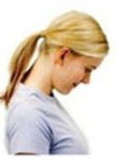
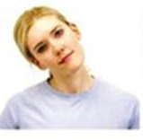
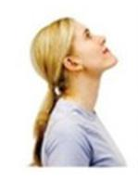
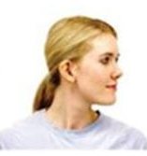
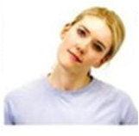
Let’s Practice!
Flex
Rotate
Stretch Sideways
Extend
Stretch Sideways
Rotate
Notes:
Here are some stretches that can help with headaches. Continuing with normal breathing whenever you are stretching, try to do these movements until you feel a little stretch – not something that hurts. If you do them consistently, you will get better at doing them.
Let's try the flex/extend exercise. Sit in a chair with your back fairly straight, not slouched, and with your shoulders relaxed. Don't lean back in your chair. Try to flex your head down and get as close as possible feeling the stretch but without hurting yourself and try to get your chin to touch your chest…. and hold this position for 15 seconds. Then try the same with your head back to extend your neck as far as possible without hurting yourself and hold the position for 15 seconds.
Let's try the rotate exercise. Check that your back is still in a good straight position, not slouched, and that your shoulders are relaxed. Don't lean back in your chair. Try to turn your head to the right as far as possible feeling the stretch but without hurting yourself and try to get your chin in line with your shoulder and hold this position for 15 seconds. Then try the same on your other side and hold the position for 15 seconds.
Let's try the side stretch exercise Sit in a chair with your back squared. Don't lean back in your chair. Move your head to the right side and get as close as possible… feeling the stretch but without hurting yourself- try to get your ear to touch your right shoulder and hold this position for 15 seconds. You can help yourself with your right hand to try to make the stretch a little more pronounced by trying to pull your head with your hand to get closer to the hand. Then try the same on your other side and hold the position for 15 seconds.
Did you try??? how do you feel?? Stretching gives us almost immediate relief of some of the pressure on our neck and head... Try this every day and add more each day. Your Community Health Worker can give you more ideas- talk to your Community Health Worker if you want to add more stretching exercises or have questions.

Slide 13
Aerobics
Notes:
This type of exercise is the one that most people imagine when we talk about exercise and it is the one that makes our heart beat a little faster. This type of exercise includes brisk walking, running, swimming, dancing, bicycling, etc. and we do it to strengthen our heart by getting the blood flowing. Many people ask us how long should we do aerobics and how often? As little as 30 minutes of brisk walking is enough to exercise our heart. However, you have to make the effort to change really fast…it is good to walk in a park (or anywhere with friends), but aerobic exercise is not a walk in the park while we chat with someone…the truth is that if you still have breath to talk, you are probably not going fast enough. We have to make a good effort for 30 minutes. Start speeding up until you feel your heart getting a workout. Don't forget to bring water and drink it little by little throughout your walk or with any exercise you do.

Slide 14
AEROBICS
CARDIO IN CHAIR
Putting the heart to work
Notes:
"But I can't do aerobics because my knee hurts, my hip hurts, etc, etc..." Sometimes we use this more than as a reason- we use it as an excuse not to exercise! You can start with the second wheel of the cart…. Aerobics…..from your own chair!! You can dance or move with your upper body and get your heart racing for a workout. If you go to YouTube.com and search for “CHAIR CARDIO” you will find several videos in Spanish with video instructions from 10 minutes to an hour with examples of how to exercise your heart without getting up from a chair. But most of us can take a step forward and get up from our chair, right?

Slide 15
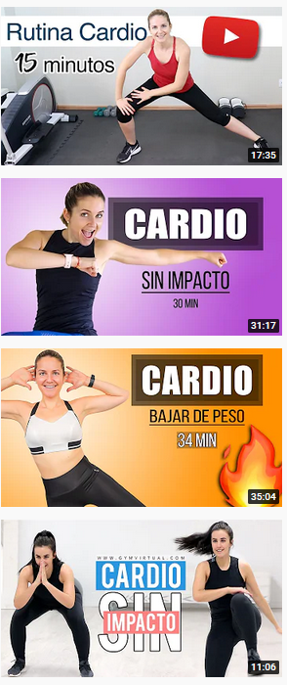
AEROBICS
LOW IMPACT CARDIO
Putting the heart through a little more work
Notes:
So….to get up from the chair, to move!
Low-impact or no-impact cardio (meaning exercising your heart) means it's less intense. There are also many of these types of videos on the internet and you can find them just by doing the search for “LOW IMPACT CARDIO”. This will give you 10-30 minute videos so you can exercise where you don't need to jump around or have as much experience. As you become more mobile, you may progress to exercises or “HIGH IMPACT CARDIO” but check with your doctor before progressing to this type of exercise.

Slide 16
What for?
Body Fat
High Blood Pressure
Diabetes
Helps you lose weight and feel better
It makes the heart work to train it to function better
Helps prevent and manage your diabetes
Notes:
AND THE AEROBICS….How do they help us? Exercise helps us in three ways:
Number 1- It helps with our level of body mass: when exercising, our body begins to adjust to the change and if we combine it with the new eating habits that we have talked about in other videos, you could lose weight and reach a level of body mass that is more desirable.
Number 2- It helps us better control high blood pressure. When the heart exercises and becomes stronger, then our pressure begins to stabilize.
Number 3- It helps with controlling diabetes or preventing the development of diabetes. If you don't have diabetes yet, this is a very effective way to prevent it- especially when combined with new eating habits. For those who already have diabetes, it is a VERY important part of controlling your glucose level.

Slide 17
How many calories did you really burn?
Notes:
Aerobic exercise is the one that helps the most with weight loss….HOWEVER…. People usually don't lose as many calories as they think. For example, if you walk for an hour, the average person burns 80 calories. That's the equivalent of an omelette or a couple of tiny teaspoons of ice cream! However, after exercising, people think they have burned so many calories which makes them eat more….usually they end up eating hundreds of calories more after exercising! That's why oftentimes, when people exercise, when they end up gaining weight and blame it on the "exercise"! The truth is that it's not the exercise that was to blame...it's what they ate after exercising.

Slide 18
BUT… Be careful with rewarding yourself!
Notes:
So be careful with rewarding yourself with food!!! Unless you're a professional athlete, exercise is just ONE of several things you'll need to do to lose the weight. The key is to combine eating less with exercising more WITHOUT REWARDING YOURSELF WITH FOOD. If you want to reward yourself in some way – do it with other things. For example, set a goal that if you are going to walk every day this week – then you are going to reward yourself with a board game you enjoy, or watching an episode of a show you like, or enjoying a hot tub… doing something that you like a lot and only reward yourself with that when you meet your goal for the week or month. Having these types of “prizes” helps us to motivate ourselves. And we ALWAYS need to keep those reasons in mind because motivating ourselves is the key to continuing good habits! Another way to motivate us is to belong to an exercise class or soccer team….. people who join sports teams like soccer (where they meet more than once a week), lose weight due the motivation driven by competition. The players depend on each other to win... you just have to be careful not to go and celebrate by eating after the game. Encourage each other to set goals and reward yourself in ways other than food. And do aerobic exercise!

Slide 19
Weight/Resistence
Notes:
The next type of exercise is Weight Lifting or Resistance Exercise! This type of exercise refers to lifting weights, but small ones, not the huge ones like those of bodybuilders. If you don't have a gym to go to, you can buy some 5 or 10 pound dumbbells at Walmart. You can also use things around your house, like water bottles, canned food containers, you can even pick up your kids!! Because these exercises can be done at home – they don't even require you to leave the comfort of your home or get in a car and drive to a park. You can add weight training in several ways. For example: the easiest and that can be done in combination with aerobics is to add something heavy to your feet (for example, there are some types of weights that are secured with Velcro to your ankles, and if combined with that, wear a couple of water bottles or small weights in your arms, you can make movements to lift that weight while walking. Also if you don't want to leave the house because of the weather... you can work out at home by just walking in your living room... you don't have to go far to exercise your heart and lift weights at home. In the same way….we recommend that if you do not do aerobic exercise, lift weights even while sitting in a chair!!! If you are going to do it while sitting down you can lift the weight of your choice with your legs while sitting or with your arms. You can also do it while sitting on the floor. You can decide what would be a good starting point for yourself….the key is to do several repetitions and to increase these repetitions more and more.

Slide 20
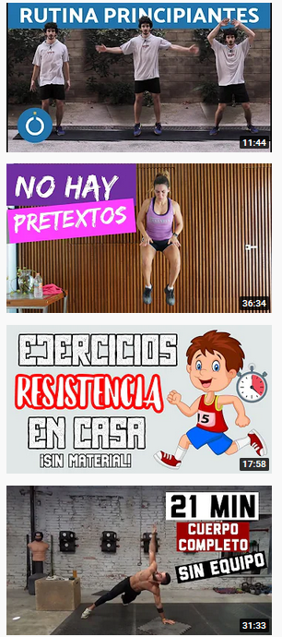
RESISTANCE
LOW-IMPACT CARDIO
to put the heart to work a little more
Notes:
And as we have seen with the other types of exercises…you can do them with instructions that you can find on the internet. If you go to YouTube.com and search for “RESISTANCE EXERCISE” you will also find LOTS of sample videos in Spanish with 10 to 30 minute video instructions…by watching these videos you will see that you can do them with things around the house, such as water bottles, vegetable cans. Some will show you some small weights, some will show you how to use some elastic resistance bands, and some will be without equipment. If we do not use the muscles, we will lose them little by little... so let's work on them

Slide 21
What for?
Posture
Bones
Balance
Core Muscles so as not to overload other parts of your body
Important for keeping your bones strong and preventing loss of bone density
Prevents falls and injuries to the knees and ankles
Notes:
These resistance exercises with Resistance Bands or lifting medium weights help you strengthen not only your muscles but also your bones! Weight-bearing exercises can help strengthen your abdominal muscles or core area of ​​your torso. People who don't have strong abdominal muscles have more difficulty with balance and poor posture, put too much stress on other parts of their body, like their back and knees to compensate- this results in more permanent muscle soreness problems. That is why when we do not do this type of exercise we end up with knee, hip or back pain. This type of exercise is also very important to maintain strong bones and prevent loss of bone density and eventually diseases such as osteoporosis. If you are very thin or if you are a woman, you are at higher risk for osteoporosis. So strengthening the bones is very necessary to avoid problems at older ages. Doing these types of exercises also helps with balance and that helps us prevent falls and hurting our knees and ankles. And as we get older, these types of resistance exercises and weights can improve our quality of life.

Slide 22
How much exercise should I do?
Notes:
How much exercise should I do? This is a very common question….but the most important thing is that we start with doing SOMETHING!! Why? Because some exercise is better than NOTHING!!!….. Sometimes having a family member or friend who exercises with us helps us to be more consistent and to stay firm in our goals while having fun. But if you still want to know what is a good goal to start with, then let's say 20 minutes a day including exercises of all three types is a good start. It takes a lot less time than an episode of your favorite TV show….so if we watch at least one 30-minute TV show, we have a chance to exercise. Remember you don't even have to stop watching the show!!! You can do it at the same time!! Pretend to walk around your room with your weights and be sure to stretch before and after the 20 minutes. We don't have much of an excuse anymore, because even if you're standing in your living room or on a chair you can lift your legs while watching the show and lift your weights – the key is to do it in a way that gets your heart and muscles working.

Slide 23
One last type of exercise.....
Notes:
Before we say goodbye... We want to add another exercise……this one is a bit different. We have been focusing and talking about the body….but the mind also needs to be exercised. It is very important that as we get older, we continue doing things that exercise our minds, such as reading books, continuing to learn, and having conversations that make us think. These habits of taking control of your thoughts are very important for your mental health. There are times that we let our thoughts rule us and that ends in a cycle of bad habits: for example, I am in prison so why bother with being healthy? Or also think: if I'm already sick, why take the medication? Or have we also heard: well, we will have to die of something, right? But your thoughts are very important. It is such an important and vital habit that we are exhorted to control our thoughts in the bible!! Remember that the bible says in 2nd Corinthians…..casting down arguments and taking every thought captive to the obedience of Christ? Many times we think that controlling thought is something that only very disciplined people can do, but we are going to try this together: Do this exercise with me: Close your eyes and think of a red flower, think of a red flower that you like a lot because of its smell or because of how red it is... Open your eyes... You can see the flower right? Can you describe it and can you tell me if it had many or few petals…. Why do you think you can almost "see" the flower? Because it is possible to control thought. It is the same when we have problems, we can refocus on God when we are worried but it requires training the mind to go to a certain thought that you decide. And the more you try, the more easily you can achieve it. What we focus our thinking on is our decision….don't let your mind wander into negative thoughts without control. Exercise your mind….

Slide 24
Our Mind
Games
Learning
Lecture
Notes:
This exercise of mind is something we should NEVER stop doing Mental skill games, learning and reading are something we can do Exercise our mind by listening to books, preaching or exposing your self to people who are experts in a subject are a few things we can do as long as we have a sense of hearing. Learn something new: How to cook, how to weave, how to fix a radio, how to build a little bird's cottage, anything that interests you….We can always learn.

Slide 25
Always keep improving!
Notes:
This is the end of the class and we will be sending out other topics of interest each month to help you with your physical and mental health! Remember that the goal is to improve our quality of life, and we can always do something more….Never stay stuck- continue to improve in some or several areas of your life. As Community Health Workers, our goal is to help you conquer obstacles and reach your goals. Please call us if you have any questions and watch for the video below. Good bye!

Slide 26
References
- Amanat, S., Ghahri, S., Dianatinasab, A., Fararouei, M., & Dianatinasab, M. (2020). Exercise and Type 2 Diabetes. Advances in experimental medicine and biology, 1228, 91–105.
- American Diabetes Association (2010). Diagnosis and classification of diabetes mellitus. Diabetes care, 33 Suppl 1(Suppl 1), S62–S69.
- Colberg, S. R., Sigal, R. J., Fernhall, B., Regensteiner, J. G., Blissmer, B. J., Rubin, R. R., Chasan-Taber, L., Albright, A. L., Braun, B., American College of Sports Medicine, & American Diabetes Association (2010). Exercise and type 2 diabetes: the American College of Sports Medicine and the American Diabetes Association: joint position statement. Diabetes care, 33(12), e147–e167.
- Get active! (2022, January 28). Centers for Disease Control and Prevention. https://www.cdc.gov/diabetes/managing/active.html
- Kirwan, J. P., Sacks, J., & Nieuwoudt, S. (2017). The essential role of exercise in the management of type 2 diabetes. Cleveland Clinic journal of medicine, 84(7 Suppl 1), S15–S21.

