Slide 1
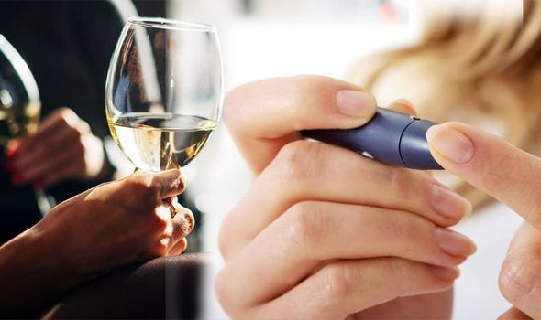
Alcohol and Diabetes
Month 8 – Alcohol and Diabetes
Notes:
Welcome! It's great that you are with us again learning more about your health and how to prevent or manage diabetes. Today we will be talking about a difficult topic and one that is tipically misunderstood by many people….alcohol. We will be seeing how alcohol affects affect the body in general – whether you have diabates or not, but also, how it affects people with diabetes or at risk of developing diabetes.
It is possible you don’t struggle with this problem, but we would like to invite you to listen in anyway – we never know when we may need this information to help a loved one.
At the end, we will also give ideas on how to stop drinking alcohol, helping a loved one who needs to and where to seek help.
Remember we are here to help you and our goal will never be to judge.

Slide 2
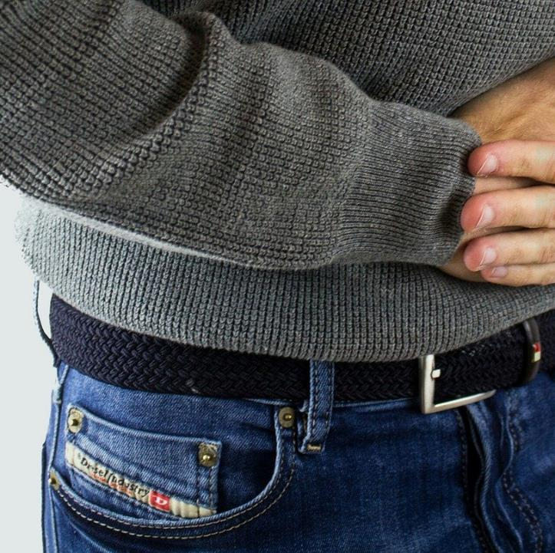
Alcohol can affect your…
Health
Pancreas
Liver
Relationship with your family
Notes:
And you should know that alcohol is just as harmful!!!
We know that alcohol can affect your life and health in many ways. This time we'll be looking at some of those ways it affects things like your general health, your pancreas, your liver, your relationship with your family…and even your A1c or glucose level.

Slide 3
Notes:
In your general health it can cause anything from memory loss, hallucinations, seizures, dementia, risk of chest infection, liver inflammation, hepatitis, cirrhosis….IN SHORT….can you see the whole list on your screen? It even includes low blood glucose control!!! And while all of the health consequences that alcohol contributes to need to be looked out for, one that we're primarily focused on in these classes is your glucose or diabetes.

Slide 4
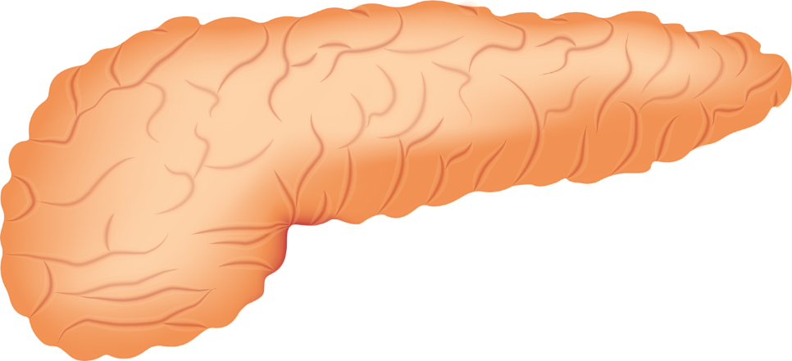
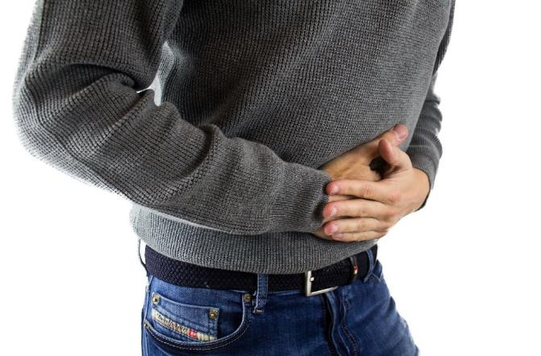
How does it affect the pancreas?
Notes:
One of the areas affected by alcohol consumption is the pancreas. How does it affect the pancreas? It causes chronic inflammation (pancreatitis) and this is important because the pancreas is the organ in charge of producing insulin. Sound familiar? Alcohol affects the ability of the pancreas to secrete insulin.

Slide 5
Insulin
DIGESTION
GLUCOSE
CARBOHYDRATE
EAT CARBOHYDRATE
CARBOHYDRATE TURNS INTO GLUCOSE
GLUCOSE ENTERS BLOOD STREEM
Notes:
Do you remember the first videos of our program? Insulin, a hormone produced by the pancreas, which allows cells to absorb and use glucose, to be used as energy.
In other words…everything you eat (be it bread, sugar, meats, fruits, vegetables….EVERYTHING) turns into glucose, and this glucose is VERY necessary for your cells to turn into energy, but the key that unlocks those cells is called insulin….without insulin – your cells don't get energy and the glucose stays in your blood and affects your whole body.
Your pancreas will do one of two jobs…helping your body produce insulin and work ideally…or…. that of being more and more damaged and requiring a lot of help to do the most basic job of converting what you eat into energy so that glucose does not stay in your blood.
Remember that insulin is the key and the organ that makes insulin is the pancreas.
So if alcohol affects your pancreas…your blood sugar level will be directly affected.

Slide 6
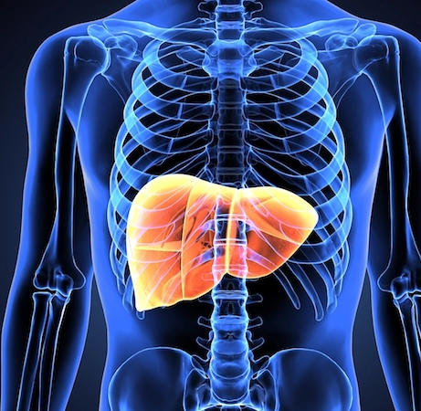
How does it affect the liver?
Notes:
Another way your body can be affected by alcohol is through your liver.
The liver releases glucose to maintain blood sugar levels. But when a person drinks alcohol - especially when they do so without having anything in their stomach - the liver is so busy breaking down the alcohol that it does a poor job of releasing glucose into the bloodstream. And this can lead to a drop in blood sugar levels that we know as hypoglycemia .

Slide 7
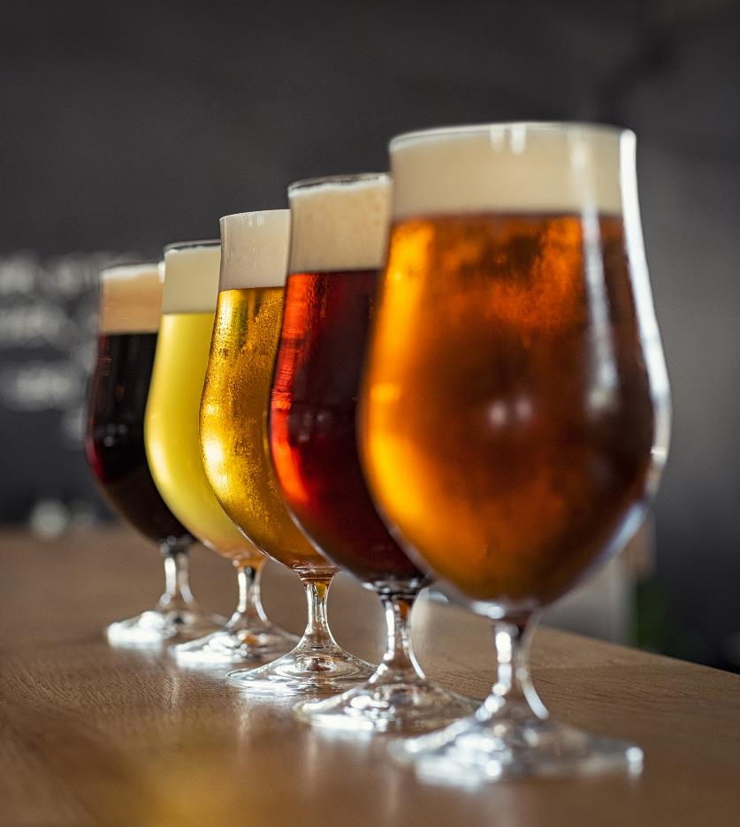
Symptoms of excess alcohol and hypoglycemia
Confusion
Drowsiness
Blurry vision
Headaches
Lightheadedness or dizziness
Lack of coordination
Unconsciousness
Notes:
This is dangerous in a number of ways, but let's look at this one in particular….do you know that the symptoms of excess alcohol and hypoglycemia can be VERY similar?
Confusion
Drowsiness
Blurry vision
Headaches
Lightheadedness or dizziness
Lack of coordination
Unconsciousness.
It would not be a good thing if someone confused the symptoms and thought that you are intoxicated instead of suffering from hypoglycemia. If they think you were knocked unconscious, they may not give you the proper help and treatment – as hypoglycaemia needs to be treated promptly.

Slide 8
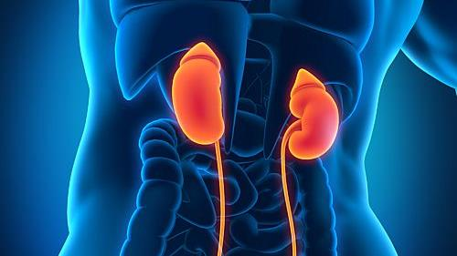
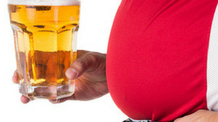
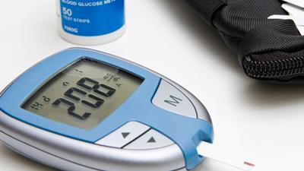
Other Harm
Notes:
And these are not the only harm….as we saw before, there are many more….
Drinking alcohol could worsen complications already common in diabetics such as neurological, eye or kidney damage
Remember that weight gain makes diabetes more difficult to control and alcohol causes possible weight gain since alcohol is high in calories.
And because of these calories, it can also spike your blood sugar since beer and sugary mixed drinks are high in carbs, and the excess carbs can cause your blood sugar levels to spike.
But….we can improve! Don't be discouraged… why do you think we focus on this topic in a diabetes prevention and management class? Because by looking for solutions for your diabetes, such as changes in eating and exercise habits, we can gradually eradicate other consequences of those bad habits that lead us to develop diabetes.
So…let's set goals!

Slide 9
The importance of goals
Notes:
The important thing about goals is not that they are huge or that they are ideal…..the important thing about goals is that we think of them as one step at a time….like when you are going to climb some stairs, the important thing is to go up each step – one by one. No one jumps up to a second floor…he goes up one step, and then another, and then another, until he reaches his goal.
Yes, it is correct to know where we are going….but we should not get frustrated if we can only climb one step at a time. The important thing is to make a plan. Plan the first step and climb that step TODAY.
So… to achieve a goal, the first thing we are going to do is:

Slide 10
Notes:
Write them down on paper! And not only that, review your goals every week and evaluate how to improve that goal or how to modify it, each time fulfilling it better. For example, you can keep a diary of what you drink (on your phone, on paper, or posted on the fridge)…so you don't fool yourself when evaluating your week.
Do not have alcohol at home! The easiest way not to drink at home is not to buy alcohol for the house….if we don't have it, we will have to think twice when the craving strikes.
Pick alcohol-free days and write them down on a calendar – so you can gradually increase the days you don't drink.

Slide 11
Don't give up!
Notes:
Beware of peer pressure! We know that there are situations or people that sometimes pressure us drink alcohol. Look for alternatives to have fun and be aware of social pressure! You may have to stay away for a while or forever from friends or situations that pressure you to drink.
Also, if you are one of those people who choose to drink alcohol out of habit after an activity or because of a problem… keep busy with other hobbies and activities that help you redirect your attention or fight your temptation – like walking, play a sport etc.
Ask for help – your Community Health Workers are at your disposal to help you. There are times that just by asking for help we find the encouragement or motivation to make those changes. We want to help you and we are part of your team.
Be persistent…don't give up if you fail. With God's help everything is possible. Remember Philippians 4:13 “I can do all things through Christ who strengthens me.”

Slide 12
Support
713-686-6300
aahouston.org
713 683-7227
www.alanon.org
Notes:
If you need help, you can contact your Community Health Worker, but we also offer these help alternatives:
Houston Alcoholics Anonymous
713-686-6300 This line is available 24 hours a day.
https://aahouston.org All information is available in English and Spanish.
Alcoholics Anonymous supports nearly 2,500 meetings per week and will put you in touch with a meeting that is close to your home and at a time that suits you best.
If you have a loved one who has a drinking problem and want to know: “How can I help you?” The Houston Al-Anon organization has meetings for families of people with alcohol problems. You can consult Al-Anon at alanon.org or call 713-683-7227.

Slide 13
Thank you!
Notes:
Thank you for listening to the information about this much-needed topic. We hope this will help you or someone you love.
So long!

Slide 14
References
- Emanuele, N. V., Swade, T. F., & Emanuele, M. A. (1998). Consequences of alcohol use in diabetics. Alcohol health and research world, 22(3), 211–219.
- NIAAA publications. (n.d.). Brochures and Fact Sheets | National Institute on Alcohol Abuse and Alcoholism (NIAAA). Last accessed September 15, 2022. https://pubs.niaaa.nih.gov/publications/aa71/aa71.htm

