Slide 1
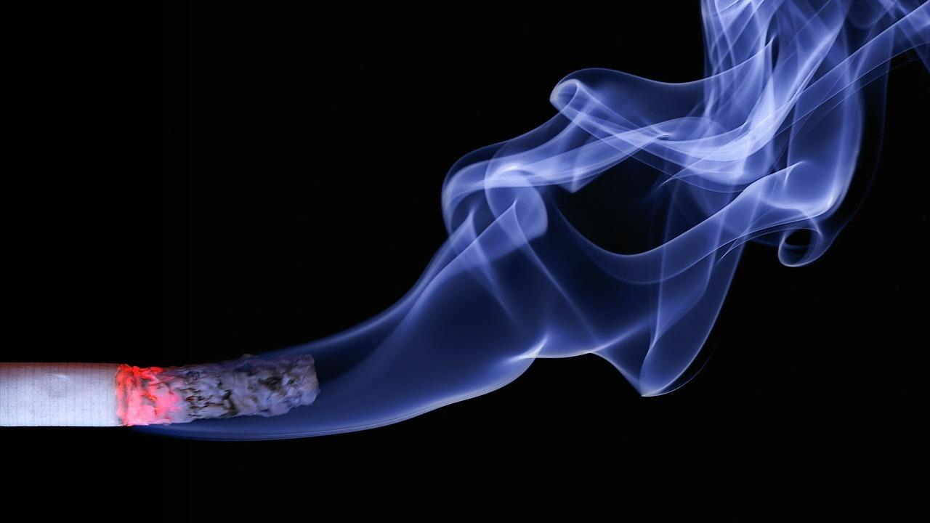
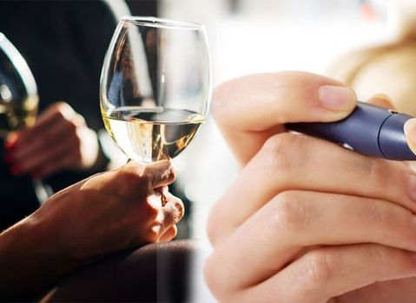
Tobacco Use, Alcohol, and Diabetes Month 9
Notes:
Welcome! It's great that you are with us again learning more about your health and how to prevent or manage diabetes. Today we will be talking about how smoking and alcohol affect the body in general, how it affects people with diabetes or at risk of developing diabetes, and we will also give you advice on how to stop smoking, drinking alcohol, or helping a loved one who needs to. This topic may not apply to your life right now, but it never hurts to know this information so you can help yourself or others.
According to Mayo Clinic Family Health, smoking addiction is defined as the addition to nicotine, which is the main component of the tobacco leaf, which produces pleasant effects in our body. According to the World Health Organization, smoking is a chronic addictive disease and is the leading cause of premature and preventable mortality. It is estimated that 4.9 million people die each year as a result of tobacco use. By 2030, 10 million deaths per year are estimated. It is also important to note that an average of 1 million people, who are called passive smokers, die yearly due to exposure to secondhand smoke.
Although smoking cigarettes is the most common way of consuming tobacco, tobacco is harmful in all its forms. It is also consumed through the pipe, the water pipe or hookahs, cigars, chewing tobacco, and the electronic cigarette that despite having less nicotine also contains toxic substances. The latter is known as vaping. In addition, there are scented and menthol cigarettes as well as snuff, among others, which are also harmful.

Slide 2
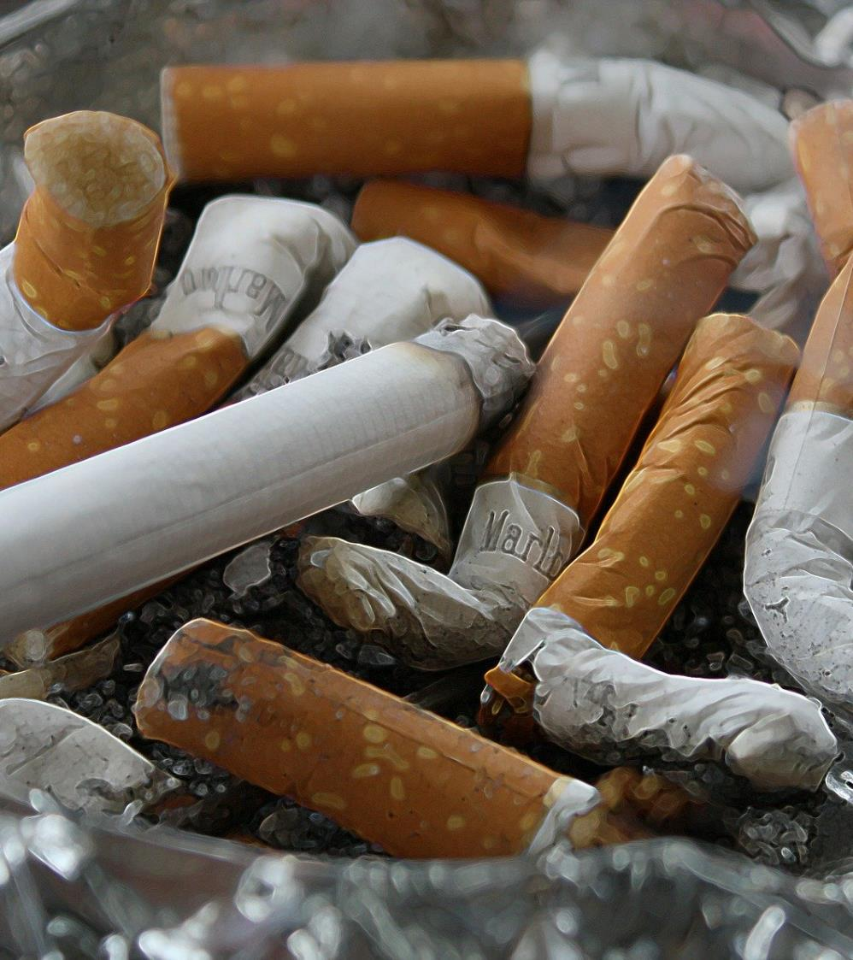
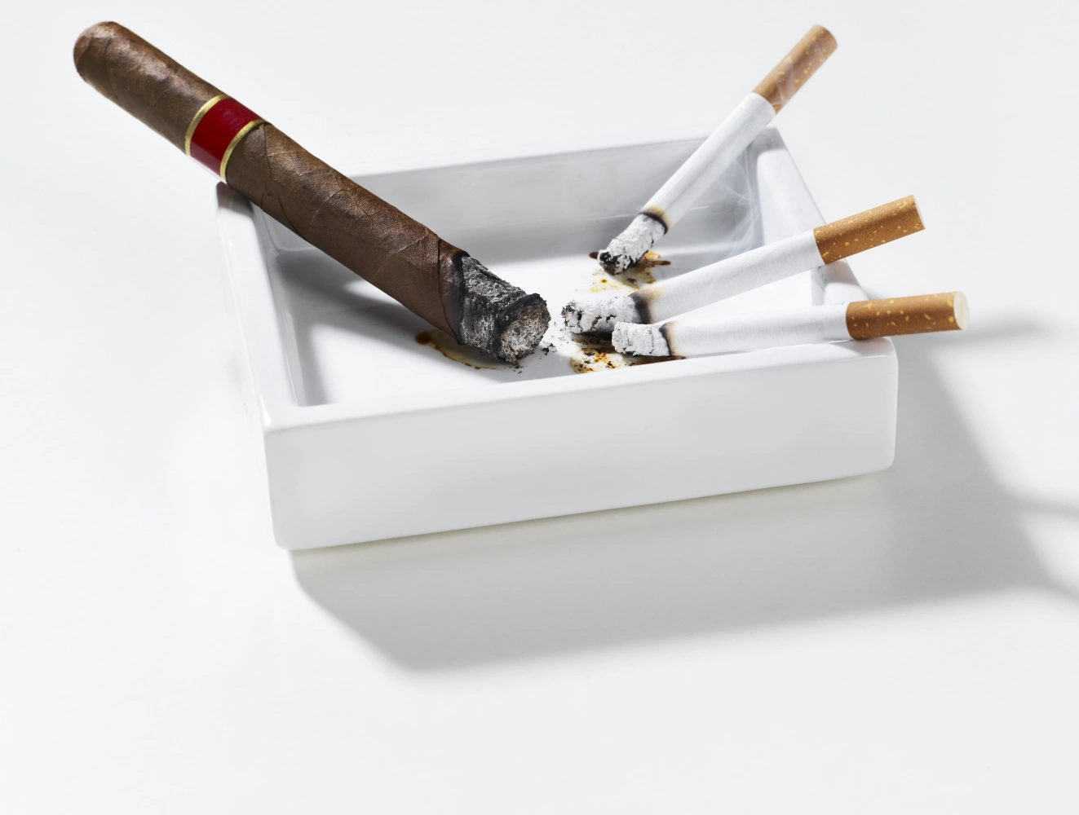
Risk Factors
Notes:
Let's start with tobacco.
According to Mayo Clinic Family Health, smoking addiction is defined as the addition to nicotine, which is the main component of the tobacco leaf, which produces pleasant effects in our body. According to the World Health Organization, smoking is a chronic addictive disease and is the leading cause of premature and preventable mortality. It is estimated that 4.9 million people die each year as a result of tobacco use. By 2030, 10 million deaths per year are estimated. It is also important to note that an average of 1 million people, who are called passive smokers, die yearly due to exposure to secondhand smoke.
Although smoking cigarettes is the most common way of consuming tobacco, tobacco is harmful in all its forms. It is also consumed through the pipe, the water pipe or hookahs, cigars, chewing tobacco, and the electronic cigarette that despite having less nicotine also contains toxic substances. The latter is known as vaping. In addition, there are scented and menthol cigarettes as well as snuff, among others, which are also harmful.
There are several risk factors….among them:
Age: the younger you start smoking, the more addicted you become
Parents and friends: children of smoking parents are more likely to be smokers too
Depression and anxiety: these mental illnesses are related to addictions
Alcohol and drugs: drinking alcohol increases the probability of consuming any type of addictive substance
There are some symptoms of smoking or that the person has some level of addiction, such as not being able to quit easily, or the person has withdrawal symptoms or discomfort when they stop smoking for a limited time.

Slide 3
What does a cigarette contain?
Notes:
Let's understand something important….do you know how a cigarette is produced or what it contains?
As you can see there are several unhealthy things like:
NICOTINE: It is the most important component that causes addiction. After 20 seconds it enters the brain and binds to the receptors where dopamine is released
CARBON MONOXIDE: It is the cause of diseases of the lungs, heart and blood vessels. The carbon monoxide binds to the blood and travels through your veins causing damage. That is why it affects the heart and brain causing heart problems and brain damage.
In addition to these two harmful substances, it also contains more than 4,000 toxic substances. These alter cells and cause abnormal growth – this is what causes tumors.
In addition, when these substances enter the lungs, they do not allow the correct cleaning of the bronchial tubes and obstruct the airways. This commonly produces the characteristic COUGH of the smoker and many other diseases that we will be seeing next.

Slide 4
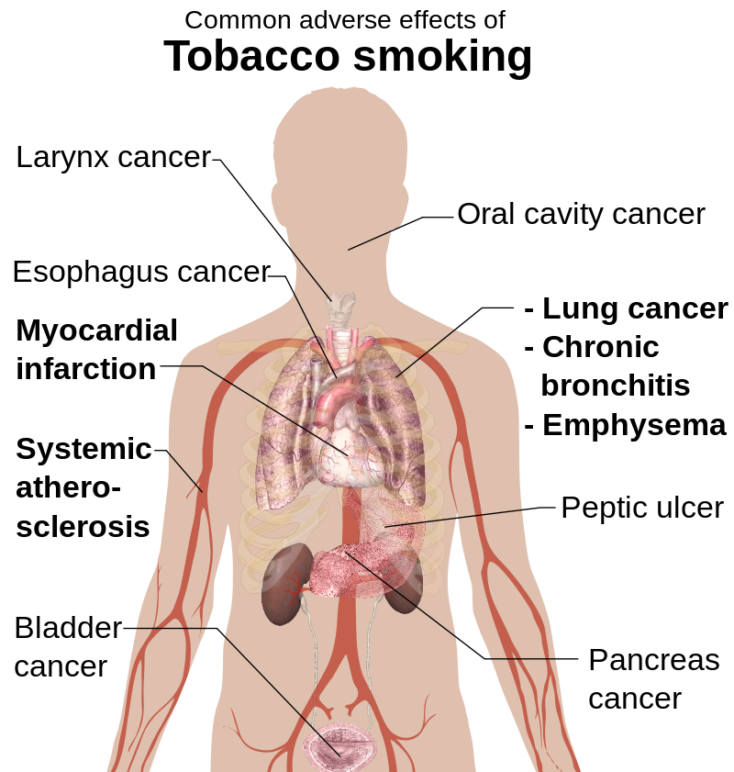
Smoking Complications
Notes:
According to the Centers for Disease Control and Prevention, complications from smoking are extensive…but some of them are:
1- Chronic lung disease
2- Diabetes and increased cholesterol
3- Heart diseases
4- Brain diseases such as embolism and strokes
5- Decreased fertility
6- Pregnancy problems such as premature babies and miscarriages
8- Cavities, bad breath, dry skin, hair loss, weight loss.
9- But also…cancer… But did you know that not only in what we commonly think?

Slide 5
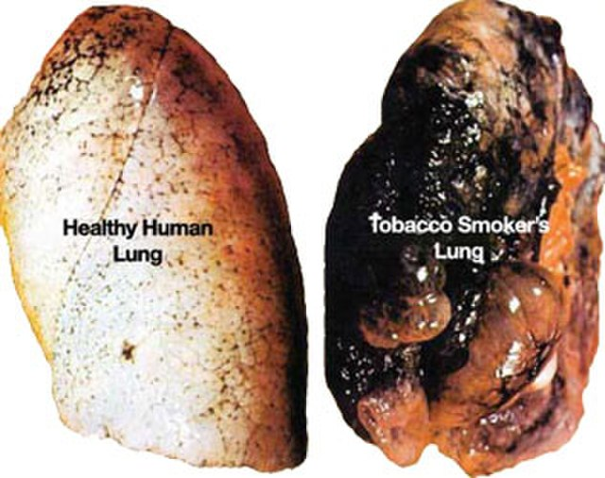
Healthy lung and Smoker’s lung
Notes:
Of course, it is very common for cancer to develop primarily in the lungs in a person who smokes and continually ingests all those toxins that we mentioned before... but that cancer can develop in other parts of the body as well.

Slide 6
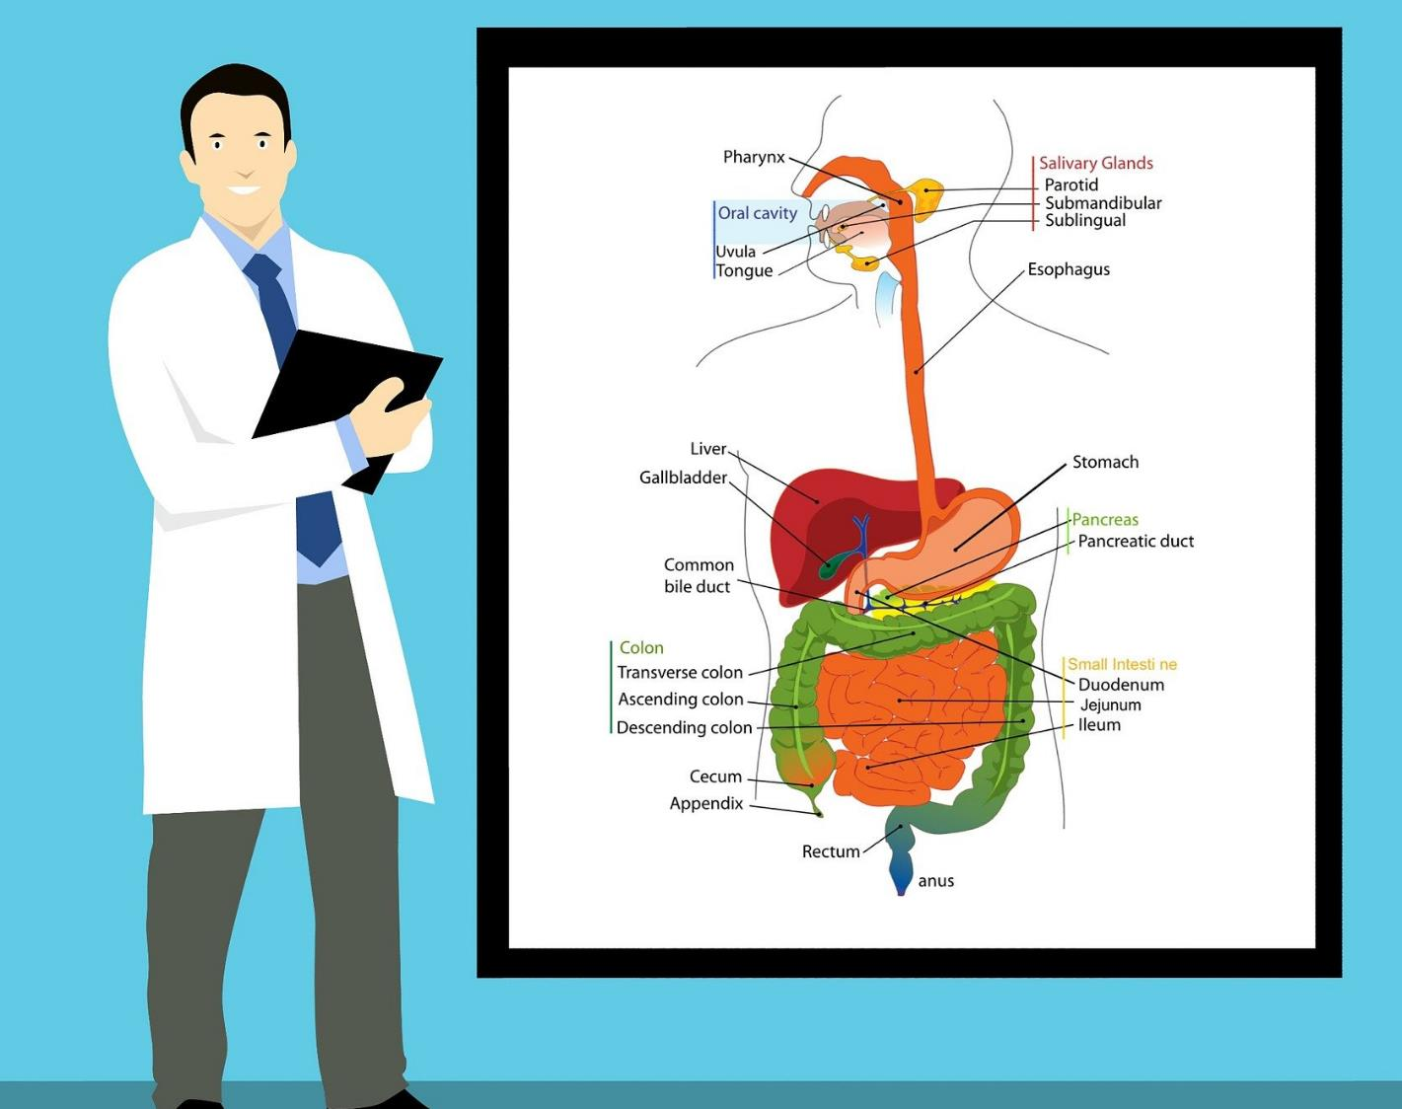
Consuming tobacco may cause cancer THROUGHOUT the body
Notes:
Can you see the image? Using tobacco can cause cancer in some of these organs….
Mouth and throat
Larynx
Bone marrow (this cancer is what we know as leukemia)
Kidneys and renal pelvis
Cervix
Urinary bladder
Esophagus
Lungs
Bronchial tubes
Windpipe
Liver
Stomach
Pancreas
Colon and rectum
Tobacco is related to 90% of tumors, 75% of chronic lung diseases, and 25% of coronary or heart diseases.
In the end, smoking…can kill you!

Slide 7
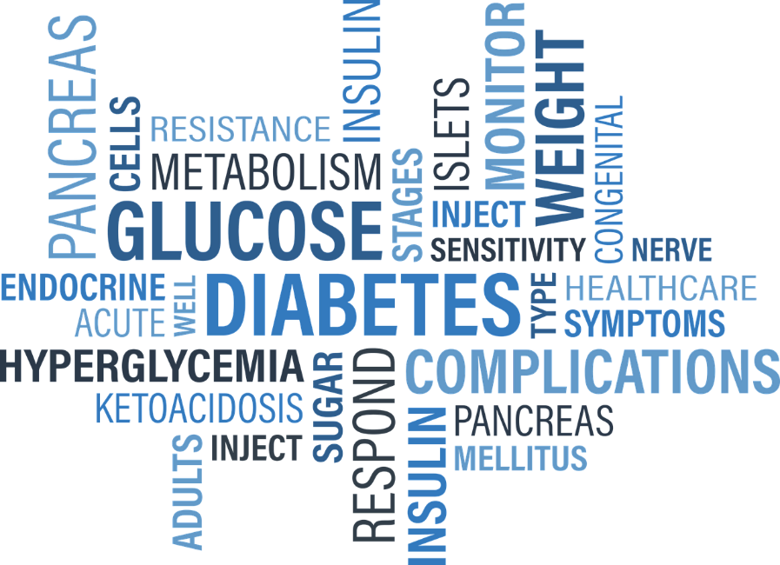
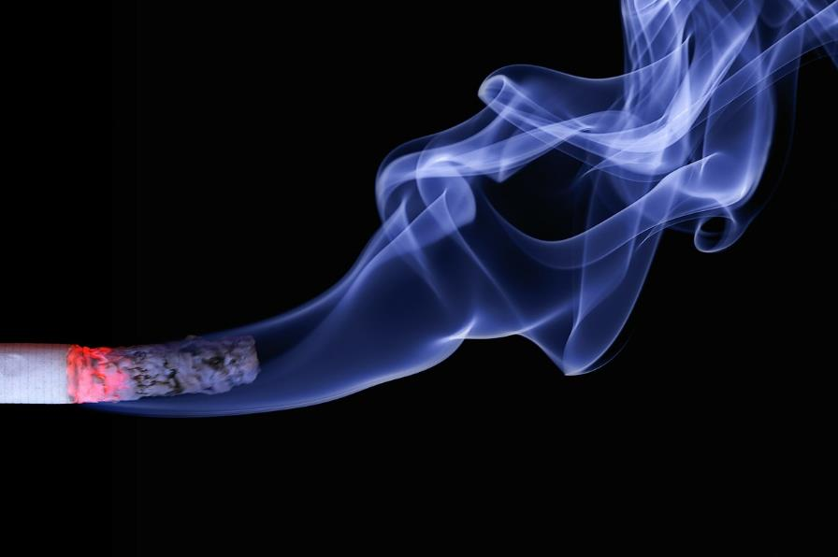
Why is smoking especially bad if you have diabetes?
Notes:
Why is smoking especially bad if you have diabetes?
People with diabetes who smoke are more likely to have serious health problems and complications than people with diabetes who do not smoke. These complications include: increased incidence of heart and kidney disease, poor blood flow to extremities, increased risk of infections, higher incidence of foot ulcers, higher rates of lower limb amputation and retinopathy. which increases the chance of blindness
People with diabetes already have to constantly work to control their blood sugar levels and prevent complications from the disease, including damage to the nerves, eyes, kidneys, and heart. The tobacco in cigarettes increases these problems and complicates diabetes control.
There are at least 70 chemicals in cigarettes that are directly linked to cancer development, aging, and oxidative stress. For example, some of the chemicals found in cigarettes include toilet bowl cleaner, candle wax, insecticide, arsenic, nicotine, lighter fluid, and carbon monoxide, just to name a few. These dangerous and addictive chemicals cause damage to cells in your body and interfere with their normal function.
In a person with diabetes, the damage caused by the chemicals in a cigarette and nicotine causes chronic inflammation, resulting in insulin resistance and higher blood sugar levels, thus making it more difficult to control diabetes.
All of these problems compound to make diabetes difficult to control and increase the likelihood of complications. For people with diabetes, the health risks of smoking a cigarette are four times higher than for a person without diabetes.
Even more surprising, a 2014 study revealed that smokers are also 30-40% more likely to develop type 2 diabetes, making the relationship between smoking and diabetes a vicious circle.
Smoking is a health hazard for anyone, but for people with diabetes or at high risk of developing the disease, smoking can contribute to serious health complications.
Researchers have long known that diabetic patients who smoke have higher blood sugar levels, which makes their disease more difficult to control and puts them at greater risk of developing complications such as blindness, nerve damage, kidney failure and heart problems. Now a new study offers the most definitive evidence as to why: the nicotine in cigarettes.
The California State Polytechnic University found that nicotine, when added to human blood samples, raises hemoglobin A1c (HbA1c) levels by up to 34%. This tells them that there would be a similar effect with diabetic smokers.
Doctors have always known that smoking can make diabetes worse, but through this study we now know why… It's the nicotine!
This study also implies that if you are a smoker and not diabetic, your chances of developing diabetes are higher."
But perhaps more importantly, the results also suggest that nicotine replacement products, such as nicotine-containing patches and e-cigarettes, are also not a safe option for patients with diabetes. Because they still contain nicotine, these products are just as likely to raise A1c levels as cigarettes. "To minimize your chances of developing diabetes or diabetic complications, you should stop smoking," says the doctor in charge of this study. That means – stop doing it immediately and cold turkey.

Slide 8
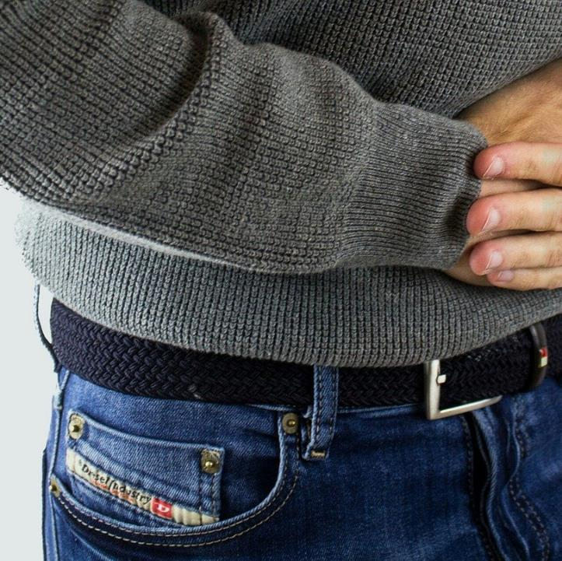
Alcohol can affect your…
Health
Pancreas
Liver
Relationship with your family
Notes:
And you should know that alcohol is just as harmful!!!
We know that alcohol can affect your life and health in many ways. This time we'll be looking at some of those ways it affects things like your general health, your pancreas, your liver, your relationship with your family…and even your A1c or glucose level.

Slide 9
Notes:
In your general health it can cause anything from memory loss, hallucinations, seizures, dementia, risk of chest infection, liver inflammation, hepatitis, cirrhosis….IN SHORT….can you see the whole list on your screen? It even includes low blood glucose control!!! And while all of the health consequences that alcohol contributes to need to be looked out for, one that we're primarily focused on in these classes is your glucose or diabetes.

Slide 10
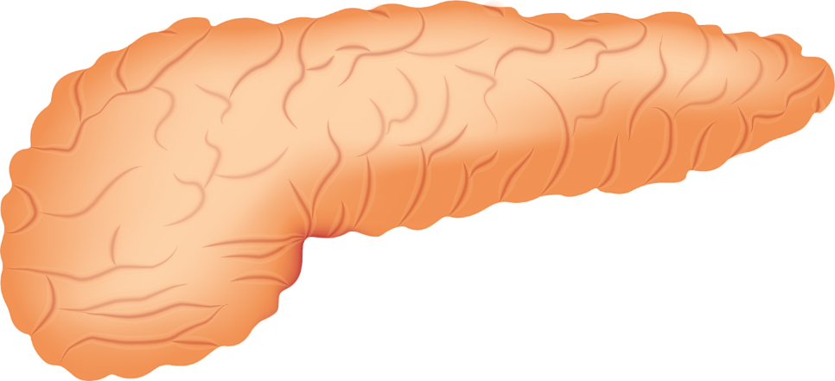
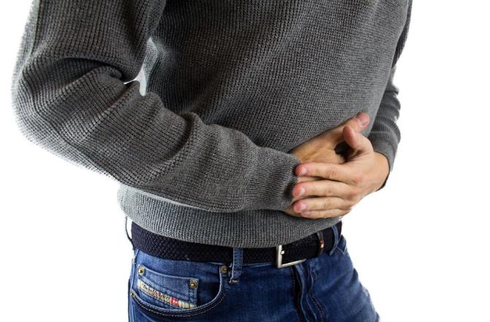
How does it affect the pancreas?
Notes:
One of the areas affected by alcohol consumption is the pancreas. How does it affect the pancreas? It causes chronic inflammation (pancreatitis) and this is important because the pancreas is the organ in charge of producing insulin. Sound familiar? Alcohol affects the ability of the pancreas to secrete insulin.

Slide 11
Insulin
DIGESTION
GLUCOSE
CARBOHYDRATE
EAT CARBOHYDRATE
CARBOHYDRATE TURNS INTO GLUCOSE
GLUCOSE ENTERS BLOOD STREEM
Notes:
Do you remember the first videos of our program? Insulin, a hormone produced by the pancreas, which allows cells to absorb and use glucose, to be used as energy.
In other words…everything you eat (be it bread, sugar, meats, fruits, vegetables….EVERYTHING) turns into glucose, and this glucose is VERY necessary for your cells to turn into energy, but the key that unlocks those cells is called insulin….without insulin – your cells don't get energy and the glucose stays in your blood and affects your whole body.
So if alcohol affects your pancreas…your blood sugar level will be directly affected.

Slide 12
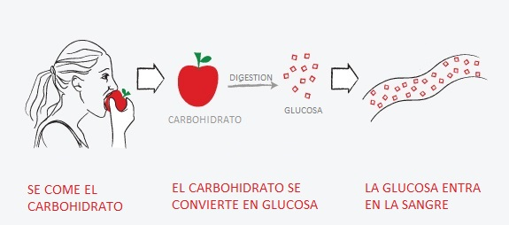
DIGESTION
GLUCOSE
CARBOHYDRATE
EAT CARBOHYDRATE
CARBOHYDRATE TURNS INTO GLUCOSE
GLUCOSE ENTERS BLOOD STREEM
Notes:
Look at the picture we have here…your pancreas will do one of two jobs…helping your body produce insulin and work ideally…or…. that of being more and more damaged and requiring a lot of help to do the most basic job of converting what you eat into energy so that glucose does not stay in your blood.
Remember that insulin is the key and the organ that makes insulin is the pancreas.

Slide 13
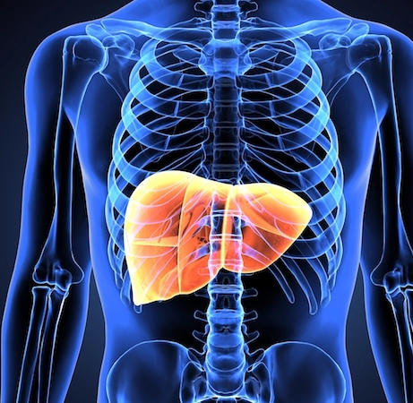
How does it affect the liver?
Notes:
Another way your body can be affected by alcohol is through your liver.
The liver releases glucose to maintain blood sugar levels. But when a person drinks alcohol - especially when they do so without having anything in their stomach - the liver is so busy breaking down the alcohol that it does a poor job of releasing glucose into the bloodstream. And this can lead to a drop in blood sugar levels that we know as hypoglycemia .

Slide 14
Symptoms of excess alcohol and hypoglycemia
Confusion
Drowsiness
Blurry vision
Headaches
Lightheadedness or dizziness
Lack of coordination
Unconsciousness
Notes:
This is dangerous in a number of ways, but let's look at this one in particular….do you know that the symptoms of excess alcohol and hypoglycemia can be VERY similar?
Confusion
Drowsiness
Blurry vision
Headaches
Lightheadedness or dizziness
Lack of coordination
Unconsciousness.
It would not be a good thing if someone confused the symptoms and thought that you are intoxicated instead of suffering from hypoglycemia. If they think you were knocked unconscious, they may not give you the proper help and treatment – as hypoglycaemia needs to be treated promptly.

Slide 15
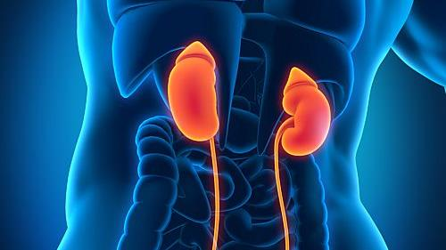
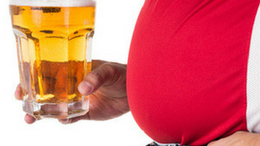
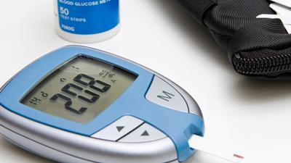
Other Harm
Notes:
And these are not the only harm….as we saw before, there are many more….
Drinking alcohol could worsen complications already common in diabetics such as neurological, eye or kidney damage
Remember that weight gain makes diabetes more difficult to control and alcohol causes possible weight gain since alcohol is high in calories.
And because of these calories, it can also spike your blood sugar since beer and sugary mixed drinks are high in carbs, and the excess carbs can cause your blood sugar levels to spike.
But….we can improve! Don't be discouraged… why do you think we focus on this topic in a diabetes prevention and management class? Because by looking for solutions for your diabetes, such as changes in eating and exercise habits, we can gradually eradicate other consequences of those bad habits that lead us to develop diabetes.
So…let's set goals!

Slide 16
How to stop smoking or drinking alcohol?
Notes:
Quitting these bad habits is important for your health.
Shortly after quitting smoking, circulation begins to improve and blood pressure begins to return to normal. Your sense of smell and taste return and you begin to breathe more easily. In the long term, quitting tobacco can help you live longer. Your risk of cancer decreases each year that passes without smoking.
Quitting is not easy. You may have short-term effects, such as weight gain, irritability, and anxiety. Some people try several times before succeeding. There are many ways to quit smoking. Some people stop it all at once. Others take avantage of the benefits of step-by-step manuals, guidance, or medications or products that help reduce nicotine addiction. Some people think that the switch to e-cigarettes may help you quit smoking, but this has not been proven. Your healthcare provider can help you find the best way to quit smoking.
NIH: The National Cancer Institute tells you that you can quit smoking for good, even if you've tried before and failed. Actually, almost all smokers have had to try several times before succeeding. Stay positive, and don't give up.

Slide 17
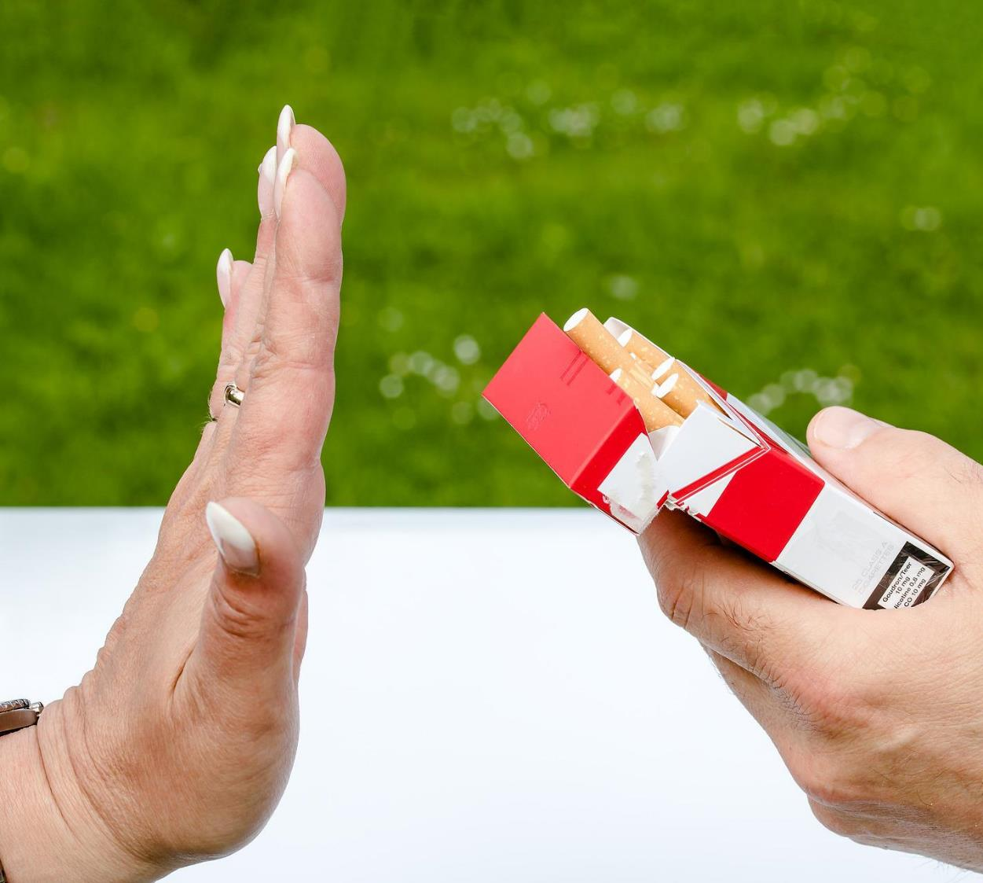
Identify your triggers
Emotional
Pattern
Social
Abstinence
Notes:
When you start to quit smoking or drinking , your body goes through nicotine and alcohol withdrawal . You may feel tired, moody, and have headaches or even other symptoms. Previously, you may have dealt with these feelings by resorting to bad habits.
Certain places and activities can trigger anxiety. If you used to smoke or drink after eating or talking on the phone, these things can make you want a cigarette or a drink.
Expect to feel anxious for a few weeks after quitting smoking and drinking. The first few days will probably be the worst. The more time passes, the anxiety should become less intense.
Triggers are things that make you want to smoke or drink. Each person has different triggers, such as a stressful situation, having a cup of coffee, going to a party, or smelling cigarette smoke or seeing someone else drink. Identifying your triggers and learning how best to handle them is your first line of defense.
Emotional: Many people smoke or drink when they have intense emotions. An emotional trigger reminds you how it felt to smoke and drink to try to improve your mood or escape a bad moment. You can learn to deal with your feelings (stress, anxiety, boredom, depression, happiness, loneliness, contentment, etc.) without relying on cigarettes or alcohol. Try these ways to manage emotional triggers: Talk about your emotions, exercise, listen to calming music, etc.
Pattern: A trigger pattern is an activity that you associate with smoking or drinking. Among these activities are:
When you talk on the phone / When you watch TV / When you finish eating / When you drink coffee / When you take a break / After having sex / Before going to bed, etc.
How to deal with trigger patterns? One way to overcome trigger patterns is to break the association with the trigger and trade the sensation for another activity.
Social: These are times that generally include other people who smoke or drink. For example: Going to a bar/Going to a party or other social event/Going to a concert/Watching someone else smoke or drink alcohol/Hanging with friends who smoke or drink alcohol/Celebrating a big event
How to handle social triggers? Once you've made the decision to quit smoking or drinking alcohol, it's best to avoid places where people do this, and ask your friends not to do it around you. Over time, it will get easier. Tell your friends and family that you have quit smoking. Ask for their support.
Withdrawal: If you've been smoking or drinking alcohol for a long time, your body is used to getting a regular dose of nicotine or alcohol. When you quit, withdrawal symptoms will produce cravings. Withdrawal triggers can be:
Craving the taste of a cigarette or alcoholic beverage
Smell cigarette smoke
See people drinking alcohol
Handling cigarettes, lighters and matches
Needing to do something with your hands or mouth
Feeling restless or having other withdrawal symptoms
All habits, compulsions and addictions are very persistent and therefore, they are difficult to stop, but not impossible. It is a fact that repetitive actions alter the brain, making it more difficult to change a pattern of behavior. However, we can all learn new behavior patterns. If you are a true believer, you have the word of God, the church of Christ and specialized community support groups to support you in changing your life. You also have the Holy Spirit who will give you the power you need from within to change your thinking and persevere in your desire to stop drinking. "For it is God who works in you to will as well as to do, according to his good will." (Philippians 2:13)

Slide 18
The importance of goals
Notes:
The important thing about goals is not that they are huge or that they are ideal…..the important thing about goals is that we think of them as one step at a time….like when you are going to climb some stairs, the important thing is to go up each step – one by one. No one jumps up to a second floor…he goes up one step, and then another, and then another, until he reaches his goal.
Yes, it is correct to know where we are going….but we should not get frustrated if we can only climb one step at a time. The important thing is to make a plan. Plan the first step and climb that step TODAY.
So… to achieve a goal, the first thing we are going to do is:

Slide 19
Notes:
Write them down on paper! And not only that, review your goals every week and evaluate how to improve that goal or how to modify it, each time fulfilling it better. For example, you can keep a diary of what you drink (on your phone, on paper, or posted on the fridge)…so you don't fool yourself when evaluating your week.
Do not have alcohol at home! The easiest way not to drink at home is not to buy alcohol for the house….if we don't have it, we will have to think twice when the craving strikes.
Pick alcohol-free days and write them down on a calendar – so you can gradually increase the days you don't drink.

Slide 20
Don't give up!
Notes:
Beware of peer pressure! We know that there are situations or people that sometimes pressure us to smoke or drink alcohol. Look for alternatives to have fun and be aware of social pressure! You may have to stay away for a while or forever from friends or situations that pressure you to drink.
Also, if you are one of those people who choose to smoke or drink alcohol out of habit after an activity or because of a problem… keep busy with other hobbies and activities that help you redirect your attention or fight your temptation – like walking, play a sport etc.
Ask for help – your Community Health Workers are at your disposal to help you. There are times that just by asking for help we find the encouragement or motivation to make those changes. We want to help you and we are part of your team.
Be persistent…don't give up if you fail. With God's help everything is possible. Remember Philippians 4:13 “I can do all things through Christ who strengthens me.”

Slide 21
Support
713-686-6300
aahouston.org
713 683-7227
www.alanon.org
Notes:
If you need help, you can contact your Community Health Worker, but we also offer these help alternatives:
Houston Alcoholics Anonymous
713-686-6300 This line is available 24 hours a day.
https://aahouston.org All information is available in English and Spanish.
Alcoholics Anonymous supports nearly 2,500 meetings per week and will put you in touch with a meeting that is close to your home and at a time that suits you best.
If you have a loved one who has a drinking problem and want to know: “How can I help you?” The Houston Al-Anon organization has meetings for families of people with alcohol problems. You can consult Al-Anon at alanon.org or call 713-683-7227.

Slide 22
Sources of More Information: CDC Centers for Disease Control and Prevention: How to Quit Smoking NIH: National Cancer Institute Smokefree.gov https://english.smokefree.gov/challenges-when-you-quit-smoking/identify-your-triggers TIME TOBACCO Why Smoking Is Especially Bad If You Have Diabetes https://healthland.time.com/2011/03/27/why-smoking-is-a-bad-idea-for-diabetics/
Notes:
If you want more information on this topic, these are the sources from which we obtained this data. However, your Comminity Health Worker will always be willing to help you better understand this topic. Call your CHW and they will gladly assist you.

Slide 23
Thank you!
Notes:
Thank you for listening to the information about this much-needed topic. We hope this will help you or someone you love.
So long!

Slide 24
References
- Maddatu, J., Anderson-Baucum, E., & Evans-Molina, C. (2017). Smoking and the risk of type 2 diabetes. Translational research : the journal of laboratory and clinical medicine, 184, 101–107.
- Emanuele, N. V., Swade, T. F., & Emanuele, M. A. (1998). Consequences of alcohol use in diabetics. Alcohol health and research world, 22(3), 211–219.
- NIAAA publications. (n.d.). Brochures and Fact Sheets | National Institute on Alcohol Abuse and Alcoholism (NIAAA). Last accessed September 15, 2022. https://pubs.niaaa.nih.gov/publications/aa71/aa71.htm
- Nicotine dependence - Symptoms and causes. (2022, April 19). Mayo Clinic. Last accessed September 15, 2022. https://www.mayoclinic.org/diseases-conditions/nicotine-dependence/symptoms-causes/syc-20351584
- Health effects of smoking and tobacco use. (2022, July 21). Centers for Disease Control and Prevention. Last accessed September 15, 2022. https://www.cdc.gov/tobacco/basic_information/health_effects/index.htm

