Slide 1
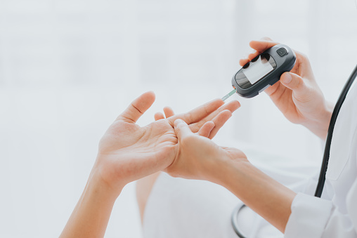
Controlling diabetes
WELCOME!
Notes:
Welcome! We are very pleased that you decided to participate in this program. This is a program that will last six months. Each month we will send you a video similar to this one to help you to prevent or to control diabetes. We hope that, over the next six months, you will watch these videos and apply some of the advice, and also answer the calls from your Community Health Workers weekly. Thank you, and we hope these videos and CHW calls will be beneficial to prevent or to control diabetes if you already have that condition.

Slide 2
Diabetes or at risk
But what is diabetes?
Notes:
To begin with, it is important to understand what diabetes is and what it means to be at risk to develop this condition. When your doctor told you for the first time about this condition, it may have been very worrisome for you. The easiest way to get relief from this worry is to educate yourself and understand the steps to take to prevent further complications. Therefore, we will look at what is happening when there is excess sugar, or glucose, in the blood.

Slide 3
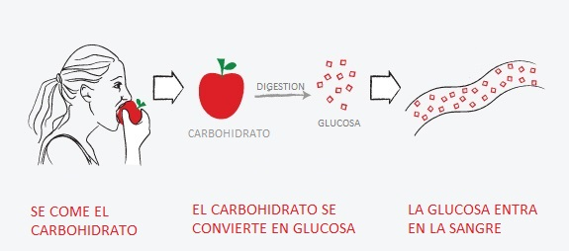
Glucose
Carbohydrate
Eats the carbohydrate
Carbohydrate is converted into glucose
Glucose enters the blood
Notes:
It is important to understand that EVERY, EVERY food we eat turns into SUGAR once eaten. This sugar is called glucose. By eating a fruit, a vegetable, or any other food, the process of digestion begins, and this process turns what you eat into glucose. Glucose itself is not bad! In reality glucose is NECESSARY for our bodies to work correctly. So a few minutes after eating some food, this transformation happens and glucose enters the bloodstream. Remember that this is the same for everybody and is a necessary process.

Slide 4
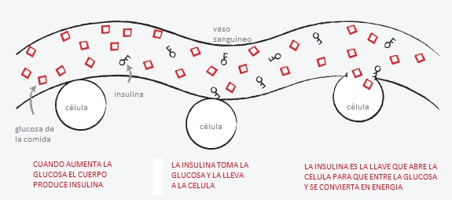
Blood vessel
Cell
Insulin
Cell
Glucose from food
Cell
Insulin is the key that opens the cell so that glucose enters and becomes energy
How much glucose increases the body produces insulin
Insulin takes glucose and carries it to the cell
Notes:
Once glucose enters the bloodstream your body starts to produce insulin. In this illustration the insulin is the little keys that you can see among the glucose. The work of the insulin that your body produces is to act like a key to open the cell and allow glucose to enter your cells. Once cells get glucose, they convert it into energy. I remind you, this process is very necessary for your body since the process enables your cells to produce the energy that we need to function effectively - to breath, walk, work, and do everything you need to do during the day. Your heart, your eyes, and every organ of your body depend on that energy.

Slide 5
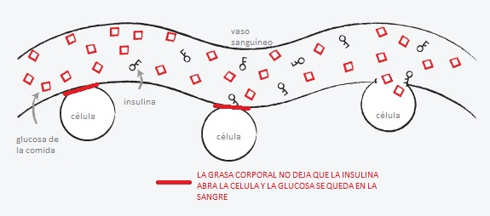
Blood vessel
Cell
Insulin
Cell
Glucose from food
Cell
Body fat doesn't let insulin open the cell and glucose stays in the blood
Notes:
Now that we understand this process, we’re going to try to understand the following question: Why does glucose remain in the blood and not enter the cells? There are a number or reasons, but we’re going to explain two of them.
1. We consume more glucose than our body needs.
2. Body fat does not allow the insulin to open the cell for glucose to enter and use it for energy. What happens then is that the extra glucose does not enter the cells and remains in the blood. That’s what we call excess sugar, or glucose, in the blood. If these cells cannot be opened using the little insulin key, then diabetes symptoms occur . . .

Slide 6
AND IT IS FOR THAT REASON THAT.......
TIREDNESS
IRRITABILITY
DRY MOUTH
CONSTANT THIRST
URINATING FREQUENTLY
Because no energy is coming to the cells
Lack of energy makes everything seem more difficult and tedious
The body is draining all the energy and drying your mouth
That lack of energy is demonstrated with a lot of thirst to replenish energy.
By satisfying its thirst, the body needs to get rid of the excess of water
Notes:
That lack of energy we feel despite having eaten is the reason why . . .
. . . we suffer from tiredness, because the energy is not getting to the cells.
. . . we also suffer from irritability. We get angry! Lack of energy makes us see everything as difficult and tedious.
. . . we also suffer from dry mouth, because our body is using up all the energy and making our mouths dry.
That dryness produces a constant thirst since the body is using everything to replenish the energy lost.
Once our thirst is satisfied, our body tells us to get rid of that water. Then the urge to urinate frequently develops.

Slide 7
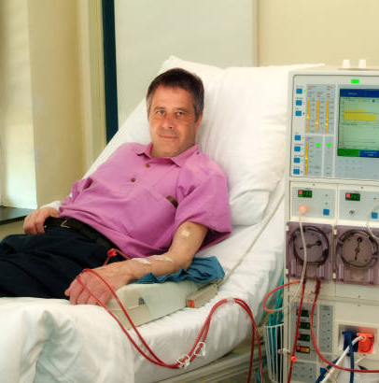
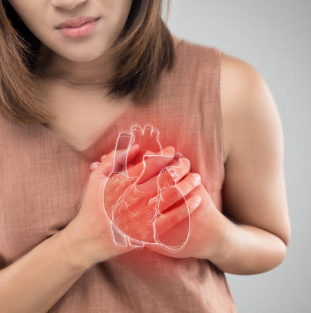
AND WHAT HAPPENS IF YOU DON'T TAKE CARE OF YOURSELF...
DIALYSIS
HEART ATTACK
LOSS OF VISION
Notes:
What happens if we don’t control the excess glucose in the blood? If our body is in a continuous imbalance of energy our vital organs start to suffer. They do not stop working immediately, but they start to deteriorate slowly. For example, kidneys begin to suffer to the point that their function is not ideal. Then they stop working and dialysis is needed in order to help the kidneys. Or also in the case of the heart, it ceases to function ideally and it weakens until it can no longer function. Also in other organs like your eyes, which stop working correctly until, little by little, vision is lost completely. This information is not intended to frighten you. We are sharing this with you because these complications cause many people to suffer greatly on a daily basis. And it is not just you. Your family suffers along with you. So what can we do? Our goal is to help you so that these complications will not occur.

Slide 8
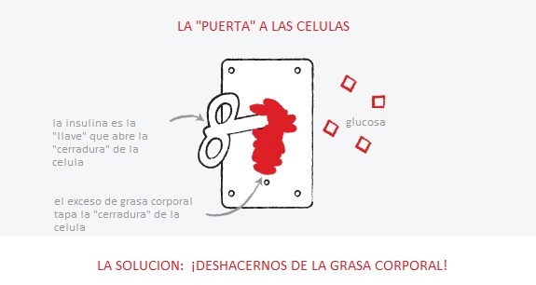
The "Door" To The Cells
insulin is the "key" that opens the "lock" of the cell
Glucose
excess body fat plugs the cell "lock”
The Solution: Get Rid of Body Fat!
Notes:
So how do we prevent or control diabetes? Reducing our body fat! Do you remember that insulin is the key that opens the cell to let the glucose in? That excess body fat keeps that key from functioning and opening that cell. Do you remember what happens when the insulin can’t open the cell? Glucose builds up in the blood. To prevent or to control our diabetes we MUST get rid of that body fat in order to help our body to work as it should. But this is a vicious circle; we don’t have energy because that cell is not receiving glucose to turn into energy. But that glucose cannot change it into energy until body fat is reduced. So we need to make an effort to move, walk, or do any other kind of physical activity. But it is also equally important to reduce our consumption of food that is not nutritious.

Slide 9
Who is at risk of developing type 2 diabetes?
Overweight
Are 45 years of age or older
Parents/Siblings
Physical Activity
Race and Ethnicity
Your body fat hinders the entry of glucose from food into the cell
As the years go by, the chances increase
If a parent or one of your brothers or sisters has type 2 diabetes
If you are physically active less than 3 times a week
Whether you are African-American, Hispanic or Latino, Native American or Alaska Native
Notes:
Who develops type 2 diabetes or is at risk to develop type 2 diabetes?
According to the reasons that we have been discussing, the most important factor is body fat. This is because your body fat keeps glucose from entering the cell.
People over 45 years old are also at risk to develop diabetes.
Another reason is our genes. If one of your parents or brothers or sisters have developed type 2 diabetes, there is a high probability that you will develop it too.
Another reason is lack of physical activity (exercise). People who are inactive and do not constantly engage in physical activity are at risk. This means five times a week for at least 30 minutes of physical activity during which your heart beats more rapidly. Generally speaking, if you walk and carry on a conversation, you are not making enough effort and the pace must be stepped up.
The last of these risk factors is the fact that we are Hispanics. The Centers for Disease Control and Prevention states that those of us who are Latino and over 45 years old have a 50% chance of developing diabetes.

Slide 10
But I feel good !
Notes:
Some diabetic patients tell us: “But I feel just fine!” Maybe this is true, but allow me to share this with you: Often the deterioration of our body and our health happens VERY slowly! That is to say that we get worse and worn down little by little, and in that process of getting worn down, we don’t feel the difference. Since this deterioration is so slow we get used to the way we feel and we think that we are fine. However the deterioration continues and the consequences occur.

Slide 11
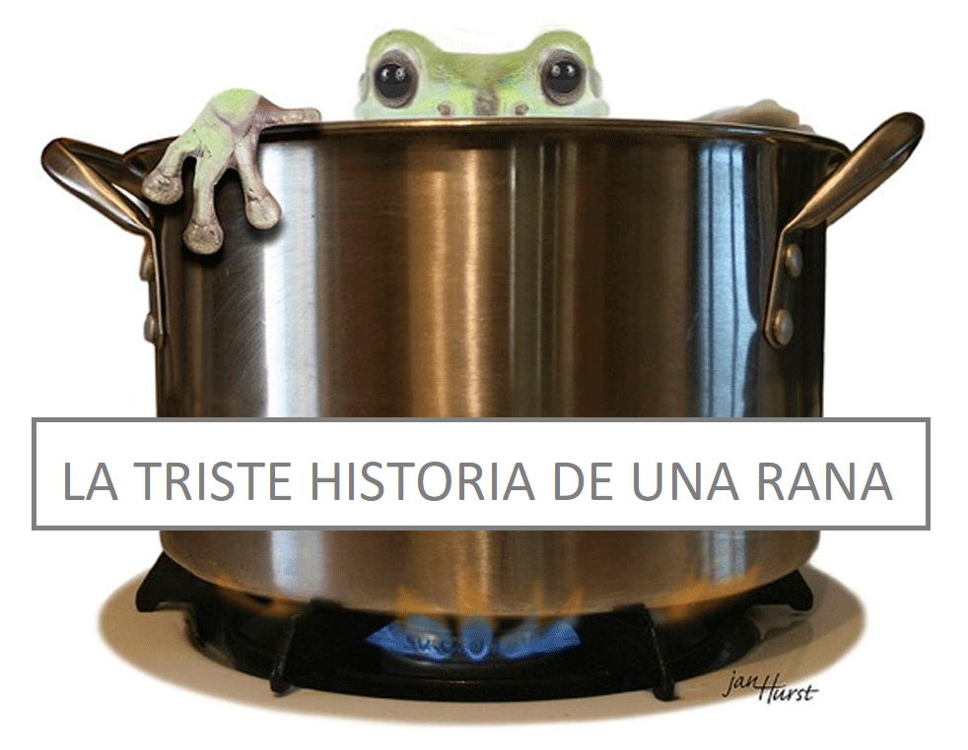
THE SAD STORY OF A FROG
Notes:
To illustrate that slow but lethal deterioration, let me share this story about a frog.
Do you know what’s going to happen if you put a frog into a pot of boiling water?

Slide 12
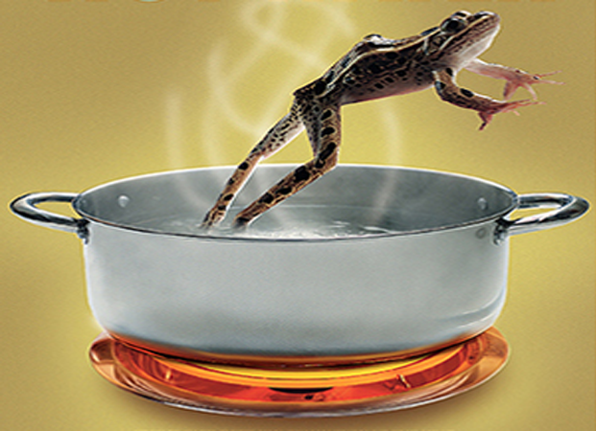
Notes:
As soon as the frog hits the hot water it will instantly leap out! The frog feels the sudden change in temperature and jumps out to save its life. But do you know what happens if you put it in water at room temperature? If you put the same frog in cool water and light the stove and little by little heat that water . . .

Slide 13
Notes:
. . . the frog will remain in the water. The frog will enjoy the warm water. However the heat will make the water boil! But since the water temperature will change little by little, the frog will not notice the difference. The frog does not have the ability to notice it. In a few minutes you will see that the water is boiling, but the frog will not jump out because it cannot feel the difference. The frog ends up cooking little by little, and will die, because it did not notice the difference even though its body suffered the consequences of the boiling water.
It could happen to us. We do not feel the excess glucose in the bloodstream. We get used to the risk levels rising slowly and we don’t notice it. However the vital organs continue to become damaged and we don’t feel it until we lose our sight or we suffer a heart attack, and then it is too late.

Slide 14
HOW DO I KNOW IF I HAVE DIABETES OR HOW CLOSE AM I TO DEVELOPING DIABETES?
Notes:
So, how do we know that we are developing diabetes if we can’t feel it? If we are relatively healthy and responsible people, we must have a medical check-up every year. There doctors perform several tests to detect if there is an illness that is starting to develop. One of those tests is the A1C. Perhaps you never hear of it, or maybe your doctor has already spoken to you about it. But the importance of this test is to understand what our A1C number is and what it means.
The A1C is an average of blood glucose. This average shows our glucose level over the last three months. It does not have to be done on an empty stomach because it is just an average and is not affected by what we ate for breakfast the day of the exam. What matters is what we ate for breakfast over the last three months. If our number shows 5.7 or above it means we are at risk to develop diabetes. We have the opportunity to make PERMANENT life changes, in what we eat and how physically active we will be, in order to avoid developing that condition. But if we reach 6.5 or more, then we are diagnosed with diabetes.

Slide 15
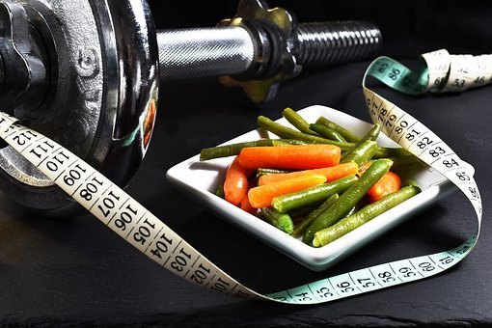
WHAT IS THE GOAL OF CONTROL IF I ALREADY HAVE DIABETES
UNDER 65 YEARS OLD
7.0
65 YEARS OR OLDER
7.5
Notes:
That does not mean we have to give up. We should still make PERMANET changes, in what we eat and how physically active we’ll be, to be able to control that condition. But in the case of people with a level of 6.5 or more, there are usually medications included to help lower the glucose level while the patient starts making those changes.
When a person has been diagnosed as diabetic, has medications, and makes permanent changes in their habits, it is easier to get to a controlled diabetes status. That number is 7.0 or less for people younger than 65 years old and 7.5 for those older than 65. Staying below 7.0 is crucial to protect our vital organs and our quality of life. It is also VERY IMPORTANT to reduce the risks that we discussed before, such as dialysis, heart attack, and vision loss, among many others that may develop.

Slide 16
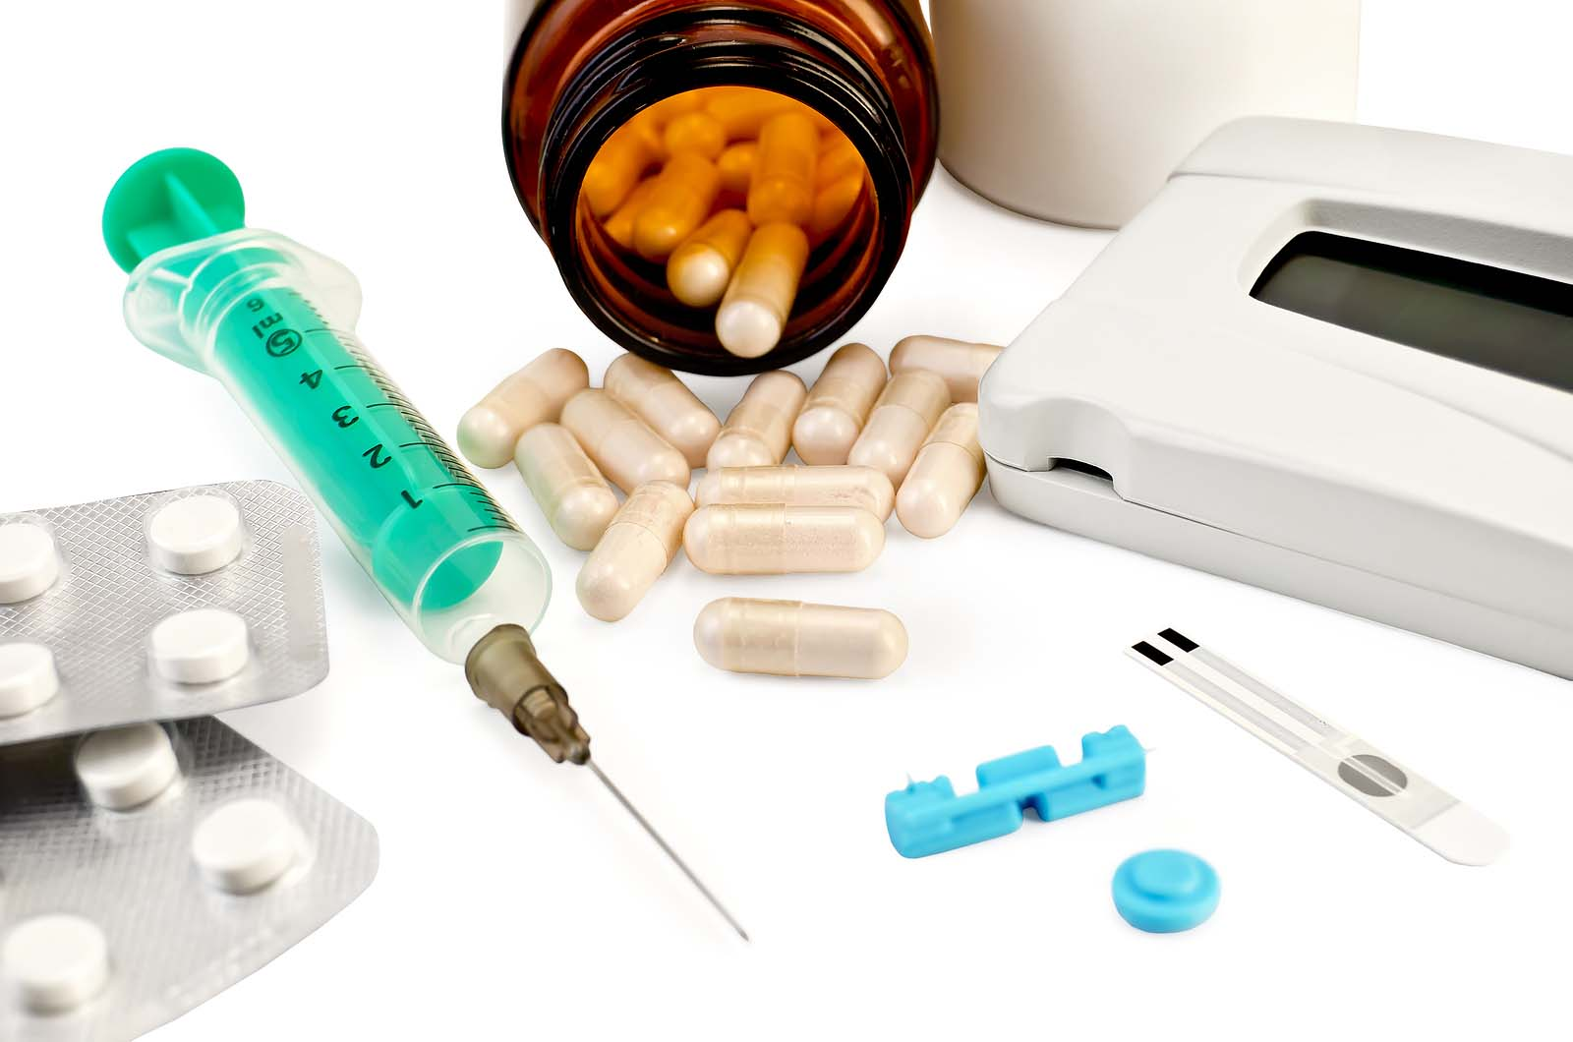
Medicine
they are VERY important!
Notes:
If it is the case that we already have diabetes, our medications become VITAL and very important. These will help us to lower our A1C number and they will protect us. But it is important not to forget that they only help to lower that number and do not actually fix the condition. WE MUST change our habits if we want to avoid tragic consequences. If you have difficulty understanding your dosage, getting your medications, or have any questions, you can talk to your Community Health Worker. We will be happy to help you with these habits of taking your medications regularly.

Slide 17
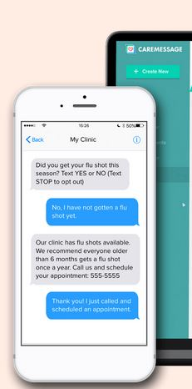
We are here to help you
We will be calling you weekly
Notes:
Speaking of your Community Health Worker!! By this time your Community Health Worker has contacted you and has begun to help you with any questions you may have. Each of us has been certified by the state of Texas to help take care of your health. We are not doctors nor are we legally authorized to give medical advice, but we have been trained in various topics including diabetes. We also communicate weekly with the doctors of the clinic and our supervising doctor to communicate everything you ask and to give us instructions on how to support and advise you. Having a Commumity Health Worker connects you directly so your doctor has the most up-to-date information and can help you more effectively prevent or manage diabetes. During more than 5 years of helping patients in this type of project, we have shown that a diabetic patient who is in communication with a Community Health Worker improves their health in most cases.

Slide 18
It's a long race
You will need support
Notes:
The prevention and control of diabetes does not occur overnight. It cannot be fixed with just a pill or an injection. It is a process of changing our habits, our routines, or even our likes, in order to have a better quality of life. Our life is a Long Race. The journey is always easier when we have a good support team on our side to cheer us on and to encourage us to continue trying.

Slide 19
Medical help
Notes:
We are here to get the answers you may need whether dealing with medical questions . . .

Slide 20
Social Assistance/Practice
Notes:
. . . or questions about how to defeat obstacles that keep us from implementing the necessary habits of nutrition and physical activity, as well as further questions . . .

Slide 21
Moral/Spiritual Help
Notes:
. . . that have more to do with our spiritual lives, that create obstacles that keep us from advancing. We are here to support you in your plan to prevent or to control your diabetes, and also to listen to you and support you in prayer.

Slide 22
CONFIDENTIALITY
Respecting the trust they give us
Notes:
And we want you to rest assured that we will always respect the trust that you give us. Our goal is to help you to reach YOUR goals.

Slide 23
Thank you for participating
Notes:
We thank you for your involvement in this program and we are happy knowing that we are here to help you. Do not forget that help is just a call away. If you have not been in touch with your Community Health Worker yet, please don’t hesitate to send a text using the same CareMessage message by which you received this video, so that you can get in touch with your Community Health Worker. Until next time, and may God bless you richly.

Slide 24
References
- American Diabetes Association (2022). Standards of Medical Care in Diabetes. Vol 45 (Supplement 1). Last accessed Sept 15, 2022. https://diabetesjournals.org/care/issue/45/Supplement_1
- Banday, M. Z., Sameer, A. S., & Nissar, S. (2020). Pathophysiology of diabetes: An overview. Avicenna journal of medicine, 10(4), 174–188.
- Hispanic/Latino Americans and type 2 diabetes. (2022, April 4). Centers for Disease Control and Prevention. Last accessed September 15, 2022. https://www.cdc.gov/diabetes/library/features/hispanic-diabetes.html
- Ismail, L., Materwala, H., & Al Kaabi, J. (2021). Association of risk factors with type 2 diabetes: A systematic review. Computational and structural biotechnology journal, 19, 1759–1785.
- Marín-Peñalver, J. J., Martín-Timón, I., Sevillano-Collantes, C., & Del Cañizo-Gómez, F. J. (2016). Update on the treatment of type 2 diabetes mellitus. World journal of diabetes, 7(17), 354–395.

Slide 25
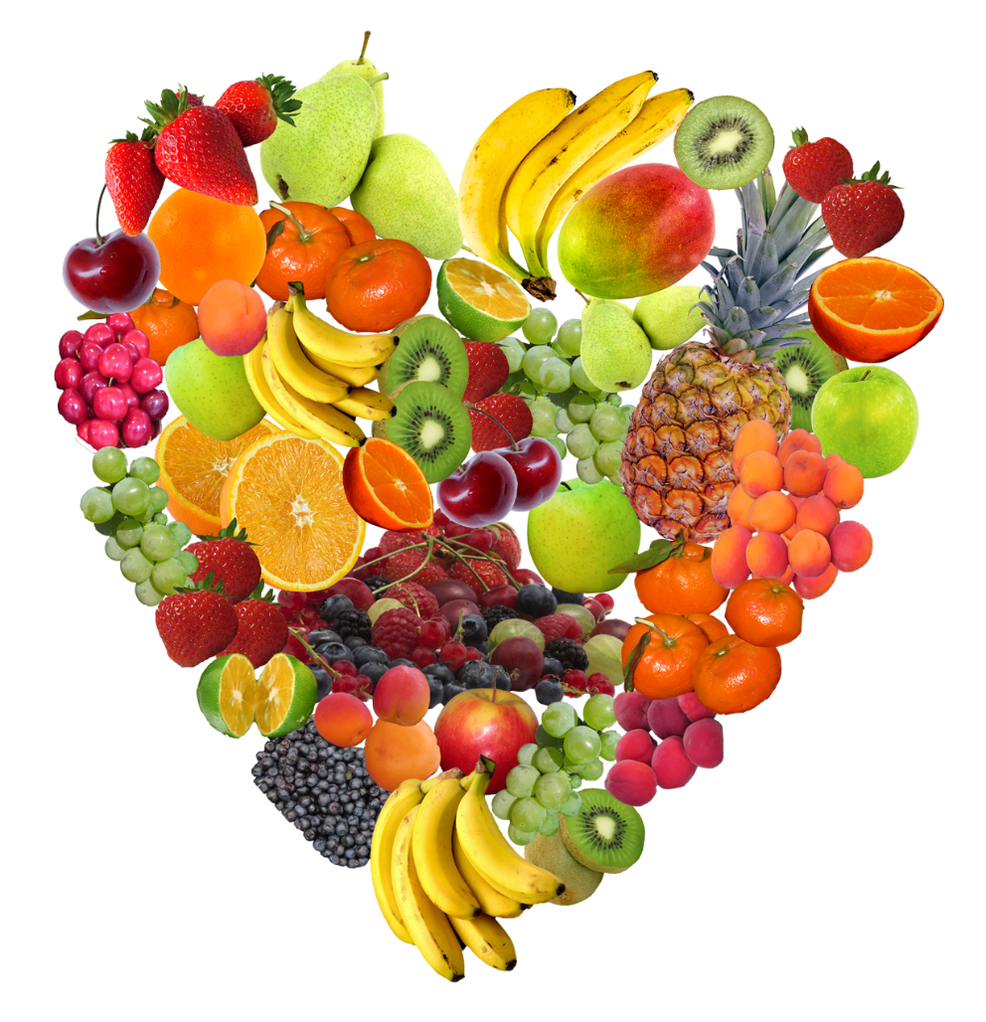
WELCOME
Controlling Diabetes with Medication
Second Month
Notes:
Welcome to our second session of diabetes prevention and management! This is the second class we'll be having and this month we'll be talking about how to control diabetes using the medications your doctor has prescribed.

Slide 26
Making Changes
Notes:
We hope the information from last month has helped you! We hope that you have been able to analyze your personal situations and have been able to identify some changes that you can begin to make in your lives. We have spoken to many of you and are glad that you are beginning to make changes to bad habits by setting achievable and measurable goals. If you don't already have a specific, measurable goal, talk to your Community Health Worker and they'll help you set up a goal that's achievable for you and will help you improve your physical activity and nutrition habits. One of the things we'll be encouraging you to change is the way you check your glucose. If you have already been diagnosed with diabetes, one of the things we have provided for free is a glucometer and the necessary strips to check your blood glucose. If you do not have it yet and YOU ARE DIABETIC, please contact your Community Health Worker so that we can give you one as soon as possible. If you already have it, USE IT! Your Community Health Worker will be explaining to you that one of the things you need to do is check your glucose at different times. Keep notes of those numbers and what time the test was done. These numbers help your doctor know if there are changes that need to be made to your medications. Remember that we are here to help you, just call us and we will gladly assist you.

Slide 27
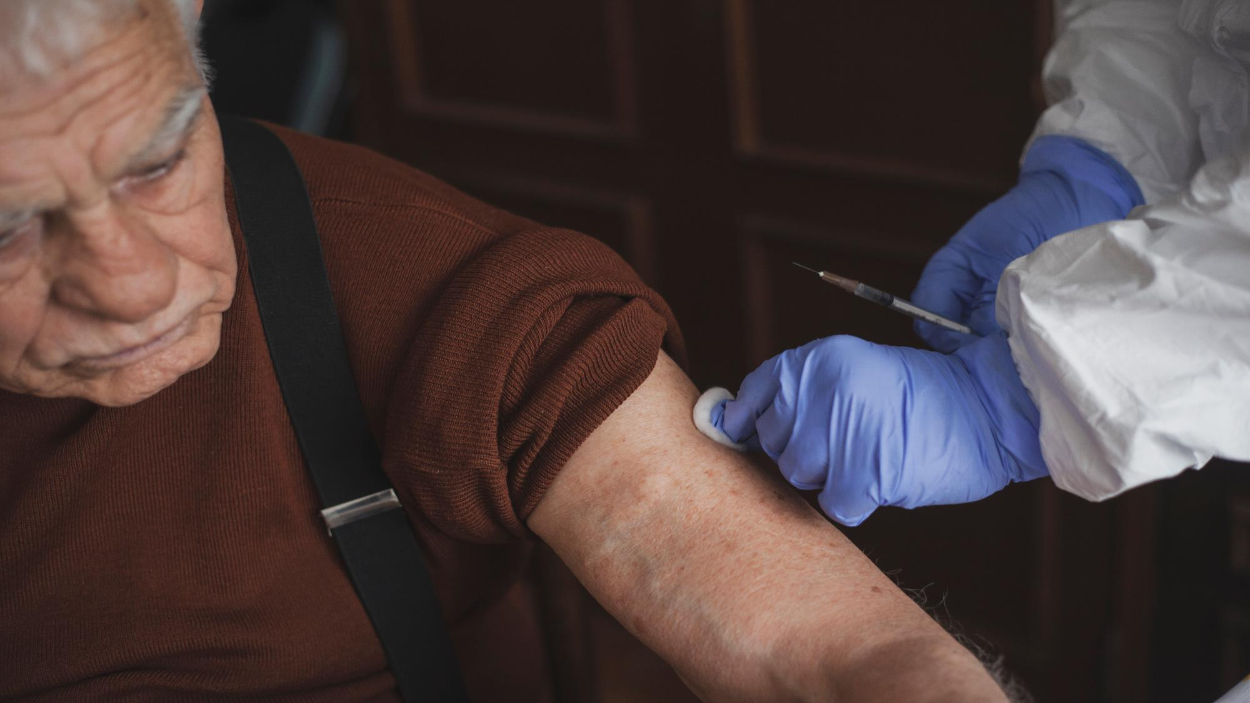
Blood and Urine Tests
Anemia
B12
Cholesterol
Thyroid
Liver
Kidneys
Notes:
This month you will receive a call for medical tests that are necessary to make sure all of your organs are working properly. Some of you have already done so and others will be contacted soon. These tests help us know if you suffer from any deficiency common to diabetics. People with diabetes are at risk of complications such as ANEMIA, low vitamin B12, HIGH CHOLESTEROL, THYROID PROBLEMS, LIVER OR KIDNEY PROBLEMS. If these tests find anything out of the ordinary, your doctor will let you know, and with that information we can help you take steps toward new good habits so your body can function more normally.

Slide 28
Diabetes
Managing diabetes is not easy
Notes:
These tests are necessary because, as we have already explained, controlling diabetes is not easy. It is NOT controlled overnight, it is achieved little by little, making small changes…. but permanently. Whenever we talk about changes, we need to understand that it is not enough for our goal to be something general like: “eat better”. Why do you think this goal is not very good? Because even though it is a phrase that sums up what we want to do, we must understand that most of us do not have a correct idea of ​​what eating better is. In our Society and in the countries where we come from, we were not taught how we should eat to be healthy. In fact, we grew up with very bad habits such as "finishing everything on our plate", or with the idea that eating well means eating a lot. But these are ideas that lead us to overweight or unbalanced eating. Eating with the right attitude and healthy ideas can change your life. Setting concrete and specific goals is what helps us move in the direction toward better habits.

Slide 29
WHAT IS THE GOAL?
UNDER 65 YEARS OLD
7.0
65 YEARS OLD OR OVER
7.5
Notes:
Remember that:
If you are overweight, or have an a1c above 5.7, you are at risk of developing diabetes. If you have ever had an a1c of 6.5 or higher in your life – you have already been diagnosed with diabetes
A diabetic person with an a1c below 7.0 (or below 7.5 if older than 65) is considered controlled diabetic. But if you have your a1c over 7.0 (or over 7.5 if you're over 65), you have uncontrolled diabetes. How can we know if we are getting better or worse? Doing glucose tests at home frequently. These numbers give you and your doctor a very good idea of ​​whether you are getting better or worse BEFORE you go back for an A1C test (which is regularly every 3 months).

Slide 30
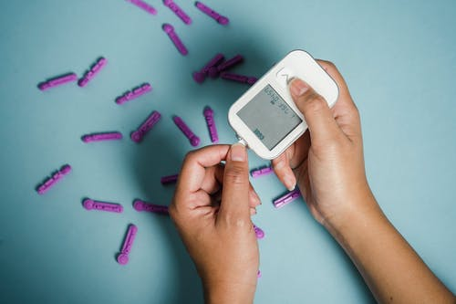
FASTING:
80-100
AFTERNOON OR EVENING BEFORE EATING:
80-150
TWO HOURS AFTER EATING:
80-200
Notes:
Also remember that there are 3 ideal times to check your glucose and that all 3 times are necessary to determine if your diabetes is being adequately controlled. 1) The first is on an empty stomach (this is the one most commonly thought of when we are told about checking our blood glucose at home). These numbers are normal if they are between 80-100. Above 100 is high. 2) The second is in the afternoon or evening before lunch or dinner. If these numbers are between 80 and 150, they are normal. If they go over 150, they're high. 3) The third is two hours after any meal (breakfast, lunch or dinner). If these numbers are between 80 and 200, they are normal. If they go over 200, they're high. Remember to do these tests at different times – not always fasting, not always before meals, and not always 2 hours after eating. Having this varied data will help your doctor detect medication needs only in the morning or only at night, or what is best suited to your body and needs. Not all of our bodies react in the same way.

Slide 31
LET'S TAKE CARE OF WHAT WE EAT!
IT IS IMPORTANT!
Notes:
It is VERY important to start being mindful of eating things that don't harm us. Some ways we can do this is by switching to nutritious food choices and eating things with LESS sugar, LESS grease, LESS processed, and cleaner foods. But above all, it is important to eat LESS overall. We need to learn how much we should eat. We will be sharing more information on that topic next month, but meanwhile let's start eating more vegetables, and less of everything that is unhealthy. This will lead to easier weight control.

Slide 32
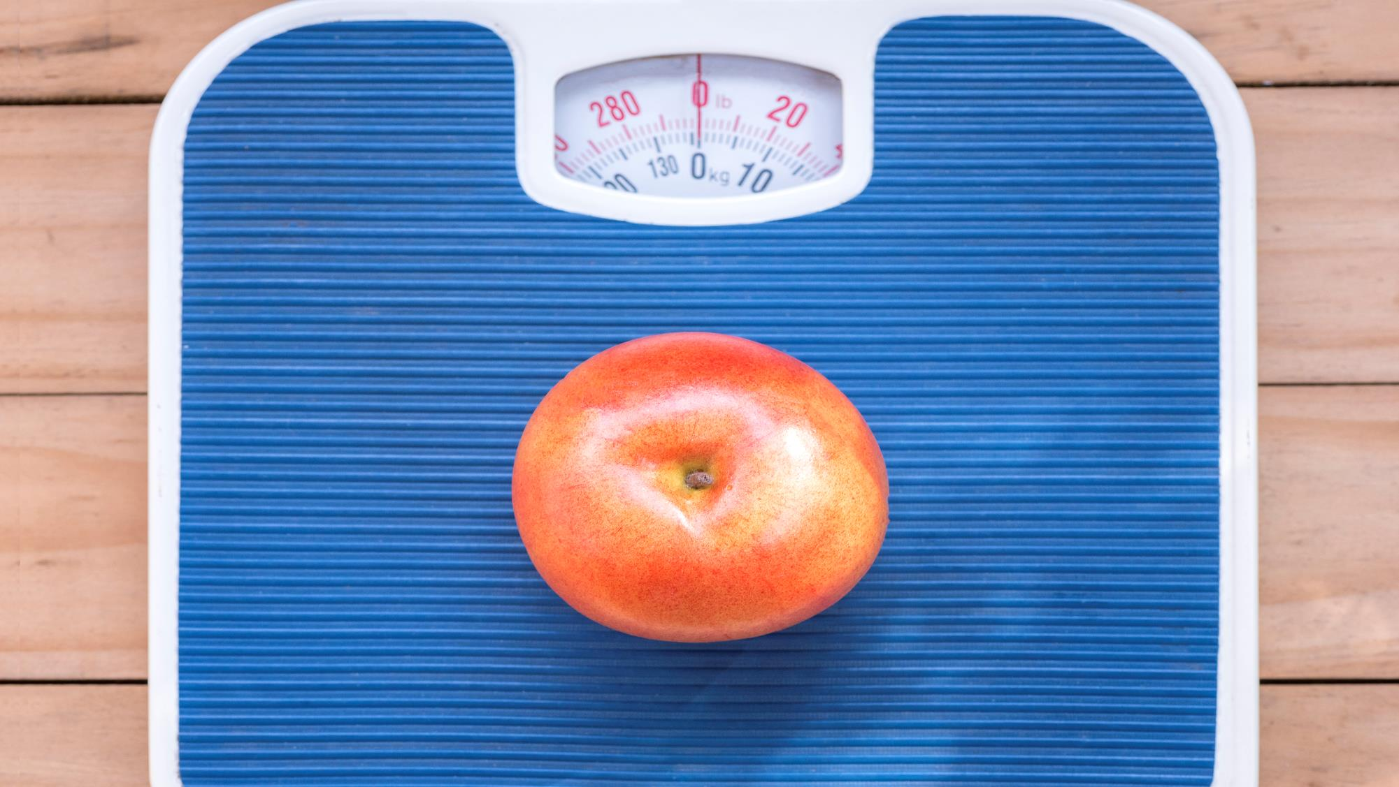
Managing your weight
is important
Notes:
The goal for most of us is to lose weight – because this loss of body fat is what helps insulin do its job of opening up the cell so that sugar can get in. This prevents sugar from staying in the blood. If you don't understand this concept, feel free to go back to the PowerPoint/video from the first month – it's always good to go over this so that we can understand it better with repetition.
So controlling and losing weight is the first step. This helps in the prevention of developing diabetes if you are at risk. If you have already developed diabetes – it helps you to gradually become less dependent on medication and to improve your body’s organ functions. Sometimes we say: “but I can't lose weight – it's too hard for me”… the worst thing we can do is give up – we have to make the effort. Weight loss is affected by many things, including how long you've had diabetes, what weight you are at, your age, and even whether you're a man or a woman. Cheer up! Learn to eat healthy, you will see that new habits do not have to be drastic, but they must be permanent.

Slide 33
Taking your medicine is important
Notes:
Taking your medications is important. Whether those medications are for diabetes or cholesterol or high blood pressure or any other condition, those medications have been prescribed by your doctor after performing important medical blood tests and after evaluating how best to protect your body. Your doctor has carefully studied these medical conditions and has experience that it works for a person suffering from these conditions and many others. You've taken the time to talk with your doctor and explain all of your health concerns, and by reviewing all of this information, your doctor has come up with a plan to help your body function at its best. However, sometimes we come home confused because we don't understand everything our doctor recommended. Being with the doctor and saying that if we understood everything, he told us is very common and many of us do, and then we don't know who to ask. That's what your Community Health Workers are for. We are not doctors or medical experts, but we do have training to help you understand what your medications are for and to answer all those questions you don't think about until your home. We have to understand that each body reacts differently to medications, so it is necessary to evaluate how each medication affects us and share that information with your doctor. If you have questions, never hesitate to write them down and bring that list to your next appointment or call your Community Health Worker and ask for more information about your medications. In this video we will focus on diabetes medications, but much of the information will apply to ANY medication you have been prescribed. So, with this we are going to learn about 5 reasons why we do not take medications:

Slide 34
But I feel good!
Notes:
Reason #1: I don't feel bad! Even if I don't take the medicine, I feel very good!!

Slide 35
THE SAD STORY OF A FROG!
Notes:
But don't forget the little frog that felt great until it slowly cooked because she never felt the danger. The damage is gradual and we don't feel it until it's too late.

Slide 36
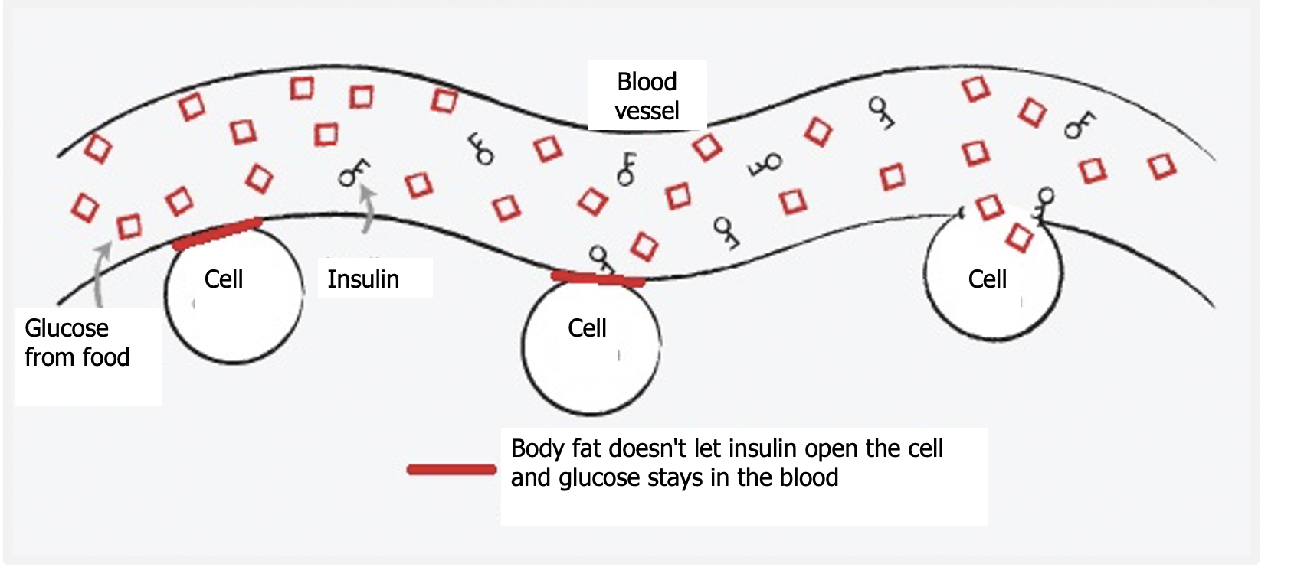
Notes:
Remember that each time your sugar gets too high, it damages your arteries, and the higher and longer that sugar is elevated, the more severe the damage. That extra sugar has nowhere to go and stays in your blood. That damages your vital organs. So even if you don't make a perfect change, slowly starting to make permanent changes will help with your blood sugar levels. Let's take action to prevent that damage!

Slide 37
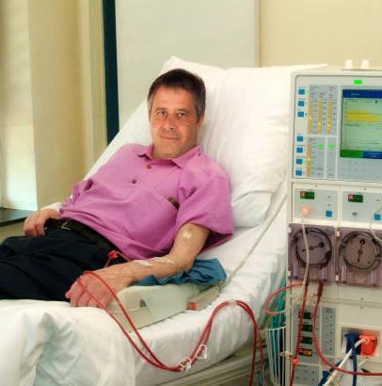
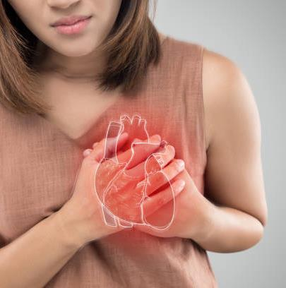
AND WHAT HAPPENS IF YOU DON'T TAKE CARE OF YOURSELF...
DIALYSIS
HEART ATTACK
LOSS OF SIGHT
Notes:
Remember that these damages are often irreversible, and the consequences come when we least expect it….Don't wait until you reach this point. Preventing and controlling diabetes is something we must take seriously.

Slide 38
Notes:
Our goal is to have a longer life, but with good quality. We can't go back and change our past, but WE CAN make our future something healthier so we can enjoy and care for our families.

Slide 39
BUT THE SIDE EFFECTS?
Notes:
Reason #2….Taking medication scares me! Side effects scare me! It is important to know about the side effects of each of your medications, ignoring them can cause serious problems! The side effects of each drug are real, but we must understand that these side effects can be controlled and in some cases eliminated with adjustments. When your doctor prescribed these medications, he performed medical tests that helped determine that you NEED these medications – the risk of these side effects is not very common……and if you compare them with the risks of continuing to live with uncontrolled diseases, the risk of damage to your vital organs is minor.

Slide 40
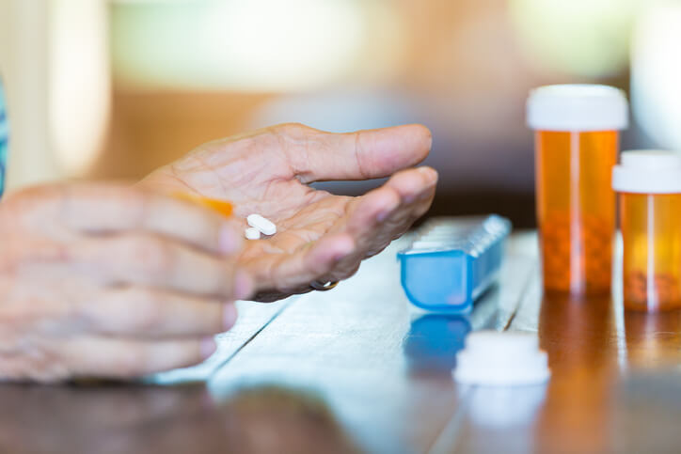
Metformin
“G’s”
Glyburide, Glimipiride
Insulin
Notes:
Know your medications – know the side effects, tell your doctor right away if you experience anything unusual, and take control of your health. The three most common medications are Metformin; the medications we will call “G” such as glyburide, glimipiride, glipizice; and insulin. Your doctor knows about the side effects of these medications and your Community Health Worker has been informed of them in order to help you determine ways to avoid these side effects, but also to inform the doctor in case any of these effects require an adjustment of medicine. Call us, we are ready to help you.

Slide 41
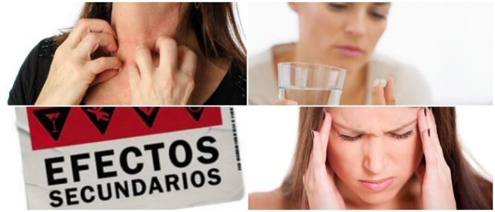
Balance
Notes:
As for the side effects… two things have to be balanced: my health or my fears. Sometimes we risk our health by not taking medication, because of the possibility of an effect that may not even happen. However, knowing the side effect of your medications helps us to detect this effect and inform the doctor, so that he can change your medication. The chance of these effects is 2 to 3 people out of 100 – but the benefits that these medications will provide are of MUCH value to your quality of life.

Slide 42
I forget!
Notes:
Reason #3: I forget to take them!! We all find it difficult to start a new habit. And getting used to taking your medications is a habit that requires planning and discipline. If we forget to take our medications, let's change where we put them – think of things you do every day without fail – wash your face, brush your teeth, pack your breakfast, charge your cell phone! Maybe it's good to move the drugs to these areas where we do something every day. Try different ways – until you find what works best for you. Put alarms on your cell phone, put a note on the mirror or refrigerator, until it becomes a habit to take your medications.

Slide 43
Social / Practical Help
Notes:
If you need more ideas or have specific situations, talk to your Community Health Worker. Together we can find the solution to your situation. Community Health Worker are here to help you break down those barriers that do not allow you to control your health.

Slide 44
I feel worse!
Notes:
Reason #4: When I take the medicine I feel worse! Have you ever carried such weights \that are tied to the feet? You walk around with that weight for a long time and then you take that weight off…..remember what happens when you take that weight off? It feels weird walking!! You will feel that each step is lighter, but it still feels very strange. Sometimes the same thing happens to us with our health. We are SO used to having certain discomforts in our body, that they have already become normal to us and when we feel a change – or an improvement – ​​we may feel that something is strange. Give your body time to get used to the changes. When your body has always had sugar in the 200s, it will feel "weird" to be normal. But trust us, your body and vital organs will thank you.

Slide 45
Tell us!
Notes:
However, tell your doctor about these changes you are experiencing. Your doctor will never know what you are feeling unless you tell them. With your help, your doctor will be able to determine if changes need to be made. And if you experience any change or don't feel good. Call your Community Health Worker and we will let you know from your doctor.

Slide 46
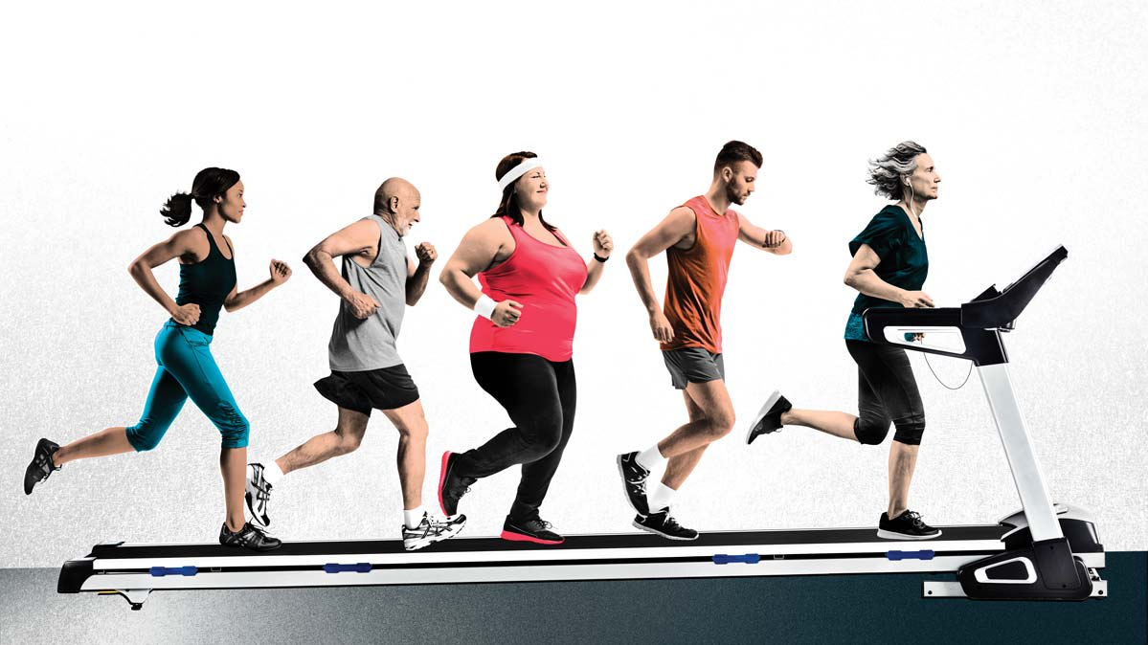
I don’t need the medicine anymore!
Notes:
Reason #5: I'm exercising and eating better and I don't need the medicine anymore! Many times we want to make changes and start to lose weight and decide that the medication is no longer needed. But be very careful! Stopping medications without consulting your doctor can worsen your health.

Slide 47
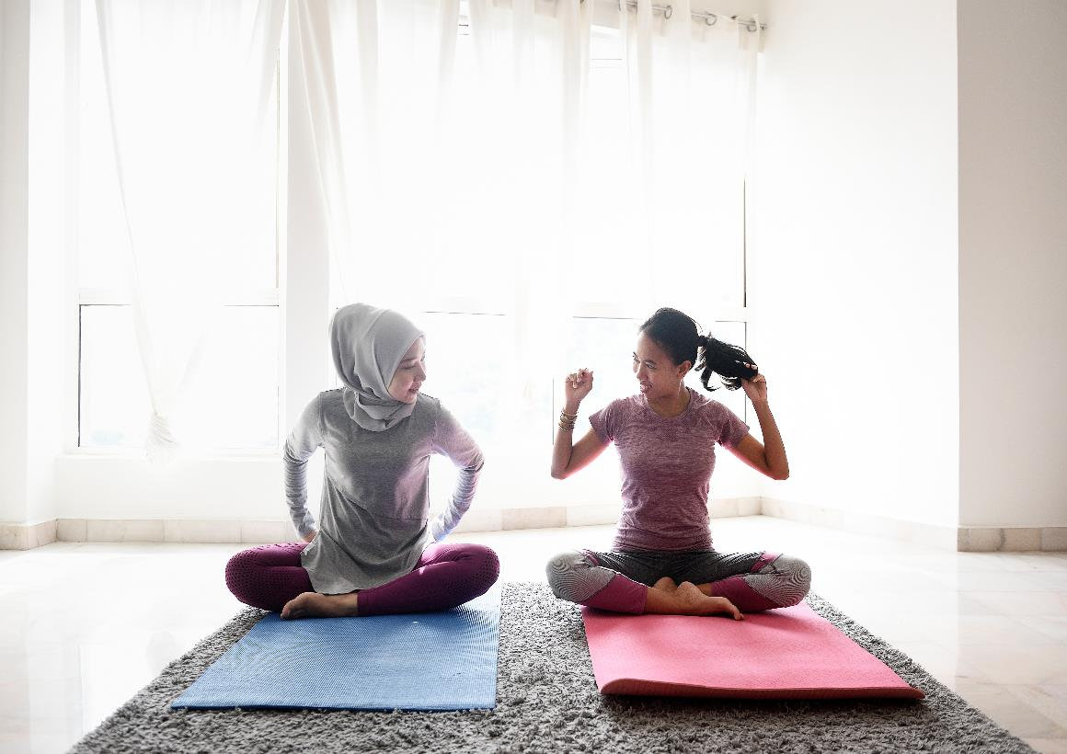
CONGRATULATIONS!……BUT…
Notes:
We encourage you to exercise, lose weight, and eat better – but remember that it's those changes AND the medicine together that are helping you feel better. If you make enough changes, your doctor will start to adjust your medication, but that's an assessment for your doctor alone. Don't interrupt your improvement: keep taking your medication – and if you see your blood sugar getting too low, talk to your Community Health Worker. We will report it to your doctor and the necessary changes will be made in the correct way.

Slide 48
So….let’s take action
Don’t let
your body
Deteriorate
further!
Notes:
So – take action – take your medications even if: 1) You feel you don't need them because you feel good 2) Balance the benefits and side effects 3) Develop a routine so you don't forget your medications 4) And if you feel bad, tell us to talk to your doctor 5) And keep making changes and reporting your glucose numbers so your doctor will determine when you can reduce your medications.

Slide 49
Ask if you have any doubts!
Notes:
If you are unsure which medications to take and if your doses are correct, please notify your Community Health Worker or call your doctor. To request that your medication be refilled, call your pharmacy. If you are no longer able to get the medication, leave a message with your doctor with the name of the medication you need. If you do not receive a call within 2 days, notify your Community Health Worker to assist you. It is very important that you take your medications and have a clear idea of how to take them.

Slide 50
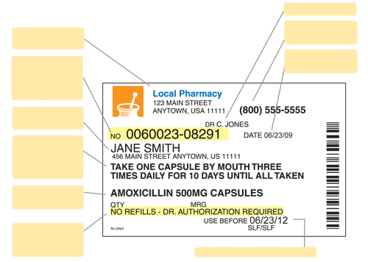
Name of Doctor
Nombre de Doctor
Pharmacy phone
Address of your pharmacy
Teléfono de la farmacia
Dirección de su farmacia
Day I filled the medicine
Prescription-pharmacy number uses this number to identify your medication
Dia que surtió el medicamento
Numero de receta – farmacia usa este numero para identificar su medicamento
Owner of this medicine
Dueño de este medicamento
Instructions on how much medication and how many times a day to take it
Instrucciones de cuanto medicamento y cuantas veces al día tomarlo
Name and strength of the drug
Nombre y potencia del medicamento
Number of times you can refill this medicine
Numero de veces que puede volver a surtir este medicamento
Fecha de caducidad del medicamento
Expiry date of the medicinal product
Notes:
This is a drug label with all the facts explained. Learn what each piece of data means. On your label you will see: Your doctor's name, The address of your pharmacy, The phone number of your pharmacy, The prescription number – with which you can refill your medication, The date you filled your medicine, Your name so you can identify your medication from others in your household, Instructions on how much medicine and how many times a day to take this medicine, The strength of your medication, The number of times you have left to refill this medicine, And the expiration date of this medicine. A couple of things worth mentioning: #1 Always keep an eye out for your medication running out – call for refills ahead of time – that way, if there are problems, they can be fixed before the one you have at home runs out. #2 Make sure you understand how much medicine and how often to take it – if you have any questions, call your Community Health Worker.

Slide 51
Pills: $4 per month or $10 per 3 months
Walmart
CVS
Kroger
GOODRX.com
Notes:
If you have trouble paying for your medicine, we remind you that most of the diabetes medicines that are prescribed, fall within the $4-per-month plans at these pharmacies. For those other drugs that don't fall into these financial plans, use GoodRX – if you don't know about this drug coupon program – tell us so we can help you
Some of you also get high-cost drugs for free through drug assistance programs. Be on the lookout to renew these programs on time so you don't run out of your medication. Talk to your doctor ahead of time about refills – as it sometimes takes a few weeks to refill these medications.

Slide 52
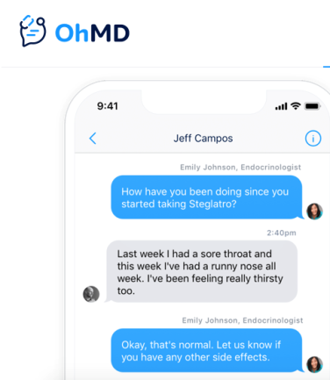
We are here to help you
Notes:
And as always – remember that we are YOUR health team...... You have our direct phone numbers and we want to help you

Slide 53
Thank You!
Don’t miss the next class!
Notes:
Thank you for your participation in this diabetes prevention and control program. Next month we will be talking about nutrition. We look forward to counting on you.

Slide 54
References
- Banday, M. Z., Sameer, A. S., & Nissar, S. (2020). Pathophysiology of diabetes: An overview. Avicenna journal of medicine, 10(4), 174–188.
- Medication & treatments | ADA. (n.d.). American Diabetes Association | Research, Education, Advocacy. Last accessed September 15, 2022. https://diabetes.org/healthy-living/medication-treatments
- Marín-Peñalver, J. J., Martín-Timón, I., Sevillano-Collantes, C., & Del Cañizo-Gómez, F. J. (2016). Update on the treatment of type 2 diabetes mellitus. World journal of diabetes, 7(17), 354–395.
- American Diabetes Association (2014). Diagnosis and classification of diabetes mellitus. Diabetes care, 37 Suppl 1, S81–S90.
- Type 2 diabetes. (2022, March 2). Centers for Disease Control and Prevention. Last accessed
September 15, 2022. https://www.cdc.gov/diabetes/basics/type2.html

Slide 55
WELCOME! NUTRITION CLASS
Month 3
Notes:
Welcome! We are very happy that you are with us again in this third month of education in your Preventing and Controlling Diabetes program! If you haven't seen the first two videos yet, we invite you to let your Community Health Worker know so they can send you the links to those videos. If you've already seen them, we hope you've been able to start making changes to prevent or control diabetes. In this third month, we will be sharing with you some of the very extensive information on nutrition. Your Community Health Worker will be available to answer questions specific to your nutrition and although we are not experts, we are surrounded by information that is very relevant and can help you.

Slide 56
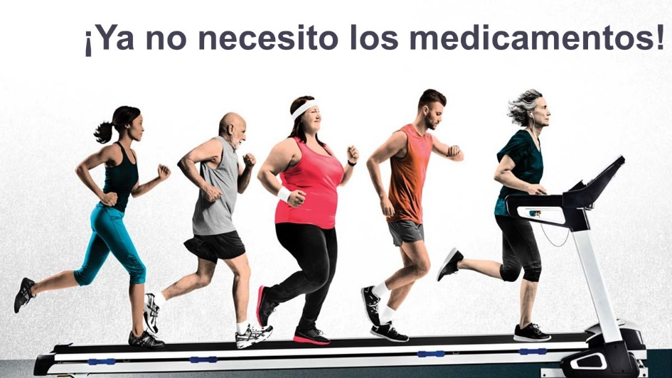
Review……
Notes:
To start off, let's quickly review some of the things we've learned in the last two months…..such as the importance of taking your medications – ones that you take to prevent or control your diabetes, as well as others that help you prevent and control other medical conditions. ALL your medications are important in your health!! Remember what we learned last month…there are 5 common reasons why we don't take our medications. The first is because we think that feeling good is a strong enough reason not to take them – when we do this, we do not recognize that there are symptoms that we cannot feel and that although for some time we “feel good”, our body and vital organs deteriorate with time. The second is that we fear side effects – remember… the best way to combat this obstacle is to inform us! The risk of a side effect is much smaller than the benefits that the medicine will give us! Remember, the key is to learn about side effects and how to prevent them! Talk to your promoter if you are experiencing any unusual effects and your promoter will help you. The third reason we don't take our medications is because we forget! - remember that in these times of smartphones, you can set alarms and reminders to help you. Talk to your Community Health Worker about the reasons why you forget to take your medications! Through our training and experience we have learned how to help you remember. The fourth reason is that when you take your medications you feel worse! When we are used to a way of feeling, we think that feeling different is worse. Remember, your body is used to a level of stress created by your medical and physical conditions. The change is going to feel different because we are not used to what we should feel under normal conditions! However, if you actually feel WORSE, talk to your Community Health Worker, and we'll let your doctor know if changes need to be made. The fifth reason for not taking your medications is that you feel like you don't need them anymore! If you make changes and your condition begins to improve to the point where you no longer need medication, medical tests will reflect the need to reduce medication, and then your doctor will make changes. DO NOT make these changes yourself without your doctor's recommendation! Stopping your medications can seriously make your situation worse.

Slide 57
Notes:
Remember, you have direct access to your Community Health Worker and we are here to help you have a better relationship and communication with your doctor. Doubts should always be clarified and we are available with a call or text message. We want to help you understand how to take better care of yourself. Our purpose will never be to scold you…..we are always a phone call away to answer your questions to prevent or manage your diabetes.

Slide 58
Notes:
So…..Have you been making changes? What has been improved? What is it that you are still struggling to change? Remember the importance of setting goals that you can measure. It is much more likely that by making goals you can achieve them. If we set ourselves the goal of exercising, it is something that is difficult to measure. But if we set a goal to go out three times this week to walk briskly for 15 minutes, we can clearly measure whether we are achieving this goal or not. Make a note of your goal and ask your advocate to help you make it measurable and achievable so that we can stay focused, but also so that we can start making changes and encourage ourselves to make these changes your new lifestyle.

Slide 59
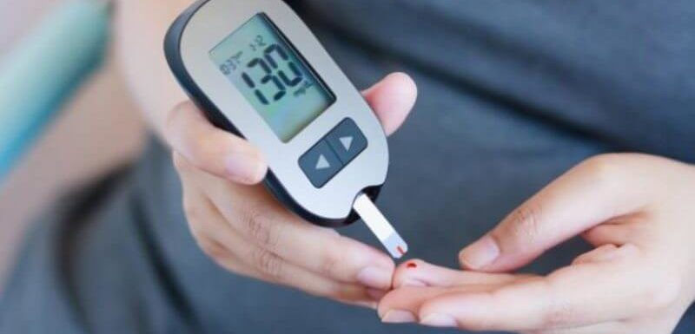
FASTING:
80-100
AFTERNOON OR EVENING BEFORE EATING:
80-150
TWO HOURS AFTER EATING:
80-200
Notes:
If you have already developed diabetes, remember that it is important to have these goals at hand. Write them down in a visible place so you can memorize them – so when you do your home glucose test, you'll know if your level is correct. Remember that fasting – must be between a minimum of 80 and a maximum of 100 before eating in the afternoon or evening – it should be at a minimum of 80 and a maximum of 150. And two hours after eating – the minimum is 80 and the maximum is 200. Learn to know your body! If your glucose is too low, you're going to feel weird - but it will also feel weird if your glucose is too high. If your blood glucose is less than 70 at any time of the day – you have low blood sugar – the recommendation in these cases is to drink a quarter cup of orange juice (no soft drinks, no sweets, no bread!). After 15 minutes you should check your glucose again and if it's still low, go back to another quarter cup of orange juice. Don't over do it! Just a quarter cup of orange juice can regulate your sugar in a healthy and safe way. If you experience low blood sugar a lot, talk to your Community Health Worker so they can alert your doctor. If your glucose is high on a daily basis, you really need to make changes. Do not have dinner so late at night, do not eat fatty or fried things, eat vegetables with your meals. If you do this, you may start to notice your glucose numbers go down.

Slide 60
WHAT IS THE GOAL?
UNDER 65 YEARS OLD
7.0
65 YEARS OLD OR OVER
7.5
Notes:
Remember that in the long term the goal is to control – not to make changes for a few weeks and return to bad habits. Our goal is that if you are under 65, you can get your a1c down to a normal level. A person has diabetes when their a1c has been 6.5 or higher at some point in their life. From then on, the goal should be to stay in control. However, going down to a normal level of less than 5.7 is IDEAL. The American Diabetes Association recommends an a1c of less than 5.7. After exceeding 5.7, a person is considered at risk of diabetes. After exceeding 6.5, a person is considered diabetic. When your a1c is above 7.0 or 7.5 (if you are over 65) it is considered uncontrolled diabetes and it affects your body and vital organs in many ways that we have reviewed in other months – this causes many problems that you could prevent if you make the decision to do PERMANENT changes! Don't wait to get diabetes or consider yourself uncontrolled diabetic – take CONTROL today! Remember that if you don't control your diabetes, your diabetes will eventually control you.

Slide 61
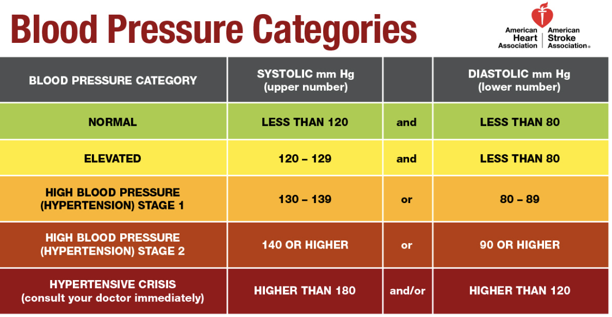
Notes:
We have also talked about blood pressure! These are the ideal levels recommended by the American Heart Association. Normal blood pressure is less than 120 over less than 80. Elevated blood pressure is between 120 to 129 over less than 80. Once it goes above 129 over 80, it is considered high blood pressure and is divided into three levels of hypertension. In this diabetes prevention and control program, our goal is for you to keep your blood pressure below 140 over 90. Achieving this goal would prevent health complications and lead a healthier life. What's important to understand is that by better managing your eating and exercise decisions, you'll be able to help lower your glucose level, and at the same time, these same changes will help control your blood pressure.

Slide 62
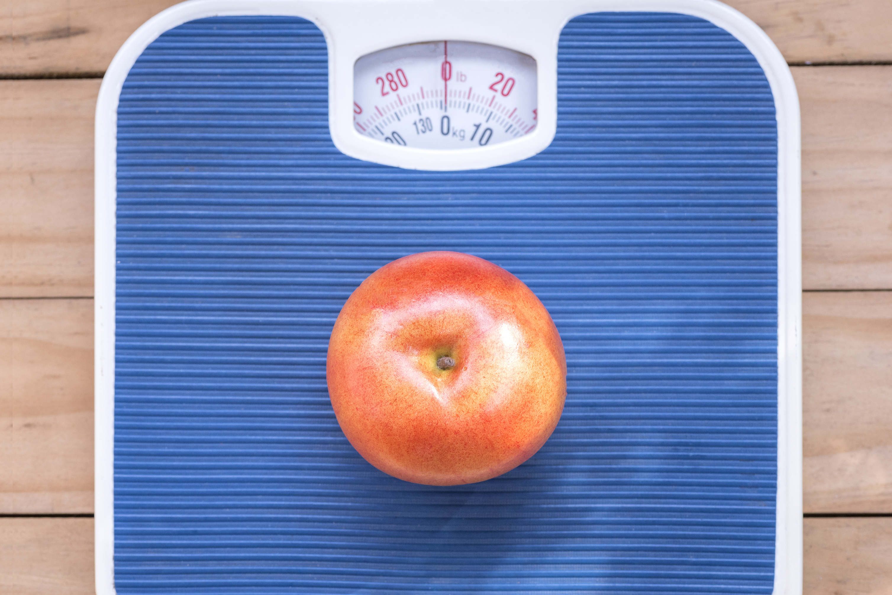
Managing your weight is important
Notes:
Controlling your weight is important! As we have talked in recent months, weight control is essential to your well-being! Our health depends on many factors, but being overweight is something that puts a lot of stress on your vital organs. This overwork by your vital organs contributes to wear and tear that leads to health complications. By reducing your weight (no matter how small) you can help your organs work more effectively and without much wear and tear.

Slide 63
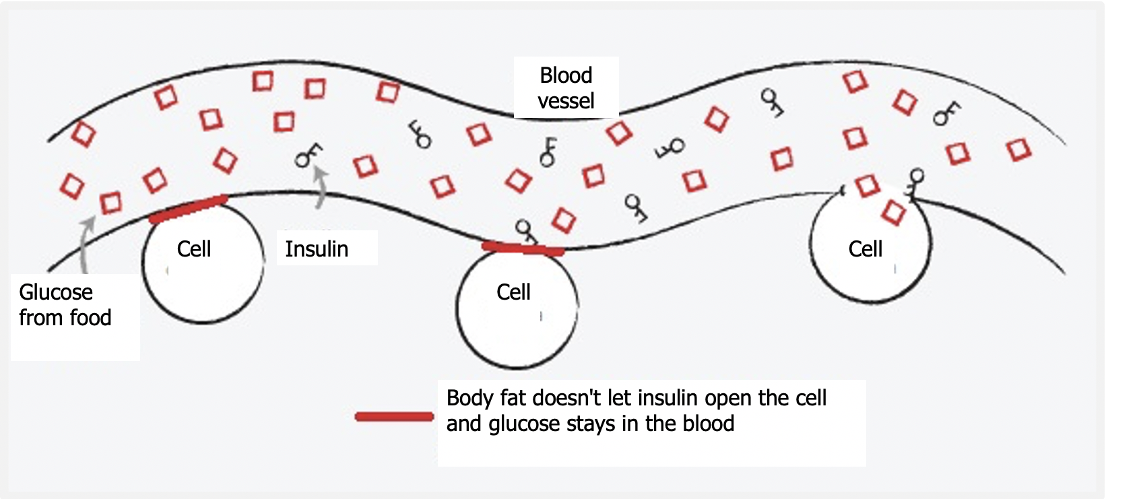
Notes:
Remember! Everything you eat turns into sugar…..EVERYTHING! That sugar is necessary for the body to produce energy. If the body can't use it - then that sugar stays in the blood. Being overweight or excess body fat is what prevents your cells from using that sugar to convert it into energy! The insulin is trying to get that sugar into your cells, but if it stays in your blood, it damages your arteries, and the bad arteries end up damaging your eyes, heart, etc. So the key to controlling your blood sugar: eat less food so your body can get rid of that fat and turn your sugar into energy – that way that sugar no longer has to stay in your blood.

Slide 64
Notes:
That body fat is not going to allow us to improve our health no matter how hard we try unless we get rid of it. Even 5 to 10 pounds less will make a difference. The goal is to improve little by little – but never return to any bad habit that we have managed to overcome. So….it is important that we set goals. As we said last month…not just the goal of eating healthy…but specifically WHAT to stop eating and for how long. Remember, the goal must be measurable and achievable.

Slide 65
Formula
Body mass index
FORMULA
WEIGHT (pounds) X 703
[HEIGHT (inches)]²
BMI BMI BMI BMI BMI BMI BMI
Notes:
Those goals like the ones we made for food, now we can do them with weight as well. But in order to make a goal about our weight, it is important to know what the ideal weight for our health is. Remember, this program is trying to help you improve your health…our weight is a big part of our health and quality of life. Our intention is not to scold you, but to help you achieve healthy goals. So, let's see the formula to know our BMI or Body Mass Index. This formula means that you are going to calculate your weight in kilos and write it down on a piece of paper. Then multiply your height by your height in meters. It sounds complicated, but here is the explanation: A person weighs 80 kilos and measures 1.50 meters. So we start by multiplying the height first: 1.50 X 1.50. That gives us 2.25. Now we know that we must divide 80 (that is, the weight) by that number that gave us the multiplication of the height, that is, 2.25. That gives us 35.6. That is the BMI of this person of 80 kilos and 1.50 meters tall….35.6. If we look at the graph, we can see that a BMI of 35 to 39.9 is classified as obesity level 2. Can you identify what the goal is? The goal is to reach a BMI between 18.5 to 24.9 Of course it is VERY difficult to reach that goal in a few months!!! But remember what we said about goals? They must be measurable and ACHIEVABLE. Perhaps our long-term goal can be to be at the normal level. But for this program, our goal is to lower your BMI. You can decide how many points to drop, but decide what your goal weight is…..5 pounds can be a starting goal (think about how long you need to achieve this goal). Write down your goal and do your best to make changes that will help you reach this goal. When you meet it… set another goal, write it down and define how long you need to achieve it. Make more changes….this is the key.

Slide 66
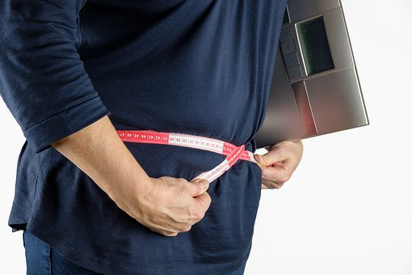
We know it’s frustrating!
(but don’t get discouraged)
Notes:
It is very important that you do not get discouraged! Your BMI changes according to your habits. So – to change your habits……Get a couple of people around you who are positive people who encourage and support you. Share your goals with those people and ask them to help you stick with your changes. Report your achievements AND your FAILURES to your Community Health Worker! Why do we report this? Because your Community Health Worker can encourage you, but they can also give you advice on how not to repeat mistakes! As we have repeated several times…..we are here to help you. That's why we call and text and ask you questions all the time…because we can get to know you and from those conversations we can come up with ideas that can help you. We are a team with you…we are on your side.

Slide 67
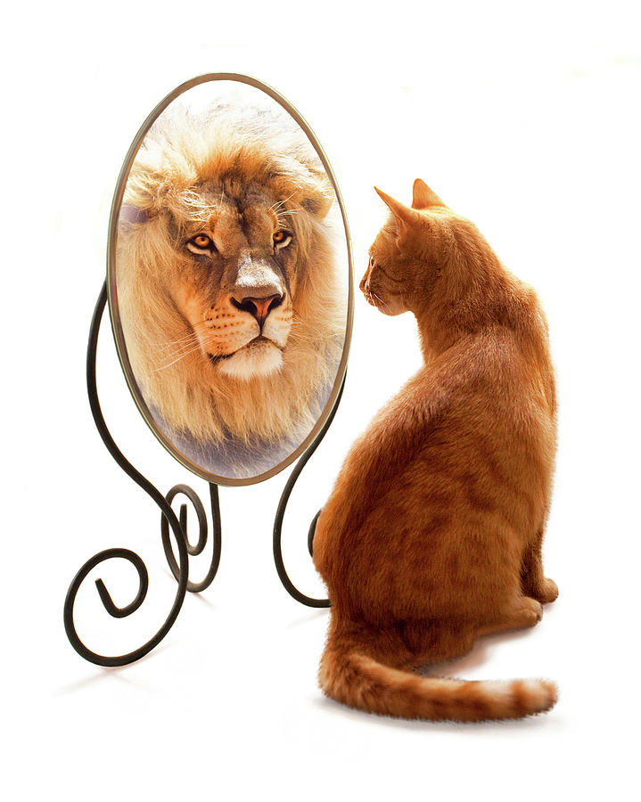
We must be realistic when
evaluating what we eat
Notes:
Why do you think it is so difficult to lose weight? Sometimes we do not evaluate what we eat in a correct way. We believe that we eat well and that despite eating well we CANNOT lose weight. But the truth is that what we think is not necessarily what reality is. What can we do to fix this incorrect perception of our habits? Learn to feed ourselves. Accept that what we are doing so far has not worked and that we need help. Being honest with ourselves about what our weaknesses are and recognizing: what we have been eating and in what quantities, what we have been eating outside of meal times, the snacks that we have been making part of our diet, and even the drinks we drink – because many times we do not know that these can also harm us. We also have to evaluate other habits, such as our sleeping habits, exercise habits, etc. To assess this correctly and find our weak points we will need help. Talk to your Community Health Worker. We can help you with that too.

Slide 68
Healthy
PLATE
Notes:
Many patients ask us for a "diet" to follow, but: remember that we want to change your lifestyle permanently, not do a "diet".

Slide 69
LET’S START WITH....
VITAMINS!
Notes:
One of the most common questions we get is about vitamins AND supplements. It is important to understand that unless your doctor has given you other instructions, the only thing necessary to supplement your diet is a multivitamin. These are sold in an option for women or men. REMEMBER….That is all that is needed UNLESS your doctor makes other recommendations. For example, there are some of you to whom your doctor will give you instructions to consume vitamins such as B12. This is because people with diabetes often tend to have a B12 deficiency. But, this is not necessary unless your doctor tells you to and this decision is made after doing blood tests that show that deficiency. Why do we emphasize this point? Because many times we think that vitamins are harmless because we think they are natural….. BUT in high doses or in the WRONG dose they can be very harmful. If you are taking vitamins other than a multivitamin, bring them to your next appointment so your doctor can take note of what you are taking. Also inform him about teas, and liquefied or liquid supplements. Not because it is "natural", it is healthy, and not because it is qualified as healthy, it is necessary in high quantities.

Slide 70
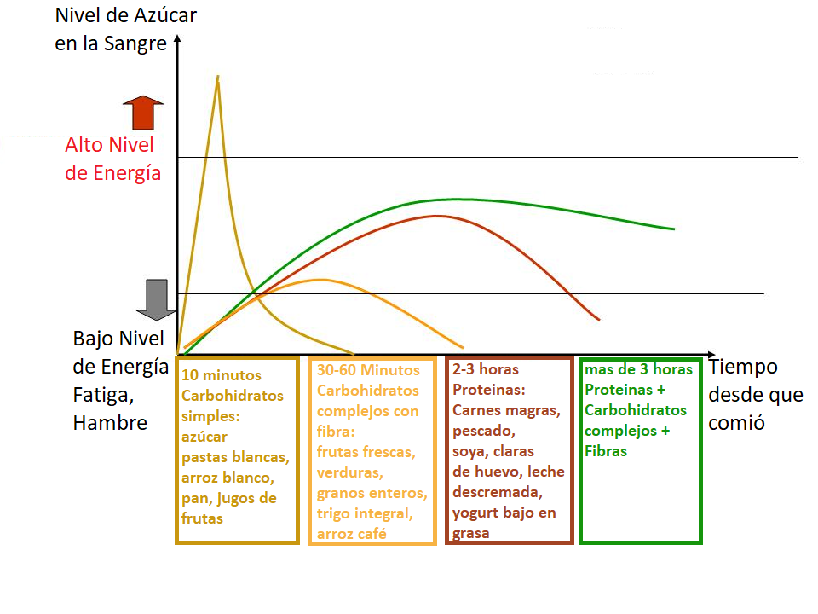
Blood sugar level
High level of energy
Low Energy Level Fatigue, Hunger
10 minutes Simple carbohydrates: sugar white pasta, white rice, bread, fruit juices
30-60 Minutes Complex carbohydrates with fiber: fresh fruits, vegetables, whole grains, whole wheat, coffee rice
2-3 hours Protein: Lean meats, fish, soy, egg whites, skim milk, low-fat yogurt
More than 3 hours Proteins Complex carbohydrates Fibers
Time since I ate
Notes:
Now…let's talk about diet and what these foods do to your body. This graph is one of the most important things we can learn…..why??? Because in this explanation you will be able to understand why when you eat certain things you feel without energy or hungry again even if only a few minutes have passed. To begin with we have to learn that the reason why we are recommended to eat a BALANCED meal is because we need all these nutrients... BUT we need them in each of the meals because each of these foods gives us a different energy level, it starts to work in your body after a certain time and lasts in our body for a certain time. In this graph we can see some lines that go up and down and the definition of each of these lines. For example….the first line that you see go up almost immediately tells us about what simple carbohydrates do in your body. Simple carbohydrates are things like sugar, candy, white pasta, white rice, bread, and fruit juices. These are the foods that should be eaten in VERY small amounts. This is because these foods, once they enter your body, are immediately activated and give energy, but this energy is used up quickly! In just 10 minutes, this energy has been activated and reaches its maximum, but as soon as it is activated, it begins to run out quickly. Do you know what happens when that energy runs out??? Your body asks you for more energy in the form of feeling hungry! So, if I'm hungry in the morning when I get up, and I eat a piece of bread with coffee, do you know how many minutes later I'll be hungry again??? In half an hour! If I eat another simple carbohydrate (for example, some cereals with sugar)….I will feel hungry again in 30 minutes!!! If I keep this up and eat more simple carbs for a snack (like some crackers with juice), I'll feel hungry again in 30 minutes! You know what this will do to weight??? It's going to make it go up... I'm going to be constantly hungry and I'll keep eating all the time without getting enough. My blood sugar level will rise out of control.
This quick spike in energy and sugar from simple carbohydrates is why some patients with low blood sugar are advised to drink ½ cup of orange juice. And it is for this very reason that we ask you to recheck your glucose 15 minutes later. So what can we do? Can you see the second line a little more clearly???? That is the complex carbohydrates. Complex carbohydrates are carbohydrates with fiber such as fresh fruits (especially those in which you eat the skin - not in syrup or processed, also in this category are vegetables, whole grains, whole wheat, brown rice, etc. These carbohydrates complexes start to give you the maximum of your energy in about 30 minutes and last giving energy in your body for about an hour. This is the reason why if you eat a bowl of oatmeal, you will feel fuller for longer – not just for 15 minutes! But let's not stop there! You can see the next line – it's a reddish one….this line shows us how proteins work. Proteins are foods like lean meats, fish, soy, egg whites, skim milk, and low-fat yogurt. Can you see that these protein foods provide you with energy for more hours? Up to 2 and 3 hours! That's why when you eat protein, you don't feel hungry for a longer period of time. Because your body feels energetic and has the ability to function without weakness.
In the last line – a green one, we can see that when you combine protein, plus complex carbohydrates, plus fiber – they combine to make sure your body is running with enough energy for more than 3 hours. That's why EVERY meal needs to be balanced – so that this set of foods can sustain your body and start giving you energy within a few minutes and continue to give you energy for over 3 hours! By making combinations that have a healthy serving of EACH of these food groups, you can begin to master your foods better.

Slide 71
MY HEALTHY PLATE!
Notes:
So let's start by defining your plate. Your plate should be made up of these food groups: protein, grains, fruits, vegetables, and dairy. EVERY GROUP is needed! ALL are beneficial if eaten in the RIGHT PORTIONS! One of the first comments we hear VERY frequently is: but if I'm diabetic I can't eat fruit because it contains A LOT OF SUGAR!! First of all, we NEED to get rid of myths – YES it is true that fruits have more sugar content (fructose) than other foods, BUT…..don't you think that it is better to eat a fruit than a hamburger!?!?!? So please remember that something natural will ALWAYS be better than something processed – plus we are DEFINITELY not talking about drinking orange juice!! Do you know that a cup of orange juice is usually made from about 5 to 6 oranges??? AND SOMETIMES EVEN MORE THAN THAT! In an orange juice you are consuming the sugars of 5 to 6 oranges! Do you think that if you were given 5 to 6 oranges in pieces to eat, you could finish them??? OF COURSE NOT!! None of us would do that! But how is it that if we think that it is bad to eat an orange and not so bad to drink a cup of orange juice! We must understand what we eat.
So, avoid fruits high in sugar, but if you have the choice between an apple and some cookies…..believe me, an apple will be better for your health! Now, if you look at the plate that's on the screen, can you see how much of that plate is made up of protein?? It's just under ¼ of the plate! That is equivalent to the fact that if you put a piece of chicken in the protein area, this piece of chicken would be the size of the palm of your hand! Just the palm of your hand – not your entire hand! That's all the protein you need for your healthy diet. Another thing we would like you to notice is that half of the plate is made up of fruits and vegetables. This area is the most important of your plate. This area is the one that will help you feel full and take advantage of that combination of protein, fiber and complex carbohydrates (like the area on the top right that indicates grains). It is in this area that you can combine your protein with grains. One important note – please remember to drink WATER! It's important and necessary – and it helps to avoid overeating and consuming liquids like smoothies. DON'T DRINK SMOOTHIES – these have the same explanation as juices – I don't think you could stand to eat yogurt, bananas, oranges and apples all at the same time unless you combine them in a smoothie. Smoothies are a tool we use so that people who are underweight can gain weight. Unless your doctor tells you to go on a liquid diet…….EAT (do not drink) your food and drink water. OH!! And before you forget it! DO YOU KNOW WHAT SIZE your plate should be??? 9 inches in diameter - please measure your plate! It is important that we have a good idea of ​​the amounts we are eating. Starting by eating on a medium plate no larger than 9 inches in diameter will help a lot! At myplate.org you can find more information and you can also find tools that help you make more varied combinations in your diet. If you have doubts about which foods are part of each group, talk to your Community Health Worker! Because although it sounds very repetitive… WE ARE HERE TO HELP YOU!

Slide 72
Colors matter a lot!
Notes:
Some extra tips……when you put your food on the plate see if there are colors! Colors are important, as every vegetable or fruit contains different nutrients, and variety is the secret to eating properly and not getting bored with the same dish. So remember, the more color, the more nutritious your meals are.

Slide 73
Avoid temptations!
Notes:
AVOID TEMPTATIONS!! Keep in mind that this smoothie or juice that you drink contains the sugar of 3 apples, or 4 oranges, or a couple of bananas and also milk and yogurt! It is very possible that you could never eat them on their own, but they are easy to blend and consume. They have a huge amount of calories!! Most people who consume these types of shakes gain weight. EAT your food and drink water! Avoid those buffets where you can eat an unlimited amount of food…it's hard to control ourselves in these places of excess food, better to avoid them.

Slide 74
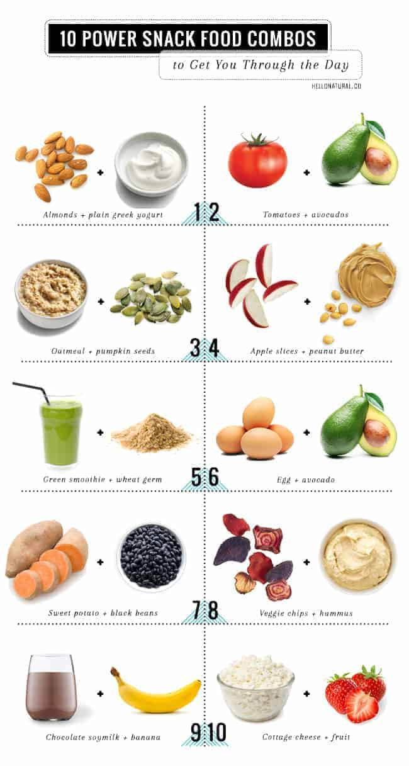
Simplify your snacks
Notes:
Another way to be successful in eating is by simplifying your snacks. These are healthy options to eat between meals in correct portions. If you have doubts about what is a correct portion, let us know, we can give you ideas on how to measure your food. If you're going to eat something light between long periods when you don't eat…make sure it's a fruit, vegetable, or protein. An example would be a small apple with a bit of cheese. Another example would be a few baby carrots with hummus.
Other important data:
Try to always eat at the same times. Don't forget to eat breakfast – it's important to eat a balanced meal at a balanced time. Don't overdo it – if you do, your blood sugar can drop too low and it can be dangerous. In addition, when we overdo it – we tend to overeat at the next meal because we're SO hungry. Eat natural things, not processed things – in the supermarket natural things are going to be found on the perimeter of the store…. These are the areas for vegetables, dairy, meats…and processed foods are going to be on the shelves in the center of the store (such as cookies, pasta, canned goods, boxes and jars). It will ALWAYS be healthier to stay away from the center shelves of a supermarket – limit how much you can eat from those shelves. Try to eat dinner as early as possible and not so heavy. If you have dinner tonight, try to walk after dinner and not lie down for at least a couple of hours.
If you have doubts or questions let us know! If we don't know the answer, we'll help you find it.

Slide 75
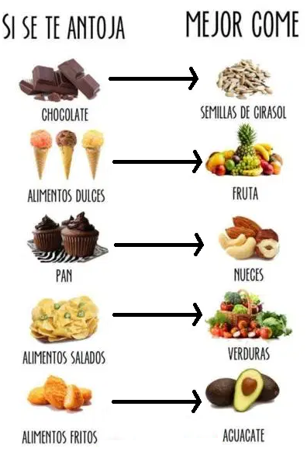
We struggle because we eat the wrong food
Notes:
So what have we learned???? That we struggle, because we eat the WRONG food!!! Note that in none of the food groups do we see:
Fried things or high-fat meals
Cakes or sweets
Sugary drinks such as juices or alcohol
Breads and tortillas
When we consume these types of foods, we are creating an endless cycle of eating, in which we feel BAD – without energy or strength, and in which we continue to consume things that continue to harm us. In this photo you can see some of the healthier alternatives – BUT REMEMBER….the portions you eat are also VERY important. NOT BECAUSE IT'S HEALTHY, I can eat it in large portions. The portions are VERY IMPORTANT!!! Talk to your Community Health Worker for alternatives to unhealthy foods. AND LET'S START to not only vary our meals, but to measure the portions.

Slide 76
Beware of emotional weight
Notes:
Since we share with you all this talk about food and weight, we want to ask you …… not to neglect your Spirit!! We are beings composed of spirit, soul and body! This is how God created us! But many times we focus on the physical weight and neglect the emotional weight. This is VERY important too! This carelessness can even make us physically sick! There are many things that affect this emotional weight – not forgiving…..living with hate….holding grudges. These consume the soul and mind and make us sick. Even this type of weight can cause lack of sleep, poor diet, lack of desire to TAKE CARE of our health. Physical weight is MANY times VERY related to emotional weight. If you are suffering from your emotional weight, we invite you to share your frustrations with us, we would love to pray with you…carrying this burden with someone else is much less burdensome. We are praying for you, for your physical health but emotional health as well. Sharing this weight with us is confidential and could help you take the first step of losing this weight too. We will be talking more about this in the coming months, but if you are going through a confusing or difficult situation – we want to pray for you and with you.

Slide 77
Thank you for being with us!
Notes:
Thank you for continuing to participate with us in this diabetes prevention and control program. We are very happy to have 3 months of classes with you and invite you to continue watching our videos, answering our calls, and allowing us to help you. God bless you and see you next month! Thank you!

Slide 78
References
- Banday, M. Z., Sameer, A. S., & Nissar, S. (2020). Pathophysiology of diabetes: An overview. Avicenna journal of medicine, 10(4), 174–188.
- Ley, S. H., Hamdy, O., Mohan, V., & Hu, F. B. (2014). Prevention and management of type 2 diabetes: dietary components and nutritional strategies. Lancet (London, England), 383(9933), 1999–2007.
- Nuttall F. Q. (2015). Body Mass Index: Obesity, BMI, and Health: A Critical Review. Nutrition today, 50(3), 117–128.
- Sami, W., Ansari, T., Butt, N. S., & Hamid, M. (2017). Effect of diet on type 2 diabetes mellitus: A review. International journal of health sciences, 11(2), 65–71.
- Understanding blood pressure readings. (2018, May 21). www.heart.org. Last accessed September 15, 2022. https://www.heart.org/en/health-topics/high-blood-pressure/understanding-blood-pressure-readings

Slide 79
Complications and Diabetes
Month 4
Notes:
Thank you for being with us again. We are very happy that you continue to faithfully advance your commitment to prevent or control your diabetes. We are working to give you ideas to reach your goals, avoid temptations and make better decisions that help you have better health. Our commitment is as always to help you, answer your questions and give you ideas that can help you overcome the obstacles you have in your health care. This month we will be talking about the possible complications that come from diabetes. The purpose is not to scare you, but rather to inform you about these complications so that you can detect and resolve them if they occur in your life. There are times that the complications do not seem to be related to diabetes, but learning about these complications can help us to fix these problems before they affect your life more profoundly.

Slide 80
How do you feel?
Notes:
So, we start as usual with trying to check on how you have been feeling? What changes have you managed to make and maintain? How has the advice you received so far helped you? Of course, if you answered us right now, we wouldn't be able to hear you, but call us or share your experiences with us the next time your Community Health Worker calls you. If you agree, you can even send us texts or contact us in the way that is most convenient for you. We want to know your needs and questions! And if another time of day works better with your schedule, let us know.

Slide 81
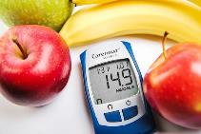
Keep checking your glucose levels!
80-100
80-150
80-200
On an empty stomach
In the afternoon/evening before eating
Two hours after eating
Notes:
In this effort that you are making for your health, one of the most important things to help you prevent and control diabetes is to understand what glucose numbers your body should have. Remember, everything we eat is converted to sugar or glucose in order to power your cells… this glucose is needed for energy and for your body to function properly, but keeping this glucose at a normal level is VERY important and it is the key in the prevention and control of diabetes. A very important reason to know your levels constantly is that UNDERSTANDING these levels helps us to form a relationship in our mind regarding which foods are the ones that raise our blood sugar level disproportionately and which foods help us maintain a normal level. A reminder… the normal fasting level is between 80 and 100. In the afternoon or evening BEFORE eating it is between 80 and 150. And after any meal (breakfast, lunch or dinner) the normal is between 80 and 200. The higher these levels are, the higher your 3-month average will be, which is called a1c.

Slide 82
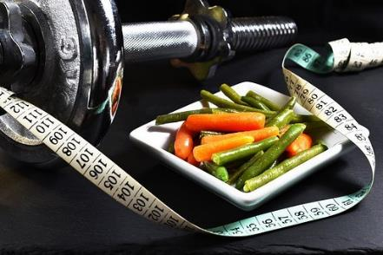
UNDER 65
YEARS OLD
7.0
65 YEARS AND OVER
7.5
What is the goal?
Notes:
Do you remember what the goal of that 3-month average is? If you are diabetic and under the age of 65, that average must be below 7.0 to be considered a controlled diabetic. Or if you are over 65, that average must be below 7.5 to be considered a controlled diabetic. If you are NOT diabetic, the American Diabetes Association recommends that your a1c be no higher than 5.7. In a person NOT diabetic, an a1c above 5.7 is categorized as a person at RISK of developing diabetes.

Slide 83
Notes:
According to the American Diabetes Association, people with diabetes are twice as likely to develop cardiovascular problems and strokes – so at the same time we must review the ideal numbers for your blood pressure. This chart shows the ideal levels recommended by the American Heart Association. Normal blood pressure is less than 120 over less than 80. Elevated blood pressure is between 120 to 129 over less than 80. Once it goes above 129 over 80, it is considered high blood pressure and is divided into three levels of hypertension. In this diabetes prevention and control program, our goal is for you to keep your blood pressure below 140 over 90. Achieving this goal would prevent health complications and lead a healthier life. What's important to understand is that by better managing your eating and exercise decisions, you'll be able to help lower your glucose level, and at the same time, these same changes will help control your blood pressure.

Slide 84
Formula
Body mass index
FORMULA
WEIGHT (pounds) X 703
[HEIGHT (inches)]²
BMI BMI BMI BMI BMI BMI BMI
Notes:
Remember we can make goals to improve our health and one of the keys has to do with weight. But in order to make a goal about our weight, it is important to know what the ideal weight for our health is. Remember, this program is trying to help you improve your health…our weight is a big part of our health and quality of life. Don't be discouraged if that number seems unattainable – the goal is to make small goals, but with determination. Let's focus on the first 5 to 10 pounds. Once this goal is achieved, we will make another goal…one goal at a time is more effective than making plans so big that they seem unattainable. Last month we explained how to calculate your Body Mass Index. If you need help doing this calculation and finding the ideal weight for your health, please call your Community Health Worker – we are ready to help you.

Slide 85
We are running a marathon – the road is long
Notes:
Remember that the prevention and control of diabetes, as well as improving our health in general, is a long race like a marathon in which it is more important to take a manageable pace that we can maintain for the rest of our lives and NOT a fast pace that wear us out and discourage us in a few weeks. We are not talking about going on a diet that will end when this diabetes prevention and control program is over…– we are talking about making lifestyle and nutritional changes that will last for the rest of your life.

Slide 86
A complicated subject
Notes:
In this long marathon of life – there may be some complications that are a bit difficult to talk about. In this program, for the first time we will be sharing this topic in a video format and not as an in-person talk. So it may be easier for you to talk about this more privately with your Community Health Worker. Let's start with a story...

Slide 87
DOCTOR, I HAVE A PROBLEM!
Notes:
A man diagnosed with diabetes comes to the clinic and, frustrated, finally shares with his doctor that he needs a prescription for Viagra. When the doctor asks more questions to try to understand what is driving this man to order this medication, his doctor discovers that this patient's diabetes has not been at controlled levels. In addition to this, other things like cholesterol level and blood pressure are in elevated numbers as well. After talking some more with the patient, the doctor also discovers that this patient has not been taking any of his medications. The patient tells the doctor that he is struggling to have relations with his wife, but nevertheless, he is very sorry to share his problem with her and says nothing…. Dealing with this problem for some time, the wife wants to separate…she suspects that he has another woman and wants to leave him….and so the patient asks for this medicine.

Slide 88
WHAT WAS THE REAL PROBLEM?
Notes:
But what do you think is the real problem? THE COMMUNICATION! He didn't talk to his wife, he didn't tell her anything about his problem – he just avoided having sex with her. She thought he was being unfaithful. No matter how much he tells her it's not like that, he can't convince her and now she wants the separation. He doesn't `t know what to do! What do you think is happening? What do you need to improve? Did you know that this is a common problem among people with diabetes?

Slide 89
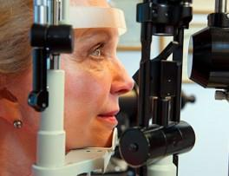
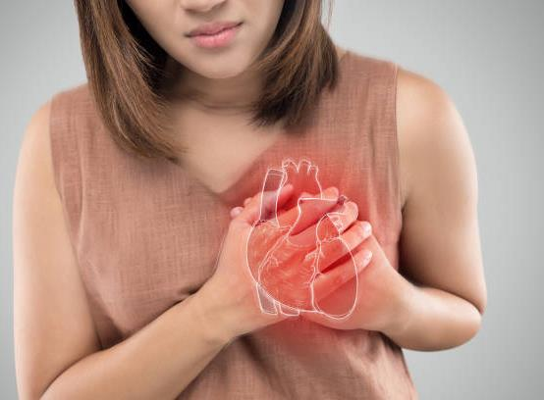
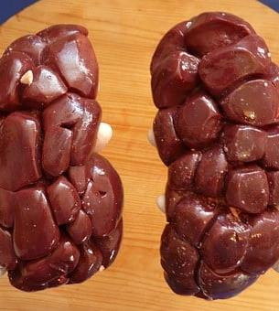
Prevention
Notes:
Next month we will be talking more about prevention and complications – for now we must understand that when you develop diabetes, your body begins to deteriorate. That excess of sugar in the blood (which remains uncontrolled and high for years), is damaging your veins and arteries. It desensitizes them. For this month, what we want to focus on is the problem that these veins and arteries produce in places that we cannot imagine.

Slide 90
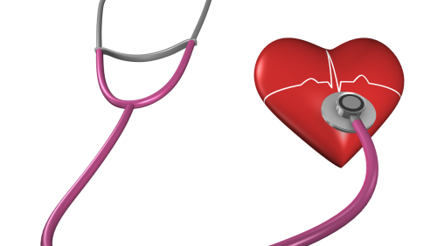
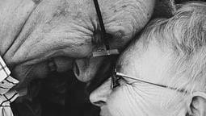
Everything is CONNECTED!
Notes:
Think about it: your body is ALL connected by these veins and arteries. These veins and arteries end in these extremities and are damaged by the uncontrolled excess of sugar. We commonly hear that they cause numbness in the extremities… in your feet and in your hands… but did you know that they also end up in your sexual organs?! These veins reach those organs and when damaged, the blood does not reach that point and loses sensitivity. That's why men who have this type of damage caused by years of deterioration from too much sugar in their blood have trouble getting an erection. When your blood sugar is high, your cholesterol is out of control and your blood pressure is elevated, these organs are affected as well… in both men and women! Women who have these uncontrolled sugar problems can also lose sensitivity and even not have enough sensitivity to enjoy sexual intercourse. The more of these medical conditions such as diabetes, high cholesterol, or high blood pressure you have, the higher your risk. We have to take care of ourselves now….because the more damage we cause to our body, the more easily it becomes irreversible damage. So, let's take care of our bodies, for our well-being and health... but also for the well-being of those around us... of those we love more.

Slide 91
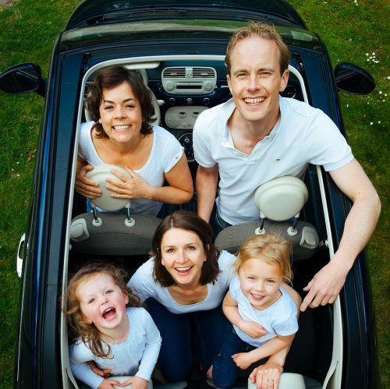
Communication
Notes:
Just as taking care of our body, taking care of our marriage on the level of communication is very important. Especially when it comes to sex. Remember that patient who had problems with his wife? If he had maintained a good communication relationship with his wife and had communicated his physical problems to her – they could have avoided conflict and separation. Communication is important to both of you in a relationship.

Slide 92
Marriage – God’s Design
Notes:
It's something we rarely talk to someone about, either in the clinic or even in church! Sex and intimacy particularly in marriage were designed by God. And it is ironic that sex is embodied by all television commercials and our entire culture in an unhealthy way….to the point that we sometimes forget that it is a wonder and gift that God gave to the husband and wife when they get married.

Slide 93
Become friends again
Notes:
Talking with your husband or wife is important. Go back to being friends….remember those things that brought you together at the beginning. Reestablish the habit of going on “dates” – even if it's just for a walk in a park – it doesn't have to be anything fancy or expensive. The purpose is to reconnect and restore the communication that brought you together in the beginning. There may already be some damage that needs to be repaired, but communication will help you find and return to being the person you were at the beginning of your relationship – it's never too late to start over. These healthy relationships are part of your health as well. Many times we see among our patients that mental and emotional health are a HUGE part of our physical health. In many cases, mental and emotional health are also part of the complications of diabetes.

Slide 94
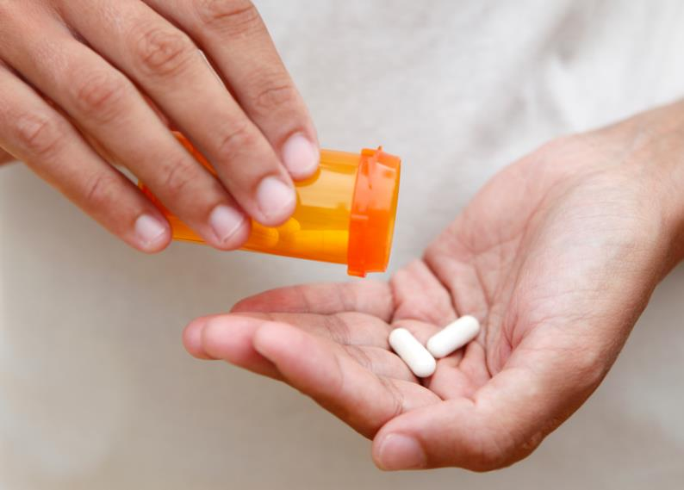
Depression
Notes:
In many cases of diabetic patients, depression and diabetes go hand in hand. Diabetes can be difficult on its own, but it is a big challenge when we add that one of the complications of diabetes is depression. Adding depression to what is already being problematic in your life can be devastating to many. You're not alone…depression is a common occurrence in people with diabetes, but it doesn't have to be hopeless. In order to begin to deal with and overcome depression we have to understand what depression is and what we can do about it.

Slide 95
What is depression
Notes:
To begin with, we have to understand what depression is: depression is a state of deep and prolonged sadness that lasts for more than a few weeks without an obvious or easily defined cause. To understand better, I give you a couple of examples: 1) If you lose your job today, it is very possible that you will feel very sad for a few weeks until your situation stabilizes and you find another job. In this case we CANNOT say that your situation of sadness is a depression because there is a very logical and normal reason for this sadness and it is due to a specific situation – job loss. Another example: 2) You lose a loved one and that leads to obvious deep sadness that paralyzes you for a few weeks – maybe even a month or two. You cry when you remember your loved one, but eventually over the weeks, you begin to return to your regular work and activities. You get sad every time you remember your loved one for a few months, but each time it is with a little more inner sanity and without this sadness preventing you from doing your job or living with people. This sadness is NORMAL, it is not depression because you can function in society and work in a normal way and you have a reason to feel this way. These two examples help us understand what depression IS NOT. Contrary to these two examples, a person in depression has no obvious reason for being sad and at many times this person cannot function normally in society or at work. You also cannot enjoy the things that normally make a person happy, such as funny movies, or birthdays, or gifts.

Slide 96
We don’t want to talk about it
Notes:
But usually, we don't want to talk about depression. THINK…if someone asks you: how are you? The response we consider appropriate in our society is: I'm FINE! To make matters worse…if we are Christians…this response MUST be positive – if not, we fear being branded as a bad Christian, or lacking in faith. Also, culturally as Hispanics, we tend not to react positively to what we don't understand. Depression is something that we often misunderstand and interpret as weakness…..weakness of character, weakness of strength, weakness of spirituality. But we MUST understand that there are MANY causes for depression. They are not a sign of weakness and should not be viewed in this way. God made us sensitive…..with feelings…..and many times we have not been able to understand that this only makes us NORMAL HUMANS! I want to inform you that as your Community Health Workers we understand very well that depression, besides being something that can happen to anyone, also has other roots that are much more common than we imagine. We also understand that for people with diabetes it is common to face complications such as depression.

Slide 97
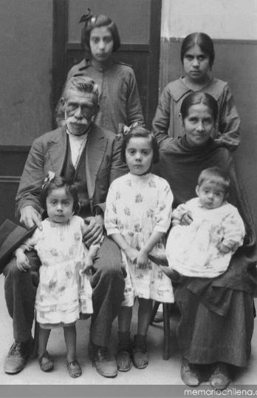
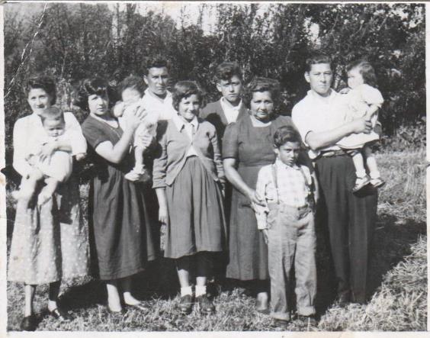
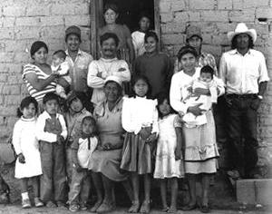
Our heritage…
Notes:
Why do some suffer from depression and others do not? Well….this is a bit complicated… To begin with, we have that… genetics or family history play an important part in being prone to depression. Some people are born with chemical imbalance problems that run in the family. Also….Life stressors are an important part of our mental health…for example the death of a spouse or children or the poor health of family members can cause depression that is difficult to cope with Other elements that contribute to depression are diseases such as diabetes!! People with diabetes are THREE times more likely to have depression!

Slide 98
Obvious solutions
Notes:
It is also important to emphasize that there are entirely physical conditions that cause depression. In other words, you may not have depression – there may be a medical problem! For example, if your vitamin B12 levels are low – your body may mimic depression. This deficiency is common in diabetes patients and this is why your doctor regularly checks your vitamin b12 levels. Make sure that if your doctor has recommended any supplements – you take them in the dosage that your doctor has recommended. MORE does not mean BETTER…you must follow your doctor's instructions. AND REMEMBER THAT IT IS IMPORTANT THAT as with any dietary supplement or vitamin – remember to tell your doctor what you are taking and in what amounts. Not just because you think it's “natural”…it's good for your health. Many of the natural things, if eaten in the wrong amounts, can be harmful. Whenever you go to the doctor, it is a good idea to bring the medications you take… but also the supplements or vitamins… It is worth having your doctor check them.

Slide 99
Our hope….
Notes:
However….whatever the reason you are experiencing any of these complications, know that you have hope that you have a team that is willing to help you whatever your situation. Most likely, as Community Health Workers, we have also gone through experiences similar to the ones you are facing. Call us, tell us your problem! We want to help you. Above all we want you to know one thing…apart from having us as your health team…you can have hope that God will provide you with the way to solve your situation…if it is health through the clinic, if it is advice – through assistance from the clinic or through your Community Health Worker. God made your body and knows your needs and ailments. Ask for help. If for any reason you need immediate help or think you may harm yourself or a loved one, call us….we are only a phone call away from being able to help you with practical help, but also with prayer.

Slide 100
Everything is CONNECTED!
Notes:
Remember what we're talking about….Everything in your body is connected and treatment for depression or problems with sexual intimacy is like treatment for diabetes….It's one of the tires of a car….Each car moves with 4 tires and when you neglect one – the car will not move forward. Your treatment includes four wheels….. Don't neglect one

Slide 101
MEDICINE
Notes:
One of those wheels is medicine. Some people will need medicine and others won't – check with your doctor…..he will tell you when to start taking a medicine and when to stop taking it. He will give you advice according to what you particularly need and in the amounts that will help you. However, we clarify that the medication for depression only works in 60% of cases… many times you will have to adjust the dose and it can take up to 6 weeks to start feeling the effects. It is good that if your doctor recommends medications, you take them and report how you feel directly or through your Community Health Worker. But don't just rely on medication...

Slide 102
Eating well
Notes:
One of the wheels that are essential for your health car to work is your food! YES, YES….again food. Your diet is key to your success in your health. We cannot separate the mind from the body. In other words, if you have a poor diet and never exercise, you can't expect other areas like your strength, mood, and sex drive to be okay! Your body is connected!!! When you eat well and eat healthy, or exercise, your body activates chemicals that make you feel upbeat and happier. These chemicals are important to your intimate and sexual life. We will talk more about exercise in the next month.

Slide 103
Exercise
Notes:
Another one of the wheels that are essential for your health car to work is keeping your weight in check. This is important for both your sexual health and your depression. Taking care of yourself and being at a healthy weight raises those good chemicals in your blood…it's like natural medicine for depression and increases your sex drive and strength. Just going for a walk and getting some fresh air goes a LONG WAY….you don't have to run a marathon!

Slide 104
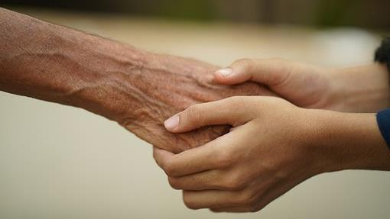
We are a team, and we are on your side
Notes:
The last of those wheels for your health car is the social support of family, friends and church. Having people who encourage you in your life is very important. Surround yourself with uplifting people….BE an uplifter – you will be able to see the change in the people around you when you become a positive uplifter yourself. Talk to someone if you feel that you are going through difficult times, go to your Community Health Worker, your pastor, your church or a place where you feel safe. Remember that if you have thoughts of harming yourself or others, talk to someone around you, your CHW or your doctor TODAY. We want to help you! You don't have to face this alone.

Slide 105
We want you to be healthy in all aspects of your life
Notes:
Diabetes and the complications that come with diabetes take a long time to improve….and there are several ways you can start to improve your health. We want you to have a long life, but we also want you to have a GOOD quality of life. Take your medicine, eat healthy, exercise, and find a community that supports and encourages you. Make goals, and share them with loved ones to help you stay focused. Having people around you to encourage you is critically important in order to MAINTAIN the discipline of those changes.

Slide 106
Thank You!
Notes:
Thank you for watching this video and don't forget we would like to talk more with you about these topics we share today. If you need more information, please contact your Community Health Worker. Until next time!

Slide 107
References
- Nuttall F. Q. (2015). Body Mass Index: Obesity, BMI, and Health: A Critical Review. Nutrition today, 50(3), 117–128.
- Chaturvedi N. (2007). The burden of diabetes and its complications: trends and implications for intervention. Diabetes research and clinical practice, 76 Suppl 1, S3–S12.
- Sartorius N. (2018). Depression and diabetes. Dialogues in clinical neuroscience, 20(1), 47–52.
- Bădescu, S. V., Tătaru, C., Kobylinska, L., Georgescu, E. L., Zahiu, D. M., Zăgrean, A. M., & Zăgrean, L. (2016). The association between Diabetes mellitus and Depression. Journal of medicine and life, 9(2), 120–125.
- Understanding blood pressure readings. (2018, May 21). www.heart.org. Last accessed September 15, 2022. https://www.heart.org/en/health-topics/high-blood-pressure/understanding-blood-pressure-readings

Slide 108
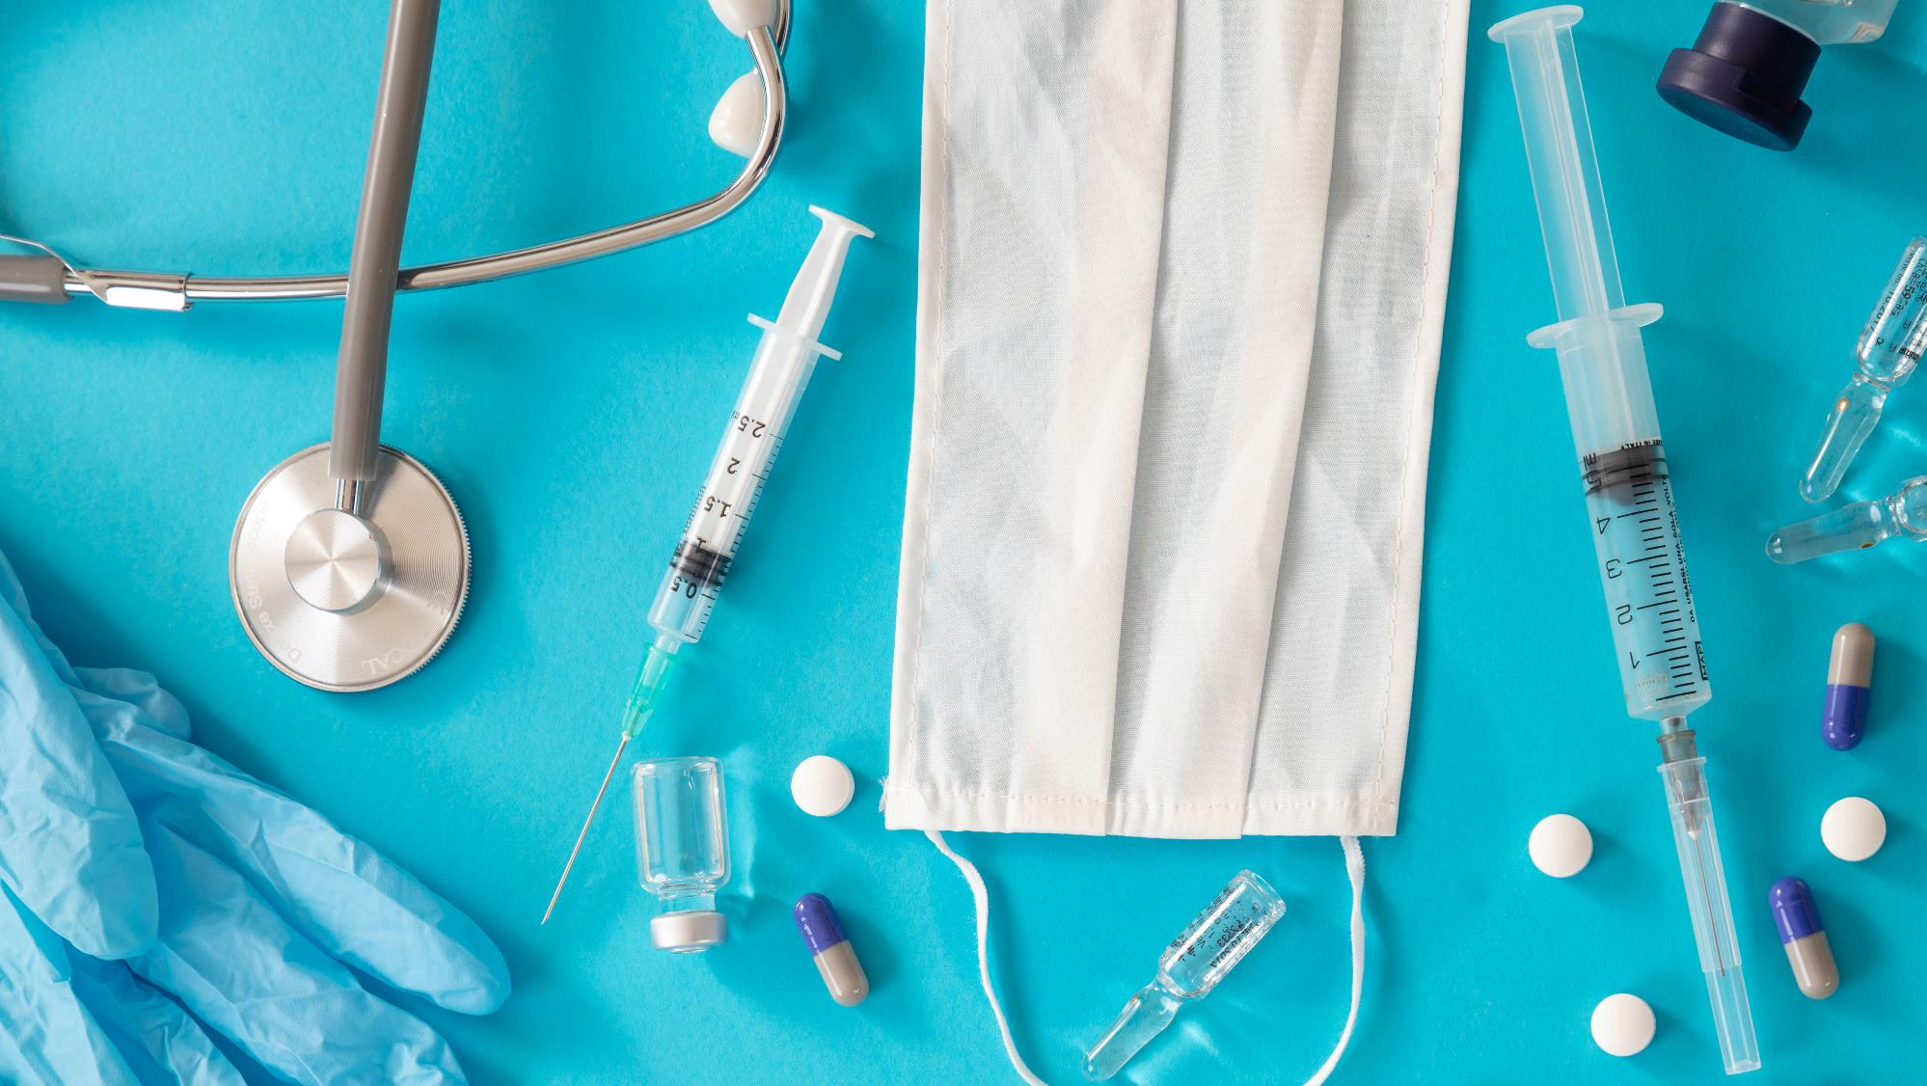
Prevention month 5
Notes:
Welcome and Thank you for once again joining our Diabetes Prevention and Control class! This class will have two parts so that we can explain in detail all the information we want to share with you.

Slide 109
Don’t get discouraged, continue your disciplines!
Stick with your medications
Stick with your good eating habits
Keep talking to your Community Health Workers
DON’T GIVE UP!
Notes:
Don't worry if you haven't managed to meet all of your goals. We want to encourage you to continue with the disciplines you've learned so far- we don't want you to get discouraged. The process of changing sometimes suffers from long moments of discipline, followed by discouragement. If you are going through a moment of discouragement, let us know, we want to help you get back to your goals. In the process of change, we really need to be able to talk with someone who has been through the same thing, through discouragement, to help us refocus. It is important that you continue with your medications, your good eating habits and that you continue to talk with your Community Health Worker. Don't give up – we all need to keep improving – there are always more ways to grow, change and improve. We need to make changes for life – not just for a season. Take back control of your health.

Slide 110
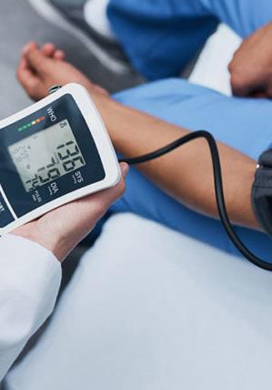
THE BEST OPTION IS PREVENTION
Notes:
Keep making changes- it is necessary because if you don't control your health, your complications end up controlling you. There are many habits that we can change to prevent illnesses – some of these habit changes even help to prevent more than one complication or illness. In that class we will teach you which diseases you could prevent by making the changes in habits that we have been teaching you in recent months. We will talk: Diabetes, High Blood Pressure, Cholesterol, Heart attack, Embolism, Kidney problems, Arterial or circulation problems, Vision problems, Loss of sensation in extremities and amputations, Respiratory complications – flu, pneumonia, and more recently the severe impact of COVID 19, depression and sexual dysfunction. These complications or illnesses are common in people who are at risk for diabetes or who are overweight. But we will be with each of these complications offering you the alternative of what we can do about it. Until now we have tried to help you prevent diabetes by teaching you: what are the sugar levels that are normal for you, what is the weight or Body Mass Index that is ideal for you, and what is the level of blood pressure in which your body functions healthiest. Why diabetes? Because we are in a diabetes prevention and control class…. But how do these diseases develop? And what are the ways to prevent them?

Slide 111
Diabetes
Notes:
Do you remember that in the first month we talked about what diabetes is??? Let's quickly review: Diabetes causes a build-up of sugar in the blood – to remind yourself how this disease works – you can watch the video from the first month titled Controlling Diabetes – if you no longer have that link, talk to your Community Health Workers and they will be happy to send it to you. So, because of that accumulation of sugar in the blood, the arteries become contaminated, they are at a disadvantage and there are more possibilities of complications. The solution to this disadvantage is to eat smaller portions, be at a more ideal weight, and take the medications that your doctor has prescribed, in order to reduce that excess sugar in your blood. The preventive test to keep this disease away or controlled is the a1c test that is done every 3 to 6 months in order to maintain an idea of ​​how our daily food is impacting our health. It is very important to check it regularly. We can prevent our body from being damaged, if we have this number monitored. In the past months we have talked about the level we should be at. Review these numbers with your Community Health Workers so you can take control of your a1c.

Slide 112
CHOLESTEROL and high blood pressure
Notes:
Another ‘contamination’ in the arteries is the accumulation of cholesterol. This is why your doctor monitors your cholesterol annually with blood tests. There are two types of cholesterol – it is very important to maintain a good balance of the two types of cholesterol. Cholesterol is a fatty substance that is deposited in the veins and arteries and this accumulation begins to prevent the passage of blood. These buildups have the same effect as when you use a garden hose. If you press or squeeze that hose, the water pressure is going to be higher…. Similarly, when it doesn't flow freely – the arteries start to get clogged and the pressure with which your blood flows increases. Prevention in these cases comes from eating less fatty foods, reducing your weight to an ideal weight, and also in the form of a low-strength aspirin pill – this aspirin (called baby aspirin) helps your blood flow more easily despite those cholesterol hurdles. That helps get your pressure to a normal level – if you like to remember normal blood pressure levels – you can find it in last month's video which talks about complications. Ask your Community Health Worker if you can't find the link to this video and they'll be happy to send you the link. Prevention of high cholesterol is directly connected to your diet. It is important to have this annual exam, but also to monitor your pressure to notice if there are any changes that have to be reported to the doctor.

Slide 113
Heart attack
Notes:
Heart attacks
High blood pressure and high blood sugar over time damage your arteries. Since arteries run throughout your body, this damage can show up anywhere in your body. The American Heart Association warns us that in the case of heart attacks, these cholesterol and sugar contaminations produce a blockage or plaque in the arteries…. As all the blood travels to the heart and from the heart to all its vital organs, that plaque detaches and reaches the heart. It then produces an arrest in the heart because the heart cannot support that plaque. So the cholesterol and sugar plaque compound in a double risk for the heart to suffer. We can prevent these attacks or the percentage of risk that we have of suffering a heart attack, by controlling our nutrition and our exercise… so that this contamination of sugar, cholesterol, plaque and other contaminants (such as tobacco) do not increase our chances of suffering from heart attack.

Slide 114
Embolism
Notes:
According to the American Heart Association, another one of the complications that we have when contaminating our blood is that of suffering a stroke or an embolism. The association explains that a stroke can be caused when a blood clot travels through the arteries to the brain and blocks the flow of blood in the arteries that nourish the brain or when the arteries rupture causing bleeding in the brain. Blood contaminated with sugar, cholesterol plaques, tobacco and the other contaminants increases the possibility of these clots.

Slide 115
Blood clots
Notes:
These blood clots are formed by the contaminations that we cause in our blood – such as excess sugar, excess cholesterol plaque, or other contaminations such as tobacco contamination. How can we prevent these clots from forming and growing? I think you are noticing that prevention is almost the same for each of these complications, right? Nourishing ourselves more healthily and in better portions, maintaining a weight closer to the ideal weight, not contaminating our blood with excess fat, sugar and tobacco, and being more active!

Slide 116
Protein in kidneys
Notes:
One of the preventive tests that your doctor also orders regularly is urine. Do you know why? Because our kidneys and the urine they expel can give us an excellent idea of ​​our health. It is through this test that your doctor can detect if your kidneys have protein. If you have protein in your kidneys it is because they are working much harder than they should. This is not good for you, because little by little your kidneys wear out and stop working. Then we have to start depending on machines that help us do the work of the kidneys.

Slide 117
Dialysis
Notes:
When your kidneys don't work, you can't urinate and get rid of chemicals that harm your body. A dialysis machine can help with this when your kidneys no longer can. This process is normally 3 hours, three times a week. It is very difficult to get to this point because many times there is no remedy or solution. But we must prevent reaching this point because there comes a time when even with the help of the machine, it is not enough. That's why your doctor tries to help you reach the health goals necessary to avoid this complication.

Slide 118
Arteries
Notes:
Our entire body is kept in good working order by our arteries. Our entire body has arteries – from our toes to our brains, from our sexual organs to our eyes – some arteries are larger and some are tiny. Everyone can cause damage to the arteries by having bad habits and everyone can stay healthy with good habits.

Slide 119
Arteries of the eyes
Notes:
Their eyes are one of the parts that have many very small arteries and by not taking care of preventing or controlling diseases like diabetes and high blood pressure, those arteries can cause problems and even cause blindness. Diabetes and high blood pressure are the most common causes of blindness.

Slide 120
Limited vision or blindness
Notes:
You, whether you have diabetes or are at risk for diabetes, should see an eye doctor annually to check the health of your eyes. Your eye doctor will be able to detect if there are problems that need to be checked more carefully and will help you know if you are still able to drive a car, read, etc. The best form of prevention (aside from your diet and exercise) is to have this exam done annually. If your eyes have not been examined this year, please talk to your Community Health Worker to help you make an appointment with your eye doctor through the Clinic.

Slide 121
Amputations
Notes:
Another one of the common complications of uncontrolled diabetes is losing sensation in your extremities due to arteries that begin to damage! When blood no longer flows healthily to our extremities, we feel no sensation in places like our feet! This is why one of the simplest but most forgotten prevention tests – when you have already developed diabetes – is the foot check. If you can, do this test at home. Just check the bottoms of your feet, and between your toes…if you can't see them without help, ask someone who lives in your home to help you check. Another idea that we can suggest is to put a medium mirror on the floor to be able to see the soles of your feet. Any problems you see should be reported to your doctor as soon as possible. All infections, cuts or blisters in a person with diabetes heal very slowly or do not heal at all, for this reason, they must be treated as soon as possible to prevent these complications from progressing and becoming a bigger problem. Remember that this is easy to prevent.

Slide 122
What can I do?
Notes:
How can we prevent these diseases and complications?

Slide 123
Vaccines
Notes:
One of the simple ways to prevent complications is vaccines. We know that there are many vaccines and that sometimes it can be confusing or sometimes it is difficult to understand how these vaccines work in your body. In our diabetes prevention and control we are concentrating on two in particular: Flu and pneumonia because these diseases are very common and can cause a lot of harm to a person who is at risk for diabetes or has uncontrolled diabetes.

Slide 124
INFLUENZA, PNEUMONIA and COVID
Notes:
Many of us are already well informed about flu viruses that change annually and require vaccinations for prevention. The Good Samaritan Clinic is offering free flu shots – contact your Community Health Worker if you still need this shot. Another preventable disease is pneumonia which requires a vaccine that is sometimes a bit expensive – if you have the possibility to apply this vaccine for free – you should consider the opportunity to do so. It is important to do this to prevent complications. Now in these times of pandemic we also have a lot of information at our fingertips about the vaccine against the COVID virus and there are possibilities to get this vaccine for free. Just like the flu, if you have not had the opportunity to do so - contact your Community Health Worker and they can help you find a place to do it. There is SO MUCH information available to people about vaccines and how they work…..and we know that in recent times there has been more confusion regarding vaccines. The reality is that sometimes we tend to think that "it's not going to happen to me" and we leave something to chance when we can actually prevent it. If you have doubts about any of these vaccines, please consult valid and medically supported websites - or talk to your Community Health Worker - we would love to help you navigate your doubts and myths about vaccines.

Slide 125
Other prevention exams
Colonoscopy
Mammogram
Pap-smear
Notes:
Other preventive tests that can make the difference between a short treatment or more advanced or more complicated diseases are:
1- Colonoscopy: The most current medical recommendations by the Center for Disease Control for colonoscopies are to have a screening beginning at age 45 and every 10 years thereafter. This test can help you find colorectal cancer and prevent it from progressing without being monitored and treated.
2- Mammography: The most current medical recommendations by the Center for Disease Control for mammograms are to have a screening beginning at age 50 and every two years thereafter. This exam can help detect breast cancer and prevent it from progressing without being monitored and treated.
3- Pap Smear: The most current medical recommendations by the Center for Disease Control for Pap smears are to have a Pap smear beginning at age 21 and every three years thereafter. This test can help detect cervical cancer and prevent it from progressing without being monitored and treated.
In any of the above-mentioned exams, it is always necessary that you follow your doctor's recommendations, since there may be other reasons or health conditions for which your doctor decides to do exams more frequently. These causes, such as susceptibility to these types of cancer in your family or other medical conditions, may change the recommendations for you in particular.

Slide 126
OTHER COMPLICATIONS
Notes:
As we discussed in one of the past lectures: the complications can be various and different in each patient. Remember that sometimes when we are at risk of diabetes or living with uncontrolled diabetes, we suffer without realizing that some complications are related to blood sugar.

Slide 127
Depression
How to fight depression?
Notes:
Like depression! In many cases of diabetic patients, depression and diabetes go hand in hand. Diabetes can be difficult on its own, but it is a big challenge when we add that one of the complications of diabetes is depression. Sometimes we ignore that depression is common in diabetics or people at risk of diabetes! But it's common….if you haven't seen the video where we talk about this topic yet – ask your Community Health Worker to send you this video so you can watch or review this information. The important thing about depression is recognizing what it is and what it is not.
WHAT IT IS: Depression is a state of deep and prolonged sadness that lasts for more than a few weeks without an obvious or easily defined cause.
WHAT IT IS NOT: It is not a sign of weakness and should not be viewed in this way.
Remember: God made us sensitive…..with feelings…..and many times we have failed to understand that this only makes us NORMAL HUMANS! Whatever the reason you are experiencing any of these complications, know that you have the hope of having a team that is willing to help you regardless of your situation. Most likely, as Community Health Workers, we have also gone through experiences similar to the ones you are facing….we are just one call away from being able to help you with practical help, but also with prayer.
How can we prevent depression? Controlling what we eat, going out to exercise and doing our routine medical check-ups…. In other words, you may not have depression – there may be a medical problem! For example, if your vitamin B12 levels are low – your body may mimic depression. This deficiency is common in diabetic patients and this is why your doctor regularly checks your vitamin b12 levels. Make sure that if your doctor has recommended any supplements – you take them in the same dosage that your doctor has recommended. MORE does not mean BETTER…you must follow your doctor's instructions. As for exercise – it is absolutely necessary for your health, but even more so if you suffer from depression – getting out, interacting with others while walking will help you feel better.

Slide 128
Sexual disfunction
Everything is connected
Notes:
Remember we talked about your body being ALL connected by these veins and arteries. These veins and arteries end in these extremities and are damaged by the uncontrolled excess of sugar. We commonly hear that they cause numbness in the extremities… in your feet and in your hands… but did you know that they also end up in your sexual organs?! These veins reach these organs. When damaged, the blood is not able to reach the organs and they lose sensitivity. That's why men who have this type of damage caused by years of deterioration from too much sugar in their blood have trouble getting an erection. When your blood sugar is high, your cholesterol is out of control and your blood pressure is elevated, these organs are affected as well… in both men and women! Women who have these uncontrolled sugar problems can also lose sensitivity and even not have enough sensitivity to enjoy sexual intercourse. The more of these medical conditions such as diabetes, high cholesterol, or high blood pressure you have, the higher your risk. We have to take care of ourselves now….because the more damage we cause to our body, the more easily it becomes irreversible damage. So, let's take care of our bodies, for our well-being and health... but also for the well-being of those around us... of those we love. Preventing all these complications is the same….

Slide 129
Everything Is Connected
Notes:
Remember what we talked about….EVERYTHING IN YOUR BODY IS CONNECTED AND PREVENTION IS Manifesting as a 4-wheeled cart…. each car moves with 4 tires and by neglecting one – the car will not advance. Your treatment includes four wheels….. Don't neglect any These four wheels are: MEDICATIONS, FOOD, EXERCISE, SOCIAL SUPPORT FROM FAMILY And FRIENDS

Slide 130
Medicine
Notes:
One of those 4 wheels is medicine. Some people will need medication and others won't – check with your doctor…..he will tell you when to start taking a medication and when to stop taking it. He will give you advice according to what you particularly need and in the amounts that will help you. However, sometimes your doctor will need to adjust the dose. It is good that if your doctor recommends medications, you take them and report how you feel directly or through your Community Health Worker. But don't just rely on medication...

Slide 131
Food
Notes:
The second wheel for that health car to work is your food! YES, YES….again with food. Your diet is key to your success in your health. We cannot separate the mind from the body. In other words, if you have a poor diet and never exercise, you can't expect other areas like your strength, mood, and sex drive to be okay! Your body is connected!!! When you eat well and healthy, your body responds positively and you begin to feel energized, encouraged and happier. This is important to prevent the complications we have discussed.

Slide 132
Exercise
Notes:
Another one of those wheels for a healthy car is keeping your weight in check. This is important both for your sexual health and for your depression and most of the complications we looked at today. Taking care of yourself and being at a healthy weight raises those good chemicals in your blood…it's like natural medicine for depression and increases your sex drive and strength. Just going for a walk and getting some fresh air goes a LONG WAY….you don't have to run a marathon! But if you have to be consistent.

Slide 133
WE ARE ON YOUR SIDE _______ WE ARE A TEAM
Notes:
The last of those wheels for your health is the social support of family, friends and church. Having people who encourage you in your life is very important. Surround yourself with uplifting people….BE an uplifter – you will be able to see the change in the people around you when you become a positive uplifter yourself. Remember that we want to be part of your team! The reason why your doctor and we, as your Community Health Workers, insist on controlling your blood sugar, blood pressure and weight numbers, is because every day we see the effects of living with uncontrolled diseases. We want you to be able to enjoy a better quality of life- because equal to or more important than how many years we live, is what quality of life we will have in those years. Everything we share with you today will help you live with better quality and prevent medical complications. We are on your side and we are here to help you.

Slide 134
Don't get discouraged, follow your disciplines
Stick with your medications
Stick with your good eating habits
Keep exercising Keep talking to your Community Health Worker
DON'T GIVE UP!
Notes:
Don't be discouraged if you haven't managed to meet all of your goals. We want to encourage you to continue with the disciplines you've learned so far, but we don't want you to get discouraged. The process of changing sometimes alternates between long moments of discipline, followed by discouragement. If you are going through a moment of discouragement, let us know, we want to help you get back to your goals. In the process of change, we really need to be able to talk with someone who has been through the same thing, through discouragement, to help us refocus. It is important that you continue with your medications, your good eating habits and that you continue to talk with your Community Health Workers. Don't give up – we all need to keep improving – there are always more ways to grow, change and improve. We need to make changes for life – not just for a season. Take back control of your health.

Slide 135
We are running a marathon – the road is long
Notes:
Remember, the goal is to run a marathon of best habits for your life – and not just making changes that last a few weeks. We hope you use this information and review it if you need to. Next month we will start talking to you every two weeks, but we hope you will call us if you need our help. Until next time!!

Slide 136
References
- American Diabetes Association (2010). Diagnosis and classification of diabetes mellitus. Diabetes care, 33 Suppl 1(Suppl 1), S62–S69.
- Chaturvedi N. (2007). The burden of diabetes and its complications: trends and implications for intervention. Diabetes research and clinical practice, 76 Suppl 1, S3–S12.
- Goeijenbier, M., van Sloten, T. T., Slobbe, L., Mathieu, C., van Genderen, P., Beyer, W., & Osterhaus, A. (2017). Benefits of flu vaccination for persons with diabetes mellitus: A review. Vaccine, 35(38), 5095–5101.
- Maiorino, M. I., Bellastella, G., & Esposito, K. (2014). Diabetes and sexual dysfunction: current perspectives. Diabetes, metabolic syndrome and obesity : targets and therapy, 7, 95–105.
- Zhang P. Y. (2014). Cardiovascular disease in diabetes. European review for medical and pharmacological sciences, 18(15), 2205–2214.

Slide 137
Exercise Month 6
Notes:
Welcome! We hope you are doing well and taking advantage of all the information we have been providing in these videos. Remember that if you have not been able to see any of the videos, you can ask your Community Health Worker to send you the links to the other videos so that you can take advantage of this program in a better way. If you have any questions, please call your Community Health Worker and we will be happy to help. This month we will be focusing on how we can prevent diabetes and indeed many other diseases and improve our quality of life through exercise.

Slide 138
Keep checking your glucose levels!
80-100
80-150
80-200
On an empty stomach
In the afternoon/evening before eating
Two hours after eating
Notes:
We start by reminding you that you always need to keep checking your glucose levels! This helps us see how our new habits are affecting our glucose level. Remember that the goals to improve our health or prevent diabetes is to keep our glucose between 80 and 100 (fasting). Numbers above 100 start to cause our body to start functioning less than ideal. Also remember that it is good to check your glucose in the afternoon or evening before eating. We should also keep these levels between 80 and 150. And you can check your glucose two hours after any meal- it should be between 80 and 200. Remember that this it is true whether or not you have diabetes and that your body will function more ideally if these limits are maintained. Maintaining these levels will also help keep your three-month average at the ideal numbers…remember what this number is called?

Slide 139
UNDER 65 YEARS OLD
7.0
65 YEARS OLD AND OVER
7.5
WHAT IS THE GOAL?
Notes:
It's called a1c. Do you remember what your A1c goal is? A person is considered diabetic when this number reaches 6.5. A1c can rise very high if not controlled. This causes the damage to your body that we have shared with you in previous lectures. So, ideally, we should keep it below 6.5, but even up to 7.0 a person is considered to have controlled diabetes (or for people over 65, 7.5). But the goal is to lower this number so your body can function better. If it's at the point of less than 7.0, Great! But if not, the most important thing is that you aim for that goal and DO NOT give up.

Slide 140
BLOOD PRESSURE
GOAL:
LESS THAN 140/90
Notes:
Same with your blood pressure. Remember what is the goal? The American Diabetes Association's recommendation is: less than 120/80…..For this program we recommend that you try to at least reach lower than 140/90. If you are not at that point, be sure to work toward your goal

Slide 141
Actividad Física
Notes:
And with these reminders we begin with our topic today...exercise. What do you think when someone mentions exercise???

Slide 142
But there is no time!... It's very difficult!...
Notes:
The answers we have received before have been: it is very difficult to establish a routine, or I don't have time, or I don't have a place to exercise, I don't know how to start…. The truth is that they are all answers that we have evaluated and we will be giving you some ideas. But let's start with a definition….what is exercise? By definition, it is a “physical effort with the goal of maintaining or achieving health”. Exercise is often a topic we don't like to talk about. There are ideas that it is not fun, it is very exhausting, and that it takes a long time. So, many people make the excuse that they don't have time, they get enough exercise at work, it hurts too much, or they just don't want to.

Slide 143
Exercise can be fun...
Notes:
However, exercise CAN be fun…you don't have to feel like you're going to pass out or throw up afterwards because of how exhausting it is. And you probably don't need as much as you're thinking. You can exercise at home, in a park, in a gym, accompanied, with family or alone. Starting to exercise is a decision to start TODAY…just TODAY…and then make the same decision tomorrow, until it becomes a habit.

Slide 144
Complete Exercise
Stretching
Weight/Resistence
Aerobic
Notes:
Among other things, exercise is like a wheel that needs to be complete in order to turn. Think of a cart wheel….if you cut a piece off that wheel (let's say one third) you think the wheel might turn….? It's the same with exercise...
There are three different types of exercise: aerobic, weight lifting, and stretching… Each of these three types is just as important as the other. And like a wheel…if you take a piece off it, it won't turn…it won't work right. So let's start with aerobic exercise….

Slide 145
Warming up and Stretching
Notes:
You don't drive a car without warming it up… right?! You know that if you do, it damages the car. The same with the body… you have to slowly stretch those muscles that you will be using during your exercise. The first wheel on this cart is WARM UP and STRETCH. You don't have to be very flexible to stretch!! Stretching is important because it helps prevent injuries, helps increase blood circulation to your muscles, and eases pain. But how does stretching help us reduce pain?? The body is all connected….for example, some people who have knee pain…have healthy knees….the problem is actually in their hips!….Why?? Because when your hips are out of balance or not in ideal condition, the body goes out of balance and that is compensated for by the knees – because they are the ones that take the stress out of coping with the hip problem!

Slide 146
Heating and Stretching
Heating Exercise
To put to work
To muscles
Notes:
On youtube.com or any internet search on your phone, you can search for CHAIR WARMING EXERCISE If you've never exercised before, or if you're having problems with balance or mobility, it's best to start warming up in a chair. If you have balance and mobility, you can just look for WARM-UP EXERCISE

Slide 147
What for?
Muscle Stiffness
Pain
Stress and Tension
Helps relieve pain caused by muscle stiffness and helps relaxation
Prevents muscle pain after exercise
Relaxes your muscles, therefore helps you relax mentally as well
Notes:
So stretching -when we wake up…..before exercising….after exercising….and at other times of the day- helps our bodies to be ready to work and free of muscular stress. It helps us with muscle stiffness…because by stretching, we learn to relax our muscles. It helps us prevent pain, because our relaxed muscles were ready for exercise. And it helps us with stress and tension…because our neck and shoulders carry a lot of our stress and if we don't stretch, it will lead to more pain. Our head and neck are connected… so sleeping poorly, carrying heavy things, stress and manual work make our necks stiffer and stiffer. When this stiffness begins to pull on the muscles of the head, it ends up causing headaches. And we usually end up taking all sorts of medications and doing expensive tests to see the reason for the headaches, when treatment should start with just stretching and maybe a pill ibuprofen. Of cours, there are going to be headaches that may need testing, but try stretching as well and see your doctor if you have any questions.

Slide 148
Let’s Practice!
Flex
Rotate
Stretch Sideways
Extend
Stretch Sideways
Rotate
Notes:
Here are some stretches that can help with headaches. Continuing with normal breathing whenever you are stretching, try to do these movements until you feel a little stretch – not something that hurts. If you do them consistently, you will get better at doing them.
Let's try the flex/extend exercise. Sit in a chair with your back fairly straight, not slouched, and with your shoulders relaxed. Don't lean back in your chair. Try to flex your head down and get as close as possible feeling the stretch but without hurting yourself and try to get your chin to touch your chest…. and hold this position for 15 seconds. Then try the same with your head back to extend your neck as far as possible without hurting yourself and hold the position for 15 seconds.
Let's try the rotate exercise. Check that your back is still in a good straight position, not slouched, and that your shoulders are relaxed. Don't lean back in your chair. Try to turn your head to the right as far as possible feeling the stretch but without hurting yourself and try to get your chin in line with your shoulder and hold this position for 15 seconds. Then try the same on your other side and hold the position for 15 seconds.
Let's try the side stretch exercise Sit in a chair with your back squared. Don't lean back in your chair. Move your head to the right side and get as close as possible… feeling the stretch but without hurting yourself- try to get your ear to touch your right shoulder and hold this position for 15 seconds. You can help yourself with your right hand to try to make the stretch a little more pronounced by trying to pull your head with your hand to get closer to the hand. Then try the same on your other side and hold the position for 15 seconds.
Did you try??? how do you feel?? Stretching gives us almost immediate relief of some of the pressure on our neck and head... Try this every day and add more each day. Your Community Health Worker can give you more ideas- talk to your Community Health Worker if you want to add more stretching exercises or have questions.

Slide 149
Aerobics
Notes:
This type of exercise is the one that most people imagine when we talk about exercise and it is the one that makes our heart beat a little faster. This type of exercise includes brisk walking, running, swimming, dancing, bicycling, etc. and we do it to strengthen our heart by getting the blood flowing. Many people ask us how long should we do aerobics and how often? As little as 30 minutes of brisk walking is enough to exercise our heart. However, you have to make the effort to change really fast…it is good to walk in a park (or anywhere with friends), but aerobic exercise is not a walk in the park while we chat with someone…the truth is that if you still have breath to talk, you are probably not going fast enough. We have to make a good effort for 30 minutes. Start speeding up until you feel your heart getting a workout. Don't forget to bring water and drink it little by little throughout your walk or with any exercise you do.

Slide 150
AEROBICS
CARDIO IN CHAIR
Putting the heart to work
Notes:
"But I can't do aerobics because my knee hurts, my hip hurts, etc, etc..." Sometimes we use this more than as a reason- we use it as an excuse not to exercise! You can start with the second wheel of the cart…. Aerobics…..from your own chair!! You can dance or move with your upper body and get your heart racing for a workout. If you go to YouTube.com and search for “CHAIR CARDIO” you will find several videos in Spanish with video instructions from 10 minutes to an hour with examples of how to exercise your heart without getting up from a chair. But most of us can take a step forward and get up from our chair, right?

Slide 151
AEROBICS
LOW IMPACT CARDIO
Putting the heart through a little more work
Notes:
So….to get up from the chair, to move!
Low-impact or no-impact cardio (meaning exercising your heart) means it's less intense. There are also many of these types of videos on the internet and you can find them just by doing the search for “LOW IMPACT CARDIO”. This will give you 10-30 minute videos so you can exercise where you don't need to jump around or have as much experience. As you become more mobile, you may progress to exercises or “HIGH IMPACT CARDIO” but check with your doctor before progressing to this type of exercise.

Slide 152
What for?
Body Fat
High Blood Pressure
Diabetes
Helps you lose weight and feel better
It makes the heart work to train it to function better
Helps prevent and manage your diabetes
Notes:
AND THE AEROBICS….How do they help us? Exercise helps us in three ways:
Number 1- It helps with our level of body mass: when exercising, our body begins to adjust to the change and if we combine it with the new eating habits that we have talked about in other videos, you could lose weight and reach a level of body mass that is more desirable.
Number 2- It helps us better control high blood pressure. When the heart exercises and becomes stronger, then our pressure begins to stabilize.
Number 3- It helps with controlling diabetes or preventing the development of diabetes. If you don't have diabetes yet, this is a very effective way to prevent it- especially when combined with new eating habits. For those who already have diabetes, it is a VERY important part of controlling your glucose level.

Slide 153
How many calories did you really burn?
Notes:
Aerobic exercise is the one that helps the most with weight loss….HOWEVER…. People usually don't lose as many calories as they think. For example, if you walk for an hour, the average person burns 80 calories. That's the equivalent of an omelette or a couple of tiny teaspoons of ice cream! However, after exercising, people think they have burned so many calories which makes them eat more….usually they end up eating hundreds of calories more after exercising! That's why oftentimes, when people exercise, when they end up gaining weight and blame it on the "exercise"! The truth is that it's not the exercise that was to blame...it's what they ate after exercising.

Slide 154
BUT… Be careful with rewarding yourself!
Notes:
So be careful with rewarding yourself with food!!! Unless you're a professional athlete, exercise is just ONE of several things you'll need to do to lose the weight. The key is to combine eating less with exercising more WITHOUT REWARDING YOURSELF WITH FOOD. If you want to reward yourself in some way – do it with other things. For example, set a goal that if you are going to walk every day this week – then you are going to reward yourself with a board game you enjoy, or watching an episode of a show you like, or enjoying a hot tub… doing something that you like a lot and only reward yourself with that when you meet your goal for the week or month. Having these types of “prizes” helps us to motivate ourselves. And we ALWAYS need to keep those reasons in mind because motivating ourselves is the key to continuing good habits! Another way to motivate us is to belong to an exercise class or soccer team….. people who join sports teams like soccer (where they meet more than once a week), lose weight due the motivation driven by competition. The players depend on each other to win... you just have to be careful not to go and celebrate by eating after the game. Encourage each other to set goals and reward yourself in ways other than food. And do aerobic exercise!

Slide 155
Weight/Resistence
Notes:
The next type of exercise is Weight Lifting or Resistance Exercise! This type of exercise refers to lifting weights, but small ones, not the huge ones like those of bodybuilders. If you don't have a gym to go to, you can buy some 5 or 10 pound dumbbells at Walmart. You can also use things around your house, like water bottles, canned food containers, you can even pick up your kids!! Because these exercises can be done at home – they don't even require you to leave the comfort of your home or get in a car and drive to a park. You can add weight training in several ways. For example: the easiest and that can be done in combination with aerobics is to add something heavy to your feet (for example, there are some types of weights that are secured with Velcro to your ankles, and if combined with that, wear a couple of water bottles or small weights in your arms, you can make movements to lift that weight while walking. Also if you don't want to leave the house because of the weather... you can work out at home by just walking in your living room... you don't have to go far to exercise your heart and lift weights at home. In the same way….we recommend that if you do not do aerobic exercise, lift weights even while sitting in a chair!!! If you are going to do it while sitting down you can lift the weight of your choice with your legs while sitting or with your arms. You can also do it while sitting on the floor. You can decide what would be a good starting point for yourself….the key is to do several repetitions and to increase these repetitions more and more.

Slide 156
RESISTANCE
LOW-IMPACT CARDIO
to put the heart to work a little more
Notes:
And as we have seen with the other types of exercises…you can do them with instructions that you can find on the internet. If you go to YouTube.com and search for “RESISTANCE EXERCISE” you will also find LOTS of sample videos in Spanish with 10 to 30 minute video instructions…by watching these videos you will see that you can do them with things around the house, such as water bottles, vegetable cans. Some will show you some small weights, some will show you how to use some elastic resistance bands, and some will be without equipment. If we do not use the muscles, we will lose them little by little... so let's work on them

Slide 157
What for?
Posture
Bones
Balance
Core Muscles so as not to overload other parts of your body
Important for keeping your bones strong and preventing loss of bone density
Prevents falls and injuries to the knees and ankles
Notes:
These resistance exercises with Resistance Bands or lifting medium weights help you strengthen not only your muscles but also your bones! Weight-bearing exercises can help strengthen your abdominal muscles or core area of ​​your torso. People who don't have strong abdominal muscles have more difficulty with balance and poor posture, put too much stress on other parts of their body, like their back and knees to compensate- this results in more permanent muscle soreness problems. That is why when we do not do this type of exercise we end up with knee, hip or back pain. This type of exercise is also very important to maintain strong bones and prevent loss of bone density and eventually diseases such as osteoporosis. If you are very thin or if you are a woman, you are at higher risk for osteoporosis. So strengthening the bones is very necessary to avoid problems at older ages. Doing these types of exercises also helps with balance and that helps us prevent falls and hurting our knees and ankles. And as we get older, these types of resistance exercises and weights can improve our quality of life.

Slide 158
How much exercise should I do?
Notes:
How much exercise should I do? This is a very common question….but the most important thing is that we start with doing SOMETHING!! Why? Because some exercise is better than NOTHING!!!….. Sometimes having a family member or friend who exercises with us helps us to be more consistent and to stay firm in our goals while having fun. But if you still want to know what is a good goal to start with, then let's say 20 minutes a day including exercises of all three types is a good start. It takes a lot less time than an episode of your favorite TV show….so if we watch at least one 30-minute TV show, we have a chance to exercise. Remember you don't even have to stop watching the show!!! You can do it at the same time!! Pretend to walk around your room with your weights and be sure to stretch before and after the 20 minutes. We don't have much of an excuse anymore, because even if you're standing in your living room or on a chair you can lift your legs while watching the show and lift your weights – the key is to do it in a way that gets your heart and muscles working.

Slide 159
One last type of exercise.....
Notes:
Before we say goodbye... We want to add another exercise……this one is a bit different. We have been focusing and talking about the body….but the mind also needs to be exercised. It is very important that as we get older, we continue doing things that exercise our minds, such as reading books, continuing to learn, and having conversations that make us think. These habits of taking control of your thoughts are very important for your mental health. There are times that we let our thoughts rule us and that ends in a cycle of bad habits: for example, I am in prison so why bother with being healthy? Or also think: if I'm already sick, why take the medication? Or have we also heard: well, we will have to die of something, right? But your thoughts are very important. It is such an important and vital habit that we are exhorted to control our thoughts in the bible!! Remember that the bible says in 2nd Corinthians…..casting down arguments and taking every thought captive to the obedience of Christ? Many times we think that controlling thought is something that only very disciplined people can do, but we are going to try this together: Do this exercise with me: Close your eyes and think of a red flower, think of a red flower that you like a lot because of its smell or because of how red it is... Open your eyes... You can see the flower right? Can you describe it and can you tell me if it had many or few petals…. Why do you think you can almost "see" the flower? Because it is possible to control thought. It is the same when we have problems, we can refocus on God when we are worried but it requires training the mind to go to a certain thought that you decide. And the more you try, the more easily you can achieve it. What we focus our thinking on is our decision….don't let your mind wander into negative thoughts without control. Exercise your mind….

Slide 160
Our Mind
Games
Learning
Lecture
Notes:
This exercise of mind is something we should NEVER stop doing Mental skill games, learning and reading are something we can do Exercise our mind by listening to books, preaching or exposing your self to people who are experts in a subject are a few things we can do as long as we have a sense of hearing. Learn something new: How to cook, how to weave, how to fix a radio, how to build a little bird's cottage, anything that interests you….We can always learn.

Slide 161
Always keep improving!
Notes:
This is the end of the class and we will be sending out other topics of interest each month to help you with your physical and mental health! Remember that the goal is to improve our quality of life, and we can always do something more….Never stay stuck- continue to improve in some or several areas of your life. As Community Health Workers, our goal is to help you conquer obstacles and reach your goals. Please call us if you have any questions and watch for the video below. Good bye!

Slide 162
References
- Amanat, S., Ghahri, S., Dianatinasab, A., Fararouei, M., & Dianatinasab, M. (2020). Exercise and Type 2 Diabetes. Advances in experimental medicine and biology, 1228, 91–105.
- American Diabetes Association (2010). Diagnosis and classification of diabetes mellitus. Diabetes care, 33 Suppl 1(Suppl 1), S62–S69.
- Colberg, S. R., Sigal, R. J., Fernhall, B., Regensteiner, J. G., Blissmer, B. J., Rubin, R. R., Chasan-Taber, L., Albright, A. L., Braun, B., American College of Sports Medicine, & American Diabetes Association (2010). Exercise and type 2 diabetes: the American College of Sports Medicine and the American Diabetes Association: joint position statement. Diabetes care, 33(12), e147–e167.
- Get active! (2022, January 28). Centers for Disease Control and Prevention. https://www.cdc.gov/diabetes/managing/active.html
- Kirwan, J. P., Sacks, J., & Nieuwoudt, S. (2017). The essential role of exercise in the management of type 2 diabetes. Cleveland Clinic journal of medicine, 84(7 Suppl 1), S15–S21.

Slide 163
Tobacco Use, Alcohol, and Diabetes Month 9
Notes:
Welcome! It's great that you are with us again learning more about your health and how to prevent or manage diabetes. Today we will be talking about how smoking and alcohol affect the body in general, how it affects people with diabetes or at risk of developing diabetes, and we will also give you advice on how to stop smoking, drinking alcohol, or helping a loved one who needs to. This topic may not apply to your life right now, but it never hurts to know this information so you can help yourself or others.
According to Mayo Clinic Family Health, smoking addiction is defined as the addition to nicotine, which is the main component of the tobacco leaf, which produces pleasant effects in our body. According to the World Health Organization, smoking is a chronic addictive disease and is the leading cause of premature and preventable mortality. It is estimated that 4.9 million people die each year as a result of tobacco use. By 2030, 10 million deaths per year are estimated. It is also important to note that an average of 1 million people, who are called passive smokers, die yearly due to exposure to secondhand smoke.
Although smoking cigarettes is the most common way of consuming tobacco, tobacco is harmful in all its forms. It is also consumed through the pipe, the water pipe or hookahs, cigars, chewing tobacco, and the electronic cigarette that despite having less nicotine also contains toxic substances. The latter is known as vaping. In addition, there are scented and menthol cigarettes as well as snuff, among others, which are also harmful.

Slide 164
Risk Factors
Notes:
Let's start with tobacco.
According to Mayo Clinic Family Health, smoking addiction is defined as the addition to nicotine, which is the main component of the tobacco leaf, which produces pleasant effects in our body. According to the World Health Organization, smoking is a chronic addictive disease and is the leading cause of premature and preventable mortality. It is estimated that 4.9 million people die each year as a result of tobacco use. By 2030, 10 million deaths per year are estimated. It is also important to note that an average of 1 million people, who are called passive smokers, die yearly due to exposure to secondhand smoke.
Although smoking cigarettes is the most common way of consuming tobacco, tobacco is harmful in all its forms. It is also consumed through the pipe, the water pipe or hookahs, cigars, chewing tobacco, and the electronic cigarette that despite having less nicotine also contains toxic substances. The latter is known as vaping. In addition, there are scented and menthol cigarettes as well as snuff, among others, which are also harmful.
There are several risk factors….among them:
Age: the younger you start smoking, the more addicted you become
Parents and friends: children of smoking parents are more likely to be smokers too
Depression and anxiety: these mental illnesses are related to addictions
Alcohol and drugs: drinking alcohol increases the probability of consuming any type of addictive substance
There are some symptoms of smoking or that the person has some level of addiction, such as not being able to quit easily, or the person has withdrawal symptoms or discomfort when they stop smoking for a limited time.

Slide 165
What does a cigarette contain?
Notes:
Let's understand something important….do you know how a cigarette is produced or what it contains?
As you can see there are several unhealthy things like:
NICOTINE: It is the most important component that causes addiction. After 20 seconds it enters the brain and binds to the receptors where dopamine is released
CARBON MONOXIDE: It is the cause of diseases of the lungs, heart and blood vessels. The carbon monoxide binds to the blood and travels through your veins causing damage. That is why it affects the heart and brain causing heart problems and brain damage.
In addition to these two harmful substances, it also contains more than 4,000 toxic substances. These alter cells and cause abnormal growth – this is what causes tumors.
In addition, when these substances enter the lungs, they do not allow the correct cleaning of the bronchial tubes and obstruct the airways. This commonly produces the characteristic COUGH of the smoker and many other diseases that we will be seeing next.

Slide 166
Smoking Complications
Notes:
According to the Centers for Disease Control and Prevention, complications from smoking are extensive…but some of them are:
1- Chronic lung disease
2- Diabetes and increased cholesterol
3- Heart diseases
4- Brain diseases such as embolism and strokes
5- Decreased fertility
6- Pregnancy problems such as premature babies and miscarriages
8- Cavities, bad breath, dry skin, hair loss, weight loss.
9- But also…cancer… But did you know that not only in what we commonly think?

Slide 167
Healthy lung and Smoker’s lung
Notes:
Of course, it is very common for cancer to develop primarily in the lungs in a person who smokes and continually ingests all those toxins that we mentioned before... but that cancer can develop in other parts of the body as well.

Slide 168
Consuming tobacco may cause cancer THROUGHOUT the body
Notes:
Can you see the image? Using tobacco can cause cancer in some of these organs….
Mouth and throat
Larynx
Bone marrow (this cancer is what we know as leukemia)
Kidneys and renal pelvis
Cervix
Urinary bladder
Esophagus
Lungs
Bronchial tubes
Windpipe
Liver
Stomach
Pancreas
Colon and rectum
Tobacco is related to 90% of tumors, 75% of chronic lung diseases, and 25% of coronary or heart diseases.
In the end, smoking…can kill you!

Slide 169
Why is smoking especially bad if you have diabetes?
Notes:
Why is smoking especially bad if you have diabetes?
People with diabetes who smoke are more likely to have serious health problems and complications than people with diabetes who do not smoke. These complications include: increased incidence of heart and kidney disease, poor blood flow to extremities, increased risk of infections, higher incidence of foot ulcers, higher rates of lower limb amputation and retinopathy. which increases the chance of blindness
People with diabetes already have to constantly work to control their blood sugar levels and prevent complications from the disease, including damage to the nerves, eyes, kidneys, and heart. The tobacco in cigarettes increases these problems and complicates diabetes control.
There are at least 70 chemicals in cigarettes that are directly linked to cancer development, aging, and oxidative stress. For example, some of the chemicals found in cigarettes include toilet bowl cleaner, candle wax, insecticide, arsenic, nicotine, lighter fluid, and carbon monoxide, just to name a few. These dangerous and addictive chemicals cause damage to cells in your body and interfere with their normal function.
In a person with diabetes, the damage caused by the chemicals in a cigarette and nicotine causes chronic inflammation, resulting in insulin resistance and higher blood sugar levels, thus making it more difficult to control diabetes.
All of these problems compound to make diabetes difficult to control and increase the likelihood of complications. For people with diabetes, the health risks of smoking a cigarette are four times higher than for a person without diabetes.
Even more surprising, a 2014 study revealed that smokers are also 30-40% more likely to develop type 2 diabetes, making the relationship between smoking and diabetes a vicious circle.
Smoking is a health hazard for anyone, but for people with diabetes or at high risk of developing the disease, smoking can contribute to serious health complications.
Researchers have long known that diabetic patients who smoke have higher blood sugar levels, which makes their disease more difficult to control and puts them at greater risk of developing complications such as blindness, nerve damage, kidney failure and heart problems. Now a new study offers the most definitive evidence as to why: the nicotine in cigarettes.
The California State Polytechnic University found that nicotine, when added to human blood samples, raises hemoglobin A1c (HbA1c) levels by up to 34%. This tells them that there would be a similar effect with diabetic smokers.
Doctors have always known that smoking can make diabetes worse, but through this study we now know why… It's the nicotine!
This study also implies that if you are a smoker and not diabetic, your chances of developing diabetes are higher."
But perhaps more importantly, the results also suggest that nicotine replacement products, such as nicotine-containing patches and e-cigarettes, are also not a safe option for patients with diabetes. Because they still contain nicotine, these products are just as likely to raise A1c levels as cigarettes. "To minimize your chances of developing diabetes or diabetic complications, you should stop smoking," says the doctor in charge of this study. That means – stop doing it immediately and cold turkey.

Slide 170
Alcohol can affect your…
Health
Pancreas
Liver
Relationship with your family
Notes:
And you should know that alcohol is just as harmful!!!
We know that alcohol can affect your life and health in many ways. This time we'll be looking at some of those ways it affects things like your general health, your pancreas, your liver, your relationship with your family…and even your A1c or glucose level.

Slide 171
Notes:
In your general health it can cause anything from memory loss, hallucinations, seizures, dementia, risk of chest infection, liver inflammation, hepatitis, cirrhosis….IN SHORT….can you see the whole list on your screen? It even includes low blood glucose control!!! And while all of the health consequences that alcohol contributes to need to be looked out for, one that we're primarily focused on in these classes is your glucose or diabetes.

Slide 172
How does it affect the pancreas?
Notes:
One of the areas affected by alcohol consumption is the pancreas. How does it affect the pancreas? It causes chronic inflammation (pancreatitis) and this is important because the pancreas is the organ in charge of producing insulin. Sound familiar? Alcohol affects the ability of the pancreas to secrete insulin.

Slide 173
Insulin
DIGESTION
GLUCOSE
CARBOHYDRATE
EAT CARBOHYDRATE
CARBOHYDRATE TURNS INTO GLUCOSE
GLUCOSE ENTERS BLOOD STREEM
Notes:
Do you remember the first videos of our program? Insulin, a hormone produced by the pancreas, which allows cells to absorb and use glucose, to be used as energy.
In other words…everything you eat (be it bread, sugar, meats, fruits, vegetables….EVERYTHING) turns into glucose, and this glucose is VERY necessary for your cells to turn into energy, but the key that unlocks those cells is called insulin….without insulin – your cells don't get energy and the glucose stays in your blood and affects your whole body.
So if alcohol affects your pancreas…your blood sugar level will be directly affected.

Slide 174
DIGESTION
GLUCOSE
CARBOHYDRATE
EAT CARBOHYDRATE
CARBOHYDRATE TURNS INTO GLUCOSE
GLUCOSE ENTERS BLOOD STREEM
Notes:
Look at the picture we have here…your pancreas will do one of two jobs…helping your body produce insulin and work ideally…or…. that of being more and more damaged and requiring a lot of help to do the most basic job of converting what you eat into energy so that glucose does not stay in your blood.
Remember that insulin is the key and the organ that makes insulin is the pancreas.

Slide 175
How does it affect the liver?
Notes:
Another way your body can be affected by alcohol is through your liver.
The liver releases glucose to maintain blood sugar levels. But when a person drinks alcohol - especially when they do so without having anything in their stomach - the liver is so busy breaking down the alcohol that it does a poor job of releasing glucose into the bloodstream. And this can lead to a drop in blood sugar levels that we know as hypoglycemia .

Slide 176
Symptoms of excess alcohol and hypoglycemia
Confusion
Drowsiness
Blurry vision
Headaches
Lightheadedness or dizziness
Lack of coordination
Unconsciousness
Notes:
This is dangerous in a number of ways, but let's look at this one in particular….do you know that the symptoms of excess alcohol and hypoglycemia can be VERY similar?
Confusion
Drowsiness
Blurry vision
Headaches
Lightheadedness or dizziness
Lack of coordination
Unconsciousness.
It would not be a good thing if someone confused the symptoms and thought that you are intoxicated instead of suffering from hypoglycemia. If they think you were knocked unconscious, they may not give you the proper help and treatment – as hypoglycaemia needs to be treated promptly.

Slide 177
Other Harm
Notes:
And these are not the only harm….as we saw before, there are many more….
Drinking alcohol could worsen complications already common in diabetics such as neurological, eye or kidney damage
Remember that weight gain makes diabetes more difficult to control and alcohol causes possible weight gain since alcohol is high in calories.
And because of these calories, it can also spike your blood sugar since beer and sugary mixed drinks are high in carbs, and the excess carbs can cause your blood sugar levels to spike.
But….we can improve! Don't be discouraged… why do you think we focus on this topic in a diabetes prevention and management class? Because by looking for solutions for your diabetes, such as changes in eating and exercise habits, we can gradually eradicate other consequences of those bad habits that lead us to develop diabetes.
So…let's set goals!

Slide 178
How to stop smoking or drinking alcohol?
Notes:
Quitting these bad habits is important for your health.
Shortly after quitting smoking, circulation begins to improve and blood pressure begins to return to normal. Your sense of smell and taste return and you begin to breathe more easily. In the long term, quitting tobacco can help you live longer. Your risk of cancer decreases each year that passes without smoking.
Quitting is not easy. You may have short-term effects, such as weight gain, irritability, and anxiety. Some people try several times before succeeding. There are many ways to quit smoking. Some people stop it all at once. Others take avantage of the benefits of step-by-step manuals, guidance, or medications or products that help reduce nicotine addiction. Some people think that the switch to e-cigarettes may help you quit smoking, but this has not been proven. Your healthcare provider can help you find the best way to quit smoking.
NIH: The National Cancer Institute tells you that you can quit smoking for good, even if you've tried before and failed. Actually, almost all smokers have had to try several times before succeeding. Stay positive, and don't give up.

Slide 179
Identify your triggers
Emotional
Pattern
Social
Abstinence
Notes:
When you start to quit smoking or drinking , your body goes through nicotine and alcohol withdrawal . You may feel tired, moody, and have headaches or even other symptoms. Previously, you may have dealt with these feelings by resorting to bad habits.
Certain places and activities can trigger anxiety. If you used to smoke or drink after eating or talking on the phone, these things can make you want a cigarette or a drink.
Expect to feel anxious for a few weeks after quitting smoking and drinking. The first few days will probably be the worst. The more time passes, the anxiety should become less intense.
Triggers are things that make you want to smoke or drink. Each person has different triggers, such as a stressful situation, having a cup of coffee, going to a party, or smelling cigarette smoke or seeing someone else drink. Identifying your triggers and learning how best to handle them is your first line of defense.
Emotional: Many people smoke or drink when they have intense emotions. An emotional trigger reminds you how it felt to smoke and drink to try to improve your mood or escape a bad moment. You can learn to deal with your feelings (stress, anxiety, boredom, depression, happiness, loneliness, contentment, etc.) without relying on cigarettes or alcohol. Try these ways to manage emotional triggers: Talk about your emotions, exercise, listen to calming music, etc.
Pattern: A trigger pattern is an activity that you associate with smoking or drinking. Among these activities are:
When you talk on the phone / When you watch TV / When you finish eating / When you drink coffee / When you take a break / After having sex / Before going to bed, etc.
How to deal with trigger patterns? One way to overcome trigger patterns is to break the association with the trigger and trade the sensation for another activity.
Social: These are times that generally include other people who smoke or drink. For example: Going to a bar/Going to a party or other social event/Going to a concert/Watching someone else smoke or drink alcohol/Hanging with friends who smoke or drink alcohol/Celebrating a big event
How to handle social triggers? Once you've made the decision to quit smoking or drinking alcohol, it's best to avoid places where people do this, and ask your friends not to do it around you. Over time, it will get easier. Tell your friends and family that you have quit smoking. Ask for their support.
Withdrawal: If you've been smoking or drinking alcohol for a long time, your body is used to getting a regular dose of nicotine or alcohol. When you quit, withdrawal symptoms will produce cravings. Withdrawal triggers can be:
Craving the taste of a cigarette or alcoholic beverage
Smell cigarette smoke
See people drinking alcohol
Handling cigarettes, lighters and matches
Needing to do something with your hands or mouth
Feeling restless or having other withdrawal symptoms
All habits, compulsions and addictions are very persistent and therefore, they are difficult to stop, but not impossible. It is a fact that repetitive actions alter the brain, making it more difficult to change a pattern of behavior. However, we can all learn new behavior patterns. If you are a true believer, you have the word of God, the church of Christ and specialized community support groups to support you in changing your life. You also have the Holy Spirit who will give you the power you need from within to change your thinking and persevere in your desire to stop drinking. "For it is God who works in you to will as well as to do, according to his good will." (Philippians 2:13)

Slide 180
The importance of goals
Notes:
The important thing about goals is not that they are huge or that they are ideal…..the important thing about goals is that we think of them as one step at a time….like when you are going to climb some stairs, the important thing is to go up each step – one by one. No one jumps up to a second floor…he goes up one step, and then another, and then another, until he reaches his goal.
Yes, it is correct to know where we are going….but we should not get frustrated if we can only climb one step at a time. The important thing is to make a plan. Plan the first step and climb that step TODAY.
So… to achieve a goal, the first thing we are going to do is:

Slide 181
Notes:
Write them down on paper! And not only that, review your goals every week and evaluate how to improve that goal or how to modify it, each time fulfilling it better. For example, you can keep a diary of what you drink (on your phone, on paper, or posted on the fridge)…so you don't fool yourself when evaluating your week.
Do not have alcohol at home! The easiest way not to drink at home is not to buy alcohol for the house….if we don't have it, we will have to think twice when the craving strikes.
Pick alcohol-free days and write them down on a calendar – so you can gradually increase the days you don't drink.

Slide 182
Don't give up!
Notes:
Beware of peer pressure! We know that there are situations or people that sometimes pressure us to smoke or drink alcohol. Look for alternatives to have fun and be aware of social pressure! You may have to stay away for a while or forever from friends or situations that pressure you to drink.
Also, if you are one of those people who choose to smoke or drink alcohol out of habit after an activity or because of a problem… keep busy with other hobbies and activities that help you redirect your attention or fight your temptation – like walking, play a sport etc.
Ask for help – your Community Health Workers are at your disposal to help you. There are times that just by asking for help we find the encouragement or motivation to make those changes. We want to help you and we are part of your team.
Be persistent…don't give up if you fail. With God's help everything is possible. Remember Philippians 4:13 “I can do all things through Christ who strengthens me.”

Slide 183
Support
713-686-6300
aahouston.org
713 683-7227
www.alanon.org
Notes:
If you need help, you can contact your Community Health Worker, but we also offer these help alternatives:
Houston Alcoholics Anonymous
713-686-6300 This line is available 24 hours a day.
https://aahouston.org All information is available in English and Spanish.
Alcoholics Anonymous supports nearly 2,500 meetings per week and will put you in touch with a meeting that is close to your home and at a time that suits you best.
If you have a loved one who has a drinking problem and want to know: “How can I help you?” The Houston Al-Anon organization has meetings for families of people with alcohol problems. You can consult Al-Anon at alanon.org or call 713-683-7227.

Slide 184
Sources of More Information: CDC Centers for Disease Control and Prevention: How to Quit Smoking NIH: National Cancer Institute Smokefree.gov https://english.smokefree.gov/challenges-when-you-quit-smoking/identify-your-triggers TIME TOBACCO Why Smoking Is Especially Bad If You Have Diabetes https://healthland.time.com/2011/03/27/why-smoking-is-a-bad-idea-for-diabetics/
Notes:
If you want more information on this topic, these are the sources from which we obtained this data. However, your Comminity Health Worker will always be willing to help you better understand this topic. Call your CHW and they will gladly assist you.

Slide 185
Thank you!
Notes:
Thank you for listening to the information about this much-needed topic. We hope this will help you or someone you love.
So long!

Slide 186
References
- Maddatu, J., Anderson-Baucum, E., & Evans-Molina, C. (2017). Smoking and the risk of type 2 diabetes. Translational research : the journal of laboratory and clinical medicine, 184, 101–107.
- Emanuele, N. V., Swade, T. F., & Emanuele, M. A. (1998). Consequences of alcohol use in diabetics. Alcohol health and research world, 22(3), 211–219.
- NIAAA publications. (n.d.). Brochures and Fact Sheets | National Institute on Alcohol Abuse and Alcoholism (NIAAA). Last accessed September 15, 2022. https://pubs.niaaa.nih.gov/publications/aa71/aa71.htm
- Nicotine dependence - Symptoms and causes. (2022, April 19). Mayo Clinic. Last accessed September 15, 2022. https://www.mayoclinic.org/diseases-conditions/nicotine-dependence/symptoms-causes/syc-20351584
- Health effects of smoking and tobacco use. (2022, July 21). Centers for Disease Control and Prevention. Last accessed September 15, 2022. https://www.cdc.gov/tobacco/basic_information/health_effects/index.htm

Slide 187
Living with Diabetes
Month 10
Notes:
So far you have learned how to control your diabetes. You have all the necessary tools and knowledge of how to control your diabetes; you are constantly taking steps to keep your diabetes under control…Congratulations! But what about our family and those around us?
The family must be considered an important pillar for the support of the patient with diabetes. A lack of support, or the insufiency thereof, from the closest nucleus can be unfavorable to the metabolic control, limiting or obstructing the adecuate control and treatment of the desease.
https://fmdiabetes.org/diabetes-en-el-entorno-familiar/

Slide 188
One of the best ways to predict how well a person will manage their diabetes is to see how much support they get from friends and family.
Notes:
Daily diabetes care is a lot of work, from taking medicine, injecting insulin, and checking your blood sugar. It also includes eating healthy, being physically active, and keeping your health care appointments. The support of a family member or friend can help make the difference in whether you feel overwhelmed or empowered.
https://www.cdc.gov.

Slide 189
Achieving Goals
Write Them Down
Define Them specifically
Make Them Measurable
Make Them Achievable
Be Accountable
Notes:
Throughout this course we have discussed that setting goals is important. Don't give up if you haven't achieved them. We must always be in a process of improving every day, so let's remember the most important strategies to achieve your goals.
The first is to write them down – if you've already reached your goal, don't erase it, keep it on the list as a reminder and as a way to keep pushing yourself to achieve more goals. Remember that your health goals are important, but other goals you may want to add to that list will give you direction to make better decisions.
Define your goals specifically – not vague phrases like “I'm going to eat better…” Make them specific to what you want to achieve – it's more effective this way.
Make it measurable – again it is important to give a date or amount as a goal – “I am not just going to walk for 30 minutes…” make it measurable: “I am going to walk 30 minutes 2 times a week for 1 month….” and then review this goal and improve it.
Make them achievable – if you don't exercise, starting out thinking you're going to run 2 miles every day is just too unattainable. We must go in gradual improvement – not jump into something that we will not be able to sustain for a long time.
Have someone to be accountable to who encourages you….and this leads us more specifically to being able to have people around us who encourage us and with whom we can be honest. We are not always going to achieve our goals, and we are going to want to give up.

Slide 190
Diabetes and the Family Environment
The attitude of those who suffer from diabetes
Emotional closeness to the person suffering from diabetes
The degree of commitment in relationships
Family adaptation reaction
Social support
Notes:
The fact that one person in the family unit is diagnosed with a chronic disease does not affect all its members in the same way, since there are many variants that come into play. Factors influence such as: the attitude shown by the person, the emotional closeness with the person with diabetes, the degree of commitment acquired in the relationship and the individual characteristics of the person with diabetes.
We can describe these variables as follows:
The attitude of those who suffer from diabetes
The diagnosis of diabetes that you receive can be assimilated in different ways. The patient may take it as an expected consequence of genetics or as a consequence of having bad eating habits, although some also take it as something that comes out of nowhere. They can also take it as a catastrophe that will disrupt their lifestyle or as a consequence that only needs to be faced with major changes in their day-to-day life.
The emotional closeness or distance in relation to the person who has diabetes
It is not about the degree of kinship that we have with the patient with diabetes, although sometimes that is very much related. But we must emphasize that the information that someone we love very much has diabetes does not have the same impact on us as someone we simply have affection for.
The degree of commitment acquired in the relationship
The more involved the person is in that relationship, the more they will influence and be influenced by what happens to the other person. Other factors, such as the skills to handle certain situations, the level of motivation, the degree of anxiety... are also elements that will nuance the relationship.
Family adaptation reaction
The adaptation of the family to the diagnosis of diabetes is extremely important, and the reaction of families to a chronic disease is not the same in all cases. Family members need education, as does the patient, in order to help them make changes in lifestyle and give them the necessary support.
Social support
It is the set of social resources that exist and that the individual receives in a certain situation, which are perceived positively or negatively, that influence the evolution of any disease. Currently, two theories have been defined that explain the association between social support and health:
If we talk about the identified risk factors that influence adherence to treatment of any disease, we can highlight: sedentary lifestyle, ignorance of the disease, distrust in the doctor's ability, the short duration of the consultation (normally 5 minutes in which the patient does not feel heard and receives just a bit of information), lack of understanding of medical instruction, low education level, marital status, intolerance of medications, use of alternative therapies... All of these can be categorized as deficiencies in communication between the doctor, the patient and the family nucleus.
In the general population there is low adherence to compliance with the prescribed treatment and medication. Lifestyle changes can become difficult, sometimes due to lack of family support or ignorance of the disease, factors that prevent the patient with diabetes from achieving optimal control.
It is essential to encourage family participation and involve health care personnel to accept the commitment to promote a series of behaviors that favor adherence to treatment.
Source: Bayer Diabetes Care

Slide 191
You've already taken steps…but do you have a support system around you?
Notes:
There are times when we have a support system around us that encourages us to continue to take care of our health. What can we do for that support system? Or what if we don't have a family, job, or community to support us?
Allow the answer.
One of the most important tools in the self-management toolbox is good communication. It is essential to be able to use the other tools correctly. And, of course, it is important to get along with other people.
Minor, Marion; Lorig, Kate; Gonzalez, Va.; Sobel, David; Laurent, Diane; Gecht- Silver, Maureen. Taking Control of Your Health (Spanish Edition) (pp. 487-488). Bull Publishing Company. Kindle Edition .

Slide 192
Ideally, we can find those people who love us or care about us and have better habits.
Notes:
Ideally, we can find those people who love us or care about us and have better habits. And many times our family is the first to want us to improve our habits. If this is the case…let them help you, don't scold – encourage!
Communication is a two-way street. If you don't feel comfortable expressing your feelings or asking for help, chances are others feel the same way. You are the one who decides if you want to open the lines of communication.
These are two keys to good communication:
1. Do not assume that others understand. Don't think “you know what I'm saying”. People can't read minds; you must explain to them how you feel.
2.You can't change the way others communicate. But you can change the way you communicate with them to make sure they understand you.
Minor, Marion; Lorig, Kate; Gonzalez, Va.; Sobel, David; Laurent, Diane; Gecht- Silver, Maureen. Taking Control of Your Health (Spanish Edition) (p. 488). Bull Publishing Company. Kindle Edition.

Slide 193
Invite them to grow and improve with you!
Notes:
Bad habits are often passed on to our children and grandchildren – unintentionally…just because they are part of what we have always done and the way we have always behaved. We eat the same unhealthy foods because we are used to them. We have the same bad habits in terms of exrcise because that's the way we grew up.
The history of diabetes in families has more to do with the bad habits we grow up with, rather than with genes. Diabetes is hereditary because customs and habits are inherited from our parents. Start creating a new legacy in your family.

Slide 194
You can start by encouraging your children and your family to eat healthier…. like you !
Notes:
Eating healthy is key to managing diabetes and preventing serious complications, and some of your favorite traditional foods can be a part of that. Learn how to prepare foods that connect you to your culture while keeping your blood sugar on target.
If you have diabetes, you've probably been told how important healthy eating is for managing your blood sugar. And you probably said to yourself: “Does this mean I have to stop eating all the foods I love? ” “The foods I grew up with?”
Many people connect with their culture through the food they eat. The cultural significance of food is passed down from generation to generation, connecting you to your ancestors and allowing you to tell their stories through food. It's hard to feel like you might have to let go of your history to manage your health. But the good news is that you can still enjoy many of the foods you and your family love and manage your diabetes, too.
But we also transmit phrases and beliefs for generations:
Mention popular phrases that our mothers told us when eating:
“Don't leave anything on your plate!”
“Didn't you like my food?”
“Your granny worked hard to prepare your food, and you don't appreciate it!”
“Food brings the family together!”
“Early Christians ate together!”
You can start by encouraging your children and family to eat healthier…just like you!
Teach them about the healthy plate and what each of the nutrients does in our bodies. Avoid eating junk food - (remember that if you don't buy it at the supermarket – it won't be available at home and it will be easier to avoid temptation).
Sadly, this subject is seldom taught in the schools of your children or grandchildren….Be encouraged to share with them what you have learned. The way a person with diabetes should eat is actually the way EVERYONE should eat. Forming these new habits of eating more fruits and vegetables, eating in healthier portions, and not consuming excess sugars is something that if we instill it in our children – it will remain as a habit in their adult years.
Try to measure your portions! This is one of the keys to eating well…sometimes we don't know how much of each type of healthy food we should put on a plate! In the social class they will help you to remember and define these portions. Share this information with your family.

Slide 195
Let's exercise as a family!
Notes:
Encourage them to move together…if your children and family are willing to exercise together – you can do fun things to move! Play a sport with them, ride a bike if you have one. Have family competitions.
Be creative…Remember what we learned a few months ago about exercise? Try to implement exercises with them. Pick up cans of food instead of buying weights, etc.

Slide 196
BUT….what if your family doesn't help you to meet your goals?
Notes:
But sometimes getting your family's support isn't that easy!
If your family does not support your changes or puts temptations within your reach…have an action plan!
Look for support in your church or community of friends. Make new friends who make health a priority.
Remember that we always have options…..
The Bible says in 1 Corinthians 10:13 - No temptation has overtaken you that is not human; but faithful is God, who will not let you be tempted beyond what you can bear, but will also provide a way out with the temptation, so that you can endure.
Remember that God is on your side as you take care of your health! We can look to God for help when all of our support systems fail us.

Slide 197
Your options
Remember that your health is your priority
Not everyone around you will understand your goals
Learn to communicate
Consider that it takes time to assimilate that we must make changes
You can't please everyone all the time - be the leader of your own life
If relationships are unhealthy, learn to set healthy boundaries.
Notes:
If your family member was diagnosed with diabetes, what would you like to know about him/her?
Tool/Communication- Learn to communicate:
Your goals
Obstacles
Your limits
Your fears: of complications, of finances, of depending on others, of being isolated, of being ignored, of the future, of death. etc.
Be accountable
Express your feelings
Ask for help, get help.

Slide 198
Remember that we are here to help you!
Notes:
Even though this program is coming to an end – Clínica Casa El Buen Samaritano is always here to help you continue your diabetes care.

Slide 199
We hope this diabetes health and management program has helped you.

Slide 200
References
FMD. (2014, 22). La diabetes en el entorno familiar. Federación Mexicana de Diabetes, A.C. https://fmdiabetes.org/diabetes-en-el-entorno-familiar/
Minor, Marion; Lorig, Kate; Gonzalez, Va.; Sobel, David; Laurent, Diane; Gecht- Silver, Maureen. Taking Control of Your Health (Spanish Edition).Bull Publishing Company.
Miller, T. A., & Dimatteo, M. R. (2013). Importance of family/social support and impact on adherence to diabetic therapy. Diabetes, metabolic syndrome and obesity : targets and therapy, 6, 421–426.
Miller, C. K., & Bauman, J. (2014). Goal setting: an integral component of effective diabetes care. Current diabetes reports, 14(8), 509.
Friends, family & diabetes. (2020, August 13). Centers for Disease Control and Prevention. https://www.cdc.gov/diabetes/library/features/family-friends-diabetes.html

