Slide 1
Category 1 CHW training- Outreach and advocacy
Dr. Elizabeth M. Vaughan, DO, MPH, CHW-Instructor
Associate Professor
Internal Medicine
NIH/NIDDK R01-129474

Slide 2
Session 1: How CHWs advocate

Slide 4
objectives
Discuss your interests
Define Community Health Worker (CHWs)
List roles of CHWs

Slide 5
Introductions
Why are you here?
Notes:
Ask individuals to state their name and tell the group why they are interested in being a CHW
Then introduce them to our CHW instructor team, individuals who will train and mentor them as they lead this program

Slide 6
How to become a cHW in the state of Texas
160 hour course
1000 hours of community work in the last 3 years
Many states have NO requirements!
Notes:
Most states do not have a certification process for CHWs.
Texas is one of two states that has recertifications requirements (20 hours every two years)
We help you get certified and re-certified

Slide 7
What are cHWs and what do they do?
CHWs are
Frontline public health workers
CHWs work to
Bridge patients to services and resources
Trusted community members
Closely connected to the community
Build capacity
Increase access to services
Educate, counsel informally, advocate
Source: American Public Health Association
Notes:
CHWs ARE important to the communities they serve and have many areas in which they work. They might be compared to a detective- trying to understand problems patients face and the barriers them and then connecting them to resources to fix those barriers

Slide 8
Roles of CHWs
Disseminate/spread information
Help with referrals
Help education to leave judgment, bias, or stereotype at the door
Identify disparities
Notes:
Go through each potential CHW role and provide examples where CHWs might intervene:
(spread information through education),
notify the clinic of disparities such as no insurance or loss of eligibility leading to loss of healthcare services,
remind patients with or help patients get referrals for preventive care appointments or specialist (sometimes applications are needed and patients can’t do them),
help non-community members understand potential areas for judgement of bias such as a patient is not eating healthy because she cannot afford the food or does not understand what to eat rather than she doesn’t want to
In summary, CHWs are often the bridge to healthcare, connecting patients to good care. If they don’t have a ride, your job is not to give them a ride but rather help them navigate resources like bus schedule or think through family support

Slide 9
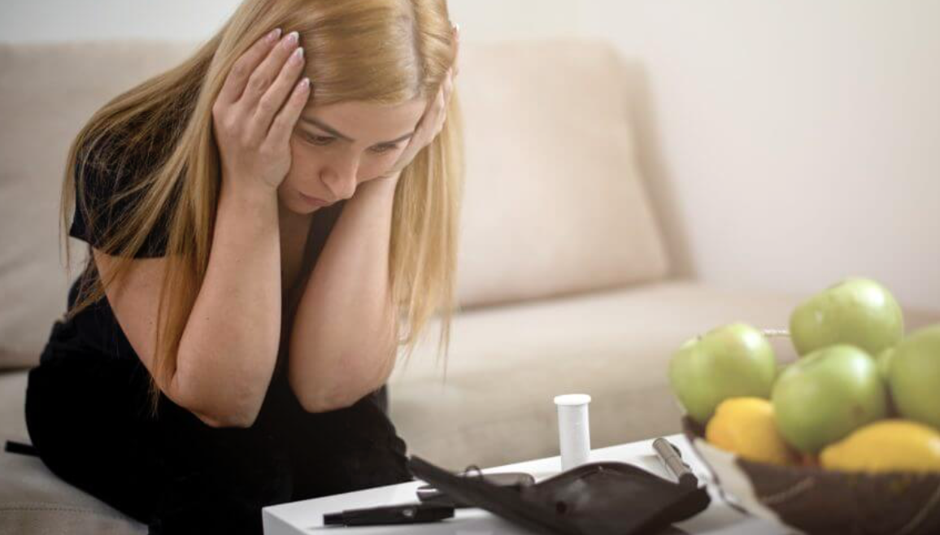
Patients with have many needs
Education that cannot be done just in the clinic
Social support and spiritual growth
It is difficult to address or know about many social and spiritual issues since their medical needs are so extensive

Slide 10
Community Partners: Where to look for CHWs?
Churches are often a source
Why? They often know and are respected by the community
They also often already have a relationship with community members?
Have experience working in the community
Bring a holistic approach to care
Do you have other community partners you might suggest?
Notes:
Allow time to think through and discuss areas to form CHW groups and partnerships

Slide 11
Next Steps to becoming a CHW
Two ways to certify as a CHW in Texas
Fill out CHW application to grandfather in
Let CHW Instructors know if you are interested and able to take the 160 hour course
Notes:
Make sure to bring applications!

Slide 12
Questions?

Slide 13
Session #2: The Importance of CHW Advocacy

Slide 14
Introductions
State your name and favorite food
In the chat state 1-2 things you would like to learn (…or not want to learn?) in CHW training (needs assessment)

Slide 15
Announcements

Slide 16
Objectives
Review CHW value as advocates and roles
Describe telehealth logistics

Slide 17
Objective #1: The Value of CHWs-Definitions
Frontline public health workers
trusted community members
have an unusually close understanding of the community served…
liaisons between services and the community
to increase access to services
CHWs build capacity
by increasing knowledge and self-sufficiency
through outreach, community education, informal counseling, social support, and advocacy
Source: American Public Health Association

Slide 18
Below are some Categories CHWs may advocate: Do you have an example of one?
Disseminate/spread information
Help with referrals
Culturally sensitive – Help leave judgment, bias, or stereotype at the door
Identify disparities
Notes:
Go through each case and provider time for each participant to provide specific examples
Help them see what might happen if a CHW is not involved

Slide 19
While you support others, we will support you: WHY?
CHWs often have the MOST contact with patients but the LEAST amount of support

Slide 20
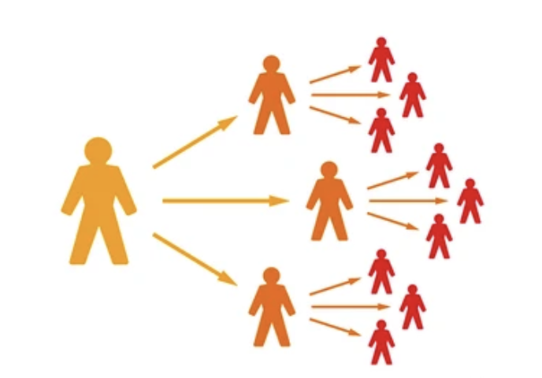
Supporting you: Training
Notes:
Discuss ways our program supports CHWs when they have questions in the field or during team meetings

Slide 21
Objective #2: ZOOM Basics
Make sure your video is on AND we can see your face☺
Keep your mute OFF! So you can speak like we are together…
Unless there is noise in background (your square turns GREEN)

Slide 22
Top “no-Nos” on ZOOM
Video turned off
Your mute is ON (unless it’s loud behind you)
Eating
You only love to see your box highlighted (talking)
Not realizing the host see can see your private messages or know if you click on another screen
Joining late
Not looking at the camera or face not in the camera
Looking uninterested
Forgetting that you’re wearing your PJs on the bottom
Not aware of what’s in your background

Slide 23
Case study

Slide 24
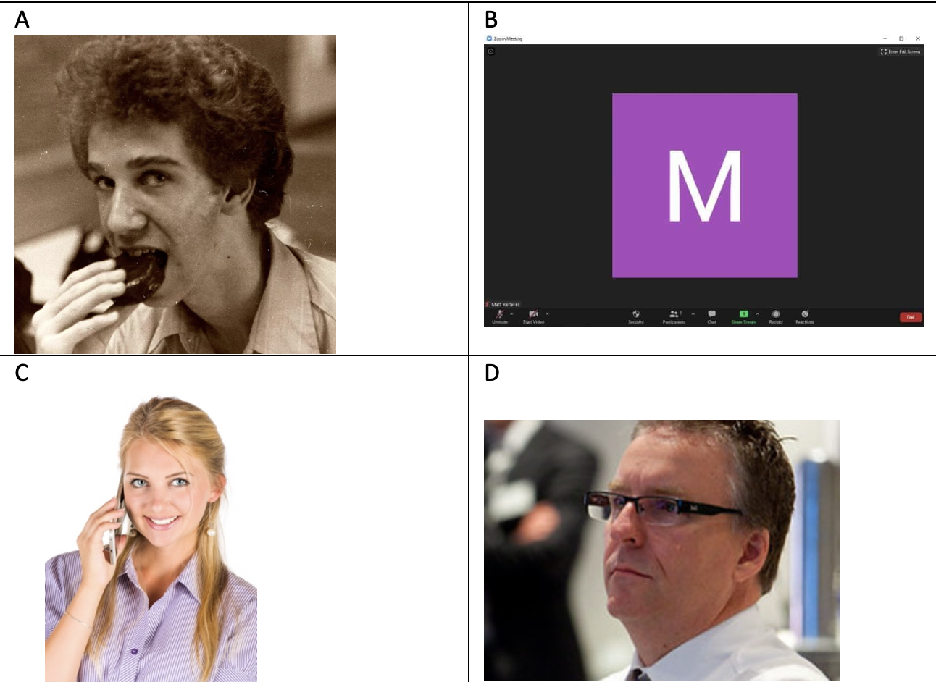
Case Study
You are attending the weekly ZOOM training. Which picture best describes how you hope your other CHW look while LISTENING to the presentation? Name 2 reasons why you chose your answer and not the other pictures.

Slide 25
Summary of Today’s points
Advocacy is a major way you help your patients
While you’re on ZOOM, do your best to act as though you were in-person
Review the chat – what you’d like during this training

Slide 26
Assignments this week

Slide 27
Questions, Comments, Concerns?

Slide 28
Session #3 Outreach: Working in Healthcare

Slide 29
Questions or Comments
Write in the chat 1 or 2 things you learned from your reading last week

Slide 30
Announcements

Slide 31
Objectives
Recognize Care Gaps
Define HIPPA and PHI
Identify Ways to recruit patients

Slide 32
Objective#1: Recognize Care gaps

Slide 33
Three major barriers to Healthcare Access
System-related
Clinic hours
Pharmacy issue
Provider-related
Language barriers
Insufficient communication
Medication cost
Patient-related
Transportation
Education
Treatment adherence
Wrong orders

Slide 34
Case study

Slide 35
One of your patients lets you that his blood sugar has been running high. He is not sure what to do. How do you respond?
Potential answers: ask what numbers he has been getting, if fasting or not, for how long; if he has been taking his medications and, if so, which ones
Key point: get as much HISTORY as possible so you can help
He lets you know his sugars are in the 200s and they use to be in the 100s. He stopped taking his medications because he ran out and cannot get ahold of the clinic. What do you say?
Potential answers: ask if he has refills and walk through how to look on the bottle for refills, ask what clinic number he has been calling at the clinic, if he has left a message (if that is the clinic protocol), and give him other numbers to call if available.
He tells you that he has called all the numbers you suggested and left a message per clinic protocol but has not heard back. He does not think he is scheduled for any appointments either. Now what do you say?
Potential answers: it sounds like he has done what he can do –let him know that if his sugars go to urgent levels (>400) to go to the ED and that in the meantime, you’ll let the clinic know

Slide 36
Objective#2: define HIPPA and PHI

Slide 37
HIPAA
What is HIPPA?
Health Insurance Portability and Accountability Act of 1996
Federal law that created national standards to protect PHI
Patient Health Information (PHI) disclosure without patient consent
What are examples of PHI?

Slide 38
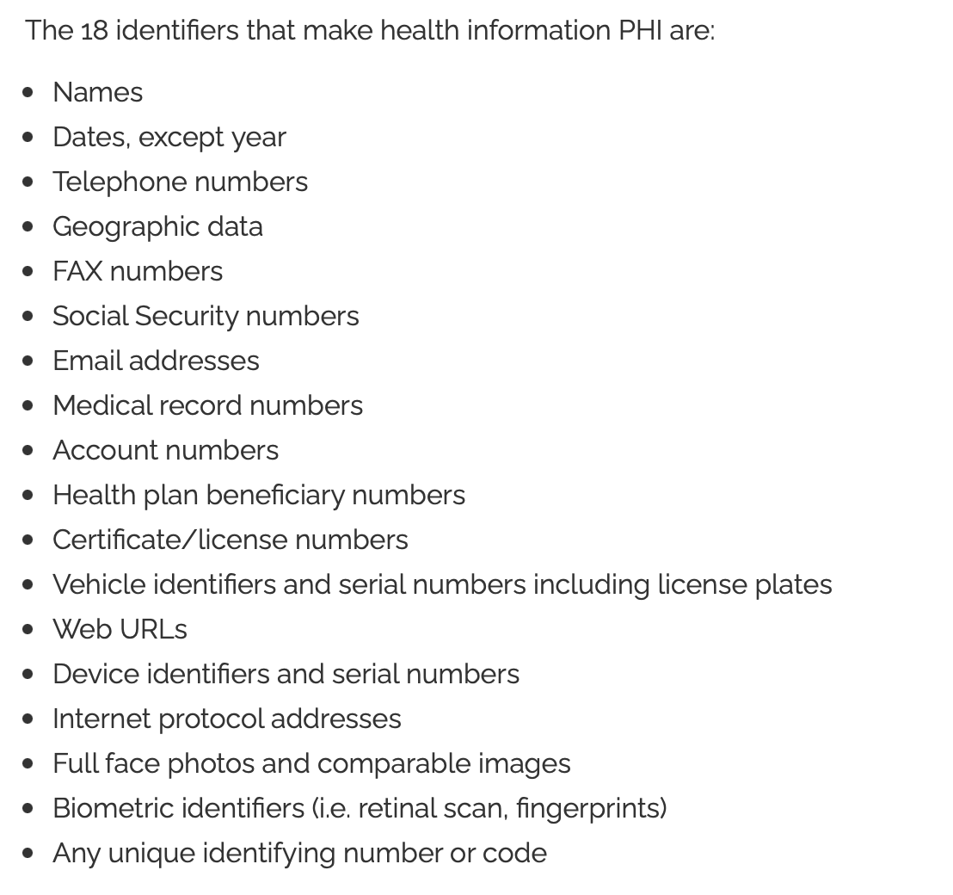
Protected health Information: PHI

Slide 39
Case study

Slide 40
You are a new CHW and call your patient, Mario. He is not home so you leave a message on Mario’s cell phone that his doctor told you that his blood sugars are getting better and looks forward to his appointment next Tuesday at 10AM. His friend (Jose) calls you back from Mario’s phone and asks if everything is OK.
You ask Jose if Mario has been taking his blood pressure and diabetes pills. Jose thinks he has but is not sure, so he texts another friend, and he reports that he is taking his pills. You tell Jose not to let Mario forget his appointment for diabetes. You think the doctor might need to do a prostate exam at the appointment Tuesday and tell Jose to tell Mario to allow a little more time at the doctor that day.
Are there any issues HIPAA violations in the case?

Slide 41
You are a new CHW and call your patient, Mario. He is not home so you leave a message on Mario’s cell phone that his doctor told you that his blood sugars are getting better and looks forward to his appointment next Tuesday at 10AM. His friend (Jose) calls you back from Mario’s phone and asks if everything is OK.
You ask Jose if Mario has been taking his blood pressure and diabetes pills. Jose thinks he has but is not sure, so he texts another friend, and he reports that he is taking his pills. You tell Jose not to let Mario forget his appointment for diabetes. You think the doctor might need to do a prostate exam at the appointment Tuesday and tell Jose to tell Mario to allow a little more time at the doctor that day.
Are there any issues HIPAA violations in the case?
Notes:
The areas in red highlight breach of HIPAA/PHI

Slide 42
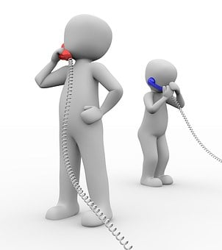
Objective#3: Identify ways to recruit patients

Slide 43
Why do CHWs Call the Patients?
In our prior projects, we found that patients were more likely to say YES to the doctor (than CHW)
but then did not come
Patients were more likely to say NO to a CHWs…but those who said YES…came
CHWs were very helping in getting other information like why they do not participate so we could adjust the program

Slide 44
Case study

Slide 45
You are assigned 100 patients to call this week for a program. You are convinced that you alone will get the 50 patients needed to enter the program. You cannot find the script anywhere so you decide to “wing it”.
The first 15 numbers are disconnected. The next 10 patients tell you “no”, but you tell them they better show up “or else”. The next 15 patients tell you ”yes”. You take a break for coffee. You feel that you deserve it….or need it. You reflect on your experience calling patients. What do you think you did right? Could improve?
Did right – 15 people entered the program, called patients, didn’t give up
Improve – use the script, know it’s a team effort, it’s OK to say “no”

Slide 46
Recruiting recap
Participation is voluntary
If they say “no”, ask why…did they understand the program?
If voicemail, do not leave confidential information (”since you have xxx disease or condition you can join our program…”)
If yes, make sure they know where and when to go
If voicemail, try FIVE total times at different days/time

Slide 47
Summary of Today’s points
Access to care has many parts including patient-, system-, and providers
CHWs can play a major role in keeping patients eligible for medications and the clinic
Calling patients can be fun…and can take a lot of patience

Slide 48
Reading Assignment this week

Slide 49
Questions, Comments, Concerns?

Slide 50
Session #4: Outreach-Site Set-up

Slide 51
Write in the chat 1 or 2 things you learned from your reading last week

Slide 52
Objectives
Discuss clinic policies & procedures
Increase awareness about Eligibility

Slide 53
Announcements

Slide 54
Objective #1: Increase awareness about eligibility

Slide 55
Eligibility
Clinic or community organization eligibility may include:
Income requirements
Cannot have other insurance
Renewal every year
Medication eligibility may include:
Patients who apply to take “expensive” medications may need to re-apply every year
Notes:
Make sure to know the various requirements for the site you work including renewals
If you work in clinical settings, it is important to understand what system they use for patients to obtain their medications, such as their own pharmacy (do patients pay and how much?) or federal programs like PAP. This is a major way CHWs can advocate

Slide 56
How CHWs can help with eligibility
Find out if their medications require renewal
Ask them if they need help applying/renewing
Remind patients to renew their clinic/medication paperwork
Start early (3 - 4 months before deadline) – these things can take a long time

Slide 57
Objective#2: Discuss clinic Policies and Procedures
Notes:
Allow time to discuss site-specific information including volunteer and employee hiring processes (what is needed and the timeframe), overall structure of the clinic, technology needs, etc.
If a clinic/organization team member can come as a guest speaker for 5-10 minutes to orient to their site, that would be valuable or allow time for CHWs/instructors already familiar with the site to explain day-to-day operations.

Slide 58
Reading Assignment this week

Slide 59
Questions…. Comments

Slide 60
Session #5: Outreach – Real World Issues

Slide 61
Write in the chat 1 or 2 things you learned from your reading last week

Slide 62
Objectives
Decipher emergent vs. non-emergent situations
2
Recognize learning sytles
3
Identify needs in Maslow's pyramid
1

Slide 63
Announcements

Slide 64
Objective#1: identify needs in Maslow’s pyramid
Notes:
(he actually used a triangle…but pyramid sounds better…”

Slide 65
Maslow’s Hierarchy of Needs Source: Desmet et al, 2020
Notes:
Desmet, P.; Fokkinga, S. Beyond Maslow’s Pyramid: Introducing a Typology of Thirteen Fundamental Needs for Human-Centered Design. Multimodal Technol. Interact. 2020, 4, 38. https://doi.org/10.3390/mti4030038
Individuals tend to start at the bottom and move up in the hierarchy of needs; often in healthcare, we address the middle or upper needs, e.g., weight loss, taking medications, healthy living but until basic needs are met, e.g., food and safety, it is very challenging to achieve these goals. This is a major way CHWs contribute to patient care – ensuring patient needs are met and bridging them to care.

Slide 66
Objective#2: Decipher emergent vs non-emergent Situations

Slide 67
Definitions
Emergent:
An emerging condition requiring immediate attention
Non-emergent
NOT requiring quick or immediate attention
Why do CHWs need to know emergent vs non-emergent?

Slide 68
TRUST
Patients may tell CHWs concerns and not their doctor
SAFETY
Keep patients safe by knowing when to get help
CONNECT
CHWs are the bridge to better health!

Slide 69
Case study

Slide 70
#1
Alma’s patient, Miguel who has type 2 diabetes, obesity, and high blood pressure calls her and tells her that his hand is a little numb. He wonders what he should do.
Potential answers – get more history (how long, any injury or anything different about today, anything else wrong)
When his wife hears Miguel talking to Alma, she takes to phone and tell her that this just happened 10 minutes ago, it has never happened before, he refused to call the clinic or go to the ED until he talked to Alma. He hasn’t been taking his blood pressure pills and their home readings have been high. Do you think this is emergent or non-emergent?
It is an getting worse, has warning signs (never had before, not taking blood pressure pills, having high readings at home): emergent
What should Alma do?
Potential answers
– ask to speak to the husband again (he didn’t give permission to speak to the wife and he may listen to Alma if she speaks directly to him)
Tell him this sounds like an emergency and he needs to call 911/go to the ED now
See if they know his blood pressure readings /take the machine to the ED to help staff know more
Notes:
Make sure to alert the clinic so this can be documented in the chart and other providers will know what happened. In our case, you will alert the CHW champion

Slide 71
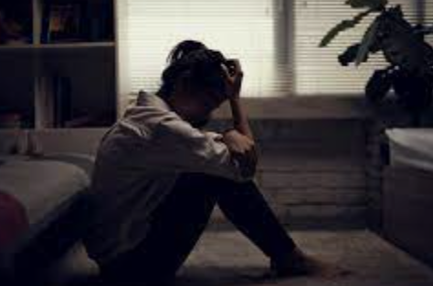
#2
Lucy is a CHW. She is concerned about her patient, Maria, a 45 year-old woman with four children who has been very stressed lately. She is having difficultly paying bills. Her husband works full-time but she does not think he is telling the truth about his income. She thinks that he may be seeing another woman and spending money on her. She is overwhelmed with her children, trying to work when available but has little time to do so. The last few months, she seems more and more distant when Lucy speaks to her. What might Lucy ask to help determine is this an emergent or non-emergent concern?
Potential answers – are you thinking of hurting yourself or others?
Maria thanks Lucy for her concern and, though she is very sad, she states that she would never hurt herself or others. Do you think this an emergent or non-emergent issue?
It is an emerging but slowly over months and not minutes or hours. There are no signs of Maria or others being in danger that need quick or immediate attention. This is likely neither. BUT she still needs help.
What should Lucy do?
Potential answers
Provide community resources (marital counseling, therapy, clinic resources, church or faith-based support)
Ask Maria if she can contact her doctor so this can be documented in the chart. Written is preferred (without PHI) to document what you did
Let Maria know that if she ever feels like she might harm herself or others to call 911 immediately

Slide 72
Objective #3 Recognize Learning Styles

Slide 73
Stages of change
Can you think of an example of each step?
Precontemplation
Contemplation
Preparation
Action
Maintenance
Relapse

Slide 74
What are the Main Learning styles?
Auditory
Visual
Tactile
Auditory
Visual
Tactile

Slide 75
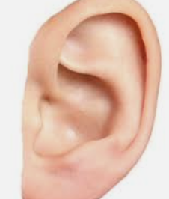
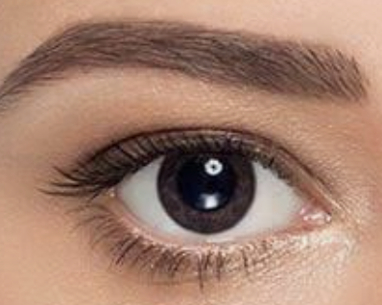
Learning Styles
Auditory
Visual
Tactile
Learns by hearing
May be able to repeat conversations word for word
Communicates comprehension saying “I hear you”
Must see to learn
Pictures help remember
Communicates comprehension saying "I see"
Movement with ideas helps learning
Has difficulty sitting and listening
Doing other activities (knitting) while listening may help learning

Slide 76
Teaching various learning styles
Auditory
Speak positive reinforcement
Read aloud
Visual
Write positive comments
Encourage note taking/drawing
Make sure learner can see you/pictures
Group conversations
Tactile
Encourage active learning
Provide hands-on opportunities
Try to be OK with the learner not sitting still☺

Slide 77
What type of Learner are you?
Auditory?
Visual?
Tactile?
Or (like most people) a mix?
Since most people are a mixture, it’s important to vary our teaching styles

Slide 78
Case study

Slide 79
You sit next to a patient who is in your Nutrition Class at the clinic. He is fairly quiet but answers when asked about your class, he can tell you word for word what you said! When you teach, he is very engaged listening to lectures. At the end you asked if there are any questions and he responded, “No, I hear you and understand.”
You are trying to find a way to determine if you are effectively teaching him and meeting his need and think figuring out his learning style might be a good start. What do you think is his learning style?
Likely auditory (”I hear you”, repeats word for word)
What can you do to meet the needs of an auditory learner?
Possible responses – speak positive reinforcement, have group conversations, read aloud

Slide 80
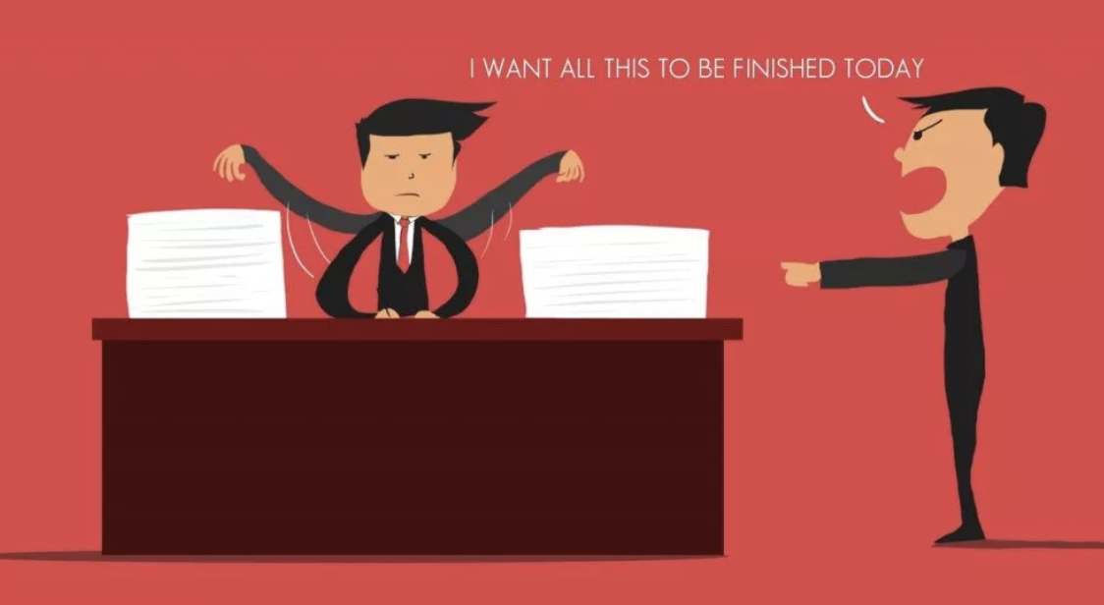
Reading Assignment this week

Slide 81
Questions and Comments

