Slide 1
CHW training: Running Group visits
Monica Arano, CHWI
Rosy Diaz, CHWI
Sandra Flamenco, CHWI
Betty Nava, CHWI
Noé Taracena, CHWI
Dr. Elizabeth Vaughan

Slide 2
Objectives
Learn how to get diabetes classes up and running, from calling the patient to the first class
Identify diabetes (and related) medications
Describe medication safety concerns including low blood sugar and side effects

Slide 3
Module 1 Recruitment #1

Slide 4
Team building/sharing Questions, or concerns?

Slide 5
how?
Each CHW/CHWI group has 30-35 patients to call
■CHWIs: Make sure the Excel sheet is correct Every week you will have some to call We will provide a text to invite you

Slide 6
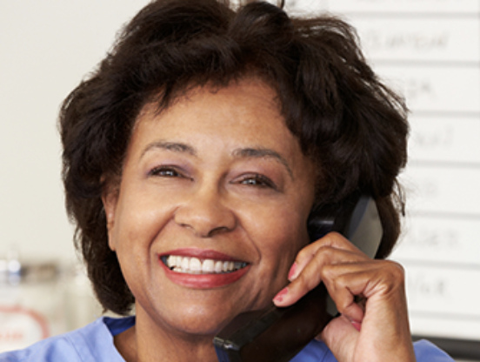
Script
Notes:
There is a script in English and in Spanish. You don’t need to say it word for word.
Keep it SIMPLE and brief. If they ask questions, answer them (or if you don’t know let them know you will get back to them with an answer).
You don’t want to be on the phone a long time the first time as they might think the program will take a lot of their time.

Slide 7
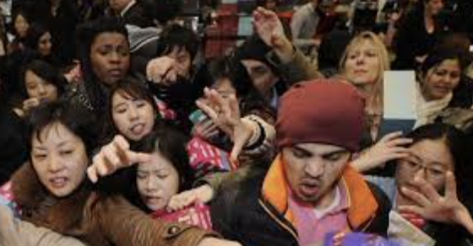
Time to tell your patients
Why? Spacing People What if my patient can't come at the allotted time? ■You can come when you need to Times:
Group 1: 8:00
Group 2: 8:30
Group 3: 9:00
Group 4: 9:30
Group 5: 10:00
Group 6: 10:30
Notes:
Each CHWI/CHW pair will have a specific time to come.
*Assign groups here

Slide 8
Small groups CHWs-CHWIs: To do
Get your cell phone.
Mute your ZOOM and turn off your video
CHWs call your patient (CHWI) and invite him/her to the class
Make sure you remember “your” time to tell him/her to come, e.g., group 1 is 8:30
Notes:
Help CHWs remember the time to come if needed

Slide 9
What did he/she say?
Notes:
yes/no/maybe… or did you get voicemail or disconnected?
How would you record this on the excel sheet?

Slide 10
Where is the patient information sheet?
CHWIs
CHWs
☺
Notes:
The information is uploaded into BOX. You will get an invitation for an Excel sheet in BOX. Your CHWI will help guide you through this process

Slide 11
What to write in Excel sheet
"1" means yes
Notes:
Here is what the excel sheet looks like. These are not real patients.
So we align with HIPAA use OhMD when you use their name, birthday, etc. (not text message)
You will have their name, gender, phone, and age. Then you will record how they responded. Also write the time that they will come.
Some patients will not be able to come at your assigned timed. That’s OK. Just write the time they will come here.
For example, Mr. Gonzalez is a male whose phone number is XXX and is XX years old. He said that he will come at 8:30.
What did Ms. Sanchez and Rodriquez say?

Slide 12
Common reasons to say no
Work Transportation Eligibility I don't need it My health is poor
Notes:
Here are common reasons patients say no.
For the ones circled, those might be fixable. In other words, if they say their health is poor, that is a good reason to come. Or, if they lost eligibility we may be able to work with the clinic to help them get it back if they want to join.
What might you say if they say they don’t need it? (try to find out why they said this, do they understand the program, etc)

Slide 13
Notes:
We talked before about PHI and HIPAA. It’s really important to not have any patient information written down or on a laptop. If you need to write notes, use their patient ID number. The Excel sheet in BOX is secure. Just don’t download it to your computer.

Slide 14
SUMMARY: Recruitment
Text can help guide you ■ Participation is voluntary If they say yes ■ be sure you know when (Sept 10 to XX) and where (5th Street House) If they say "no" ■ Ask why? Did you understand the program? If you leave a voice message ■ Don't leave confidential information ■ "Because you have diabetes you can be in our program" Try 5 times in total at different times and days

Slide 15
Summary: Recruitment
If they say yes ■ Be sure you know when (Sept 10 to XX) and where (5th Street House) If they say "no" ■ Be sure you write the reason If you leave a voice message ■ Don't leave confidential information ■ Try 5 times in total at different times and days

Slide 16
Small groups with your CHWI – to do
1. Discuss any questions or concerns you have about calling patients
2. Work to log onto Excel
3. Practice recording patients
***CHWIs: ultimately in charge of making sure BOX is correct

Slide 17
This week: Time to call!
Everyone has an invitation to the patient list
This week call 5 total patients for CHWI/CHW team

Slide 18
Questions, comments, concerns

Slide 19
Module 2 Recruitment #2

Slide 20
Team building/sharing Questions, or concerns?

Slide 21
Tonight’s agenda - how is it going?
Discuss how calling patients is going
What questions to you have?
Any hiccups?
What went well…what could go better?
Any suggestions?
This week call ________ patients
Groups need ______ to say “yes”
Person(s) with the most “yes” AND show will get a prize
Notes:
CHWI – this week is to review anything from last week and answer CHW questions about calling patients

Slide 22
Module 3 Orientation #1

Slide 23
Team building/sharing Questions, or concerns?
Notes:
This week is an overview of orientation
Next week we will discuss who does what (let your CHWI know if you have preferences)

Slide 24
Orientation: Summary
Notes:
Orientation is a time for everyone interested in the program to come. It allows us the ability to get their blood drawn, surveys, consents, etc. We set it up like a health fair where patients can come and go to stations as they want
At orientation, we Will assign group 1 and group 2, one will be in the program and one will stay in the clinic. It is completely random
Every patient who comes (not their family) will get a $25 gift card from Walmart at orientation. At the end of the program, both group 1 and group 2 Will get another $25 gift card for getting their 12-month labs and surveys done.

Slide 25
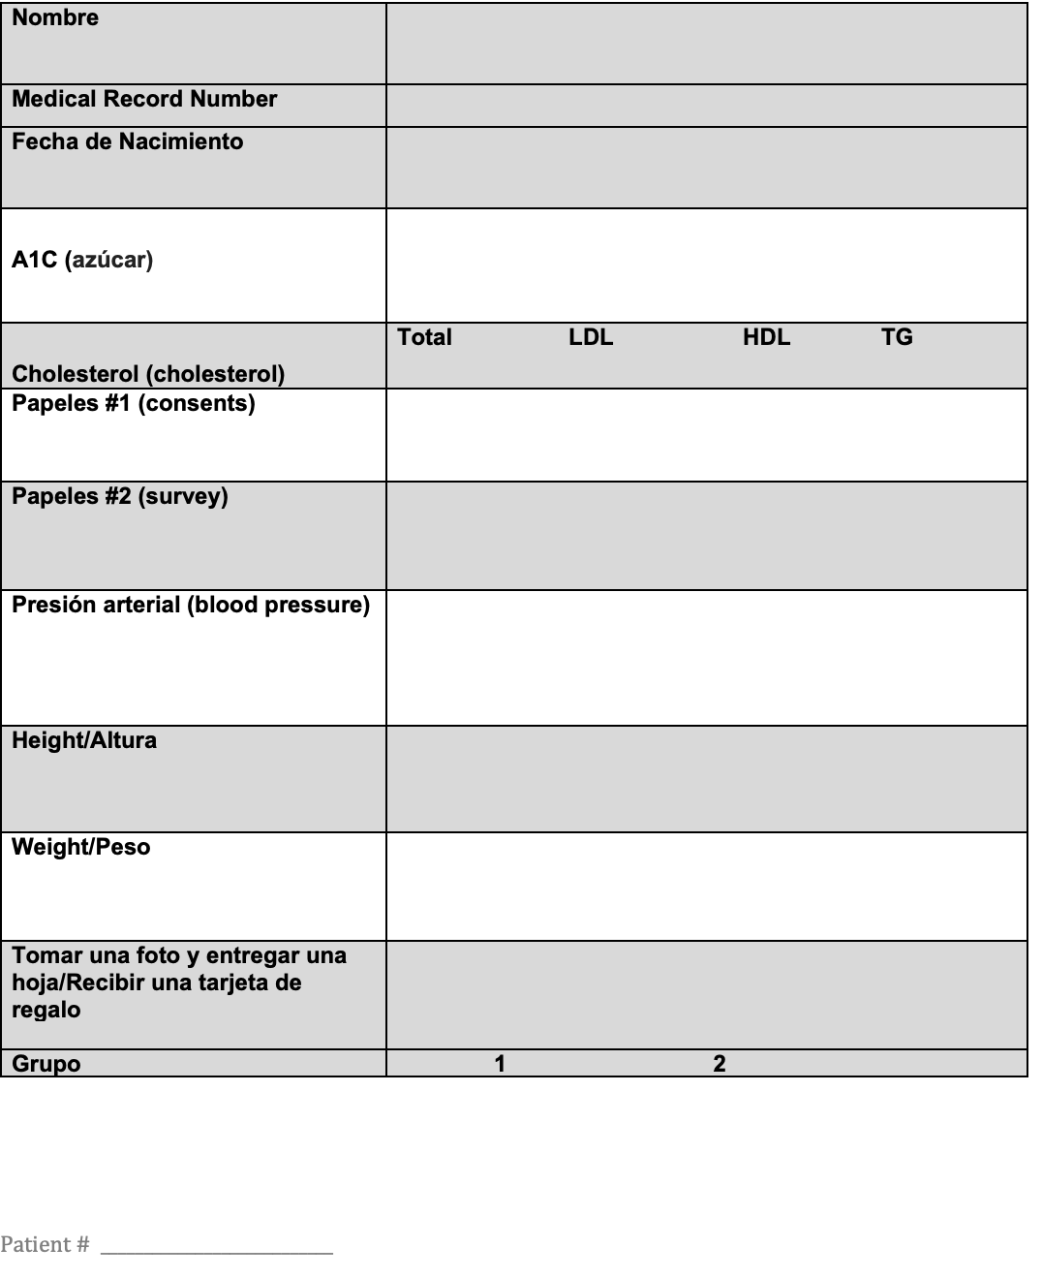
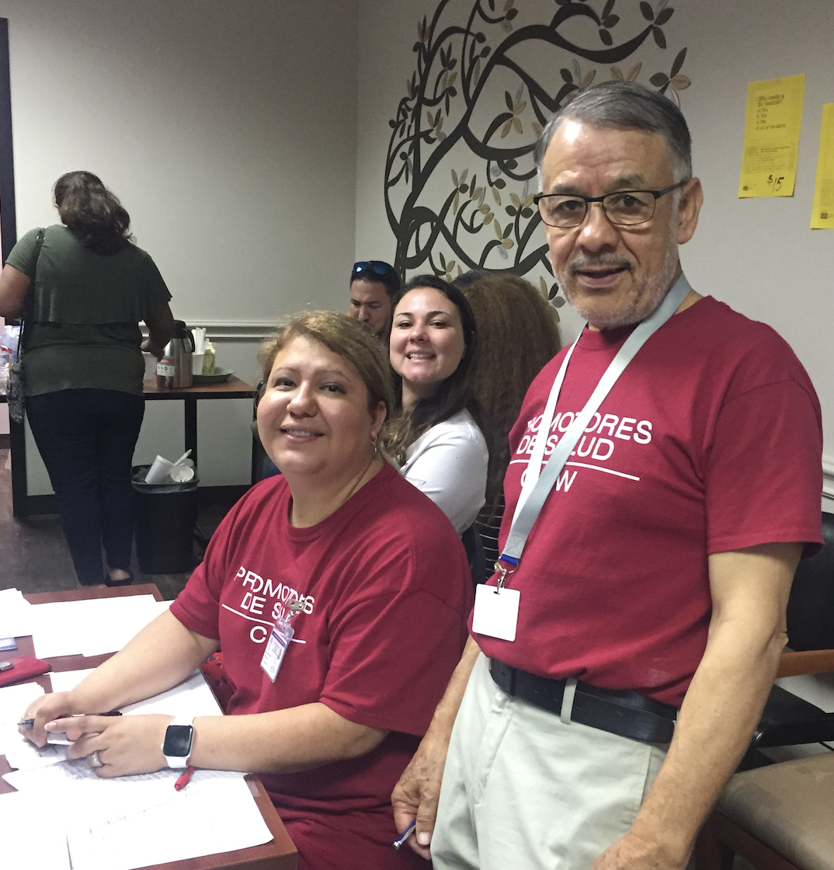
Notes:
Here is an example of what the sheet looks like. Each station is highlighted differently. For example, registration station will do name, medical record number, birthday, and consent. Another station will be A1c, etc.
CHWIs will lead the stations and CHWs will assist until they feel comfortable on their on, working in teams of 2 at each station or station groups.
We will all learn the stations to help out each other if needed. I will assign a station to you but if there another one you’d like to do, please let me know.
Let’s learn about the stations now.

Slide 26
Station 1: Register -
Notes:
Station 1: Registration (make sure to change the CHW names here for future classes)
1. You will have a printed excel sheet of everyone who said that they are going to come and their name, MRN, and birthday. When they come, there will be a space on the excel sheet to check that they are there
2. Write their first and last name, medical record number, and birthday from the sheet. Ask them to sign the consent to participate
3. Let them know that this is like a health fair – and at the end the patient will receive a $25 gift card for completing the sheet.
To complete the sheet, go to the stations in any order desired. Once complete, come back to this desk to receive their gift card.
**Make sure to ask if they have a family member/close friend coming today so we can put them in the same group

Slide 27
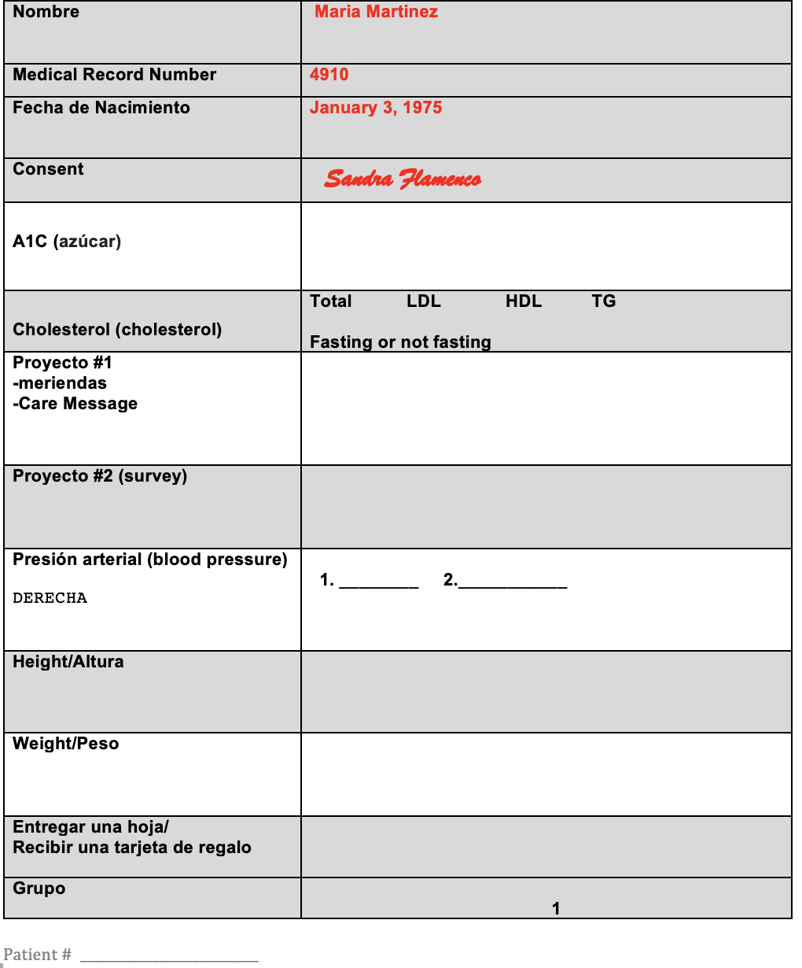
Station 1: Register
Notes:
At the end of station one, here is how the sheet should look
Now moving onto A1c (but remember, they can go wherever they want. That helps avoid long lines)
BUT if not line at A1c and Cholesterol, get them to go there first since those tend to back up
We will go through these in order but patients do not have to

Slide 28
ProJect #1
Notes:
-Explain the program to them and good things about it. Answer questions. Make sure they understand the three forms they signed. Participation is voluntary and they can leave the group at any point and will receive the same care at the clinic.
-Explain group 1 (program) vs. group 2 (same care in the clinic). We will tell them their group at the end). Everything is random. If not in the program, we are planning to have another after this and they will be first call

Slide 29
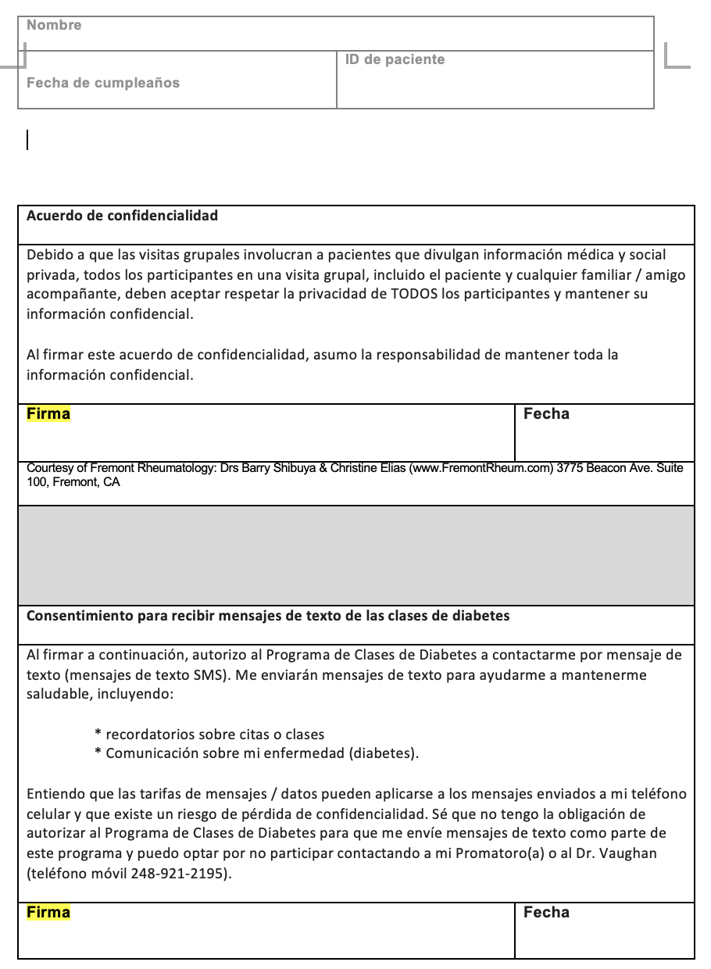
Notes:
The consent form will look like this. There are TWO pages and THREE places to sign and date.
1. Page one – this is consent to participate. Sign it above “sujeto” and date it using US system like September 1, 2022 is 9/1/22 (not 1/9/22). Victoria will and sign and date for Testigo.
No other signatures are needed here. Print the full name and write the medical record number on the top of the form
2. Page two – this is a reminder that everything in the class stays in the class (confidentiality) and permission to text them on their cell phones. CHWs fill out the name, birthday, and patient ID. They sign and date in TWO places.

Slide 30
Consent
Patient name
MRN 9999
Patient’s name
Jan 1, 1975 9999
Patient’s signature 9/10/22
Patient’s signature 9/10/22
Patient’s signature 9/10/22
Notes:
At the end, the forms might look like this (but in blue or black ink)
Notice – page 1 the patient and staff member signed and dated it. Same for page 2.
Also on the top right on page 1, notice the CHW wrote her name and medical record number (sometimes we cannot read their handwriting)
We will have these in Spanish. We do have English copies but Baylor made them 5 pages long so unless someone requests English, use Spanish

Slide 31
A1c
Notes:
A1c takes 5-10 minutes. It is a fingerstick test and does not require blood draw (like checking their blood sugar on the glucometer)
2. They can go onto other stations instead of waiting BUT must come back to get their number. Sometimes there is an error for A1c and they have to redo it SO always have 1-2 people waiting to get A1cs. This is where lines can get really long if we don’t get people there first
3. We will have four machines!
4. You will have an excel sheet with their names. Write their A1c on the excel sheet AND their sheet

Slide 32
Cholesterol
Notes:
The cholesterol station is similar to A1c - fingerstick, takes 5-10 minutes, they can go elsewhere while waiting for their value, and lines can get long.
Make sure there is always a person or two in line and get them here first so we do not have a lot of people at the end.
Write fasting or not fasting on their sheet. If not fasting write what they ate like “eggs, dry toast, cereal”
You will have an excel sheet with their names. Write their A1c on the excel sheet AND their sheet

Slide 33
Module 4 Orientation #2

Slide 34
Team building/sharing Questions, or concerns?
Notes:
This week is an overview of orientation
Next week we will discuss who does what (let your CHWI know if you have preferences)

Slide 35
Project #2
Notes:
Project #2 is surveys. Do in a group if possible and read out loud. It’s possible that some patients cannot read or write so reading out loud will help, but also be aware of the need to write for them if needed.
Some patients may not see well so may need your help too.
Make sure they understand what is “good” and “bad” (like 10 is agree/good) but “1” is disagree/bad
Sign their sheet when done
(this isn’t the exact survey we will use)

Slide 36
Blood pressure
140 or higher
90 or higher
= REPEAT in 5 minutes
Notes:
1. Clothing: should be lightweight (no jackets, sweaters)
2. Position: feet on floor. Arm resting on table at 90 degrees
3. Measure the right arm only. If the top is 140 or higher OR the bottom is 90 or higher, ask them to come back in 5 minutes to repeat.
When repeat, right arm, write down the numbers on the excel sheet and patient sheet
**We need to have two BP machines going

Slide 37
Notes:
Here is how the sheet might be looking now.
Notice CHWs signed off on Project #1 and #2
Also, blood pressure was taken on the right. Since one number was high (either top 140 or higher, bottom 90 or higher), the patient was asked to come back in 5 minutes and the repeat

Slide 38
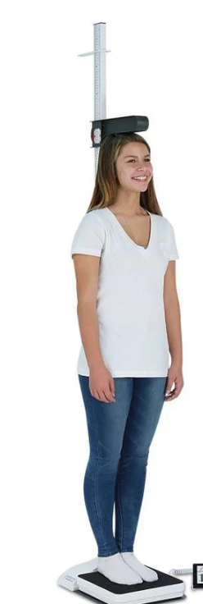
Taking height
Notes:
1. Make sure the patient is not wearing shoes
2. Pull up lever
3. Turn so Patient’s back is to the scale bar and Put lever on top of patient’s head
4. Read the number on the bar. It is in inches. Record as “62 inches” (not 62 or 62” since it could be confused as 6 feet, two inches or 62 inches (5 feet 2 inches)
5. Write the height on the patient sheet and the excel sheet

Slide 39
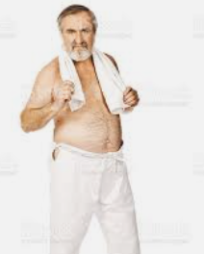
Taking Weight
Notes:
1. Make sure the scale is calibrated (balance in the middle when no one is on it). If not, get a MA or doctor to help you
2. Only lightweight clothes and no shoes
3. How to work the scale:
top and bottom squares are all the way to the left
move the bottom square to the right by the 50 pounds. It’s a guess when you first start.
move the top square to the right until the balance is in the middle. Up is too light. Down is too heavy. If it stays up the entire way, move the bottom square to one notch over to the next 50 pounds and try the top bar again. Repeat until it balance is in the middle
When done, write the value on the excel sheet and patient sheet

Slide 40
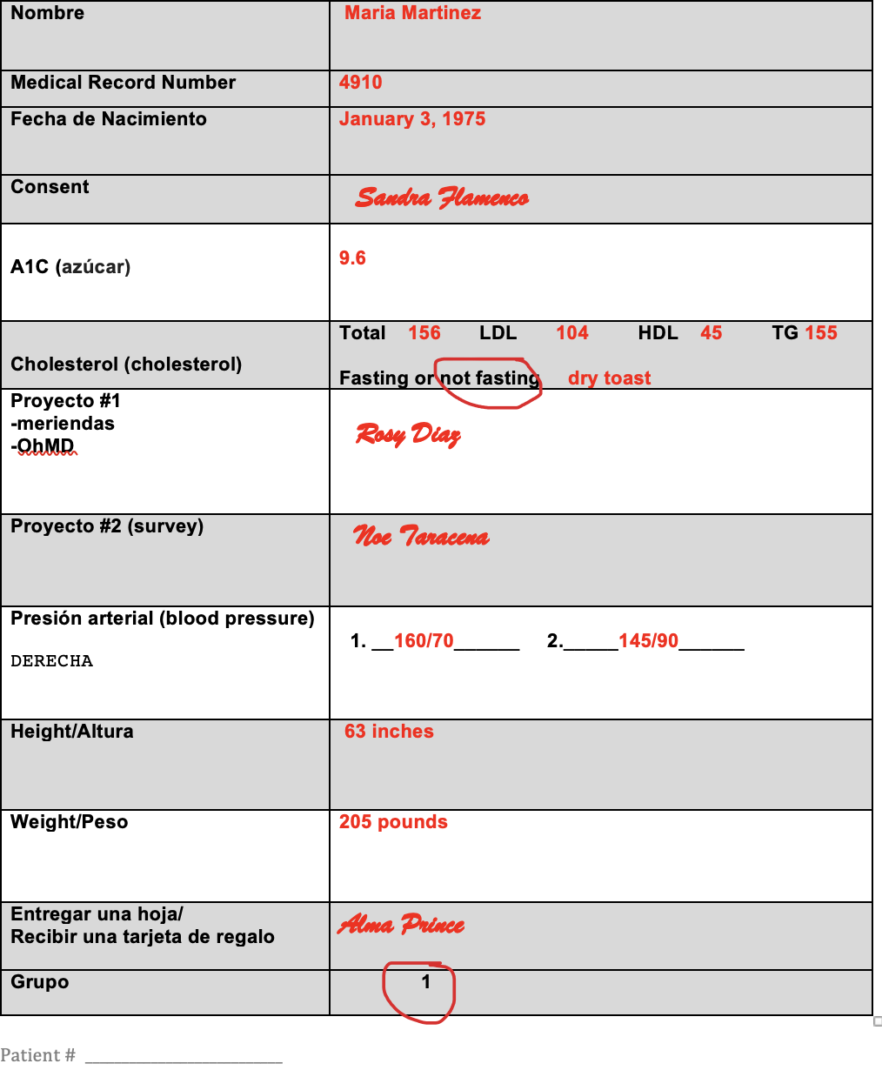
dismissal
Notes:
Here is what the sheet looks like now. Height and weight were recorded in inches and pounds
At the last station, sign the last row, they turn in the sheet (they might want to take a picture of it so they have their numbers), and give them a gift card.
Let them know if they are in Group 1 or Group 2 and explain each group

Slide 41
Group
Notes:
Group XXX is not in the classes.
We will have a handout for them with all of the events at Casa to support them in their health.
They should follow-up with their Casa provider to review the numbers from today (make sure they took a picture. We will also put in their chart)
They are not in this round of classes but we are working with the clinic to have future opportunities and will prioritize them
We will be checking on them again at the end of the year. If they come back next year to check on their labs and sugars, we will give them another $25 gift card. We will call to follow-up with them.

Slide 42
Group
January 20
February 17
March 24
April 14
May 26
June 16
Notes:
-Grupo XXX: is in the classes (make sure not to tell people this BEFORE this station!!)
-we will provide a sheet that has the dates on it something like this
-remind them that it is a one stop shop so they do not need to see their doctor for diabetes, blood pressure, or cholesterol and we will cancel those appointments for them when the class starts

Slide 43
Floaters
Notes:
Once they get their stations settled, Betty and Sandra will help where needed.
Yes, we will need to wear masks… or go along with current clinic policies.
Do patients need to wear masks?? (need to check with clinic before orientation)

Slide 44
Key Points
Learn all the stations, so you can help others if needed
CHWIs have done this a lot. They are there to support CHWs
Help patients know where to go!
Wear your CHW shirt
For many stations you will need to write on an Excel sheet AND patient sheet
This will make a lot more sense once you’re there

Slide 46
Module 5 Orientation #2

Slide 47
Team building/sharing Questions, or concerns?
Notes:
This week is an overview of orientation
Next week we will discuss who does what (let your CHWI know if you have preferences)

Slide 48
Tonight’s agenda
Review orientation sheet
Notes:
CHWI - go over the orientation sheet and who does what. Make sure to leave time for questions at the end.
After the meeting, send the orientation sheet to everyone

Slide 49
Module 6 Orientation Recap, planning Class #1

Slide 50
Team building/sharing Questions, or concerns?
Notes:
This week is an overview of orientation
Next week we will discuss who does what (let your CHWI know if you have preferences)

Slide 51
Important Points
You are “assigned” roles based on your interests and project needs
You are not STUCK in that role for eternity
The hope is that you swap roles with other CHWs
The better you know all roles, the more you can help others

Slide 52
An Overview of Saturday
Small groups: 10-11:30
8-9 patients
9:30-10
Large group
All patients
Medical
Social
Behavioral
8:30-9:30
Registration and Vitals
11:30-12
Lunch
8:30-9:30
Registration and Vitals

Slide 53
Floaters and Set-up
Notes:
Discuss the set up and floater CHWs, supplies and to-do

Slide 54
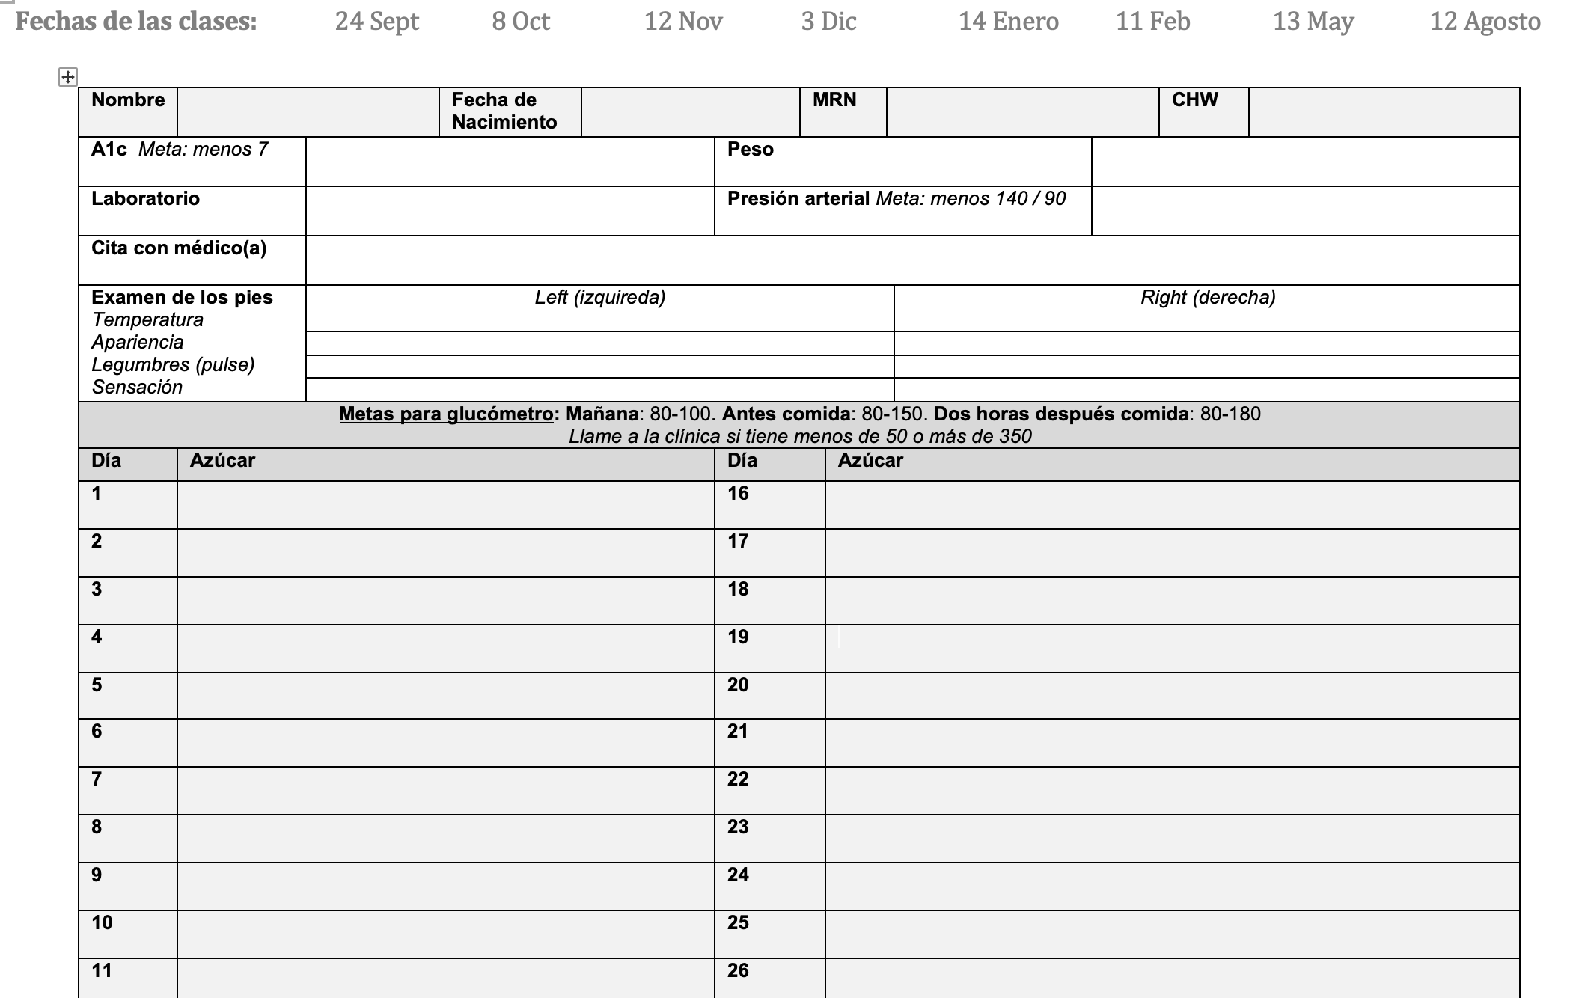
Notes:
Like orientation, patients will carry a sheet around with them. During class, we will fill out the top part circled in red.
We will prefill their name, birthday, MRN, and CHW
They take the sheet home with them and fill out their glucose values during the month and bring the sheet to the next class

Slide 55
Notes:
There is also a back of the sheet for them to fill out their medications during the month, what they are for, and why they take them
This may help some patients but overwhelm others. It is only to help and not mandatory.
You might work with them on it month two when we talk about medication adherence
Let’s look at the sheet closer

Slide 56
Notes:
Discuss the entrance/registration CHWs, supplies and to-do

Slide 57
Notes:
Discuss the blood pressure, weight, and foot exam CHWs, supplies and to-do
We have monofilament tests (keep it and sanitize between patients. They are expensive!!)

Slide 58
Diabetes Foot Exam
TAPS
Temperature
Appearance
Pulse
Sensation

Slide 59
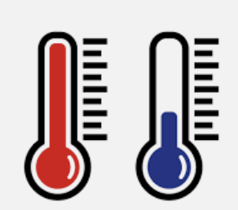
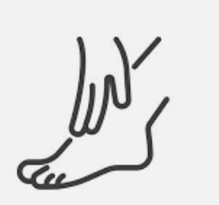
Let’s practice a foot exam
TAPS
After you take off your socks and shoes, feel your feet – how is your temperature?
What is the appearance of your feet?
Using your second and third fingers, can you feel a pulse on each foot?
Can you feel at the end of each of your toes (sensation)?
How would you document your exam?

Slide 60
Taking height
Notes:
1. (review) Make sure the patient is not wearing shoes
2. Pull up lever
3. Turn so Patient’s back is to the scale bar and Put lever on top of patient’s head
4. Read the number on the bar. It is in inches. Record as “62 inches” (not 62 or 62” since it could be confused as 6 feet, two inches or 62 inches (5 feet 2 inches)
5. Write the height on the patient sheet and the excel sheet

Slide 61
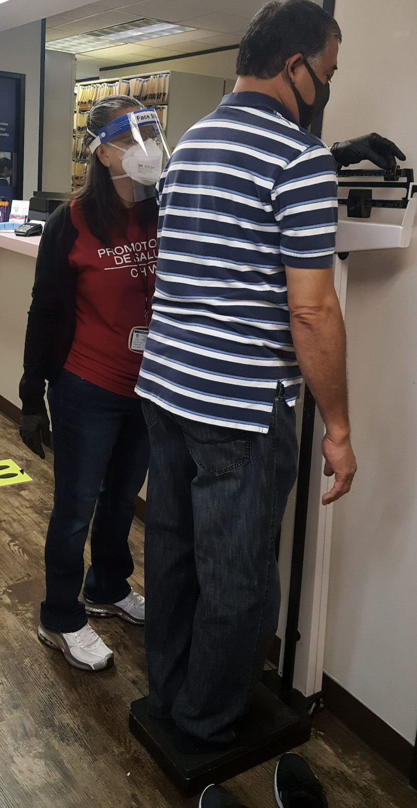
Taking Weight
Notes:
1.(review) Make sure the scale is calibrated (balance in the middle when no one is on it). If not, get a MA or doctor to help you
2. Only lightweight clothes and no shoes
3. How to work the scale:
top and bottom squares are all the way to the left
move the bottom square to the right by the 50 pounds. It’s a guess when you first start.
move the top square to the right until the balance is in the middle. Up is too light. Down is too heavy. If it stays up the entire way, move the bottom square to one notch over to the next 50 pounds and try the top bar again. Repeat until the balance is in the middle
When done, write the value on the excel sheet and patient sheet

Slide 62
Lab
Everyone gets an A1c every time (unless the doctor says differently)
Month 1
everyone gets a urine sample (drink water before class!)
If providers order labs, they will get the next class unless they are urgent
If urgent, the provider will send to the lab
If there is not time during the medical group, they can get during lunch
Notes:
Microalbumin urine helps show early signs of kidney damage
The treatment is controlling blood sugar

Slide 63
Large Group
Small groups: 10-11:30
8-9 patients
9:30-10
Large group
All patients
Medical
Social
Behavioral
8:30-9:30
Registration and Vitals
11:30-12
Lunch
8:30-9:30
Registration and Vitals
Month 1: Diabetes 101 | Month 2: Medication Adherence | Month 3: Nutrition | Month 4: Sex, Depression, and Intimacy
Month 5: Preventive Care | Month 6: Exercise | Month 9: Alcohol, Tobacco, and Diabetes | Month 12: Involving Your Family for Lifelong Healthy Living

Slide 64
ChildREN’s Nutrition Program
9:30: adults go to large group, kids to program
11:30: parents pick up kids, all eat together

Slide 65
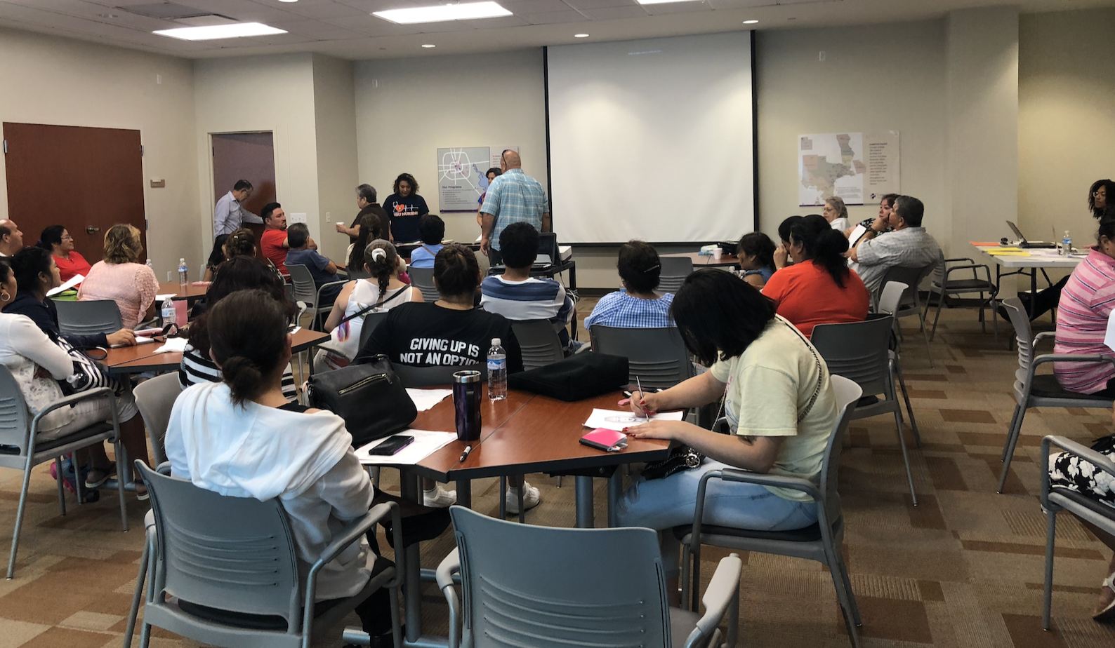
During Large Group

Slide 66
Where do patients go?
Large group
25 patients
Medical
8 patients
Social
8-9 patients
Behavioral/Ministry 8-9 patients
Rotate medical->social->ministry

Slide 67
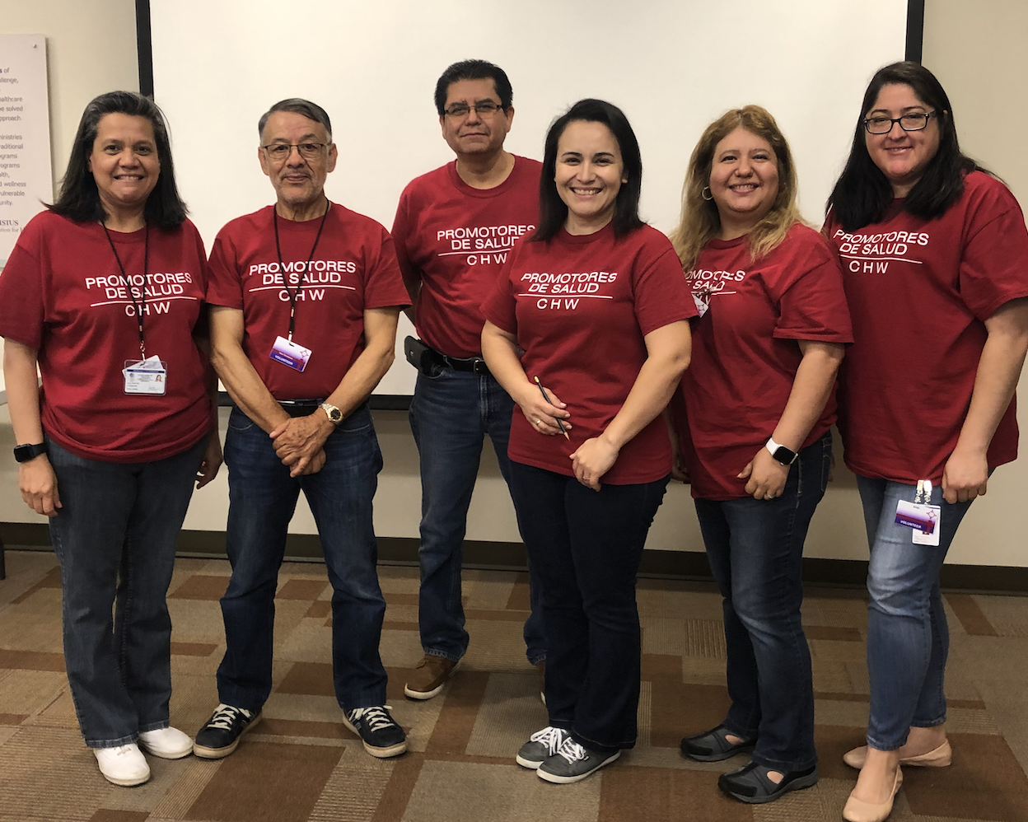
Key points
Help each other, learn each station
Keeping on time is really important (yes, please help the doctors)
Rotate groups at 25 and 55 past the hour so the next can start on time

Slide 68
Module 7 planning Class #1

Slide 69
Team building/sharing Questions, or concerns?
Notes:
This week is an overview of orientation
Next week we will discuss who does what (let your CHWI know if you have preferences)

Slide 70
Small Groups
Small groups: 10-11:30
8-9 patients
9:30-10
Large group
All patients
Medical
Social
Behavioral
8:30-9:30
Registration and Vitals
11:30-12
Lunch
8:30-9:30
Registration and Vitals

Slide 71
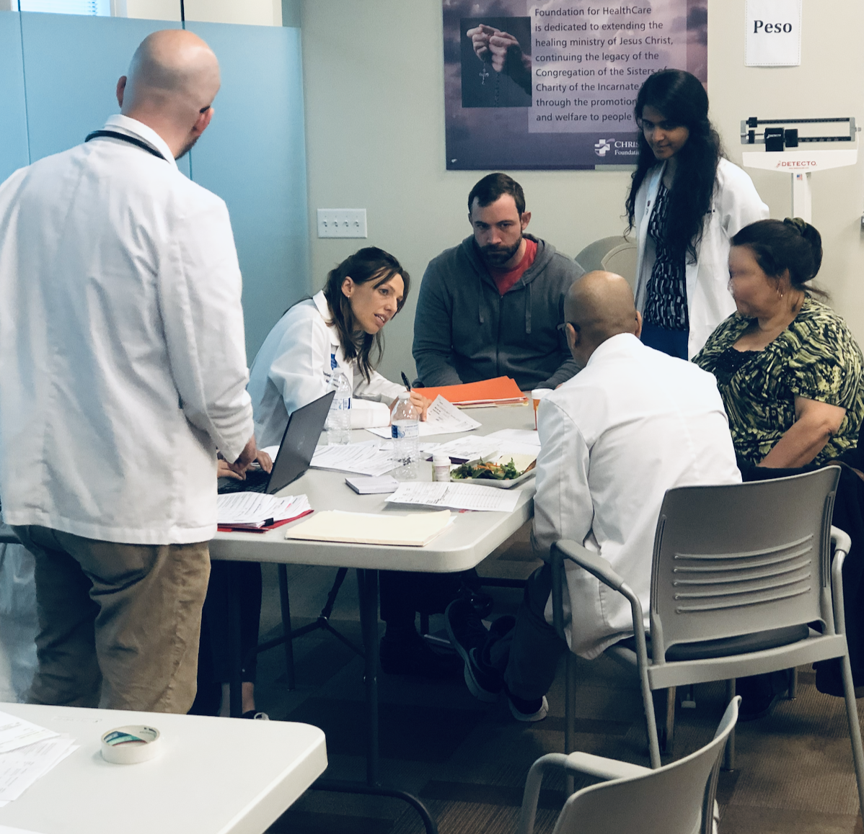
Medical Small Group

Slide 72
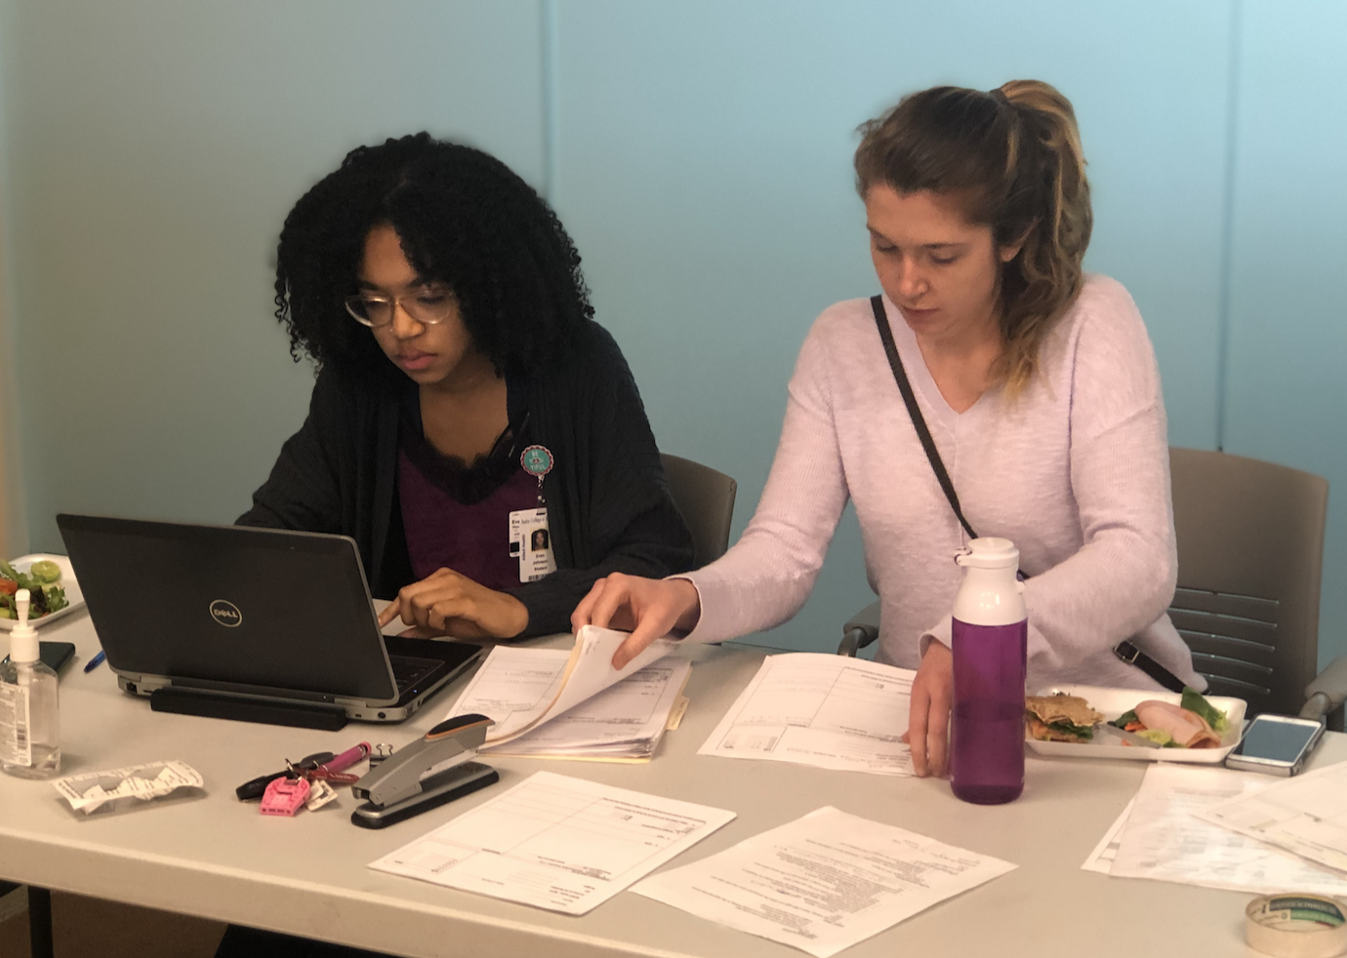
What are patient assignments?
If 32 patients, there will be ~10 people/group if everyone comes
With 4 providers, each has 2-3 patients every 30 minutes
We might need to see patients over lunch!
We never know who is coming!
Couples may (or may not!) want to be together
Providers may have a preference for who they see

Slide 73
How does translating work?
Sit next to the provider and…translate!
Needs will vary monthly based on the providers
Keep it brief and say what they say.
If not sure or clear, ask!
You may have 2 providers so sit in-between them… or you may have 0
If 0, help out the other CHWs with the medical group

Slide 74
Notes:
Here is a provider schedule
Assign patient #1 and #2 first in the three groups, then patient #3 and #4 to latecomers since they might not be seen until lunch
If a patient has to wait there the whole time talk to them and reassure them

Slide 75
Social Small Group
Notes:
Does everyone have copy of the curriculum for social and ministry??

Slide 76
Social Group

Slide 77
Ministry Small Group

Slide 78
Ministry/Behavioral Group
Remember that you are the bridge to spiritual and behavioral needs
Are there church partners who might want to attend?

Slide 79
Lunchtime!!
Small groups: 10-11:30
8-9 patients
9:30-10
Large group
All patients
Medical
Social
Behavioral
8:30-9:30
Registration and Vitals
11:30-12
Lunch
8:30-9:30
Registration and Vitals

Slide 80
Who does what during lunch?
Team Mary (talk to patients)
CHWs
Team Martha (serve, clean-up)
CHWs:
CHWIs:
CHWIs
Great time for members of the church to be with patients

Slide 81
Questions, comments, concerns

Slide 82
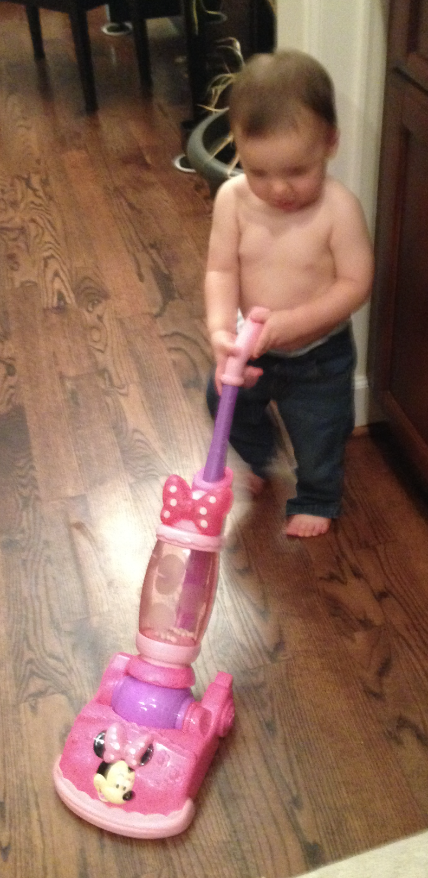
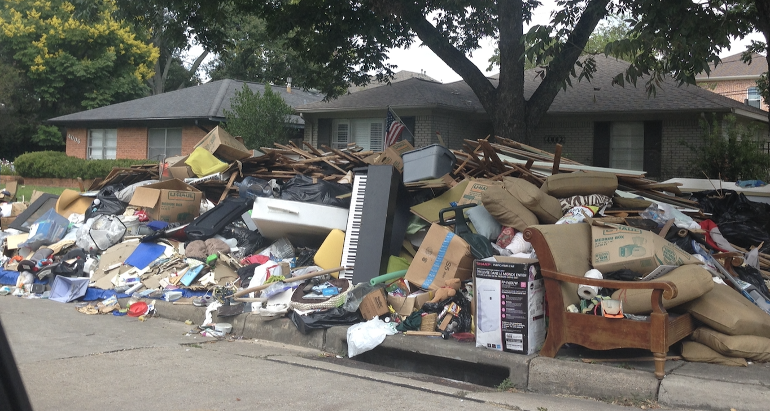
Clean up
Sweep
Tables and chairs
Take out trash
Lock up
Check with CHW Champion before leaving

Slide 83
Module 8 planning Class #1
Tonight we will review the class to-do sheet with your roles and answer any questions you might have

Slide 84
Team building/sharing Questions, or concerns?
Notes:
This week is an overview of orientation
Next week we will discuss who does what (let your CHWI know if you have preferences)

Slide 85
Module 9 Class #1 Recap, planning Class #2

Slide 86
Team building/sharing Questions, or concerns?
Notes:
This week is an overview of orientation
Next week we will discuss who does what (let your CHWI know if you have preferences)

Slide 87
How did it go??
Registration
Vitals: BP, DM foot exam, weight
Large Group
Medical group
Translators
Social Group
Ministry Group
Lunch
Mary and Martha teams
Notes:
CHWI – go through each part, allow CHWs to have time to ask questions, suggestions, concerns, changes, etc.

Slide 88
Time to celebrate
Lunch after the April class??
Also, April 10 is off due to Easter weekend

Slide 89
Module 10 planning Class #2
Reminder: April 10 we will not meet to celebrate Easter weekend
Tonight we will review Class #2, your role, and any changes
Notes:
CHWI- go through the class to-do sheet CHW by CHW (not by time), their role, and if they have any questions.

Slide 90
Team building/sharing Questions, or concerns?
Notes:
This week is an overview of orientation
Next week we will discuss who does what (let your CHWI know if you have preferences)

Slide 91
Module 11 Medication Pre-evaluation
Notes:
CHWI – make sure they are ready for Saturday’s class

Slide 92
Team building/sharing Questions, or concerns?

Slide 93
Agenda
Any questions/are you ready for Saturday’s class?
Get a blank sheet of paper and pen/pencil
When done with the pre-evaluation, text a picture of it to Sandra 832-860-5249
You probably won’t know a lot of the answers and that’s OK. We will be teaching you ALL of this!!

Slide 94
QUESTION #1
The most common side effect of metformin is:
Weight loss
Weight gain
Stomach upset
Low blood sugar

Slide 95
Question #2
What diabetes medication(s) are FOUR dollars at CVS or Walmart?
Actos
Metformin
The "g" drugs e.g., glimepiride, glyburide, glipizide
B and C
All of the above

Slide 96
QUESTION #3
What medication class end in "pril" or "artan" I.e., lisinopril, losartan?
Cholesterol medications
Diabetes medications
Weight loss medications
Blood pressure medications

Slide 97
QUESTION #4
The most common side effect of the "prils" is":
Cough
Diarrhea
Stomach upset
Leg cramps

Slide 98
QUESTION #5
What medication class end in "statin"?
Cholesterol medications
Diabetes medications
Weight loss medications
Blood pressure medications

Slide 99
QUESTION #6
The most common side effect of the "statins" is:
Leg cramps
Stomach upset
Weight loss
Cough

Slide 100
QUESTION #7
A side effect of Actos (pioglitazone) is:
A rash
Headache
Blurry vision
Leg swelling

Slide 101
QUESTION #8
Actos was once taken off the market in other countries since some thought it increased the chances of:
Skin infection
Bladder cancer
Amputation
Kidney failure

Slide 102
Question #9
The most common medication in diabetes is/are:
The "g" drugs e.g., glimepiride, glyburide, glipizide
Actos (pioglitazone)
Metformin
Insulin

Slide 103
QUESTION #10
What does insulin do to blood sugar?
Increases blood sugar
Does not change blood sugar
Decreases blood sugar

Slide 104
Question #11
What does orange juice do to blood sugar?
Increases blood sugar
Does not change blood sugar
Decreases blood sugar

Slide 105
Question #12
What US pharmacy sells some insulin for $25 per bottle?
CVS
Walmart
Kroger
Walgreens

Slide 106
QUESTION #13
What is the maximum daily dose of metformin?
500 mg
1000 mg
1500 mg
2000 mg

Slide 107
QUESTION #14
Which medication(s) may cause patients to GAIN weight?
Actos/pioglitazone
The "g" drugs e.g., glimepiride, glyburide, glipizide
Metformin
Insulin
A, B, and D

Slide 108
QUESTION #15
Which medication should be stored in the refrigerator?
Insulin
Enalapril
Metformin
Actos/pioglitazone
The "g" drugs e.g., glimepiride, glyburide, glipizide

Slide 109
Question #16
Which medication must be taken with food?
Atorvastatin
Lisinopril
The "g" drugs e.g., glimepiride, glyburide, glipizide
Actos/pioglitazone

Slide 110
QUESTION #17
How much is metformin increased weekly?
250 mg
500 mg
1500 mg
2000 mg

Slide 111
QUESTION #18
Less than _______ is "severe" low blood sugar.
20
30
40
50

Slide 112
Question #19
A patient's blood sugar is 62. He drank a cup of orange juice. After how many minutes should he recheck his blood sugar?
5
15
45
60
90

Slide 113
Question #20
A patient's medication is expired. Now, the medication may:
Be stronger than before
Be weaker than before
Not change at all
All of the above

Slide 114
QUESTION #21
What are symptoms of high blood sugar?
Needing to urinate less
Wanting to drink more
Constipation
Less hunger

Slide 115
QUESTION #22
Your patient tells you that her blood sugar is 425. You tell her to:
Drink water
Recheck her sugar
Take her medications as prescribed
Call her doctor/clinic
All of the above

Slide 116
QUESTION #23
Where is the preferred place to inject insulin?
Thigh
Buttocks
Stomach
Leg

Slide 117
QUESTION #24
What is the starting and highest dose for glimepiride (mg daily)?
2 and 8
4 and 12
5 and 10
15 and 25

Slide 118
QUESTION #25
What is the starting and highest dose (mg) for Actos per day?
4 and 8
5 and 10
15 and 45
2 and 4

Slide 119
Question #26
A patient's bottle of medicine is empty. She has 2 refills, expiration 1/1/2019. What should she do?
Call the clinic (pharmacy) to fill for refills
Call the clinic to make an appointment with her doctor
Wait until her appointment next month and ask her doctor

Slide 120
Question #27
What should fasting sugar be? _______ (without food for eight hours)

Slide 121
Question #28
What should your patient's sugar be before eating lunch? _______

Slide 122
Question #29
What should your patient's sugar be two hours after eating lunch? _______

Slide 123
QUESTION #30
What insulin is the cheapest?
Lispro
NPH
Lantus
Levemir

Slide 124
Next week…
We will go over all of the answers
The next several months, we will go over all the answers and why so you have a better idea of what is going on with your patient
CHWs are the bridge…the more you understand, the more you can help direct which bridge your patient needs

Slide 125
Module 12 Medication evaluation review

Slide 126
Team building/sharing Questions, or concerns?

Slide 127
Overview of CHW training: Past and Present
Month | Education | How often? | Hours | Formal/ Informal
May | CHW Introduction | Weekly | 5 | Formal
June - July | Digging Deeper into CHW Education | Weekly | 12 | Formal
Aug ‘22-Feb ’23 |  | Weekly | 10 | Informal
Aug – Oct | Running Diabetes Classes: Set-up | Weekly
Nov - Feb | Diabetes (and Related) Medications | Weekly
Mar ‘23 – Aug ‘23 | Answering CHW Questions | Monthly | 6-12 | Formal

Slide 128
Tonight – review the pre-evaluation
It’s OK if you got most of them wrong!!
From Nov to Feb we will be providing training for you to learn about these so you can better understand their care
But just an overview - don’t worry!!

Slide 129
Question
What does orange juice do to blood sugar?
a. Increases blood sugar
b. Does not change blood sugar
c. Decreases blood sugar

Slide 130
Question
What should fasting sugar be? _______________ (without food for eight hours)
80-100

Slide 131
Question
What should your patient’s sugar be before eating lunch? _____________
Less than 150

Slide 132
Question
What should your patient’s sugar be two hours after eating lunch?
Less than 180

Slide 133
Question
What diabetes medication(s) are FOUR dollars at CVS or Walmart?
a. Actos
b. Metformin
c. The “g” drugs e.g., glimepiride, glyburide, glipizide
d. B and C
e. All of the above

Slide 134
Question

Slide 135
Question
What US pharmacy sells some insulin for $25 per bottle?
CVS
Walmart
Kroger
Walgreens

Slide 136
Question
A patient’s blood sugar is 62. He drank a cup of orange juice.
After how many minutes should he recheck his blood sugar?
5
15
45
60
90

Slide 137
Question
A patient’s medication is expired. Now, the medication may:
A. Be stronger than before
B. Be weaker than before
C. Not change at all
D. All of the above

Slide 138
QUESTION
What are symptoms of high blood sugar?
Needing to urination less
Wanting to drink more
Constipation
Less hunger

Slide 139
QUESTION
Your patient tells you that her blood sugar is 425. You tell her to:
drink water
check her sugar
take her medications as prescribed
call her doctor/clinic
All of the above

Slide 140
QUESTION

Slide 141
Question

Slide 142
Question

Slide 143
QUESTION

Slide 144
QUESTION

Slide 145
QUESTION

Slide 146
QUESTION

Slide 147
QUESTION

Slide 148
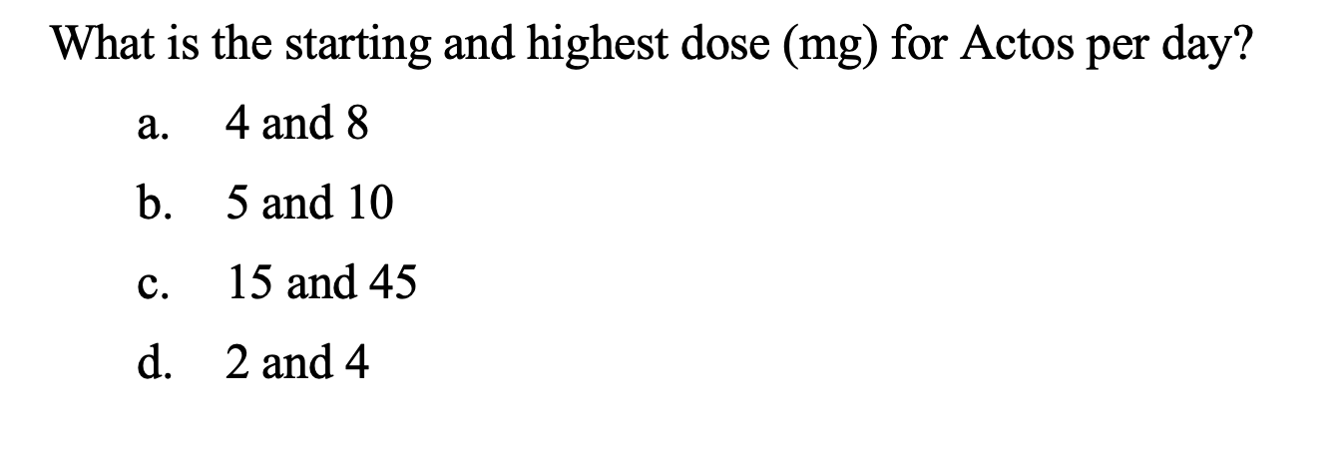
QUESTION

Slide 149
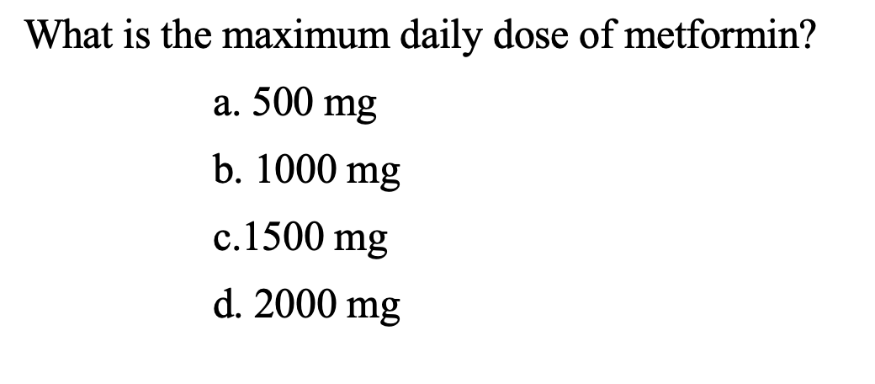
QUESTION

Slide 150
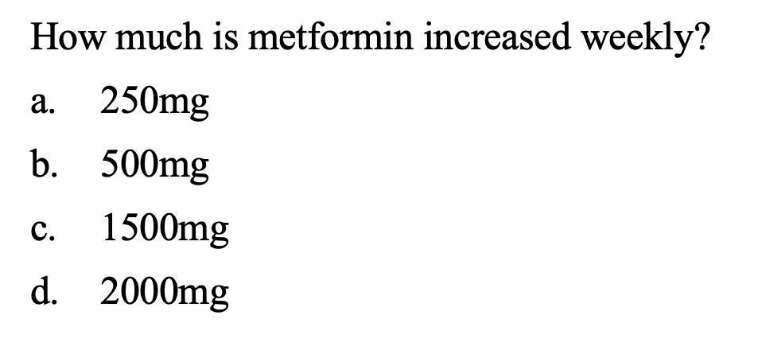
QUESTION

Slide 151
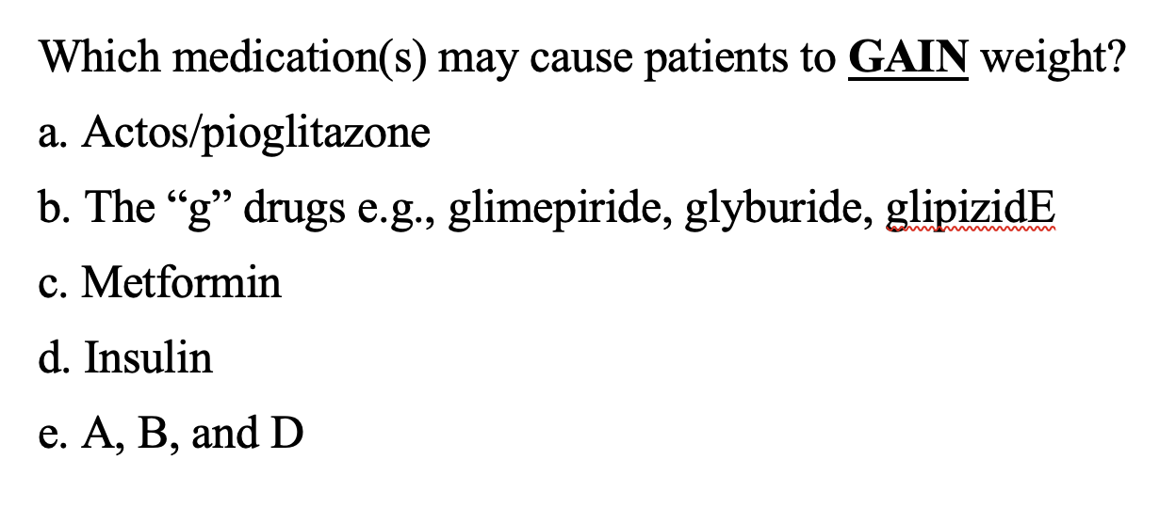
QUESTION

Slide 152
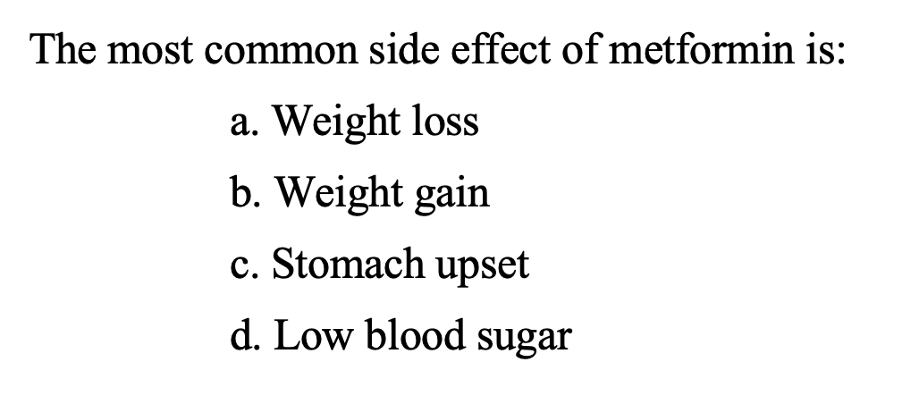
QUESTION

Slide 153
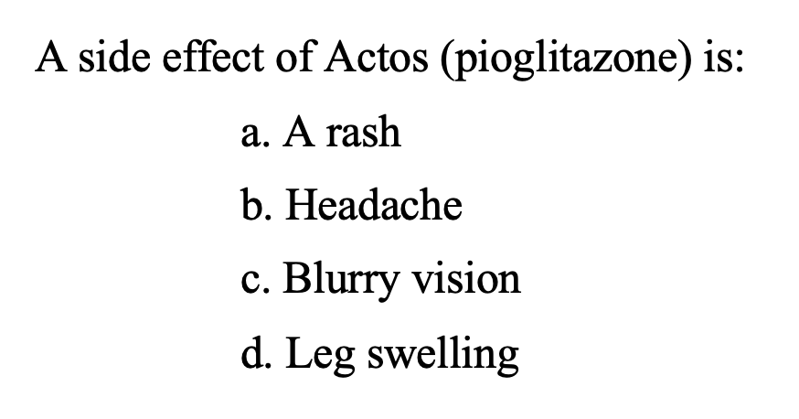
QUESTION

Slide 154
QUESTION

Slide 155
QUESTION

Slide 156
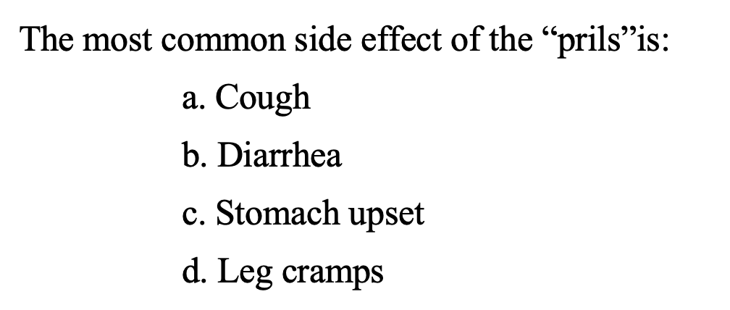
QUESTION

Slide 157
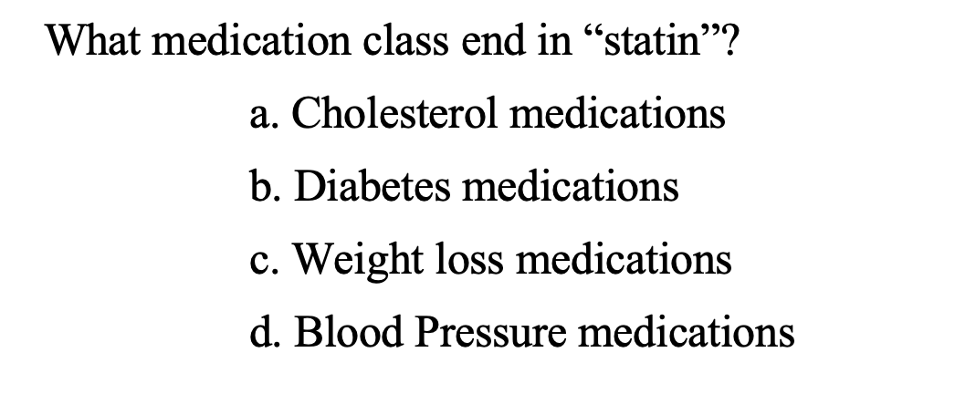
QUESTION

Slide 158
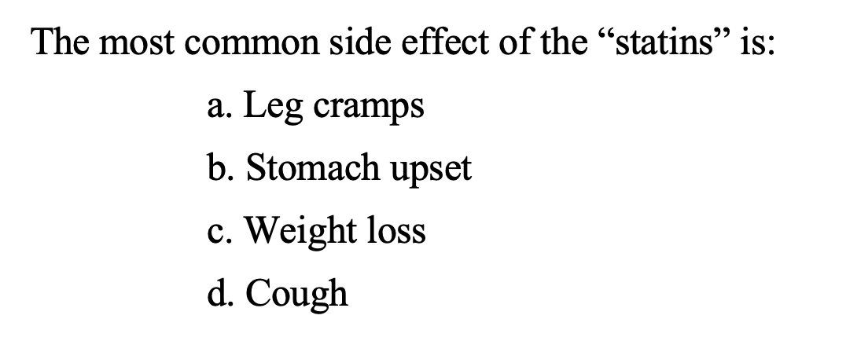
QUESTION

Slide 159
Agenda – November to February
7P: meet with the Tomagwa CHWs for prayer
Put requests in the chat section (there are now 18 CHWs/CHWIs!)
7:05: Break into small groups on ZOOM (Casa and Tomagwa)
Sandra, Betty, and Noe will lead your small group
7:05-7:15: answer your questions
7:15: discuss announcements, upcoming clinics and homework from the last week
You didn’t have homework for today
This homework should be fun☺
7:30-8:00: Educational topic of the night
Notes:
CHWI – send them a copy of the CHW schedule that has the dates and class topics

Slide 160
Agenda: March to August
Only two clinics: May and August
Similar 7-8P structure but meet MONTHLY, the first Monday of the month
The goal is to support you and answer your questions at this meeting
Your CHWI will still be available and check on you

Slide 161
Module 13 Medication barriers - PAP

Slide 162
Team building/sharing Questions or concerns?

Slide 163
Announcements –

Slide 164
Let’s talk about PAP meds…
PAP meds = Patient Assistance Program for high cost medications
Are any of your patients taking a PAP meds? If so, what has your experience been? For example:
Getting meds is easy/hard
Understanding eligibility is easy/hard

Slide 165
Here are some examples of diabetes PAP meds – does your patient have any?
Medication | Starting dose (mg) | Maximum dose (mg) | PAP* med?
Metformin/Glucaphage | 500 | 2000 | No
Metformin XR/Glucaphage | 500 | 2000 | No
Glimepiride | 1-2 | 8 | No
Glyburide | 1.25 - 5 | 20 | No
Glipizide IR/ER | 5/2.5 | 40/20 | No
Actos/Pioglitazone | 15 | 45 | No
Jardiance/Empaglifozin | 10 | 25 | Yes
Farxiga/Dapagliflozin | 5 | 10 | Yes
Trulicity/Dulaglutide | 0.75 | 3 | Yes
Bydureon,Byetta. Exenatide | 5 mcg | 10 mcg | Yes
Victoza/Liraglutide | 0.6 | 1.2 | Yes
Januvia/Sitagliptin | 100 | 100 | Yes
Tradjenta/Linagliptin | 5 | 5 | Yes
Janumet/Sitagliptin + Metformin | 100/1000 | 100/2000 | Yes
Jentadueto/Linagliptin + Metformin | 5/1000 | 5/2000 | Yes
Synjardy/Empagliflozin + Metformin | 10/1000 | 25/2000 | Yes

Slide 166
Why PAP meds ARE helpful
There are only three cheap meds in diabetes:
Metformin
The “g” drugs like glimepiride
Actos but only with a goodrx.com coupon
All other meds are hundreds per month
If patients take three diabetes meds, they could be paying thousands monthly
And that’s just diabetes medications

Slide 167
Why PAP meds are challenging
One word: ELIGIBILITY
Medications have different requirements
Companies have different requirements
Patients have to fill out paperwork that may be confusing
Patients have to come into clinic to provide paperwork and income forms
Patients have to renew eligibility (and don’t know it)
Patients and doctors often don’t know if they are approved and when they will get their medications

Slide 168
there are many challenges with PAP meds. How can CHWs help?

Slide 169
how chws can be a big help with pap meds
1. Know if your patient is taking a PAP medication(s) and the name and dose
2. Make sure Jennifer knows about your patient(s) and it’s on BOX
3. Understand the system at Casa to get their medications
4. Follow-up

Slide 170
What is the system at Casa?
Jennifer – can you walk us through the system at Casa?
How are CHWs helping?
What can CHWs do differently?

Slide 171
Module 14 Medication barriers

Slide 172
Team building/sharing Questions or concerns?

Slide 173
Announcements

Slide 174
Homework
Go to BOX and write if your patient is taking a PAP med, the name and the dose
If they are not taking one (or you do not know), write “not taking” or “I don’t know)
How did it go…did you learn anything?

Slide 175
Tonight’s topic: medication barriers
As you learned, PAP medications can be a great help…but they can also be challenging
Today we’ll talk about other barriers and solutions

Slide 176
Question- pre
2. What diabetes medication(s) are FOUR dollars at CVS or Walmart?
Actos
b. Metformin
c. The “g” drugs e.g., glimepiride, glyburide, glipizide
d. B and C
e. All of the above

Slide 177
About the $4 list
What is it? A list of medications for many diseases available for $4 per month or $10 every three months
It is available at Walmart, CVS, and other major pharmacies
You can find the list online or at the store (but not always at the store)
Be careful to look at the dose and any special medication name
For example certain forms of medications may not be available like “ER” (extended release)

Slide 178
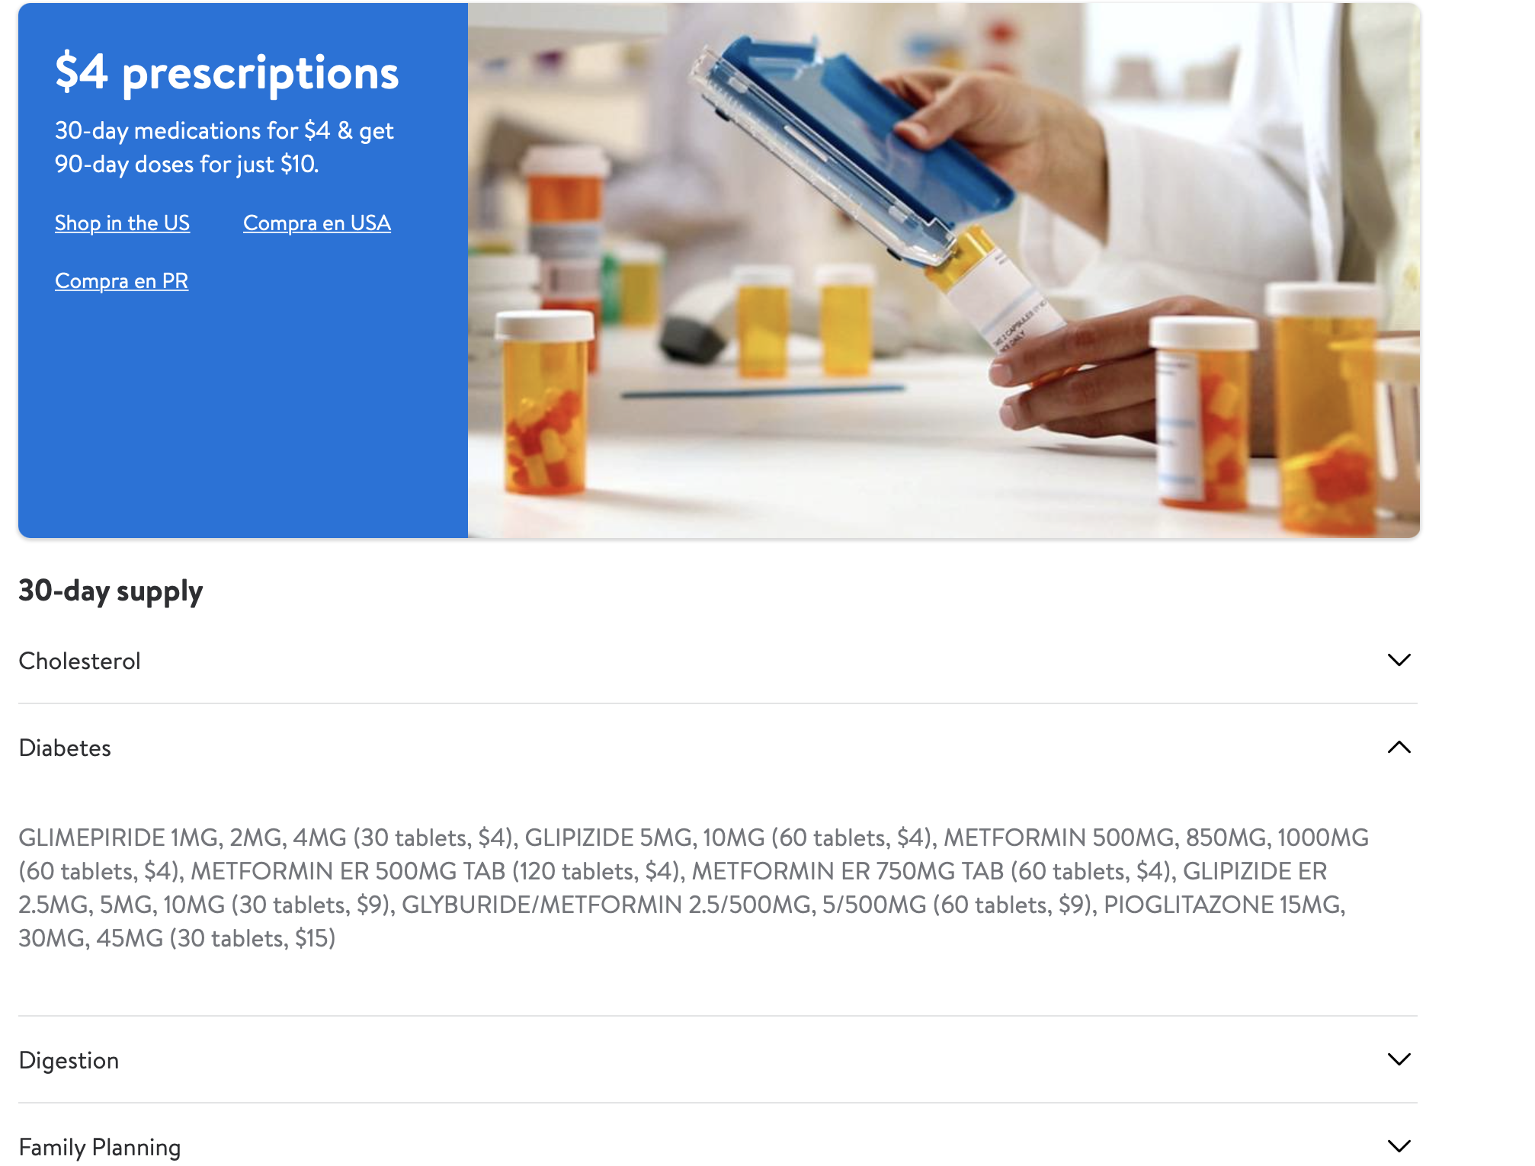
How to get the list….
Search for “$4 medications Walmart”
Click on the link
Once the screen is open, choose the disease (like diabetes) and the medication list will show

Slide 179
What if the medication is not on the $4 plan?
Many medications are not on the $4 plan
First, make sure the problem is medication and not the type
For example metformin may be there but metformin ER may not
Usually the doctor can change the type easily but let the champion know
Next see if it’s on goodrx.com

Slide 180
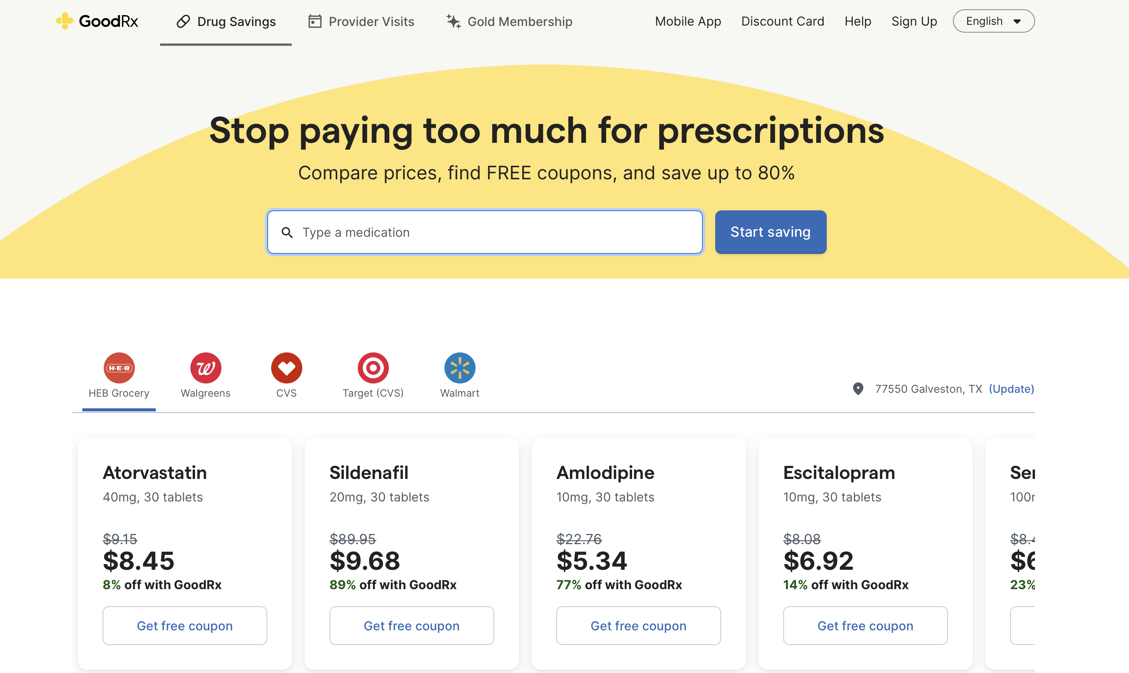
Goodrx.com
By going to goodrx.com you can enter the medication
It will list the medications and the cost at several pharmacies
Make sure the medication dose and number of pills is correct
Sometimes changing the number of pills can greatly lower the costs
For example 30 pills may cost $100 but 90 pills cost $15

Slide 181
Question
What US pharmacy sells some insulin for $25 per bottle?
CVS
Walmart
Kroger
Walgreens

Slide 182
Insulin
There are three types of “cheap” insulin: NPH, 70/30, and Regular
70/30 is just 70% NPH and 30% Regular
“Cheap” insulin is $25 per bottle…but if the patient is taking 5 bottles, it is $125 per month
Plus strips and syringes…insulin can get quite expensive
Part of the provider training teaches doctors how much insulin costs
CHWs can help by letting doctors know if their patients cannot afford insulin

Slide 183
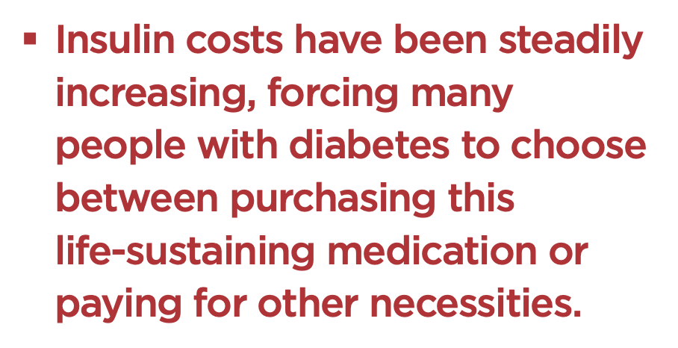
If your patients cannot afford insulin, they are not the only one

Slide 184
Question
Key Point – remember to look at the expiration date and not just the refills. If it’s expired, the pharmacy will not refill it.

Slide 185
Homework For next week
Google “$4 medications” at Walmart
Do you recognize any medications?
Look at goodrx.com and put in Actos 15mg for 90 pills
Does the dose (mg) or number of pills matter if you change it?
We’ll share what you find next week

Slide 186
Module 15 Glucose

Slide 187
Team building/sharing Questions OR concerns?

Slide 188
Announcements…

Slide 189
Homework From Last week
When you looked up “$4 medications” at Walmart, did you recognize any medications?
When you looked at goodrx.com and put in Actos 15mg for 90 pills, did the dose (mg) or number of pills matter if you change it?
If so, how?
Were there some places cheaper than others to buy Actos with goodrx.com?

Slide 190
Question
What should fasting sugar be? _______________ (without food for eight hours)
80 - 100

Slide 191
Fasting Sugar
Fasting sugar is usually first in the morning but this could vary if your patient has different schedules like night work
This is when patients like to take their sugar because it is the lowest

Slide 192
Question
What should your patient’s sugar be before eating lunch (or dinner)? _______________
80 - 150

Slide 193
Before meal sugar
This sugar is higher than fasting because food is still in the body from the previous meal
It can take as little as 2 hours and up to 8 hours for food to digest

Slide 194
Foods digest differently
High carb food like candy spike sugar and digest quickly
Low carb food like wheat and oats do not spike or drop sugar
Proteins like meat and fish take longer to get in and out of your body
Fats like butter and fried foods take the longest to get out of your body

Slide 195
Question
What should your patient’s sugar be two hours after eating lunch (or dinner)?
Less than 180

Slide 196
After meal sugar
This is when patients do not like to check their sugar since it is usually the highest
This is why it is important to check sugars at different times of the day. They could be “good” in the morning (fasting) but very high in the afternoon

Slide 197
These numbers are listed on your patient’s sheet. CHWs can help patients by showing this to them and helping them understand.

Slide 198
How often should my patient check their sugar?
It depends!
The doctor should tell them (tell the patient to ask if not)
In general, if controlled doctors recommend check 2-3 times per WEEK
If not controlled, doctors recommend to check daily
Sometimes doctors ask patients to check 2-3 times per day if their sugars are not well controlled.
For example a patient who often gets low in the afternoon but is very high in the morning.
Or, a patient taking insulin and the doctor is trying to figure out how much to take

Slide 199
What should I tell my patients?
1. Ask their doctor how much they should check their sugars
2. Help them understand that sugar may be “good” some times and “not good” at others, so it’s important that they check at different times

Slide 200
My patient doesn’t want to check his/her sugars…what do I say?
It’s OK!
The CHW’s job is to report this to the champion
The CHW’s job is to know how much the doctor wants to the patient to check his/her sugar
The CHW’s job is to educate the patient why doctors may ask patients to check sugars
It’s NOT the job of the CHW to make (or force!) patients to take sugars
It may decrease the amount they trust you or may them not want to get healthcare

Slide 201
Checking sugars
It usually benefits the patients more than the doctors if they check their sugars by teaching them that sugar is different during the day and can be very high after some meals

Slide 202
Homework For this week
If you have a glucometer (or know someone who does) Check your sugar!
One day fasting
One day before a meal
One day two hours after a meal
If you don’t have a glucometer, borrow one if you can

Slide 203
Module 16 diabetes - safety

Slide 204
Team building/sharing Questions or concerns?

Slide 205
AnnouNcements –

Slide 206
Announcements –

Slide 207
Homework From last week
What did you find after you check your sugar?
One day fasting
One day before a meal
One day two hours after a meal
How do you think checking sugar at different times of the day might help patients?
How did you feel about poking yourself? Did it help you understand how your patients might feel?

Slide 208
QUESTION - PRE

Slide 209
Question

Slide 210
Orange juice - high “SIMPLE” carb
Orange juice is exactly what patients need when blood sugar is low
It quickly gets into the body
Other food like milk or chocolate have protein and fat in them, slowing the time to get into the body

Slide 211
Question
A patient’s blood sugar is 62. He drank a cup of orange juice.
After how many minutes should he recheck his blood sugar?
5
15
45
60
90

Slide 212
Why just one cup? Why 15 minutes?
One cup of orange juice has enough sugar (carbohydrates) in it to get blood sugar up
Too much orange juice and the next sugar will be 400!
As the graph shows, it takes about 15 minutes for orange juice to get in the body

Slide 213
QUESTION
Your patient tells you that her blood sugar is 425. You tell her to:
drink water
check her sugar
take her medications as prescribed
call her doctor/clinic
All of the above

Slide 214
QUESTION
What are symptoms of high blood sugar?
Needing to urination less
Wanting to drink more
Constipation
Less hunger

Slide 215
What happens when blood sugar is high?
Drink water

Slide 216
Why do these things happen with high sugars? The body is trying to get rid of the sugar
Sickness,
Not taking medications,
Stress
Increased sugars
Body tries to get rid of sugar by urinating
Increased urination
Thirsty
Dehydration
Severe Illness or death

Slide 217
Question
A patient’s medication is expired. Now, the medication may:
A. Be stronger than before
B. Be weaker than before
C. Not change at all
D. All of the above

Slide 218
Should I use expired meds? Let’s ask the FDA

Slide 219
Homework This week
Go to your medicine cabinet and look at the expiration dates.
Are any expired?
CHWIs will send you the FDA link about expired medications. See what you think: https://www.fda.gov/drugs/special-features/dont-be-tempted-use-expired-medicines

Slide 220
Questions?

Slide 221
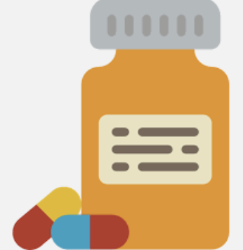
Module 17 Diabetes Medications - Metformin

Slide 222
Team building/sharing Questions or concerns?

Slide 223
Announcements

Slide 224
Homework From last week
What did you find in your medicine cabinet…any expired medications?
What do you think about the FDA’s recommendations?
https://www.fda.gov/drugs/special-features/dont-be-tempted-use-expired-medicines

Slide 225
Question - Pre

Slide 226
Diabetes Medications: overview
There are a lot of diabetes medications
You should have a chart of them (if not, let your CHWI know!)
You do not need to know all of them (most docs don’t!)
The most common ones are:
-metformin
-glimepiride and other “g” drugs
-Actos
-insulin
-PAP ones: Jardiance, Januvia, Janumet

Slide 227
QUESTION - PRE

Slide 228
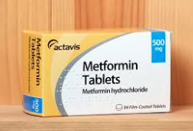
Metformin
Most common medication to treat diabetes
ALL patients should be taking it (protects their heart)
EXCEPT some kidney failure patients
CHEAP!: on $4 plan at Walmart
No insurance needed, just a prescription
Protects the heart and kidneys from damage

Slide 229
QUESTION - PRE

Slide 230
Metformin
It can help with weight LOSS (not a side effect – it’s good!)
Most common side effect: nausea/ stomach upset
Tell your patients: eat with food to avoid stomach upset
Patients need to start slow and increase by 500mg weekly to avoid stomach upset

Slide 231
QUESTION -

Slide 232
Case
Your patient is taking metformin 500mg in the morning and 1000mg at night. She has sugars that are 140 in the morning and doesn’t check in the afternoon or evening. What should she do?
Ask her to check in afternoon.
If high, the doctor might increase by 500mg each week

Slide 233
Homework For this week
Call 2-3 pharmacies this week from different stores (Walmart, Walgreens, CVS)
Let them know that you are a CHW and trying to see if different pharmacies have different types of metformin
Do they sell a particular brand of metformin?
Do all of their stores sell the same brand or are they different?
You can do this with another CHW if you’d like

Slide 234
Questions

Slide 235
Module 18 Diabetes Meds – “g” drugs and Actos

Slide 236
Team building/sharing Questions or concerns?

Slide 237
AnnouNcements

Slide 238
Homework From last week
To do: Call 2-3 pharmacies this week from different stores (Walmart, Walgreens, CVS). Let them know that you are a CHW and trying to see if different pharmacies have different types of metformin
What did you find?
Do they sell a particular brand of metformin?
Do all of their stores sell the same brand or are they different?
Some patients say that the metformin some pharmacies sell makes them sick while others do not bother them. Does this make any more sense to you now?

Slide 239
Question - Pre

Slide 240
QUESTION - PRE

Slide 241
The “g” drugs
Like insulin in that they quickly lower blood sugar but are pills
Advantages:
Pills and not injections
Lower blood sugar
Disadvantages:
Can quickly lower blood sugar and cause hypoglycemia
Can cause weight gain

Slide 242
The G drugs… (why are they so difficult to pronounce?)
Class is sulfonylureas (if you were curious)
Glyburide (least common, most side effects)
Glipizide more common
Glimepiride: most common…why?

Slide 243
Glimepiride: the best g drug?
As a class, some docs don’t like them due to side effects
But studies show that all drugs in the class are not the same
Glimepiride has the least amount of bad things: weight gain, low blood sugar, heart effects
Glimepiride can be used if the patient has bad kidneys (renal failure)

Slide 244
Case
You patient is taking glimepiride 2 mg daily. His morning sugars are 170s and his afternoon sugars before meals are 190s. What might the doctor do?
Increase glimepiride to 4 mg daily

Slide 245
QUESTION - PRE

Slide 246
Glimepiride: how is it dosed?
Starting dose is…
2 mg once daily
Maximum dose is…
8 mg once daily
It can be split into morning and night but doesn’t need to be (unless issues with low AND high blood sugar)

Slide 247
Case
Your patient is taking glimepiride 4mg daily. His morning sugars are 200. He says in the afternoon he feels shaky and is 65. What might you ask?
Is he eating with his medication?
Is he eating consistently or does he eat a lot one time and not much another?
Congratulate him for checking his sugar when he doesn’t feel good. Otherwise it is hard to know if it is a sugar problem or something else.

Slide 248
Homework
One cup of orange juice has 15 grams of carbohydrates and 60 calories
Find four items with about 15 grams of carbohydrates
How does/does not reading nutrition labels affect the way you eat?

Slide 249
Module 19 Diabetes Meds - Actos

Slide 250
Team building/sharing Questions or concerns?

Slide 251
Announcements

Slide 252
Homework From last week
What 4 items did you choose that have 15 grams of carbohydrates?
How does reading nutrition labels affect the way you eat?

Slide 253
Moving onto Actos
It’s generic name is pioglitazone
Advantages
Low cost WITH goodrx.com
Does not drop blood sugar quickly
Disadvantages
Can cause weight gain (“water weight”)

Slide 254
QUESTION - PRE

Slide 255
QUESTION - PRE

Slide 256
Actos: how is it dosed?
Starting dose is…
15 mg once daily
Maximum dose is…
45 mg once daily

Slide 257
QUESTION - PRE

Slide 258
Homework
Choose your homework:
Option 1: Ask someone who takes insulin is you can have one of their syringes and poke your stomach. How do you like needles? If you had to do this several times daily, would you?
Option 2: No homework

Slide 259
Module 20 Diabetes Meds - insulin

Slide 260
Team building/sharing Questions or concerns?

Slide 261
Announcements

Slide 262
Homework
What option did you choose?
Option 1: Ask someone who takes insulin is you can have one of their syringes and poke your stomach. Option 2: No homework Option 3: Check Box notes?
If option 1: How did you like needles?
Either: If you had to do this several times daily, would you?

Slide 263
QUESTION

Slide 264
Insulin
Insulin is the quickest medication to drop sugar
There are “rapid” acting insulins that work in 15-30 minutes
lispro
There are “intermediate” insulins that work in 2-3 hours
Regular
There are “long” acting insulins that work in 12-24 hours
NPH, Lantus, Levemir
Most of our patients are taking Lantus, 70/30 (NPH/Regular), NPH, or Regular
Are these rapid, intermediate, or long acting?

Slide 265
QUESTION
Refrigerating it helps it stay better longer

Slide 266
QUESTION

Slide 267
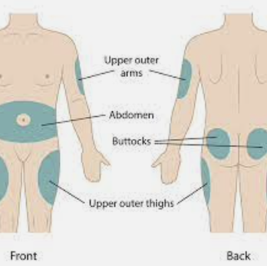
Where to inject insulin?
The stomach is the preferred place
There are several other options if needed
Inject 2 inches (5 cm) from the belly button

Slide 268
QUESTION

Slide 269
Cheap insulin?
NPH, Regular, and 70/30 (70% NPH with 30% Regular) are $25 at Walmart.
Other insulins costs $100s
This is the cost per vial, and sometimes patients need many vials.
If your patient needs 4 bottles of NPH monthly and pays $20 for syringes and extra tests strips monthly, how much will they pay monthly?
How much will they pay every year just for insulin (get out your calculators!)
…and this is the “cheap” one….

Slide 270
Needle phobia
How do you feel about needles?
How do you think your patient feels?
“Needle phobia” is very common. If your patient has this, try to understand and let the doctor know.
It’s a top reason that patients will not take their medications
There might be another option if the doctor knows about it

Slide 271
Insulin/Injectables
Short acting: lispro, aspart, regular “R”
Medium acting: NPH
Long acting: glargine, lantus, detemir, levemir
Once/week injectables

Slide 272
Homework
What did you choose?
Option 1: Ask someone who takes insulin is you can have one of their syringes and poke your stomach. How do you like needles? If you had to do this several times daily, would you?
Option 2: No homework

Slide 273
Module 21 hypertension

Slide 274
Team building/sharing Questions, or concerns?

Slide 275
HOW DID Homework GO?
What did you choose?
Option 1: Ask someone who takes insulin is you can have one of their syringes and poke your stomach. How do you like needles? If you had to do this several times daily, would you?
Option 2: No homework

Slide 276
Announcements

Slide 277
Hypertension
What is it:? High blood pressure
Or how hard the heart is working to push blood through the body
Two parts:
Systolic or working
Diastolic or resting
Notes:
Think of a hose – the less space there is inside the hose for water to travel, the more pressure the water is under – have you ever folded or pinched a hose?
Systolic and Diastolic are working and resting blood pressure numbers – think of breathing – you inhale and you are making an effort, you exhale and you are just letting go of the air. Both are important and necessary – same with the systolic number (working) and with the diastolic number (resting) – if the numbers are too high, the pressure is too high on both….it means the higher the number, the more we’re making the heart work and the more we run the risk of the heart giving up on us.

Slide 278
Hypertension
Do you remember…what is normal blood pressure?
120/80
What numbers do we want to see our patients under?
Systolic less than 140
Diastolic less than 90
Or less than 140/90
Notes:
Why do we allow these higher numbers for diabetics? Because we understand that our patients with diabetes tend to already have problems with weight and higher weight usually leads to a more sedentary live which leads to higher blood pressure

Slide 279
Hypertension
Why is it important?
…the harder the heart is working, the more stress on the body
…if it works hard for a long time, blood vessels can be damaged…they can:
Narrow
Rupture
Leak
Form a blood clot
Notes:
What happens if the blood pressure is too high?

Slide 280
Hypertension
This damage or clots are what cause a heart attack or stroke
What do we look for?
Chest discomfort. Most heart attacks involve discomfort in the center of the chest that lasts more than a few minutes – or it may go away and then return. It can feel like uncomfortable pressure, squeezing, fullness or pain.
Discomfort in other areas of the upper body. Symptoms can include pain or discomfort in one or both arms, the back, neck, jaw, or stomach.
Shortness of breath. This can occur with or without chest discomfort.
Other signs. Other possible signs include breaking out in a cold sweat, nausea, or lightheadedness.

Slide 281
Hypertension
What do we do if we get a call with one of these symptoms?
First things first – The patient should call 911 or go to the nearest emergency room
Call your champion
Keep in touch with your patient and let your champion know anything you find out form your patient
Champion – call doctor to make recommendations and keep CHW and doctor informed

Slide 282
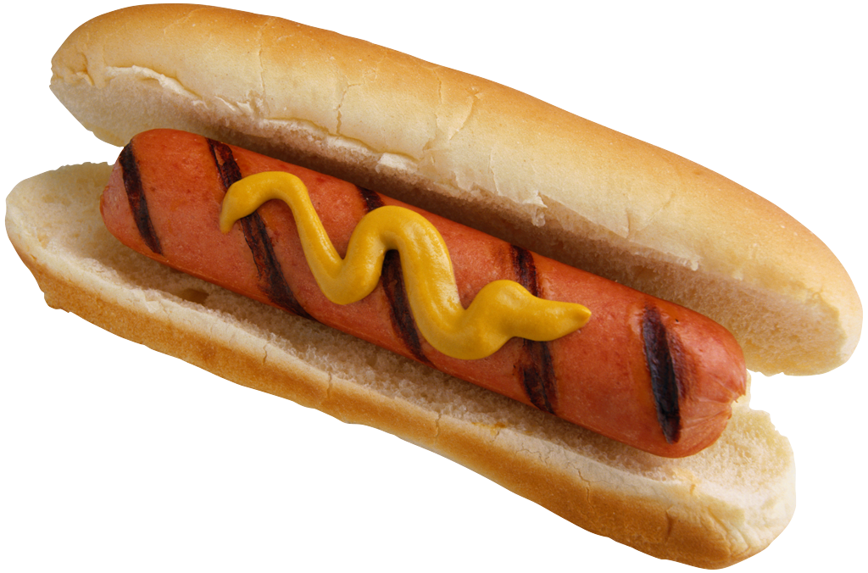
Hypertension
What can we recommend to our patients?
1. Healthy weight (diet and exercise)
2. What about salt?
Notes:
Same as diabetes – exercise and limiting what we eat is key
Salt – limit your intake of sodium to less than 2000, but Ideally less than 1500

Slide 283
Homework
Investigate what is the website for the American Heart Association
Investigate what are the most common medications for hypertension and their price
Check what you eat this week – how much sodium are you consuming?
No need to send us the answers – we will discuss next week

Slide 284
Module 22 Blood pressure meds

Slide 285
Team building/sharing Questions, or concerns?

Slide 286
Announcements

Slide 287
HOW DID Homework GO?
Investigate what is the website for the American Heart Association
Investigate what are the most common medications for hypertension and their price
Check what you eat this week – how much sodium are you consuming?

Slide 288
QUESTION
What are the most commonly used medications for hypertension?
a) Metformin and insulin
b) medicines ending in "PRIL" (enalapril, lisinopril, perindopril and ramipril)
c) drugs that begin with G ("g" drugs – such as glipizide and glimiperide)
d) medicines ending in "artan" (Candesartan, Irbesartan, Losartan, Valsartan and Olmesartan)

Slide 289
answer
What are the most common medications for hypertension?
a) Metformin and insulin
b) medicines ending in "PRIL" (enalapril, lisinopril, perindopril and ramipril)
c) drugs that begin with G ("g" drugs – such as glipizide and glimiperide)
d) medicines ending in "artan" (Candesartan, Irbesartan, Losartan, Valsartan and Olmesartan)

Slide 290
QUESTION
What is the most common side effect in a person who starts taking medications that end in "pril"?
weight gain
b) low sugar
c) swelling in the legs
d) cough
e) blurred vision

Slide 291
QUESTION
What is the most common side effect in a person who starts taking medications that end in "pril"?
a) weight gain
b) low in sugar
c) swelling in the legs
d) cough
e) blurred vision

Slide 292
Hypertension
1. Medications
What are the BP medications??
Take them!
Usually 1 or 2 but sometimes more 4+
The “prils” or the “arbs”
What is their most common side effect?
Cough

Slide 293
Questions, or concerns?

Slide 294
HOW DID Homework GO?
Investigate at the website for the American Heart Association what cholesterol is and how it contributes to heart problems.
How much cholesterol should we consume?

Slide 295
Module 23 cholesterol meds

Slide 296
Team building/sharing Questions, or concerns?

Slide 297
QUESTION - PRE

Slide 298
QUESTION - PRE

Slide 299
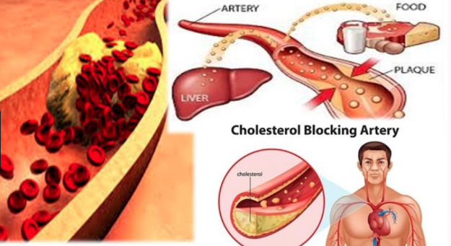
HIGH CHOLESTEROL
What it is: too much fat in the blood
Or how hard the heart is working to push blood through the body
Four parts:
Total
LDL or “bad”
HDL or “good”
Triglycerides

Slide 300
CHOLESTEROL
What is a normal cholesterol?
It’s complicated…
“old” guidelines
Bad or LDL less than 100
“new” guidelines
LDL (bad) not too high (more than 160)
People with diabetes take a _____

Slide 301
CHOLESTEROL
Why is it important?
…too much fat in your blood can cause a clot
Increase risk of heart attack or stroke

Slide 302
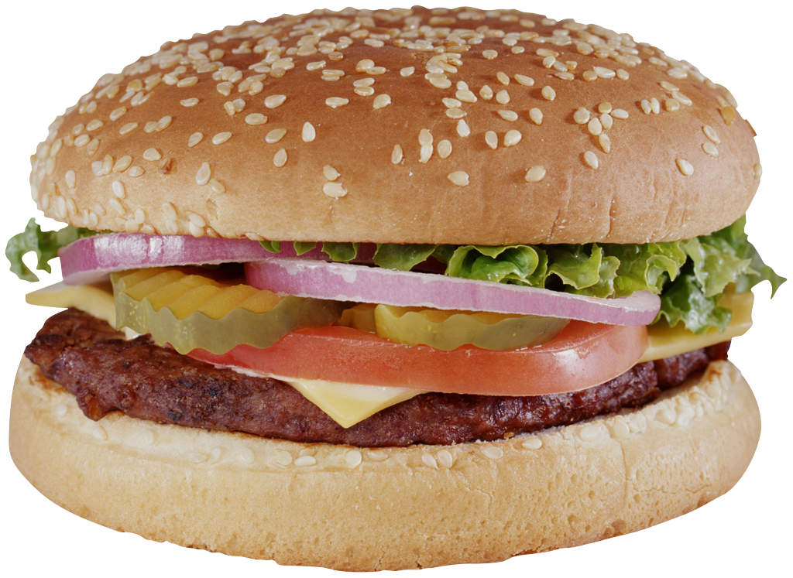
CHOLESTEROL
What do we do?

Slide 303
CHOLESTEROL
1. Medications
What are the cholesterol medications??
Take them!
Usually 1 …sometimes two
The “statins”
What is their most common side effect?
Muscle cramps

Slide 304
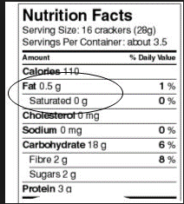
CHOLESTEROL
2. Healthy weight (diet and exercise)
What about saturated fat?

Slide 305
Module 24 cholesterol meds

Slide 306
Team building/sharing Questions, or concerns?

Slide 307
Triglycerides (from last time)
What it is: stored fat in the blood
You eat → “unwanted food”→TG
Your body uses TG in between meals for energy
Food>burning
High TG

Slide 308
TG
Less than 150: normal
Very high >500
If not “very high” a “statin” is usually enough
If “very high” patients usually need “fenoFIBRATE”

Slide 309
Heart Attack and Stroke
What they are
Heart attack:
Loss of blood supply to the heart due to a blood clot
Stoke:
loss of blood supply to the brain due to a blood clot or breaking of blood vessels

Slide 310
Why is it important?
Heart attacks lead to damaged heart tissue and heart failures
Stokes damage the brain and therefore the area that the brain controls

Slide 311
Prevention
1. taking medications (sounding familiar)??
2. healthy living
Diet…getting to a healthy weight
Exercise…about 20 minutes daily
Stress relief…

Slide 312
Does stress cause heart attacks, strokes, high blood pressure…?

Slide 313
YES! (kind of)
The is a link to heart disease and long-term stress
“large hearts” are also seen with stress
But scientists don’t really understand it
Types of stress:
Work-related
Loneliness
Social isolation

Slide 314
Religious behavior helps promote healthy behaviors
Diet, exercise, and less “unhealthy” behaviors
Praying improves coping skills
More “religion”, less “bad” habits then less “bad” habits

Slide 315
Module 25 review

Slide 316
Team building/sharing Questions, or concerns?

Slide 317
Question
What does orange juice do to blood sugar?
a. Increases blood sugar
b. Does not change blood sugar
c. Decreases blood sugar

Slide 318
Question
What should fasting sugar be? _______________ (without food for eight hours)
80-100

Slide 319
Question
What should your patient’s sugar be before eating lunch? _____________
Less than 150

Slide 320
Question
What should your patient’s sugar be two hours after eating lunch?
Less than 180

Slide 321
Question
What diabetes medication(s) are FOUR dollars at CVS or Walmart?
a. Actos
b. Metformin
c. The “g” drugs e.g., glimepiride, glyburide, glipizide
d. B and C
e. All of the above

Slide 322
Question

Slide 323
Question
What US pharmacy sells some insulin for $25 per bottle?
CVS
Walmart
Kroger
Walgreens

Slide 324
Question
A patient’s blood sugar is 62. He drank a cup of orange juice.
After how many minutes should he recheck his blood sugar?
5
15
45
60
90

Slide 325
Question
A patient’s medication is expired. Now, the medication may:
A. Be stronger than before
B. Be weaker than before
C. Not change at all
D. All of the above

Slide 326
QUESTION
What are symptoms of high blood sugar?
Needing to urination less
Wanting to drink more
Constipation
Less hunger

Slide 327
QUESTION
Your patient tells you that her blood sugar is 425. You tell her to:
drink water
check her sugar
take her medications as prescribed
call her doctor/clinic
All of the above

Slide 328
QUESTION

Slide 329
Question

Slide 330
Question

Slide 331
QUESTION

Slide 332
QUESTION

Slide 333
QUESTION

Slide 334
QUESTION

Slide 335
QUESTION

Slide 336
QUESTION

Slide 337
QUESTION

Slide 338
QUESTION

Slide 339
QUESTION

Slide 340
QUESTION

Slide 341
QUESTION

Slide 342
QUESTION

Slide 343
QUESTION

Slide 344
QUESTION

Slide 345
QUESTION

Slide 346
QUESTION

Slide 347
Module 26 Post-evaluation

Slide 348
Team building/sharing Questions, or concerns?

Slide 349
Week 14: Tonight’s agenda
Get a blank sheet of paper and a pen/pencil

Slide 350
QUESTION #1
The most common side effect of metformin is:
Weight loss
Weight gain
Stomach upset
Low blood sugar

Slide 351
Question #2
What diabetes medication(s) are FOUR dollars at CVS or Walmart?
Actos
Metformin
The "g" drugs e.g., glimepiride, glyburide, glipizide
B and C
All of the above

Slide 352
QUESTION #3
What medication class end in "pril" or "artan" I.e., lisinopril, losartan?
Cholesterol medications
Diabetes medications
Weight loss medications
Blood pressure medications

Slide 353
QUESTION #4
The most common side effect of the "prils" is":
Cough
Diarrhea
Stomach upset
Leg cramps

Slide 354
QUESTION #5
What medication class end in "statin"?
Cholesterol medications
Diabetes medications
Weight loss medications
Blood pressure medications

Slide 355
QUESTION #6
The most common side effect of the "statins" is:
Leg cramps
Stomach upset
Weight loss
Cough

Slide 356
QUESTION #7
A side effect of Actos (pioglitazone) is:
A rash
Headache
Blurry vision
Leg swelling

Slide 357
QUESTION #8
Actos was once taken off the market in other countries since some thought it increased the chances of:
Skin infection
Bladder cancer
Amputation
Kidney failure

Slide 358
Question #9
The most common medication in diabetes is/are:
The "g" drugs e.g., glimepiride, glyburide, glipizide
Actos (pioglitazone)
Metformin
Insulin

Slide 359
QUESTION #10
What does insulin do to blood sugar?
Increases blood sugar
Does not change blood sugar
Decreases blood sugar

Slide 360
Question #11
What does orange juice do to blood sugar?
Increases blood sugar
Does not change blood sugar
Decreases blood sugar

Slide 361
Question #12
What US pharmacy sells some insulin for $25 per bottle?
CVS
Walmart
Kroger
Walgreens

Slide 362
QUESTION #13
What is the maximum daily dose of metformin?
500 mg
1000 mg
1500 mg
2000 mg

Slide 363
QUESTION #14
Which medication(s) may cause patients to GAIN weight?
Actos/pioglitazone
The "g" drugs e.g., glimepiride, glyburide, glipizide
Metformin
Insulin
A, B, and D

Slide 364
QUESTION #15
Which medication should be stored in the refrigerator?
Insulin
Enalapril
Metformin
Actos/pioglitazone
The "g" drugs e.g., glimepiride, glyburide, glipizide

Slide 365
Question #16
Which medication must be taken with food?
Atorvastatin
Lisinopril
The "g" drugs e.g., glimepiride, glyburide, glipizide
Actos/pioglitazone

Slide 366
QUESTION #17
How much is metformin increased weekly?
250 mg
500 mg
1500 mg
2000 mg

Slide 367
QUESTION #18
Less than _______ is "severe" low blood sugar.
20
30
40
50

Slide 368
Question #19
A patient's blood sugar is 62. He drank a cup of orange juice. After how many minutes should he recheck his blood sugar?
5
15
45
60
90

Slide 369
Question #20
A patient's medication is expired. Now, the medication may:
Be stronger than before
Be weaker than before
Not change at all
All of the above

Slide 370
QUESTION #21
What are symptoms of high blood sugar?
Needing to urinate less
Wanting to drink more
Constipation
Less hunger

Slide 371
QUESTION #22
Your patient tells you that her blood sugar is 425. You tell her to:
Drink water
Recheck her sugar
Take her medications as prescribed
Call her doctor/clinic
All of the above

Slide 372
QUESTION #23
Where is the preferred place to inject insulin?
Thigh
Buttocks
Stomach
Leg

Slide 373
QUESTION #24
What is the starting and highest dose for glimepiride (mg daily)?
2 and 8
4 and 12
5 and 10
15 and 25

Slide 374
QUESTION #25
What is the starting and highest dose (mg) for Actos per day?
4 and 8
5 and 10
15 and 45
2 and 4

Slide 375
Question #26
A patient's bottle of medicine is empty. She has 2 refills, expiration 1/1/2019. What should she do?
Call the clinic (pharmacy) to fill for refills
Call the clinic to make an appointment with her doctor
Wait until her appointment next month and ask her doctor

Slide 376
Question #27
What should fasting sugar be? _______ (without food for eight hours)

Slide 377
Question #28
What should your patient's sugar be before eating lunch? _______

Slide 378
Question #29
What should your patient's sugar be two hours after eating lunch? _______

Slide 379
QUESTION #30
What insulin is the cheapest?
Lispro
NPH
Lantus
Levemir

Slide 380
Results
Text your answers to your mentor
Notes:
Sandra- email /text a picture to Dr. Vaughan

Slide 381
CHW evaluation
Your mentor will send you a CHW evaluation regarding this course on diabetes medications
Send it to your mentor by this Friday
Once you send it to her, she will send you a certificate for 12 hours Informal CHW hours
Total hours – 29 formal and 12 informal hours (need 20 every 2 years)
CHW Introduction: 5 formal hours
Digging Deeper: 12 formal hours
Running Group Visits: 12 informal hours
Answering CHW Questions (next up): 12 formal hours
Notes:
Sandra – send CHW evaluation “Running Group Visits” to CHWs
Once complete, send to Alma with a record of attendance
Alma – send to the state with a record of attendance and CC me

