Slide 1
chw TRAINING - answering chw’s diabetes-related questions
Elizabeth Vaughan
Total Formal Hours: 12
Knowledge of a specific health issue (3 hours), service coordination (4 hours), teaching (2 hours), interpersonal (3 hours)

Slide 2
OBJECTIVES
Identify 2 questions you have about diabetes Practice case studies to improve your diabetes patient education skills Name 3 reasons why patients do not take their medicine and how you can help improve compliance/adherence

Slide 3
Module 1:
Diabetes Questions module #1 of 6
Team building and sharing Questions and Concerns?

Slide 4
Diabetes Questions
Overview: ● This month we will focus on defining diabetes ● What is the A1C, identify the ideal levels ● Blood pressure levels by age ● Obesity

Slide 5
What is diabetes?
Diabetes occurs when your body cannot properly use the carbohydrate content of the food you eat for energy
Types of diabetes: ● Type 1 and type 2 ● Gestational diabetes

Slide 6
WhAT is the A1c TEST?
What level of A1c says diabetes is under control?
The results are done in a laboratory.
An A1C test result will show the average blood glucose level for approximately the preceding 3 months.
UNDER 65 YEARS OLD
7.0
65 YEARS OR
OLDER
7.5
WHAT A1c level sayS you have diabetes?
AT RISK

Slide 7
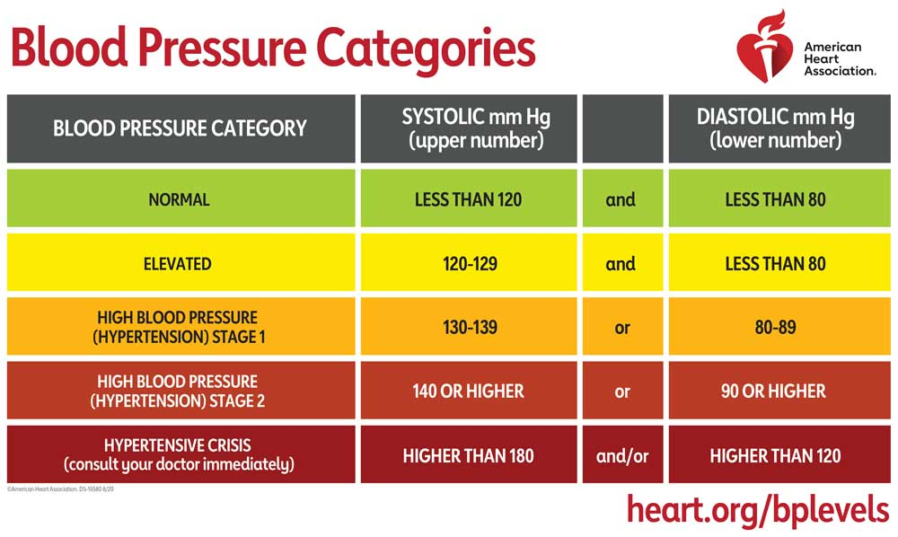
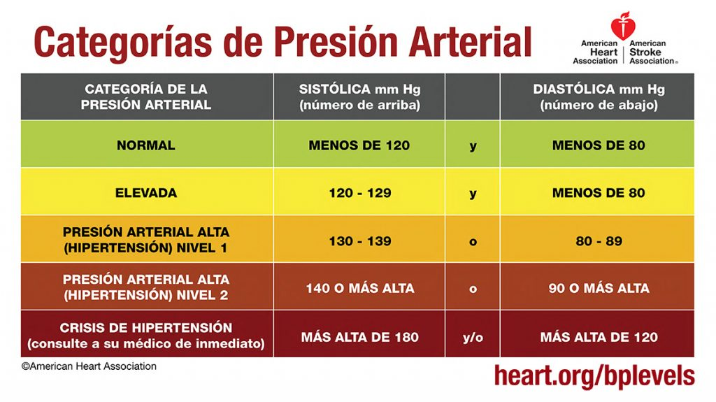
What is High Blood Pressure or hypertension level 2?
140 or higher
90 or higher

Slide 8
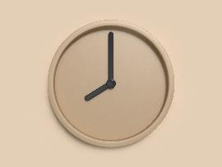
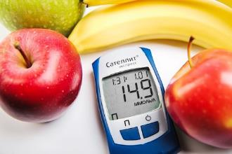
DO YOU KNOW WHAT THE IDEAL BLOOD SUGAR LEVES ARE,
USING THE GLUCOMETER?
80-100
80-150
80-200
Fasting
In the afternoon/evening before eating
Two hours after eating

Slide 9
GENERAL QUESTIONS
1
2
3
4
5
6
7
8
9
10
CONTINUE TO OBESITY AND DIABETES

Slide 10
1. WHAT IS INSULIN?
a. Stimulates appetite and prepares the body to receive food.
b. A hormone produced by the pancreas, which regulates the amount of glucose in the blood.
c. Keeps the body healthy. Intervenes in metabolism.
d. Changes mood, lifts the mood and stabilizes it.
CHOOSE YOUR ANSWER

Slide 11
KEEP TRYING
TRY AGAIN

Slide 12
CORRECT!
CHOOSE YOUR QUESTION

Slide 13
2. WHAT ARE THE “G” MEDICINES FOR?
a. Diabetes
b. Cancer
c. Blood Pressure
CHOOSE YOUR ANSWER
d. Triglycerides

Slide 14
KEEP TRYING
TRY AGAIN

Slide 15
CORRECT!
CHOOSE YOUR QUESTION

Slide 16
3. WHAT IS THE MOST COMMON "G" DRUG?
a. Gliclazide
b. Glipizide
c. Glimepiride
CHOOSE YOUR QUESTION
d. Glyburide

Slide 17
KEEP TRYING
TRY AGAIN

Slide 18
CORRECT!
CHOOSE YOUR QUESTION

Slide 19
4.WHAT ARE DRUGS ENDING IN “PRIL” FOR? e.g.: Lisonopril
Blood pressure
b. Diabetes
c. Cholesterol
CHOOSE YOUR ANSWER
d. Pain

Slide 20
KEEP TRYING
TRY AGAIN

Slide 21
CORRECT!
CHOOSE YOUR QUESTION

Slide 22
5. WHAT ARE DRUGS ENDING IN “STATIN” FOR? e.g.: Atorvastatin
a. Diabetes
b. Cholesterol
c. Cancer
CHOOSE YOUR ANSWER
d. Pain

Slide 23
KEEP TRYING
TRY AGAIN

Slide 24
CORRECT!
CHOOSE YOUR QUESTION

Slide 25
6. WHAT IS THE SIDE EFFECT OF METFORMIN?
a. Cough
b. Gain weight
c. Dizziness
CHOOSE YOUR ANSWER
d. Upset stomach

Slide 26
KEEP TRYING
TRY AGAIN

Slide 27
CORRECT!
CHOOSE YOUR QUESTION

Slide 28
7. IS THE MOST COMMON CAUSE OF DIABETES THE LACK OF AN EFFECTIVE INSULIN IN THE BODY?
a. Yes
b. No
CHOOSE YOUR ANSWER

Slide 29
KEEP TRYING
TRY AGAIN

Slide 30
CORRECT!
CHOOSE YOUR QUESTION

Slide 31
8. DOES THE PANCREAS PRODUCE INSULIN?
a. True
b. False
CHOOSE YOUR ANSWER
TRY AGAIN

Slide 32
KEEP TRYING
TRY AGAIN

Slide 33
CORRECT!
CHOOSE YOUR QUESTION

Slide 34
9. IF A PATIENT'S BLOOD SUGAR LEVEL IS 62, HE SHOULD DRINK A CUP OF ORANGE JUICE. AFTER HOW MANY MINUTES SHOULD HE CHECK HIS BLOOD SUGAR AGAIN?
a. 20
b. 45
c. 15
d. 10
CHOOSE YOUR ANSWER

Slide 35
KEEP TRYING
TRY AGAIN

Slide 36
CORRECT!
CHOOSE YOUR QUESTION

Slide 37
10. Name 2 medicines in the PAP (Prescription Assistance Program)
a. Gimepiride
b. actos
c. Farxiga
d. Januvia
CHOOSE YOUR ANSWER

Slide 38
KEEP TRYING
TRY AGAIN

Slide 39
CORRECT!
CHOOSE YOUR QUESTION

Slide 40
IS DIABETES A DISEASE?
IS OBESITY A DISEASE?
Yes, both are chronic diseases.
- Diabetes may have complications of pain, fatigue, shortness of breath, physical function, and difficult emotions
- Obesity may have all of the same - What if someone has diabetes and obesity? How do you think that affects their symptoms?

Slide 41
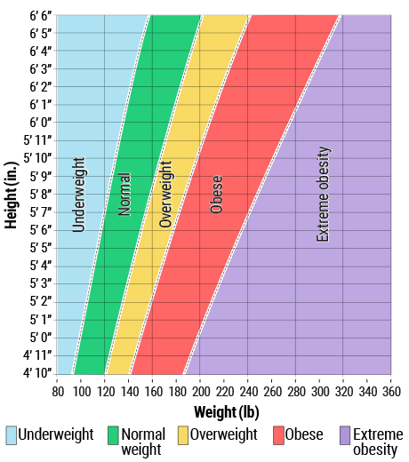
BMI (body mass index) =
WEIGHT (LB)
HEIGHT ² (IN)
FORMULA
UNDERWEIGTH NORMAL OVERWEIGTH OBESITY I OBESITY II OBESITY III OBESITY IV
https://www.nhlbi.nih.gov/health/educational/lose_wt/BMI/bmicalc.htm

Slide 42
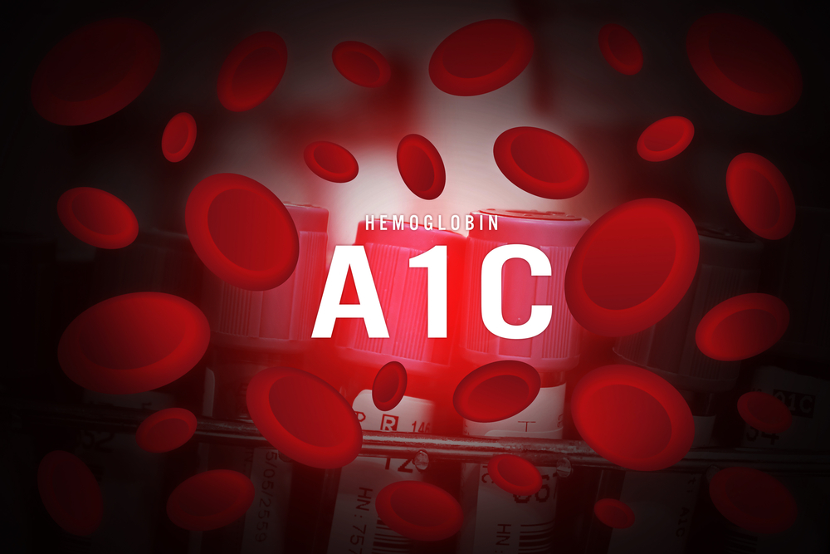
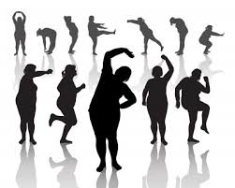
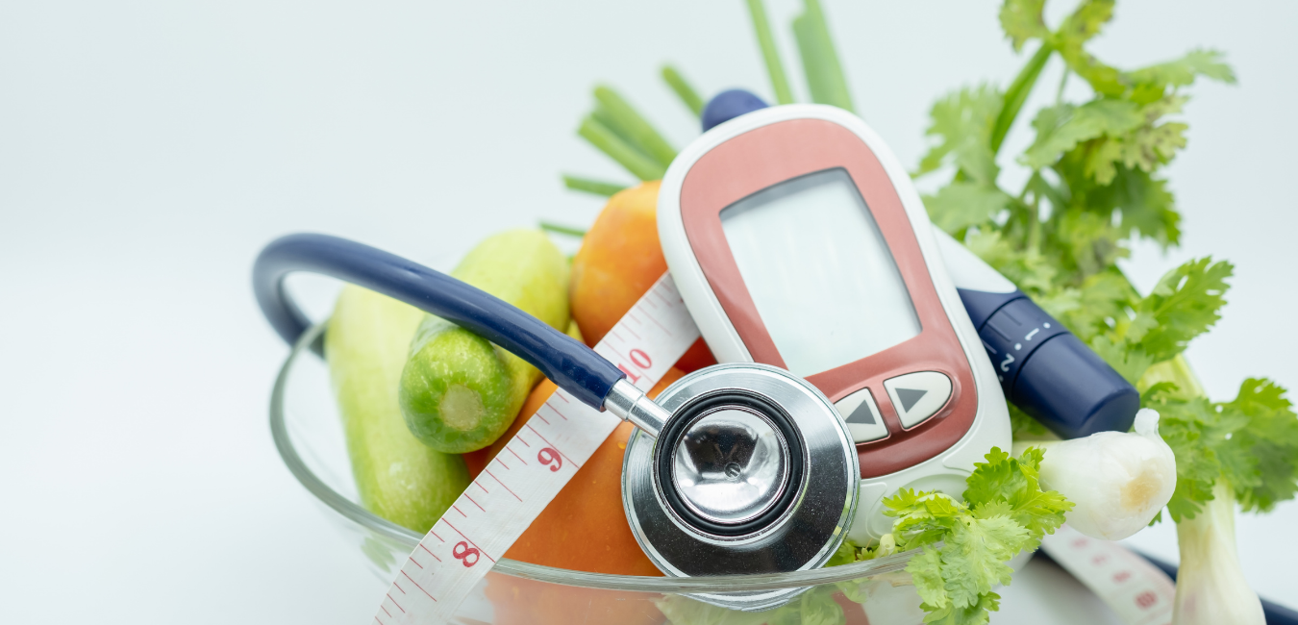
HOW CAN WE HELP OUR PATIENTS?
Take medicine Lose weight
Improve A1C Lose weight
Emotional support Lose weight
Exercise Improve A1C Lose weight
Emotional support Nutrition Improve A1C Lose weight
High sugar content and excess weight cause problems. So losing weight and improving A1C solve the problem.

Slide 43
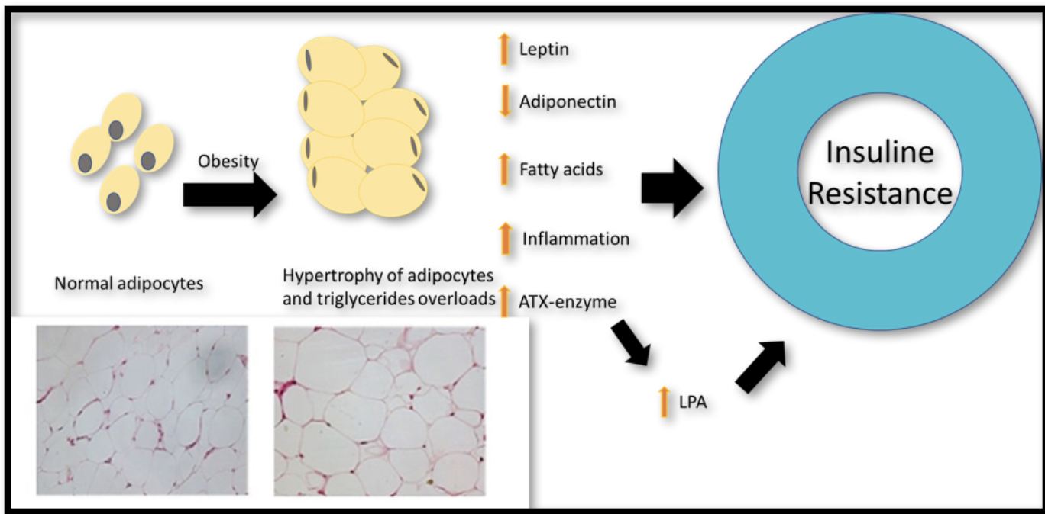
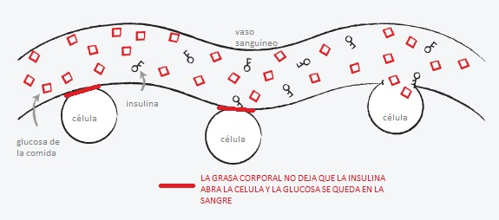
Why obesity increases diabetes
BLOOD VESSEL
CELL
INSULIN
CELL
FOOD GLUCOSE
CELL
BODY FAT DOES NOT ALOW INSULIN TO OPEN THE CELL AND GLUCOSE REMAINS IN THE BLOOD
Notes:
43

Slide 44
module1 HOMEWORK
Check your BMI (BODY MASS INDEX)

Slide 46
Module 2: PREVENTIVE CARE module #2 of 6
Team building and sharing Questions and Concerns?

Slide 47
PREVENTIVE CARE module #2 of 6
1. Foot ulcers 2. Wearing appropriate shoes 3. Skin care 4. Practical tips

Slide 48
1. ULCERS ON THE FEET

Slide 49
2. WEARING DIABETIC APPROPRIATE SHOES
● What are appropriate shoes?
● Type
●“diabetic shoes" ● jogging or walking shoes
● Soft, stretchable leather
● Lace-up moccasins
● Cushioned with thin leather sole
● Tips
● Do not shop for shoes later in the day when feet are swollen
● ½ thumb width from longest toe to tip of shoe
● Wear the socks you will wear
● Wear 1-2 hours first time, then 3-4 next time, etc…building up their use

Slide 50
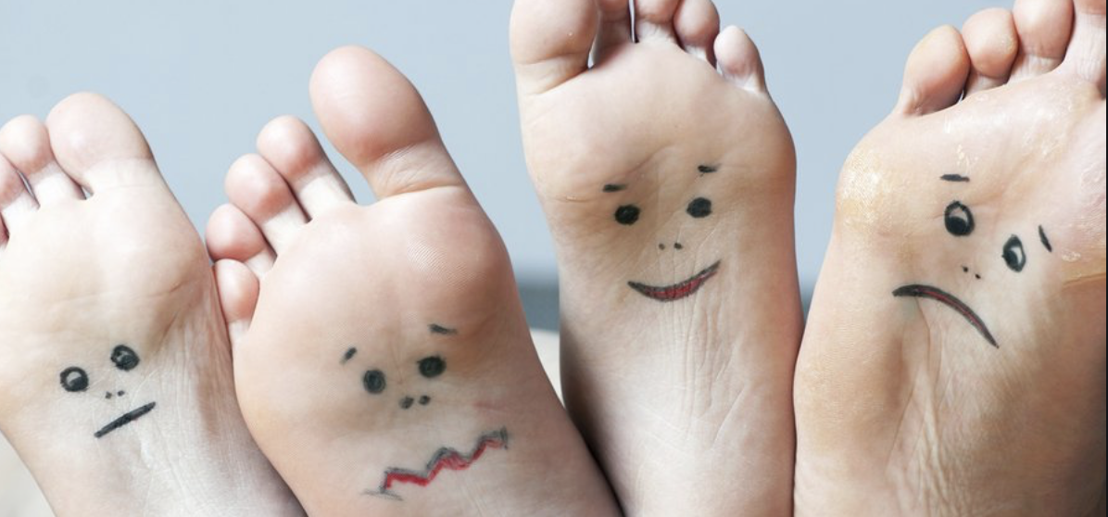
Can anyone check your feet weekly?

Slide 51
3. IMPORTANCE OF SKIN CARE
A key example is foot care, but general skincare is important too.
These are vulnerable places where skin breakdown is easy.
Foot fungus
Groin
Chapped lips

Slide 52
4. PRACTICAL TIPS
Keep skin clean and dry (avoid wet socks and flip-flops) Inspect your body after showering Avoid long baths/showers or with very hot water Keep skin moisturized and place moisturizer on your lips Treat skin cuts immediately Drink plenty of water Apply sun protection

Slide 53
WHY IS IT IMPORTANT TO CHECK YOUR BLOOD WITH THE GLUCOMETER ?
It helps prevent long-term diabetes complications High blood sugar for a long time can cause problems to the heart, eyes, kidneys, and nerves, as well as lead to amputations
Why check fasting sugar (glucose) levels?
It is possible to have normal sugar level in the morning, but higher in the afternoon Why? Why will patients only give us a morning sugar level?

Slide 54
MORE ABOUT CARE
What are self-management skills?
● Skills needed to treat a disease ● Skills needed to continue normally ● Skills to deal with emotions

Slide 55
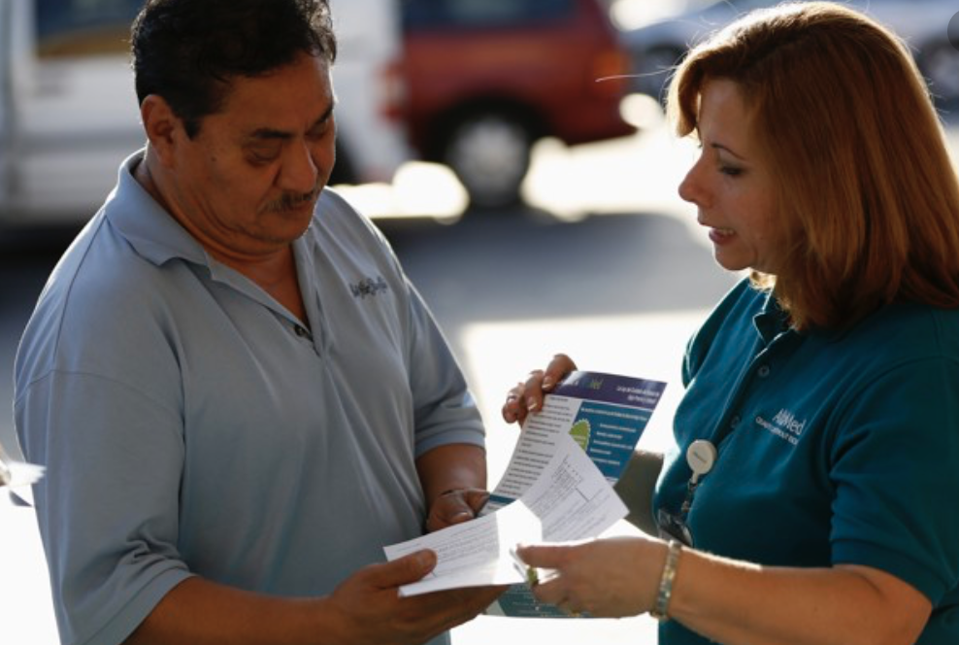
HOW CAN YOU HELP YOUR PATIENT TAKE CARE OF
THEMSELVES?
Stop blaming yourself Don’t stay by yourself, get social support Identify beyond diabetes The disease may offer you other opportunities Look for opportunities because you have diabetes

Slide 56
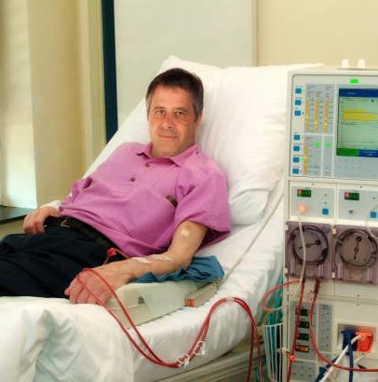
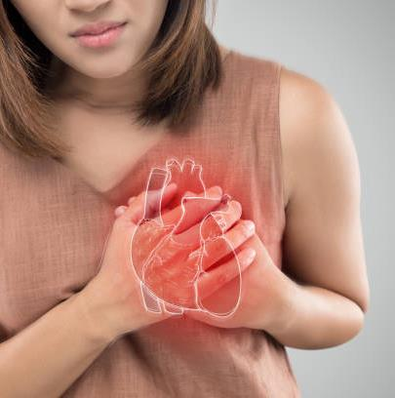
WHAT HAPPENS IF YOU DON'T TAKE CARE OF YOURSELF?
HEART ATTACK
VISION LOSS
DIALYSIS
56

Slide 58
Module 3: MEDICATION ADHERENCE
Module #3 of 6
Questions or concerns? Announcements

Slide 59
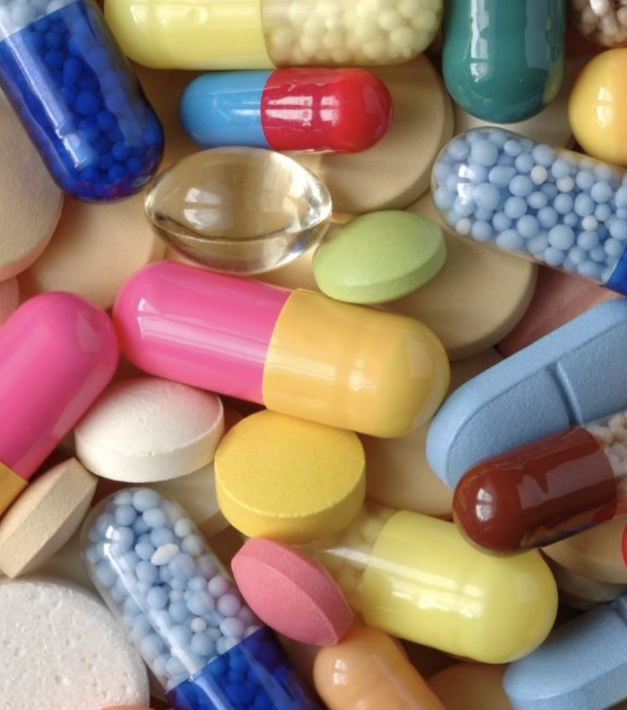
What questions or concerns about medications
have you had and how have you addressed them?

Slide 60
Let's review the side effects of these diabetes medications
MEDICINE | SIDE EFFECTS
METFORMIN
GLIMEPIRIDE
STATINS
ACTS
PRILS (Lisonopril, Enalapril)
Cough
Muscle aches
Stomach pain
Shortness of breath and leg swelling
Weight loss
Notes:
Ask then click for each answer.

Slide 61
TAKING YOUR MEDICATIONS
1. What are some of the more common reasons/barriers to taking medications and how can we resolve them? 2. Fear: Adverse reactions and side effects of hypoglycemic agents
3. Social barriers: ● Financial and various options including goodrx.com ● Time restrictions and how to set up reminders ● Eligibility and working with paperwork 4. What are practical ways to identify if (and the reason) our patients are struggling with non-adherence?
5. What are the most effective teaching techniques/tools for solving non-adherence barriers?

Slide 62
ADHERENCE TO MEDICATIONS
Overview:
Our most recent project revealed that barriers related to medicine are the most common. Most CHWs identified 85% of these barriers. ●These barriers may be out of the patient's control
Example: eligibility and what alternatives the patient might have

Slide 63
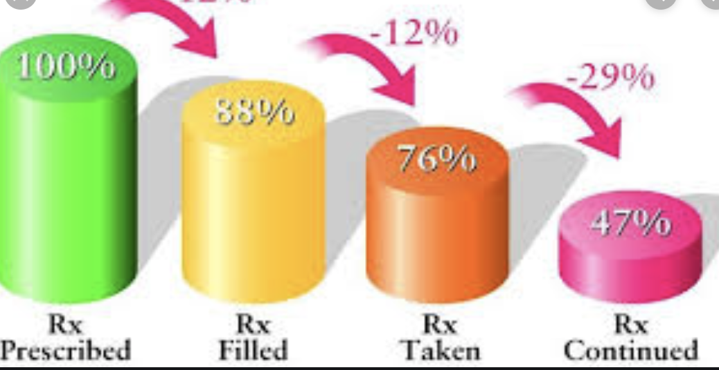
So how do WE figure out why they won’t take their medications?
Sometimes it's easy. Sometimes it's not easy...

Slide 64
1. Reasons not to take medications
Reason #1 I don't feel bad!
Even if I don't take the medicine I feel great.
Reason #2 Taking medication scares me! The side effects scare me!
Reason #3 I forget to take them!
Reason #4 When I take the medications I feel worse!
Reason #5 I'm exercising and eating better and I don't need them anymore!

Slide 65
2. Suggestions to address fear of side effects and adverse events
How can we overcome fear? 1. We need to know the side effects/adverse events
2. We need to ask them what their specific concerns are

Slide 66
KNOW THE SIDE EFFECTS
CHECK THE DRUG LABEL READ THE INFORMATION THAT COMES WITH MEDICINE https://medlineplus.gov/

Slide 67
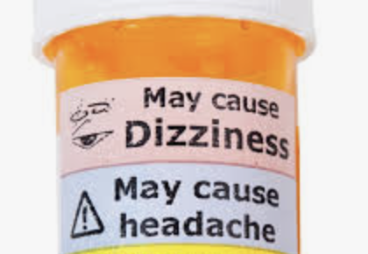
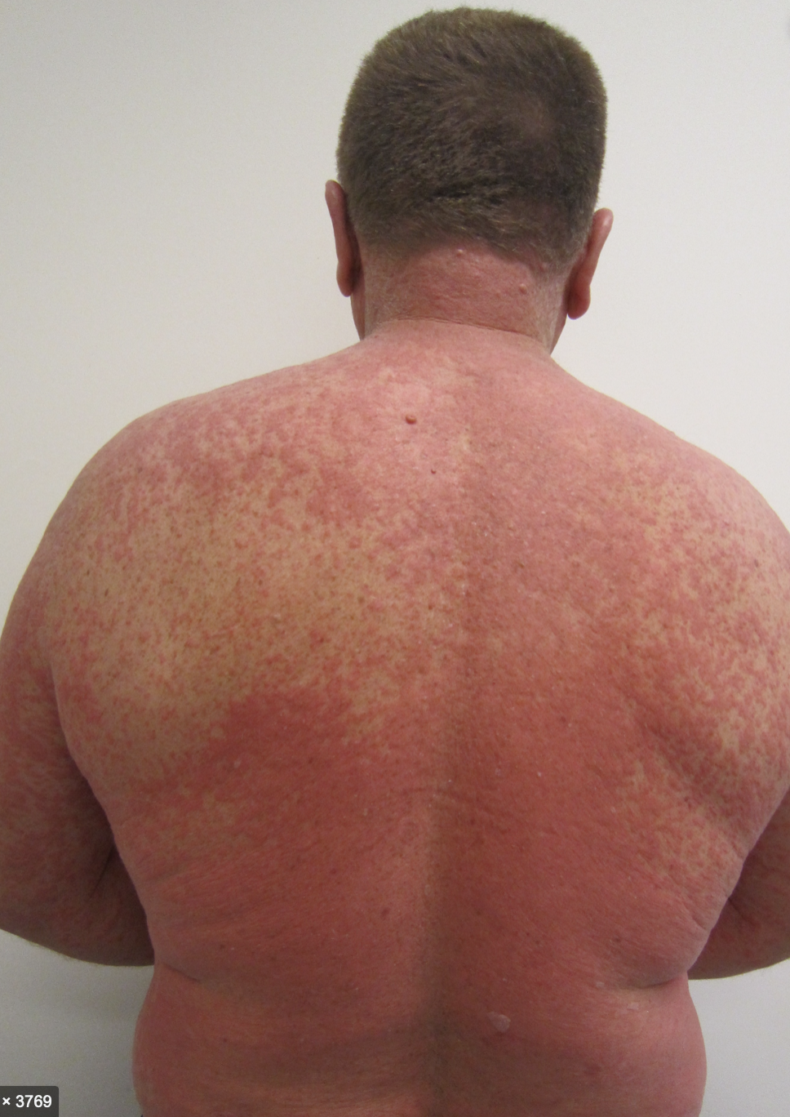
1. Adverse reaction VS Side effects
Adverse reaction - an unexpected reaction to a drug Having hives or another allergic reaction
Usually occur within hours of taking the medication Have to stop the medication Side effect - a typical but undesired effect of a drug
Weight gain from a medication
Usually occur within days or months You may or may not have to stop or decrease the medication

Slide 68
Adverse reaction VS Side effects
1. A 58-year-old woman in diabetes classes has just started taking Actos. She noticed that she is starting to gain weight in her legs. ● Is this an adverse reaction or a side effect? ● What should we do?
2. A 64-year-old male stated taking Actos. A few hours after taking it, he was short of breath and went to the emergency room ● Is this an adverse reaction or a side effect? ● What should we do?

Slide 69
2. Practical ways to identify the reason with the lack of adherence.
Where did I learn about this? Could something else have caused ______ Are there any specifi,c fears that you have of one medication or is it more general and about all medications? How does being able to afford your medications contribute to your fears? Others?

Slide 70
Are there any medication adherence barriers that are specific to the Hispanic community?

Slide 71
3. Social barriers to care
What are some of the social barriers to taking medication and how can we address them? Financial and various options including goodrx.com Eligibility and working with paperwork. Time restrictions and how to set reminders.

Slide 72
SOCIAL BARRIERS
Of the 425 million people living with diabetes, 80% live in low or middle- income countries. In high-income countries most people with diabetes are low to middle-income There are 11 OHMs, of which three are available at low cost (<$10/month) in the U.S. - metformin, “G” drugs, and Actos PAP meds: Farxiga and Januvia They are among the most expensive of the eight classes. Farxiga: $399/month Januvia or Janumet: $711/month

Slide 73
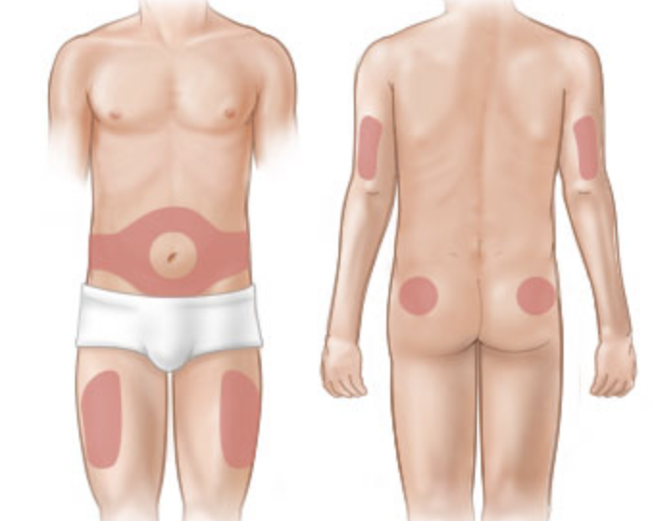
What about insulin in the U.S. and abroad?
The average cost is $265/month Depends on the type and amount More bottles, more cost.
Versus pills – go up on strength so the same number of pills, same cost Metformin 500 twice daily costs $4.00; metformin 1000 twice daily costs $4.00 Insulin is available in pharmacies for 93.8% of high-income countries 40.2% of middle-income countries 10.3% of low-income countries

Slide 74
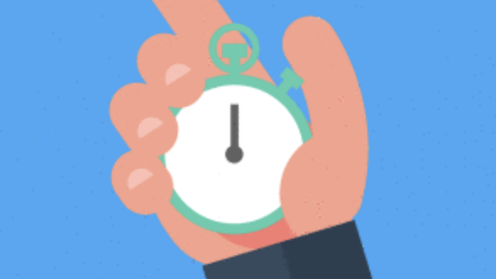
How do we help our patients remember? (your thoughts)
If they take the morning dose but not the evening dose, let the doctor know and maybe can change to a once daily pill

Slide 75
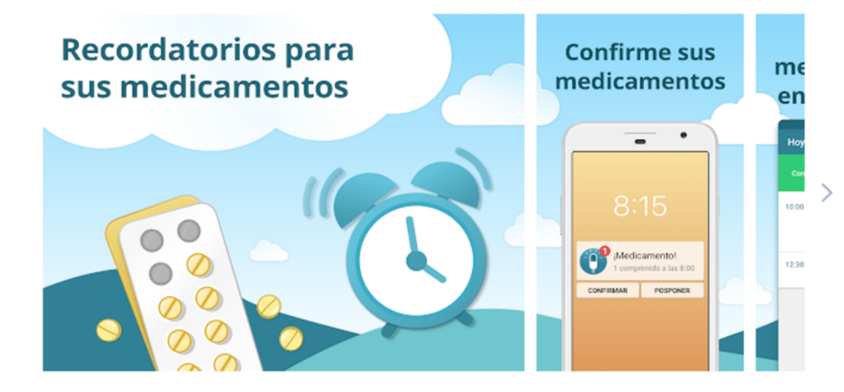
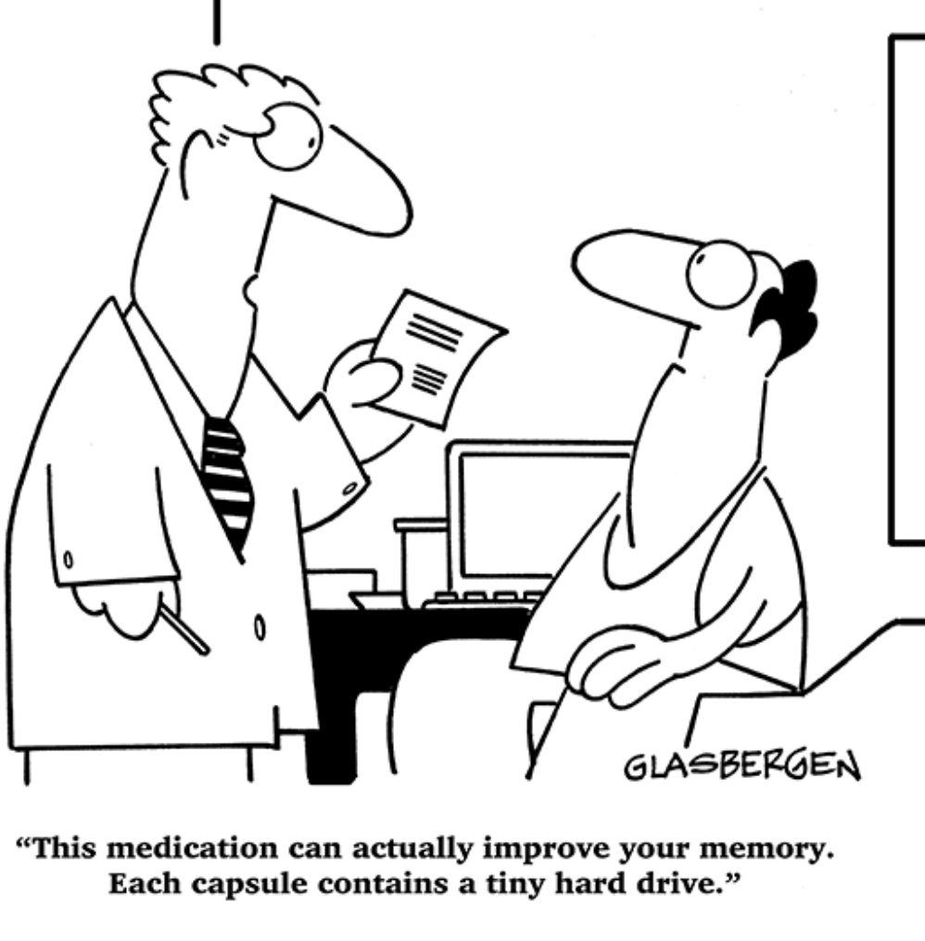
REMINDERS TO TAKE your medication
Make it obvious (next to the toothbrush, breakfast table, etc.) Use a checklist or organizer. Use an electronic reminder Have others remind you
Don’t run out!
MEDICATION REMINDER
CONFIRM
MEDICATION

Slide 76
4. ELIGIBILITY AND WORKING WITH PAPERWORK
1. Know the system and what is needed:
It’s a difficult process
Schedule
Fill out paperwork (It is tedious)
Delays
2. Understanding patient barriers
Fear
Lack of knowledge
Language
3. Stay informed

Slide 77
5. EFFECTIVE TEACHING TECHNIQUES FOR aDHERENCe to medication
PROVIDE education (not nagging) about the reason for medications and taking daily
2. LISTEN to their fears and barriers (can you help with any of them?) 3. HELP find ways of taking medicines within the normal daily routine

Slide 78
Helping Your Patients WANT to Take Their Medications
Help understand why: relieve symptoms, prevent further problems, improve/slow disease progression, etc. Mind over matter: hope for the best Examine your beliefs about treatment Think of your medications the way you think of vitamins (you're doing something positive to promote health) Imagine how the medication is helping you Keep in mind why you are taking the medication

Slide 80
Module 4: NUTRITION module #4 OF 6
Team building and sharing Questions or Concerns? Announcements

Slide 81
NUTRITION
Overweight Meaning of healthy eating
Why is it so hard to take care of yourself? Example: habits The healthy plate Goal setting, 4 weeks with specific objectives
BMI (body mass index) and its importance

Slide 82
WHAT IS OVERWEIGHT?
Overweight and obesity are defined as: an excessive accumulation of fat that can be harmful to health
DOES OVERWEIGHT AFFECT HEALTH?
Yes, being overweight or obese can have serious impacts on health. Carrying extra fat leads to serious health consequences. More weight puts pressure on the bones and joints. This can lead to oesteoarthritis, a disease that causes joint pain and stiffness. The heart is one of the affected organs in those who suffer from obesity. The reason is that you overwork and have increased pressure because you need to move more blood to more volumen of tissue, which can end up influincing your heart’s ability to pump blood properly.

Slide 83
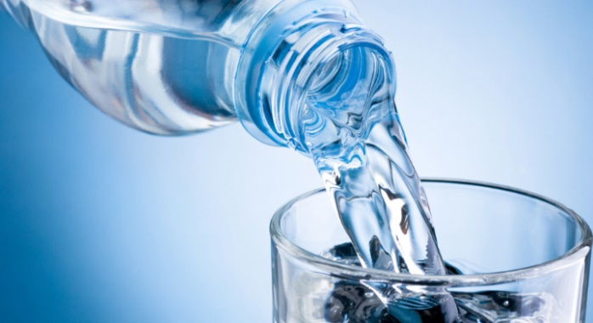
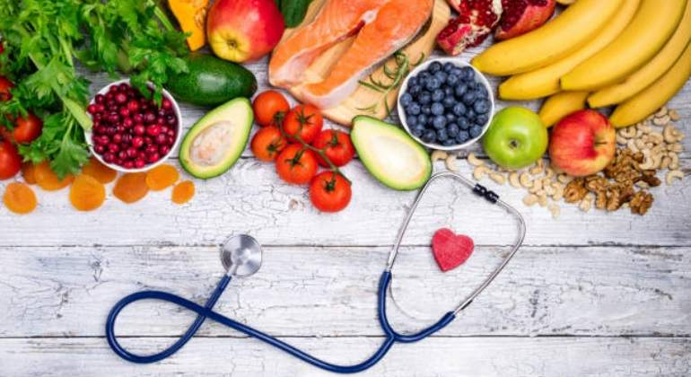
Choose health-friendly foods and drinks most of the time.
The human body is like a car; it needs the fuel with the appropriate formula. If the formula is not correct, the car will not run well, or stop working.
MEANING OF HEALTHY EATING

Slide 84
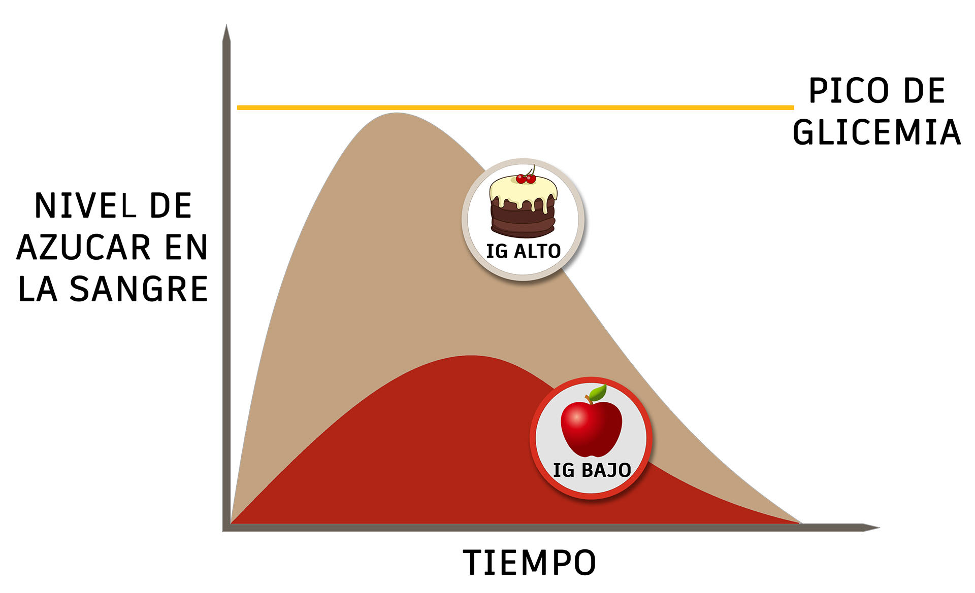
The effect of food on glucose
GLYCEMIA PEAK
BLOOD GLUCOSE LEVEL
HIGH GI
LOW GI
TIME
Notes:
When a person is diagnosed with diabetes, they must learn to eat a healthy diet that does not have to be associated with restrictions, nor is it a condemnation to deprive themselves of good food. It is always possible to eat tasty and well when you have diabetes
The effect of food on glucose For most people with diabetes, the first resort to controlling glucose is some method of counting carbohydrates. To control the level of glucose in the blood it is key to reach a balance between total carbohydrate consumption, physical activity and diabetes pills or insulin. Since each type of carbohydrate has different effects on blood glucose, using GI can be helpful in perfecting glycol control
Glycemic index and diabetes
The glycemic index (GI) is a measure of how quickly a food can raise its blood sugar (glucose) level. Only foods that contain carbohydrates have a GI. Foods such as oils, fats, and meats do not have a GI, although in people with diabetes, these can affect blood sugar
In general, foods with a low GI slowly increase glucose in your body. Foods with a high GI rapidly increase blood glucose. If you have diabetes, foods with a high GI can make it hard to control the disease
Information Not all carbohydrates work the same way in the body. Some cause a rapid rise in blood sugar, while others work more slowly, preventing large or rapid increases in blood sugar. The glycemic index addresses these differences by assigning a number to foods that reflects how quickly they increase blood glucose compared to pure glucose (sugar). The GI scale ranges from 0 to 100. Pure glucose has the highest GI and is assigned a value of 100. Eating foods with a low GI can help you achieve tighter control over your blood sugar. Paying attention to the GI of food can be another tool to help manage diabetes, along with carbohydrate counting. Following a diet with a low GI can also help you lose weight
Glycemic index of certain foods Low GI foods (0 to 55):
Bulgur, barley Pasta, parboiled rice (processed) Quinoa Whole grain cereal high in fiber, oat slices or flakes Carrots, non-starchy green vegetables Apples, oranges, grapes, and many other fruits Most nuts, legumes and beans Milk and yogurt Foods with moderate GI (56 to 69): Pita bread, bread Couscous Brown rice Raisins High GI foods (70 and greater): White bread and bagel Most processed cereals and instant oats Most snacks Potatoes White rice Honey Sugar Watermelon, pineapple
Meal planning with the glycemic index When planning your meals: Choose foods that have a low to medium GI. When eating a high-GI food, combine it with low-GI foods to balance the effect on your glucose levels. The GI of a food, and its impact on people with diabetes can change when you combine it with other foods. The GI of a food is affected by certain factors, such as the maturity of a piece of fruit. Then you need to think about more than a food's GI when choosing healthy options. It's a good idea to keep these matters in mind when choosing meals. Serving size still matters because calories still matter, as does the amount of carbs. You need to be aware of the serving size and number of carbohydrates in your meal, even if it contains foods with a low GI. In general, processed foods have a higher GI. For example, fruit juice and instant potatoes have a higher GI than whole fruit and whole baked potatoes. Cooking can affect the GI of a food. For example, pasta al dente has a lower GI than cooked pasta. Foods with a higher fat or fiber content tend to have a lower GI. Certain foods in the same class may have different GI values. For example, converted long-grain white rice has a lower GI than brown rice. And white short-grain rice has a higher GI than brown rice. Similarly, fast oats or grits have a high GI, but whole grain oats and whole-grain breakfast cereals have a lower GI. Choose a variety of healthy foods keeping in mind the nutritional value of the whole meal, as well as the GI of the foods. Some high GI foods are high in nutrients. So balance them with foods with a lower GI. For many people with diabetes, carbohydrate counting helps limit carbohydrates to a healthy amount. Carbohydrate counting along with healthy food choices and maintaining a healthy weight may be enough to control diabetes and decrease the risk of complications. But if you're having trouble controlling your blood sugar or want tighter control, you may want to talk to your health care provider about using the glycemic index as part of your action plan..
Fuente: https://medlineplus.gov/english/ency/patientinstructions/000941.htm

Slide 85
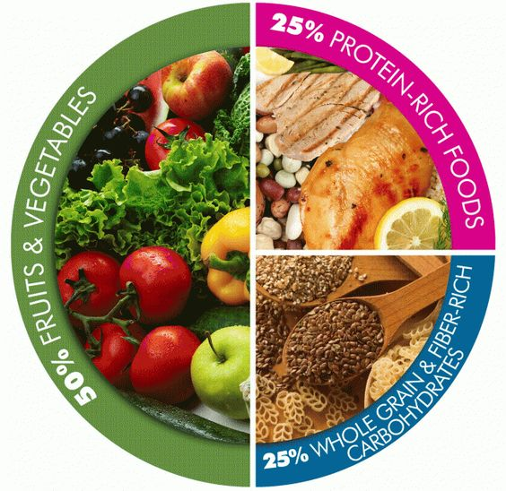
PORTION SIZES
H e a l t h y L u n c h
Notes:
Proper portion balance
In order to consider that person has a balanced diet, the caloric distribution of the food he/she eats should be as follows: 55%-60%, carbohydrates 15%-20% protein and 20%-30% fat. Of course, certain factors must be taken into account when managing these percentages, such as age, sex, weight, height, degree of activity, the climate in which the person lives and even the biological moment in which the person is
Las porciones de las comidas
Controlling portion size is still relevant for controlling blood glucose and for losing weight or keeping it. There are two ways to plan meal portions, the first is the "plate method" and the second, "the carbohydrate count“. In both cases it is advisable to respect the following criteria:
●We must individualize our eating plan ●We must eat varied and balanced ●It is better to divide food into five or six doses a day (lower volume of food per feeding, better control)
Proportion should be consistent with insulin treatment or oral antidiabetic drugs and the practice of physical exercise The diet should be rich in fiber (vegetables, legumes, nuts, whole grains and fruit, in the appropriate quantities in each division)
A diet low in saturated fat and cholesterol (moderate the consumption of complete dairy products, fatty meats and eggs, etc
Alcohol is a hypoglycemic agent (lowers blood sugar.) If you drink it, include it in the main meals and never on an empty stomach
It is important to eat every three or four hours, as this avoids, for example, possible hypoglycemia Maintain an established schedule for meals, as it facilitates a better metabolic balance.
Source: https://vive-sano.org/delivery-menu-healthy/must-contain-a-healthy-and-balanced-lunch/

Slide 86
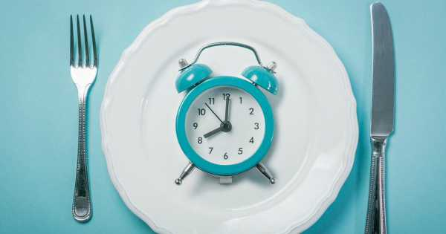
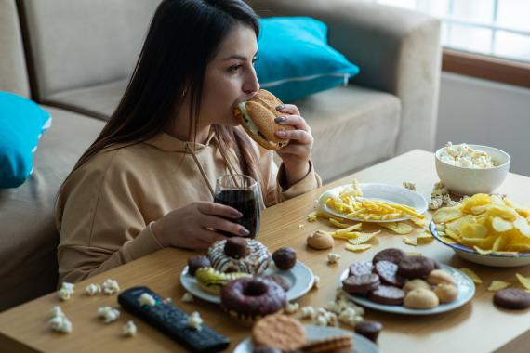
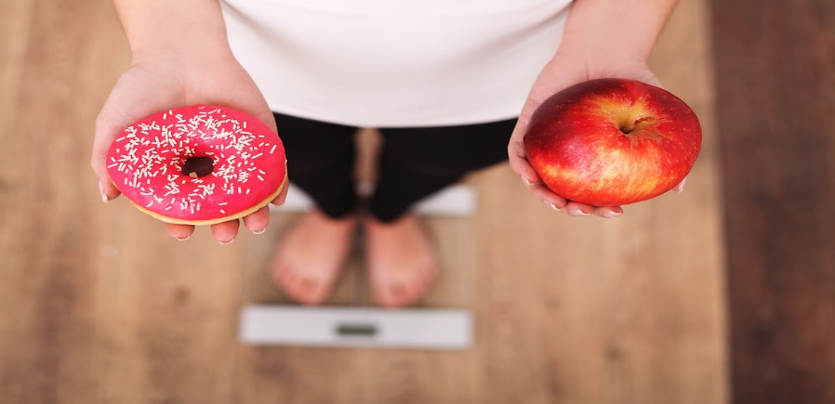
WHY IS IT SO DIFFICULT TO TAKE CARE OF YOURSELF?
CULTURAL HABITS
2. Lack of time, we choose fast food
1. Tradition
3. We overeat or eat unhealthy due to anxiety
4. We choose badly for pleasure.

Slide 87
IS DIETING RECOMMENDED FOR WEIGTH LOSS?
Many patients ask us for a "diet" to follow. Remember that we want to change your
lifestyle permanently, not DO a "diet."

Slide 88
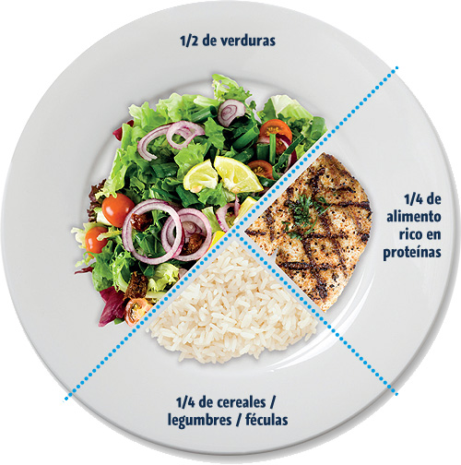
NUTRITION QUESTIONS
How do you divide the healthy plate?
ALL are necessary! ALL are beneficial if eaten in the RIGHT PORTIONS!
VEGETABLE
PROTEINS
CARBOHYDRATES

Slide 89
IS IT GOOD TO TAKE SUPPLEMENTS?
In some cases, using supplements could even be harmful. Many times we think that vitamins are natural and therefore harmless, but in high doses or in the wrong dose they can be very harmful
Also tell your doctor if you are taking teas, liquefied supplements, or liquids. Just because it’s "natural“ doesn’t mean it is qualified as healthy. And even if it is healthy it is not necessary in high quantities.

Slide 90
SETTING GOALS WEEK BY WEEK
Week 1: Carbohydrates, proteins and fats: definition and their sources
% of meals

Slide 91
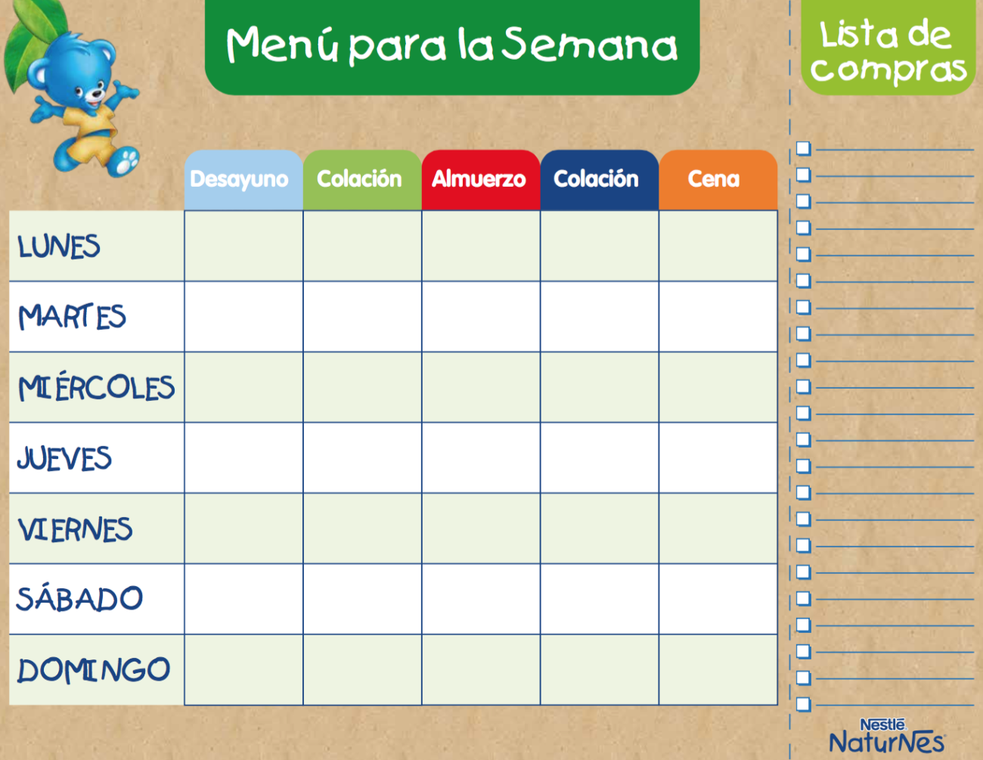
Week 2: Simple Recipe Planning
Shopping List
W e e k l y M e n u
Breakfast
Snack
Lunch
Snack
Dinner
MONDAY
TUESDAY
WEDNESDAY
TURSDAY
FRIDAY
SATURDAY
SUNDAY

Slide 92
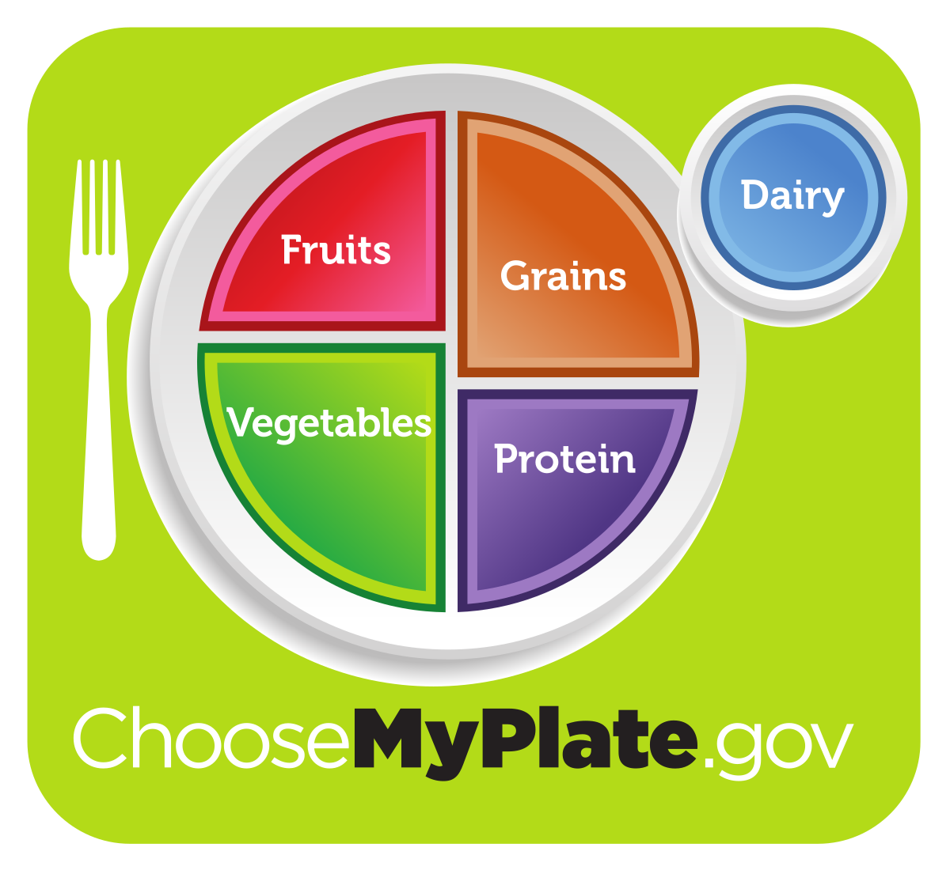
Week 3: Portion Control

Slide 93
Week 4: CHALLENGES OF EATING OUTSIDE OF THE HOME
Calories and cost Carbohydrates, proteins and fats: definition and their sources
% of meals Grilled, oven or steamed dishes instead of fried meals Small plates (portion control)

Slide 94
BMI: BODY MASS INDEX
BMI
FORMULA
WEIGHT (KG)
HEIGHT X HEIGHT (M)
BMI
UNDERWEIGHT NORMAL OVERWEIGHT OBESITY I OBESITY II OBESITY III OBESITY IV

Slide 95
Why is it important to know which group your BMI belongs to?
BMI is important; it helps to know what kind of health complications you may have due to obesity.

Slide 96
WEIGHT LOSS TIPS
1. Set small goals step by step
2. Identify specific actions for weight loss
3. Watch what you eat
4. Choose the right food and know the recommended portion size
5. Avoid excessive portion sizes
6. Don't skip meals
7. Eat slowly
8. Drink plenty of water
9. Build a support group

Slide 98
Module 5: DEPRESSION, SEX, ALCoHOL, SMOKING AND DIABETES module #5 of 6
Team building and sharing
Questions and concerns

Slide 99
depression, SEX, and diabetes
1. Depression overview 2. What are the symptoms of depression? 3. Diagnostic
4. Discuss sexual intimacy and its complications as they relate to diabetes

Slide 100
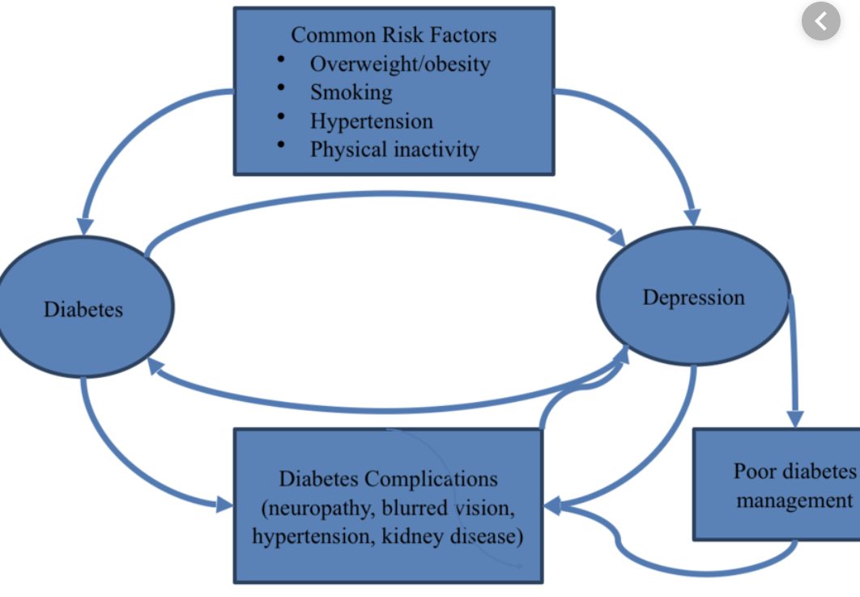
1. WHAT IS DEPRESSION?
Depression is a state of deep and prolonged sadness that lasts for more than a few weeks without an obvious or easily defined cause. It can be connected to family history or chemical imbalances.
People with diabetes are three times more likely to have depression. What are the treatments for depression? Medications, counseling, lifestyle

Slide 101
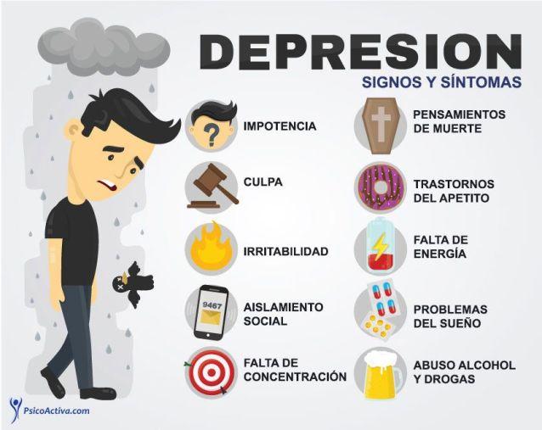
2. WHAT ARE THE SYMPTOMS OF DEPRESSION?
DEPRESSION
Signs and symptoms
HELPLESS-NESS
THOUGHTS OF DEATH
BLAME
APPETITE DISORDERS
LACK OF ENERGY
IRRITABILITY
SOCIAL ISOLATION
SLEEP PROBLEMS
LACK OF CONCENTRATION
ALCOHOL AND GRUG ABUSE

Slide 102
3. DIAGNOSING DEPRESSION WHAT EXAM SHOULD BE DONE?
Doctor orders you to be tested for vitamin B12 deficiency. Your body may mimic depression. This deficiency is common in diabetes patients and this is why your doctor regularly checks your vitamin B12 levels.
Make sure that if your doctor has recommended any supplements that you take them in the dose your doctor has recommended.

Slide 103
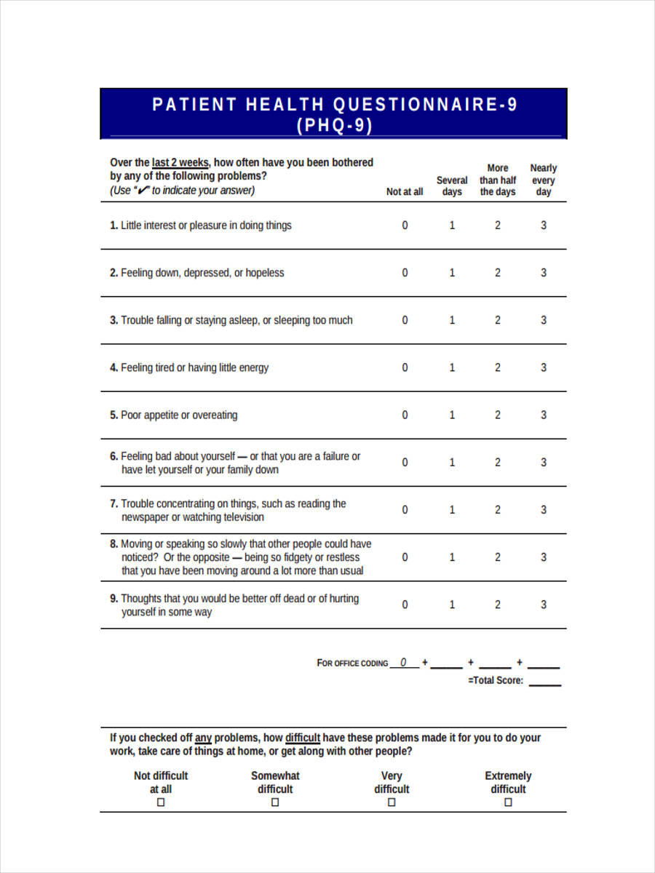

Slide 104
4. SEXUAL INTIMACY PROBLEMS?
High blood sugar over a long period of time can damage the veins and arteries. These veins reach those organs and when damaged, the blood does not reach that point and they lose sensitivity. That's why men who have this type of damage caused by years of deterioration from too much sugar in their blood have trouble getting an erection. Women who have these uncontrolled sugar problems can also lose sensitivity and even not have enough sensitivity to enjoy sexual intercourse.

Slide 105
What would you say to a couple in which one or both of them have diabetes and have problems in their marriage?
Just as we must take care of our body, we must take care of our marriage. Dialogue is very important, especially when it comes to sexual intercourse.
Talk to your doctor.
These healthy relationships are part of your health as well. We often see among our patients that mental and emotional health are a BIG part of our physical health.

Slide 106
Spirituality and Religion
How does spirituality or religion affect depression, sexual intimacy, and the marriage relationship? How have we seen the following in our current group? . Faith . Influence . Community . Address

Slide 107
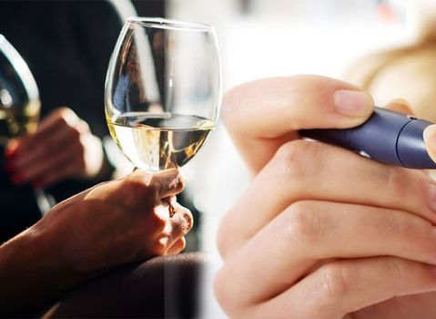
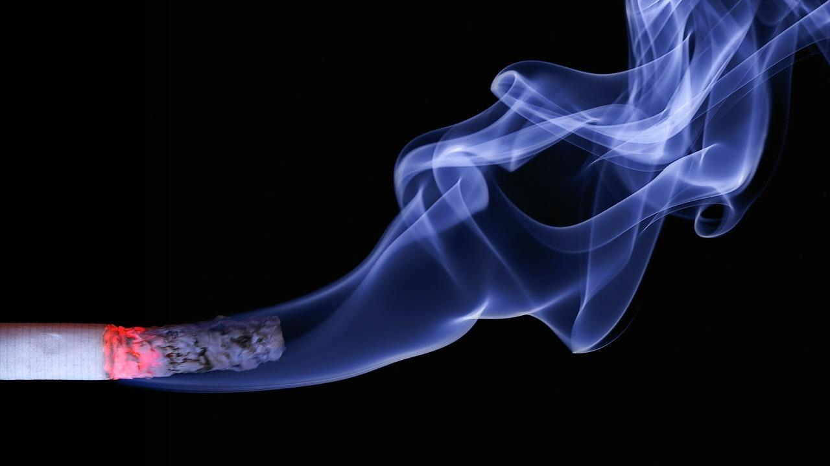
Smoking, Alcohol, and Diabetes
Notes:
Welcome! It’s great that you're with us again learning more about your health and how to prevent or manage diabetes. Today we will be talking about how smoking and alcohol affects the body in general, how it affects people with diabetes or at risk of developing diabetes, and we will also give you advice on how to quit smoking and drinking or help a loved one who needs to. This topic may not apply to your life right now, but it never hurts to know this information so you can help yourself or others.
According to Mayo Clinic Family Health, smoking addiction is defined as the addition to nicotine which is the main component of the tobacco leaf, which produces pleasurable effects on our body. According to the World Health Organization, smoking is an addictive disease and is the leading cause of premature and preventable mortality. It is estimated 4.9 million people die each year as a result of tobacco use. By 2030, an estimated 10 million deaths are estimated. It is also important to note that an average of 1 million people, who are called smokers, die yearly due to exposure to secondhand smoke. Tobacco is harmful in all its forms, smoking cigarettes is the most common way to consume tobacco. But it is also consumed through the pipe, the hookah pipe, cigars, chewing tobacco paste, and the electronic cigarette that despite having less nicotine also contains toxic substances. The latter is known as vaping steam. In addition, there are scented and menthol cigarettes as well as snuff, among others, which are also harmful.

Slide 108
Smoking, alcohol, and diabetes
Tobacco use
Complications of tobacco use in diabetics Alcohol and diabetes Definition of hypoglycemia Active self-manager

Slide 109
WHAT IS SMOKING?
(Tobacco use)
It is the addiction to tobacco caused, mainly, by one of its active components: NICOTINE. Nicotine is the main component of the tobacco leaf which produces a pleasurable effect on the body.
1. Is smoking a disease? Yes or no?
Smoking is the leading cause of premature and preventable mortality. It is an addictive and chronic disease.

Slide 110
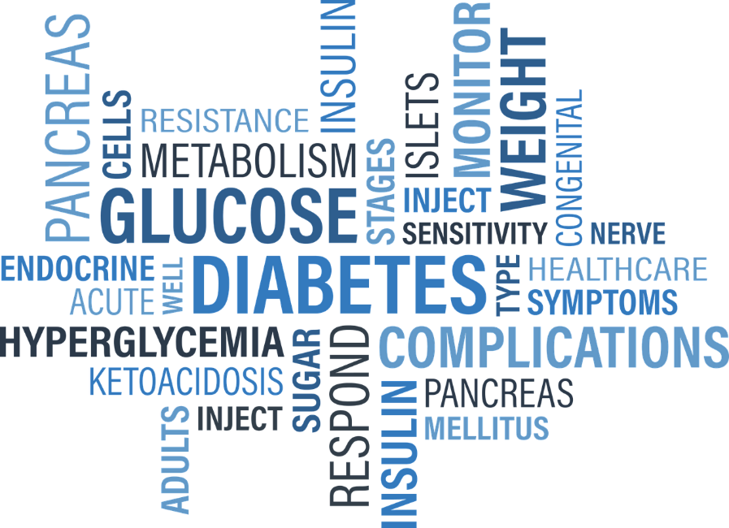
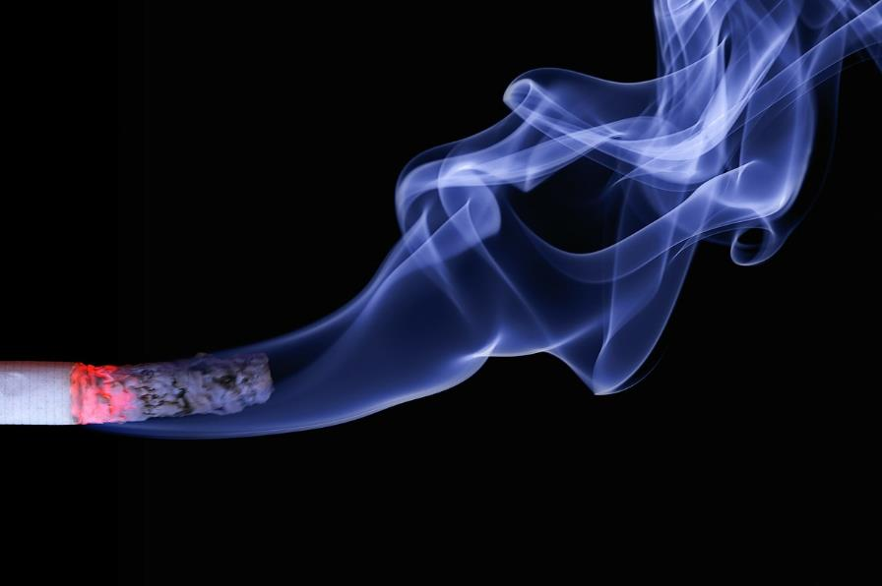
Why is smoking especially bad if you have diabetes?
Notes:
Why is smoking especially bad if you have diabetes? People with diabetes who smoke are more likely to have serious health problems and complications than people with diabetes who don't smoke. These complications include: increased incidence of heart and kidney disease, poor blood flow to the extremities, increased risk of infections, higher incidence of foot ulcers, higher rates of lower limb amputation, and retinopathy. which increases the likelihood of blindness
People with diabetes already have to work constantly work to control their blood sugar levels and prevent complications from the disease, which include damage to the nerves, eyes, kidneys and heart. Tobacco in cigarettes increases these problems and complicates diabetes control
There are at least 70 chemicals in cigarettes that are directly linked to cancer development, aging and oxidative stress. For example, some of the chemicals found in cigarettes include toilet bowl cleaner, candle wax, insecticide, arsenic, nicotine, lighter fluid, and carbon monoxide, just to name a few. These dangerous and addictive chemicals cause damage to your body's cells and interfere with their normal function
In a person with diabetes, the damage caused by a cigarette chemicals and nicotine causes chronic inflammation, resulting in insulin resistance and higher blood sugar levels, and therefore, making it more difficult to control diabetes
All of these problems compound to make diabetes difficult to control and increased the likelihood of complications. For people with diabetes, the health risks of smoking a cigarette are four times greater than for a person without diabetes
Even more surprising, a 2014 study revealed that smokers are also 30-40% more likely to develop type 2 diabetes, making the link between smoking and diabetes a vicious cycle
Smoking is a health hazard for anyone, but for people with diabetes or at high risk of developing the disease, smoking can contribute to serious health complications
Researchers have long known that diabetic patients who smoke have higher blood sugar levels, which makes their disease more difficult to control and puts them at greater risk of developing complications such as blindness, nerve damage, kidney failure and heart problems. Now, a new study offers the most definitive evidence as to why: nicotine in cigarettes
California State Polytechnic University found that nicotine, when added to human blood samples, raises hemoglobin A1c (HbA1c) levels by up to 34%. This indicates to them that there would be a similar effect with diabetic smokers.
Doctors have always known that smoking can make diabetes worse, but through this study we now know why. It's nicotine!
This study also implies that if you are a smoker and not diabetic, your chances of developing diabetes are higher
But perhaps most importantly, the results also suggest that nicotine replacement products, such as nicotine-containing patches and e-cigarettes, are also not a safe option for patients with diabetes. Because they still contain nicotine, these products are just as likely to increase A1c levels as cigarettes. "To minimize your chances of developing diabetes or diabetic complications, you should stop smoking," says the doctor in charge of this study. That means – stop doing it immediately and all at once.

Slide 111
2. SMOKING COMPLICATIONS IN DIABETICS
The chemicals in cigarettes and nicotine cause chronic inflammation Insulin resistance and higher blood sugar levels make it harder to control diabetes Higher incidence of heart and kidney disease Poor blood flow in the limbs Increased risk of infections, higher incidence of foot ulcers, higher amputation rates Diabetic retinopathy is an injury to the blood vessels of the retina which carries consequences from blurred or distorted vision to blindness

Slide 112
3. ALCOHOLISM AND DIABETES
A chronic disease in which a person feels a desire to drink alcoholic beverages and cannot control that desire What is the side effect of alcohol consumption? Drinking too much alcohol can lead to
High blood pressure Diabetes Sleep disorders Depression Erectile dysfunction Cancer

Slide 113
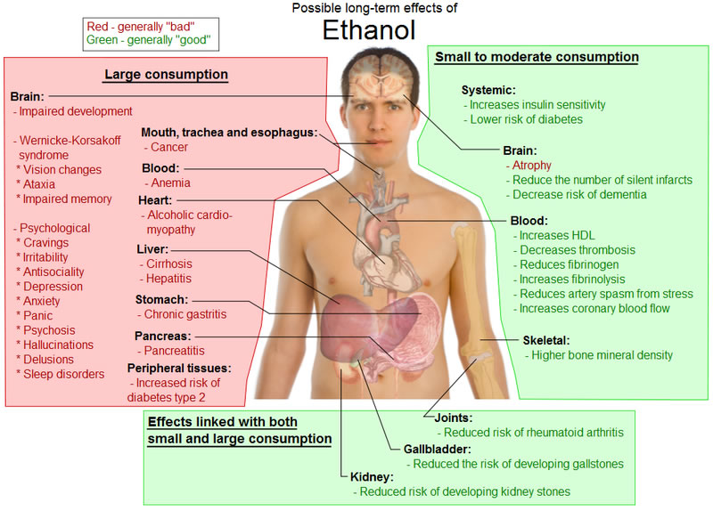
Notes:
In your general health it can cause anything from memory loss, hallucinations, attacks, dementia, risk of chest infection, liver inflammation, hepatitis, cirrhosis.... in SHORT..... Can you see the whole list on your screen? Includes up to low blood glucose control!!! And although all the health consequences that alcohol contributes to need to be look out for, one that we’re primarily focused on in these classes is your glucose or diabetes.

Slide 114
3. WHAT IS HYPOGLYCEMIA?
Hypoglycemia is a decrease in blood sugar or simply: Low blood sugar ● Less than 70 or 80 ● Severe is less than 50
Symptoms ● Mild/moderate: confusion, aggression ● Serious: unconsciousness/death.
Drunkenness is often confused with hypoglycemia.

Slide 115
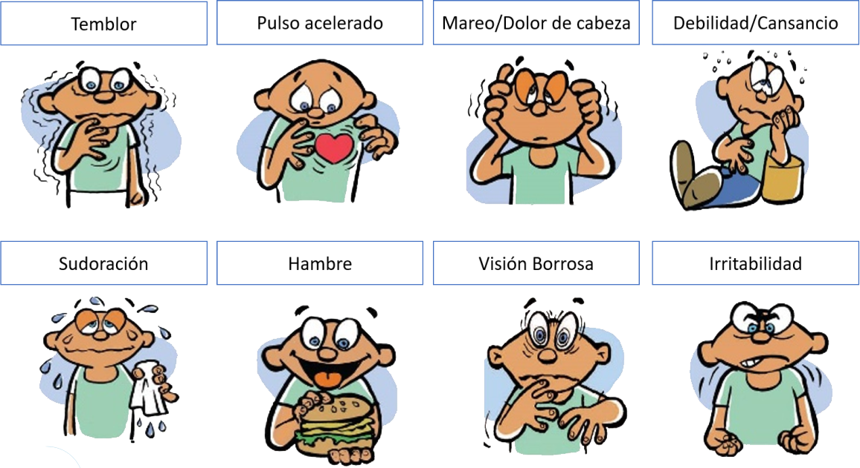
WHAT ARE THE SYMPTOMS of hypoglycemia?
People with type 1 have a higher risk of hypoglycemia than type 2
SHAKING
FAST HEARTBEAT
DIZZINES/HEADACHE
WEAKNESS/FATIGUE
SWEATING
HUNGER
IMPAIRED VISION
IRRITABLE

Slide 116
WHY IS IT IMPORTANT TO KNOW about HYPOGLYCEMIA?
86,000 deaths are associated with hypoglycemia each year The index is higher in the elderly and insulin-dependent What to do? Conscious Unconscious

Slide 117
5.Active self-managEMENT: controlling sugar
1. Identify the problem 2. List of ideas to solve the problem 3. Select a method to test 4. Is it working? 5. Choose another idea if the first one didn't work 6. Use other resources 7. Accept that the problem may not be solved now

Slide 118
ALCOHOLISM SCREENING
“CAGE”
C Have you ever felt you should CUT down on your drinking?
A Have you ever become ANNOYED by criticism of your drinking?
G Have you ever felt GUILTY about your drinking?
E Have you ever had a morning EYE-OPENER to get rid of a hangover?

Slide 119
Recreational drugs
It is actually a growing problem among older adults age 60+
Drugs and alcohol can make the medication less effective or even useless, or it makes the medication harmful or toxic to your body.

Slide 120
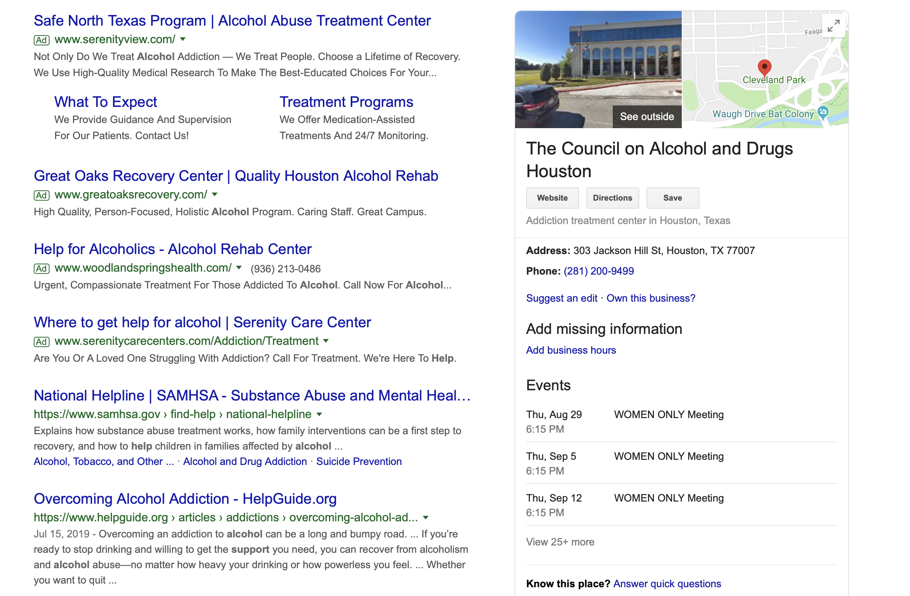
Where to get help? (Remember that insurance can be an ISSUE...)

Slide 122
module 6 GENERAL QUESTIONS about EXERCISE: module #6 OF 6
Prayers and Praises
Questions or Concerns? Announcements

Slide 123
Summary-Preventive Care
Week 1: Increased physical activity Rationale: weight loss, lower glucose levels, increased insulin sensitivity Week 2, 3: Increased dietary fiber Rationale: improve glucose, weight loss, general health, increasing satiety Daily amount Food suggestions: WHOLE cereals Going to the grocery store Week 4: Preventive Care General concepts When should you go to the doctor: over 45+, overweight/obese, family history, inactive, pre DM?

Slide 124
QUESTION 1
Why should I increase physical activity?
Rationale: weight loss, lower glucose levels, increased insulin sensitivity

Slide 125
WHAT IS EXERCISE?
RELAXED STATE.
PHYSICAL EFFORT AS A GOAL OF MAINTAINING HEALTH
STILLNESS

Slide 126
KEEP TRYING

Slide 127
CORRECT

Slide 128
WHAT ARE THE MOST COMMON EXCUSES FOR NOT EXERCISING?
I DON'T HAVE TIME TO DO IT
I CAN’T DUE TO MY KNEES
I MAY FALL
IT'S HOT/COLD
Go to YouTube. Search: Type of Exercise. You will find different kinds of exercise that have different effects on your body. We recommend the following: Sitting Down, Strength, Stretching, Balance, etc.
Brisk walking 30 minutes a day 5 days a week. It is good for a healthy heart.

Slide 129
WHAT ARE THE 3 TYPES OF EXERCISES?
JOGGING, JUMPING AND WALKING
WARM-UP AND STRETCHING AEROBICS WEIGHTS/RESISTANCE
CARDIO, WEIGHTS, SWIMMING

Slide 130
KEEP TRYING

Slide 131
CORRECT

Slide 132
What are STRETCHING
exercises for?
PREPARE THE BODY TO WORK PREVENT PAIN
FOR MUSCLE STIFFNESS
STRESS AND STRAIN

Slide 133
What ARE aerobic exercises for?
BODY MASS
HIGH BLOOD PRESSURE
DIABETES

Slide 134
What ARE Weights and resistance exercises for?
POSTURE
STRENGTHEN MUSCLES AND BONES
BALANCE

Slide 135
How can I increase my exercise?
Plan Organize Repeat

Slide 136
HOW MUCH SHOULD I INCREASE MY EXERCISE?
10 minutes of moderate-intensity walking 3 times a day 5 times a week 20 minutes of moderate intensity cycling 3 days/week 30 minutes of dancing (moderate) Why is it difficult? The "excuses"

Slide 137
QUESTION 2
● Why should I increase my dietary fiber? ● Rationale: improving glucose, weight loss, general health,
increase satiety ● Daily amount ● Food suggestions: WHOLE cereals

Slide 138
QUESTION 3
● How can I increase my dietary fiber? ● Going to the grocery store ● Case study: Fiber

Slide 139
Case Study
A 69-year-old male patient with diabetes has a hemoglobin A1C of 12.9. He mentions frequent constipation and wonders about eating foods with fiber.
What do you recommend? Talk about DM and peristalsis, fiber, and foods recommendations.
Whole grains, dried beans, peas, lentils, fruits, vegetables, nuts and seeds have fiber.

Slide 140
Homework
Make a plan for your exercise each day this week. Make a structure for your exercise each day of this week. Repeat!

Slide 141
Objectives of the review: We did it!
Identify 2 questions you have about diabetes Practice case studies to improve your ability to educate your patient with diabetes List 3 reasons why patients with diabetes do not take their medications and how you can help improve adherence/adherence.

Slide 142
The end!
It's time to submit your reviews It's time for me to give out your certificates.

Slide 143
Congratulations!

