Slide 1



Am I at risk for diabetes?
WELCOME!
Video #1
Notes:
Welcome!
We’re glad you’ve joined this program. Each month, we’ll send a short video with tips to help prevent or manage diabetes. We encourage you to watch the videos, try the suggested strategies, and participate in weekly calls from your Community Health Worker. We hope these resources will support your health and well-being.

Slide 2

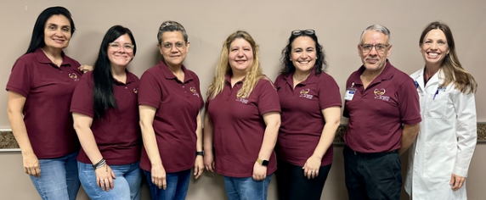
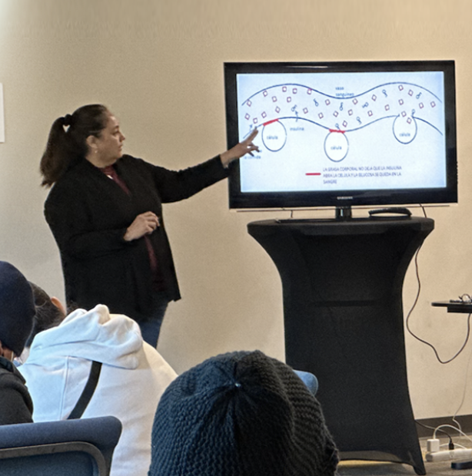
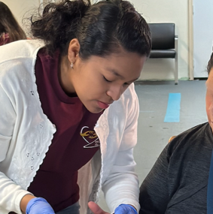
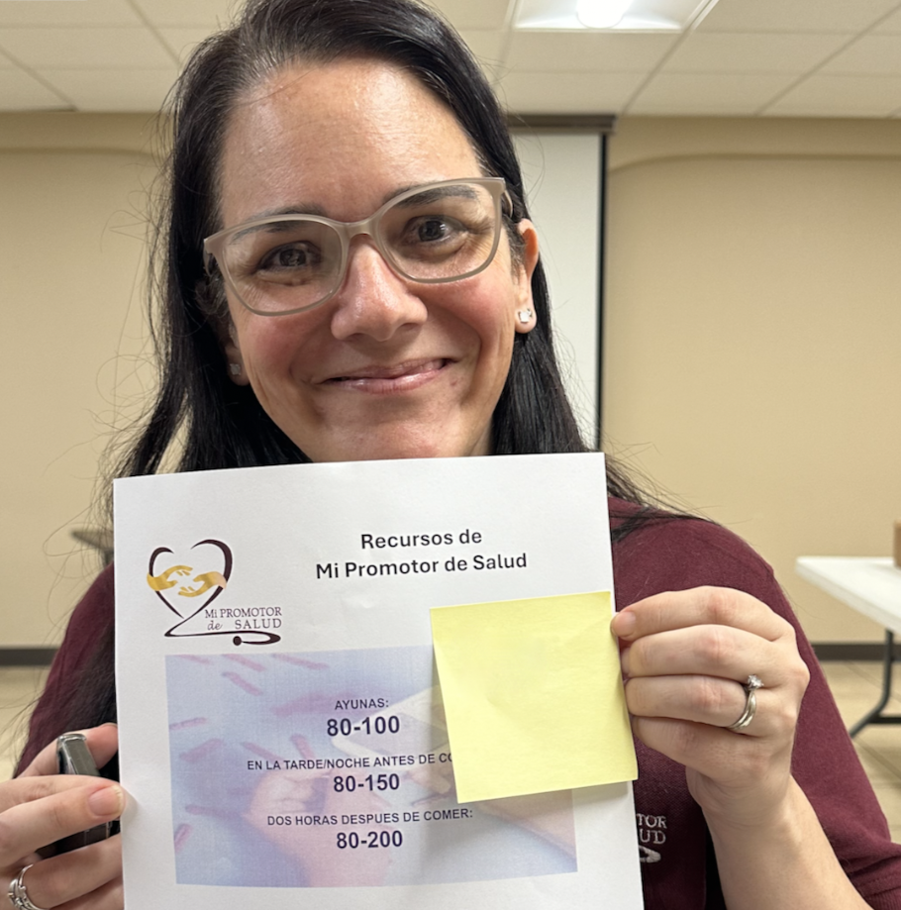
Mi Promotor de Salud – connecting people to care
Notes:
Our team is led by six CHW instructors and a physician who provide training and ongoing support to your CHWs.
We have helped thousands of individuals with and at risk for diabetes live healthier lives by CONNECTING them to healthcare.

Slide 3
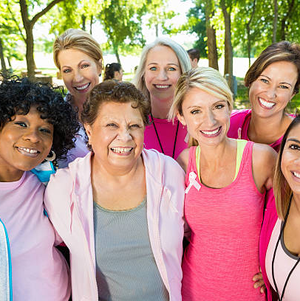




Who is at risk of developing type 2 diabetes?
Hispanic/Latino/a
45+ years
Family with diabetes
Low Physical Activity
Overweight/
Obesity
Notes:
Hearing that you have diabetes or that you are at risk can be concerning, but becoming informed helps you take care of your health and prevent complications.
There are several factors that increase the risk of developing diabetes. The more risk factors a person has, the higher their risk:
Being Hispanic or Latino (1 in 2 adults will develop diabetes).
Being 45 years of age or older.
Having close family members with diabetes.
Low levels of physical activity (at least 30 minutes, 5 days a week is recommended).
Overweight or obesity, one of the most important risk factors. Let’s look at why.

Slide 4
What happens when I eat food?
Eat food
Food turns into sugar (glucose)
Sugar enters the blood
Notes:
What happens when I eat?
When we eat, food is converted into a type of sugar called glucose. Glucose is not bad. The body needs it for energy. After eating, glucose enters the bloodstream. This is normal.

Slide 5

Insulin is the key.
It opens cells and lets sugar in
Notes:
When sugar enters the bloodstream, the body produces insulin.
Insulin works like a key that opens the cells so sugar can enter.
Inside the cells, sugar is converted into energy that we need to live and function each day.

Slide 6
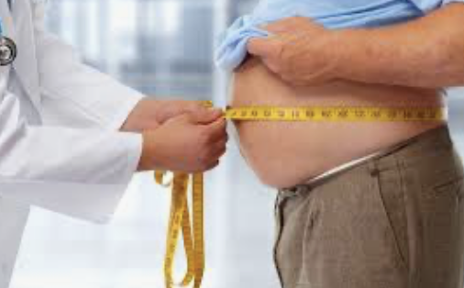
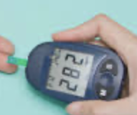
What happens when I eat food?
Food turns into sugar (glucose)
Sugar enters the blood
Notes:
Sometimes, insulin cannot properly open the “door” to the cells.
Excess body fat can make it harder for insulin to work correctly.
When sugar does not enter the cells and stays in the bloodstream, blood sugar levels rise, and the body does not feel well.

Slide 7






When blood sugar is high we don’t feel good because.......
Fatigue
Irritability
Dry Mouth
Thirst
Frequently urination
Notes:
Even after eating, we may feel tired because our cells are not receiving energy. This can make us feel irritable or uncomfortable.
We may experience a dry mouth, feel very thirsty, and need to urinate more frequently.

Slide 8

If body fat causes high blood sugar, how can you lower blood sugar?
Notes:
If body fat causes high blood sugar, how can you lower blood sugar?

Slide 9

The Solution: Reduce of Body Fat!
Notes:
By reducing body fat!
Insulin is the key that helps sugar enter the cells. If the key does not work well, sugar cannot enter the cells.
However, moving more and eating healthy foods helps reduce excess body fat. When there is less excess fat, sugar can enter the cells more easily and provide us with energy.

Slide 10
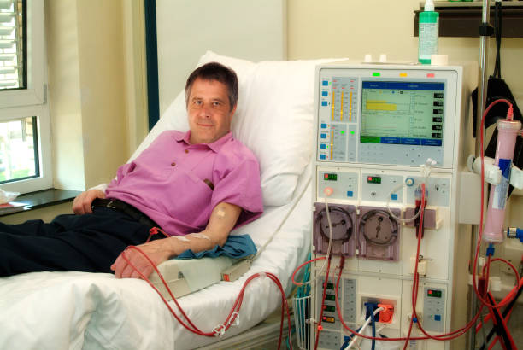
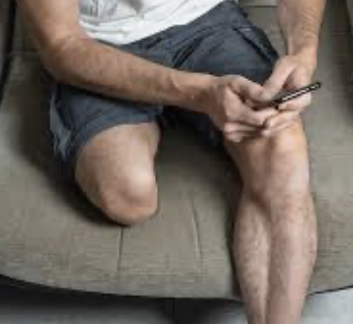
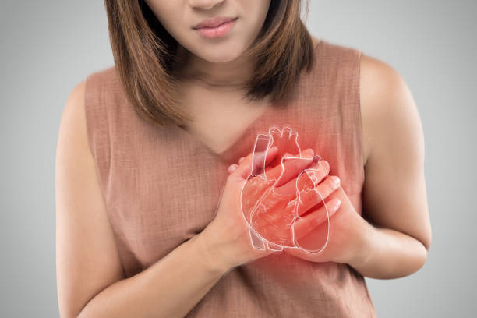

Diabetes Consequences: COMPLICATIONS
DIALYSIS
AMPUTATIONS
HEART ATTACK
LOSS OF VISION
Notes:
What are the possible complications of diabetes?
Diabetes can increase the risk of health problems such as kidney disease, amputations, heart attacks, strokes, and vision loss.
The good news is that many of these problems can be prevented or delayed when blood sugar levels are kept under control.

Slide 11

But I feel good !
Notes:
Some people with diabetes say, “I feel fine!”
This can be true, but often the damage to the body happens very slowly. Little by little, our health gets worse, and we may not notice.
Because the change is slow, we get used to how we feel and think we are fine. But the damage keeps happening, and problems can occur over time.

Slide 12
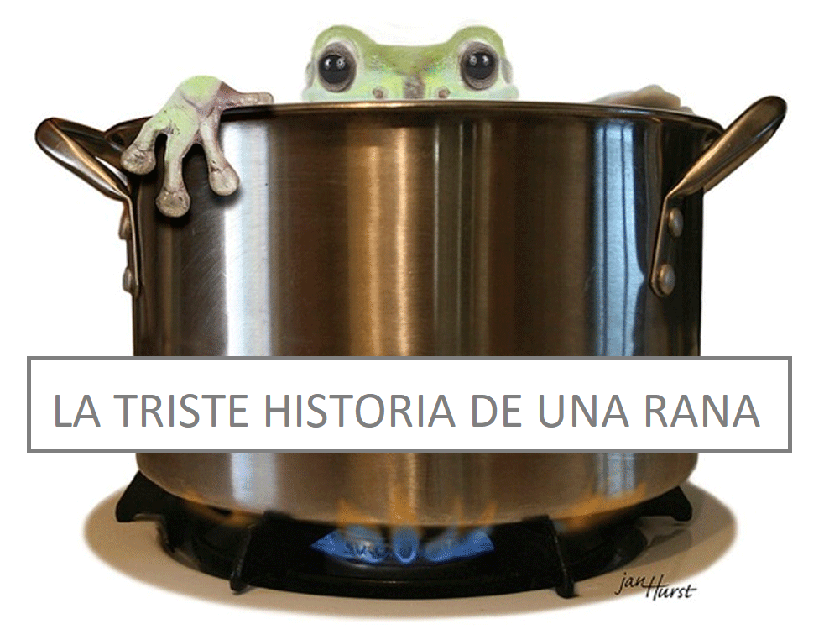
THE SAD STORY OF A FROG
Notes:
To illustrate that slow but lethal deterioration, let me share this story about a frog.
Do you know what happens if you put a frog into a pot of boiling water?

Slide 13

Notes:
it jumps out right away to save itself!
But if you put it in cool water and heat it slowly, the frog stays in the water and doesn’t notice the danger.

Slide 14

Notes:
The water eventually boils, and the frog cannot escape.
This can happen to us with diabetes. We do not feel extra sugar in our blood.
Over time, our organs can be damaged without us noticing. By the time we feel the effects—like losing sight or having a heart attack—it can be too late.

Slide 15

So…do I have diabetes?
Notes:
So, do I have diabetes? How can I know if I don’t feel different?

Slide 16
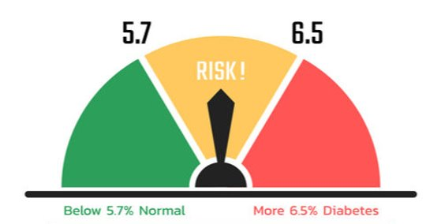
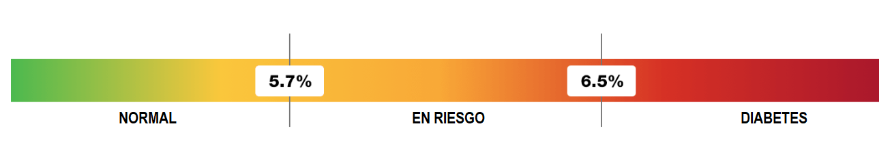
Let’s talk about A1C
Notes:
The most reliable way to know if you have diabetes is to see a doctor for an A1C test, which shows your average blood sugar level over the past three months. You do not need to fast for the A1C test; you can eat before the exam.
An A1C between 5.7 and 6.4 indicates a risk of developing diabetes. This is a good time to make lasting changes in eating habits and physical activity.
An A1C of 6.5 or higher indicates diabetes.
Remember: If your A1C has ever been 6.5 or higher, you have diabetes. If your number is now lower, for example 6.2, this may mean that your diabetes is well controlled due to lifestyle changes or medications.

Slide 17

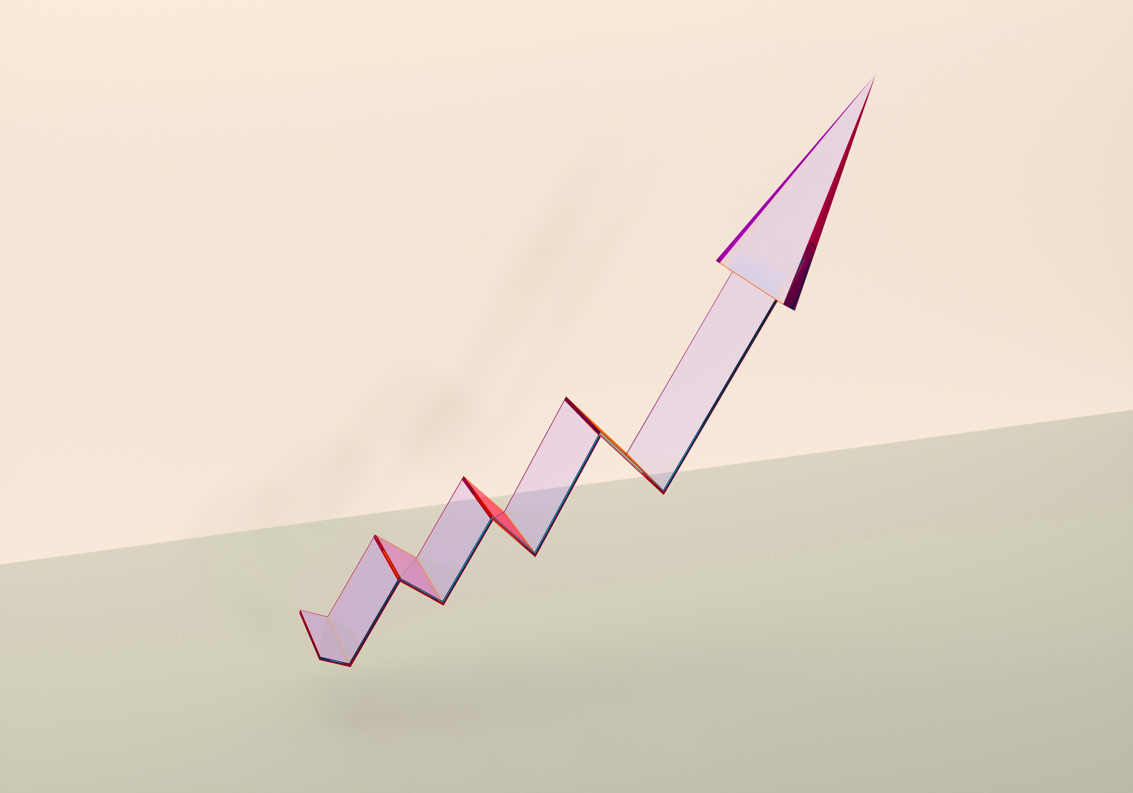
When is diabetes “controlled”?
less than 65 years
7.0
65+ years
7.5
Notes:
Do you know your A1C level? Knowing your A1C is an important step in managing diabetes.
If you are under 65 years old, the goal is to keep your A1C below 7 to be considered well controlled.
If you are 65 years or older, the goal is to keep your A1C below 7.5 to be considered well controlled.
If you take diabetes medications and your blood sugar is under control, do not stop taking your medications without talking to your doctor. Medications help keep blood sugar levels within your target range.
Even if your blood sugar is not perfectly controlled, every point closer to your goal lowers your risk of complications. The farther you are from your target, the higher your risk.

Slide 18
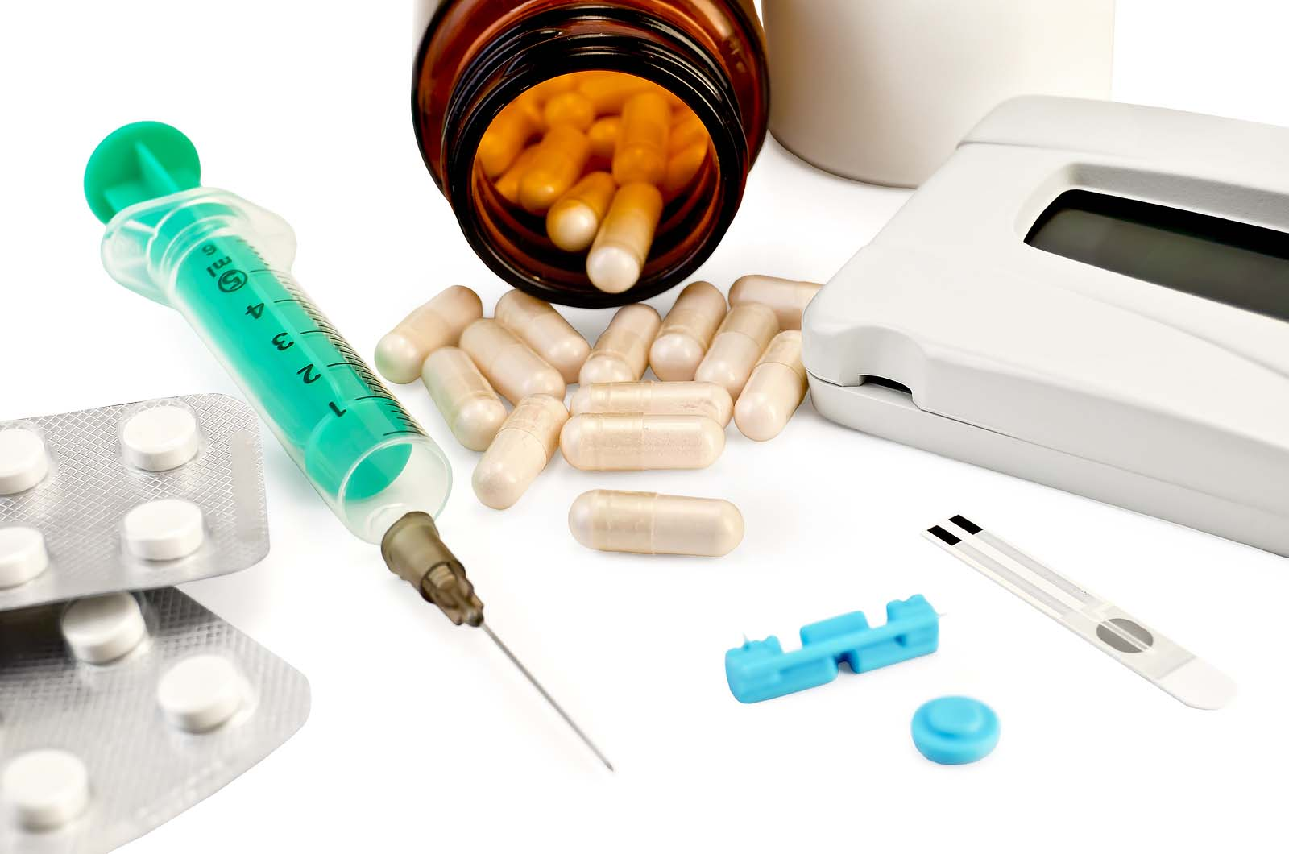
Medicine
they are VERY important!
Notes:
Your medications are very important. They help lower your A1C and protect your body. However, medications alone do not cure diabetes; healthy lifestyle changes are also needed to prevent serious complications.
If you have trouble understanding your dosage, getting your medications, or if you have questions, you can talk with your community health worker. They can help you build the habit of taking your medications regularly and support you in staying healthy.

Slide 19

We are here to help you
We will call you weekly
Notes:
Your CHW is here to help you with questions about your health. CHWs are trained in diabetes and work with your doctor to give the best support. Patients who work with a CHW usually improve their health.

Slide 20


It's a long journey
Your CHW will help CONNECT
you to care
Notes:
When you joined the program, you filled out a survey to tell us about your needs.
Your Community Health Worker will use that survey and your weekly talks to help CONNECT you to care you during this program.

Slide 21
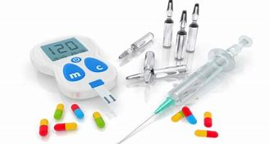
Medical Support
Notes:
Your CHW is here to help CONNECT you to medical care

Slide 22

Social Support
Notes:
Social support matters because your community health worker will help you set goals to build healthy habits related to nutrition and physical activity, and will also help answer any other questions you may have.

Slide 23
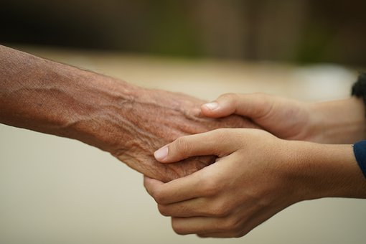
Moral/Spiritual Support
Notes:
And with moral or spiritual support, because personal beliefs and values influence how a person faces challenges and makes health-related changes. Strengthening confidence in one’s ability to overcome difficulties can be part of preventing or managing diabetes.
Your community health worker can offer support and a listening ear in this area in a respectful and voluntary way.

Slide 24

CONFIDENTIALITY
Respecting the trust they give us
Notes:
And we want you to rest assured that we will always respect the trust that you have in us. Our goal is to help you to reach YOUR goals.

Slide 25

Thank you for participating
Notes:
Thank you for being part of this program.
We are here to help you, and help is just a call away.
If you haven’t contacted your CHW yet, call or send a text message using the same number you received this video from to get in touch.

Slide 26
References
American Diabetes Association. (2022). Standards of Medical Care in Diabetes. Vol. 45 (Supplement 1). Last accessed: September 15, 2022. https://diabetesjournals.org/care/issue/45/Supplement_1
Banday, M. Z., Sameer, A. S., & Nissar, S. (2020). Pathophysiology of diabetes: An overview. Avicenna Journal of Medicine, 10(4), 174–188.
Hispanics/Latinos and type 2 diabetes. (April 4, 2022). Centers for Disease Control and Prevention. Last accessed: September 15, 2022. https://www.cdc.gov/diabetes/library/features/hispanic-diabetes.html
Ismail, L., Materwala, H., & Al Kaabi, J. (2021). Association of risk factors with type 2 diabetes: A systematic review. Computational and Structural Biotechnology Journal, 19, 1759–1785.
American Diabetes Association Professional Practice Committee. (2024). 2. Diagnosis and Classification of Diabetes: Standards of Care in Diabetes—2024. Diabetes Care, 47(Supplement 1), S20-S42. https://doi.org/10.2337/dc24-S002
Slater, A., Cantero, P. J., Alvarez, C., Cervantes, L., Talavera, G., & Morales, L. S. (2022). Latino Health Access: Comparative Effectiveness of a Community-Initiated Promotor/a-Led Diabetes Self-management Education Program. Family & Community Health, 45(1), 34-45. https://doi.org/10.1097/FCH.0000000000000311
Notes:
Thank you!

