Slide 1
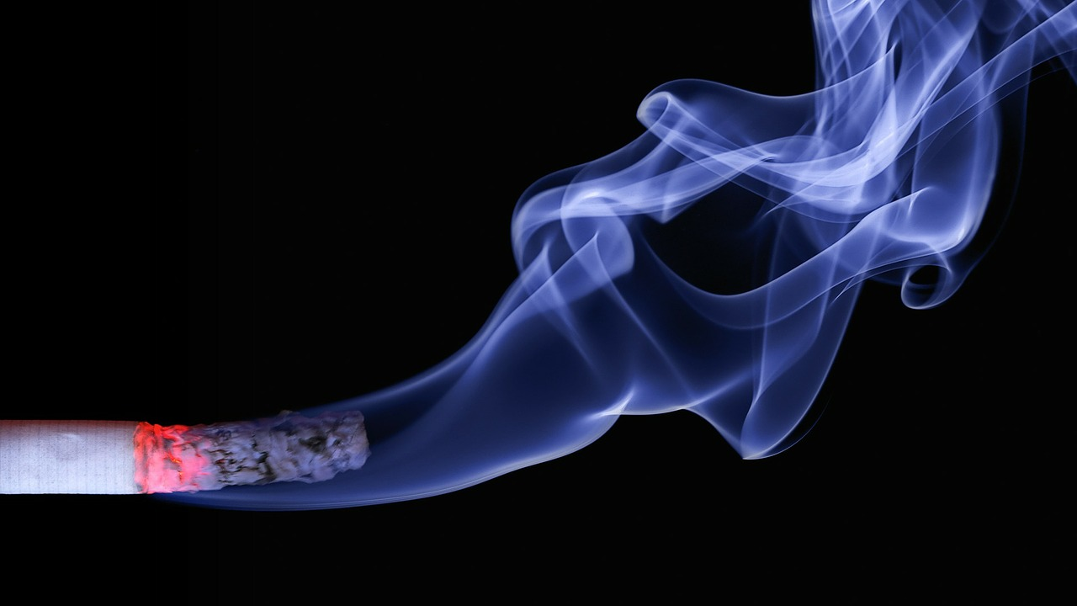

How Tobacco Affects Your Health Video 10
Notes:
Welcome to Video #10!! We are glad you are here again to learn more about your health and how to prevent or manage diabetes.
Today we will talk about how tobacco affects the body, how it affects people with diabetes or at risk for diabetes, and ways to quit smoking or help someone else quit.
This information may not apply to you right now, but it is good to know to help yourself or others.

Slide 2
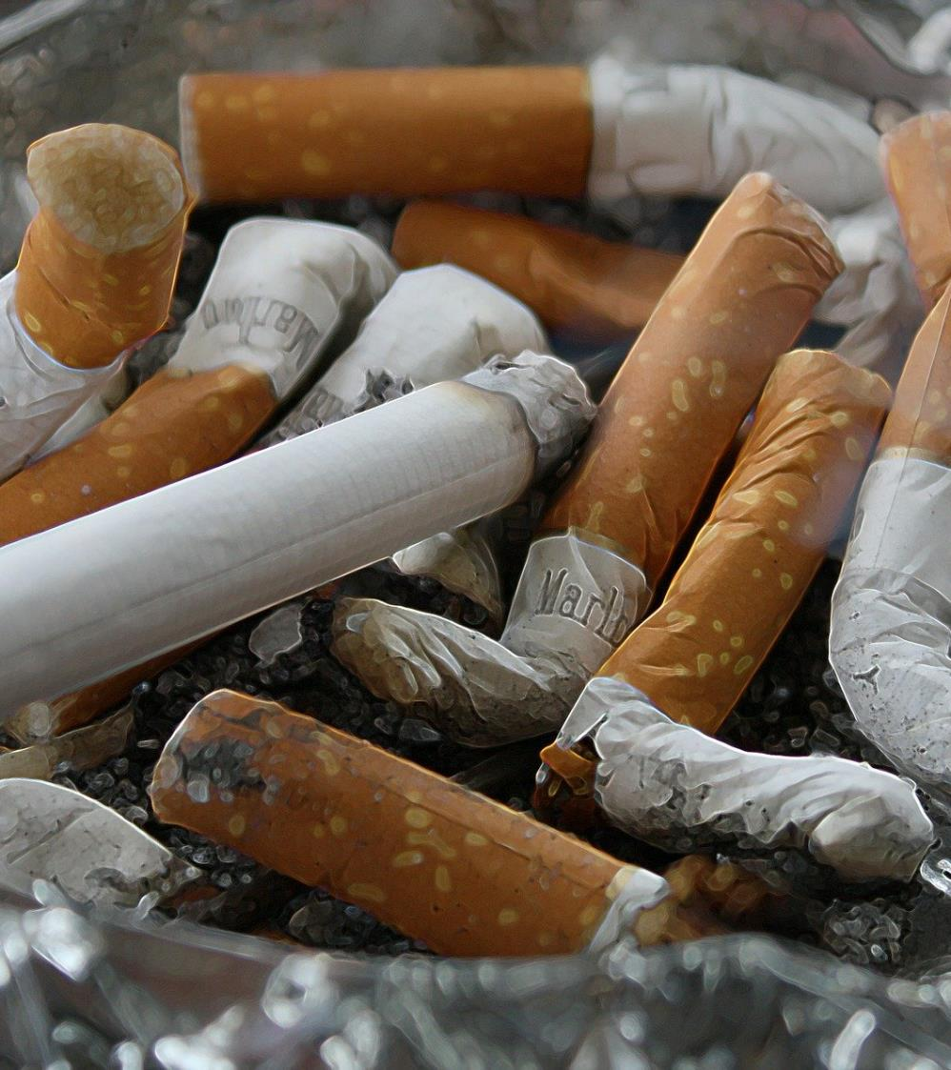
Notes:
Smoking is an addiction caused by nicotine, which is in tobacco. It gives a feeling of pleasure in the body.
Smoking is a leading cause of early, preventable death.
Each year, about 4.9 million people die from tobacco use. By 2030, this could rise to 10 million deaths each year. About 1 million people die each year from secondhand smoke, also called passive smoking.
Tobacco is harmful in all forms.
Cigarettes are the most common, but tobacco can also be used in pipes, water pipes or hookahs, cigars, chewing tobacco, and e-cigarettes. E-cigarettes have less nicotine but still have toxic substances.
Other forms like flavored cigarettes, menthols, or powdered tobacco are also harmful.

Slide 3




Risk Factors
Notes:
There are several risk factors for smoking, including:
Age: the younger a person starts smoking, the more likely they are to become addicted
Parents and friends: children of parents who smoke are more likely to smoke too
Depression and anxiety: these mental health conditions are linked to addiction
Alcohol and drugs: drinking alcohol can increase the chance of using other addictive substances
Some signs that a person may be addicted to tobacco include:
Difficulty quitting
Feeling sick or uncomfortable when they do not smoke for a while

Slide 4

¿qué contiene un cigarrillo?
What do cigarettes contain?
Notes:
Let’s understand something important. Do you know how a cigarette is made or what it contains?
Cigarettes have many unhealthy things, including:
Nicotine: the main ingredient that causes addiction. It reaches the brain in 20 seconds and makes the brain release dopamine, which gives a pleasurable feeling.
Carbon monoxide: this harms the lungs, heart, and blood vessels. It travels in the blood and can cause heart problems and brain damage.
Cigarettes also contain more than 4,000 toxic substances. These can change cells and cause abnormal growth, which can lead to tumors.
These substances also damage the lungs and stop the airways from cleaning properly. This often causes the smoker’s cough and many other health problems.

Slide 5
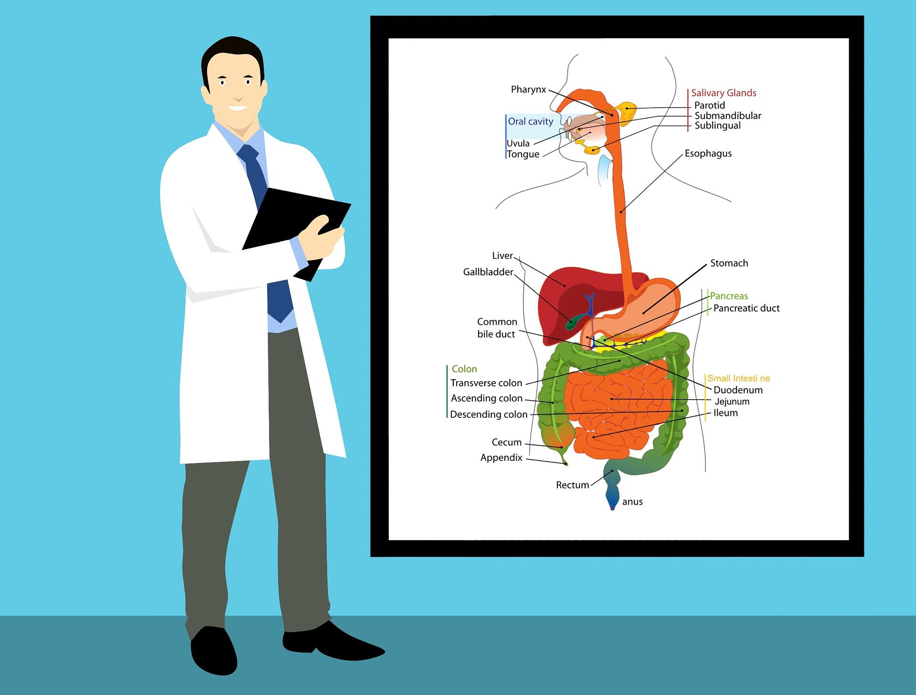
El consumir tabaco puede causar cáncer en TODO el cuerpo
Notes:
Smoking can cause many serious health problems!!!
It can hurt your lungs, heart, brain, and metabolism, and can cause diabetes, high cholesterol, and strokes!!
It can also cause problems if you smoke during pregnancy, tooth decay, and cause bad breath, dry skin, hair loss, and weight loss.
Smoking can cause cancer in many parts of the body, including the mouth, throat, voice box, lungs, bladder, stomach, liver, pancreas, colon, and even bone marrow.
In total, tobacco is linked to most tumors, many lung diseases, and some heart diseases. In the end, smoking can kill you.

Slide 6
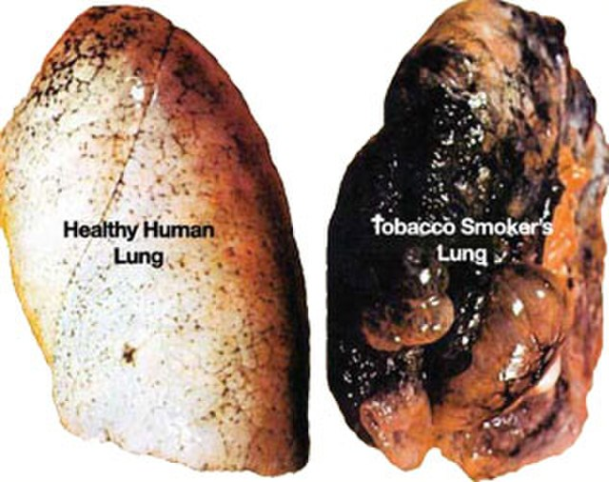
Notes:
Most often, smoking causes cancer in the lungs because the person breathes in toxic substances from cigarettes.
But this cancer can also develop in other parts of the body.

Slide 7

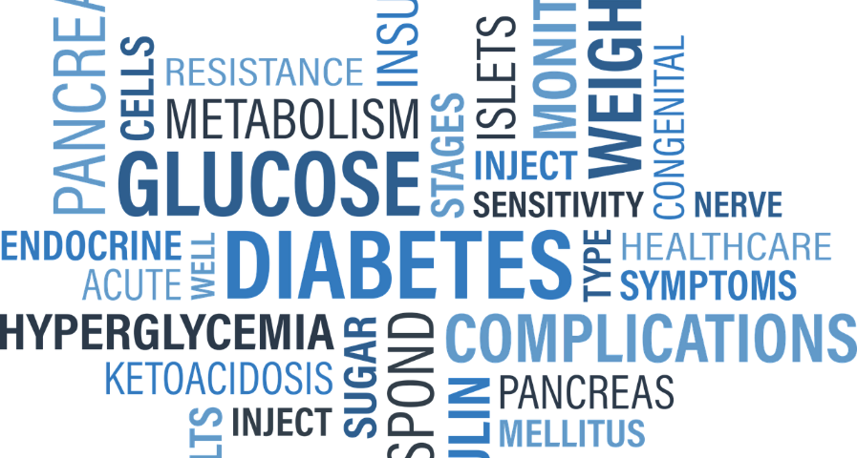
Why is smoking so bad if you have or at risk for diabetes?
Notes:
Why is smoking especially bad if you have diabetes?
People with diabetes who smoke have more health problems than those who don’t. This includes heart and kidney problems, poor circulation, infections, foot ulcers, amputations, and eye damage that can lead to blindness.
Smoking makes it harder to control blood sugar. Chemicals in cigarettes, like nicotine and carbon monoxide, damage cells and cause inflammation. This raises blood sugar and makes insulin less effective.
People with diabetes who smoke have four times more risk of serious health problems than those who don’t. Smoking also increases the risk of developing type 2 diabetes in people who don’t already have it.
Even nicotine replacement products, like patches or e-cigarettes, can raise blood sugar. The best way to protect your health and manage diabetes is to quit smoking now.

Slide 8

To smoke not to smoke
Notes:
Quitting smoking is important for your health.
Soon after you quit, your circulation improves and your blood pressure starts to go back to normal. Your sense of smell and taste return, and it becomes easier to breathe. Over time, quitting can help you live longer. Your risk of cancer goes down each year you stay smoke-free.
Quitting is not always easy. You may have short-term effects like weight gain, irritability, or anxiety. Many people try several times before they succeed. There are many ways to quit. Some people stop all at once. Others use step-by-step guides, counseling, or medications to reduce nicotine cravings. Switching to e-cigarettes has not been proven to help. Your healthcare provider can help you find the best way to quit.
You can quit smoking for good, even if you tried before and did not succeed. Most smokers need to try several times before they quit for good. Stay positive and do not give up.

Slide 9
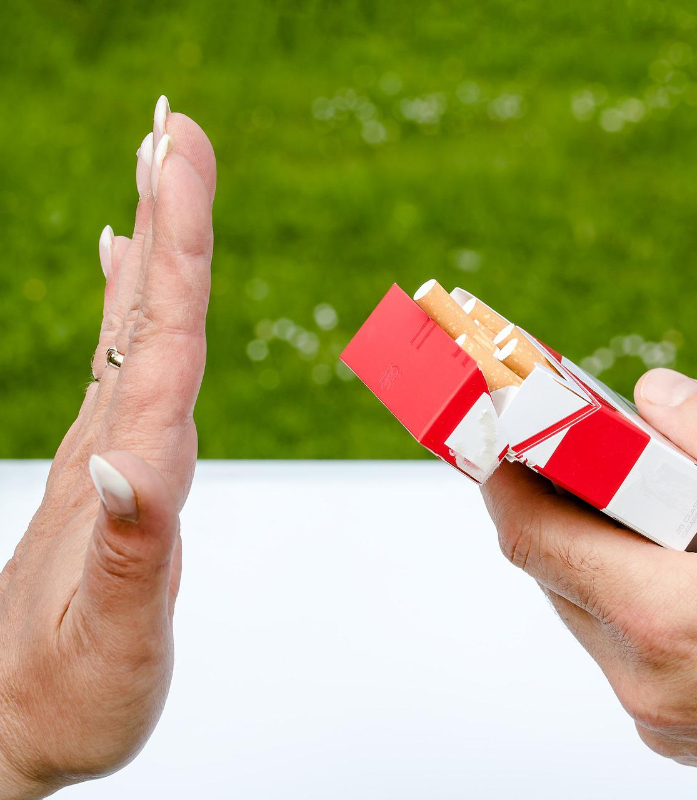
Identify your Triggers
Notes:
When you start to quit smoking, your body goes through nicotine withdrawal. You may feel tired, moody, or have headaches. Before, you may have handled these feelings by smoking a cigarette.
Certain places or activities can trigger cravings. For example, if you used to smoke after eating or while on the phone, these can make you want a cigarette. Cravings are strongest in the first 3 days but should get easier over time.
Triggers are things that make you want to smoke. They can be:
Emotional: Strong feelings like stress, anxiety, boredom, sadness, or happiness can make you want to smoke. You can handle emotions in other ways: talk to someone, exercise, or listen to music.
Patterns: Activities linked to smoking, like drinking coffee, finishing a meal, watching TV, or taking a break at work. You can change the activity or do something else instead.
Social: Being around others who smoke, like at parties, bars, or events. Avoid these situations at first and ask friends or family not to smoke around you.

Slide 10

Withdrawal symptoms
Notes:
Withdrawal symptoms may include:
craving the taste of a cigarette, smelling smoke, handling cigarettes or lighters, needing something in your hands or mouth, and feeling restless.
Habits and addictions are hard to break because repeated actions change the brain.
But it is possible to learn new behaviors. Faith, community support, and prayer can help you find strength to quit.

Slide 11

Notes:
Let’s also review your goals – how are you doing?
What is going well & What has been difficult?
Are there any goals you need to make based on today’s class? If this class applied to you, make a goal to stop this bad habit. Your CHW can help you create a plan to stop smoking!!

Slide 12


CHW can CONNECT you to these resources: CDC – Centers for Disease Control and Prevention: How to Quit Smoking NIH – National Cancer Institute Smokefree.gov: Identify Your Triggers TIME – Tobacco: Why Smoking Is Especially Bad If You Have Diabetes
Your CHW can help you how to CONNECT to resources!!
Notes:
If you want more information on this topic, here are some of the sources we used.
This is another area to involve your family and friends!!
If you need help CONNECTING to your family or to resources to help you stop smoking, let your CHW know.
They will be happy to help you.
See you next time!

Slide 13
References
smokefree.gov. “Home.” Smokefree.gov, smokefree.gov/.
Park, Alice. “Why Smoking Is Especially Bad If You Have Diabetes | TIME.com.” TIME.com, 2026, healthland.time.com/2011/03/27/why-smoking-is-a-bad-idea-for-diabetics/. Accessed 27 Mar. 2026.
CDC. “How to Quit Smoking .” Centers for Disease Control and Prevention, 2019, www.cdc.gov/tobacco/campaign/tips/quit-smoking/index.html.
NIAAA publications. (n.d.). Brochures and Fact Sheets | National Institute on Alcohol Abuse and Alcoholism (NIAAA). Last accessed September 15, 2022. https://pubs.niaaa.nih.gov/publications/aa71/aa71.htm
Nicotine dependence - Symptoms and causes. (2022, April 19). Mayo Clinic. Last accessed September 15, 2022. https://www.mayoclinic.org/diseases-conditions/nicotine-dependence/symptoms-causes/syc-20351584
Health effects of smoking and tobacco use. (2022, July 21). Centers for Disease Control and Prevention. Last accessed September 15, 2022. https://www.cdc.gov/tobacco/basic_information/health_effects/index.htm

