Slide 1
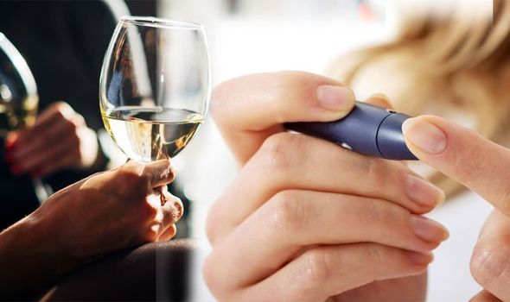

How Alcohol Affects Your Health Video 11
Mes 10 – Alcohol y Diabetes
Notes:
Hello! It’s great to see you again, learning more about how to manage your diabetes and improve your health.
Today we will talk about a topic that can be difficult or misunderstood by many people: alcohol. We will look at how it affects your body, whether you have diabetes or not, and the special risks for people with diabetes or at risk.
You might think this topic does not apply to you, but we invite you to stay and listen.
You never know when this information could help you or someone you care about.
At the end, we will share ideas to reduce alcohol use and get support if it is a problem for you.
Remember, we are here to help, not to judge.

Slide 2

Effects of Alcohol
health
pancreas
liver
relationships
Notes:
We know that alcohol can affect your life and your health in many ways.
Today we will look at how alcohol affects your
overall health,
your pancreas,
your liver,
your family relationships,
and even your blood sugar (A1C) levels.

Slide 3
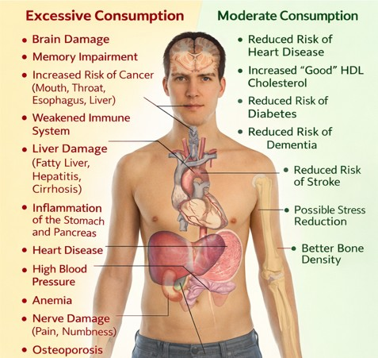
Effects of alcohol on the body
Notes:
Alcohol can affect your health in many ways. It can cause memory loss, hallucinations, seizures, dementia, lung infections, liver inflammation, hepatitis, cirrhosis, and even poor blood sugar control.
You can see the full list on your screen. While all these health effects are important, in this class we are focusing mainly on how alcohol affects your blood sugar and diabetes.

Slide 4
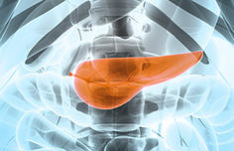
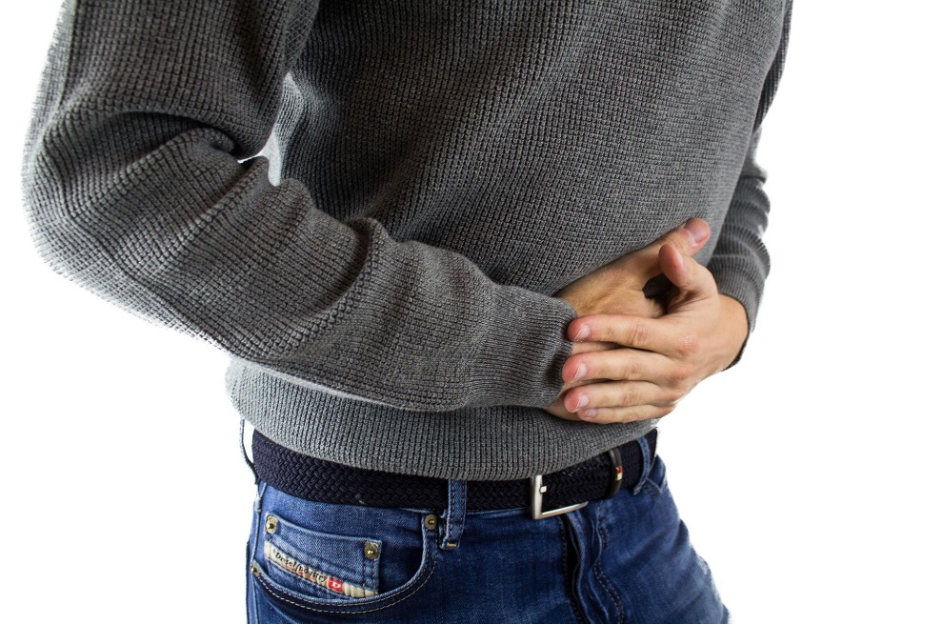
Pancreas
Notes:
One area where alcohol affects your body is the pancreas.
How does it affect the pancreas? It can cause chronic inflammation, called pancreatitis. This is important because the pancreas makes insulin.
Alcohol can make it harder for your pancreas to produce insulin.

Slide 5

Pancreas and Insulin
Notes:
Do you remember the first videos in our program?
Everything you eat—bread, sugar, meat, fruits, vegetables—turns into sugar (glucose).
The pancreas makes insulin, which is the key to let sugar into your cells
Without insulin, your cells do not get energy, and glucose stays in your blood, affecting your whole body.
Too much alcohol damages the pancreas. Since your pancreas make insulin, damage to the pancreas damages the way insulin is made…and you blood sugar and A1c go up.

Slide 6
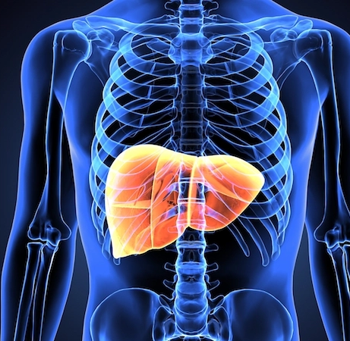
How does it affect the liver?
Notes:
Another way alcohol affects your body is through your liver.
When blood sugar gets too low, the liver releases sugar into the blood. Too much alcohol, especially on an empty stomach, damages the liver.
When the liver is busy breaking down alcohol, it cannot release enough glucose. This can cause blood sugar to drop too low, called hypoglycemia.
Drinking alcohol for a long time can cause the liver to stop working properly. This can lead to low blood sugar and swelling, called edema, where fluid builds up in the legs or stomach and does not go away.

Slide 7

What if I drink too much?
Confusion and sleepiness
Blurry vision
Headache and lightheadedness
Headache
Poor concentration
Loss of consciousness
Notes:
This is dangerous in many ways, but let’s focus on one important risk.
Did you know that the symptoms of drinking too much alcohol and low blood sugar can be very similar? Both can cause:
Confusion
Sleepiness
Blurry vision
Headaches
Dizziness or lightheadedness
Poor coordination
Loss of consciousness
This is dangerous because someone may think you are drunk when you are actually having low blood sugar. If this happens, you may not get the right help right away. Low blood sugar must be treated quickly to avoid serious harm.

Slide 8
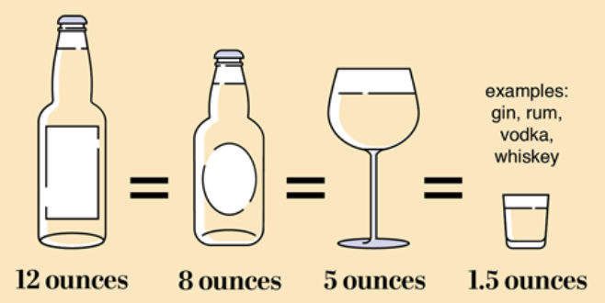
What is too much alcohol?
For women—1 drink or less in a day
For men—2 drinks or less in a day
Notes:
Too much alcohol is one drink or less per day for women and 2 or less for men.
Note the size – a shot of whiskey is one drink
Also note that that doesn’t mean that you can “store up” and have 7 drinks on a Saturday. It’s 1-2 per day and that’s it.
Anything beyond that is more than your body can take.
The further you go past that, the greater the damage.

Slide 9

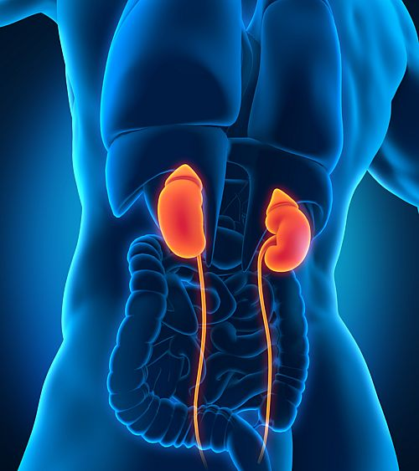
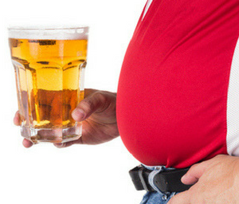
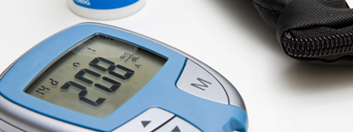
Other concerns of alcohol
Notes:
These are not the only harms. As we saw before, alcohol can cause many more problems.
Drinking alcohol can make common diabetes problems worse, such as nerve damage, eye problems, and kidney disease.
Alcohol can also cause weight gain. Extra weight makes diabetes harder to control. Alcohol has many calories, and drinks like beer or sugary mixed drinks are high in carbohydrates.
These extra carbs can raise blood sugar levels.
But we can improve. Do not feel discouraged. We focus on this topic in a diabetes prevention and management class because making changes—like eating better, being more active, and cutting back on alcohol—can help improve diabetes and reduce other health problems.
So now, let’s set goals.

Slide 10


Setting goals is important
Notes:
The most important thing about goals is not that they are big or perfect. What matters is taking one step at a time.
Think of climbing stairs. No one jumps to the second floor.
You go up one step, then another, then another, until you reach your goal.
It is good to know where you want to go, but do not feel frustrated if you can only take one small step at a time. What matters is having a plan.
Plan the first step and take that step today.
So, to reach a goal, the first thing we will do is:

Slide 11

Notes:
Write your goals down on paper. Review them every week and see how you are doing. Adjust your goal as you improve.
Keeping a simple drink log can help. You can write it on paper, on your phone, or post it on the refrigerator. This helps you be honest with yourself when you review your week.
Do not keep alcohol at home. The easiest way to avoid drinking at home is not to buy alcohol. If it is not there, you will think twice when a craving comes.
Choose alcohol-free days and mark them on a calendar. Over time, try to add more days without alcohol.

Slide 12


Don’t Give Up!
Notes:
Be careful with peer pressure.
Some people or situations may push you to drink. Look for other ways to have fun, and step away from situations that pressure you.
If you drink out of habit or stress, stay busy with healthy activities like walking, sports, or a hobby.
Ask for help. Your health promoters are here to support you. You are not alone.
Be persistent. Do not give up if you make a mistake.
You may know the verse in Philippians that says, “I can do all things through Christ who strengthens me.” It’s a great reminder.

Slide 13


Help is here when you’re ready
877-390-6300
888‑4AL‑ANON
Notes:
If you think you may have a problem with alcohol, help is here. You have to make the first step.
Maybe it’s to call one of these numbers.
Alcoholics Anonymous or AA Website: aa.org
AA has about 2,500 meetings per week and can help you find a meeting near your home at a time that works for you.
Al-Anon – for family and friends of people with drinking problems Website: alanon.org These organizations can give support and guidance for you or a loved one.

Slide 14


Do you need help getting an appointment?
Your CHW help CONNECT you
Notes:
Maybe it’s asking your CHW for help connect to a clinic or doctor.
Do you need help getting into a clinic?
The first step is being eligible to receive services at the clinics, like through the clinic or with insurance.
This can be difficult to do – since forms can be complicated and hard to understand
The next step is finding a clinic and getting an appointment.
If you need help with these, ask your CHW to CONNECT you.
Thank you for listening to this important topic.
We hope this information can help you or someone you care about.
See you next time!

Slide 15
References
National Institute on Alcohol Abuse and Alcoholism (NIAAA) ,(2019) Alcohol's Effects on Health
https://www.niaaa.nih.gov/alcohols-effects-health
Singal, A. K., & Mathurin, P. (2021). Diagnosis and treatment of alcohol-associated liver disease: A review. JAMA, 326(2), 165–176. https://doi.org/10.1001/jama.2021.7683
Bataller, R., Arab, J. P., & Shah, V. H. (2022). Alcohol-associated hepatitis. New England Journal of Medicine, 387(26), 2436–2448. https://doi.org/10.1056/NEJMra2207599
Chaudhry, H., Sohal, A., Iqbal, H., & Roytman, M. (2023). Alcohol-related hepatitis: A review article. World Journal of Gastroenterology, 29(17), 2551–2570. https://doi.org/10.3748/wjg.v29.i17.2551
Mellinger, J. L., Sutton, A., & Traverse, E. (2023). The changing epidemiology of alcohol-associated
National Institute on Alcohol Abuse and Alcoholism (NIAAA). (2022). Drinking levels defined. U.S. Department of Health and Human Services. https://www.niaaa.nih.gov/alcohol-health/overview-alcohol-consumption/moderate-binge-drinking
Kim SJ, Kim DJ. Alcoholism and diabetes mellitus. Diabetes Metab J. 2012 Apr;36(2):108-15. doi: 10.4093/dmj.2012.36.2.108. Epub 2012 Apr 17. PMID: 22540046; PMCID: PMC3335891. https://pmc.ncbi.nlm.nih.gov/articles/PMC3335891/

