Slide 1


WELCOME!
Getting help with your medicine
Class #2
Notes:
Welcome to our second class!
Today we will talk about how to control diseases like diabetes by taking the medicine as your doctor recommends.

Slide 2


Review - When is diabetes “controlled”?
less than 65 years
7.0
65+ years
7.5
Notes:
Do you know your A1C now? Remember, knowing your A1c is the first step to controlling diabetes. If you know it, tell your CHW!
If you are under 65, your A1C should be below 7. If you are 65 or older, it should be 7.5 or lower. If you take medicine and are controlled, don’t stop—your medicine helps keep your sugar down.
Even if your sugar is not fully controlled, the closer it is to your goal, the lower your risk of complications. The further away it is, the higher your risk.

Slide 3
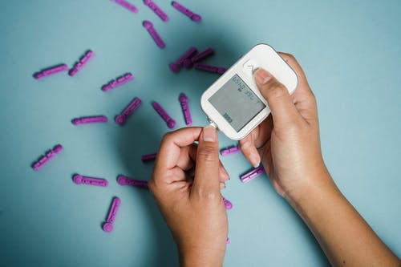
BEFORE BREAKFAST (FASTING):
80-100
AFTERNOON OR EVENING BEFORE EATING:
80-150
TWO HOURS AFTER EATING:
80-180
Notes:
The A1C test is helpful, but checking your blood sugar at home is important. A1C shows an average, but it may not catch high sugars. Checking your sugar helps you see how food and daily habits affect you.
If you do not have diabetes, check once a week. If you have diabetes, check daily or as your doctor says.
Check at different times, because your sugar can be normal at one time and high at another.

Slide 4
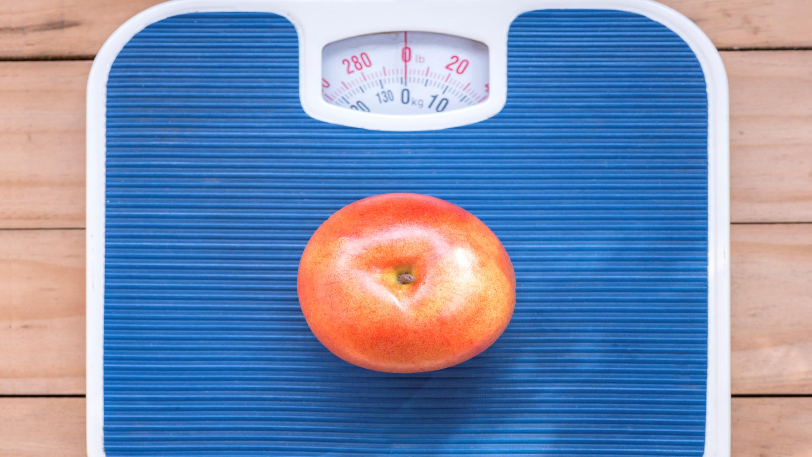
Review – what often blocks insulin, causing high blood sugar?
Notes:
Fat!
Losing body fat helps insulin get sugar out of your blood and into your cells
Weight loss is usually the first step to both prevent and control diabetes if you are at risk.
Losing weight is not easy, but don’t give up. Healthy changes do not have to be big, but they must be long-lasting

Slide 5

Making Changes
Setting Goals
Notes:
We hope you are starting to make small changes in your habits. Talk to your CHW to set a goal and 2-3 specific ways to reach it.
For instance, if your goal is to lose weight, 2-3 specific ways to reach it may be to eat 5-9 fruits/vegetables daily and to be active for 30 minutes on Monday, Wednesday and Friday.
Or, if your goal is to lower your A1c, you could check your blood sugar every day and bring the numbers to your doctor. This helps your doctor adjust your medicine.

Slide 6

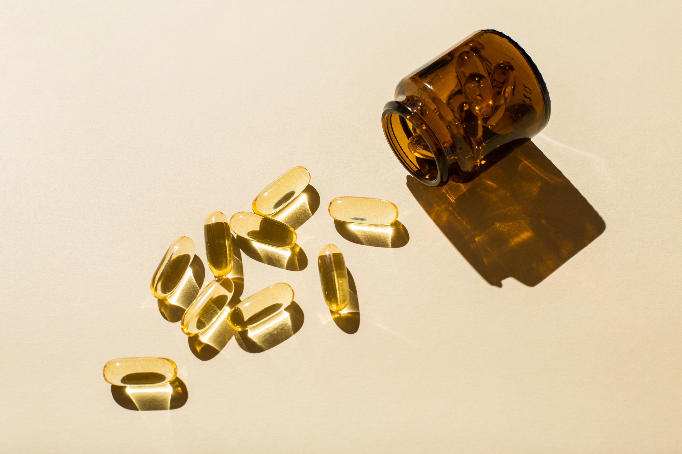
Taking your medications is important
Your CHW will help connect you to your medications
Notes:
Are you taking your medicines the way your doctor told you?
People may not because they
have no insurance, need an appointment for refills, cannot afford them,
are scared of the side effects or forget
or do not understand how to take them or do not like them.
If you need help with your medicines, tell your CHW. They can help CONNECT you to care.

Slide 7

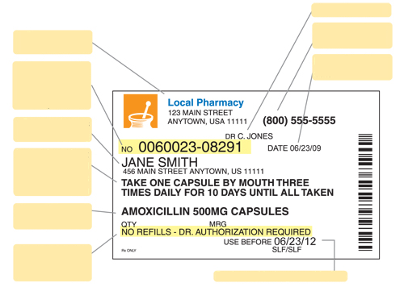
Name of Doctor
Nombre de Doctor
Pharmacy phone
Address of your pharmacy
Teléfono de la farmacia
Dirección de su farmacia
Day I filled the medicine
Prescription-pharmacy number uses this number to identify your medication
Dia que surtió el medicamento
Numero de receta – farmacia usa este numero para identificar su medicamento
Owner of this medicine
Dueño de este medicamento
Instructions on how much medication and how many times a day to take it
Instrucciones de cuanto medicamento y cuantas veces al día tomarlo
Name and strength of the drug
Nombre y potencia del medicamento
Number of times you can refill this medicine
Numero de veces que puede volver a surtir este medicamento
Fecha de caducidad del medicamento
Expiry date of the medicinal product
Notes:
Medication labels can be confusing, so let’s look at them closely. On your label you will see:
Your doctor’s name
Your pharmacy’s name, address, and phone number
Prescription number (for refills)
Date you filled the medicine
Your name
How much medicine to take and how often
Strength of the medicine
Number of refills left
Expiration date
Tips: Always watch for when your medicine is running out and refill early. Make sure you understand how much and how often to take it. If you have questions, call your Community Health Worker.

Slide 8
It’s TOO MUCH! Pills: $4 per month or $10 per 3 months
Walmart
CVS
Kroger
GOODRX.com
Notes:
If paying for your medicine is hard, many diabetes medicines are just $4 per month at some pharmacies.
For other medicines, you can use GoodRx. If you don’t know how, ask your CHW for help.
Some high-cost medicines may be free through assistance programs. Make sure to renew on time so you don’t run out.
Always talk to your doctor at least 2-4 weeks ahead of time for refills, because it can take a few weeks to get your medicine.

Slide 9

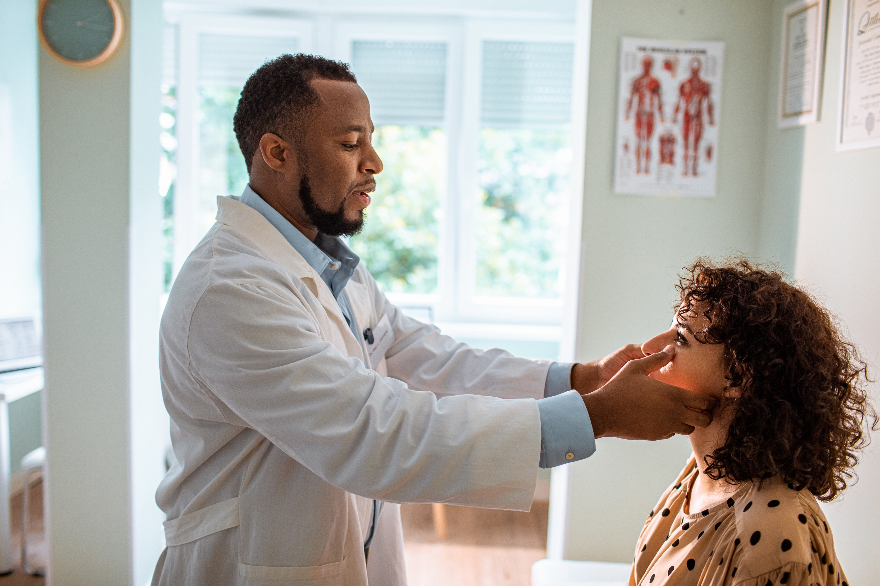
I need an appointment!
Notes:
Let’s talk about how to overcome problems with taking medicine.
The first step in taking care of yourself and your medicines is having insurance or a clinic you can go to.
People with diabetes or other long-term conditions usually need to see a doctor every 1–3 months until their disease is controlled.
If not, see your doctor at least once a year for a check-up.
When was your last visit? What is stopping you from going? Ask your CHW for help getting a clinic or appointment.

Slide 10

But I feel good!
Notes:
Some people do not take medications because they say, “Even if I don't take the medicine, I feel very good!!”
Some people feel better, lose weight, or see their A1C improve and think they don’t need medicine anymore.
Be careful! Don’t stop your medicine without talking to your doctor…you can lose all the hard work you’ve done!

Slide 11
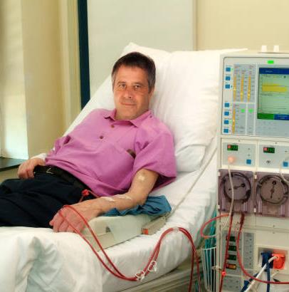


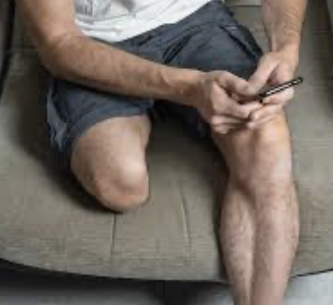
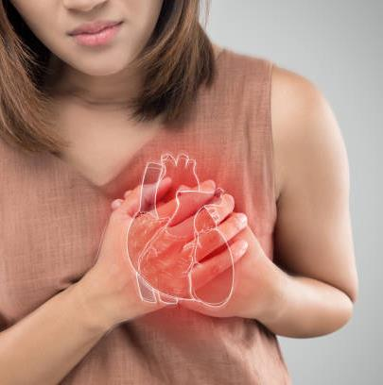
THE SAD STORY OF A FROG!
Notes:
and don't forget the little frog that felt great until it slowly cooked because she never felt the danger. The damage is gradual, and we don't feel it until it's too late.
Every time your sugar is high, your arteries are damaged.. Affecting every part of your body from your head to your toes.

Slide 12

Notes:
Our goal is to have a longer life, but with good quality. We can't go back and change our past, but WE CAN make our future something healthier so we can enjoy and care for our families.

Slide 13

BUT THE SIDE EFFECTS?
Notes:
Also, some people worry about side effects. Talk to your doctor—most side effects can be addressed.
Your doctor gave you medicine because you need it. Side effects are rare, but not taking it is more risky.
The benefits of taking your medicine are much greater than the risks.

Slide 14

I forget!
Notes:
Additionally, forgetting to take medications is common.
Taking medicine is a new habit and takes practice.
Try keeping your medicine where you do daily things, like brushing your teeth, packing breakfast, or charging your phone.
Use alarms or notes until it becomes a habit. Keep trying until you find what works for you.

Slide 15

Tell us!
Notes:
Tell your CHW and doctor about your concerns.
Your doctor can only help if he/she knows.

Slide 16

Patient Story
Maria is 53 years old. Her A1c is 8.4.
She used to take medicine, but she lost her clinic and has no insurance. She feels good and thinks she is okay.
Questions:
Maria has diabetes. Is it controlled?
What do you suggest she do?
Notes:
Can you use what you’ve learned in a patient story?
Maria is 53 years old. Her A1c is 8.4.
She used to take medicine, but she lost her clinic and has no insurance. She feels good and thinks she is okay.
Questions:
Maria has diabetes.
Is it controlled?
What do you suggest she do?

Slide 17
Is Maria’s diabetes controlled?
No, her A1c is more than 7
What do you suggest she do?
She needs
insurance/eligibility
clinic/appointment
medications
Notes:
Remember, controlled diabetes means an A1C less than 7.
Maria first needs insurance or clinic eligibility so she can make an appointment and get her medicines. Ask your CHW if you have this need
Is Maria’s diabetes controlled?
No, her A1c is more than 7
What do you suggest she do?
She needs
insurance/eligibility
clinic/appointment
medications

Slide 18

Let’s take action
Notes:
So – take action – take your medications
what is holding you back from taking your medication and what can you (and your CHW) do about it?
Take control today!

Slide 19
References
Banday, M. Z., Sameer, A. S., & Nissar, S. (2020). Pathophysiology of diabetes: An overview. Avicenna Journal of Medicine, 10(4), 174–188.
American Diabetes Association. (n.d.). Medications and treatments. Research, education, and advocacy. Last accessed: September 15, 2022.
Centers for Disease Control and Prevention. (March 2, 2022). Type 2 diabetes. Last accessed: September 15, 2022.
American Diabetes Association Professional Practice Committee. (2025). 6. Glycemic Goals and Hypoglycemia:
American Diabetes Association Professional Practice Committee. (2025). 8. Obesity and Weight Management for the Prevention and Treatment of Type 2 Diabetes: Standards of Care in Diabetes—2025. Diabetes Care, 48(Supplement_1), S167-S180. https://doi.org/10.2337/dc25-S008
Gow, K., Rashidi, A., & Whitehead, L. (2024). Factors Influencing Medication Adherence Among Adults Living with Diabetes and Comorbidities: A Qualitative Systematic Review. Current Diabetes Reports, 24(2), 19-25. https://doi.org/10.1007/s11892-023-01532-0
Notes:
Thank you!

