Slide 1
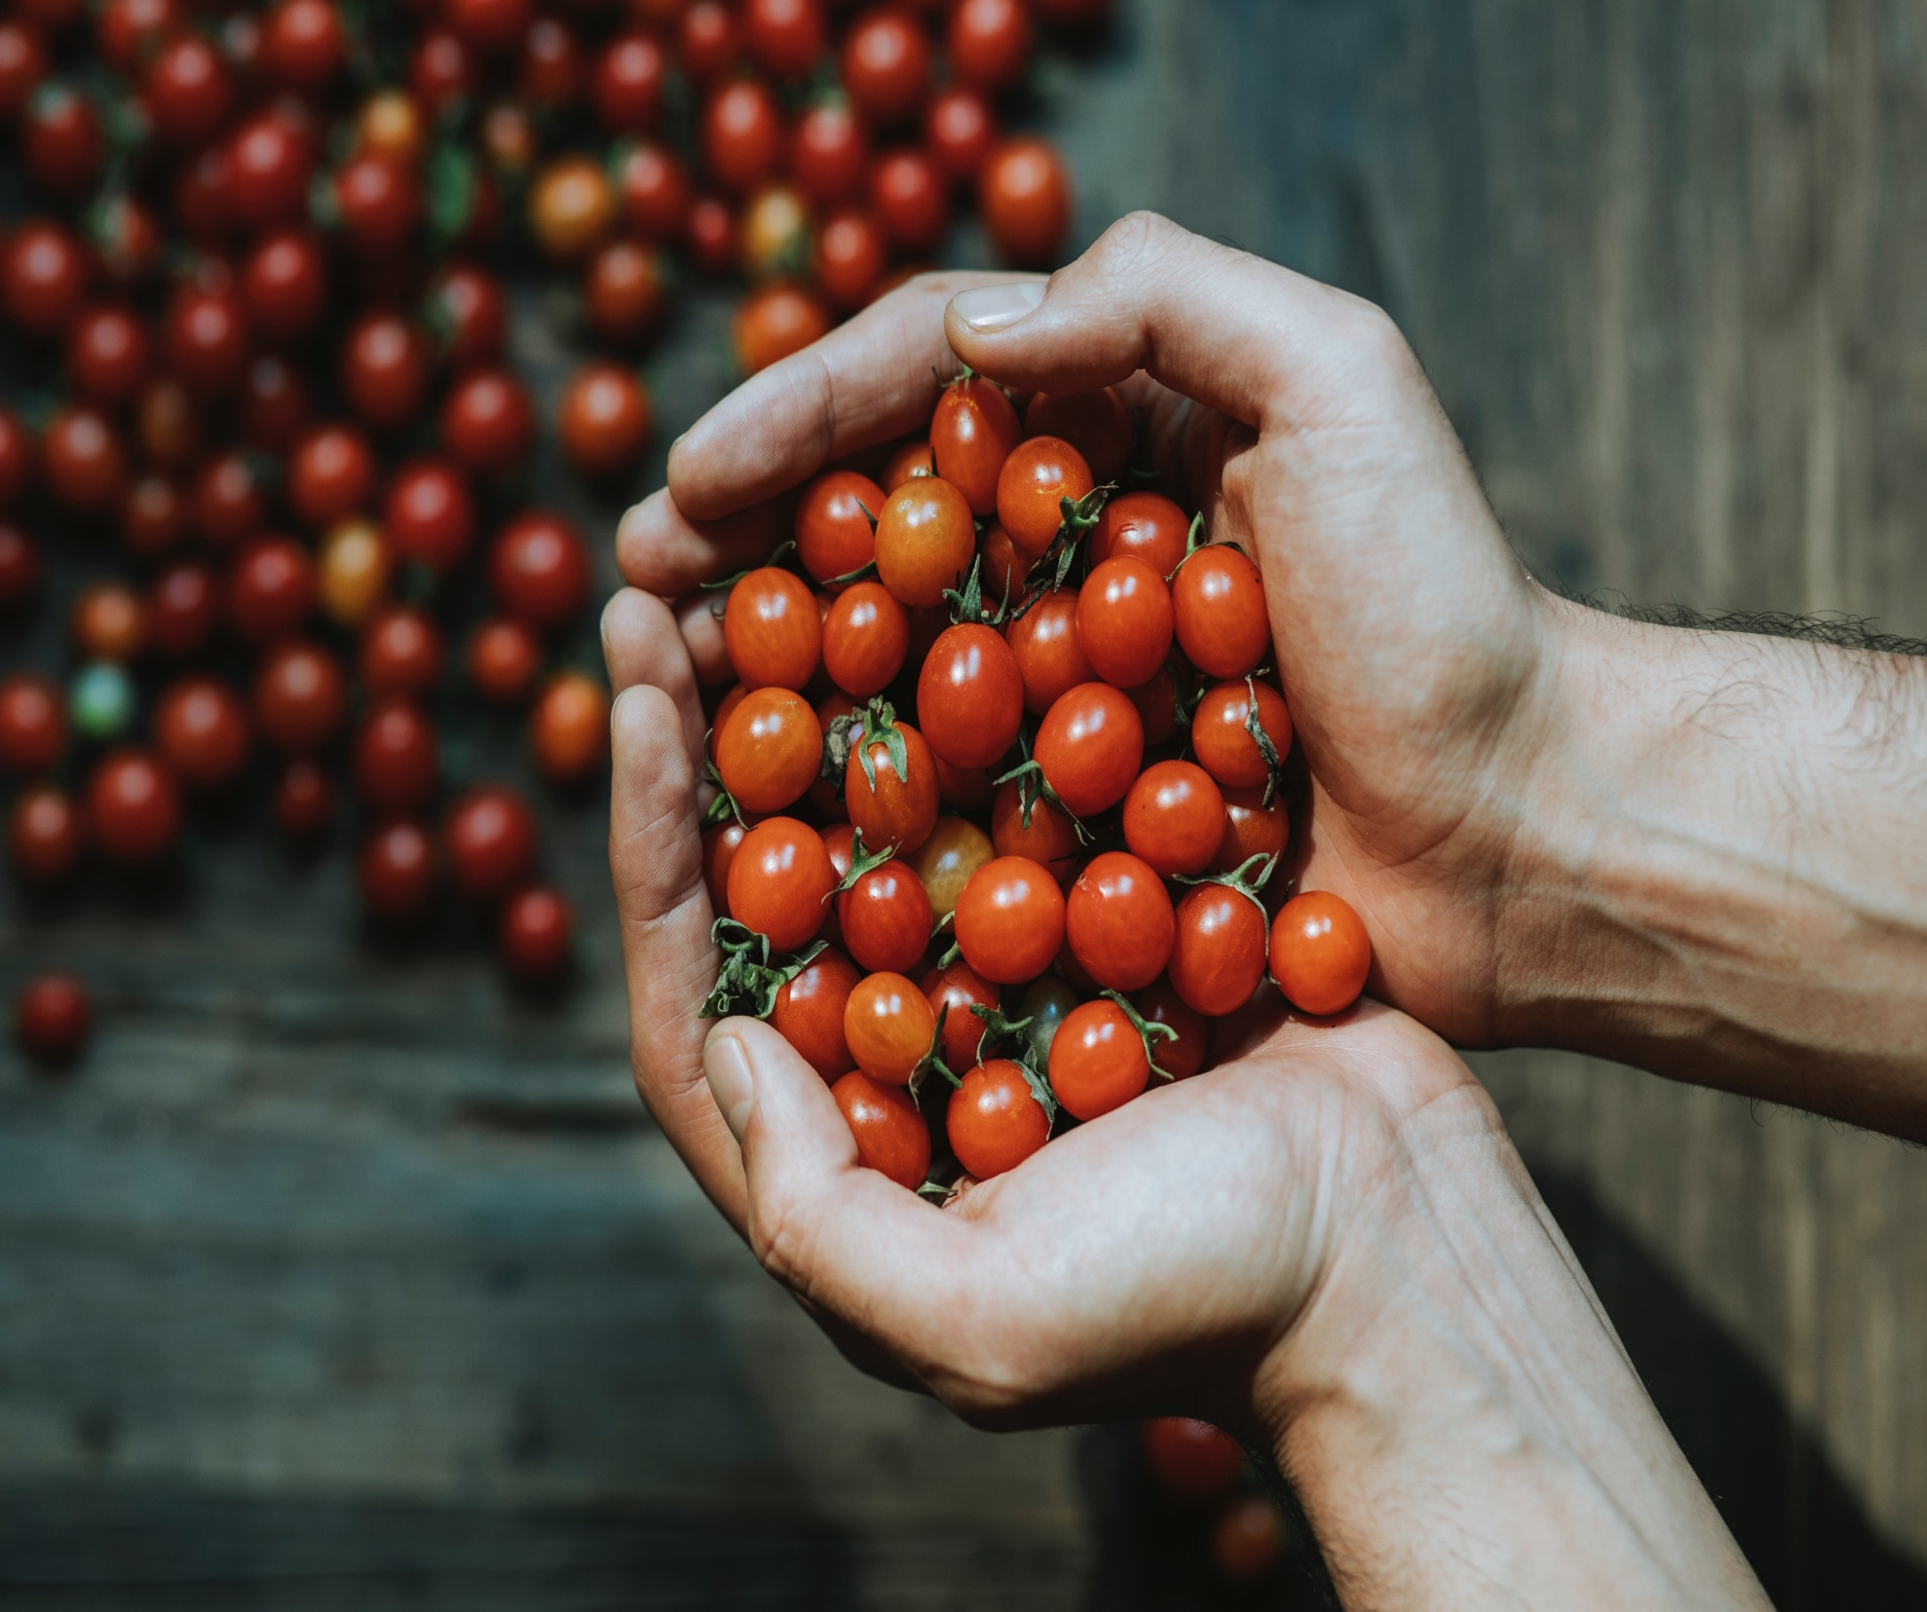

Healthy food Healthy you
Session #3
Notes:
Welcome to the third session of your Preventing and Controlling Diabetes program!
If you have not seen the first two videos, ask your CHW for the links.

Slide 2
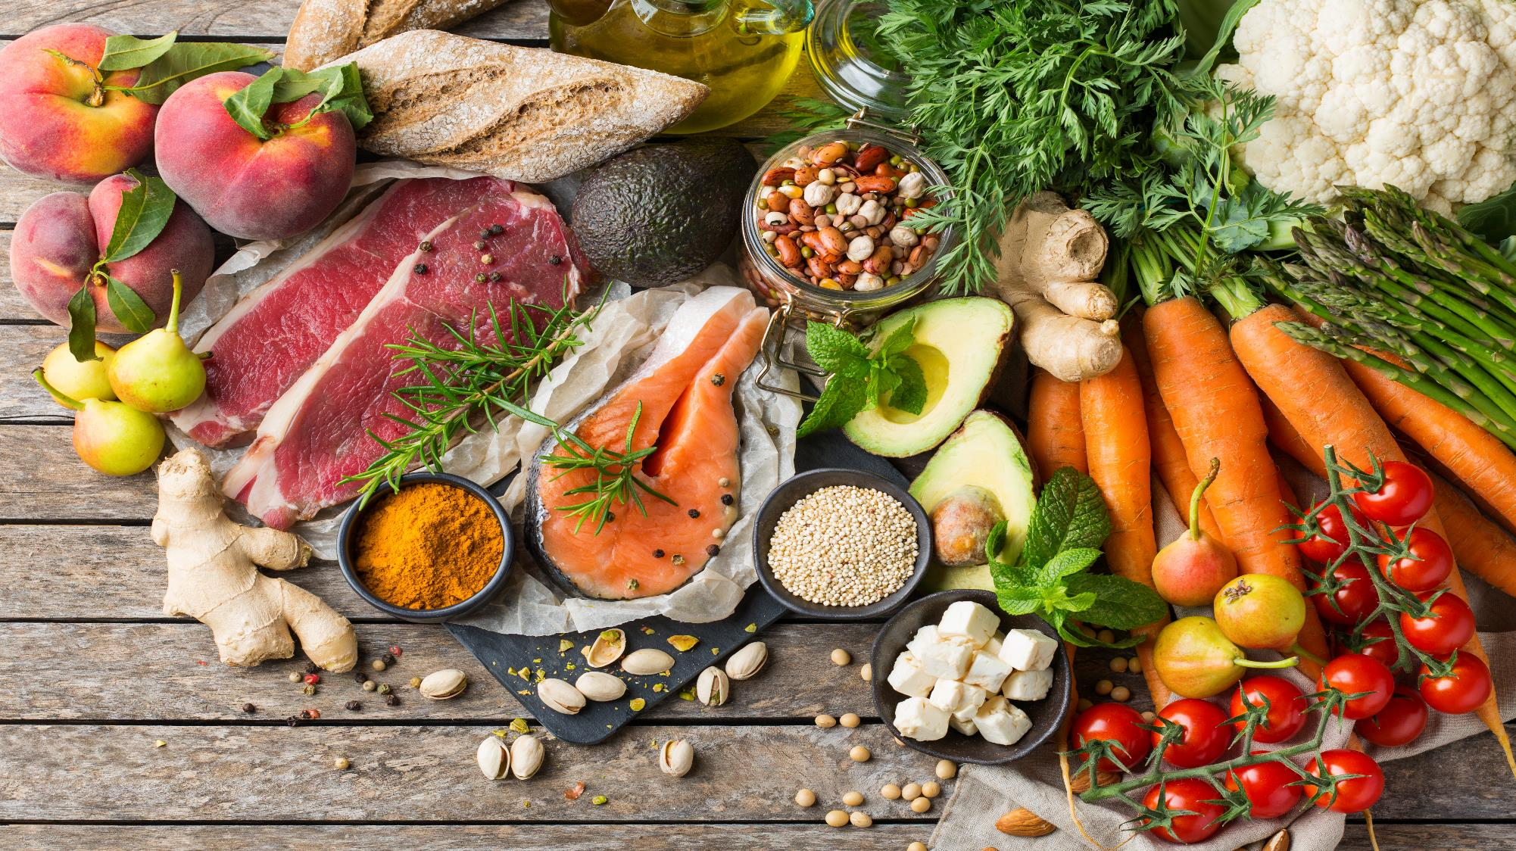
LET'S TAKE CARE OF WHAT WE EAT!
IT IS IMPORTANT!
Notes:
In this class we will learn to eat healthier food, less sugar, fat, and processed foods.
And to eat more vegetables and smaller portions.
This will help control your weight.

Slide 3
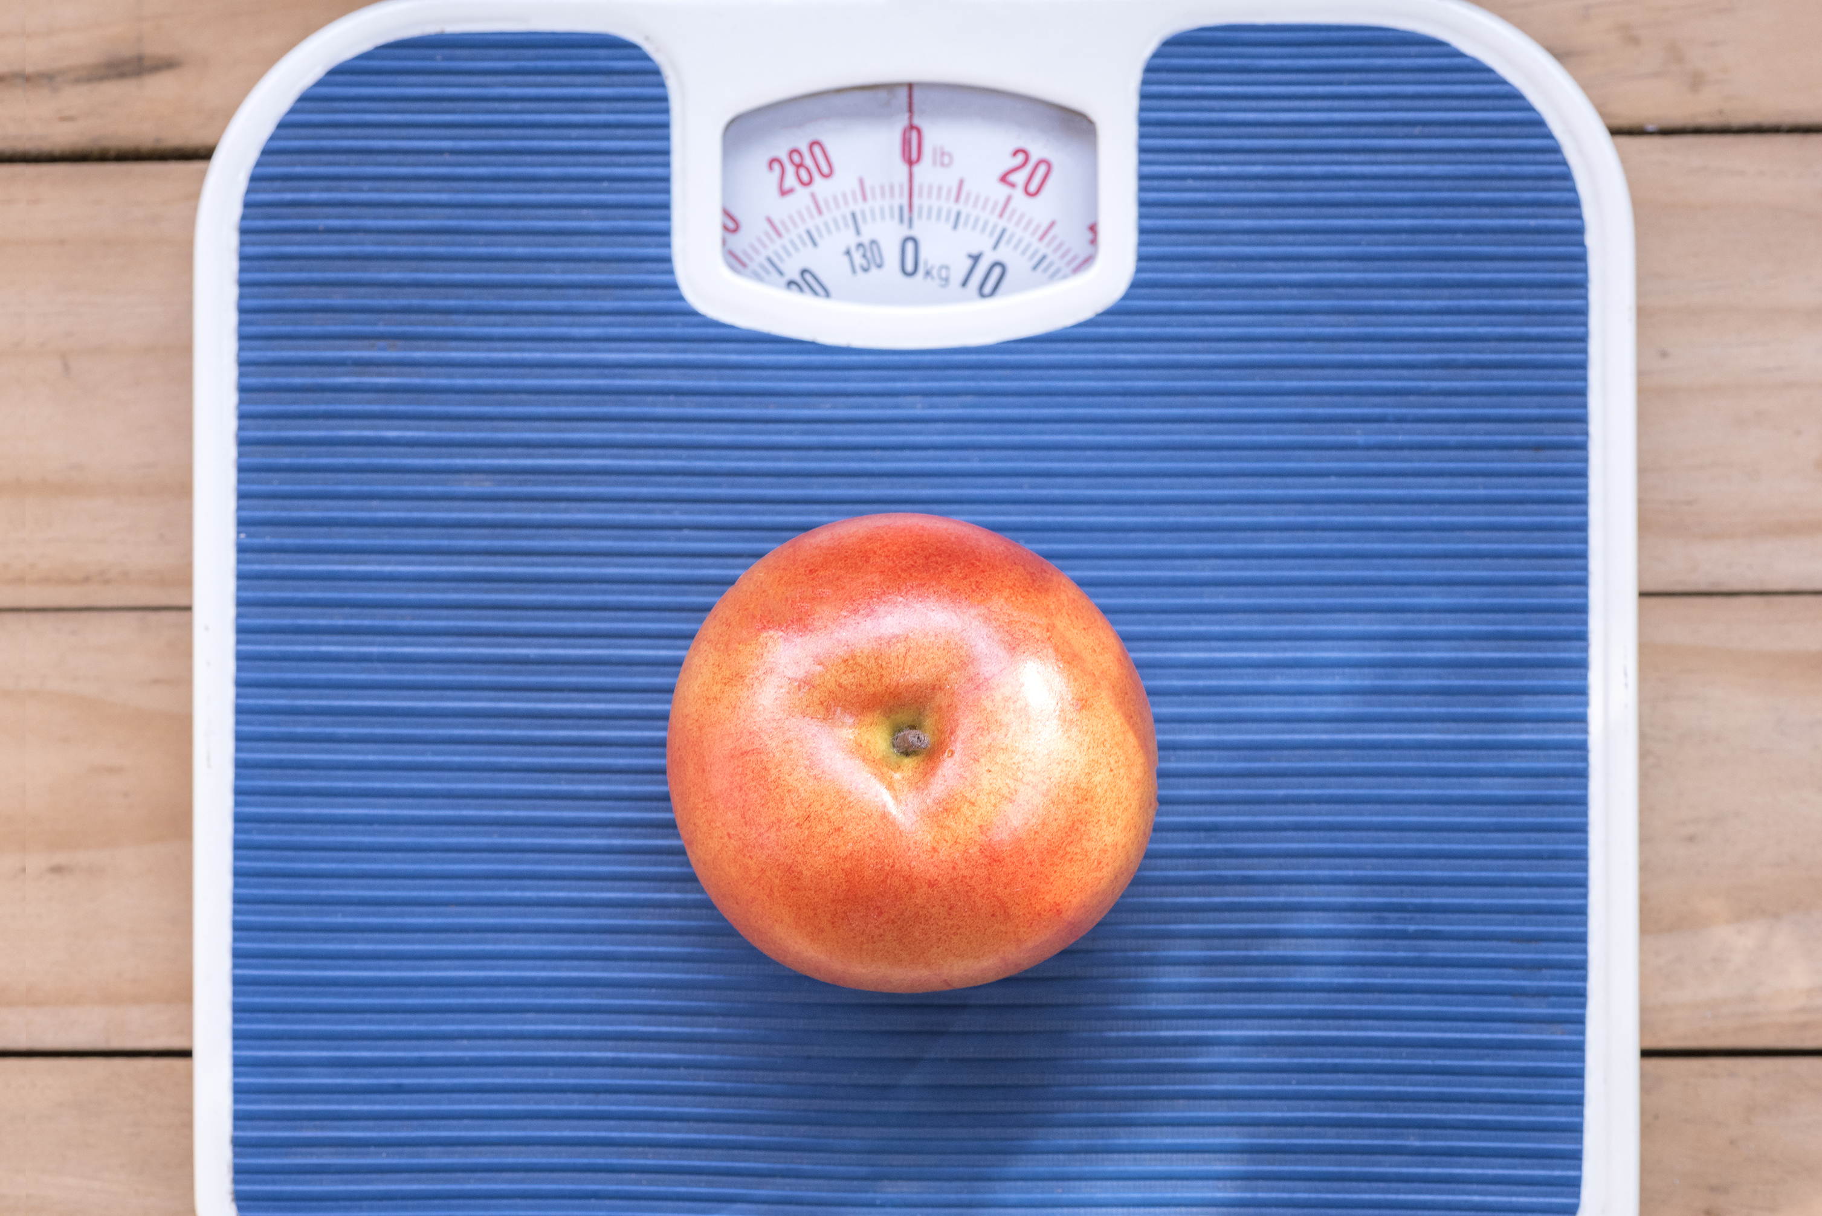
Eating healthy is important
Notes:
Eating healthy is important because it helps prevent too much body fat from accumulating.
Extra fat can block insulin from moving sugar into the cells, which makes diabetes harder to control and increases your chances of getting diabetes.
All food turns into sugar.
Sugar gives energy, but when it stays in the blood, it can damage the eyes, heart, and blood vessels. Even small weight loss helps your body work better.

Slide 4
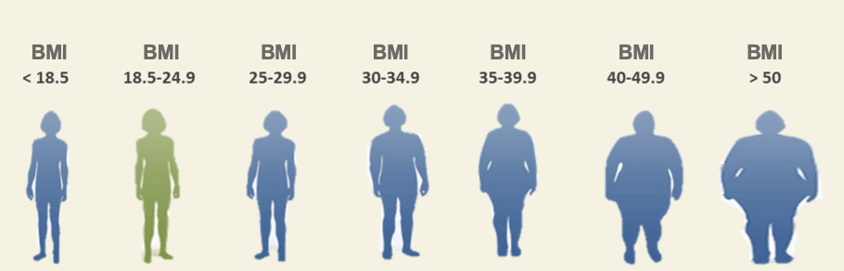
Body mass index
WEIGHT (pounds) X 703
[HEIGHT (inches)]²
BMI = Body Mass Index
Notes:
Doctors use a calculation called BMI or body mass index to determine the category of your weight? For instance, if your BMI is 30, you are in the obese category.
The higher your BMI, the higher chances you have of diseases like diabetes and high blood pressure and complications from them like heart and kidney problems.
Do you know your BMI? There are equations to do this. You just need to know your height and weight. Your CHW can show you an equation. https://www.nhlbi.nih.gov/calculate-your-bmi

Slide 5

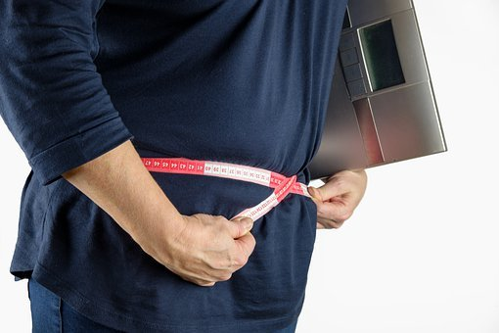
We know it’s frustrating!
(but don’t get discouraged)
Notes:
If your BMI is too high (and most people’s is), don’t get discouraged!
Start with a small, realistic goal, like losing 5 pounds. Write your goal down and decide how long it will take. When you reach it, set a new goal. Small changes over time are the key.

Slide 6

We must be realistic when
evaluating what we eat
Notes:
Losing weight is hard because we often think different of ourselves than we really are.
What we think we eat is not always the same as what we really eat, so we need to be honest about our habits.
Look at what you eat… even measure how much you eat, snacks, drinks, sleep, and exercise.
Accept that you may need help.

Slide 7
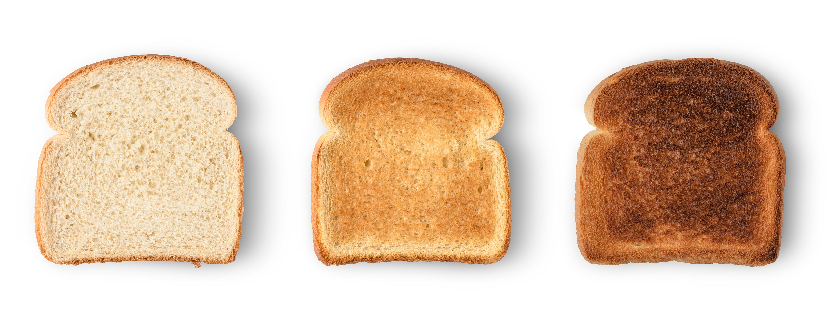
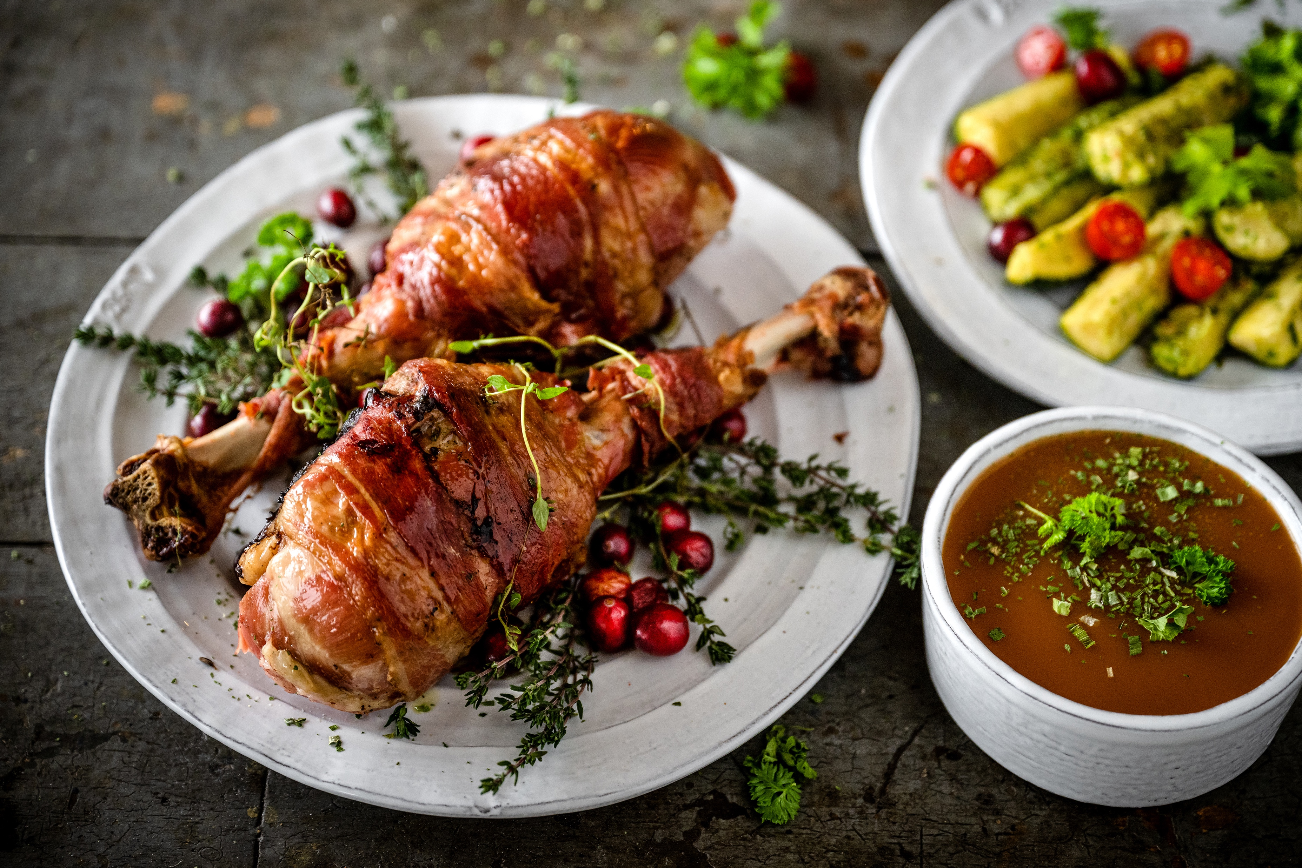
Energy
Notes:
Let’s talk about how food gives your body energy. This helps explain why some foods make you hungry again very fast.
Red line - Simple carbohydrates (sugar, candy, white bread, white rice, juice) give energy very fast, but it lasts only a short time. After about 30 minutes, you feel hungry again. This can raise blood sugar and cause weight gain.
Blue line - Complex carbohydrates (vegetables, whole grains, brown rice, whole fruit) give energy more slowly and last longer. They help you feel full longer.
Protein (chicken, fish, eggs, beans, low-fat dairy) gives energy for even more hours and helps control hunger.
When you combine protein + complex carbs + fiber, your body gets steady energy for 3 hours or more. This is why every meal should be balanced. Balanced meals help control hunger, blood sugar, and energy levels.

Slide 8
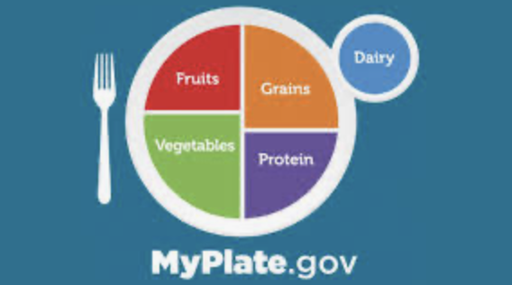
Notes:
Help starts with leaning what to do. It’s NOT following a diet as many think. It IS making long-lasting changes like a “healthy plate”.
A healthy plate has all food groups: protein, grains, fruits, vegetables, and dairy.
All groups are important when eaten in the right amounts.
Fruit is okay for people with diabetes. Fruit has sugar, but it is still healthier than processed foods like cookies or fast food. Eat whole fruit, not juice. Juice and smoothies have too much sugar because they use many fruits at once.
Use a 9-inch plate.
Protein: about ¼ of the plate, about the size of your palm
Fruits and vegetables: ½ of the plate (the most important part)
Grains: the remaining ¼ of the plate
Dairy – like a glass of low-fat milk or ½ cup of yogurt on the side
Drink water. Eat your food—do not drink it. If you have questions about foods or portions, talk to your Community Health Worker. We are here to help.

Slide 9
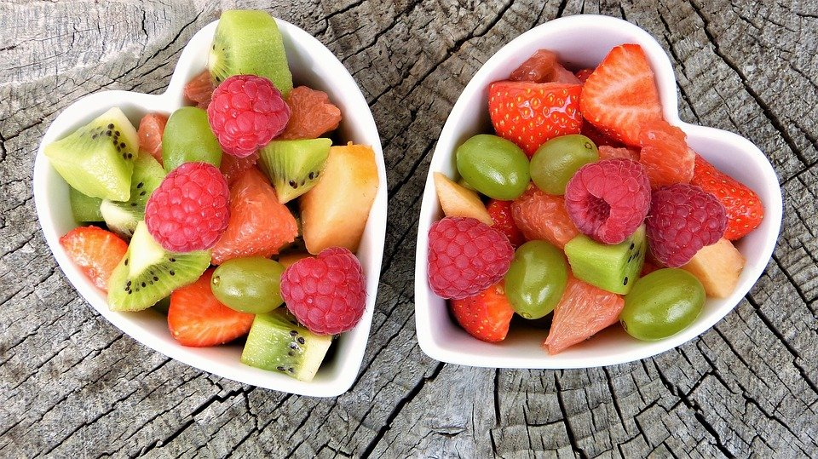
What color is your plate?
Notes:
Extra tip: Look for a lot of color on your plate.
Different colors in fruits and vegetables give your body different nutrients.
Eating many colors helps you eat better and not get bored. More color means a healthier meal.

Slide 10
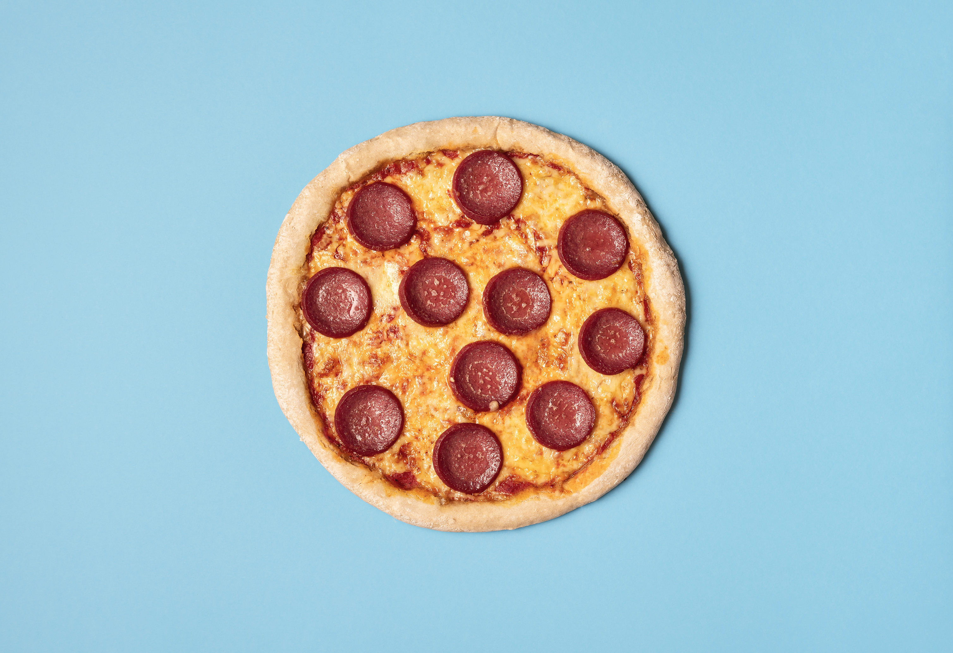


Avoid temptations!
Notes:
Avoid temptations! Such as…
All-you-can-eat buffets— make it easy to eat too much.
Smoothies and juices have a lot of calories. They have a lot of calories and can cause weight gain.
Eat food and drink water vs. ”drink food” (like juice).

Slide 11
Tips for snacking
Keep healthy snacks with you when away from home
Walk after meals
Snack on fruit, veggies, or protein while you cook
Eat until you're content, not stuffed
Have healthy foods in eyesight at home

Slide 12


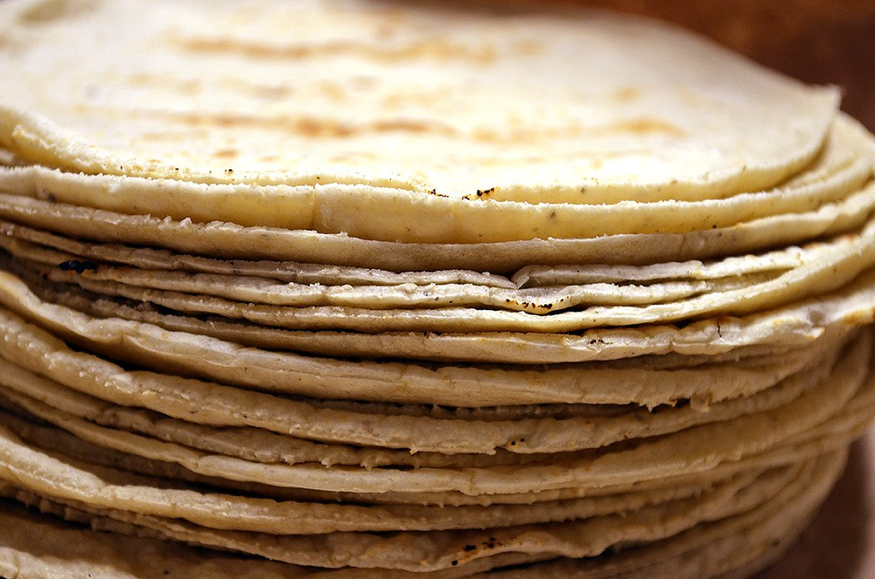
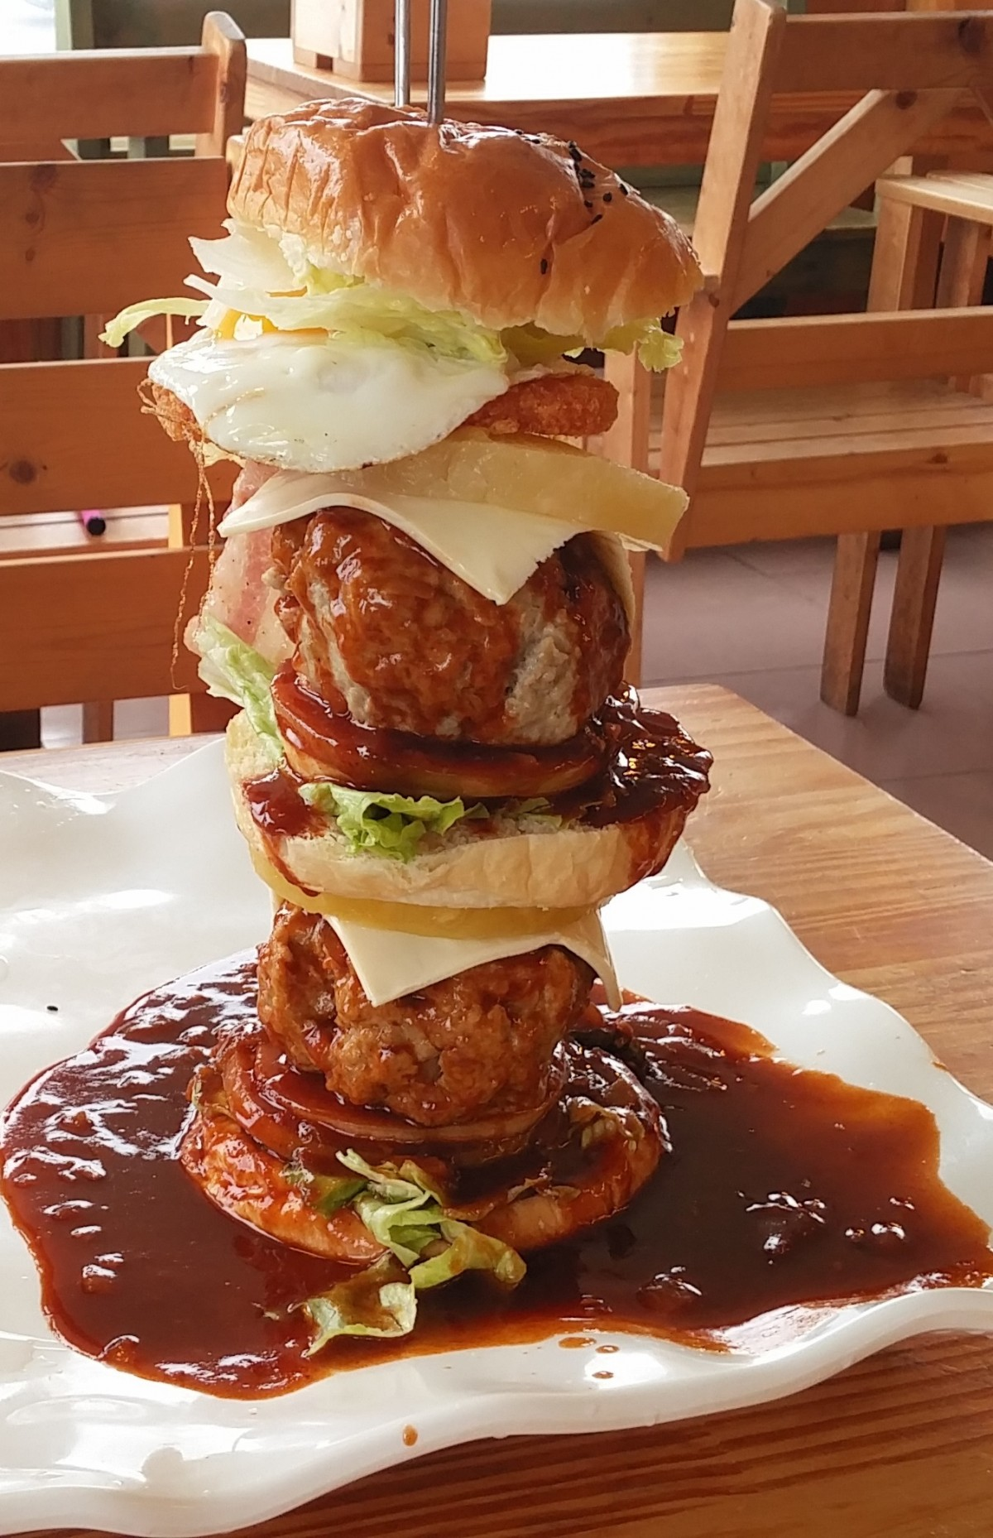
Common Eating Challenges
Fatty food
Sweets
Breads
Portions
Notes:
Here are common challenges with food. You don’t need to change everything—just pick one to start.
Examples: eating too much fried food, sweets, sugary drinks, bread, or large portions.
Focus on what is most important for you.

Slide 13

Supplements
Notes:
A common question is about supplements like vitamins and minerals.
Most people only need a multivitamin unless your doctor says otherwise. There are many people out there that will try to sell you more, which can waste your money and sometimes do harm.
Talk to your doctor if you should take more than a multivitamin. For example, some people may need supplements like B12 calcium and vitamin D.
Bring all vitamins, teas, or liquid supplements to your doctor and tell them what you take.

Slide 14

Making Changes
Setting Goals for change
Notes:
Have you been making changes? What is better, and what is still hard to change?
It is important to set goals you can measure.
For example, instead of just “lose weight,” set a goal like “eat 5 servings of fruits/vegetables daily” and “walk 15 minutes daily”
Write down your goal and ask your CHW to help make it measurable. This helps you stay focused and turn changes into a healthy lifestyle.

Slide 15

Thank you for being with us!
Notes:
Thank you for continuing to participate with us in this diabetes prevention and control program. We are very happy to have 3 months of classes with you and invite you to continue watching our videos, answering our calls, and allowing us to help you. God bless you and see you next month! Thank you!

Slide 16
References
American Diabetes Association Professional Practice Committee. (2024). 6. Glycemic Goals and Hypoglycemia: Standards of Care in Diabetes—2024. Diabetes Care, 47(Supplement_1), S111-S125
Geng, Y., & Qi, L. (2020). The Role of Nutrition in the Prevention and Intervention of Type 2 Diabetes. Frontiers in Bioengineering and Biotechnology, 8, 575442
Lean, M. E. J., et al. (2023). Embracing complexity: making sense of diet, nutrition, obesity and type 2 diabetes. Diabetologia, 66(7), 1153-1165.
Hamman, R. F., et al. (2024). The Role of Obesity in Type 2 Diabetes Mellitus—An Overview. International Journal of Molecular Sciences, 25(3), 1882.
Cheng, R., et al. (2024). Managing Impending Nonsevere Hypoglycemia With Oral Carbohydrates in Type 1 Diabetes: The REVERSIBLE Trial. Diabetes Care, 47(3), 476-484.
Carvalho, J. V., et al. (2023). Nutritional Strategies for the Management of Type 2 Diabetes Mellitus: A Narrative Review. Nutrients, 15(24), 5096.
Notes:
Thank you!

