Slide 1


Stop Problems Before They Start
Video 5
Notes:
Welcome to video #5 on diabetes prevention and control!
In this video, we will talk about the diseases and complications that diabetes can cause, as well as how to prevent them.
We are not sharing this information to scare you, but to give you the tools you need to protect your health and prevent these problems.

Slide 2
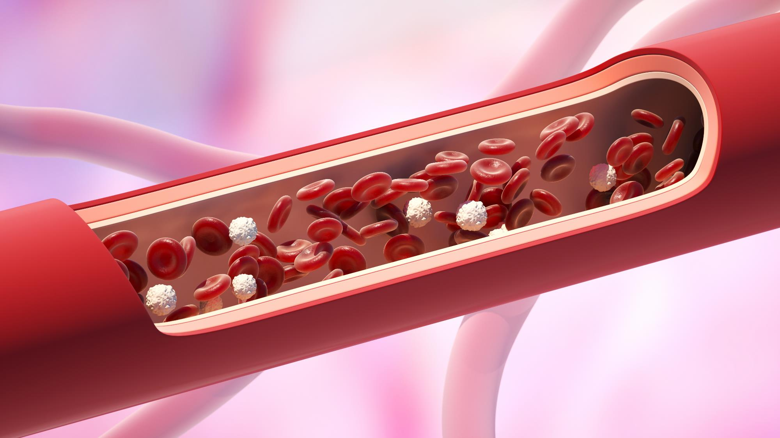
Arteries are Everywhere
Notes:
Did you know that arteries carry blood throughout the whole body? They run from the head to the feet, including the eyes and the sexual organs. Some arteries are large, and others are very small.
Uncontrolled diabetes, as well as many other risk factors—including smoking, older age, overweight, and obesity—increase your chances of developing the diseases we will discuss.
Good habits, such as taking your medications, eating healthily, having a clinic you trust and attending your appointments, and controlling your diseases, help lower your risk.
So, what are these complications?

Slide 3

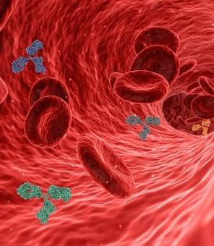
CHOLESTEROL and high blood pressure
Notes:
Cholesterol and High Blood Pressure
Cholesterol damages the arteries by making them narrower and stiffer. When blood cannot flow properly, the heart works harder, and blood pressure can rise.
High cholesterol increases the risk of high blood pressure, heart attacks, and strokes.
To lower cholesterol, stay active (20 minutes, 3 times a week), work toward a healthy weight, and take your medications as prescribed.
Know your blood pressure—your goal is less than 140/90.
Have your cholesterol checked every year. If you haven’t done so, make an appointment at your clinic.

Slide 4

Stroke
Notes:
Strokes
A stroke can occur when a blood clot blocks blood flow to the brain or when a blood vessel in the brain bursts.
High blood sugar, high cholesterol, and smoking damage blood vessel health and increase the risk of clots.
Keeping blood sugar, cholesterol, and blood pressure under control helps prevent strokes and embolisms.

Slide 5

Heart attack
Notes:
Heart Attacks
High blood sugar and high blood pressure damage the arteries over time. Cholesterol and sugar can build up as plaque in the arteries.
If a plaque blocks blood flow to the heart, it can cause a heart attack.
Controlling blood sugar, blood pressure, and cholesterol reduces the risk.
Eating a healthy diet, exercising regularly, and avoiding tobacco help prevent heart attacks.

Slide 6


Kidney Disease
Notes:
Kidney Disease
The two most common causes of kidney problems are diabetes and high blood pressure. Having both increases the risk.
Your doctor can check your kidneys with a urine or blood test. The urine test should be done once a year.
If the kidneys fail, dialysis is needed. This is a serious condition in which a machine filters the blood, usually two to three times per week.

Slide 7
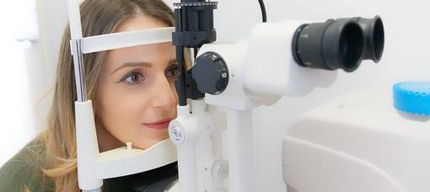
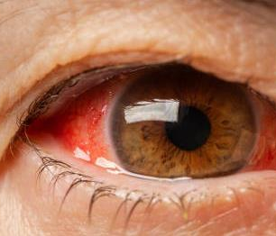
Eye disease
Notes:
Eye Diseases
The eyes have many tiny arteries. Diabetes and high blood pressure can damage them and cause blindness.
Have an eye exam every year. Your ophthalmologist can detect problems early and help you maintain your vision.
If you have not had an exam this year, ask your community health worker to help you schedule an appointment.

Slide 8
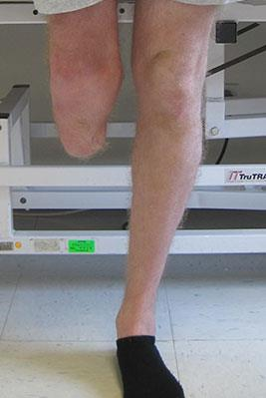
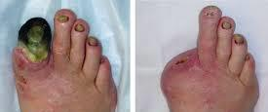
Amputations
Notes:
Amputations
Uncontrolled diabetes can damage the arteries and nerves in the feet and hands, causing loss of sensation.
Check your feet at home: look at the soles and between your toes. Ask a family member for help or use a mirror if you cannot see the soles.
Report any cuts, blisters, or infections to your doctor immediately.
Diabetes can make wounds take longer to heal, so early care prevents bigger problems.
Foot checks are simple but very important for prevention. They should be done every year.

Slide 9
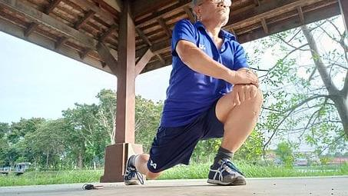

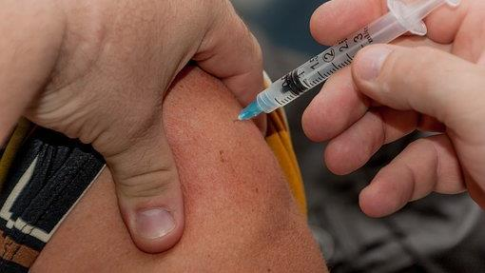

What can
I do?
Notes:
How can we prevent these diseases and complications?

Slide 10
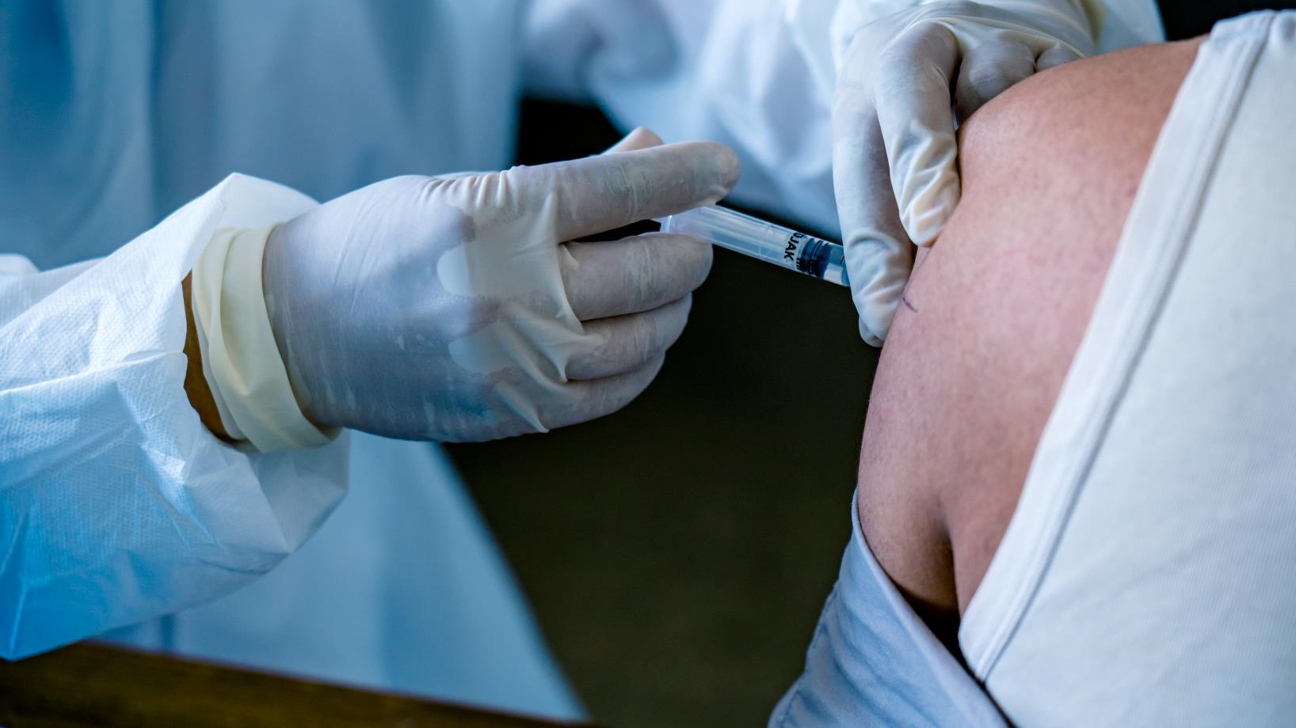
Vaccines
Notes:
Vaccines are an easy way to prevent complications.
Having the flu can be very dangerous for people with diabetes or at risk for diabetes as we as older adults. That’s why it’s important to get the flu shot every year.

Slide 11

I’m scared of vaccines!
Notes:
It is normal to feel afraid of vaccines. Many people worry about pain, side effects, or do not fully understand how they work. But vaccines are safe, and side effects are usually mild, such as arm soreness.
Vaccines protect against serious illnesses that can cause complications, especially in people with diabetes or high blood pressure. They do not make you sick. They help prevent spreading diseases to others, such as the elderly or those with weakened immune systems, like cancer patients.
If you have any questions, talk to your doctor or your community health worker. They can help ease your concerns… because getting vaccinated is one of the best ways to protect your health.

Slide 12

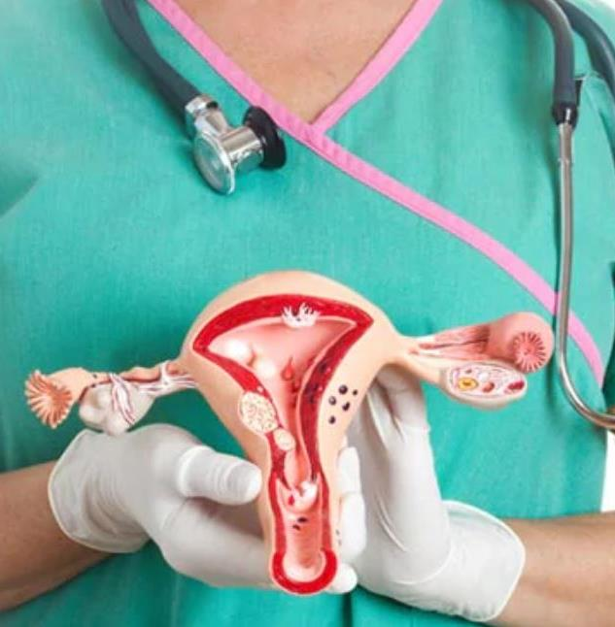

Other prevention exams
Colonoscopy
Mammogram
Pap-smear
Notes:
There are other important tests that can detect problems early, helping to prevent more serious diseases in the future. Some of the most important are:
1. Colonoscopy: Starting at age 45, have this test every 10 years. It helps detect colorectal cancer at an early stage.
2. Mammogram: Starting at age 40, have a mammogram every 1–2 years. It helps detect breast cancer early.
3. Pap Smear: Starting at age 21, have this test every 3–5 years. It helps detect cervical cancer at an early stage.
4. Prostate-Specific Antigen (PSA): Starting between ages 40–50, depending on your family risk. This blood test measures PSA levels to help identify possible prostate problems.

Slide 13


WE ARE ON YOUR SIDE
_______
WE ARE A TEAM
Notes:
It is very important to have people in your life who encourage you. Surround yourself with people who uplift you… and BE someone who uplifts others. You will notice a positive change in the people around you when you become a positive person who encourages others.
Remember, we want to be part of your team. The reason your doctor and we, as community health workers, emphasize controlling your blood sugar, blood pressure, and weight is because every day we see the effects of living with uncontrolled chronic diseases.
We want you to enjoy a better quality of life, because as important—or even more important—than the number of years we live, is the quality of life we have during those years. Everything we share with you is meant to help you live better and prevent medical complications. We are on your side, and we are here to help.

Slide 14

Do you need vaccines, medical referrals or preventive care?
Your CHW can help CONNECT you
Notes:
Do you need help getting vaccines, medical referrals, or preventive care?
Your community health worker can help you CONNECT with opportunities or referrals for your vaccines (such as the flu shot) and eye exams.

Slide 15


Continue your hard work!
Stick with your medications
Stick with your good eating habits
Keep talking to your Community Health Workers
DON’T GIVE UP!
Notes:
Don’t worry if you haven’t reached all your goals.
Change is a process: sometimes we succeed, and other times we feel discouraged.
Keep taking your medications, eating well, and talking with your community health worker.
If you feel discouraged, ask for help: we can help you get back on the healthier path you are aiming for.
Remember: healthy changes are for a lifetime, not just for a short period. Take back control of your health.

Slide 16

We are running a marathon
– the road is long
Notes:
Remember, the goal is to run a marathon of best habits for your life – and not just making changes that last a few weeks.
We hope you use this information and call us if you need our help.
Until next time!!

Slide 17
References
American Diabetes Association Professional Practice Committee. (2024). Standards of Care in Diabetes—2024. Diabetes Care, 47(Supplement 1), S1-S321. https://diabetesjournals.org/care/issue/47/Supplement_1
Templer, S., Abdo, S., & Wong, T. (2024). Preventing diabetes complications. Internal Medicine Journal, 54(8), 1264-1274. https://pubmed.ncbi.nlm.nih.gov/39023283/
Naaman, S. C., & Bakris, G. L. (2023). Diabetic Nephropathy: Update on Pillars of Therapy Slowing Progression. Diabetes Care, 46(9), 1574-1586. https://diabetesjournals.org/care/article/46/9/1574/153530/Diabetic-Nephropathy-Update-on-Pillars-of-Therapy
Tan, T. E., & Wong, T. Y. (2023). Diabetic retinopathy: Looking forward to 2030. Frontiers in Endocrinology, 13, 1077669. https://pmc.ncbi.nlm.nih.gov/articles/PMC9868457/
McDermott, K., Fang, M., Boulton, A. J. M., Selvin, E., & Hicks, C. W. (2023). Etiology, Epidemiology, and Disparities in the Burden of Diabetic Foot Ulcers. Diabetes Care, 46(1), 209-221. https://diabetesjournals.org/care/article/46/1/209/148198/Etiology-Epidemiology-and-Disparities-in-the
Verket, M., Jacobsen, M., Schütt, K., Marx, N., & Müller-Wieland, D. (2023). Influenza vaccination in patients affected by diabetes. European Heart Journal Supplements, 25(Supplement A), A36-A41. https://pmc.ncbi.nlm.nih.gov/articles/PMC10021494/
Mastrovito, B., Lardon, A., Dubromel, A., Nave, V., Beny, K., & Dussart, C. (2024). Understanding the gap between guidelines and influenza vaccination coverage in people with diabetes: a scoping review. Frontiers in Public Health, 12, 1360556. https://pmc.ncbi.nlm.nih.gov/articles/PMC11066301/

