Slide 1

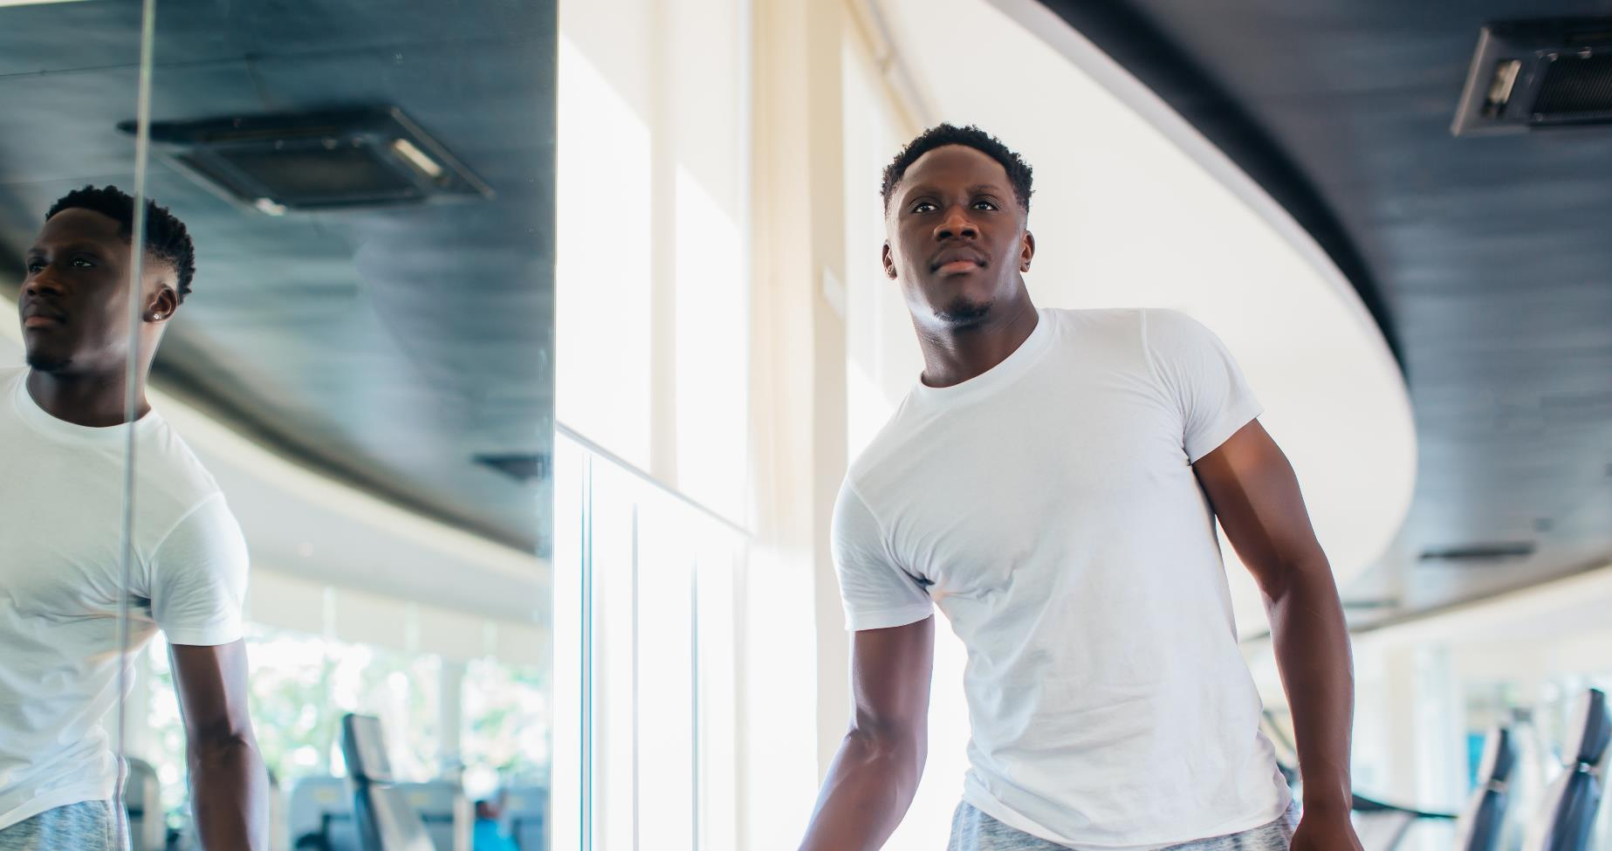
exercise Session 6
Notes:
Welcome! We hope you are doing well and taking advantage of all the information we have been providing in these videos.
Remember that if you have not been able to see any of the videos, you can ask your CHW to send you the links to the other videos so that you can take advantage of this program in a better way.
If you have any questions, please call your Community Health Worker and we will be happy to help. This month we will be focusing on how we can prevent diabetes and indeed many other diseases and improve our quality of life through exercise.

Slide 2
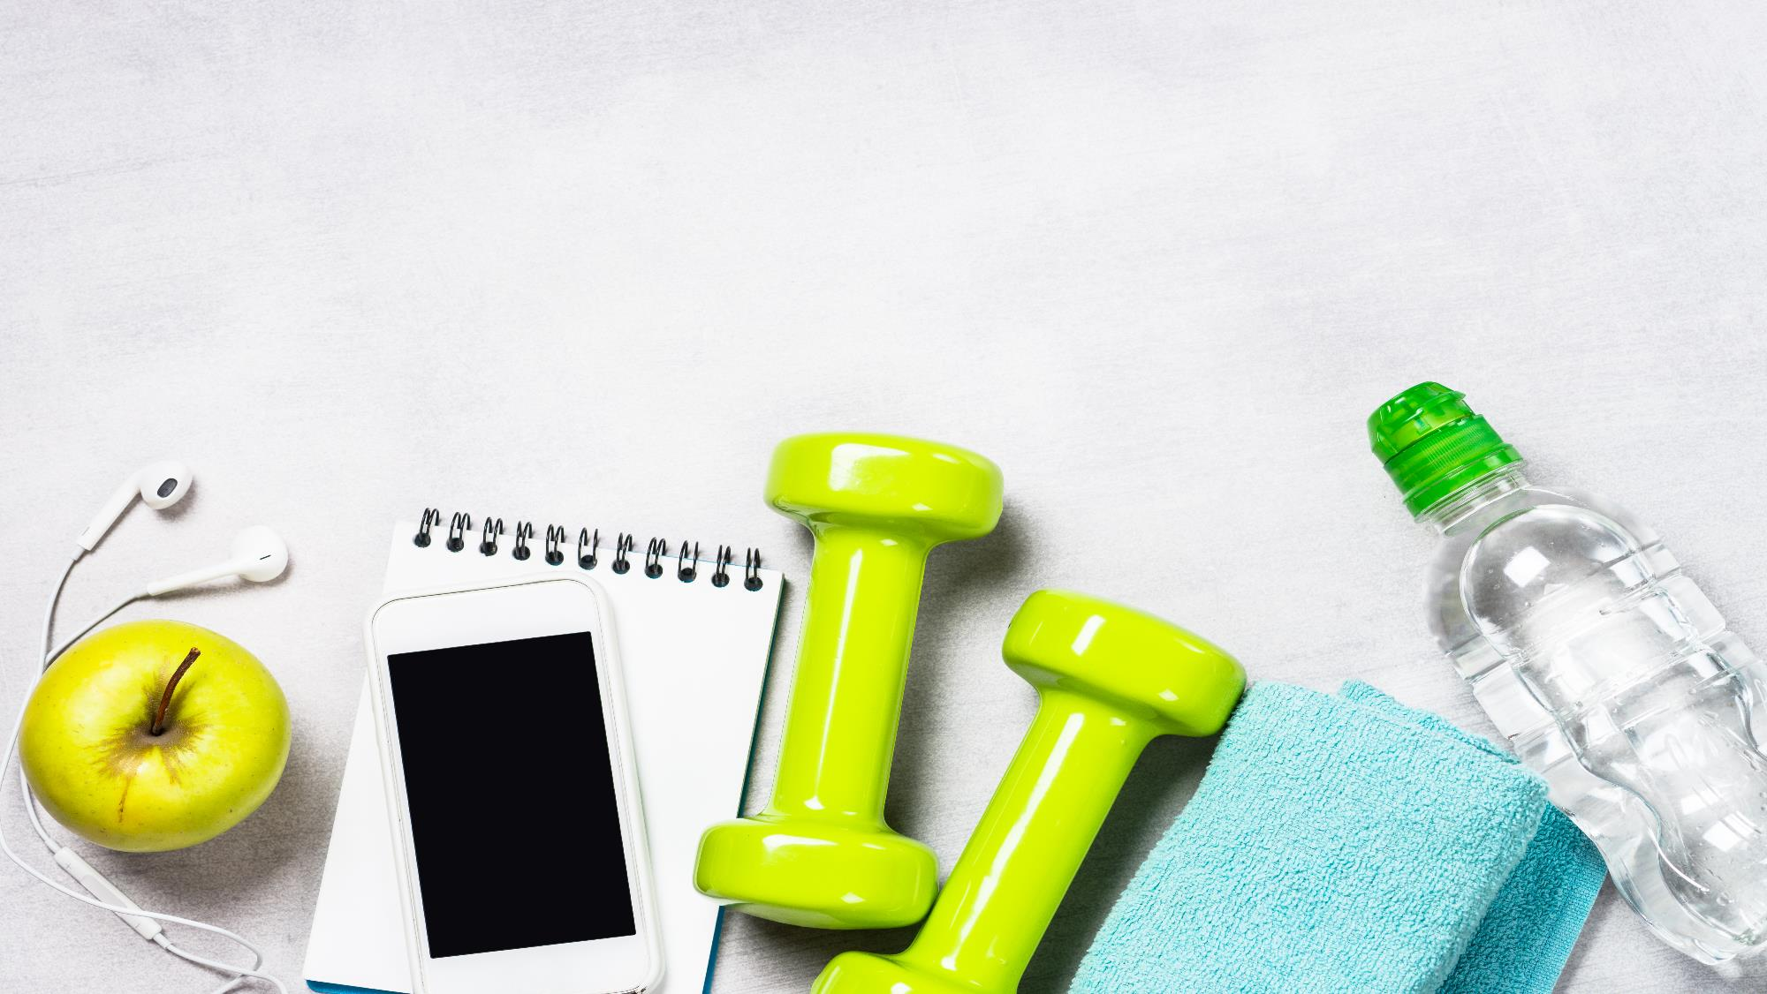
Reasons NOT to be active: I don’t have time! It’s too hard! It’s not fun! I don’t know what to do!
Notes:
Many people tell us that exercise is hard to start. They say they don’t have time, don’t have a place to exercise, don’t know how to begin, or that it hurts or feels tiring.
We will share some ideas to help.
First, let’s talk about what exercise is; it is any physical movement done to help keep your body healthy.
Many people think exercise is not fun, takes too much time, or is too hard. That’s why we’re here—to help make it easier and more realistic.

Slide 3
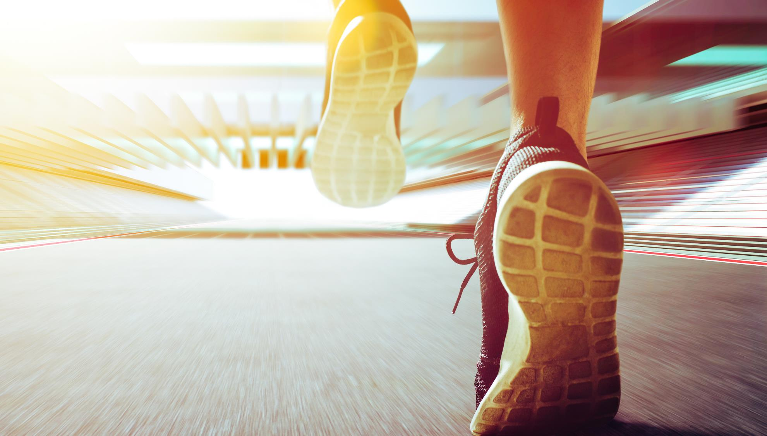
exercise
20 minutes
three times per week
Notes:
And with these reminders we begin with our topic today...exercise and physical activity. What do you think when someone mentions exercise or physical activity???
The GOAL is at least 20 minutes three times per week

Slide 4
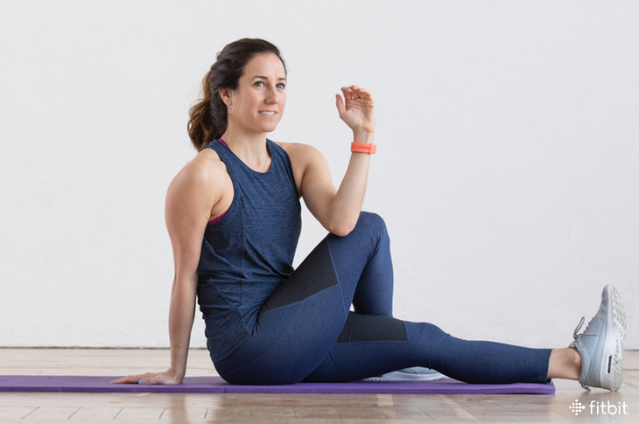
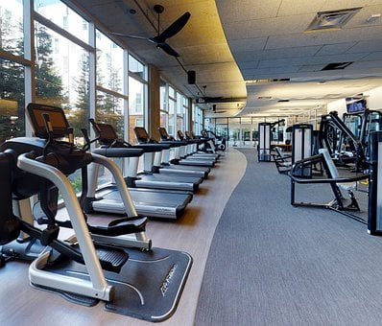
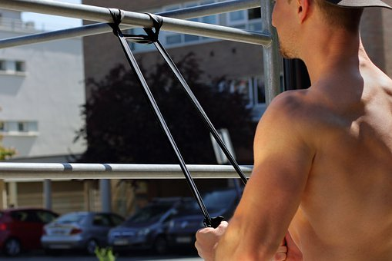
Complete Activity
Stretching
Weight/Resistence
Aerobic
Notes:
Physical activity is like a wheel. For a wheel to turn, it must be complete.
Think of a cartwheel. If a big piece is missing, the wheel will not turn well.
Your body works the same way. There are three types of exercise:
aerobic
strength (weight-lifting)
Stretching
All three are important. If one is missing, the body does not work as well.

Slide 5
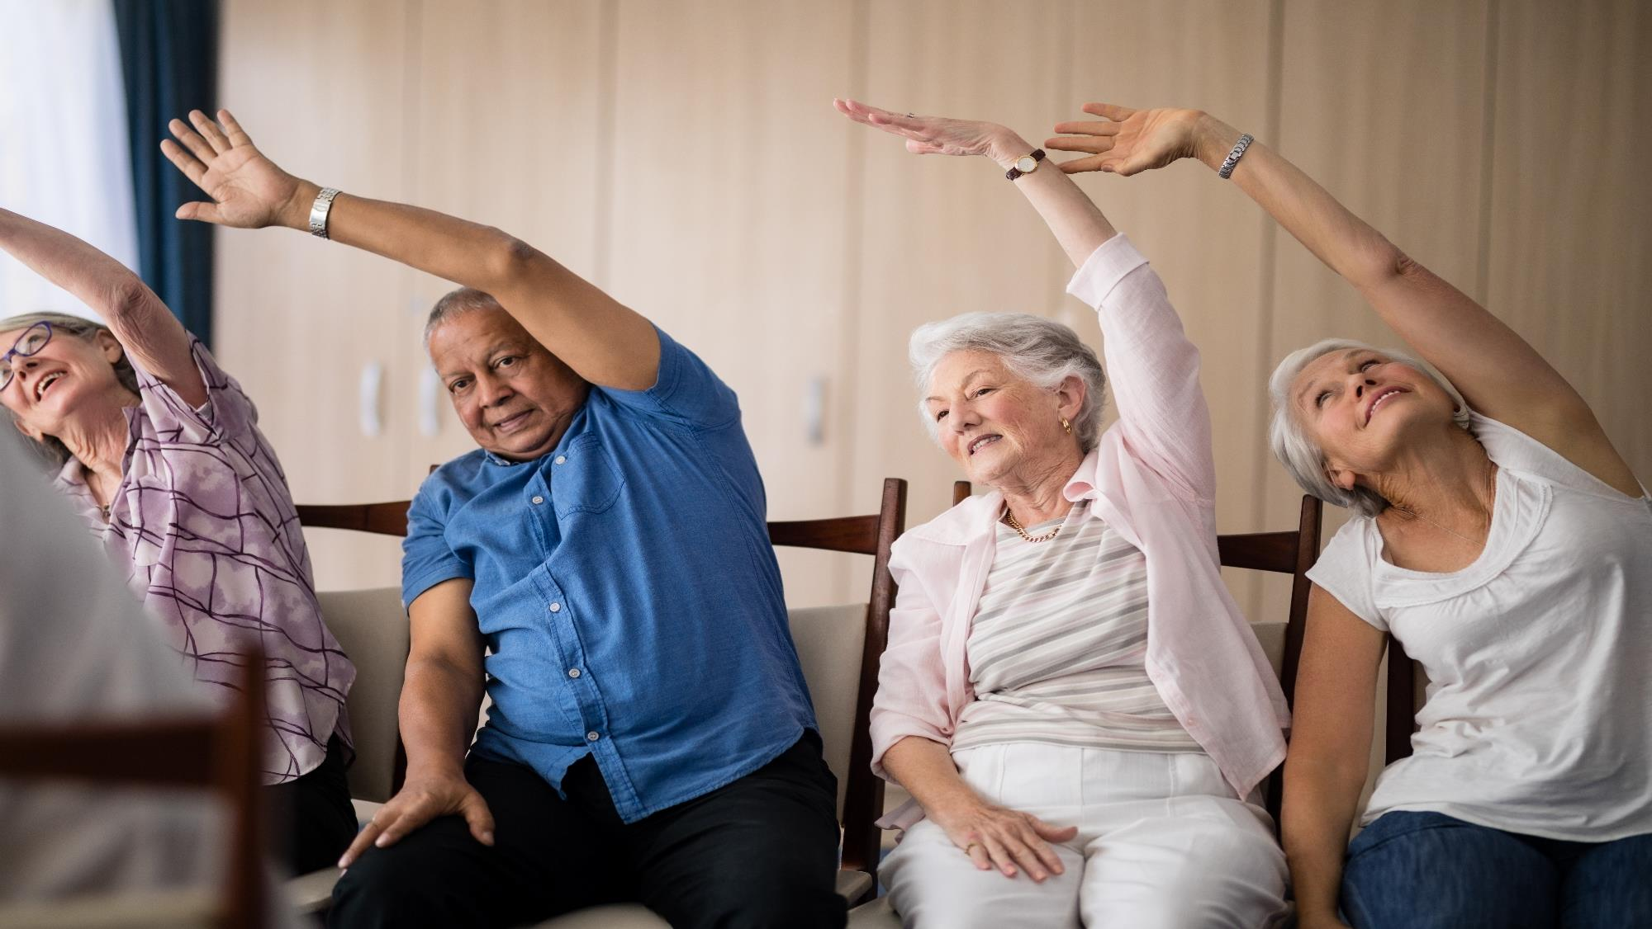
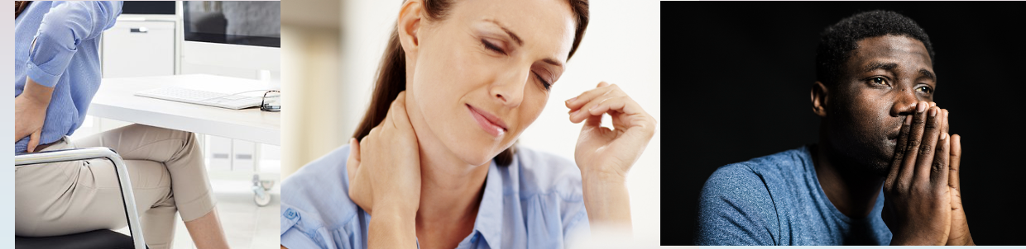
Warming up and Stretching
Notes:
Warming up and stretching
You wouldn’t drive a car without warming it up, right? If you do, it can get damaged! Well, the same is true for your body!
Before exercising, you should warm up and stretch the muscles you will use. You don’t need to be very flexible to stretch.
Stretching is important because it:
- Helps prevent injuries,
- Improves blood flow to your muscles,
- and because it can reduce pain!
Why does stretching help with pain? The body is all connected!
For example: some people have knee pain, but their knees are healthy. So the problem may actually be in the hips.
Why? because when the hips are out of balance, the knees take extra stress. Stretching and keeping your muscles balanced helps reduce this pain.

Slide 6
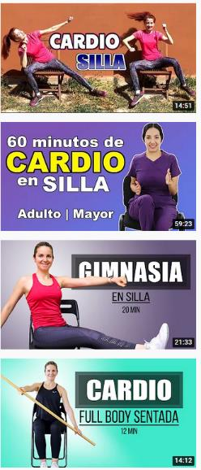
Heating and Stretching
Heating Exercise
To put to work
To muscles
Notes:
On youtube.com or any internet search on your phone, you can search for CHAIR WARMING EXERCISES If you've never exercised before, or if you're having problems with balance or mobility, it's best to start warming up in a chair. If you have balance and mobility, you can just look for WARM-UP EXERCISES

Slide 7

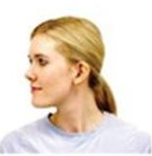


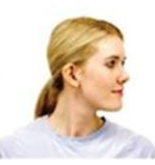

Let’s Practice!
Flex
Rotate
Stretch Sideways
Extend
Stretch Sideways
Rotate
Notes:
Headache & Neck Stretches
Do the following exercises!
While you do, please remember to breathe normally and only stretch until you feel a gentle pull. Do not push to pain!
If you do these stretches regularly, they will become easier each time!
IMPORTANT NOTE: The video will go fast, but please pause this video each time you perform one of the exercises mentioned so you can do it for 15 seconds…then… resume the video when you finish each exercise…
Ready to start?…let’s practice!

Slide 8
¡Practiquémos!
Flex
Extend
Notes:
Flex and Extend:
Sit straight, shoulders relaxed, don’t lean back.
Flex head down, chin to chest, hold 15 seconds.
Then, extend head back, hold 15 seconds.

Slide 9
¡Practiquémos!
Rotate
Rotate
Notes:
2. Rotate:
Keep back straight, shoulders relaxed.
Turn head to the right, chin in line with shoulder, hold 15 seconds.
Then, turn head to the left, hold 15 seconds.

Slide 10
¡Practiquémos!
Stretch Sideways
Stretch Sideways
Notes:
3. Side Stretch:
Now, ….Sit straight with your shoulders relaxed…
Tilt head toward right shoulder, and then hold 15 seconds….
you can use your hand to gently pull in order to deepen stretch, but, do this only if it is comfortable.
Then…. Repeat on left side.

Slide 11
Let’s Practice!
Flex
Rotate
Stretch Sideways
Extend
Stretch Sideways
Rotate
Notes:
Tips:
Do these every day and add more stretches slowly….
Stretching can relieve pressure in your neck and head….
Ask your Community Health Worker if you want more ideas or guidance!

Slide 12
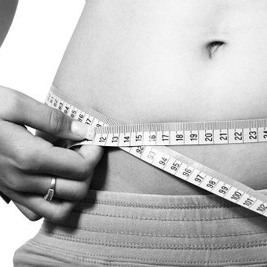
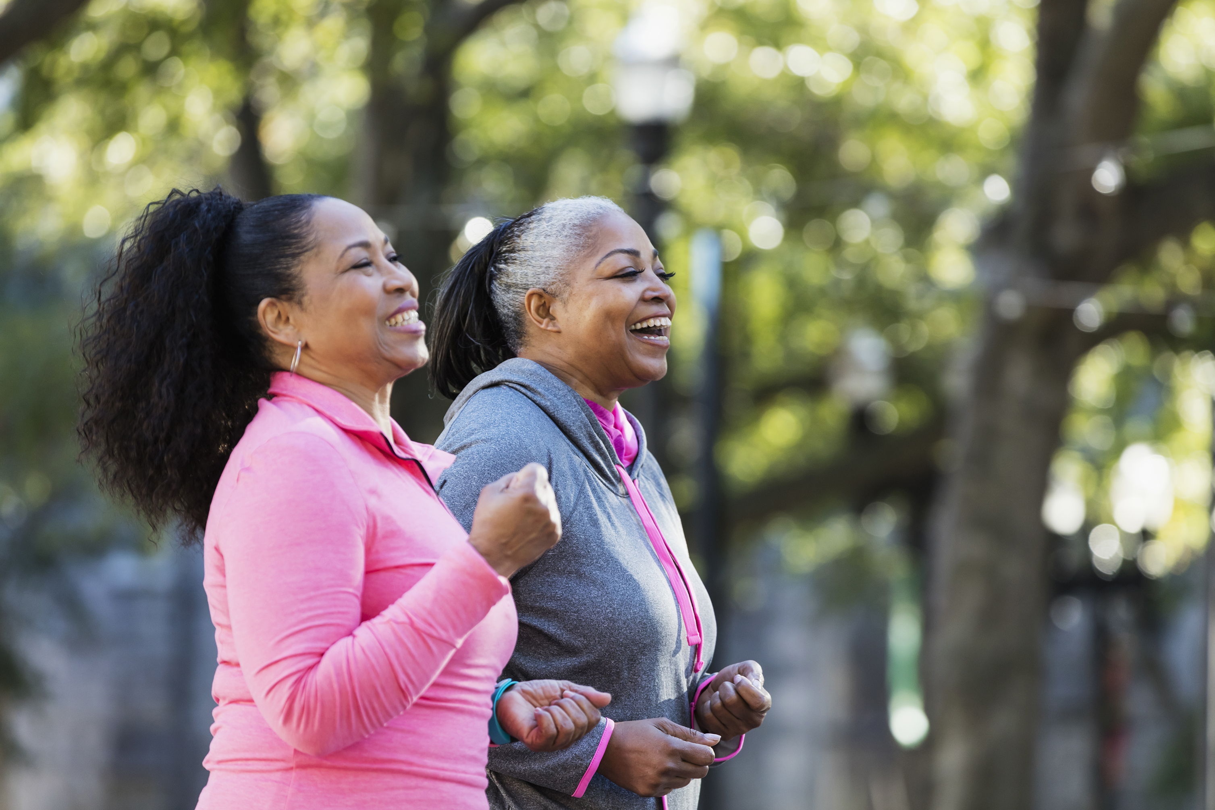
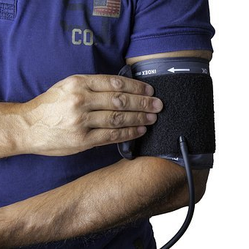
Aerobic activity
Lose Weight
Control disease
Notes:
Aerobic exercise
Aerobic exercise is the type most people think of. It makes your heart beat faster and keeps it strong.
Examples include brisk walking, running, swimming, dancing, or bicycling. Even 20 minutes of brisk activity is enough. Walk faster than a casual stroll—if you can still talk easily, go a little faster. Remember to drink water in small amounts while you exercise.
Aerobic exercise helps in three ways.
First, … it supports a healthy body weight, especially when combined with good eating habits.
Second, … it helps prevent or control diabetes.
Third, …. it is very helpful for managing blood sugar.

Slide 13
AEROBICS
CARDIO IN CHAIR
Putting the heart to work
Notes:
Some people say, “I can’t do aerobics because my knees or hips hurt.” Often, this is an excuse, not a reason.
You can start aerobics from your chair, moving your arms or dancing to get your heart pumping.
Search YouTube for “CHAIR CARDIO” in Spanish for 10- to 60-minute videos. Most of us can also stand up and add more movement.

Slide 14
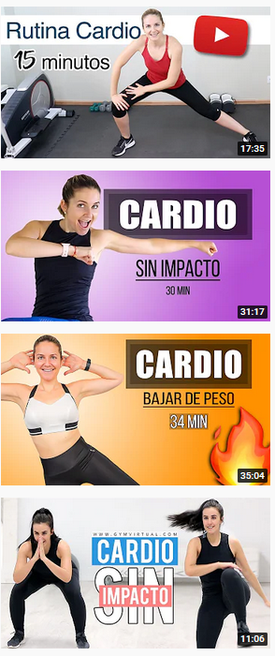
AEROBICS
LOW IMPACT CARDIO
Putting the heart through a little more work
Notes:
So….to get up from the chair, to move!
Low-impact cardio is easier on your joints and still exercises your heart. You can find many videos online by searching “LOW IMPACT CARDIO.” These videos usually last 10 to 30 minutes and don’t require jumping or much experience.
As you become more mobile, you may try higher-impact cardio… but check with your doctor before doing so.

Slide 15

Be careful with “rewarding” yourself!
How many calories did you really burn?
Notes:
Aerobic exercise can help with weight loss, but most people don’t burn as many calories as they think. For example, walking for an hour burns about 80 calories—the same as a small omelet or a couple teaspoons of ice cream.
Many people eat more after exercising because they think they burned a lot, and this can cancel out the calories burned. That’s why exercise alone doesn’t usually lead to weight loss—you also need to eat less and avoid rewarding yourself with food.
If you want to reward yourself, do it with something other than food, like a board game, watching a show you like, or enjoying a hot tub—something you do only when you reach your goal.
Being part of a class or sports team can also motivate you because you depend on others and feel accountable. Just be careful not to reward yourself with food afterward.
The key is to combine aerobic exercise with healthy eating and other ways to motivate yourself.

Slide 16
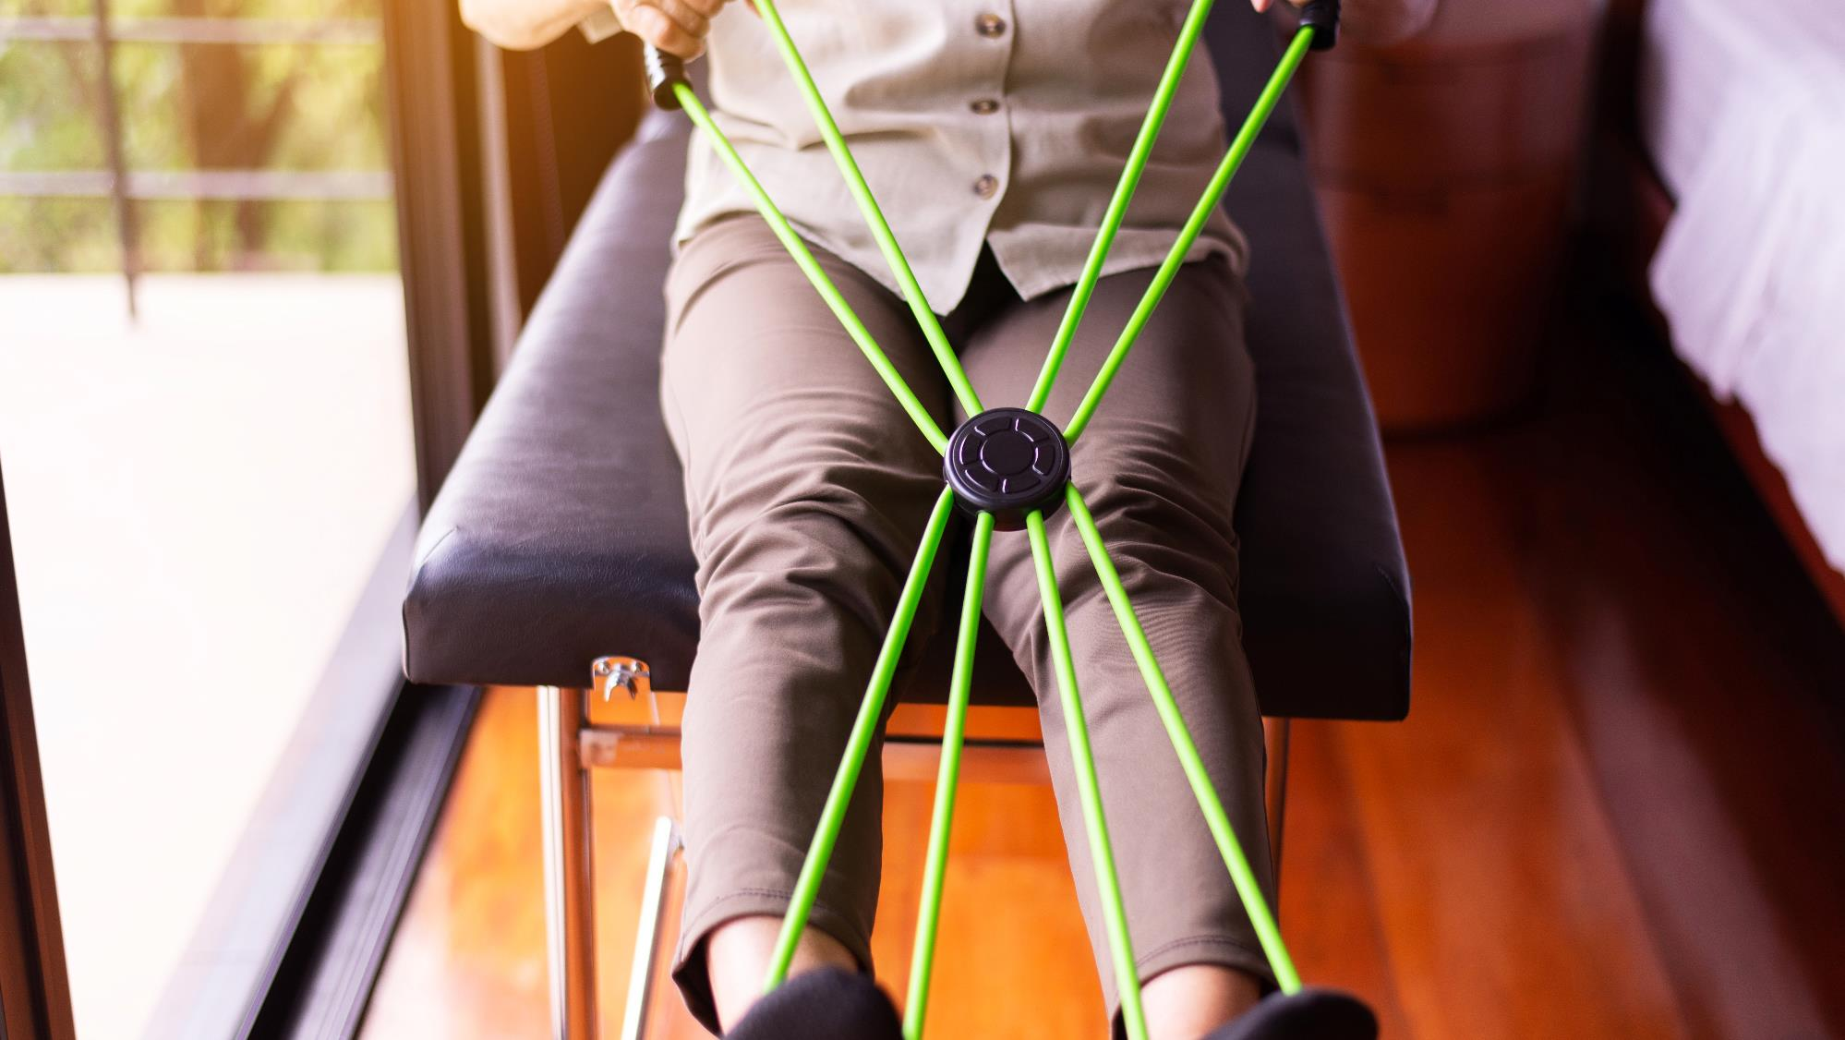
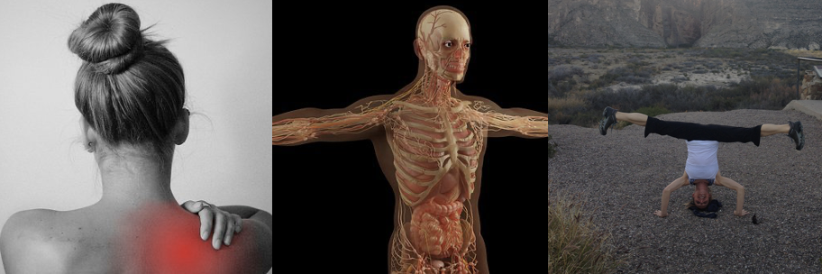
Weight/Resistence
Notes:
Weightlifting or Resistance
The next type of exercise is weightlifting or resistance exercise. This means lifting weights, but small ones—not like bodybuilders.
You can do this at home with dumbbells, water bottles, canned goods, or even your children. You don’t need a gym or park. You can also lift weights while walking, sitting in a chair, or on the floor. Start with a weight that feels comfortable and do several repetitions, gradually increasing over time.
Resistance exercises help strengthen muscles and bones, including your core. Strong abdominal muscles improve balance and posture, reducing stress on your knees, hips, and back.
Weight-bearing exercises help prevent bone loss and osteoporosis, especially in women or very thin people. They also improve balance, reduce falls, and increase overall quality of life as we get older.

Slide 17
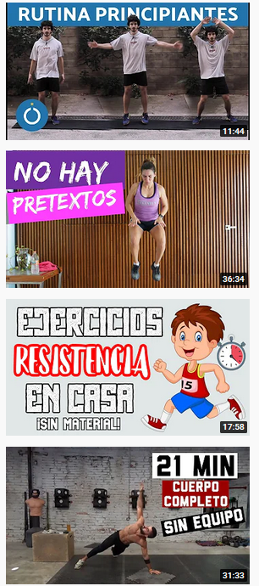
RESISTANCE
LOW-IMPACT CARDIO
to put the heart to work a little more
Notes:
Just like with other types of exercise, you can follow instructions online. Go to YouTube.com and search for “RESISTANCE EXERCISE”.
You will find many 10- to 30-minute videos.
These videos show you how to use things around the house, like water bottles, canned food, or small weights. Some show resistance bands, and some exercises don’t need any equipment at all.
Remember, if we don’t use our muscles, we lose them little by little. Let’s work on them!

Slide 18

How much exercise should I have each week?
20 minutes
3 times per week
Notes:
Remember! ….. At least 20 minutes three times per week CAN make a BIG difference!

Slide 19

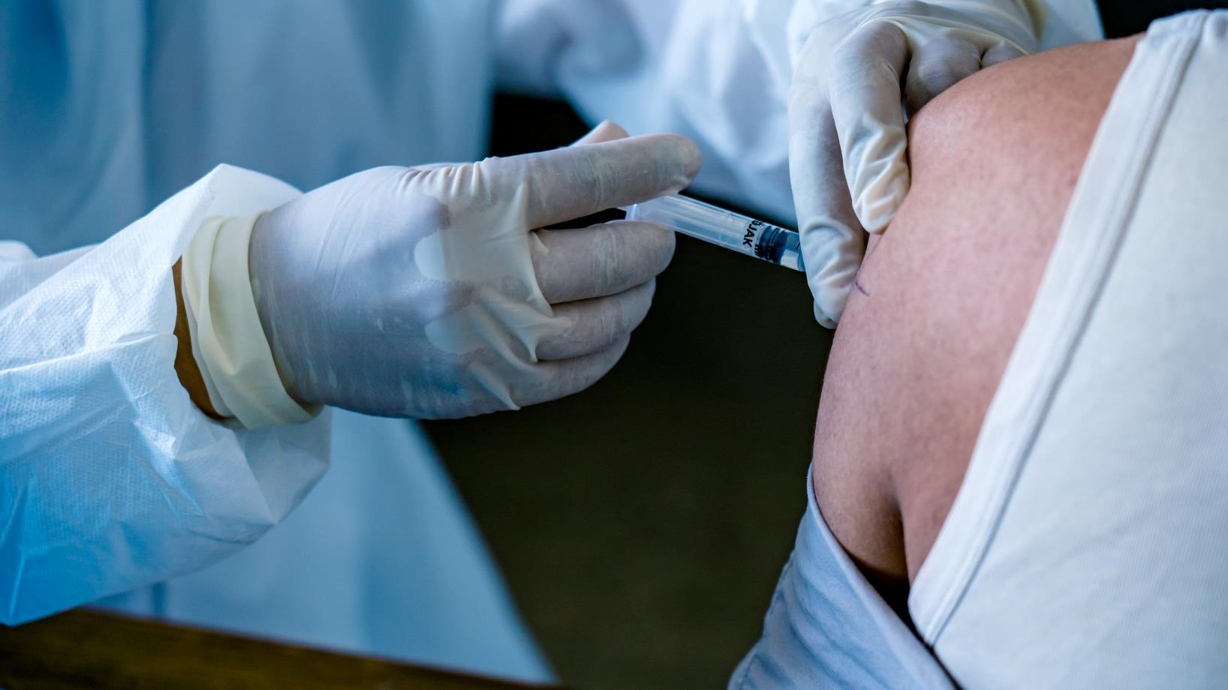
Do you help getting started with exercise?
20 minutes
3 times per week
Your CHW can help CONNECT you
Notes:
If your blood pressure or blood sugar is too high,… ask your CHW to help connect you to care.
Need ideas for exercise or ways to be more physically active? CHWs also can help connect you to options like community activities, discounted gyms, or exercises you can do at home.

Slide 20

Let’s practice – what are your exercise goals?
Notes:
Can you name exercise goal like…. “be more active”!?
Now, what are 2-3 things you can do this week to meet that goal?
For example:
Meet up with my friend Ana on Tuesday and Thursday at 6:00pm to walk for 20 minutes.
Do a video you watch about cardio on chair on Monday, Wednesday and Friday mornings.
Weightlifting at home on Saturday at 10:00am for 15 minutes
Notice how important it is to be specific…and it feels good too to check something off your list and know you’ve done it.

Slide 21

exercise should be fun...
Notes:
Activity should be fun. It should not make you feel sick or exhausted. You don’t need to do as much as you may think. Even small amounts help.
You can be active at home, in a park, at a gym, alone, or with family or friends.
Starting activity is a decision to start today—just today.
Then make the same decision tomorrow, until it becomes a habit.
Thank you for listening
Until next time!

Slide 22
References
U.S. Department of Health and Human Services. (2018). Physical Activity Guidelines for Americans (2nd ed.). Washington, DC: U.S. Department of Health and Human Services
Colberg, S. R., Sigal, R. J., Yardley, J. E., Riddell, M. C., Dunstan, D. W., Dempsey, P. C., ... & Tate, D. F. (2016). Physical activity/exercise and diabetes: A position statement of the American Diabetes Association. Diabetes Care, 39(11), 2065–2079. https://doi.org/10.2337/dc16-1728
Colberg, S. R., Sigal, R. J., Fernhall, B., Regensteiner, J. G., Blissmer, B. J., Rubin, R. R., ... & American Diabetes Association. (2010). Exercise and type 2 diabetes: The American College of Sports Medicine and the American Diabetes Association joint position statement. Diabetes Care, 33(12), e147–e167. https://doi.org/10.2337/dc10-9990
Amanat, S., Ghahri, S., Dianatinasab, A., Fararouei, M., & Dianatinasab, M. (2020). Exercise and type 2 diabetes. Advances in Experimental Medicine and Biology, 1228, 91–105
Kirwan, J. P., Sacks, J., & Nieuwoudt, S. (2017). The essential role of exercise in the management of type 2 diabetes. Cleveland Clinic Journal of Medicine, 84(7 Suppl 1), S15–S21. https://doi.org/10.3949/ccjm.84.s1.03
Souza, D., Barbalho, M., Vieira, C. A., Coswig, V. S., de Oliveira Campos, M. H., & Gentil, P. (2022). The effect of resistance training on bone mineral density in older adults: A systematic review and meta-analysis. Healthcare, 10(6), 1129. https://doi.org/10.3390/healthcare10061129
Zhang, H., Guo, Y., Hua, G., Guo, C., Gong, S., Li, M., & Yang, Y. (2024). Exercise training modalities in prediabetes: A systematic review and network meta-analysis. Frontiers in Endocrinology, 15, 1308959. https://doi.org/10.3389/fendo.2024.1308959

