Slide 1
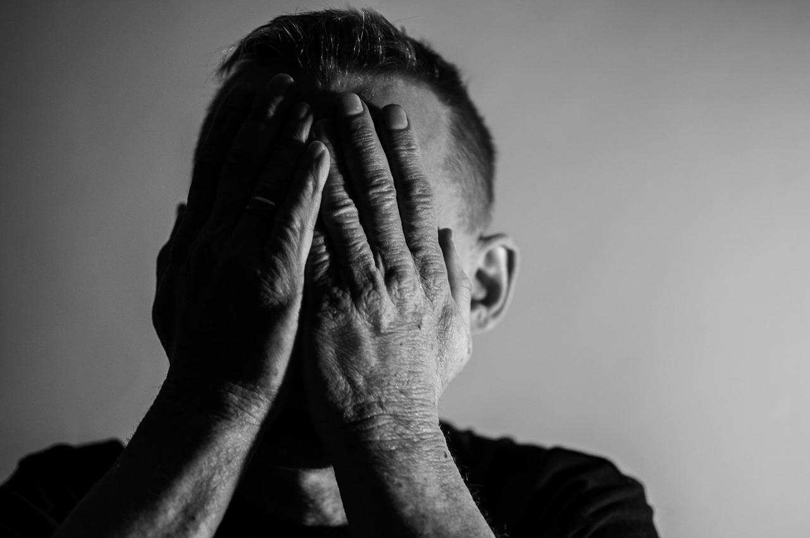

Finding Peace in Your Mind
Video 7
Notes:
Welcome again!
We hope the topics we have shared are helping you. This month, we will talk about depression and anxiety. These are common problems. Sometimes they are hard to see or understand.
When we try to do our daily responsibilities, we may not realize we are working harder than someone without depression. Or we may know we are depressed but don’t know how to start feeling better.
This month, we will help you face and manage these feelings. We talked a little about this topic before, but it is so important that we want to go over it again and give more ideas.
If you see yourself in these symptoms or want more help, remember your community health worker is always ready to help you.

Slide 2
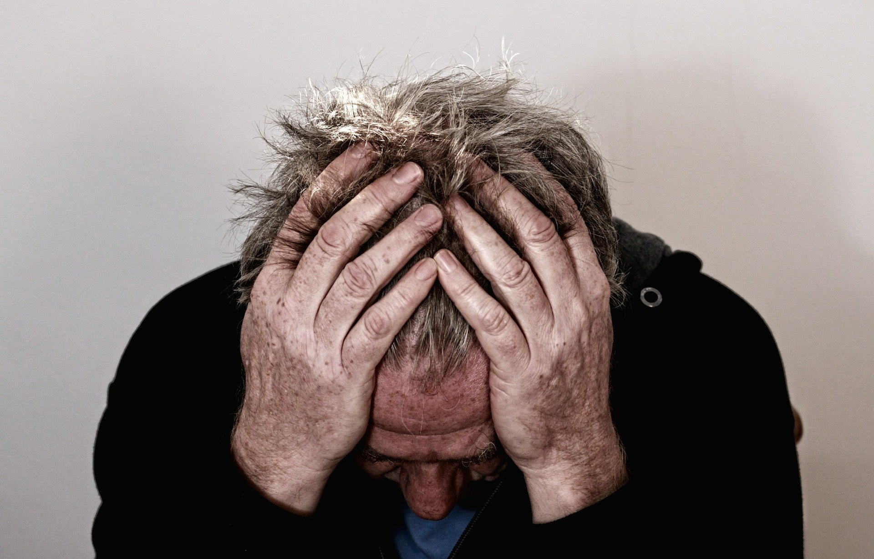
Depression and Anxiety are not…
Notes:
Before we talk about depression and anxiety, we need to know what they are not.
Depression and anxiety are not weakness, lack of spirituality, madness, ignorance, sin, or not praying.
Depression and anxiety are illnesses, like diabetes or high blood pressure. Many people feel shame, but ignoring them will not help.
Doctors can often diagnose these problems and help manage them. Sometimes tests show vitamin or health issues that explain symptoms.
Causes can include past abuse, older age, some medications, family or work conflicts, loss of loved ones, gender, genes, big life changes, alcohol or substance use, chronic illness, or isolation.
We can’t always know the reason. We are not weak because of our genes, and we cannot prevent most causes.
This month, we will learn what depression and anxiety really are and what we can do to help ourselves.

Slide 3

Depression is…
Notes:
What is depression?
First depression is very common:
one out of three people have had it at some point in their life
One or two out of every four people with diabetes have depression
Next, depression is often poorly treated and difficult for patients to describe to their doctors.
Depression is more than feeling sad for a few days—it lasts for weeks, months, or even years and can make life very hard.
Depression is a serious disease, affecting how we feel, think, and handle daily activities like sleeping, eating, or working.

Slide 4

Anxiety is…
Notes:
People who have depression often have anxiety.
Anxiety is worry or fear about something in the future.
It can make your heart beat fast and your body tense, causing other diseases or conditions
Learning to manage anxiety can help you feel calmer and live more peacefully.

Slide 5
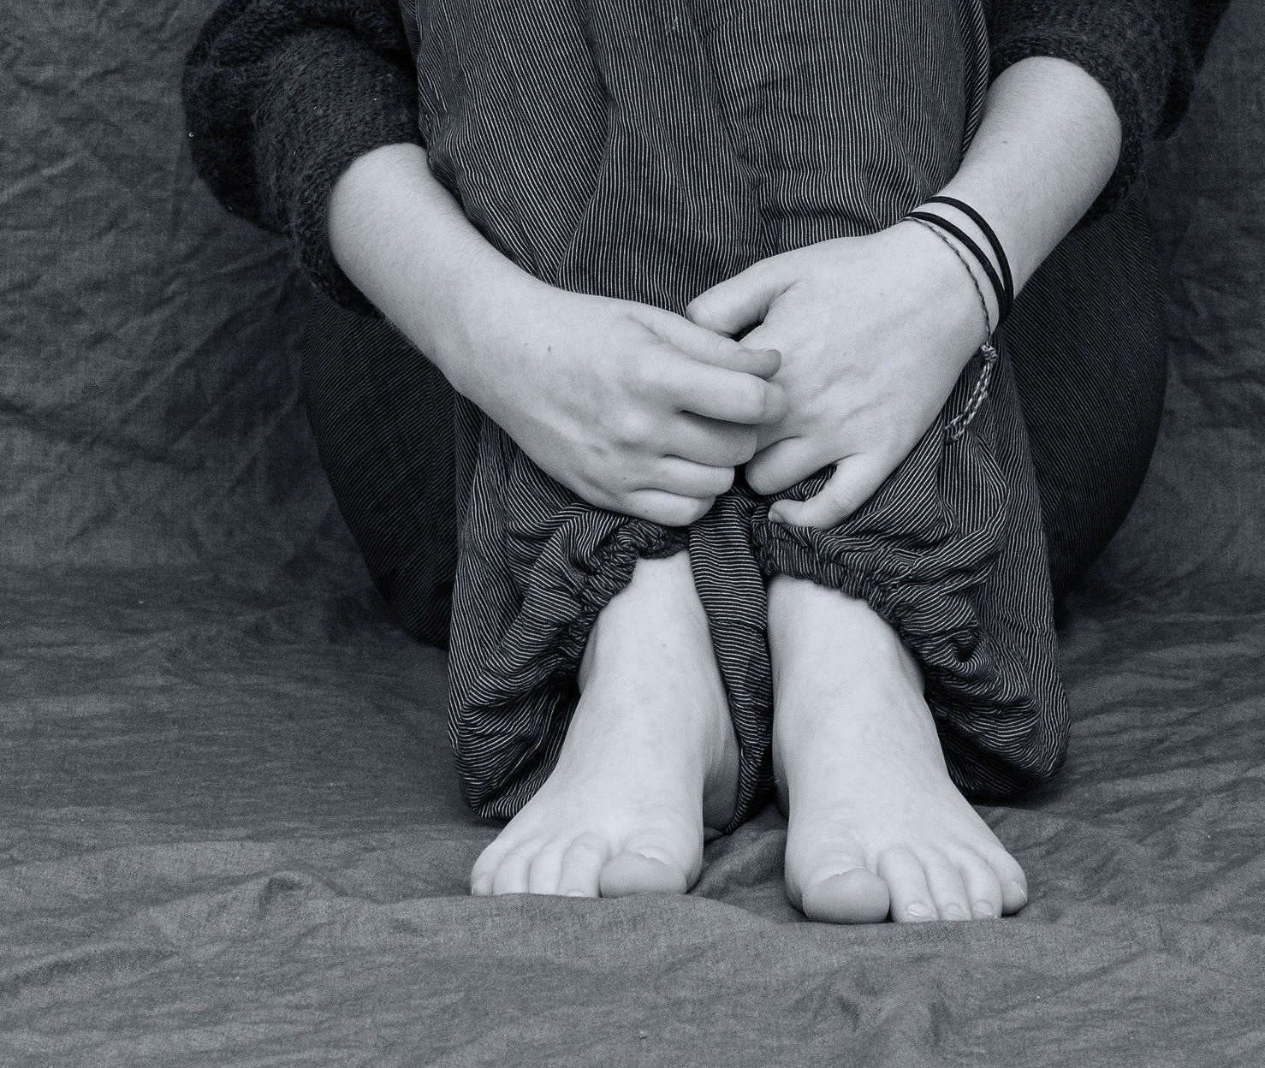
Am I Depressed?
Feelings of
  Sadness, anger, hopeless
  Non interested
Changes
  eating or sleeping
  Headaches, stomach pain, body ache
Thoughts
  Ending life, death*
Notes:
Like diabetes, depression is not a feeling, it is a diagnosis and needs to be made by your doctor.
Here are some conditions individuals who are depressed may Like diabetes, depression is not a feeling, it is a diagnosis and needs to be made by your doctor.
Here are some conditions individuals who are depressed may have:
Feeling sad or empty,
Losing interest in daily life,
Eating too little or too much,
Sleeping too little or too much,
Feeling very tired,
Feeling angry, worried, hopeless, or guilty,
Headaches, stomach pain, or other body aches,
Or Thinking about death or suicide
**NOTE! IF you are having thoughts or a plan of harming yourself or others you need help. You can tell you CHW, call 9-11, tell your doctor, go to the hospital. If you have a plan to harm yourself, you need help today.

Slide 6
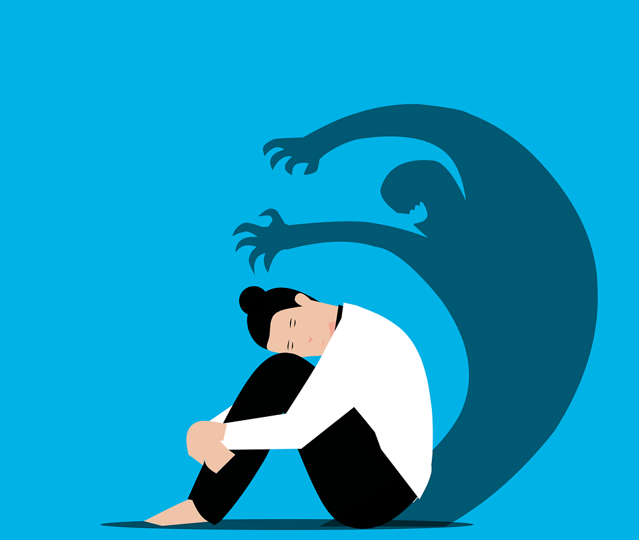
Am I anxious?
Feelings of
- Worry
- Restlessness, tired
- Irritable
Changes
- Concentration
- Sleeping
Notes:
Some anxiety symptoms are like depression, but others are different.
Common signs of anxiety include:
Worrying too much about daily things,
Trouble controlling worries or feeling nervous,
Feeling restless or unable to relax,
Trouble concentrating or feeling tired,
Trouble sleeping,
Feeling irritable, dizzy, short of breath, sweating, or needing the bathroom often!
Children and teens may worry a lot about school, sports, family fights, or disasters like shootings, earthquakes, or wars.
Adults may worry about work, health, money, children, being late, or household tasks.
Anxiety can also cause physical symptoms that make daily life hard.

Slide 7

Where do I start?
Notes:
This may feel like a lot, but there is help.
Depression and anxiety are hard to face alone. Talk to a community health worker, doctor, or pastor.
We are not meant to be alone.
I like the book of Acts in the Bible where it often reminds us that God created people to be part of a community.
Being part of a group or church can help us get support, encouragement, and care. A friend or community health worker can guide us and help us start feeling better.

Slide 8

IMPORTANT
YOU ARE NOT ALONE!
Call: 832-416-1199
Text: 281-201-4430
Notes:
A very important point:
If you or someone you care about feels like hurting themselves or others, get help immediately.
Call: 988
Help is available!! Don’t wait—call or text for support!

Slide 9





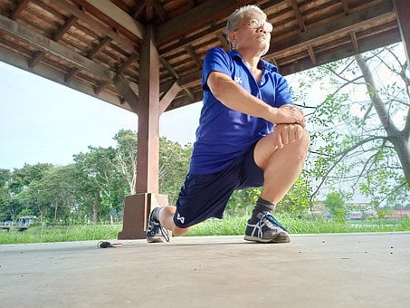
What steps can I take?
Talk to your CHW
Talk to your doctor
Sleep well
Eat 5-9 fruits and vegetables daily
Move more!
20 minutes, 3 times per week
Notes:
What is the step (or goal) you have? Then find 2 to 3 things you can do this week.
For example,
Talk to your CHW every Saturday at 3pm,
Make an appointment with your doctor to discuss depression and anxiety!,
Sleep 8 hours per night this week,
Eat 5 to 9 fruits or vegetables daily,
OR, Be physically active!! (do you remember how much?? 20 minutes, three times per week)

Slide 10

Without guidance, plans fail; with many advisors, they succeed
Proverbs 15:22
Notes:
Setting goals or plans is so important to things going better.
This great Proverb reminds us of that.
Without guidance, plans fail; with many advisors, they succeed,
When we are anxious or depressed the last thing we want to do is…something. We often want to be alone and do nothing.
But you must make yourself do the opposite…find others to be with you… and plan something.

Slide 11

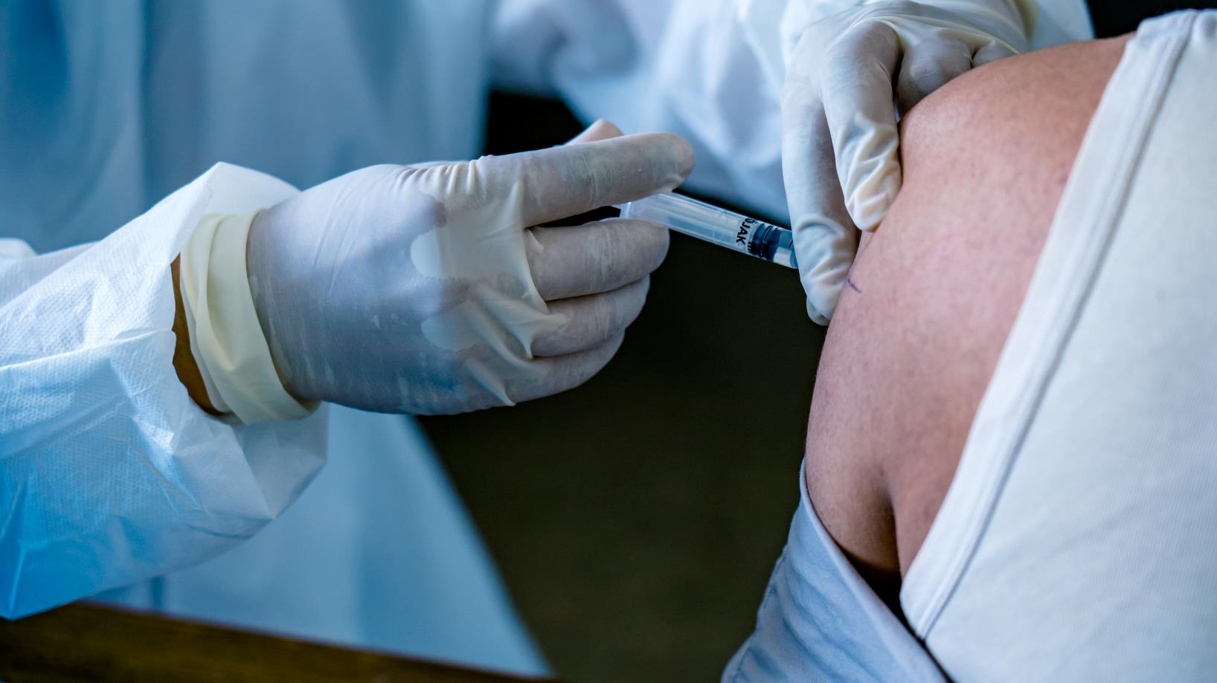
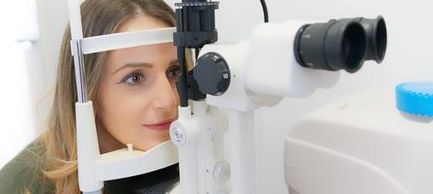
Do you need vaccines or eye referrals?
Your CHW can help CONNECT you
Notes:
It may sound small but taking care of yourself can be the first step in moving from depression and anxiety.
Getting your flu shot … going to see the eye doctor for example are two ways that you can plan to live a healthier life and feel better that YOU are going to get through a difficult time.
Do you need help connecting to vaccine or eye referral services? If so, your CHW can help CONNECT you.

Slide 12

Notes:
We are here to walk your journal with you. Let us know how we can help.
Thank you for listening!

Slide 13
References
National Institute of Mental Health (NIMH). (2023). Major Depression. U.S. Department of Health and Human Services. https://www.nimh.nih.gov/health/statistics/major-depression
Pratt, L.A., Duran, B., & Terlizzi, E.P. (2024). Symptoms of Anxiety and Depression Among Adults: United States, 2019 and 2022. National Health Statistics Reports, No. 213. CDC/National Center for Health Statistics. https://www.cdc.gov/nchs/data/nhsr/nhsr213.pdf
Farooqi, A., Gillies, C., Sathanapally, H., et al. (2022). A systematic review and meta-analysis to compare the prevalence of depression between people with and without Type 1 and Type 2 diabetes. Primary Care Diabetes, 16(1), 1–10. https://doi.org/10.1016/j.pcd.2021.11.001
Noetel, M., Sanders, T., Gallardo-Gómez, D., et al. (2024). Effect of exercise for depression: systematic review and network meta-analysis of randomised controlled trials. BMJ, 384, e075847. https://doi.org/10.1136/bmj-2023-075847
Acoba, E.F. (2024). Social support and mental health: the mediating role of perceived stress. Frontiers in Psychology, 15, 1330720. https://doi.org/10.3389/fpsyg.2024.1330720
National Alliance on Mental Illness (NAMI). (2025). Mental Health By the Numbers. NAMI. https://www.nami.org/about-mental-illness/mental-health-by-the-numbers/

