Slide 1

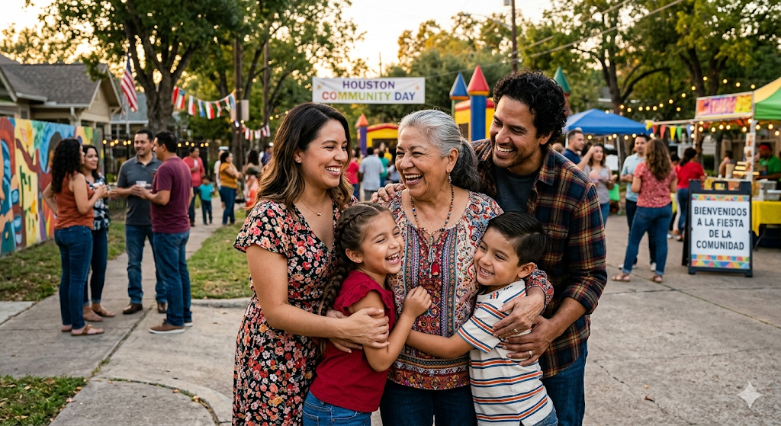
How to Involve Family and Friends in Your Health
VIDEO 12
01
Notes:
Welcome to our Video 12
In this video we will talk about How to Involve Family and Friends in Your Health

Slide 2
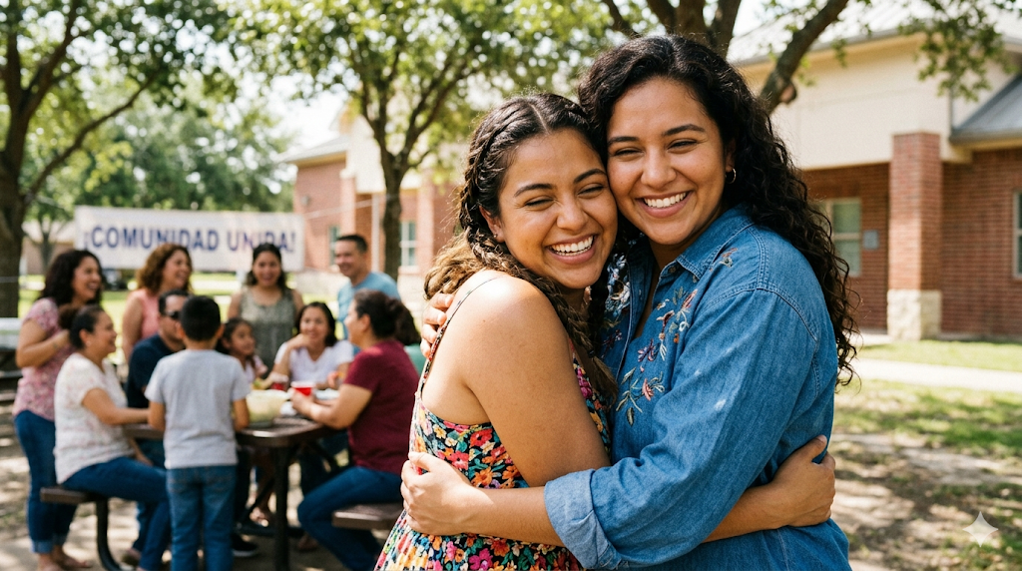
You don't have to do this alone.
Managing diabetes every day is a lot of work. The right people in your corner can help you feel less overwhelmed and more empowered.
1
Pick people you trust
2
Find an accountability partner
3
Start small
Notes:
Today we will talk about how friends and family can help you with your health.
Think about who you trust and who really cares about you. These are good people to include.
Some people may not support your goals. You do not have to include them.
You can have an “accountability partner.” This is someone who helps you stay on track.
For example, you and your partner can agree to walk every day at the same time. You remind each other and celebrate small successes.
Having support makes it easier to keep healthy habits. You do not have to do it alone.
Pick one person you trust and start small. It is about support, not pressure.

Slide 3


Spirituality and health are connected.
PRAYER · PRACTICE · PEACE
HEART · HEALTH · HOPE
Notes:
Spirituality and health are connected. Studies show that people who are involved in spiritual or faith practices often have lower stress, better mental health, and sometimes better control of chronic conditions like diabetes.
Spirituality and faith can also help your health. Believing in something bigger than yourself, praying, or attending church can give you strength and hope.
Good people to connect with can be family, close friends, neighbors, or members of your church or community group.
These are people you trust and feel safe with.
Combining support from people and your faith can make it easier to reach your health goals.

Slide 4

One of the strongest predictors of how well someone manages diabetes
is the support they get from family and friends.
Notes:
Daily diabetes care is a lot of work, from taking medicine, injecting insulin, and checking your blood sugar.
It also includes eating healthy, exercise, and keeping your health care appointments.
The support of a family member or friend can help make the difference in whether you feel overwhelmed or empowered.

Slide 5


Making your goals.
Improvement is a daily process. Write your goals down, keep them visible, and let small wins build your motivation.
Specific · Measurable · Achievable · Realistic · Timed
Notes:
Setting goals is essential, and not reaching them right away doesn’t mean failure.
Improvement is a daily process.
Write your goals down and keep them, even after achieving them, as motivation to keep growing.
Goals should be specific, measurable, and realistic—avoid vague ideas and focus on clear actions with timelines. Start gradually so goals are sustainable. Finally, have someone who holds you accountable and encourages you, because setbacks happen and support helps you keep going.

Slide 6




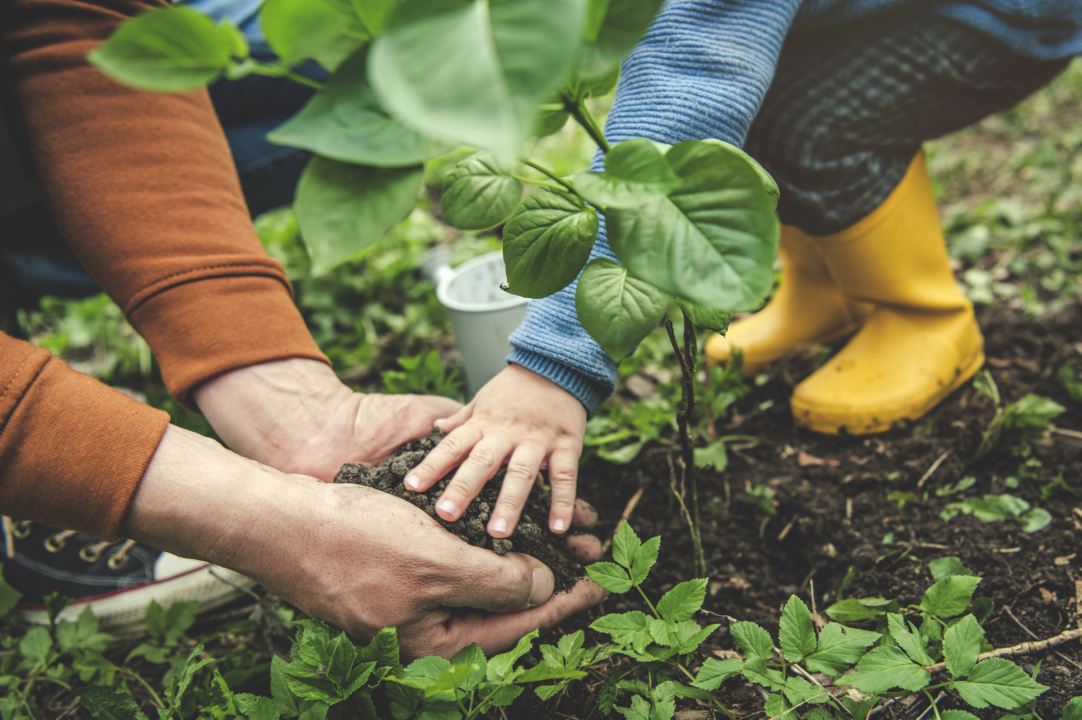
Having people who support you makes a difference.
1
EMOTIONAL
2
PRACTICAL
3
MOTIVATION
4
GUIDANCE
5
POSITIVE
Loved ones who know your goals can encourage healthier habits for the whole family.
06
Notes:
Having family and friends help with your health is very important.
Emotional support,: Being close to people you care about helps you feel less stressed and handle illness better.
Practical support,: Family can help you plan meals, remember medicines, exercise, and make healthy choices.
Motivation,: Loved ones can encourage you to follow treatment and healthy habits.
Guidance,: Family who know about your illness can help you understand it and follow your doctor’s instructions.
Positive influence,: Supportive friends and family make you feel better and healthier.!

Slide 7

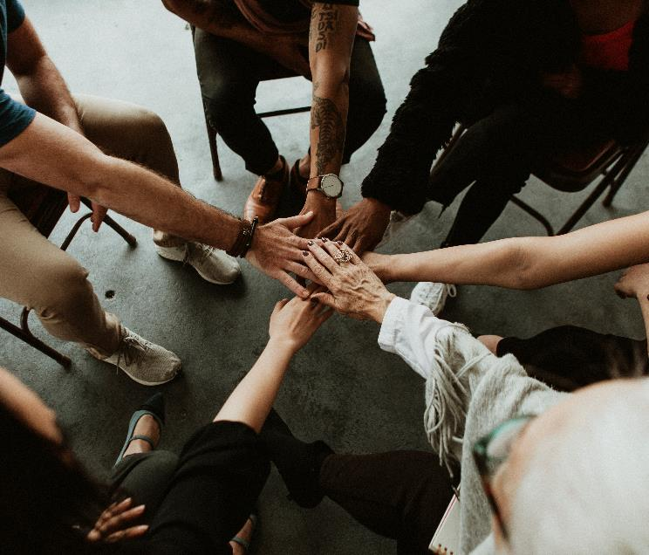
Find those people who care about you to have better habits.
Notes:
Do you have a person or a few people in mind?
It helps to have people who care about you and have healthy habits. Often, family wants you to improve too!! Let them help you, and encourage you…, NOT scold you.
Good communication is important. If you don’t feel comfortable talking or asking for help, others might feel the same. You decide if you want to start talking.
Two tips for better communication:
Don’t assume people understand you—explain clearly how you feel.
You can’t change how others talk, but you can change how you talk so they understand you.

Slide 8

Start by encouraging your family to eat healthier.
Notes:
Eating healthy is key to managing diabetes—and you can still enjoy traditional foods that connect you to your culture.
Teach your family about healthy eating: fill the plate with fruits, vegetables, and proper portions, and limit sugar and junk food.
Share the knowledge with your children, so healthy habits last a lifetime.
Measuring portions and making small changes at home helps everyone stay healthy while keeping family traditions alive.

Slide 9
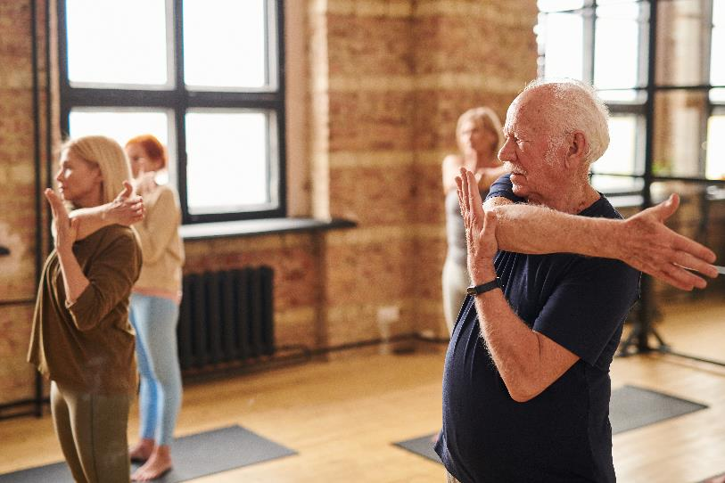



Exercise as a family.
If your children and family are willing to move with you, it stops feeling like exercise and starts feeling like time together.
Notes:
Encourage them to move together…if your children and family are willing to exercise together – you can do fun things to move! Play a sport with them, ride a bike if you have one. Have family competitions.
Be creative…Remember what we learned a few months ago about exercise? Try to implement exercises with them. Pick up cans of food instead of buying weights, etc.

Slide 10

But what if your family
doesn't help you reach
your goals?
Notes:
Getting your family’s support isn’t always easy. If they don’t support your changes or tempt you, make an action plan.
Seek support from your church, friends, or community, and connect with people who prioritize health.
Remember, you always have options—and God is with you to help when other support systems fall short.

Slide 11

How are your health
goals doing?
?
What is going well?
?
What is hard right now?
Notes:
How are your health goals are doing?
What is going well?
-
What is hard?
-
Make small changes one step at a time. Today we talked about asking family or friends for help. Look for a couple of goals you can set for your self in keeping communication open with loved ones. Or maybe your goal can be finding an accountability partner to help you on your journey to a healthier lifestyle
-

Slide 12

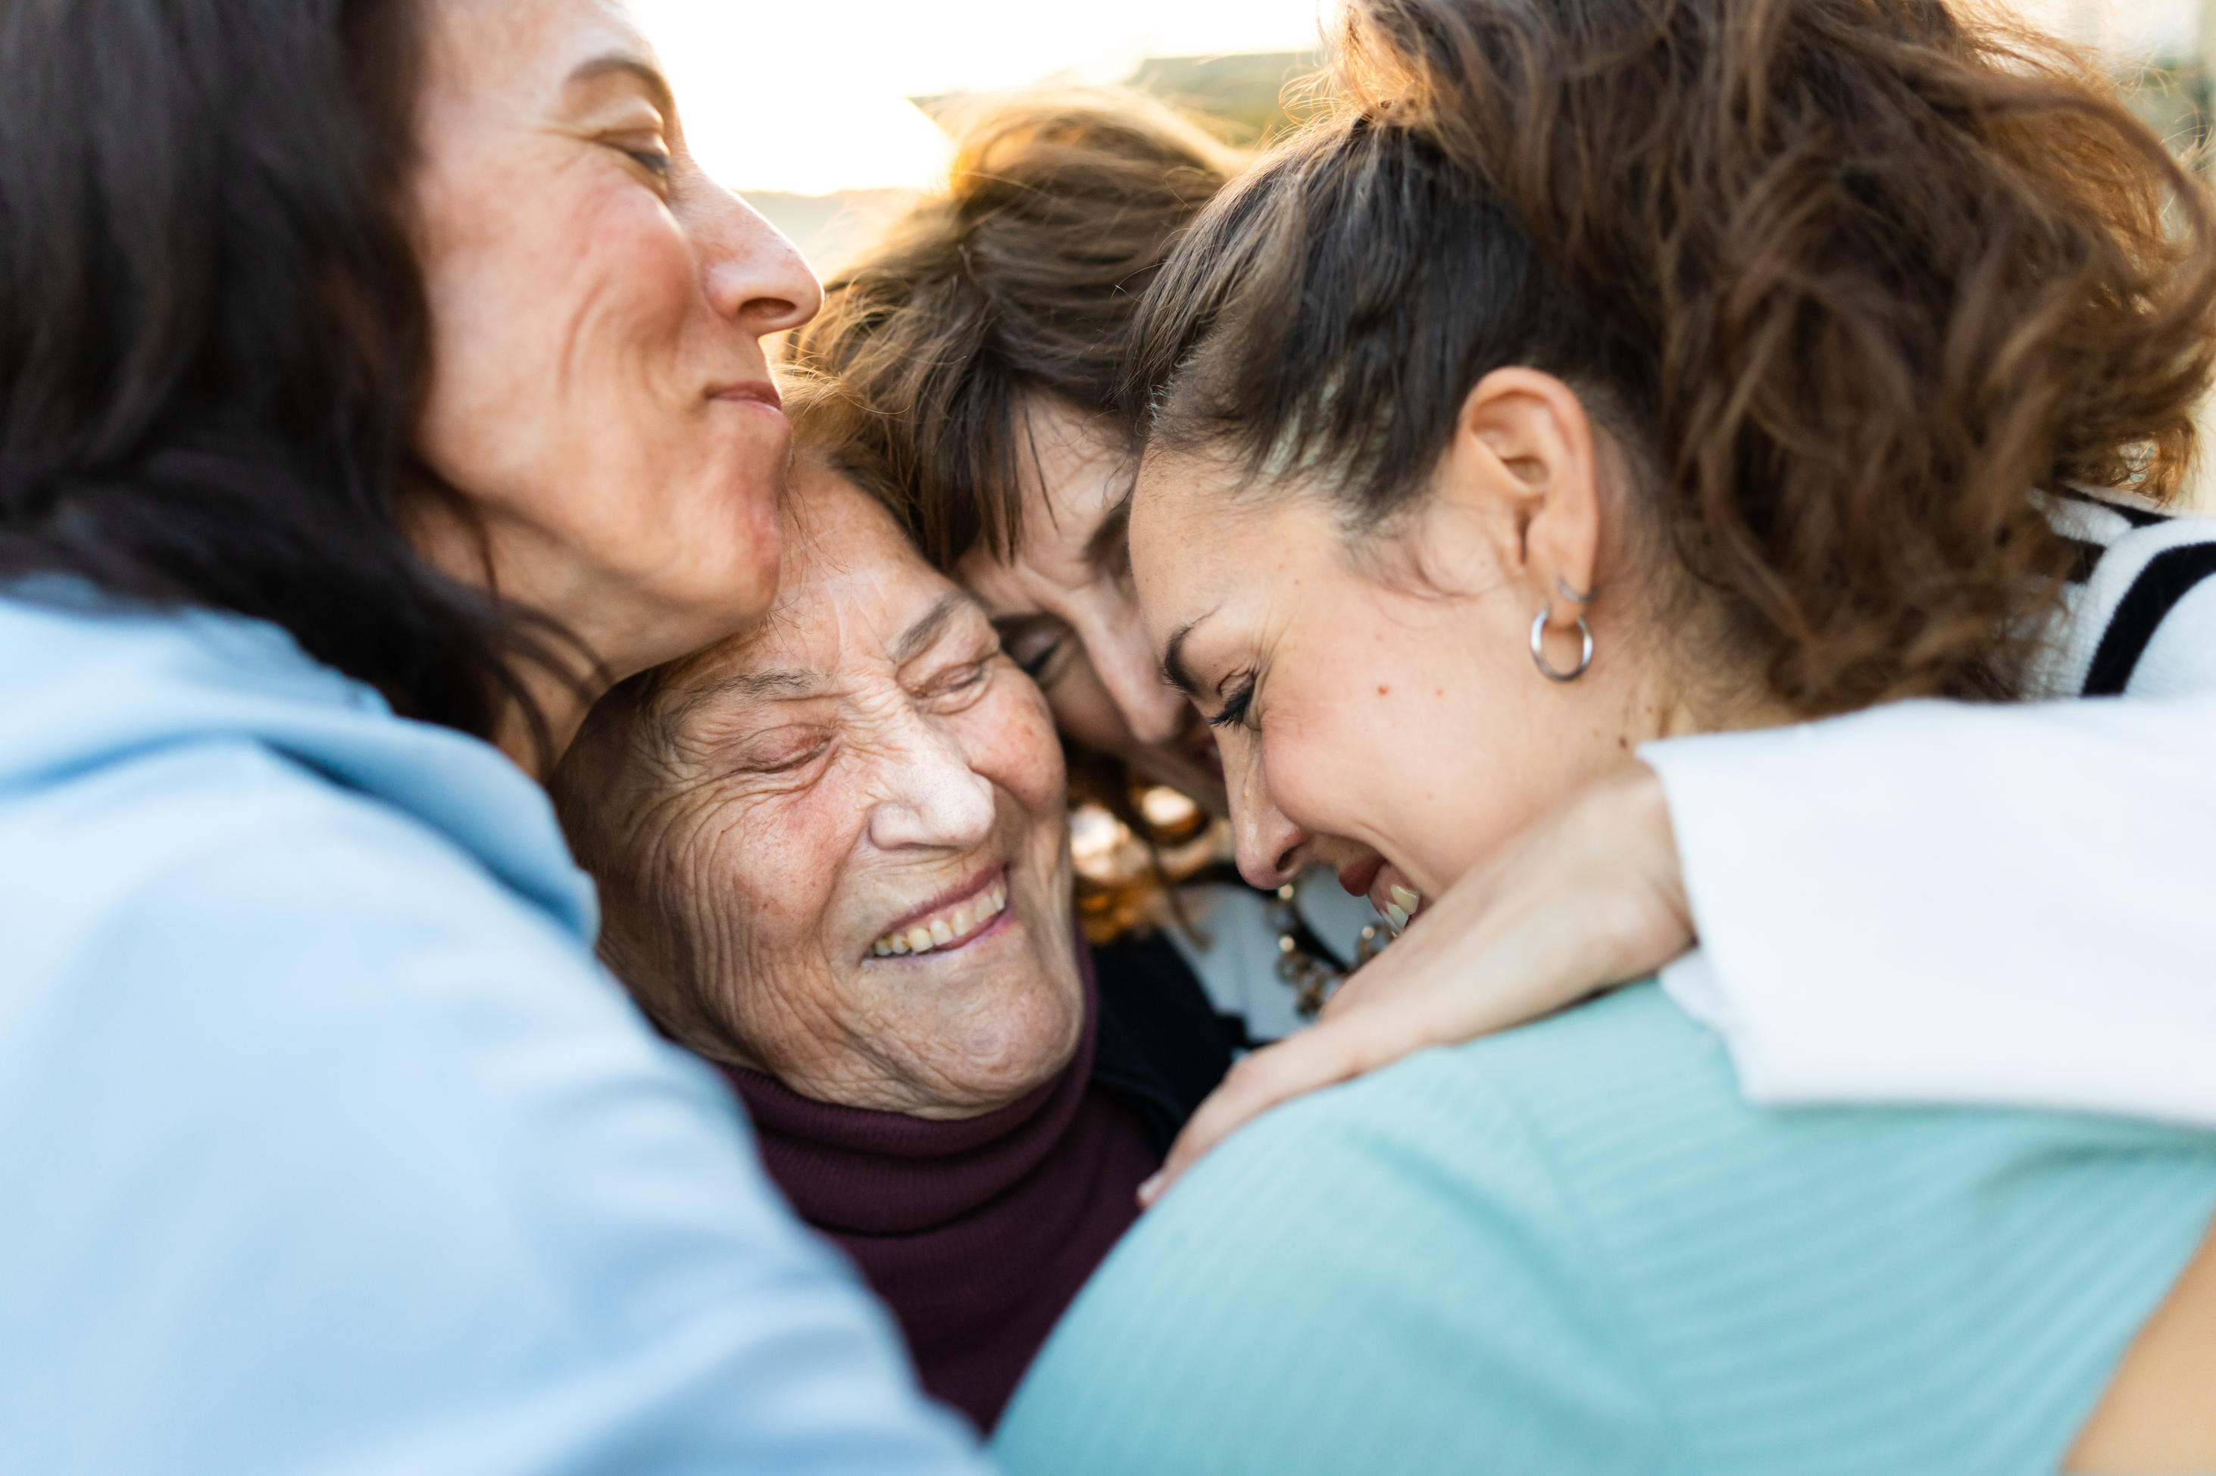
Do you need help talking to your friends and family ?
Your CHW can teach you how to CONNECT with others
Notes:
Remember that life was not meant to be lived alone! Yet sometimes in the most difficult of times we often isolate ourselves.
When things are difficult, that is when we must make ourselves seek others and help.
For example, if you have not been able to see the doctor, could you involve a family or friend this week to help you make that appointment?
Talk to your CHW about how to CONNECT you with others.
As always, thank you for listening!

Slide 13
References
Almubaid, Z., et al. (2024). The impact of social support on health outcomes of diabetic patients: A systematic review. Cureus, 16(8), e67842. https://doi.org/10.7759/cureus.67842
Jordan, O.J., Benitez, A., Burnet, D.L., Quinn, M.T., & Baig, A.A. (2024). The role of family in diabetes management for Mexican American adults. The Diabetes Educator, 22(2), 109–118. https://doi.org/10.1177/15404153231206086
Hazime, D., et al. (2024). Social support via internet communication technology for diabetes self-management: A scoping review. mHealth, 10. https://doi.org/10.21037/mhealth-23-34
Stryczek, K., et al. (2024). A systematic review of diabetes prevention programs adapted to include family members. Preventive Medicine Reports, 39, 102655. https://doi.org/10.1016/j.pmedr.2024.102655
Balboni, T., VanderWeele, T., Doan-Soares, S., et al. (2022). Spirituality in serious illness and health. JAMA, 328(2), 184–197. https://doi.org/10.1001/jama.2022.11086
Slater, A., Cantero, P.J., Alvarez, G., et al. (2022). Latino Health Access: Comparative effectiveness of a community-initiated promotor/a-led diabetes self-management education program. Family & Community Health, 45(1), 34–45. https://doi.org/10.1097/FCH.0000000000000311
Sherman, L.D., Cisneros-Franco, C.L., Prochnow, T., et al. (2023). Personal agency and social supports to manage health among non-Hispanic Black and Hispanic men with diabetes. American Journal of Men's Health, 17(6). https://doi.org/10.1177/15579883231211057

