Slide 1


Sleep Well, Live Well
How Stress and Sleep Affect Your Risk for Diabetes
Video 8
Notes:
Welcome everyone! Today we are sharing Video #12 and we're going to talk about something that affects nearly all of us every single day: stress and sleep, and how they directly impact our risk for developing diabetes or our ability to control it. By the end of this video, you will understand why sleep and stress matter for diabetes, what happens in your body when you don't sleep enough or feel too much stress, and some simple things you can do starting tonight to protect your health. This is not about making you feel bad. It is about giving you information that can really help.

Slide 2

Let's Start with a Question...
How many of you slept
less than 6 hours last night?
7–9
1 in 3
⚠️
hours adults
need nightly
adults don't
get enough sleep
Poor sleep raises
diabetes risk
Notes:
How many nights during the past week did you sleep 6 hours or less? Most of us in our communities are running on too little sleep. And what many people don't know is that the connection between sleep, stress, and diabetes is very real and very serious. Most adults need 7 to 9 hours of sleep each night. Over 1 in 3 American adults regularly don't get enough sleep. And chronic sleep loss is a major risk factor for type 2 diabetes. Let me show you why.

Slide 3
Stress → Sleep → Diabetes: They're All Connected
STRESS
Raises cortisol
& blood sugar
Breaking ANY link in this cycle can protect your health! You don't have to
fix everything.
Just start with
one small change.
POOR SLEEP
Disrupts hunger
hormones
Each
feeds
the other
DIABETES
RISK
Insulin resistance
& weight gain
Notes:
I want you to picture this triangle. Stress, poor sleep, and diabetes risk are all connected…. they feed each other in a cycle. Stress makes it harder to sleep. Poor sleep raises your stress hormones. And both together push your blood sugar higher and make your body less able to use insulin effectively. Here is the good news: you don't have to fix everything at once. If you break even one link in this chain! If you sleep a little better, or find one way to reduce stress; your whole body benefits!!

Slide 4
What Stress Does to Your Body
Hurts blood vessels
45% higher risk of
type 2 diabetes with
high chronic stress
Increases Sugar
Stress
Comfort eating
Long-term stress is the most harmful. Financial worry, family stress, and daily pressures can build up in your body over time.
Hormone imbalances
Notes:
Your body has a 'fight or flight' system to keep you safe in danger.
But today, many of us feel stress every day — from work, money, or family. When you feel stressed, your body thinks you are in danger and sends out a hormone called cortisol. Cortisol tells your body to release sugar into your blood for energy — what you'll need if you are running or moving.
But most of us are not moving — we are sitting, and the sugar stays in your blood, which can hurt your body.
Your body has to work harder to control your blood sugar. This can lead to type 2 diabetes. Important: Long-term stress (like money problems or caring for family) can harm your health the most. People with a lot of stress are 45% more likely to get type 2 diabetes.

Slide 5


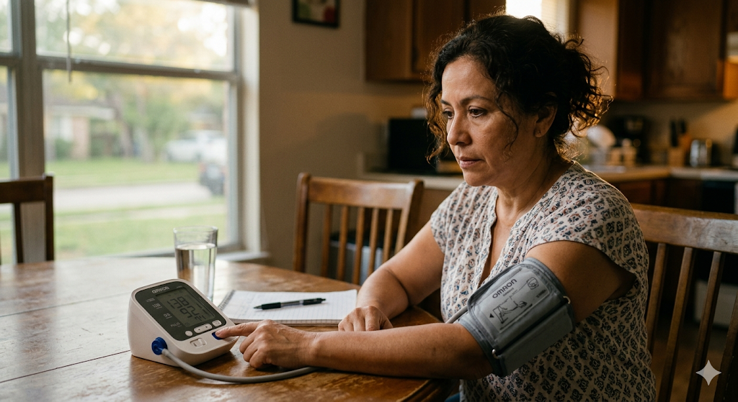

What Happens When You Don't Sleep Enough
More Hunger
More Stress
2×
more risk
of diabetes
(less than
6 hrs/night)
Crave sweets & carbs
Tired = harder to cope
Higher Blood Sugar
Harder to Exercise
Even after one bad night
Low energy all day
Notes:
Most of us think that losing sleep just makes us tired… but it goes much deeper than that. When you sleep less than 6 hours, hunger hormones get thrown off.
The hormone that makes you hungry….goes up.
The hormone that tells you you're full….. goes down.
You end up eating more, especially sugary and high-carb foods. Even one night of poor sleep can temporarily make your body process glucose normally. And over time, poor sleep promotes belly fat, which is directly linked to diabetes.
People who regularly sleep less than 6 hours have double the risk of developing type 2 diabetes.

Slide 6
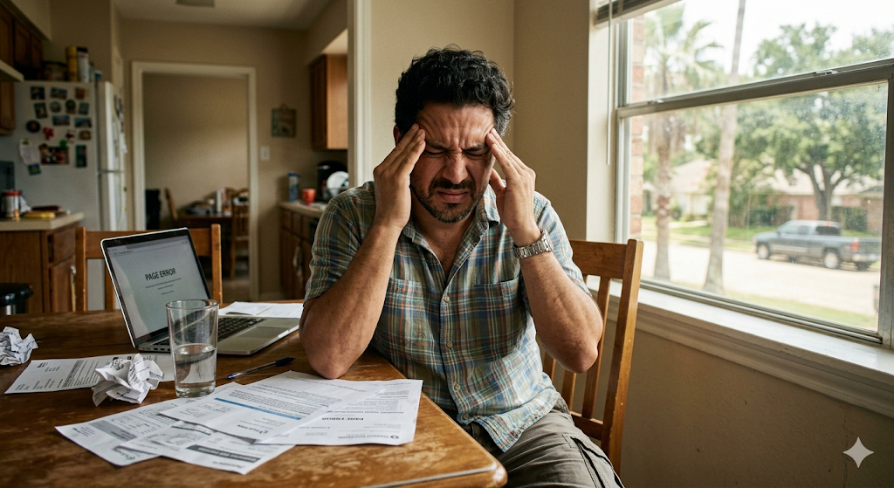

It Becomes a Cycle...
CHRONIC
STRESS
Cortisol rises
MORE
ANXIETY
Cravings & fatigue
CAN'T
SLEEP
Mind races
Breaking
ANY link
helps!
BLOOD SUGAR
GOES UP
Higher A1C
Notes:
This is why we call it a cycle, and why it's so hard to break on your own. You're stressed, so you can't fall asleep.
You can't sleep, so you're more anxious the next day.
That anxiety makes it harder to control blood sugar.
Higher blood sugar leads to fatigue and cravings.
Which causes more stress. But here is the important message: breaking ANY link in this chain helps.
If you improve your sleep even a little, or reduce stress in one small way, the whole cycle starts to slow down.
You don't have to fix everything at once.

Slide 7

Who Is Most at Risk?
🌮 Hispanic / Latino Community
2× more likely to develop diabetes
🌙 Night & Shift Workers
Body clock is disrupted
👩‍👧 Caregivers & Parents
Sleep interruptions + daily stress
💸 Financial Stress
Strongest predictor of sleep problems
Notes:
Let's be honest about who we're really talking about here. Hispanic and Latino adults are twice as likely to develop type 2 diabetes. That's not a coincidence… it's connected to higher rates of chronic stress, less access to healthcare, and neighborhoods that don't always support healthy sleep or active lifestyles. Night shift and shift workers are also at very high risk because working against your natural body clock disrupts blood sugar even when you get enough total hours of sleep. Caregivers, parents, and people facing financial stress are also particularly vulnerable because their stress is constant, not just occasional. If any of this sounds like you…. this information is for you! And there are things you can do.

Slide 8

How much is enough sleep?
Children (6–12)
9–12 hours
Teens (13–18)
8–10 hours
Adults (18–64)
7–9 hours
Older Adults (65+)
7–8 hours
Notes:
So, what does healthy sleep actually look like?
Most adults need 7 to 9 hours. Not because that's a nice round number, but because your body literally needs that time to regulate hormones, repair cells, and reset your metabolism.

Slide 9

What Good Sleep Looks Like
Signs of
Good Sleep
Fall asleep within 20 min
Sleep through the night
Wake up feeling rested
Alert without extra caffeine
Good mood & focus
Notes:
But hours alone aren't enough! Quality matters!! If you're waking up many times, or you feel tired even after 8 hours, that's a sign your sleep quality needs attention too. Good sleep means you fall asleep within 20 minutes, you stay asleep most of the night, and you wake up feeling rested and alert without needing extra coffee to function.
Signs of Good Sleep
Fall asleep within 20 min
Sleep through the night
Wake up feeling rested
Alert without extra caffeine
Good mood & focus

Slide 10


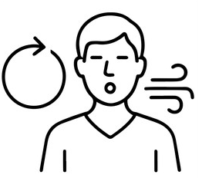



Simple Steps That Really Help
Same Bedtime
Every Night
No Phones
30 Min Before Bed
4-7-8 Breathing
Trains your body clock
Blue light blocks sleep
Breathe in 4, hold 7, out 8
10-Min Walk Daily
Prayer / Community
No Caffeine After 2pm
Lowers cortisol same day
Connection reduces stress
Protects deep sleep
Notes:
These six strategies are practical, free, and evidence-based. You don't need a gym membership or a prescription. Work on establishing a sleep schedule that is realistic and consistent.
1) Go to bed and wake up at the same time every day - even weekends. This trains your body clock. 2) Avoid phones and screens at least 30 minutes before bed. The blue light blocks the hormone melatonin that helps you fall asleep. 3) The 4-7-8 breathing exercise is one of the fastest ways to activate your body's relaxation response. Inhale for 4 seconds,…. hold for 7,….. exhale for 8…… Do this 3 times….. 4) Even a 10-minute walk after dinner can lower cortisol and improve your sleep quality that same night.
5) Prayer, faith community, and social connection are also proven stress reducers. Use the strengths you already have!! And 6) watch caffeine!! Even afternoon coffee can disrupt the deep sleep stages your body needs most.

Slide 11

Connect you with free or low-cost medical care
Help you build a personal sleep & stress plan
Refer you to mental health & community resources
Educate you in your language, at your pace
Your CHW can help CONNECT you to resources to break this cycle – one step at a time
Walk alongside you - every step of the way
Notes:
We want you to know that you are not alone in this. Your CHW is specifically trained to help you navigate exactly these kinds of health challenges. Your CHW can connect you with free or low-cost medical help, help you create a personal sleep and stress management plan that fits your real life, and provide referrals to mental health services, sleep specialists, and community resources. They offer ongoing education in your language and at your own pace. And most importantly, they walk alongside you. They are not just a resource, they are a partner in your health journey!!

Slide 12

Set GOALS to Protect Your Health!
One small step tonight can begin to break the cycle.
🌙 TONIGHT
📅 THIS WEEK
Try the 4-7-8 breathing
technique before bed.
Inhale 4 sec →
Hold 7 sec →
Exhale 8 sec
Repeat 3 times.
Set a consistent bedtime
and stick to it for 7 days.
Tell a family member
your goal - sharing makes
it easier to keep!
Let your CHW help you set goals that fit YOUR life!
Notes:
How are your goals going? Remember: goals are the key to making long-lasting changes! Let's leave you with two simple goals: one for tonight and one for this week. You don't have to change everything at once. Start with one. Just one. And see what happens. Remember: sleep is not wasted time. It is when your body heals, resets, and protects itself. It is one of the most powerful things you can do to lower your diabetes risk. Your CHW is here to help you build goals that are realistic for your life. Don't hesitate to ask for their help.

Slide 13

Remember: ✅ Diabetes care includes mind AND body ✅ Sleep and stress ARE controllable ✅ Small changes = big results over time ✅ You are not alone - support is here
¡Gracias!
Thank You!
Notes:
To close today, I want to bring everything together. Diabetes is not only about medication or food. It is about the whole person… your body, your mind, your emotions, and your daily habits. Sleep and stress are two areas that we often overlook, but they are very powerful in influencing blood sugar. The most important message is that you are not alone in this. Support exists in your family, your community, and your health team. Thank you for your time today, and I encourage you to take one small step starting today.

Slide 14
References
American Diabetes Association Professional Practice Committee. (2023). Standards of care in diabetes-2023. Diabetes Care, 46(Suppl. 1), S1–S291.
Cappuccio, F. P., & Miller, M. A. (2017). Sleep and cardio-metabolic disease. Current Cardiology Reports, 19(11), 110.
Centers for Disease Control and Prevention. (2022). National diabetes statistics report. U.S. Department of Health and Human Services.
Grandner, M. A. (2020). Sleep, health, and society. Sleep Medicine Clinics, 15(2), 319–340.
Ingrosso, D. M. F., et al. (2023). Stress and diabetes mellitus: Pathogenetic mechanisms and clinical outcome. Hormone Research in Paediatrics, 96(1), 34–43.

